Slide 1
MOAT Germline Variant Analysis
Lucas Lochovsky
A Cancer subgroup
2016-11-04

Slide 2
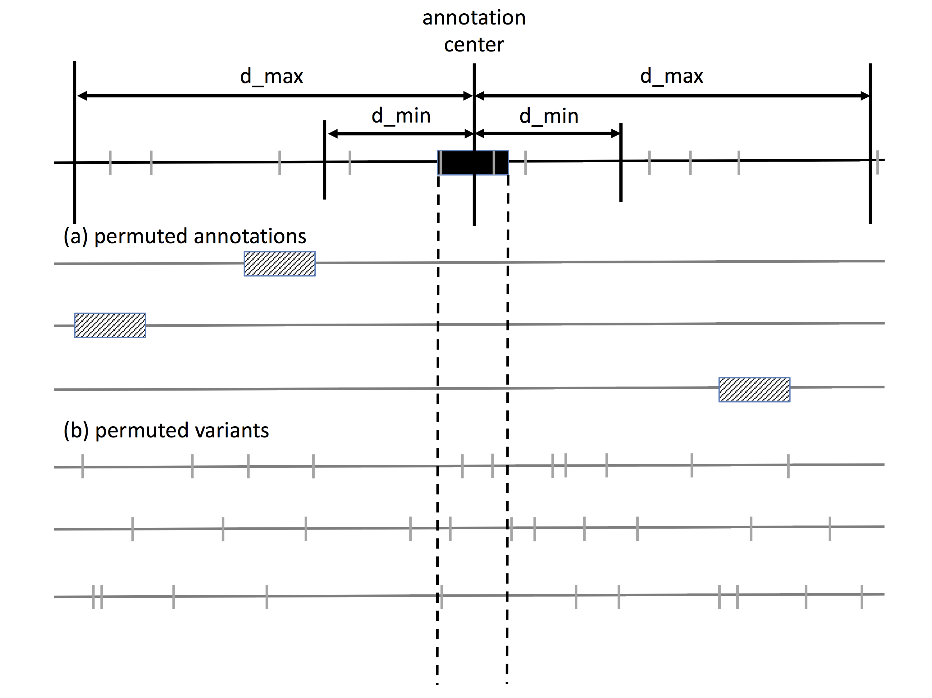
MOAT Overview/Recap

Slide 3
Relevant MOAT Parameters
MOAT-a
  d_min: Minimum distance from annotation for picking a random bin
  d_max: Maximum distance from annotation for picking a random bin
MOAT-v
  bin width: The width that represents the local genome context. Variants are shuffled to new locations within their containing bin.
  min bin width: In the event that an especially small bin is formed, either due to a chromosome end or subtraction of a blacklist region, merge the bin with the nearest full size bin if it’s below this width.

Slide 4
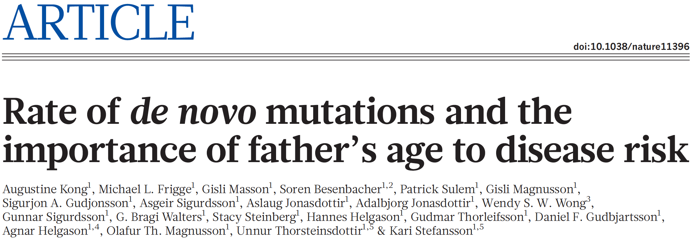
MOAT Germline Variant Analysis
Demonstrate MOAT capability on germline variants
Work with a large (~5000) de novo mutation set from:
  Kong, A. et al. Rate of de novo mutations and the importance of father’s age to disease risk. Nature 488, 471–475 (2012).
Sequencing of 78 trios, 44 of which have autism spectrum disorder (ASD)
  Evaluate MOAT recapitulation of ASD-associated genes

Slide 5
De novo results
Results are typically a range of p-values, but after BH correction, all p-values are mapped to either 0s or 1s
Counts for p-value=0 genes:

Slide 6
De novo results
Kong et al. drew attention to variants in the exons of 3 ASD-associated genes
  NRXN1, CUL3, EPHB2
MOAT-v with low bin width produces a small set
  But at 1kb/10kb, only CUL3 is recapitulated
At higher bin widths, all 3 are recapitulated, but we also see many more unrelated genes
  Sensitivity/specificity tradeoff

Slide 7
De novo results with ANNOVAR
Combine recurrence with functional impact
For gene-based annotations, there is ANNOVAR
  Wang K, Li M, Hakonarson H. ANNOVAR: Functional annotation of genetic variants from next-generation sequencing data Nucleic Acids Research, 38:e164, 2010
  Chang X, Wang K. wANNOVAR: annotating genetic variants for personal genomes via the web Journal of Medical Genetics, 49:433-436, 2012
  Yang H, Wang K. Genomic variant annotation and prioritization with ANNOVAR and wANNOVAR Nature Protocols, 10:1556-1566, 2015
Pick out the nonsynonymous variants

Slide 8
De novo results

