Slide 1
Asthmaseq exceRpt
09 Nov 2016
Dan Spakowicz
P2-TECH

Slide 2
Background
General Question
  Can sequencing the sputum of asthmatic patients stratify them by asthma severity
  Does microbial composition in sputum correlate with asthma severity (mild to severe asthma, no controls)?
Previously:
  Pilot microbiome analysis –
  10 patients
    Sputum processed to cell lystate (CL) and supernatent (S)
  Data
    16S amplification (bacteria) – presented last time
    ITS amplification (fungi)
This presentation: RNAseq + exceRpt
  ~230 samples,
  ~30 2nd visits

Slide 6
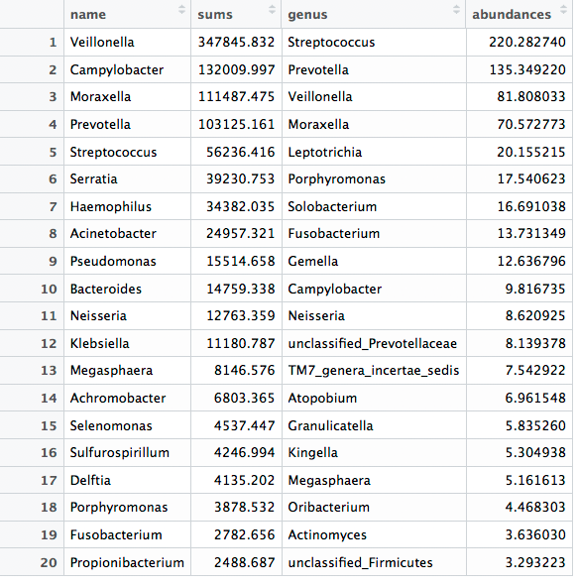
Most abundant 20 bacterial genera in the exceRpt bulkRNAseq vs barcode sequencing

