Slide 1
Correcting for biological variation in RNA structure probing experiments
Michael Rutenberg-Schoenberg
Matt Simon & Mark Gerstein labs

Slide 2
Outline
Intro: Learning about RNA structure through chemical probing
RNA structure probing data are overdispersed relative to current statistical models
A negative binomial model improves inference of modified nucleotides relative to Poisson statistics

Slide 3
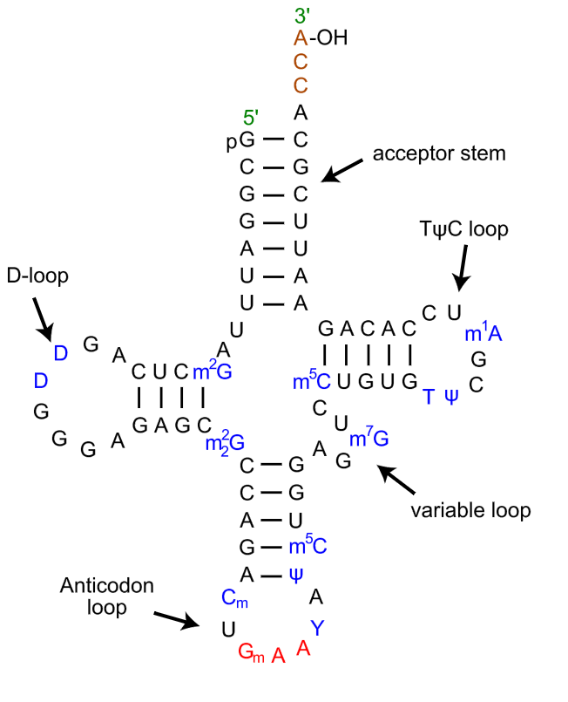
RNA secondary structure
S. cerevisiae tRNA^{Phe}
What do functional noncoding RNAs look like?
e.g. Xist is the master regulator of X inactivation in female mammals
Maps of base pairing interactions of RNA
https://en.wikipedia.org/wiki/Transfer_RNA; reviewed in Kevin Weeks Curr Opin Struct Biol 2010

Slide 4
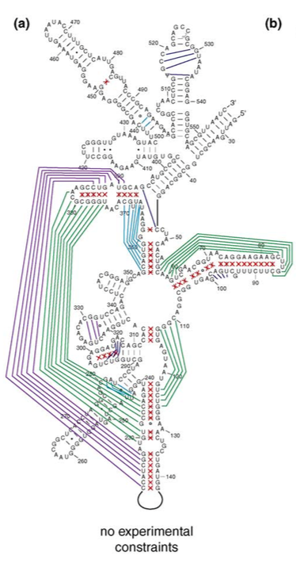
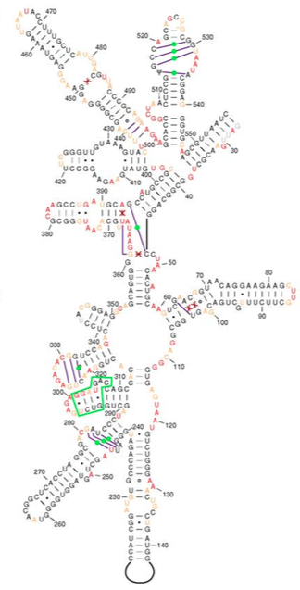
Constraints can improve RNA secondary structure prediction
E. coli 16S rRNA
naïve prediction
constrained prediction
Green and purple indicate mistakes in structure prediction
Prior knowledge of which nucleotides are single- or double-stranded aids prediction.
Deigan et al. PNAS 2009; Kevin Weeks Curr Opin Struct Biol 2010

Slide 5
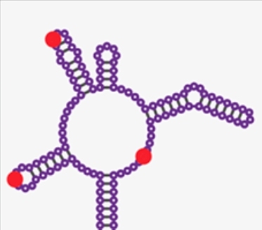
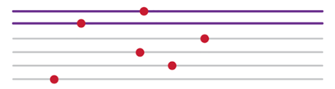
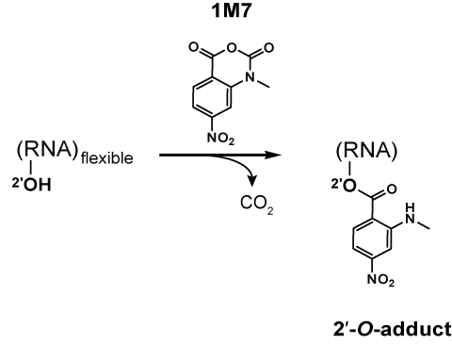
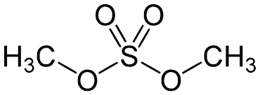
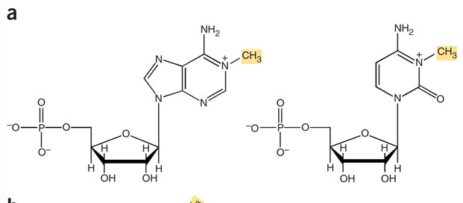
Chemical probing of RNA
Chemically modify RNA
  Usually unstructured nucleotides are modifiable
Read out with reverse transcriptase
Stops & Mutations
Chemically modify RNA
(mainly unstructured regions)
SHAPE
(Selective 2’-hydroxyl acylation & primer extension)
Dimethyl Sulfate (DMS)
A
C
Reviewed in Kubota et al Nat Chem Biol 2016; https://en.wikipedia.org/wiki/Nucleic_acid_structure_determination, Tijerna et al. Nat Protocols 2007
Notes:
DMS – methylates the Watson-Crick face of A,C
1M7 (SHAPE reagent) – acylate flexible 2’ OH in the ribose sugar

Slide 6

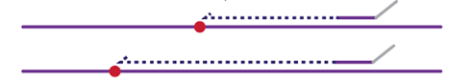
Chemical probing of RNA
Chemically modify RNA
  Usually unstructured nucleotides are modifiable
Read out with reverse transcriptase
Stops & Mutations
Chemically modify RNA
(mainly unstructured regions)
Read out with Reverse Transcriptase
Stops
Mutations
(SHAPE-MaP)
mutation
Reviewed in Kubota et al Nat Chem Biol 2016
Siegfried et al. Nat Methods 2014
Notes:
DMS – methylates the Watson-Crick face of A,C
1M7 (SHAPE reagent) – acylate flexible 2’ OH in the ribose sugar

Slide 7
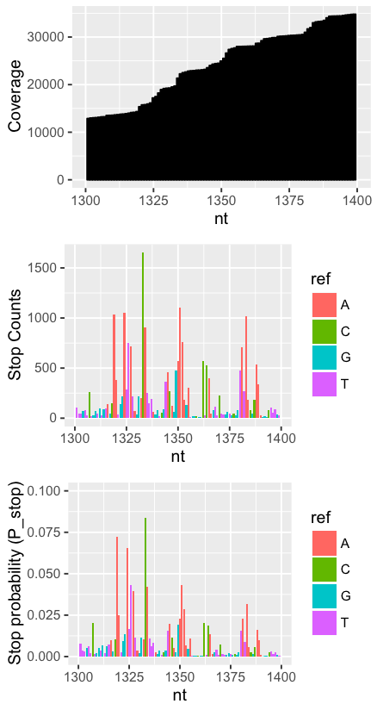
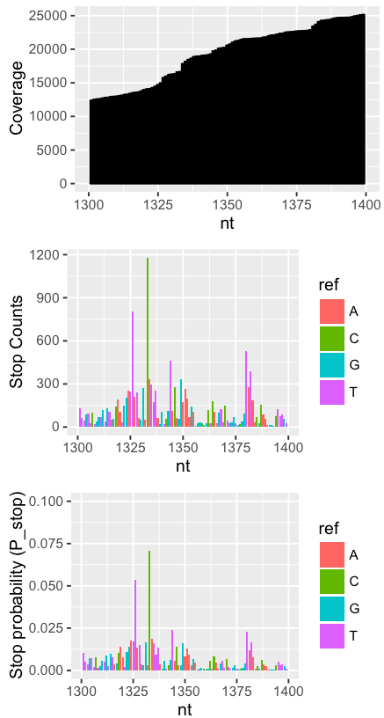
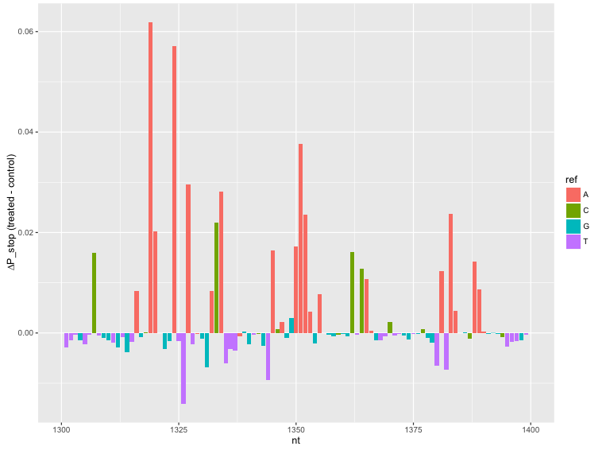
Basic analysis of chemical probing data
Treated
Control
i∈nucleotides; N total
P_{stop}(i) = stops(i)/coverage(i)
∆P_{stop}(i) = P_{stop}(treated) - P_{stop}(control)
DMS-Seq data for Xist RNA
A and C should be modified
Combined
Fang, Moss et al. PLoS Genet. 2015
Notes:
Fang, Moss et al. PLoS Genet. 2015

Slide 8
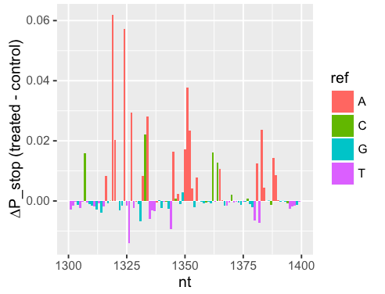
How do we statistically identify modified nucleotides?
Typical work in the field: Poisson statistics
  Reverse transcription stops are counts, compare between treated & untreated samples
Extensively used in the chemical probing field to describe variation of data
  Aviran et al. PNAS 2011
  Choudhary et al. Bioinformatics 2016
  Smola et al. Biochemistry 2015
  Smola et al. PNAS 2016
  Siegfried et al. Nat Methods 2014

Slide 9
Why have people been using Poisson statistics?
Chemical probing has been traditionally done in vitro → good experiments should behave like technical replicates
Only more recently has in vivo analysis become widespread
  Rouskin et al. Nature 2014 – DMS-Seq genome-wide
  Spitale et al. Nature 2015 – icSHAPE genome-wide
  Fang, Moss et al. PLoS Genet 2015 – DMS-Seq Xist
  Smola et al. Biochemistry 2015 – ∆SHAPE
  Smola et al. PNAS 2016 – ∆SHAPE Xist
  (several others)

Slide 10
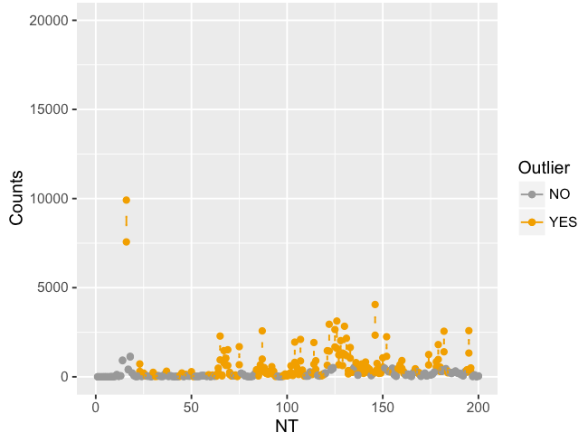
Chemical probing data are overdispersed relative to the Poisson distribution
Xist RNA
  First 200 nt shown
Simulated 99% confidence intervals
1217 outliers (170 expected)
Experiment by Alec Sexton
Notes:
----- Meeting Notes (10/27/16 15:24) -----
Plot one
Look for reactive nucleotides
Relative to biological variation
Average, then split out two points, then
Stops (pseudocounts)
transparent/open circles
one primer/spread out

Slide 11
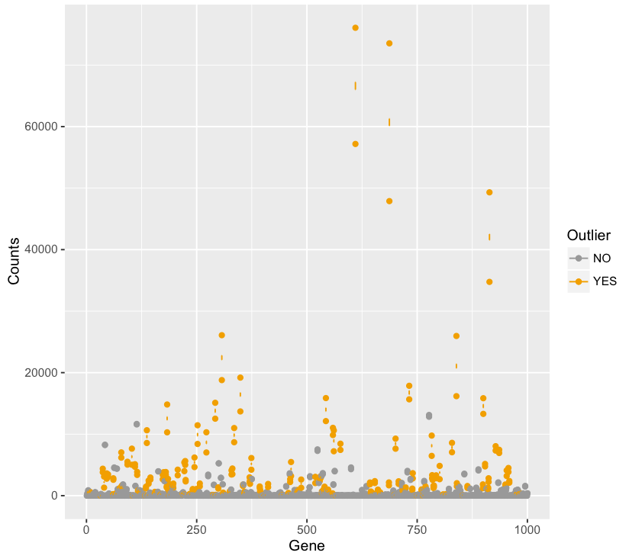
A familiar problem
293T RNA-Seq gene-level counts
Data by Erin Duffy
Simulated 99% Poisson confidence interval
139 outliers (expect 10 in 1000 genes)

Slide 12
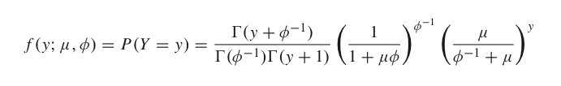
What’s a better distribution than Poisson?
Negative binomial
  Y = counts; µ = mean; α = dispersion
  σ² = µ + αµ²
    α = 0 → Poisson
    Larger alpha → more overdispersed
  Widely used for RNA-Seq
  Problem: how to fit dispersion parameter with 2-3 replicate data points
ß-binomial also a good option

Slide 13
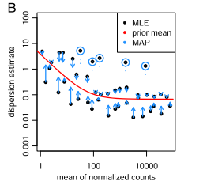
Fitting of dispersion parameter using common information from many data points
General approach pioneered by Gordon Smyth (edgeR) and Simon Anders (DESeq) groups
Clear relationship between mean and “dispersion” parameter that controls distribution shape
DESeq2 method
  Fit dispersion parameter for each gene
  Fit trend to the dispersion parameters
  Squeeze values toward trend (more evidence for high dispersion → further from trend)
Robinson and Smyth Bioinformatics 2008
Love et al. Genome Biol 2014

Slide 14
Input parameters
Chemical probing
i∈nucleoti des; N total
j∈samples; M total
Y_{ij} = stop (or mutation) counts for nucleotide i in sample j
Coverage for nucleotide i in sample j
  C_{ij} =
S_{ij} = relative coverage for nucleotide i in sample j
  S_{ij} =
Pseudocounts
  P_{ij} = Y_{ij}/S_{ij}
RNA-Seq
i∈genes; N total
j∈samples; M total
Y_{ij} = counts for gene i in sample j
C_{j} = total coverage for sample j
S_{j} = relative library size
Pseudocounts
  P_{ij} = Y_{ij}/S_{j}
Notes:
----- Meeting Notes (10/27/16 15:24) -----
RNA-Seq on left
Make things correspond as clearly as possible

Slide 15
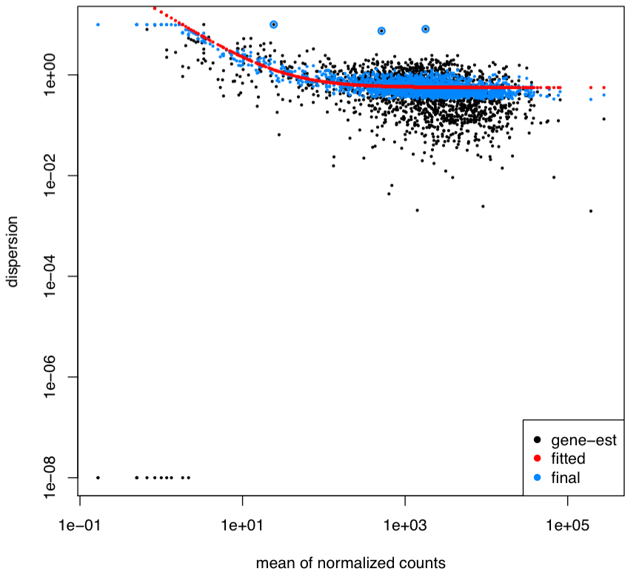
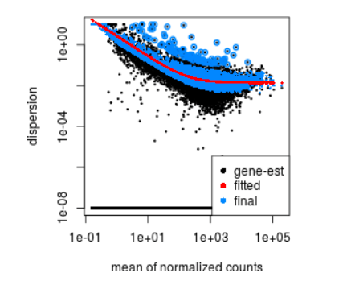
Fitting Dispersions
Yeast 18s rRNA
Sample RNA-Seq data
Black: MLE of dispersion parameter
Red: fitted trend
Blue: final estimated dispersion
Hector et al. NAR 2014
DESeq2 Bioconductor Package
Notes:
----- Meeting Notes (10/27/16 15:24) -----
Slide to explain fitting of dispersions

Slide 16
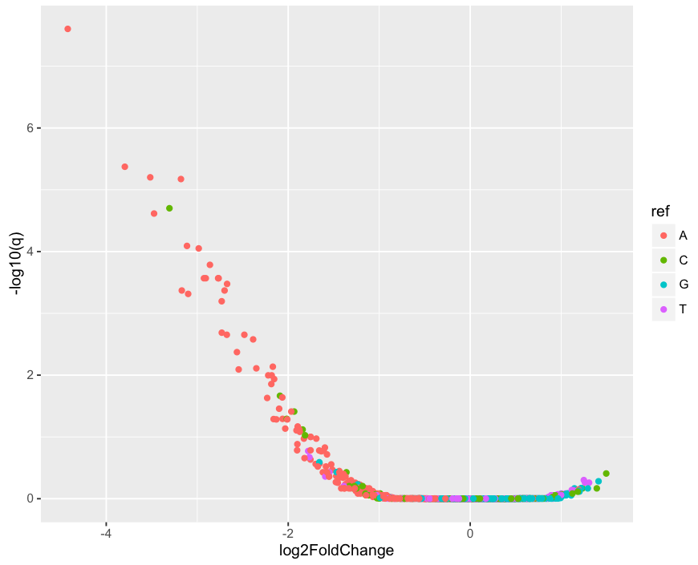
Volcano Plot for negative binomial test
Hector et al. NAR 2014

Slide 17
Negative binomial test vs. Poisson test
Hector et al. NAR 2014

Slide 18
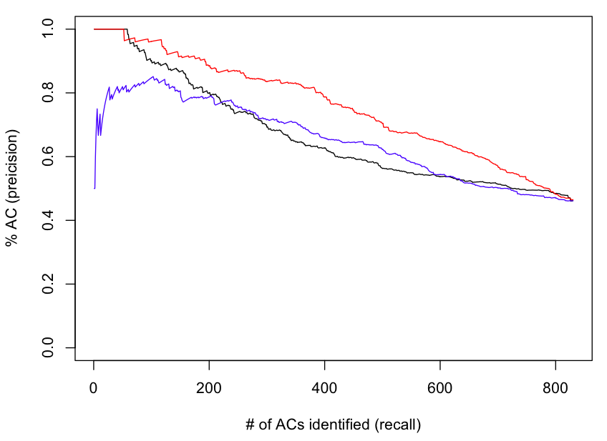
Precision-Recall of A’s and C’s
(only these nucleotides are modified by DMS)
Negative-binomial test
Poisson test
∆P_{stop} (effect size)
Hector et al. NAR 2014

Slide 19
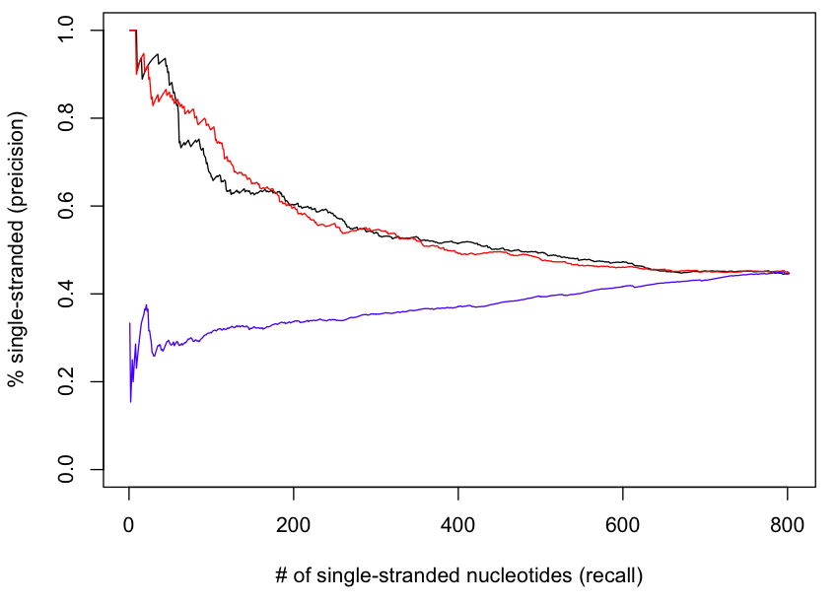
Precision-Recall of single-stranded nucleotides
Negative-binomial test
Poisson test
∆P_{stop} (effect size)
Hector et al. NAR 2014

Slide 20
Future directions
Emprical Bayes moderation of ∆P_{stop} (effect size)?
Compare to Selega et al. Nat Methods (came out on Mon)
  Addresses same problem with substantially different methodology
Implement differential test for chemical probing between different biological states (e.g. in vitro and in vivo)

