Slide 1
P2 Brain
Summary slides of the Roadmap enhancer data

Slide 2
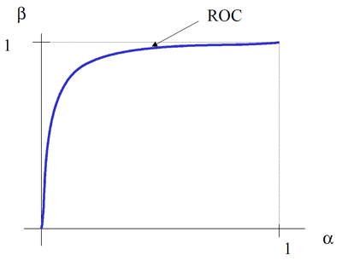
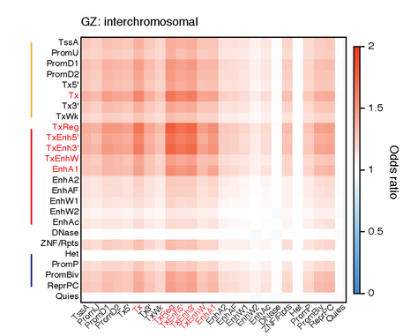
Flowchart
Gene
20M
20M
Logistic Regression
Roadmap tissue enhancers
Supervised learning
Gene-enhancer linkages by Hi-C
eQTL
Gene

