Slide 1

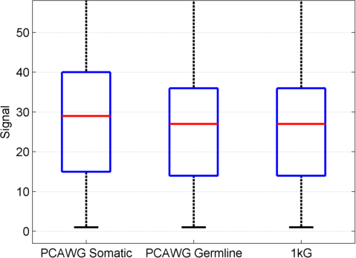
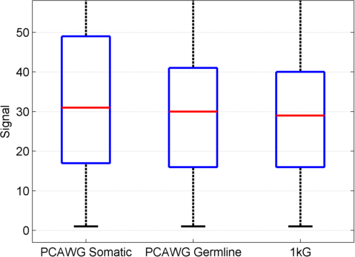
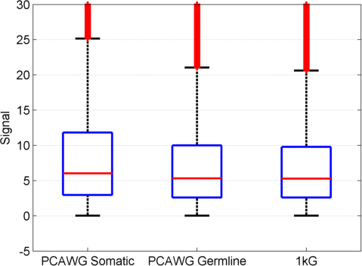
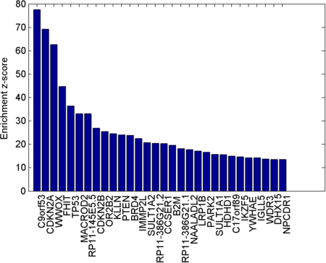
SVFX Analysis
Pipeline
(a)
Functional Genomics Data
Conservation
Annotation
ENCODE
REMC
PhyloP
GENCODE
Tissue Specific
Data
Somatic SVs
Germline SVs
Feature Extraction
Supervised Machine Learning
Prioritized Somatic SVs
1kG
SVs
H3K27ac
H3K4me1
Conservation
Gene Enrichment

