Slide 1
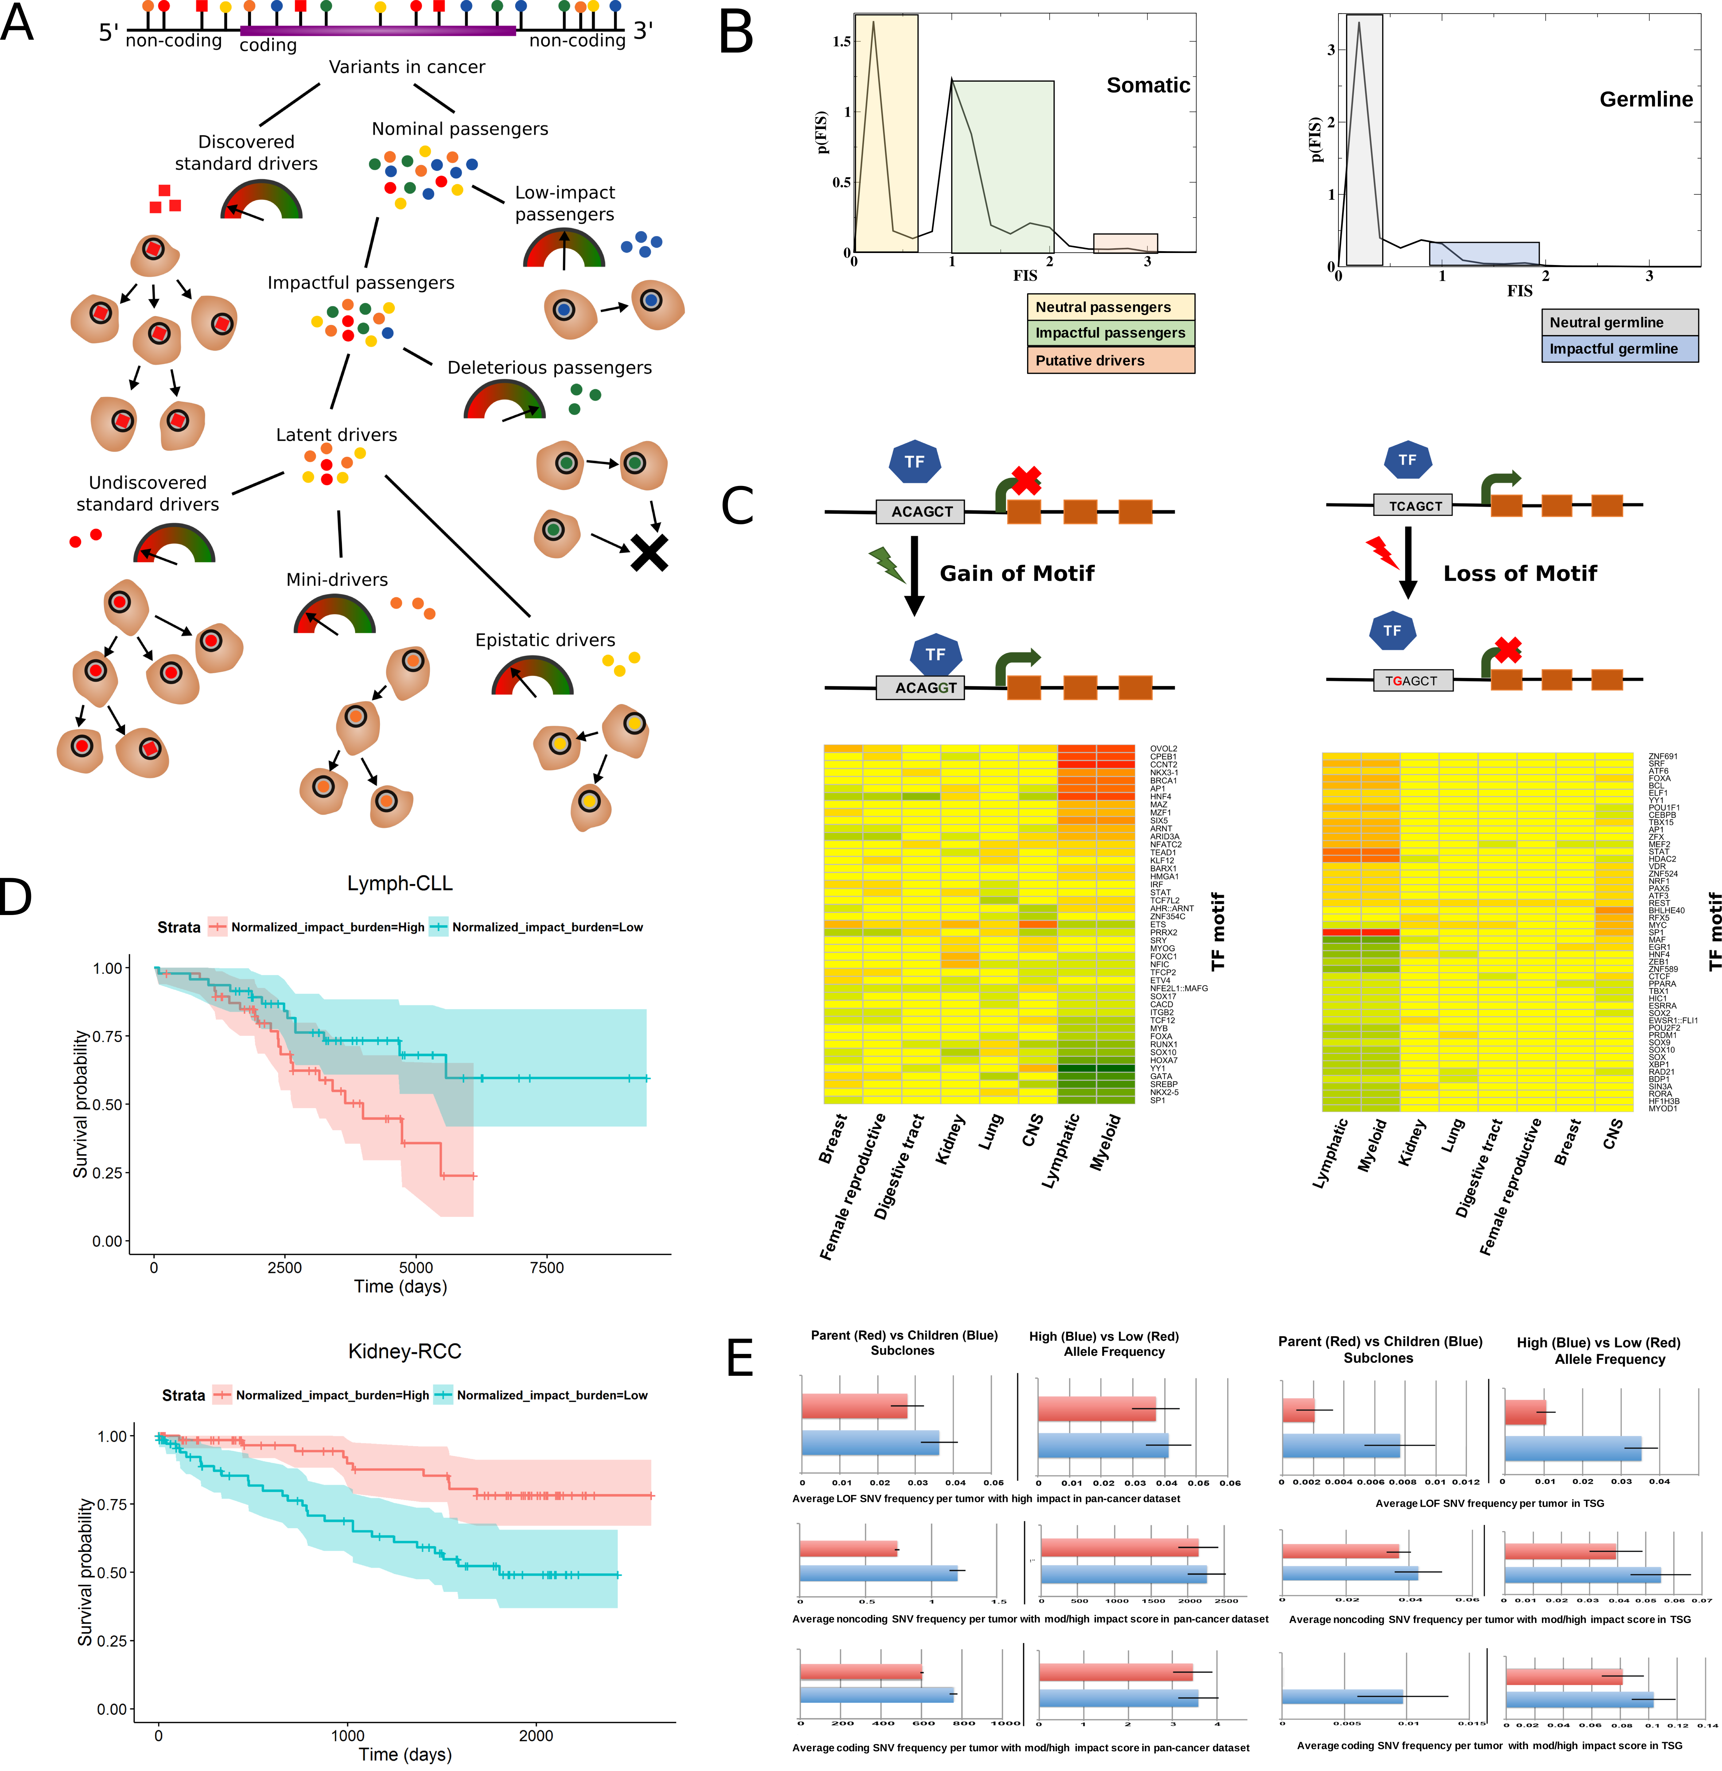
Notes:
Figure A. Classification of somatic variants into different categories based on their functional impact on cancer genome. Discovered standard drivers are variants discovered through canonical driver identification methods employing statistical enrichment and/or functional impact of variants in cancer; nominal passengers are rest of the variant dataset. Most nominal passengers are low-impact, but some are predicted to be impactful, based off features such as the evolutionary conservation of the affected genomic positions, gains or losses of functional motifs, and measures of the biological importance of the affected noncoding element or gene. Impactful variants divide into latent drivers, which promote cancer progression, and deleterious passengers, which inhibit tumor growth. Latent drivers further subdivide into three types: Mini-drivers incrementally promote tumor growth but are unnecessary for tumor survival. Epistatic drivers confer a meaningful selective advantage to tumors only in synergistic combination with other specific somatic or germline variants. Undiscovered standard drivers have a functional impact similar to the known driver variants reported in literature, but they have not yet been detected as drivers due to limited statistical power/cohort size.
Figure B. Functional impact score distribution of non-coding SNVs present in the PCAWG pan-cancer variant set for a) somatic and b) germline genome. We clearly observe three distinct subgroups based on somatic SNV impact distribution. Low and high impact score regions consist of neutral passenger mutations and putative driver mutations, respectively. In addition, we also observe impactful passengers with intermediate functional impact score. In contrast, functional score distribution for germline SNVs indicate presence of mostly neutral SNVs with very few mild/high impact variants.
Figure C. Overall functional burdening of TF motifs: TFs can undergo functional burdening via a) gain-of-motif (left panel) and b) loss-of-motif (right panel) events upon somatic mutation in various cancers. Functional burdening of TF motifs varies between different cancer types as well as within same cancer cohort. Further based on these functional burdening we can deduce influence of somatic variants on various regulatory networks. Red and green color in the heat-map signifies enrichment & depletion of high impact SNVs in various TF motifs, respectively. Columns in the heat map correspond to different cancer meta-cohorts, while the rows indicate different TF motifs.
Figure D. Correlating functional impact and patient survival: Survival curves in CLL (top panel) and RCC (bottom panel) with 95% confidence intervals, stratified by normalized impact burden. Patients in the top half of impact burden (in red), normalized by low-impact mutation load, die sooner in CLL but live longer in RCC, plausibly reflecting the different balance of latent drivers versus deleterious passengers in these two subtypes.
Figure E. Impact of coding and non-coding mutations in tumor progression: We divide each variant i) based on their prevalence in a parental-early subclone (in blue) vs child-late subclone (in red), and ii) based on their respective variant allele frequency (VAF). A high VAF (in blue) suggests early mutations or mutations in dominant/parental subclone, while low VAFs represent late mutations or mutations in low-fitness populations. In left panel, we show that the average number of LOF (top), non coding mutations (middle)and coding mutations (bottom)with moderate and high functional impact score per tumor sample. In right panel, we depict the average number of LOF(top), non-coding(middle) and coding mutations(bottom) with moderate and high impact that occurred in tumor suppressor gene (TSG) regions. We observe higher prevalence of impactful passenger and LOF variants in the early phases of cancer progression.

