Slide 1
Intensification slidepack

Slide 2
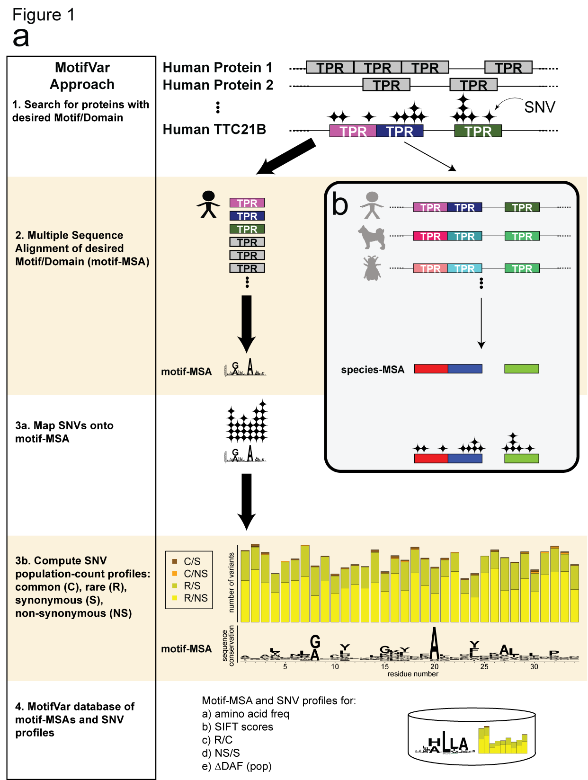
Figure 1. Our MotifVar approach and database and it also serves as a “variant information amplifier” as compared to the species-MSA.

Slide 3
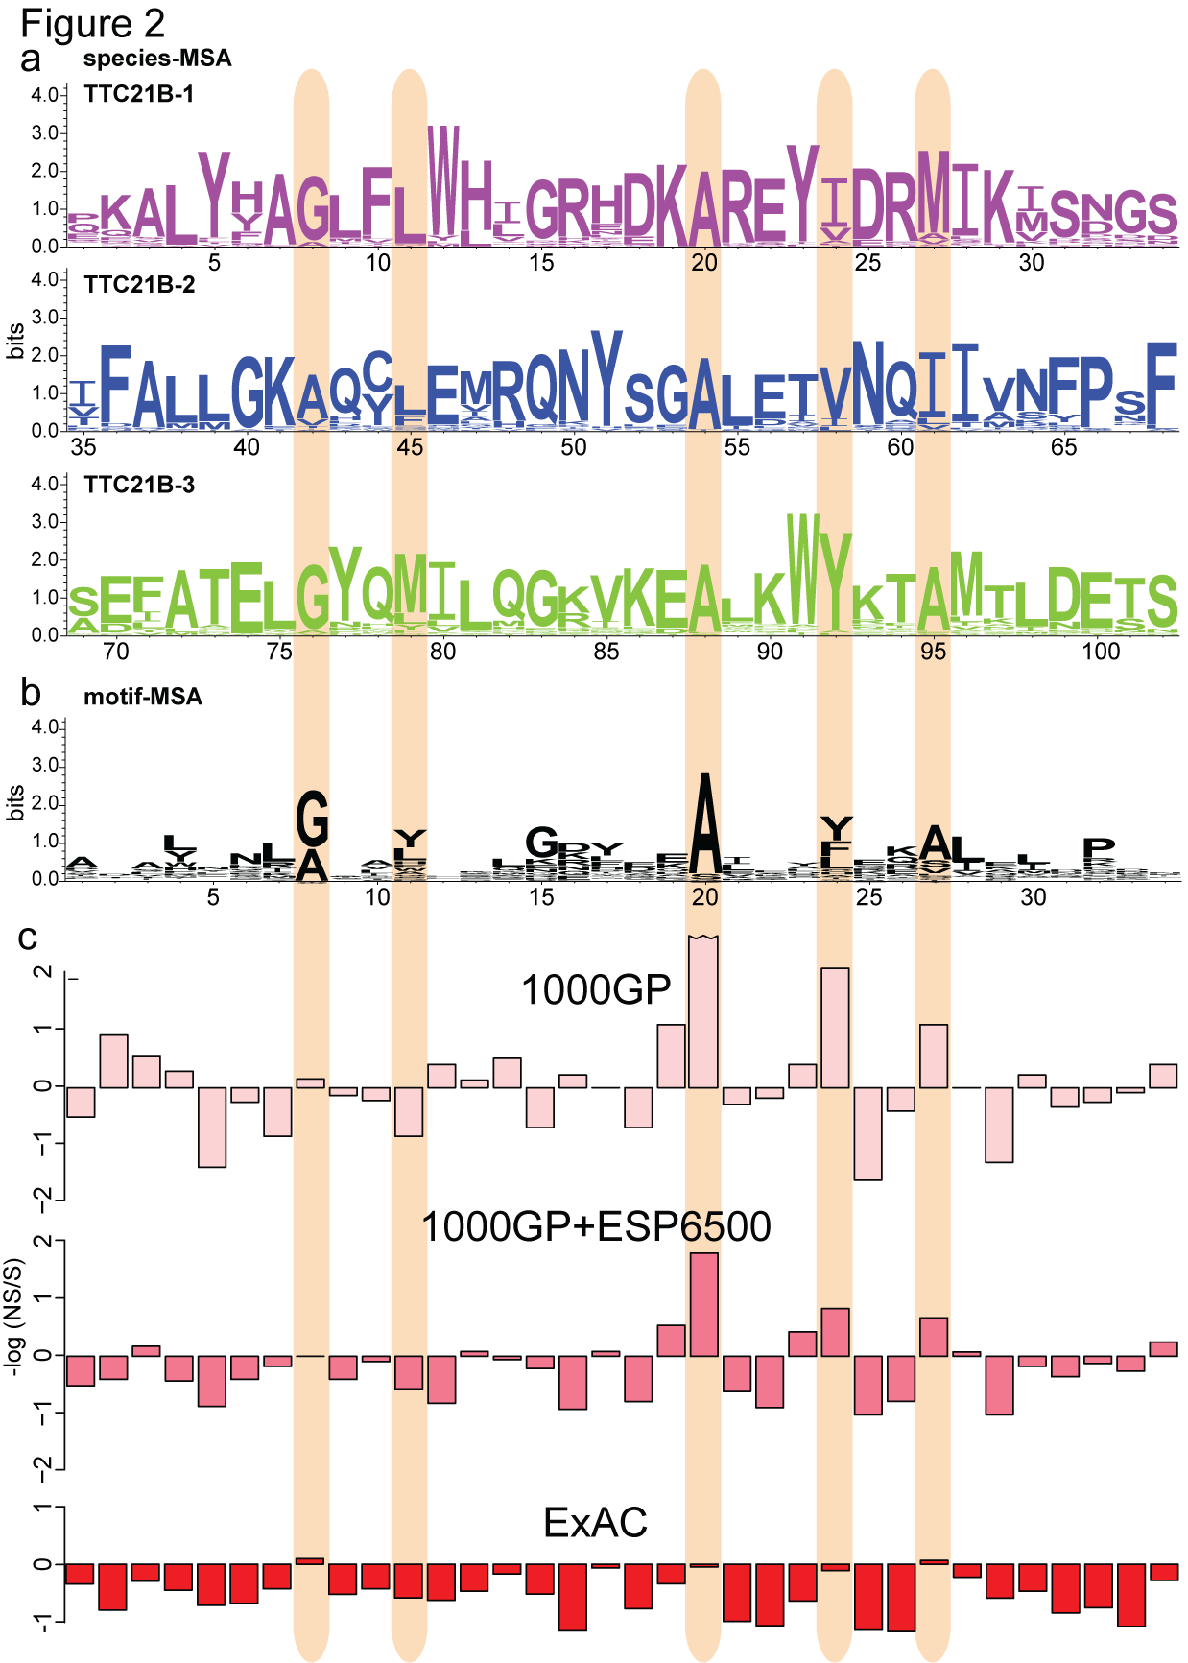
Figure 2. Motif-MSA can uncover important domain positions missed by species-MSA.

Slide 4
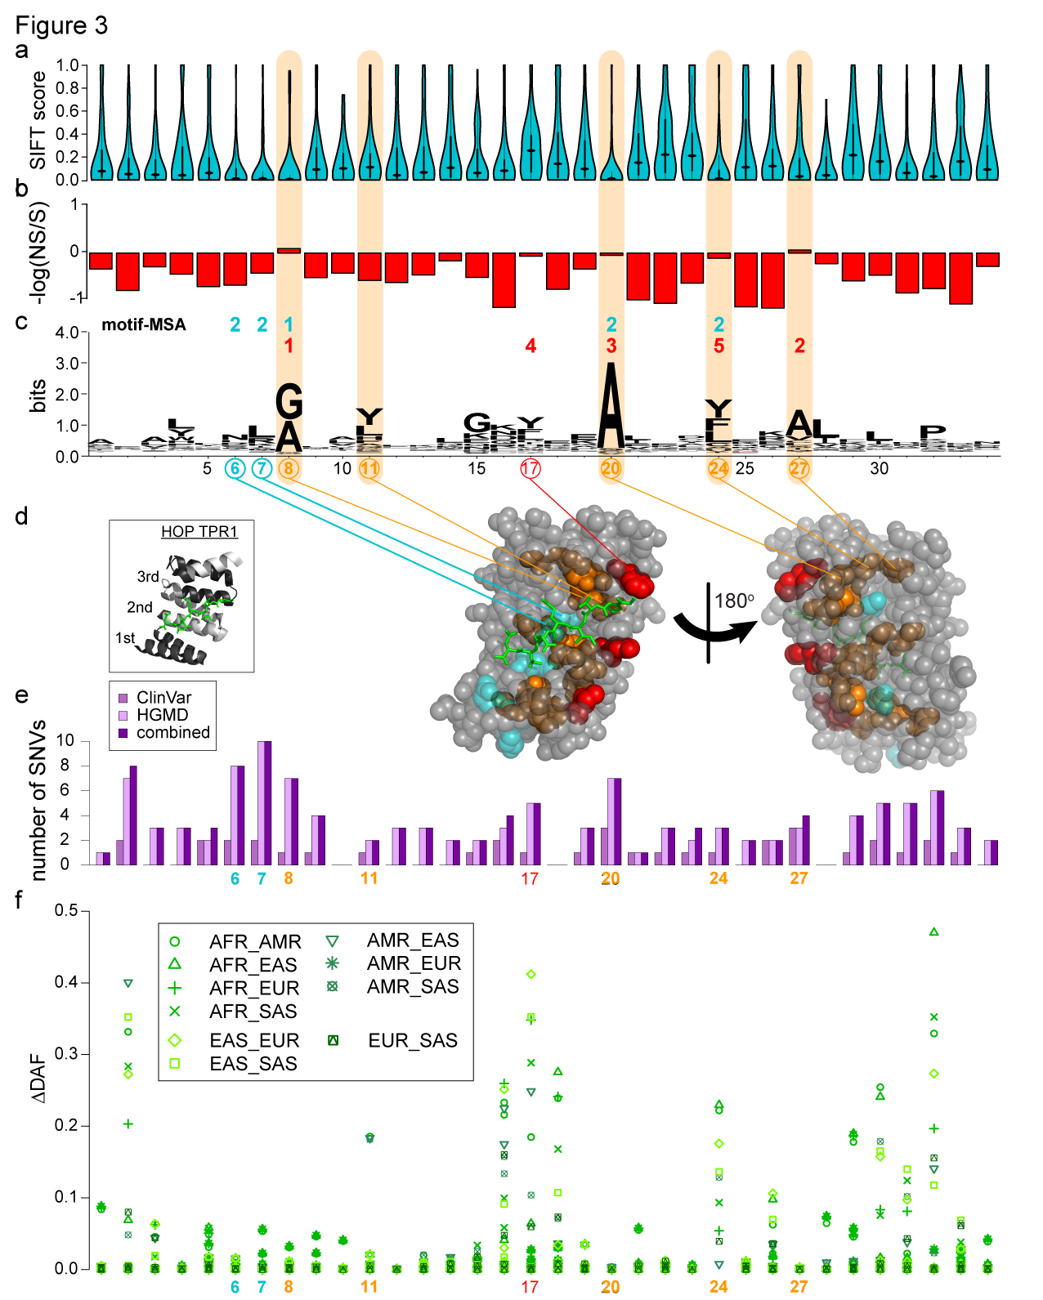
Figure 3. Using genomic variant information in the motif-MSA profile to investigate selective constraints in PPI motifs.

Slide 5
Supplementary Materials

Slide 6
Supplementary Figure 1 - TPR most frequent motif size

Slide 7
Supplementary Figure 2 – log(R/C)

Slide 8
Supplementary Figure 3 – are conserved positions enriched for disease SNVs

Slide 9
Supplementary Table 1 – list of repeat protein domains in the Intensification database and compare all datasets
Supplementary Table 1. Number of SNVs in each dataset. The 1000 Genomes Project (1000GP) provides the least number of autosomal SNVs, followed by an approximate 6-fold increase in number of exomes in the combined set of 1000GP and Exome Sequencing Project (ESP6500); this is a corresponding ~3-fold increase in the number of autosomal SNVs. Our study uses the dataset from ExAC, with 60,706 individuals, an almost 8-fold increase from the combined set of 1000GP+ESP6500; this is a corresponding ~5-fold increase in the number of autosomal SNVs.

Slide 10
Supp table 2 – Species vs Motif-MSA

Slide 11
Supp table 3 – Spearman correlation between conservation and various pop gen metrics

