Slide 1
Functional Burdening Impact on Survival
Version 4
Will Meyerson

Slide 2
What is the clinical significance of passenger mutations?
Causal significance
Latent drivers
Muller’s ratchet
(Tumor neoantigens)
Evidentiary significance
Correlation with underlying mutation process
Confounding
Correlation with patient age
Would like to empirically quantify and deconvolute these potentially relationships where possible

Slide 3
Track potential relationships with two genomic and one clinical covariates
To track causal relationships* – define patient functional mutation burden score
To track evidentiary relationships – define patient nonfunctional mutation load score
To track (and remove) confounding relationships – include patient age at diagnosis as a covariate
Need enough events (patient deaths) to support three covariates
Restricted analysis to just those 9 cancer subtypes for which we have 20 or more sequenced donors with recorded deaths and age at diagnosis, namely:
Breast-AdenoCA, CNS-GBM, Eso-AdenoCA, Kidney-RCC, Liver-HCC, Lymph-CLL, Ovary-AdenoCA, Panc-AdenoCA, and Skin-Melanoma
* Except tumor neoantigen impact

Slide 4
Define patient-centric functional burdening scores
Patient functional mutation burden score
A coding subcscore and non-coding subscore enter into the Functional mutation burden score
Coding subscore: sum of the FunSeq scores for coding mutations in essential genes that are not known to be driver genes
Noncoding subscore: number of noncoding mutations in sensitive regions of the genome that earn FunSeq scores > 2.75
Each subscore is ranked with respect to the same subscore across samples in the same tumor subtype.
The average of the ranks of the subscores yields the functional mutation burden score, which is then linearly re-scaled to range from 0 to 4.
Patient nonfunctional mutation load score
number of noncoding mutations that earn FunSeq Scores < 0.5, ranked, then re-scaled to range from 0 to 4.

Slide 5
Best precedent and strongest signal when essentiality determined by top 1,878 cancer cell line essential genes
Look at black first – all essential genes.
Purple is with Vogelstein’s drivers removed.
2015 Science paper by Eric Lander: Identification and characterization of essential genes in the human genome

Slide 6
Patient functional and nonfunctional load scores have clinically meaningful and statistically significant affects on survival in select tumor subtypes.
 | Hazardous | Protective
Functional | CLL (1.99, 0.0098) | RCC (0.45, 0.00067)
Nonfunctional | RCC (1.54, 0.035) | CLL (0.55, 0.00063) GBM (0.61, 0.030) Ovary-AdenoCA (0.76, 0.028)
Subtype (Hazard ratio, p-value)
Read as “For each quartile in functional mutation burden score a CLL patient ascends, their instantaneous chance of death doubles.”
The direction of impact varies by tumor, and the directions of the two scores are discordant.
None of these tumors subtypes have evidence of violation of proportionality assumptions, as assessed by R’s cox.zph function.

Slide 7
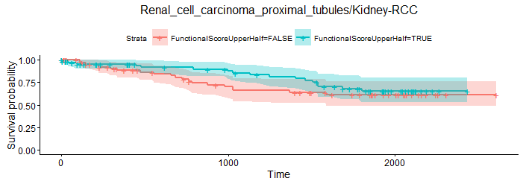
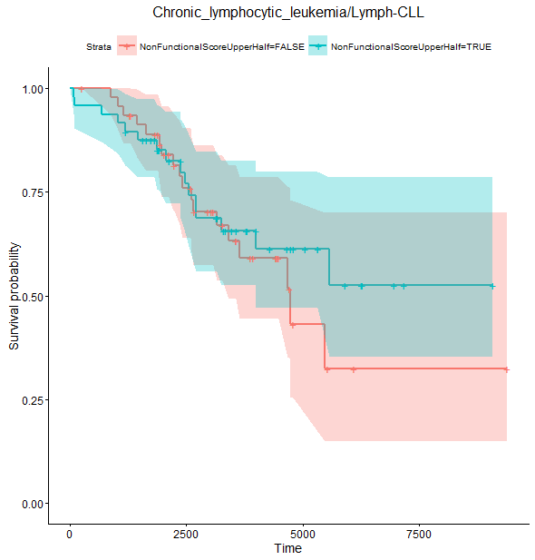
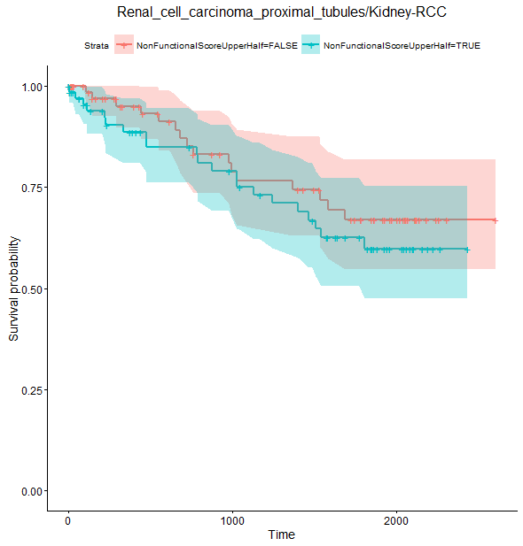
Survival stratified by high functional rank or high nonfunctional rank in CLL and RCC
CLL
RCC
High functional rank in blue
High functional rank in blue
RCC
CLL
High non-functional rank in blue
High non-functional rank in blue

Slide 8
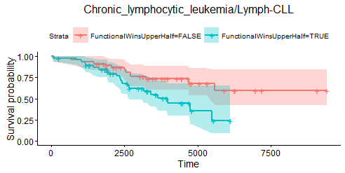
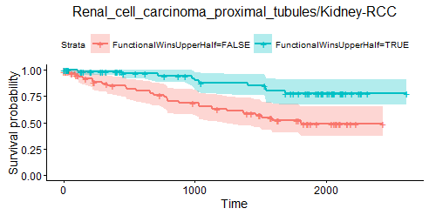
Good separation: Survival stratified by high or low signed difference between functional rank and nonfunctional rank

Slide 9
Conclusion
Evidence for latent drivers in CLL
Evidence of Muller’s ratchet in RCC
In addition, non-functional mutations have evidentiary significance for mutational processes correlated with good survival in CLL, GBM, and Ovary-AdenoCA and with poor survival in RCC

