Slide 1
Journey to the Center of the EBI (for CLL data)
As told by LL
ENCODE+cancer subgroup
2016-10-25

Slide 2
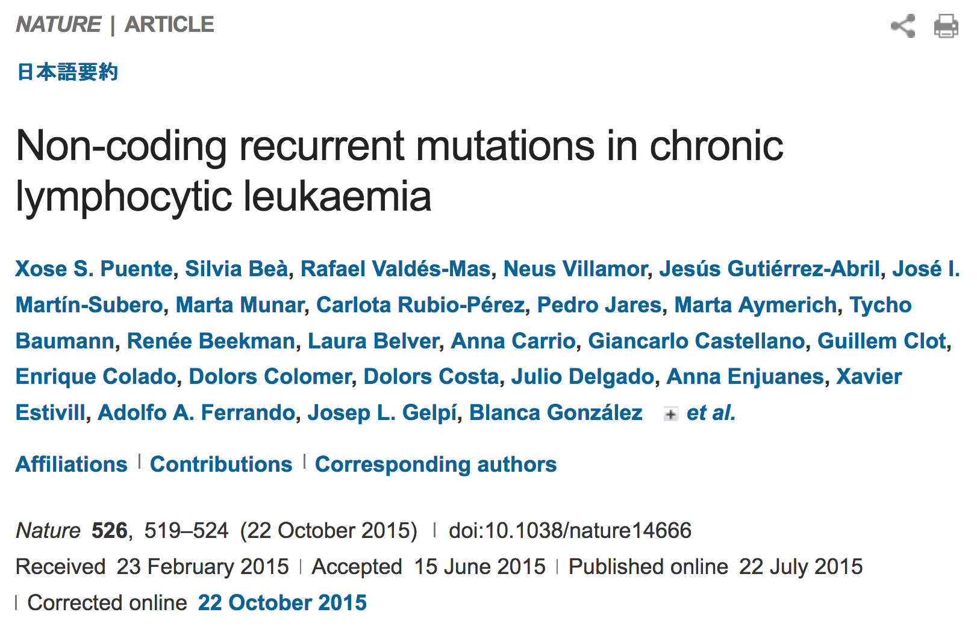

Slide 3
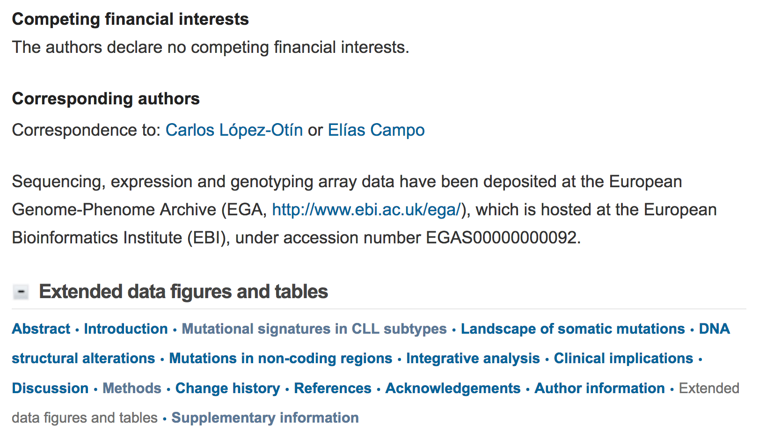

Slide 4
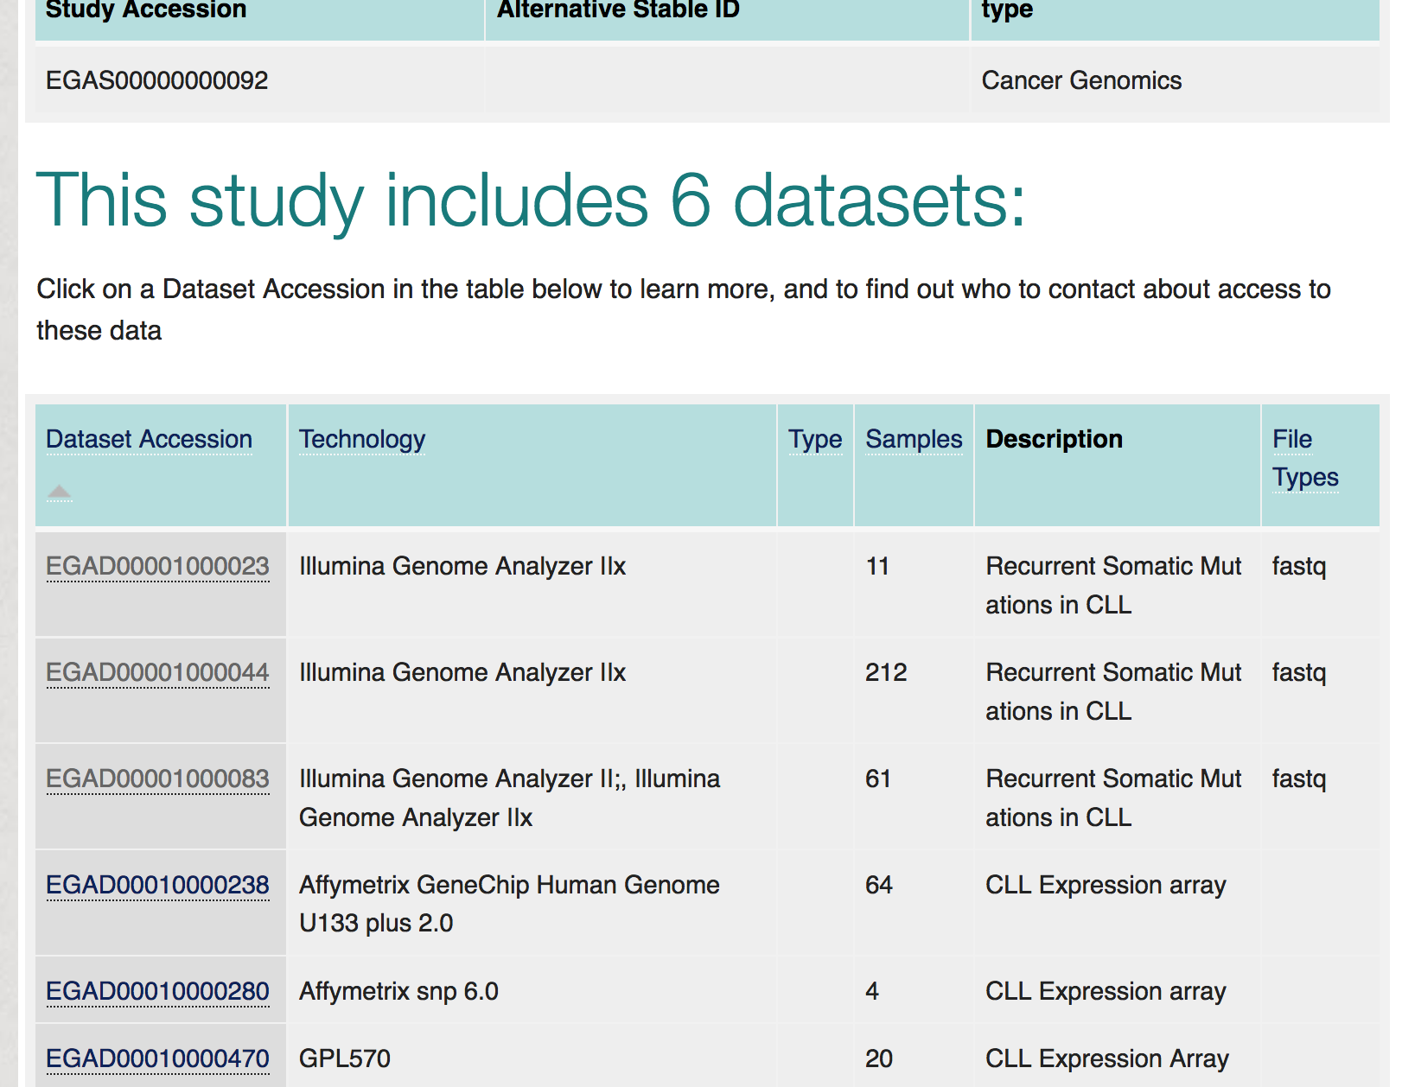

Slide 5
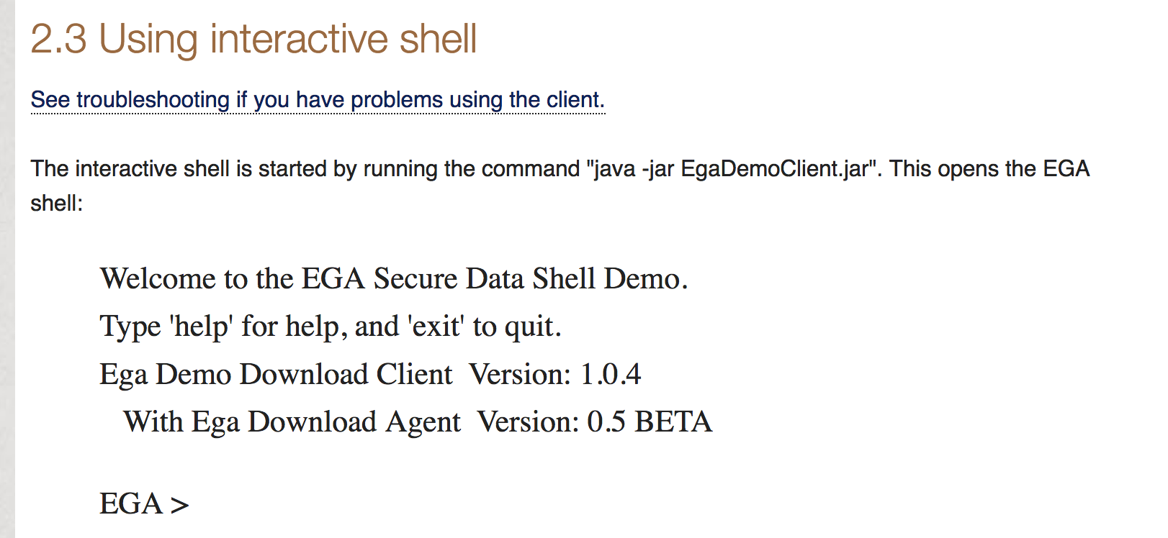

Slide 7
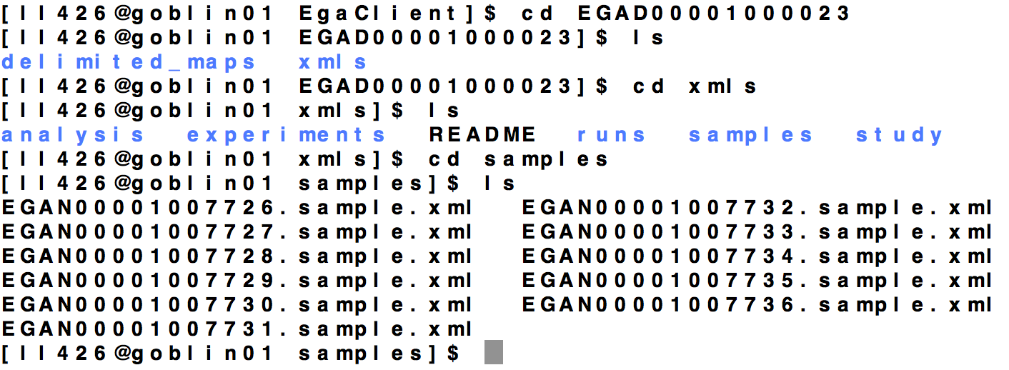

Slide 8
<?xml version = '1.0' encoding = 'UTF-8'?><SAMPLE_SET>
<SAMPLE alias="001-0001-01ND" center_name="Hospital Clinic Barcelona" broker_name="EGA" accession="ERS035823">
<IDENTIFIERS>
<PRIMARY_ID>ERS035823</PRIMARY_ID>
<SUBMITTER_ID namespace="Hospital Clinic Barcelona">001-0001-01ND</SUBMITTER_ID>
</IDENTIFIERS>
<TITLE>CLL Genome Project. Whole Genome Sequence. Sample: 001-0001-01ND</TITLE>
<SAMPLE_NAME>
<TAXON_ID>9606</TAXON_ID>
<COMMON_NAME>Human</COMMON_NAME>
<SCIENTIFIC_NAME>Homo sapiens</SCIENTIFIC_NAME>
</SAMPLE_NAME>
<DESCRIPTION>normal DNA from matched control of patient CLL-001</DESCRIPTION>
004-0013-01ND EGAN00001007734 wg/42P3BAAXX_1_1_fastq.gz.gpg EGAF00000068541
004-0013-01ND EGAN00001007734 wg/42P3BAAXX_2_1_fastq.gz.gpg EGAF00000068542
004-0013-01ND EGAN00001007734 wg/42P3BAAXX_5_1_fastq.gz.gpg EGAF00000068543
004-0013-01ND EGAN00001007734 wg/42P3BAAXX_6_1_fastq.gz.gpg EGAF00000068544
004-0013-01ND EGAN00001007734 wg/616FVAAXX_1_2_fastq.gz.gpg EGAF00000068545
004-0013-01ND EGAN00001007734 wg/616FVAAXX_2_2_fastq.gz.gpg EGAF00000068546

Slide 9
Dataset Summary
Dataset | Sample Manifest | File Manifest
EGAD00001000023 | WGS | WGS + others
EGAD00001000044 | WGS | Exome
EGAD00001000083 | RNAseq | RNAseq
These are sequence.txt files

