Slide 1
K562 vs GM12878
JZ

Slide 2
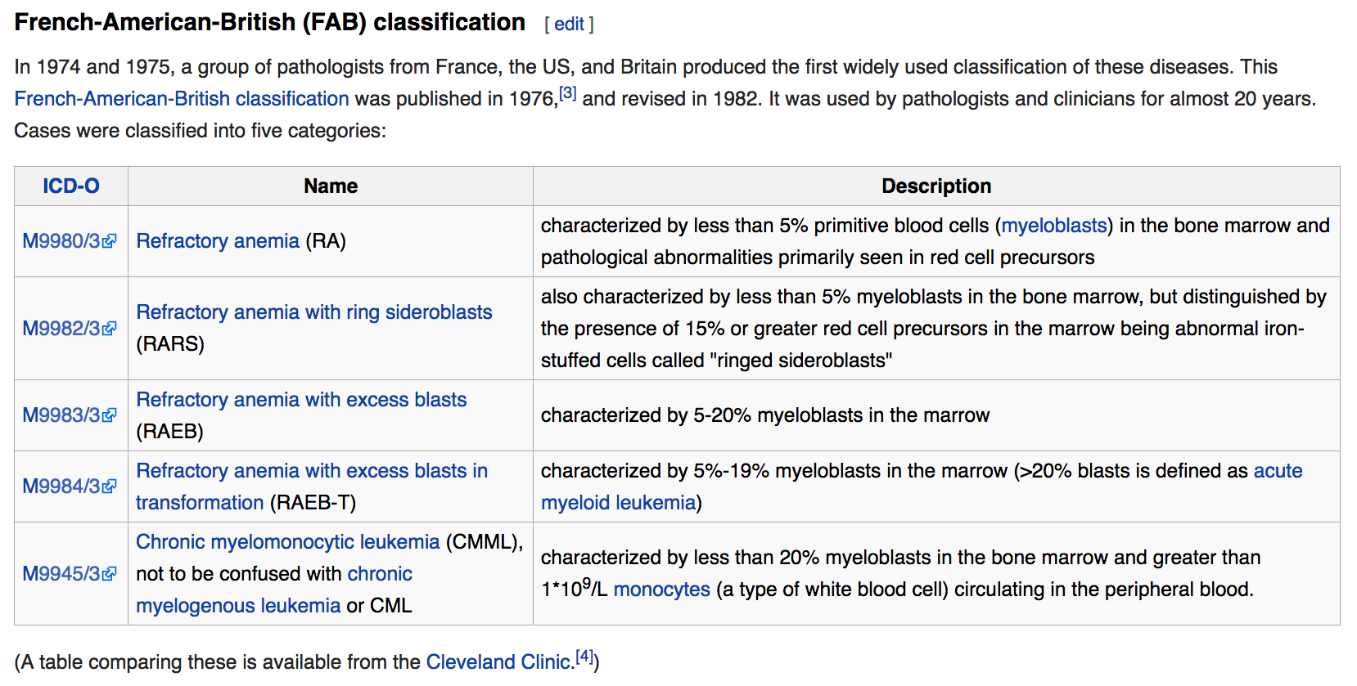

Slide 3
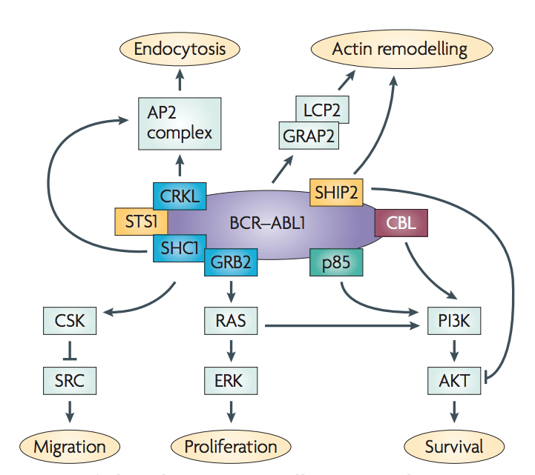
Whether leukemia is acute or chronic depends on whether most of the abnormal cells are immature (and are more like stem cells) or mature (and are more like normal white blood cells).
ONLY CMDI and AML data in either ICGC &TCGA
BCR-ABL1 fusion cause CML, but to get to the accurate stage, it needs some other mutations

Slide 4
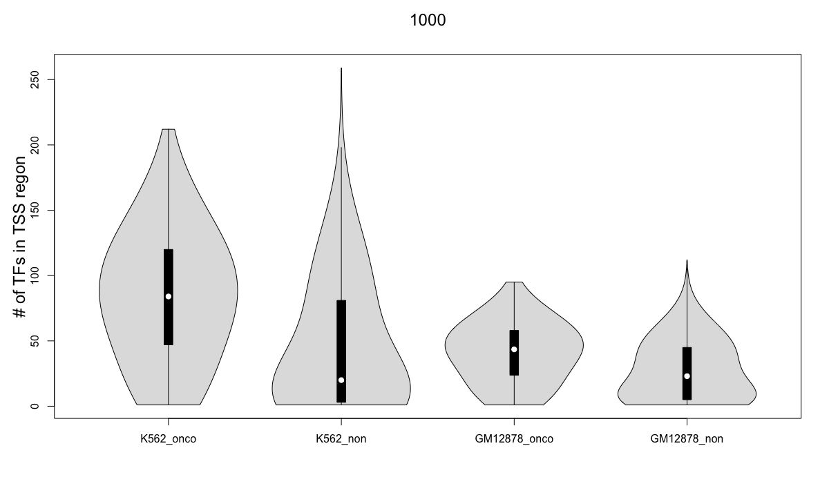

Slide 5
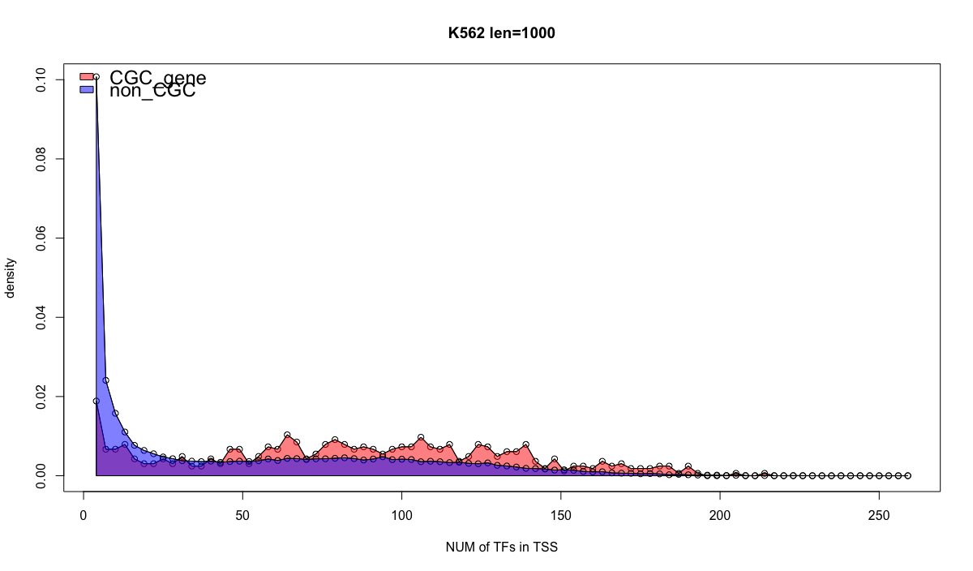

Slide 6
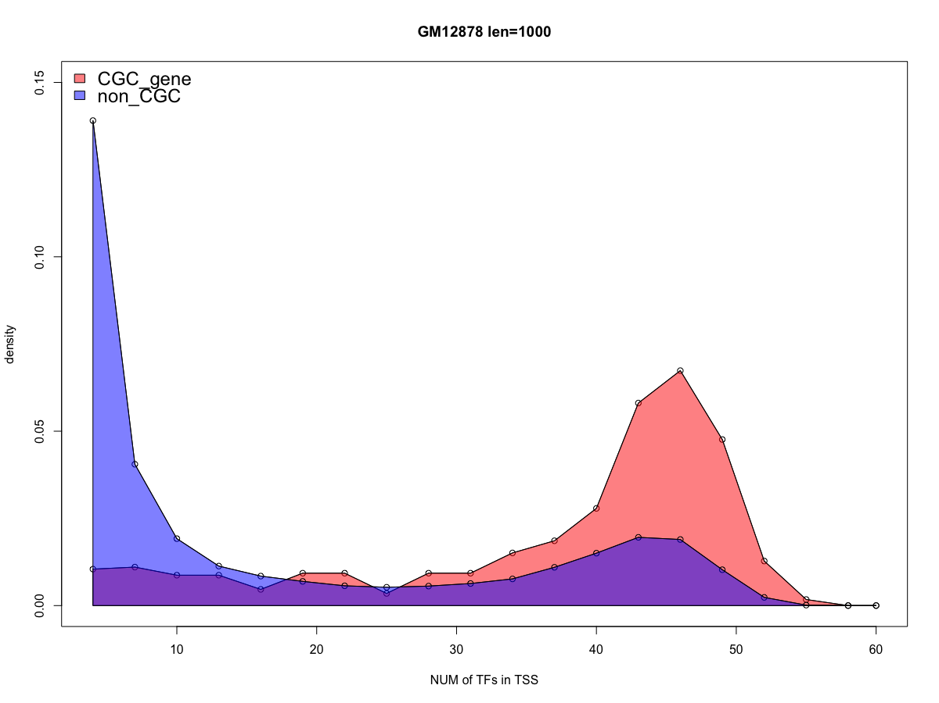

Slide 7
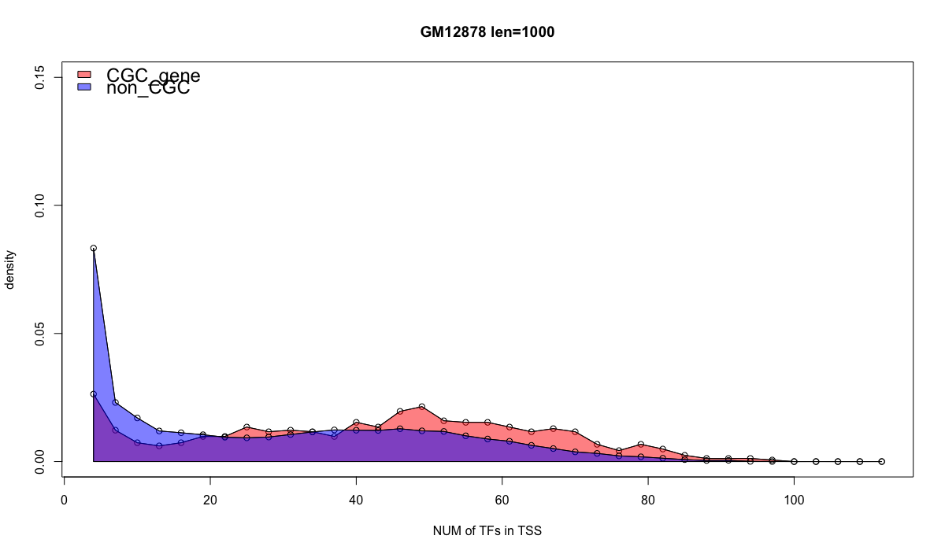

Slide 8
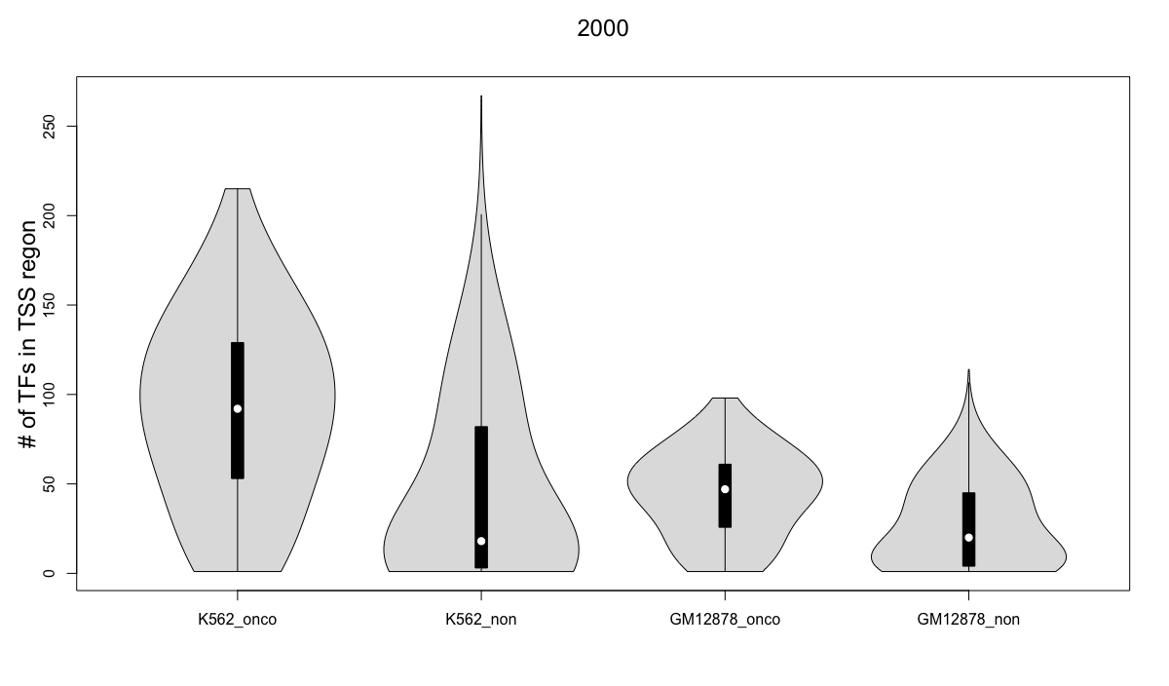

Slide 9
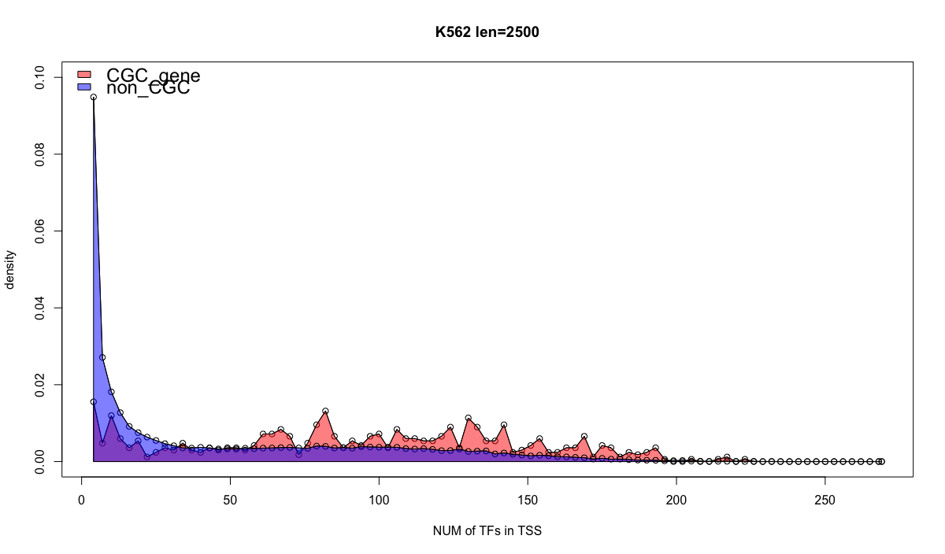

Slide 10
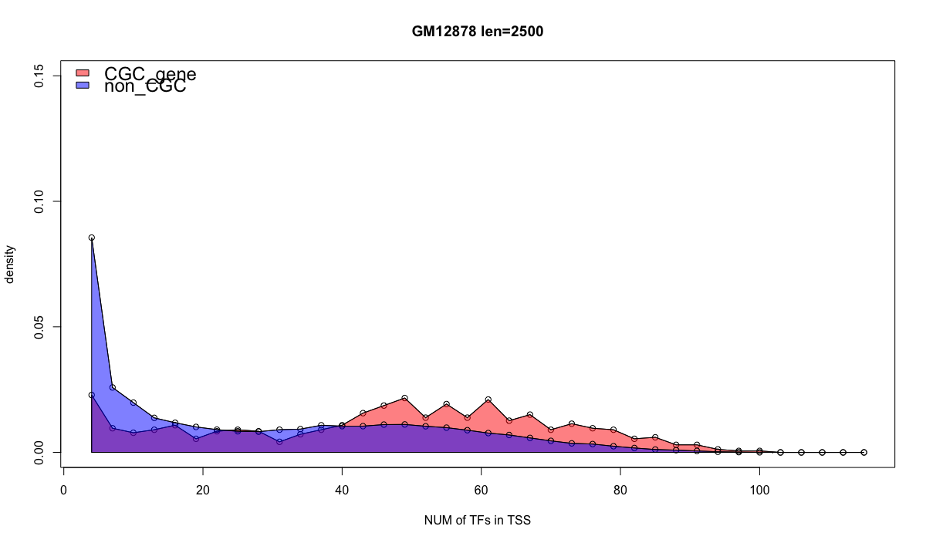

Slide 11
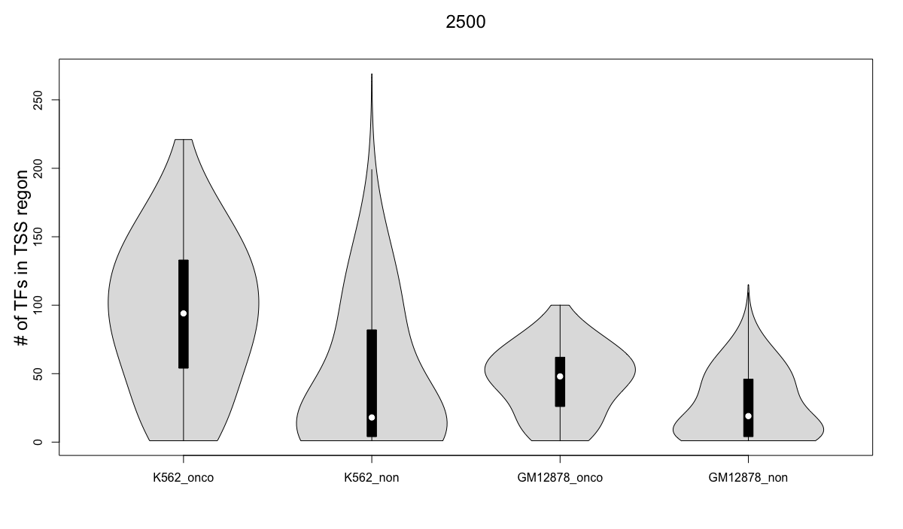

Slide 12
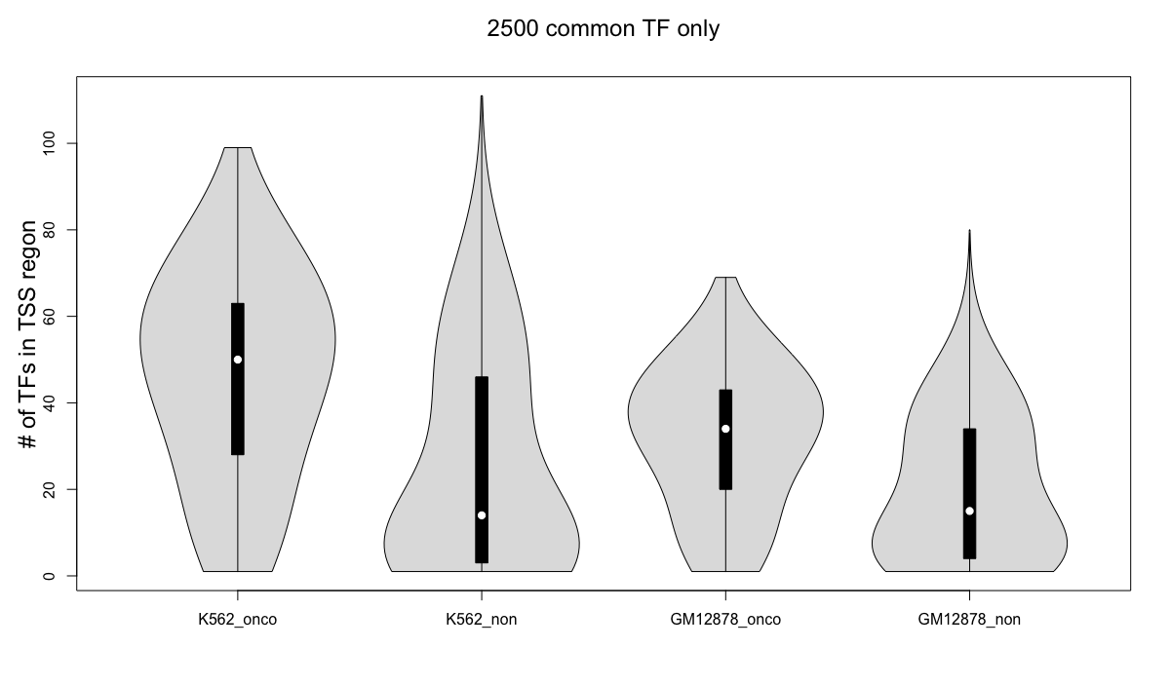

Slide 13
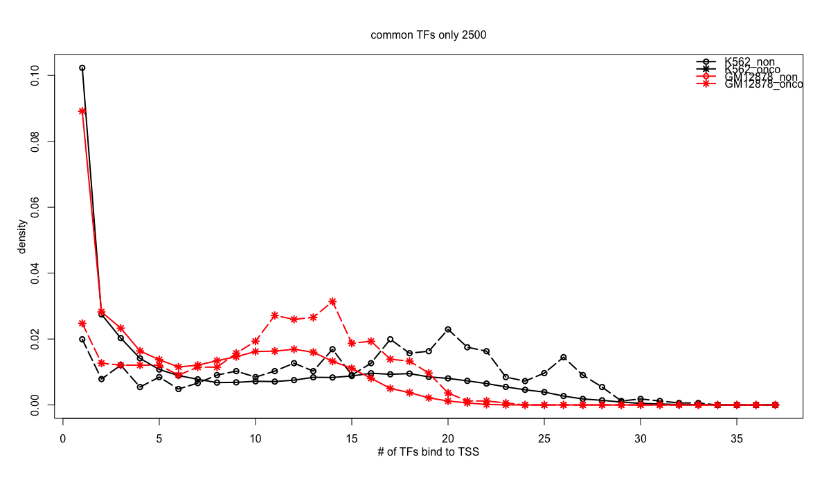

Slide 14
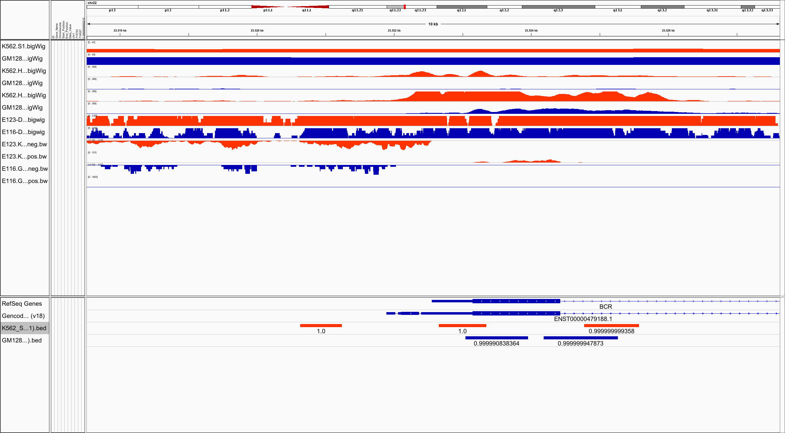
RepliTime
H3k27ac
H3k4me3
DHS
RNASeq

Slide 15
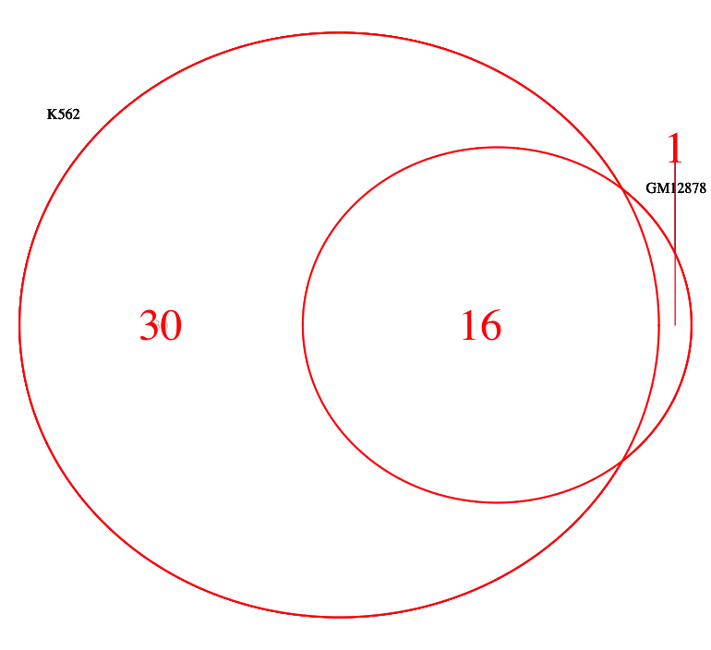
ATF3 BCL3 BCLAF1 BHLHE40 CEBPB CHD1 ELK1 EP300 ETS1 GABPA JUND MXI1 MYC PML POLR2A RCOR1 RFX5 SIN3A SP1 SRF TBL1XR1 TBP UBTF USF1 USF2 ZBTB33 CEBPZ NRF1 SUZ12 NFE2
CHD2 CTCF EGR1 ELF1 JUNB MAX MAZ RAD21 SMC3 SPI1 YY1 ZNF143 ETV6 HDGF MLLT1 TARDBP

Slide 16
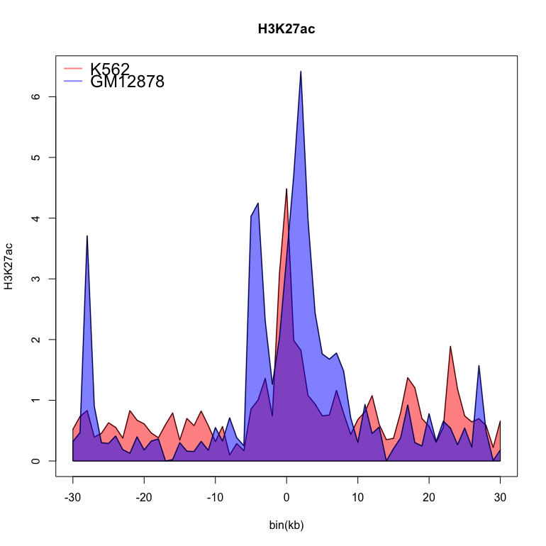

Slide 17
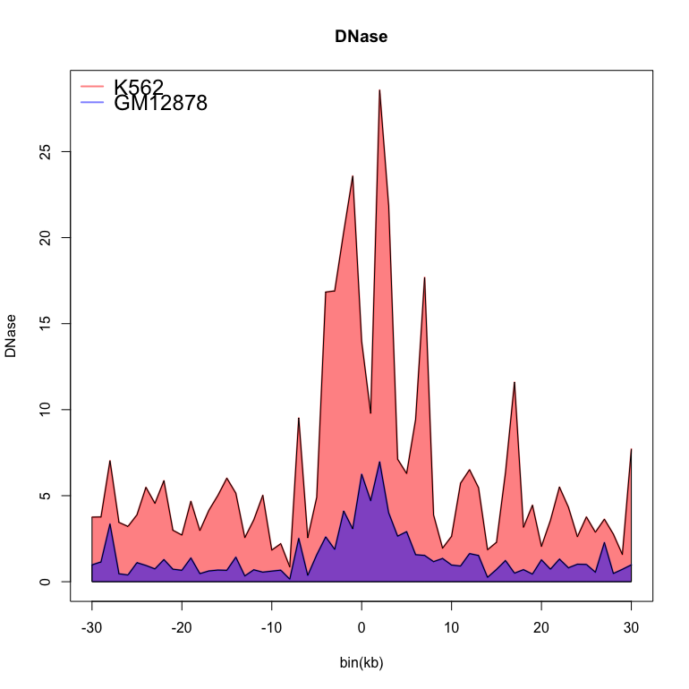

Slide 18
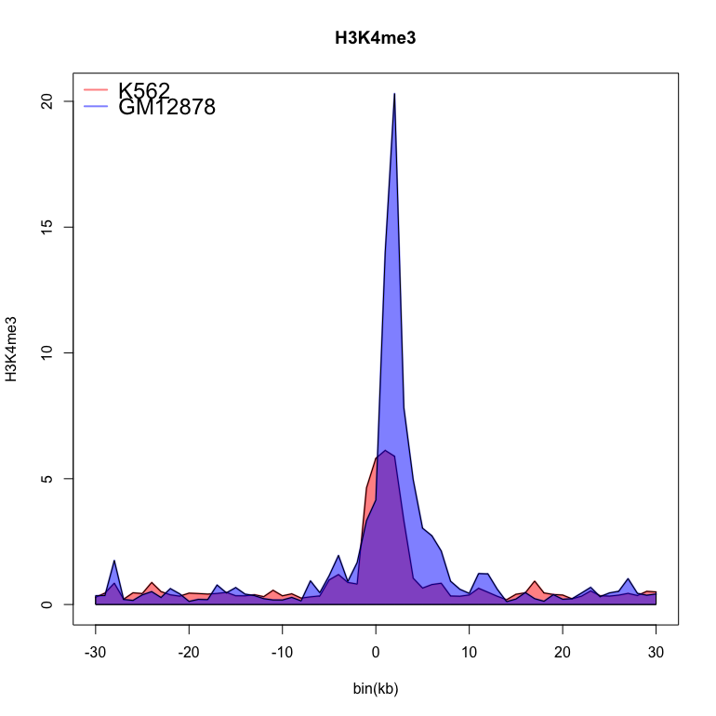

Slide 19
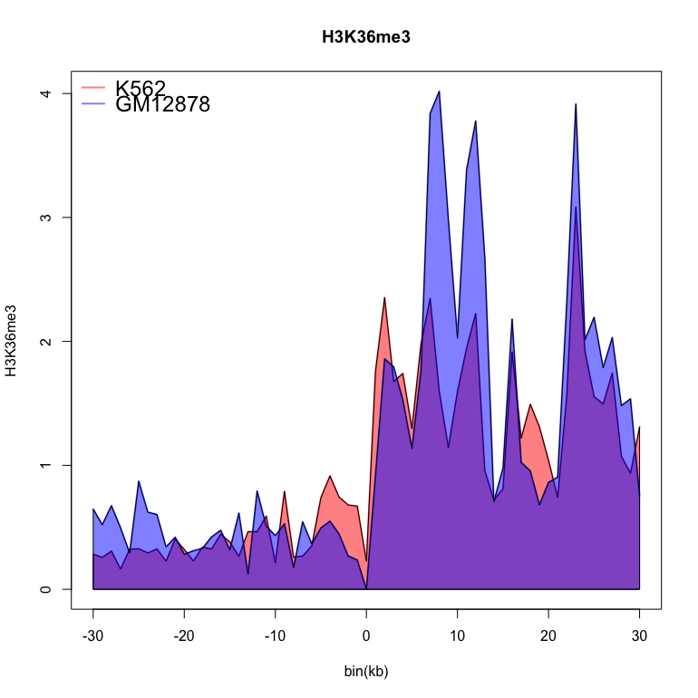

Slide 20
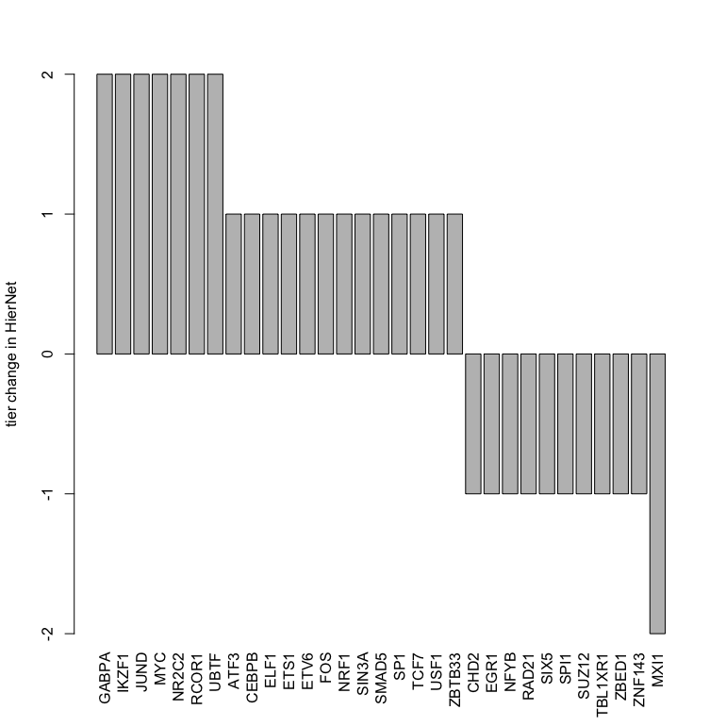

Slide 21
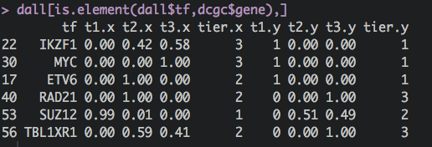

Slide 22
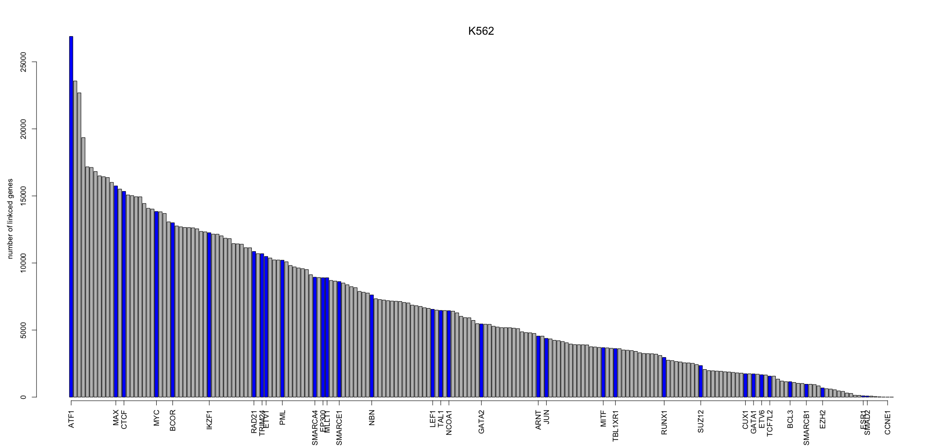

Slide 23
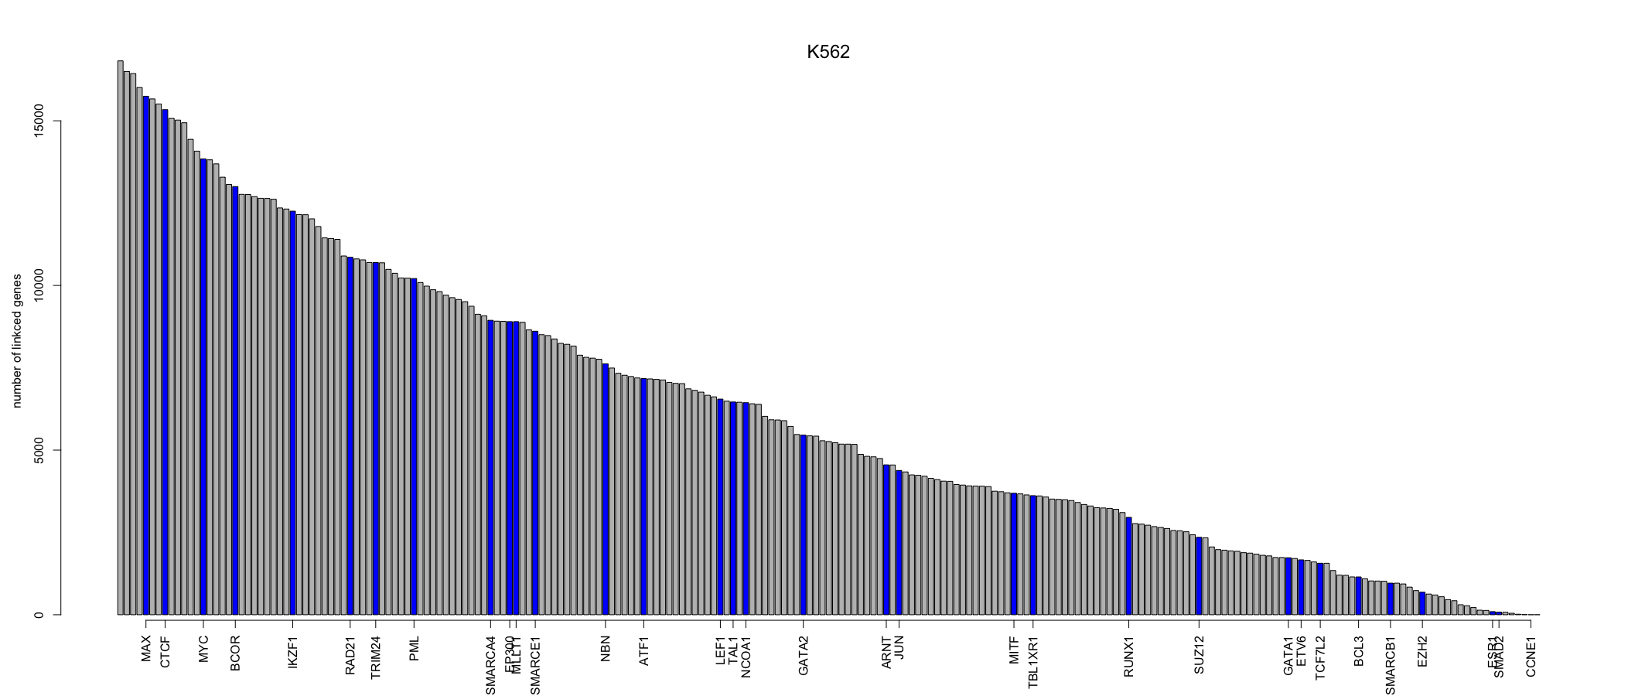

Slide 24
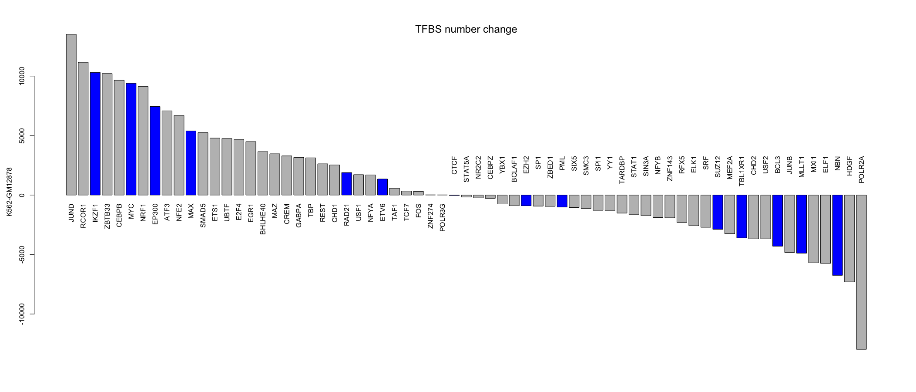

Slide 25
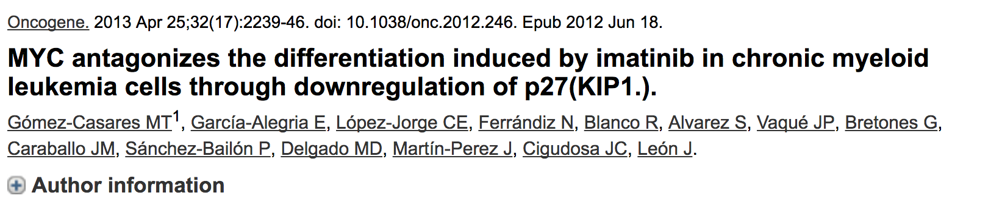
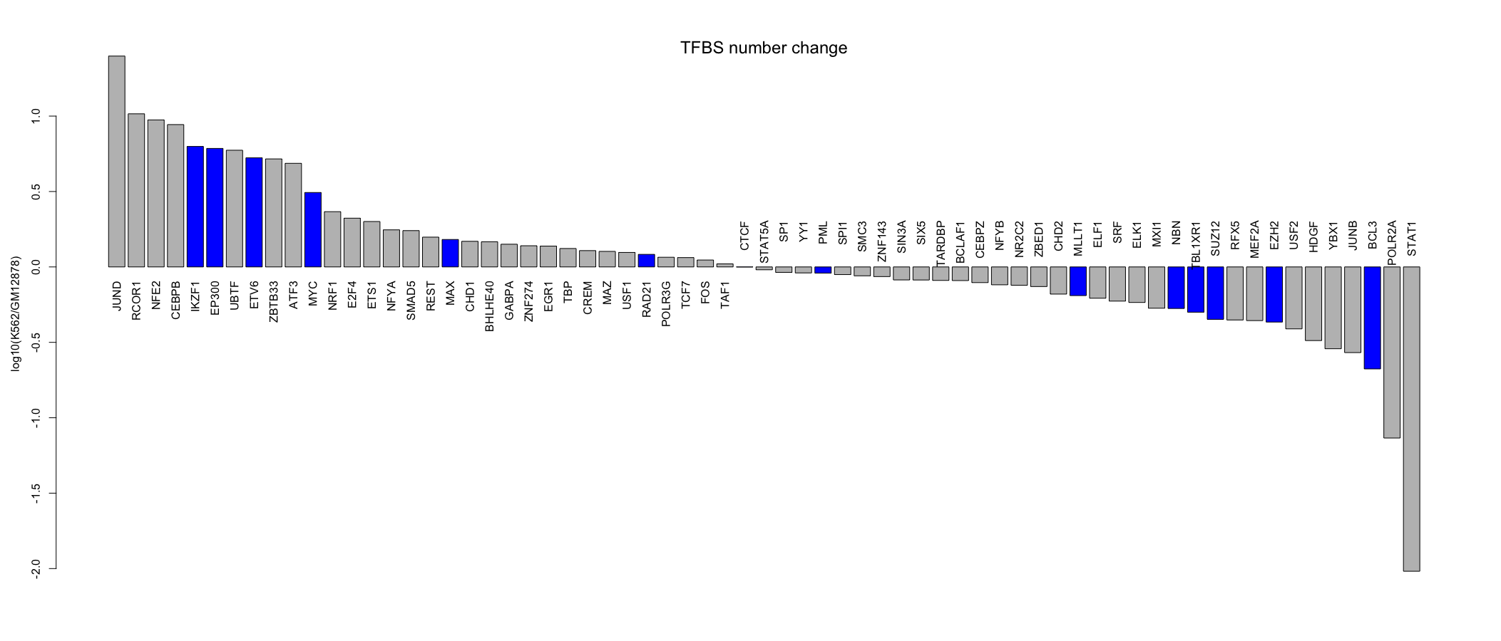
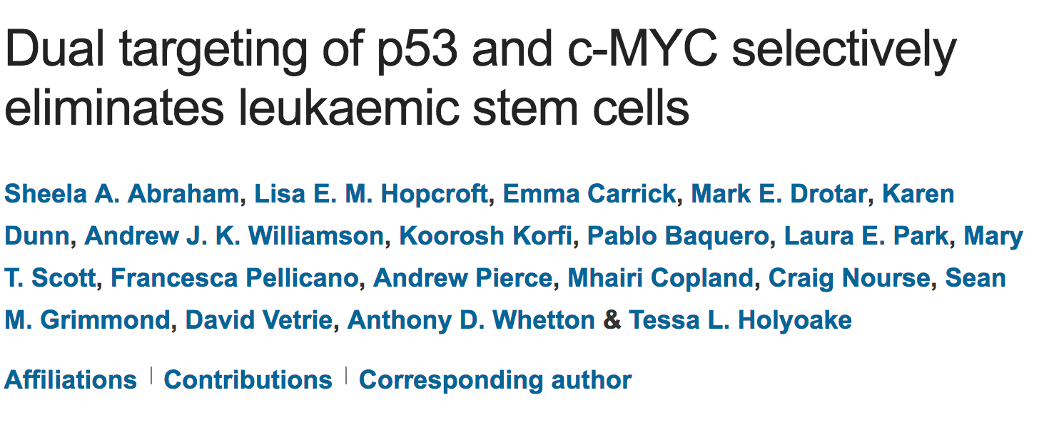

Slide 26
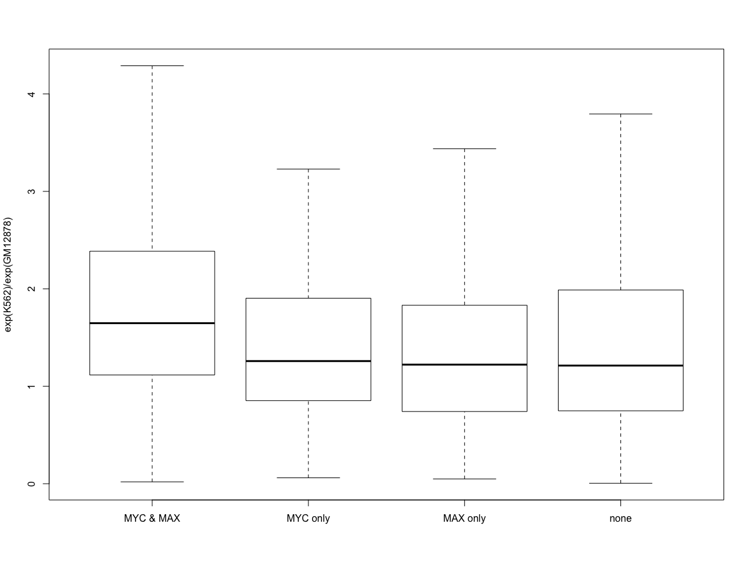

Slide 27
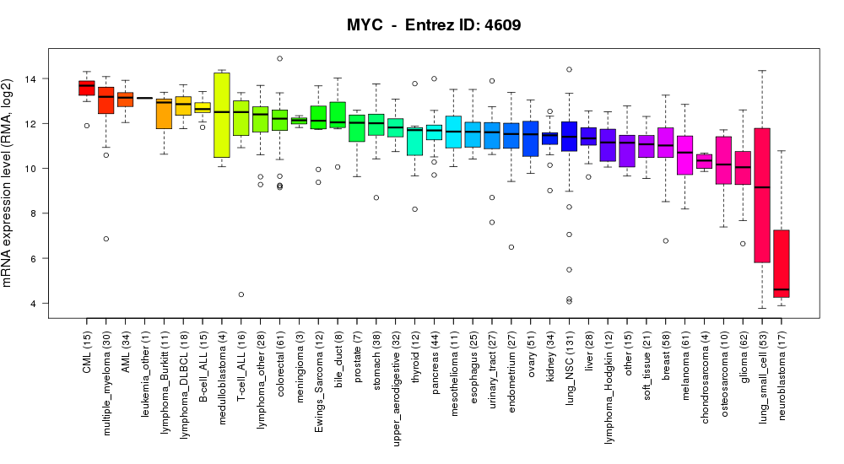

Slide 28
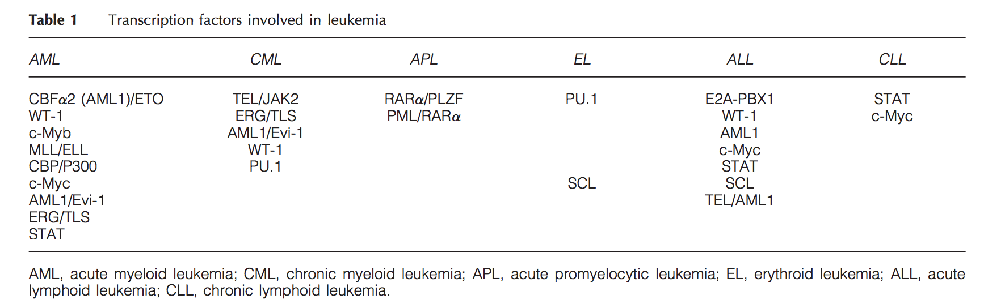

Slide 29
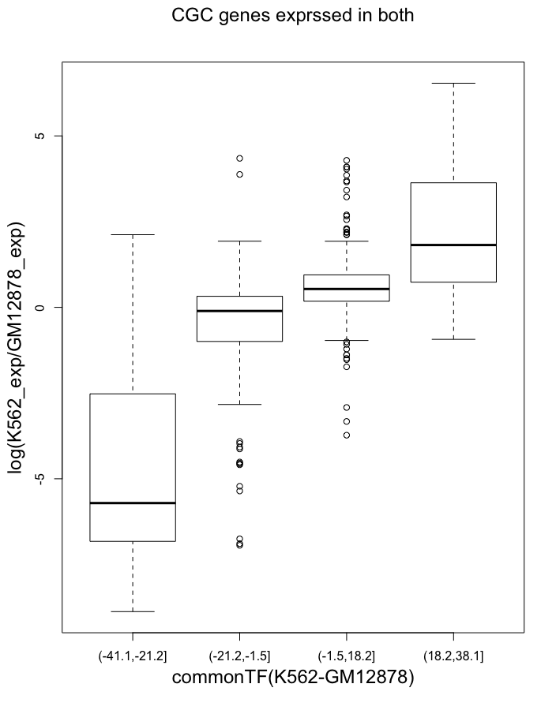
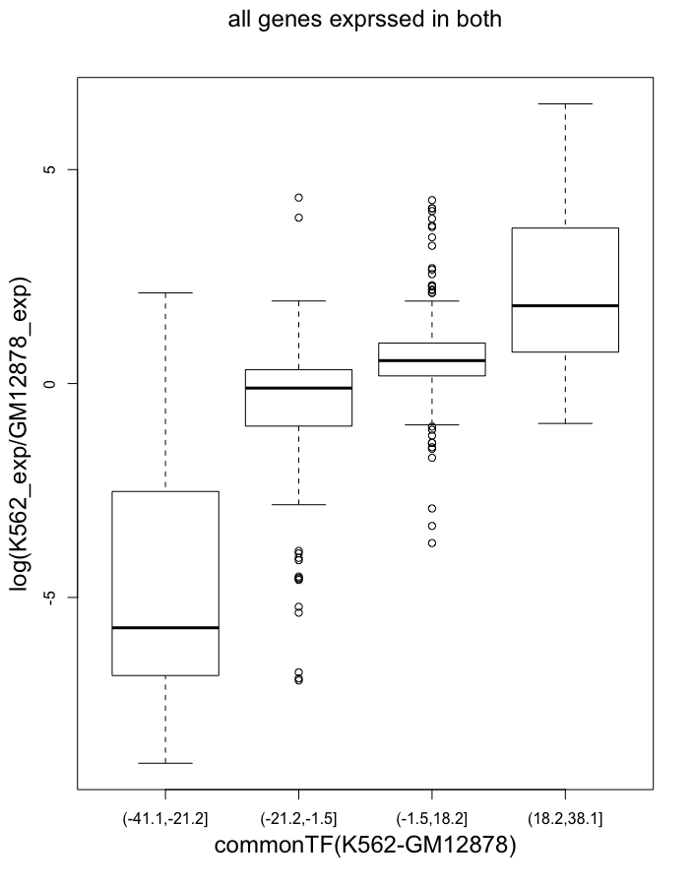

Slide 30
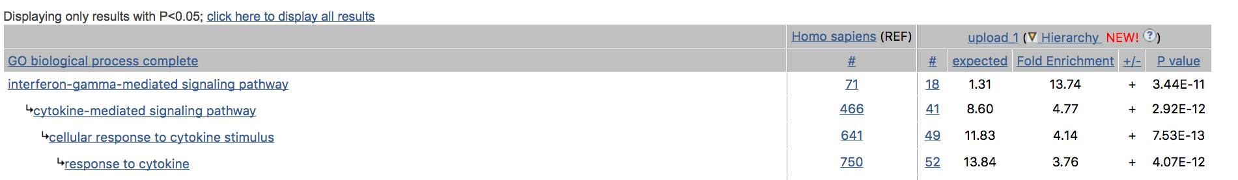
Enrichment of the top 1 percent MORE regulated genes in K562

Slide 31
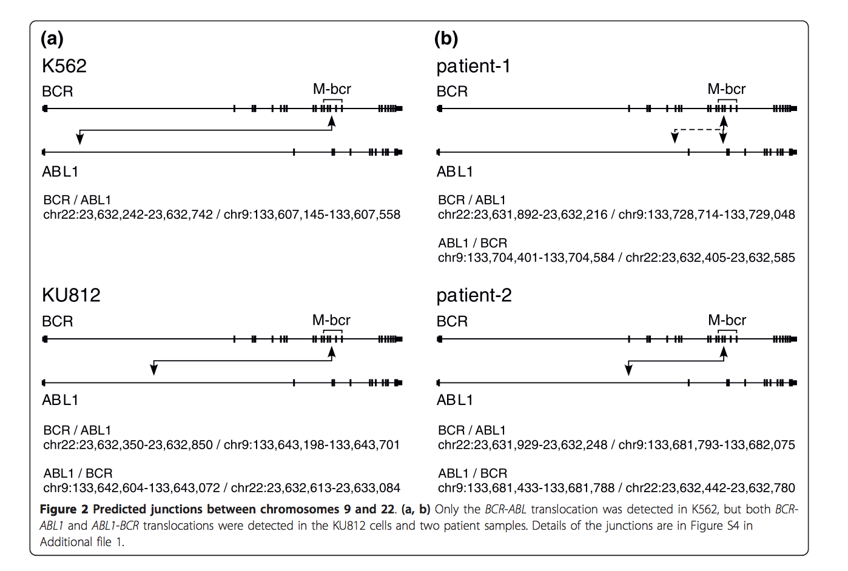

Slide 32
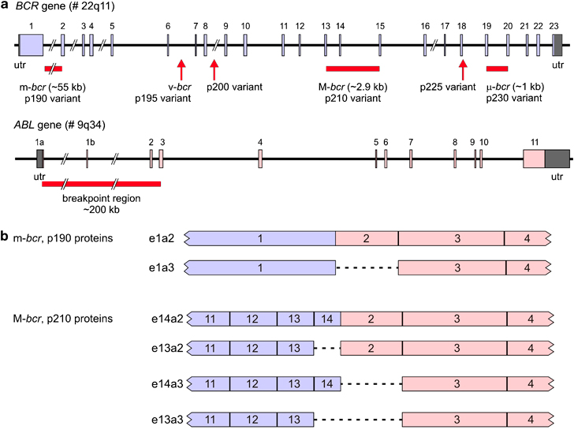
Philadelphia chromosome positive cell lines were K562 and LAMA-84, both from CML blast crisis with the p210 BCR–ABL protein, TOM-1 from precursor-B-ALL with the p190 BCR–ABL protein and AR230 from an atypical CML with the p230 BCR–ABL protein

Slide 33
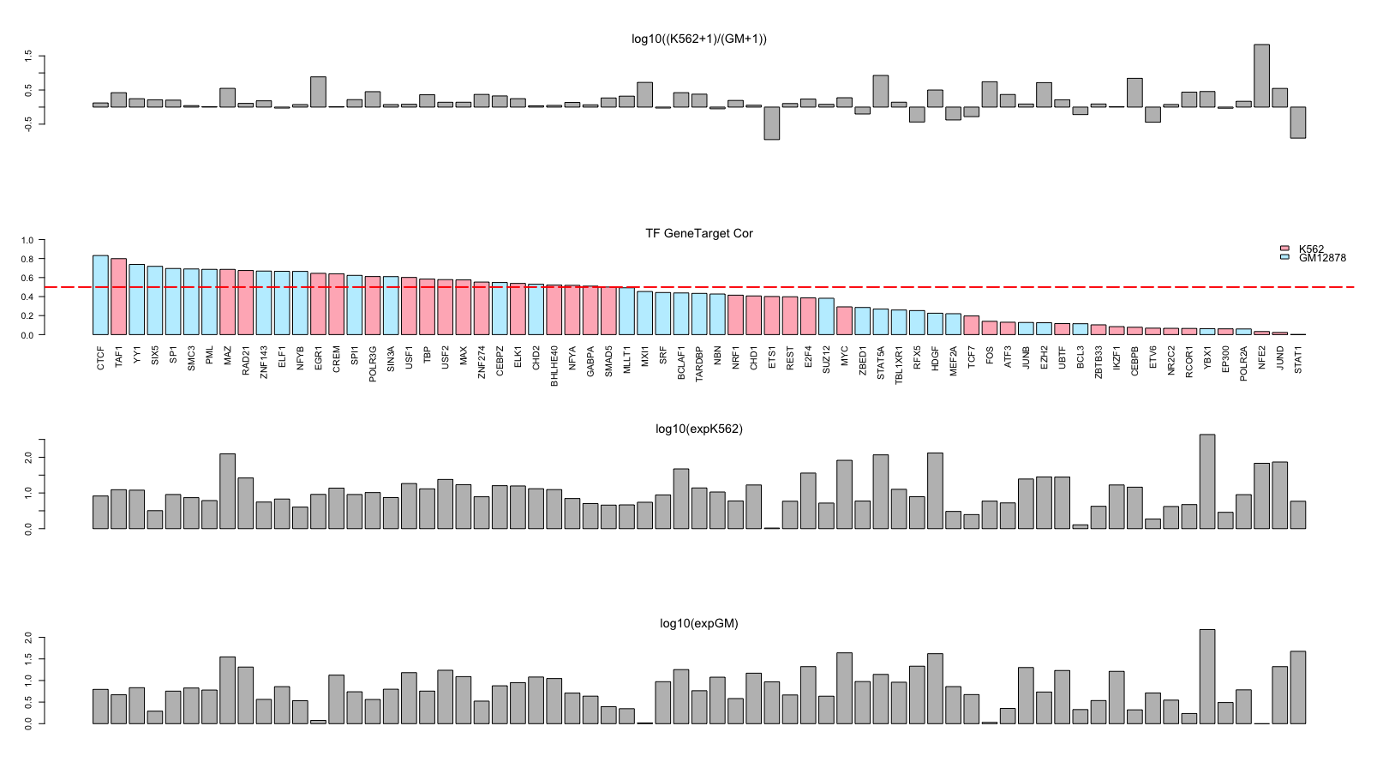
Target Correlation: 2.5kb TSS, cor = (Target_K_&_G)/(max(Target_K, Target_G))

Slide 34
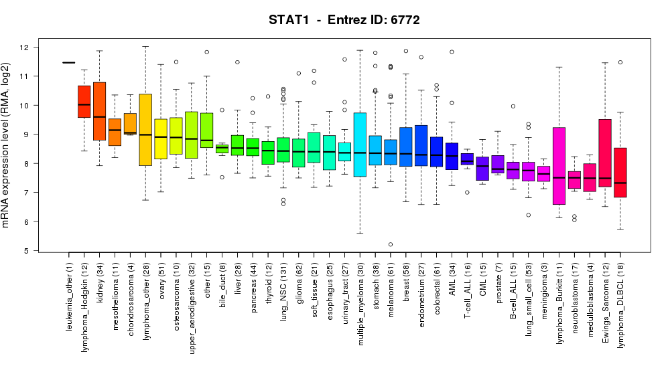
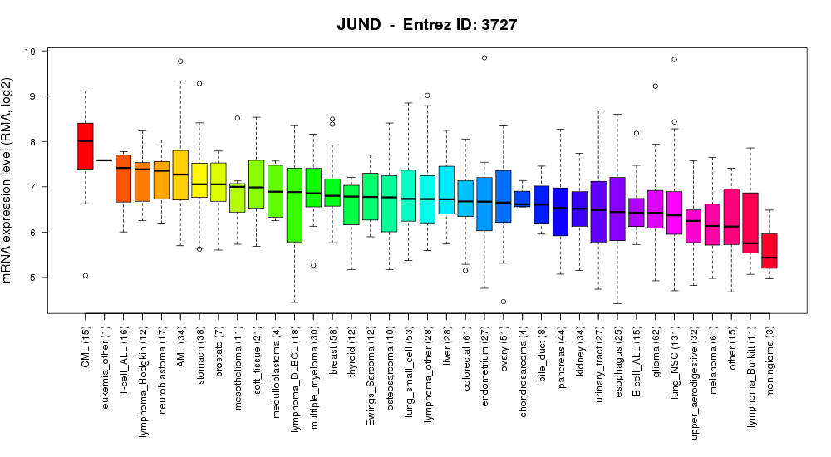
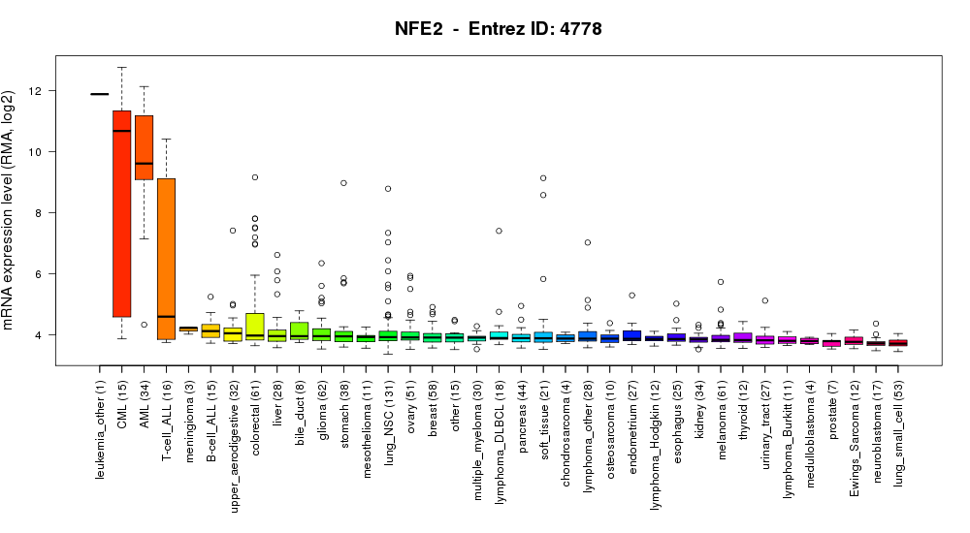
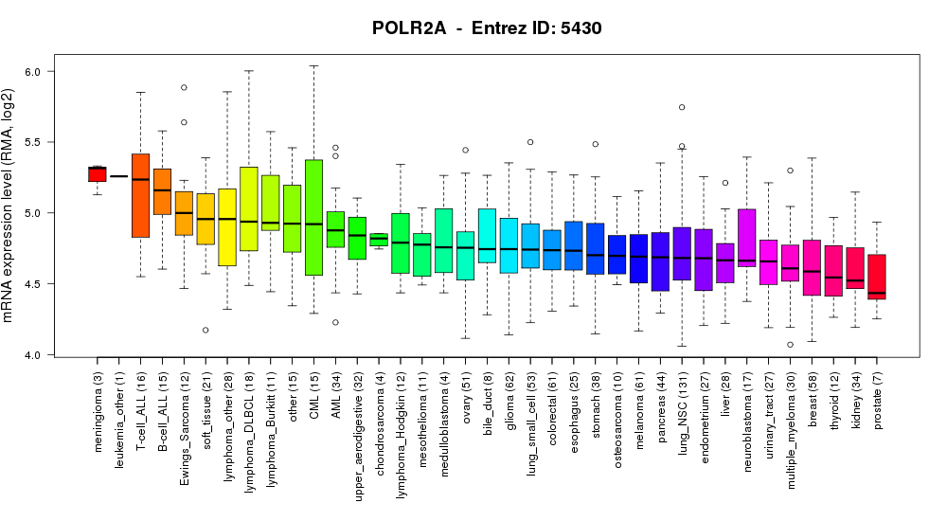
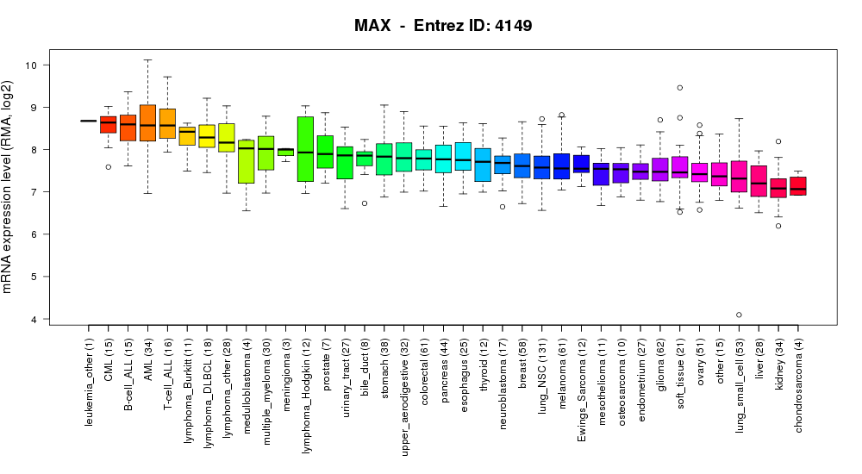

Slide 35
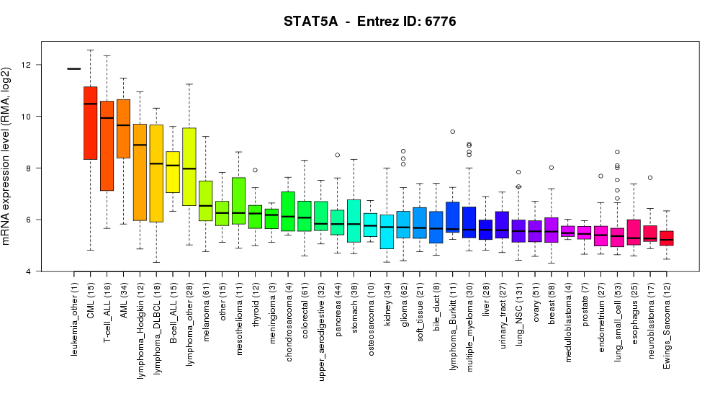

Slide 36
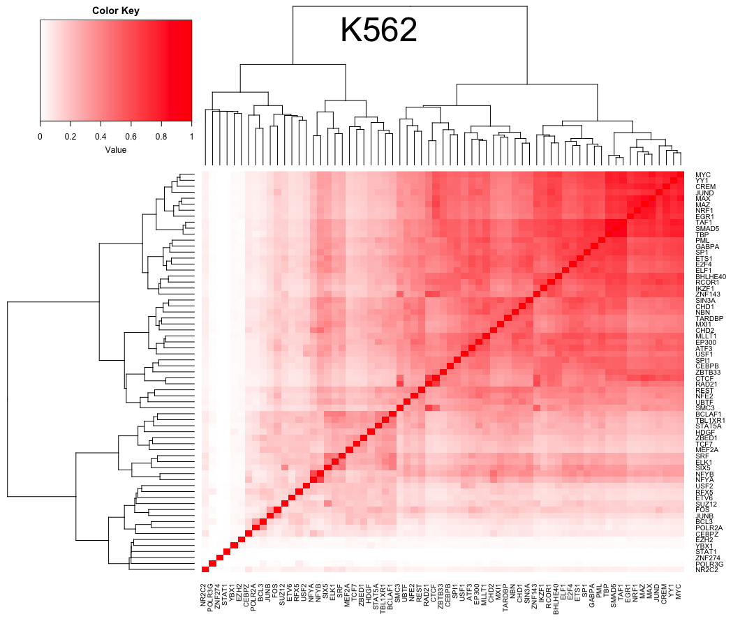

Slide 37
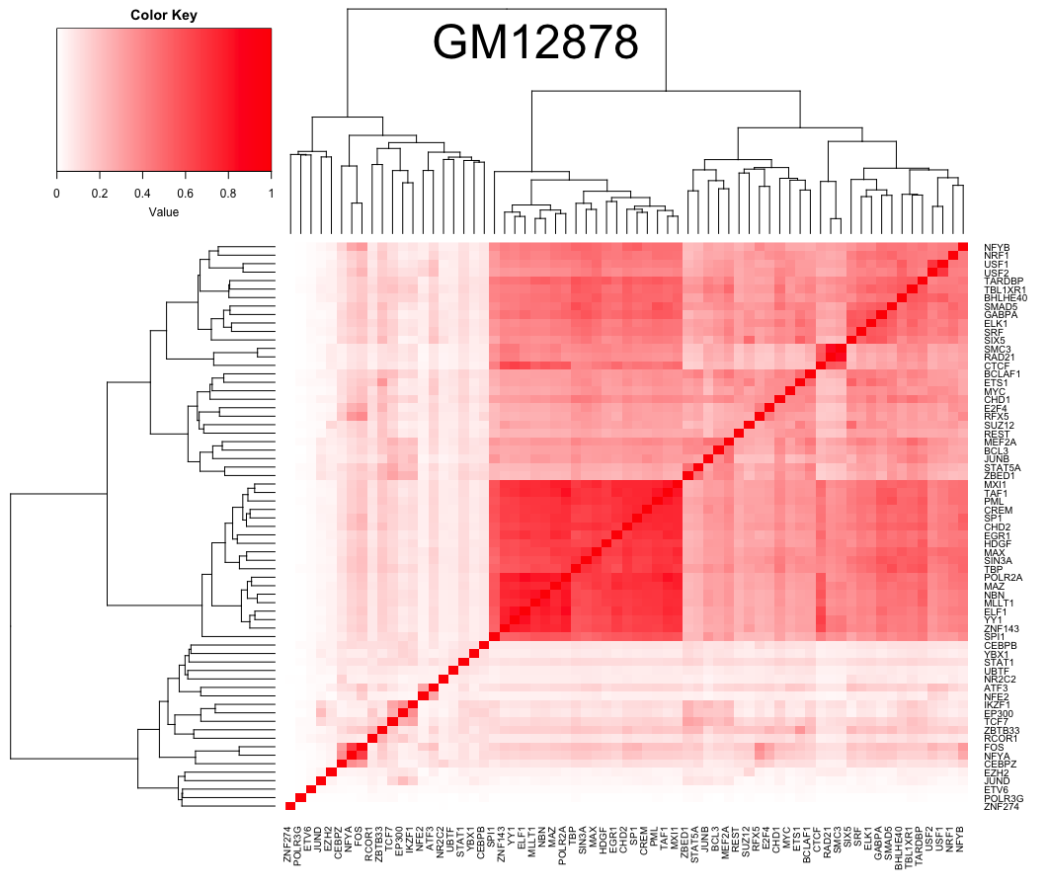

Slide 38
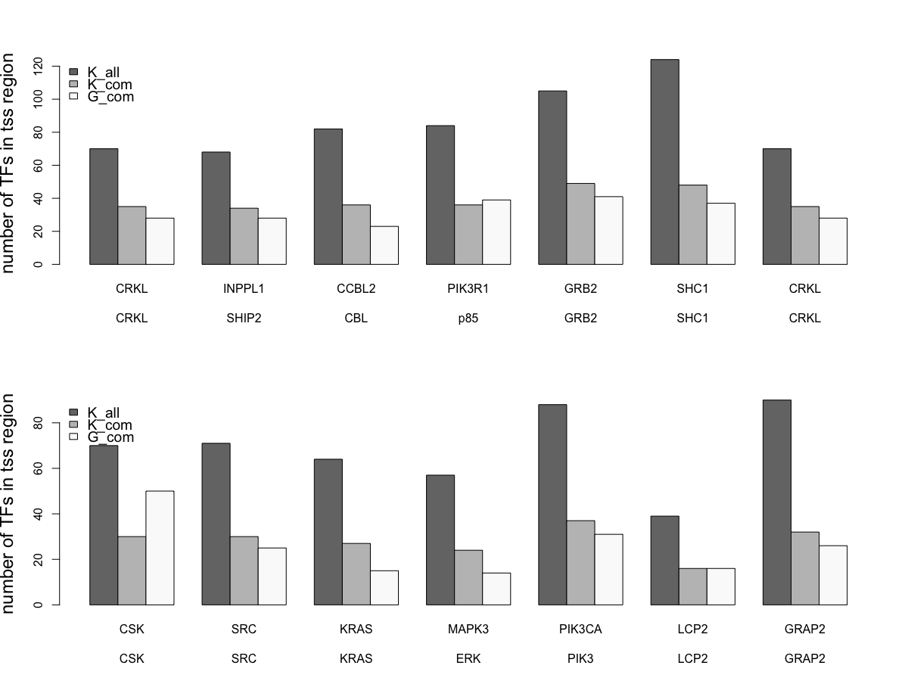

Slide 40
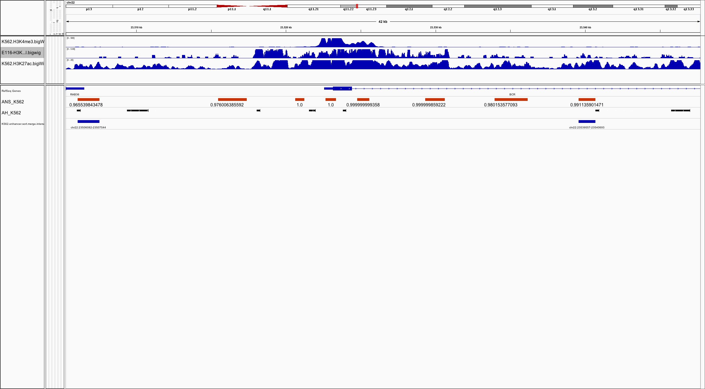

Slide 41
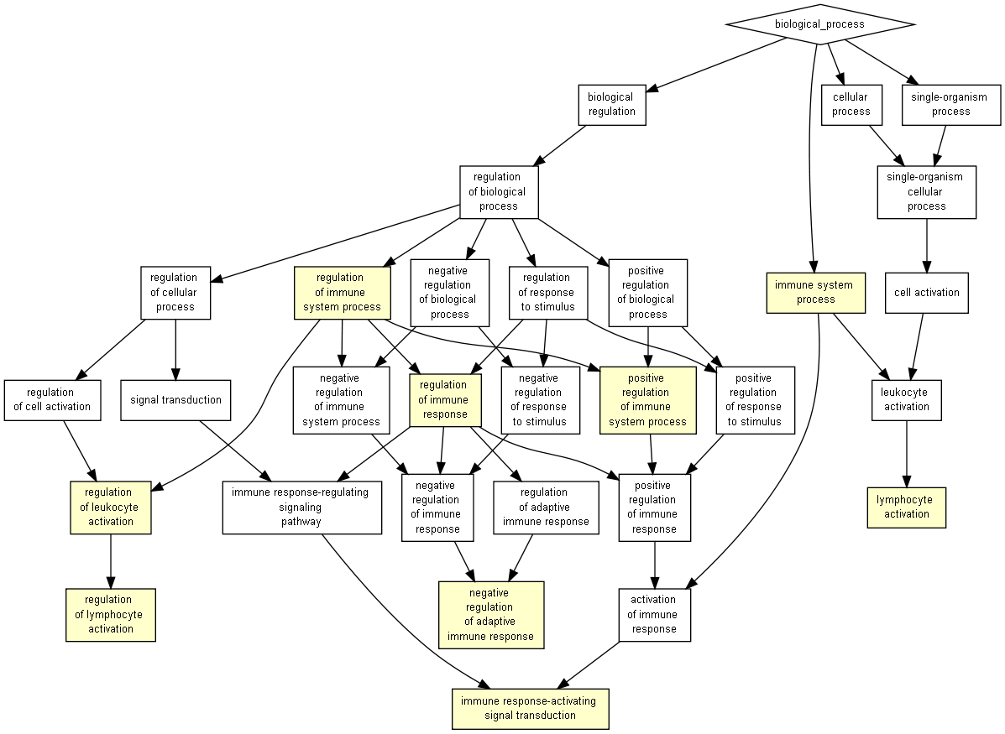
1.2 fold single ranked genes

Slide 42
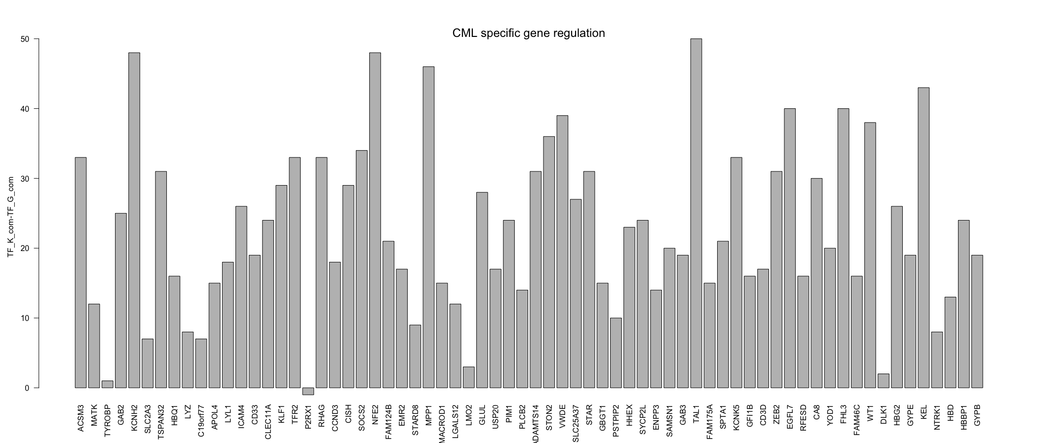
How to select CML Key genes:
Those that are highly expressed in CML, but not in non-blood cancer using wilcoxon test in CCLE data
Of the genes that are selected in 1, only find those genes that are upregulated in K562 related with GM12878

Slide 43
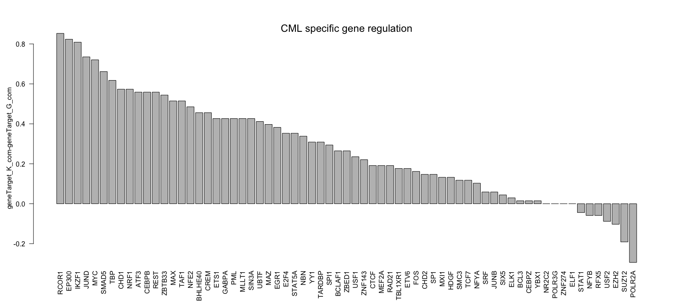

Slide 44
