Slide 1
Encode Cancer Figure Slides

Slide 2
(A)
(B)
(C)
(D)
TP53
HIST1H2AH
PIK3CA
HIST1H3D
HIST1H3G
CBFB
TBC1D31
PURA
AKT1
H2AFJ
PTEN
PLXNA3
CDH9
HIST1H2BO

Slide 4
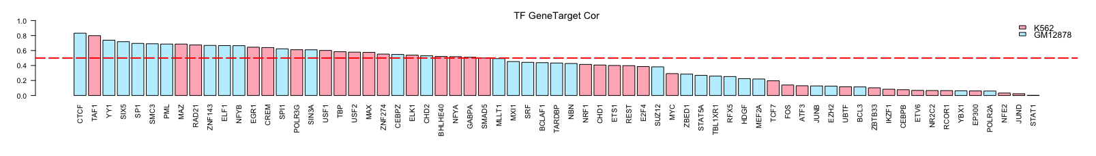
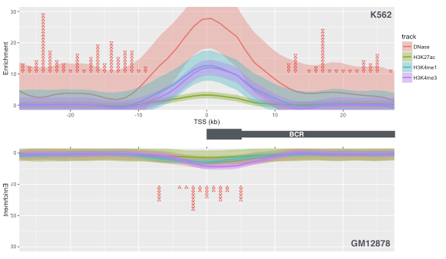
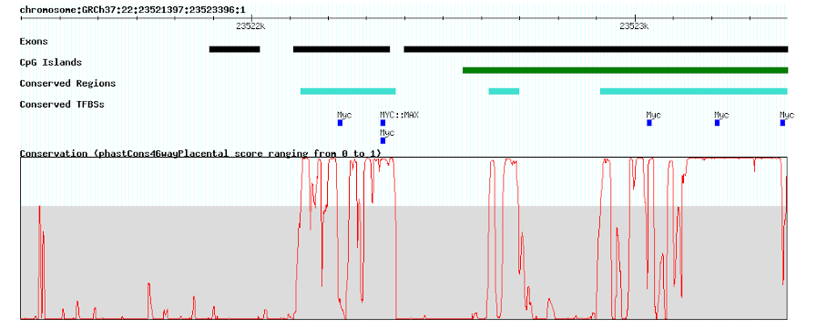
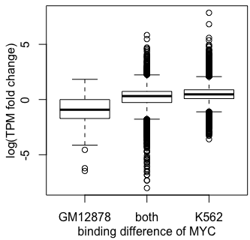
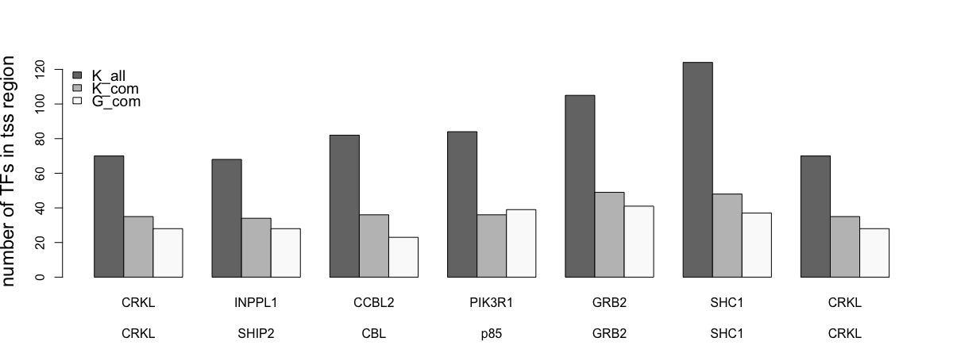

Slide 5
