Slide 1
Functional Burden impact on Survival in PCAWG
Will Meyerson
Version 3
Paper E

Slide 2
How does functional burdening impact survival across cancers?
Mutations with a high functional impact alter the expression or activity of affected genes.
ONCOGENIC HYPOTHESIS: Theoretically, this altered activity can either be oncogenic, in the case of mutations that activate oncogenes or deactivate tumor-suppressor genes
A) Maybe that’s what it took for this to become a clinically detectable cancer?
B) Maybe these mutations underwent positive selection among this tumors’ subclones?
GUNK HYPOTHESIS: Or, it can retard tumor growth, in the case of mutations that disrupt essential genes
Requires negative selection of tumor-inhibiting mutations to be incomplete, but we already know this from Muller’s ratchet.
GENERATIVE CONFOUNDING HYPOTHESIS: Functional burdening may be spuriously correlated with survival patterns in part because both functional burdening and survival patterns may be influenced by the mutation-generating process (e.g. cigarette smoke, patient age, mismatch repair deficiencies)

Slide 3
How can we address this quantitatively using PCAWG data?
Choose model
Choose model parameters
Select input data
Run model
Examine model fit
Tweak model, re-run
Interpret results
0. Ask PCAWG-10 people what they do

Slide 4
1 . Model Selection: Survival Analysis is a Well-Developed Science
Cox Proportional Hazard Model is the most widely used survival analysis model with ~36K hits on pubmed due to
Simple, flexible, rigorous statistical framework
Intelligently handles “right-censored” data
Doesn’t require knowledge of “baseline hazard function”
Known pitfalls and workarounds
Standard functionality in statistical software
In this context, we would say: “Your instantaneous chance of death at a given time after your cancer diagnosis, conditional on you having lived long enough to reach that time, equals the baseline hazard function for patients with that cancer, multiplied by an exponential function of linear combinations of regression-fitted covariates.”
Output: Hazard ratio, confidence interval, p-value, survival plot

Slide 5
The Cox Proportional Hazards Model has Known Pitfalls and Work-arounds
Pitfall
How I (plan to) address them
Violation of proportional hazards assumption
Undue influence of outliers
Non-linearity in true relationship between predictors and response
Examine scaled Schoenfeld residuals of model fit using R function cox.zph to gauge whether data consistent with proportional hazards. Unfold predictors into time-bins as needed.
Estimate changes in regression coefficients due to deletion of each observation in turn.
Plot martingale residuals against covariates
http://socserv.socsci.mcmaster.ca/jfox/Books/Companion/appendix/Appendix-Cox-Regression.pdf

Slide 6
Principled Selection of Co-variates and Cancer Subtypes for Analysis
Which covariates?
By design must include some functional burdening variable (more on which kinds later)
Standard clinical data very poorly filled out, <20% of samples have non-empty values each for alcohol history, smoking history, first therapy type, and first therapy response
Age is well-filled-out, and is a very important predictor of mortality
Gender is well-filled-out, but is not a great predictor of mortality
Only 2 variables are both important and well-annotated: functional burdening and age
(Use more than one functional burdening variable where possible?)
Which cancer subtypes?
Literature-reported rule of thumb: 10 events (deaths) per predictor
Therefore only examine cancer subtypes with 20 or more deaths for which patient age was recorded
Only 9 of 37 cancer subtypes meet this criteria (Breast-AdenoCA, CNS-GBM, Eso-AdenoCA, Kidney-RCC, Liver-HCC, Lymph-CLL, Ovary-AdenoCA, Panc-AdenoCA, Skin-Melanoma)
Perhaps other subtypes can be included in organ-based and histology-based analyses
Peter Peduzzi et al. Importance of events per independent variable in proportional hazards regression analysis II. Accuracy and precision of regression estimates. Journal of Clinical Epidemiology. Volume 48, Issue 12, December 1995, Pages 1503-1510

Slide 7
What is the right functional burdening score?
I would love to have a priori reasons for choosing some functional burdening scoring schemes over others.
In the meantime I am conducting exploratory analyses with different kinds of scores that differ with regards to:
Genomic region: coding, noncoding (how to combine?)
Filter: none vs coding–essential genes (which threshold?) or noncoding–sensitive_vs_ultrasensitive regions
Aggregation function: count, mean, max
a priori some preference for mean and max over count, due to greater (but not complete) disentanglement from GENERATIVE CONFOUNDER HYPOTHESIS
Transformations: log, rank, normalized rank
Eventually need to reduce the number of analyses in a principled manner to mitigate combinatorial expansion of multiple hypothesis testing

Slide 8
Coding region results <ranked mean>: Borderline significance favoring GUNK in Liver-HCC. No extra signal with essentiality filter.
Coding variants in essential genes
(~1000 genes that are both subviable in mice and top-quintile-undertruncated in ExAc
Coding variants in all genes
SUBTYPE | HAZARD_RATIO | CI95_L | CI95_U | P_VALUE
Diffuse_glioma/CNS-GBM | 1.647418 | 0.756909 | 3.585617 | 0.208356
Adenocarcinoma/Eso-AdenoCa | 0.696294 | 0.398428 | 1.216848 | 0.203758
Renal_cell_carcinoma_proximal_tubules/Kidney-RCC | 0.957517 | 0.541462 | 1.693266 | 0.881351
Hepatocellular_carcinoma/Liver-HCC | 0.649761 | 0.423196 | 0.99762 | 0.048736
Chronic_lymphocytic_leukemia/Lymph-CLL | 1.345619 | 0.72965 | 2.481588 | 0.341787
Adenocarcinoma/Ovary-AdenoCA | 1.210064 | 0.847936 | 1.726846 | 0.293312
Adenocarcinoma/Panc-AdenoCA | 1.150556 | 0.875408 | 1.512186 | 0.314537
Melanoma/Skin-Melanoma | 0.931774 | 0.590666 | 1.469873 | 0.76125
SUBTYPE | HAZARD_RATIO | CI95_L | CI95_U | P_VALUE
Diffuse_glioma/CNS-GBM | 1.101787 | 0.569559 | 2.131359 | 0.773394
Adenocarcinoma/Eso-AdenoCa | 1.571292 | 0.930307 | 2.65392 | 0.091055
Renal_cell_carcinoma_proximal_tubules/Kidney-RCC | 0.84908 | 0.486728 | 1.481192 | 0.56444
Hepatocellular_carcinoma/Liver-HCC | 0.742387 | 0.48987 | 1.125069 | 0.160197
Chronic_lymphocytic_leukemia/Lymph-CLL | 0.859284 | 0.485693 | 1.520239 | 0.602363
Adenocarcinoma/Ovary-AdenoCA | 1.044748 | 0.711767 | 1.533507 | 0.823094
Adenocarcinoma/Panc-AdenoCA | 0.88667 | 0.675378 | 1.164064 | 0.386432
Melanoma/Skin-Melanoma | 0.680631 | 0.420669 | 1.101241 | 0.117075
Read as: for every 2 quartiles you jump in mean coding FunSeq score among HCC patients, you cut your instantaneous risk of death by a third
Tx PDM!
All subtypes meeting event criteria (more than 20 deaths with ages) met proportionality assumption

Slide 9
But if you’re hunting for GUNK HYPOTHESIS, you want to check essential but non-driver genes
SUBTYPE | HAZARD_RATIO | CI95_L | CI95_U | P_VALUE
Diffuse_glioma/CNS-GBM | 1.170138 | 0.561626 | 2.437963 | 0.674823
Adenocarcinoma/Eso-AdenoCa | 1.298301 | 0.76682 | 2.198152 | 0.331188
Renal_cell_carcinoma_proximal_tubules/Kidney-RCC | 0.697254 | 0.391639 | 1.241355 | 0.220448
Hepatocellular_carcinoma/Liver-HCC | 0.740342 | 0.493139 | 1.111464 | 0.146993
Chronic_lymphocytic_leukemia/Lymph-CLL | 0.768675 | 0.42132 | 1.402406 | 0.391118
Adenocarcinoma/Ovary-AdenoCA | 0.925478 | 0.616554 | 1.389188 | 0.708612
Adenocarcinoma/Panc-AdenoCA | 0.842949 | 0.640832 | 1.108813 | 0.221892
Melanoma/Skin-Melanoma | 0.626264 | 0.392886 | 0.99827 | 0.049151

Slide 10
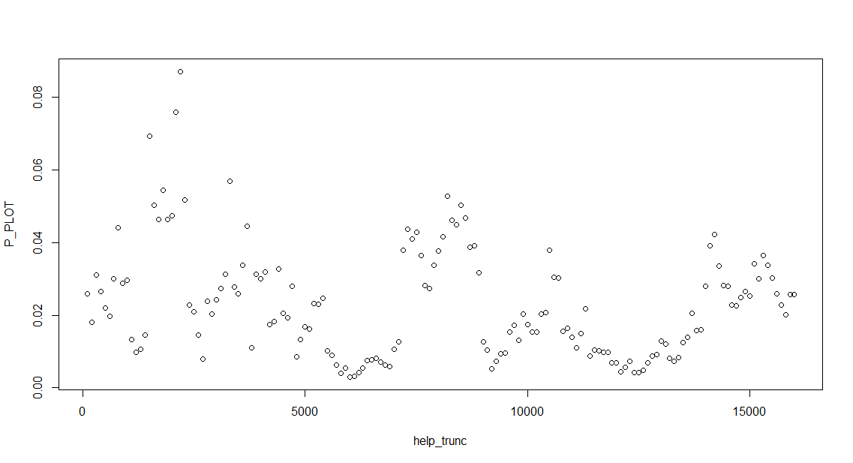
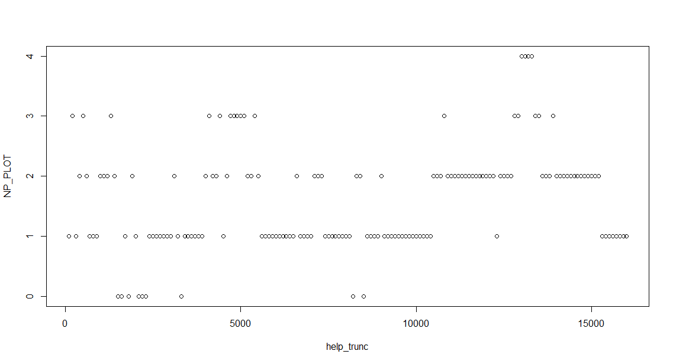
It does matter how you threshold essentiality. Minimum p-values (top) and number of significant p-values (bottom) obtained, plotted against top X ExAc genes considered essential. (These p-values are deprecated)

Slide 11
Noncoding region: Select cancer subtypes show evidence of GUNK HYPOTHESIS, but suspicion for model violation
All_noncoding max
Sensitive max
SUBTYPE | HAZARD_RATIO | CI95_L | CI95_U | P_VALUE
Adenocarcinoma/Breast-AdenoCa | 0.679937 | 0.059708 | 7.742888 | 0.755937
Diffuse_glioma/CNS-GBM | 0.09133 | 0.017387 | 0.479721 | 0.004684
Adenocarcinoma/Eso-AdenoCa | 0.953016 | 0.330329 | 2.749501 | 0.929065
Renal_cell_carcinoma_proximal_tubules/Kidney-RCC | 0.186269 | 0.050751 | 0.683651 | 0.0113
Hepatocellular_carcinoma/Liver-HCC | 0.700929 | 0.30168 | 1.62855 | 0.408714
Chronic_lymphocytic_leukemia/Lymph-CLL | 0.776587 | 0.222531 | 2.710133 | 0.691727
Adenocarcinoma/Ovary-AdenoCA | 0.586588 | 0.27482 | 1.252036 | 0.167909
Adenocarcinoma/Panc-AdenoCA | 0.582344 | 0.329808 | 1.028251 | 0.062327
Melanoma/Skin-Melanoma | 0.73722 | 0.28535 | 1.904657 | 0.528995
SUBTYPE | HAZARD_RATIO | CI95_L | CI95_U | P_VALUE
Adenocarcinoma/Breast-AdenoCa | 1.271637 | 0.086608 | 18.67111 | 0.860837
Diffuse_glioma/CNS-GBM | 0.443401 | 0.123978 | 1.585794 | 0.210992
Adenocarcinoma/Eso-AdenoCa | 1.448181 | 0.501512 | 4.181813 | 0.493698
Renal_cell_carcinoma_proximal_tubules/Kidney-RCC | 0.256258 | 0.075164 | 0.873667 | 0.029569
Hepatocellular_carcinoma/Liver-HCC | 0.79017 | 0.359044 | 1.738975 | 0.558425
Chronic_lymphocytic_leukemia/Lymph-CLL | 0.526113 | 0.144427 | 1.916501 | 0.330188
Adenocarcinoma/Ovary-AdenoCA | 0.497919 | 0.233493 | 1.0618 | 0.071106
Adenocarcinoma/Panc-AdenoCA | 0.842531 | 0.492272 | 1.442002 | 0.532001
Melanoma/Skin-Melanoma | 0.602846 | 0.231744 | 1.568211 | 0.299472
Purple indicates proportionality assumption violated

Slide 12
Kidney-RCC is the most promising non-coding lead so far, but follow-up required
SUBTYPE | allnc_count | sense_count | ultra_count | allnc_mean | sense_mean | ultra_mean | allnc_max | sense_max | ultra_max
Adenocarcinoma/Breast-AdenoCa | 0.913156 | 0.866066 | 0.210617 | 0.767052 | 0.070959 | 0.437774 | 0.755937 | 0.860837 | 0.270061
Diffuse_glioma/CNS-GBM | 0.027996 | 0.005497 | 0.189513 | 0.22664 | 0.951147 | 0.939278 | 0.004684 | 0.210992 | 0.435616
Adenocarcinoma/Eso-AdenoCa | 0.528463 | 0.606712 | 0.847813 | 0.110961 | 0.374469 | 0.771146 | 0.929065 | 0.493698 | 0.799025
Renal_cell_carcinoma_proximal_tubules/Kidney-RCC | 0.939794 | 0.57591 | 0.596396 | 0.26583 | 0.006188 | 0.188836 | 0.0113 | 0.029569 | 0.151832
Hepatocellular_carcinoma/Liver-HCC | 0.246192 | 0.290343 | 0.119941 | 0.512375 | 0.579706 | 0.192242 | 0.408714 | 0.558425 | 0.440928
Chronic_lymphocytic_leukemia/Lymph-CLL | 0.010895 | 0.233724 | 0.233503 | 0.8955 | 0.781039 | 0.164329 | 0.691727 | 0.330188 | 0.183303
Adenocarcinoma/Ovary-AdenoCA | 0.00034 | 6.10E-05 | 0.007652 | 0.015712 | 0.277339 | 0.202761 | 0.167909 | 0.071106 | 0.157176
Adenocarcinoma/Panc-AdenoCA | 0.623548 | 0.422227 | 0.658607 | 0.101138 | 0.456273 | 0.525396 | 0.062327 | 0.532001 | 0.441267
Melanoma/Skin-Melanoma | 0.214233 | 0.162064 | 0.275552 | 0.154695 | 0.851589 | 0.148759 | 0.528995 | 0.299472 | 0.208917
Orange highlights are significant p-values
Maroon font indicates violation of proportionality assumptions
Yellow highlights are subtypes that have significant associations between survival and noncoding count-related burden schemes and therefore likely represent mere GENERATIVE CONFOUNDING even when also significant by non-count related burden schemes
Only RCC has significant associations between survival and noncoding exclusively non-count-related burden schemes and may be a true hit. However, the existence of violation of proportionality in one burden scheme warrants detailed follow-up, through residual plots, and time-unfolding. May want to check which variants contribute most.

Slide 13
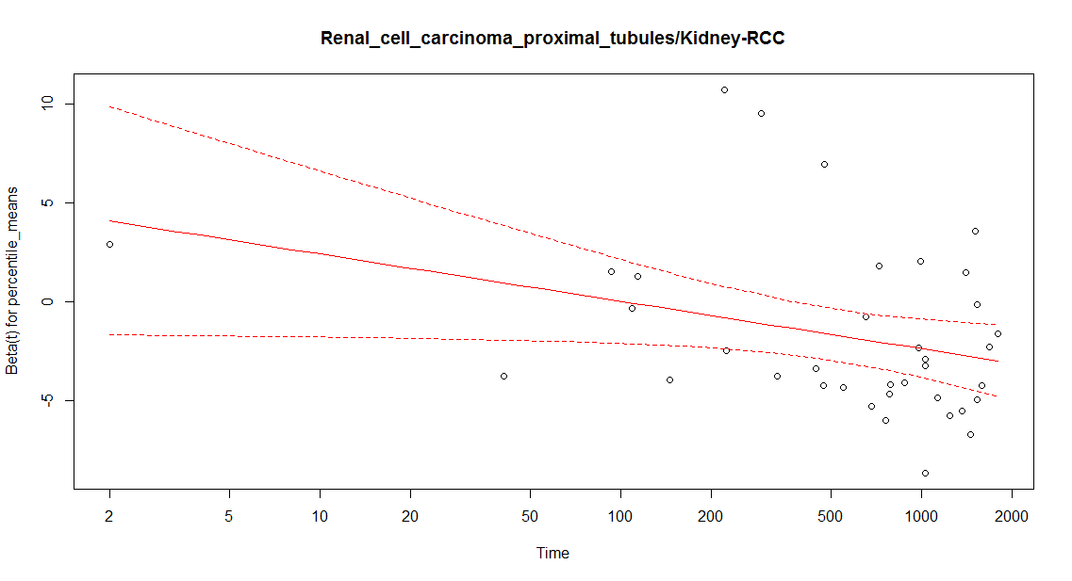
These plots might be helpful …
I wonder if the outlier who died at 2 days is messing things up

Slide 14
TO DO:
Outlier analysis
Better reporting of proportionality testing
Show plots for survival curves (already done some but with deprecated values)
Metagroup analysis
Include mutation load as a covariate?
Determine principled threshold for essentiality
Combine coding and noncoding analyses?
Talk with PCAWG-10 folks !!

