Slide 1
K562 vs GM12878
JZ

Slide 2
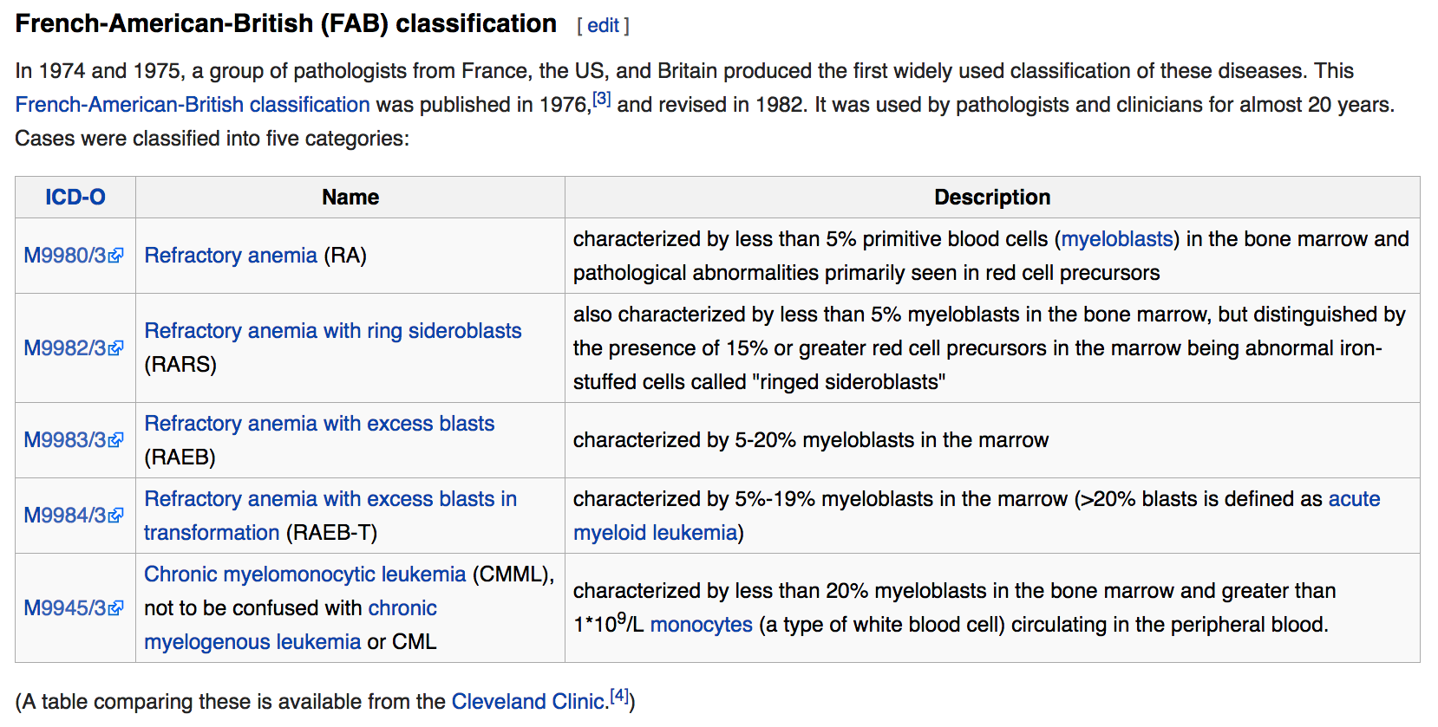

Slide 3
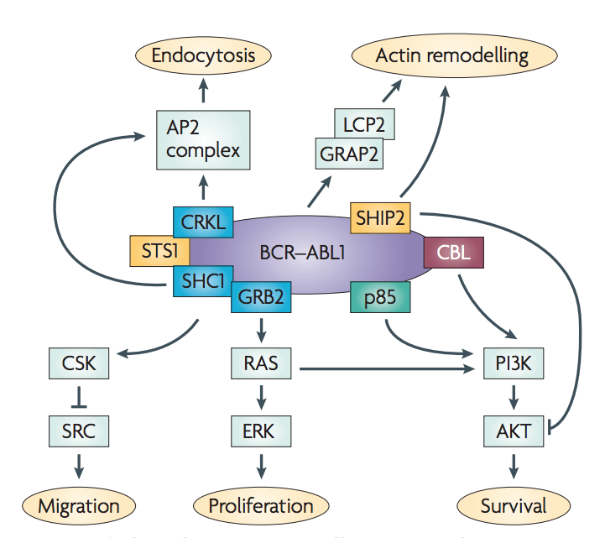
Whether leukemia is acute or chronic depends on whether most of the abnormal cells are immature (and are more like stem cells) or mature (and are more like normal white blood cells).
ONLY CMDI and AML data in either ICGC &TCGA
BCR-ABL1 fusion cause CML, but to get to the accurate stage, it needs some other mutations

Slide 4
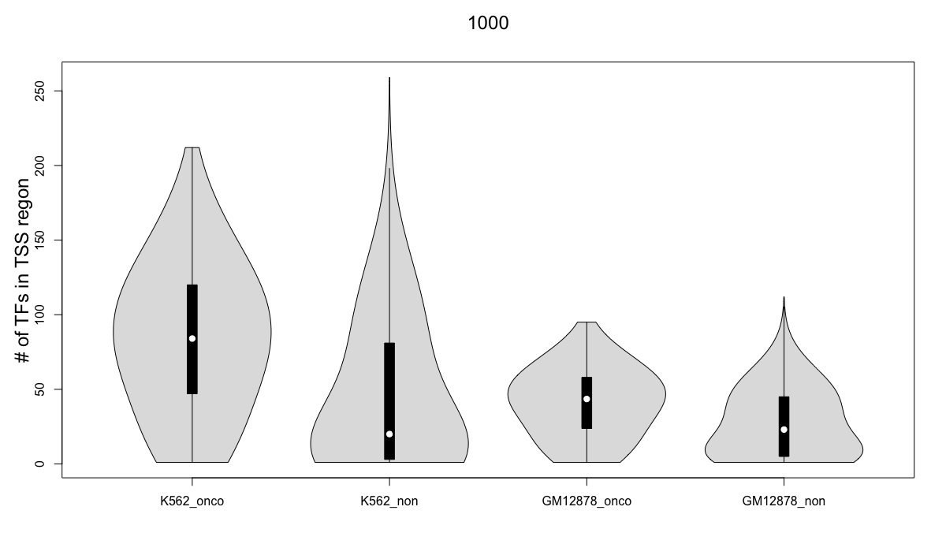

Slide 5
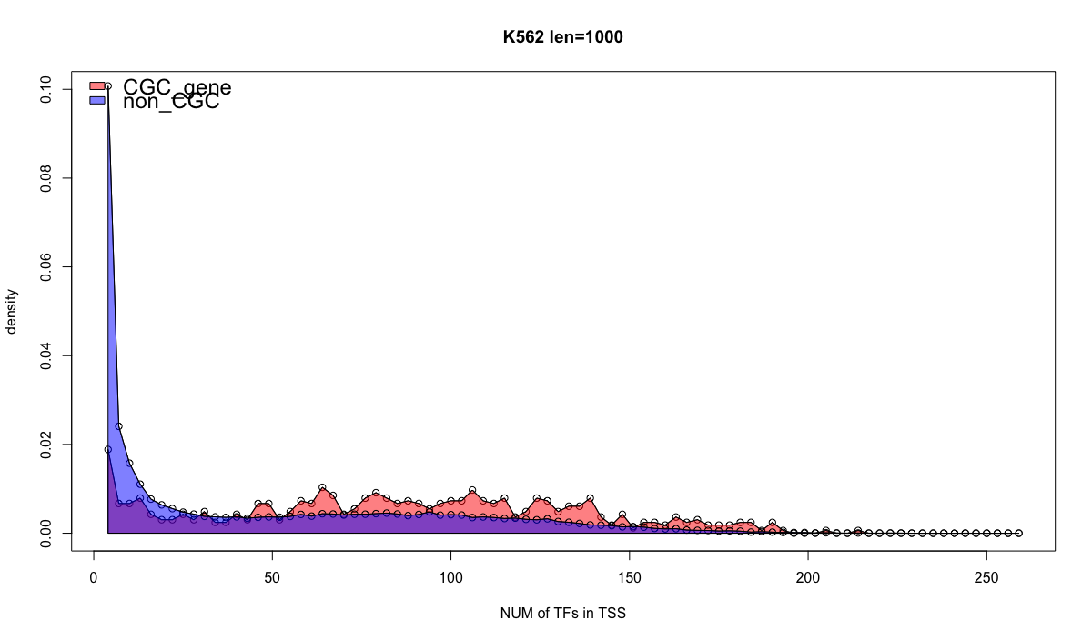

Slide 6
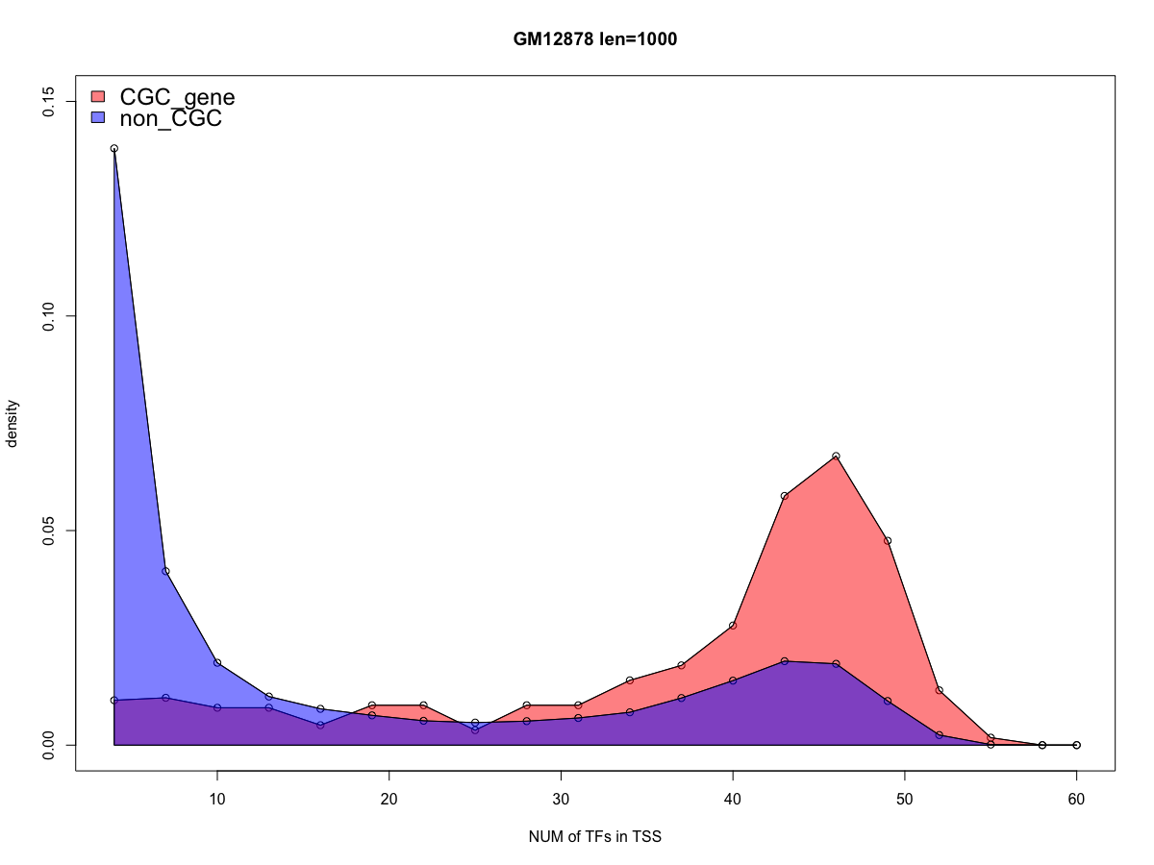

Slide 7
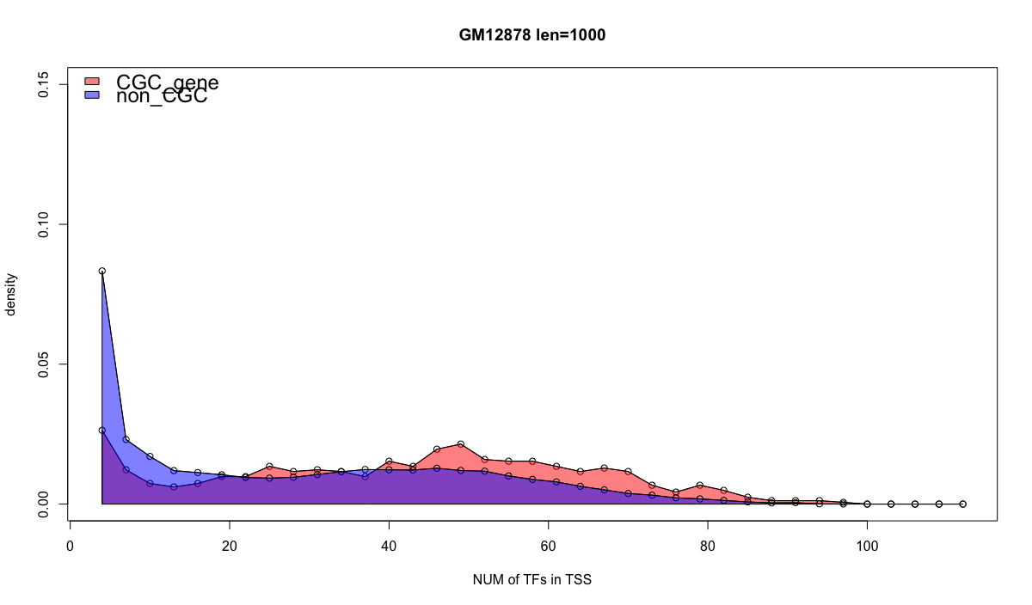

Slide 8
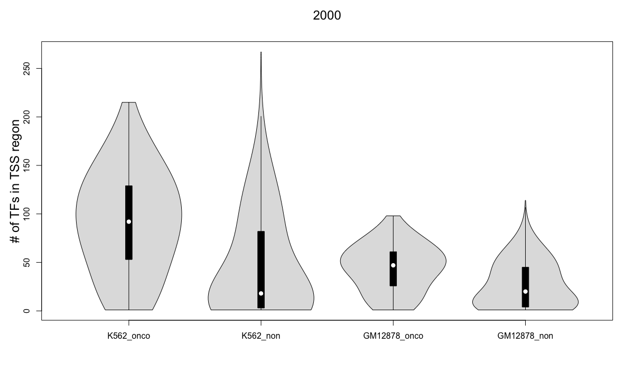

Slide 9
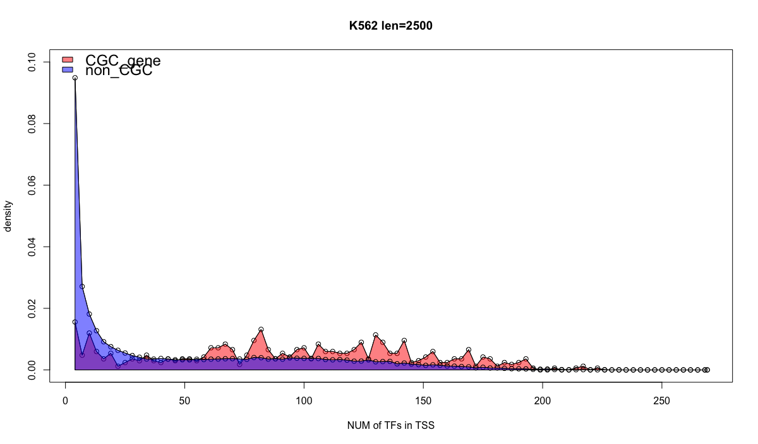

Slide 10
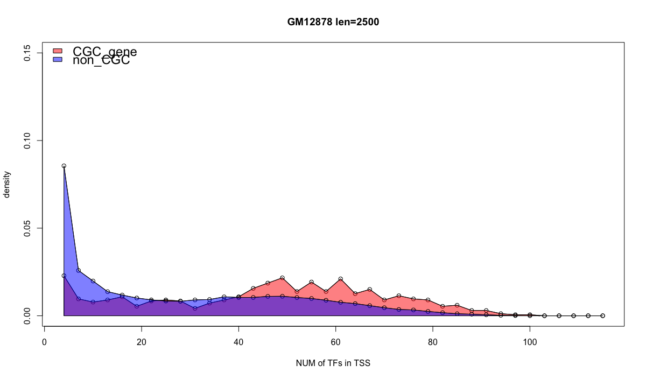

Slide 11
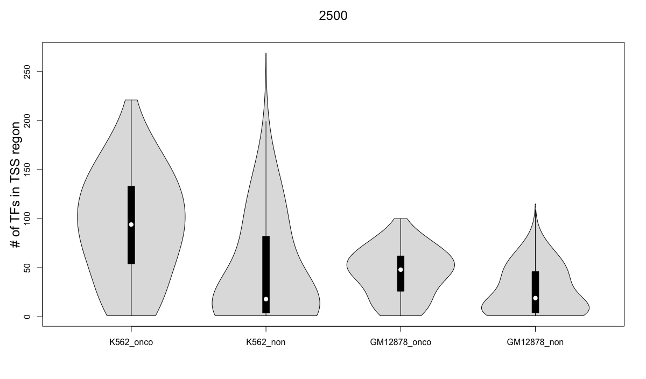

Slide 12
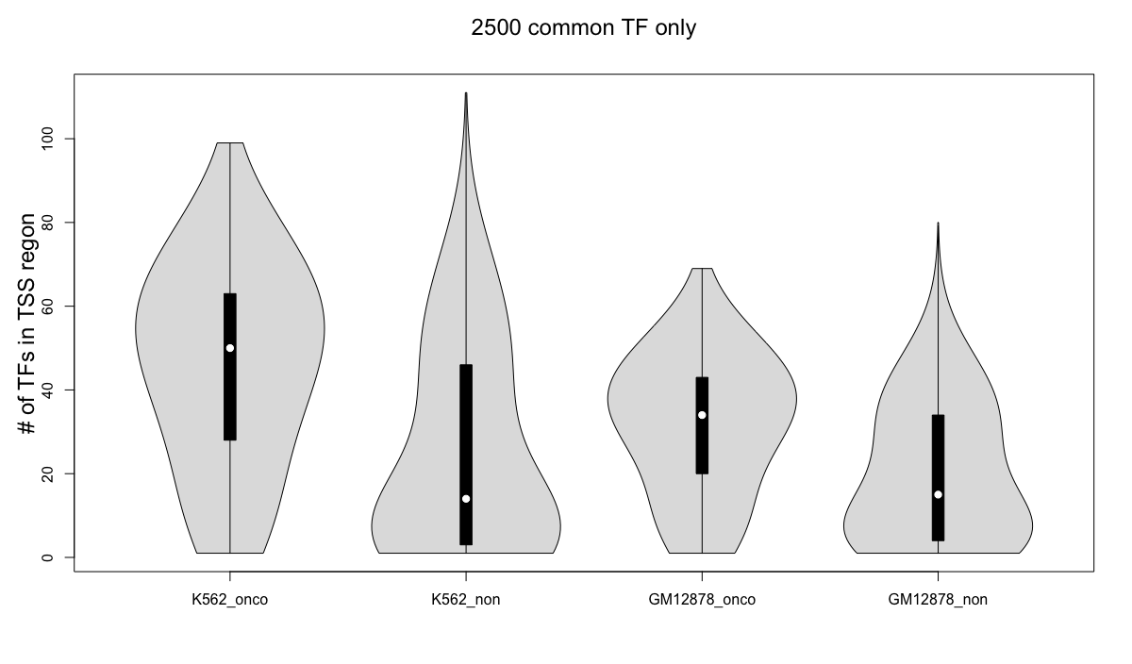

Slide 13
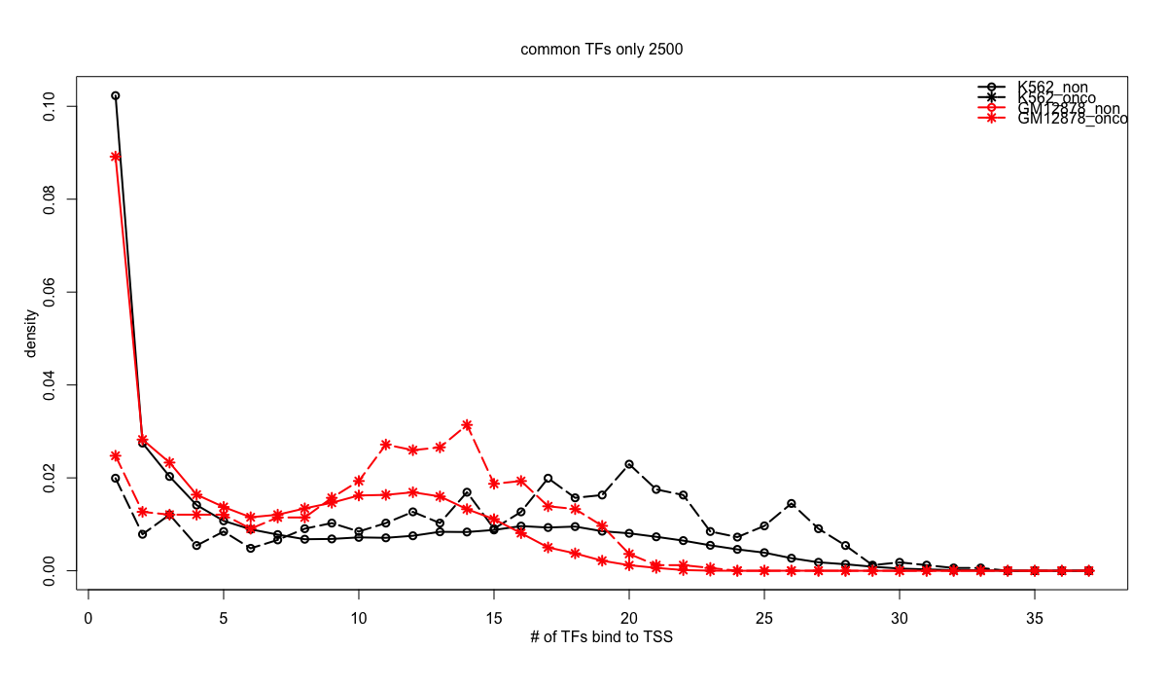

Slide 14
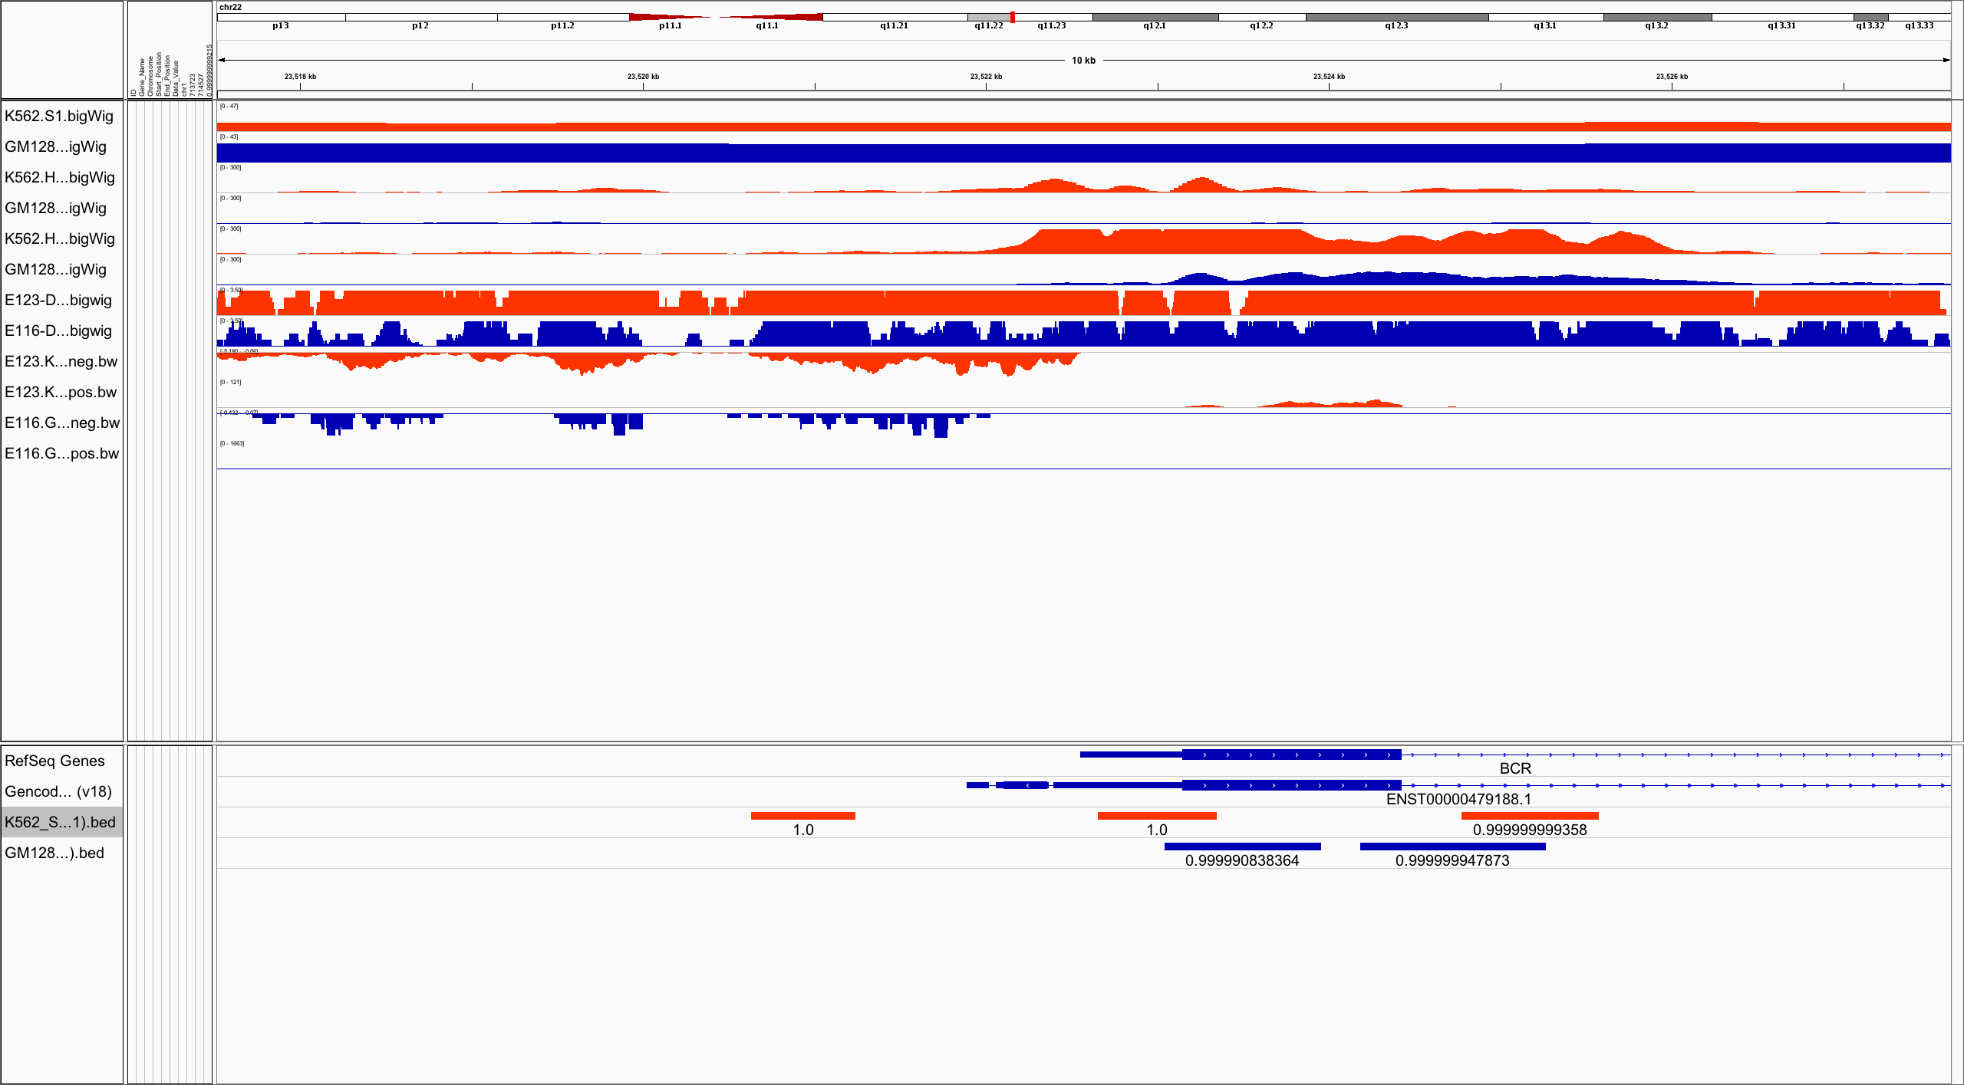
RepliTime
H3k27ac
H3k4me3
DHS
RNASeq

Slide 15
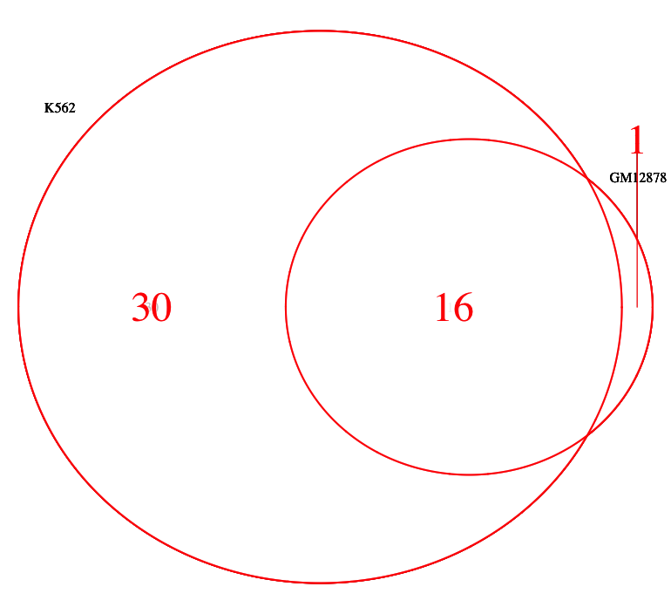
ATF3 BCL3 BCLAF1 BHLHE40 CEBPB CHD1 ELK1 EP300 ETS1 GABPA JUND MXI1 MYC PML POLR2A RCOR1 RFX5 SIN3A SP1 SRF TBL1XR1 TBP UBTF USF1 USF2 ZBTB33 CEBPZ NRF1 SUZ12 NFE2
CHD2 CTCF EGR1 ELF1 JUNB MAX MAZ RAD21 SMC3 SPI1 YY1 ZNF143 ETV6 HDGF MLLT1 TARDBP

Slide 16
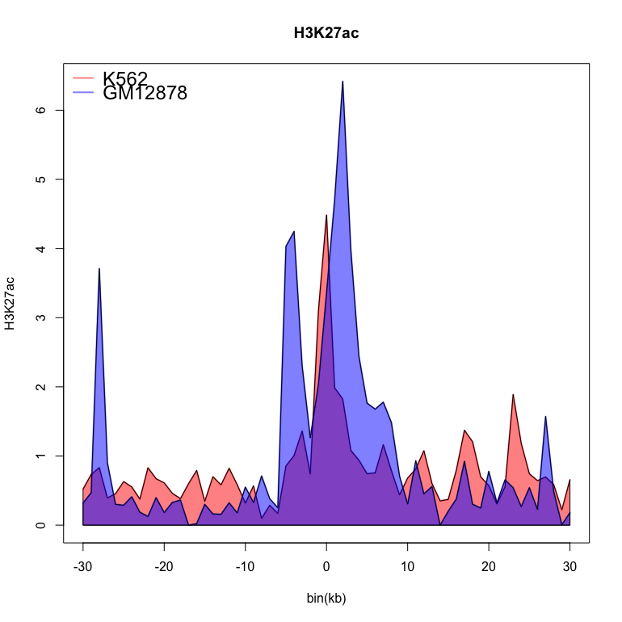

Slide 17
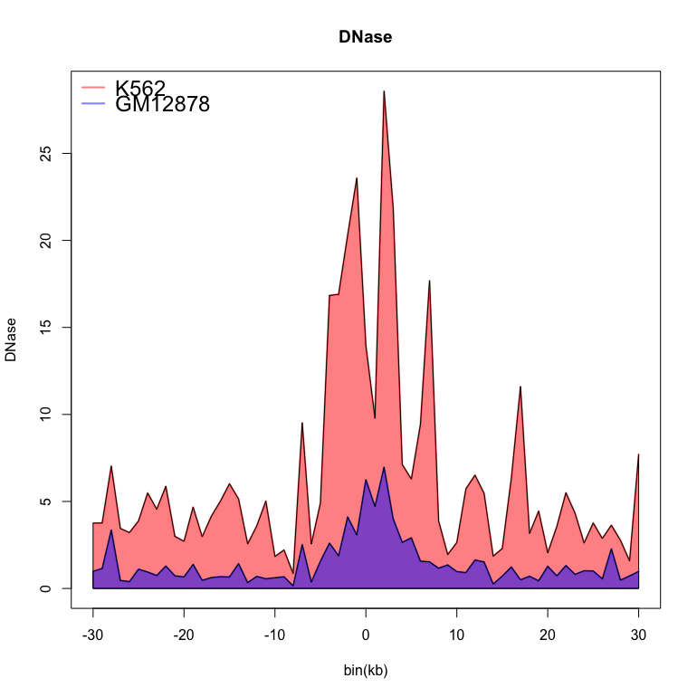

Slide 18
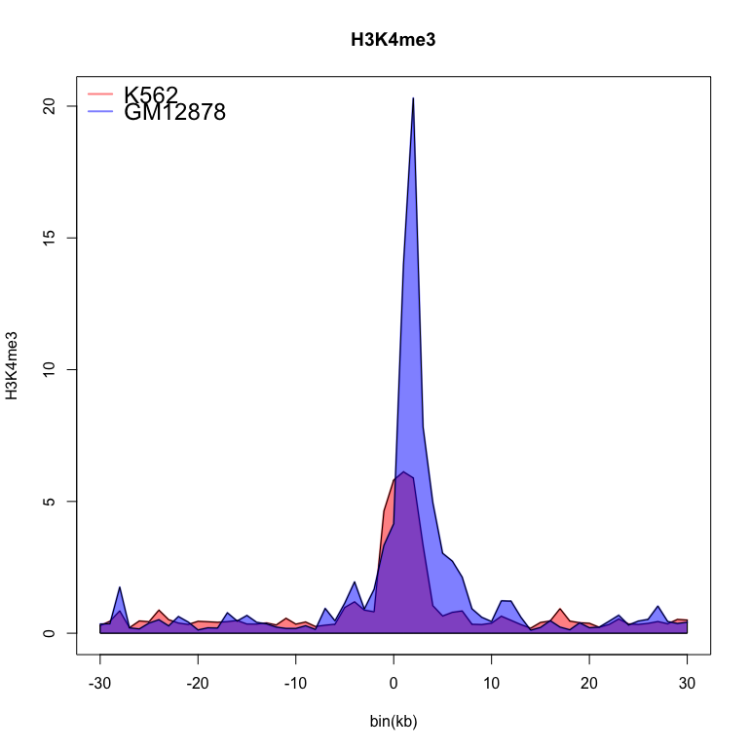

Slide 19
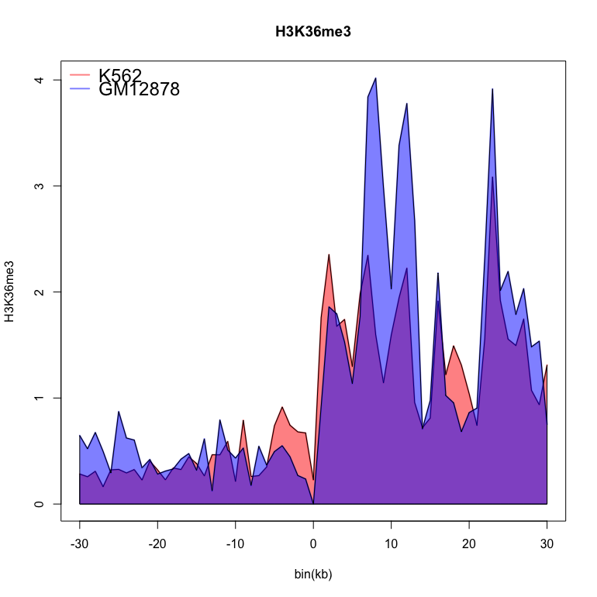

Slide 20
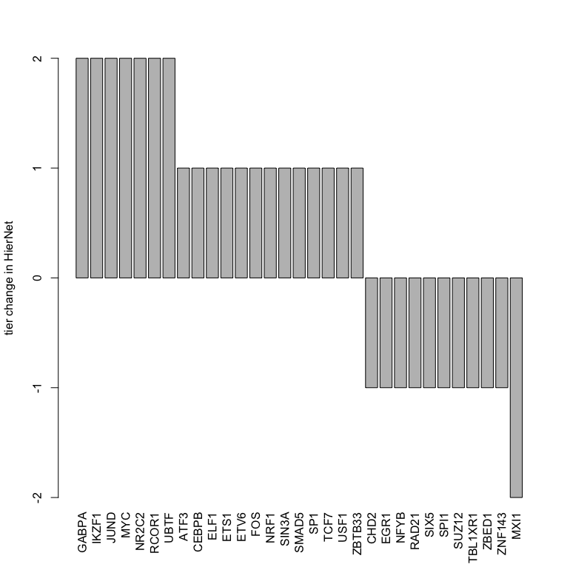

Slide 21
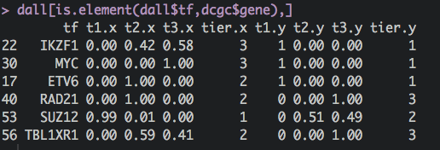

Slide 22
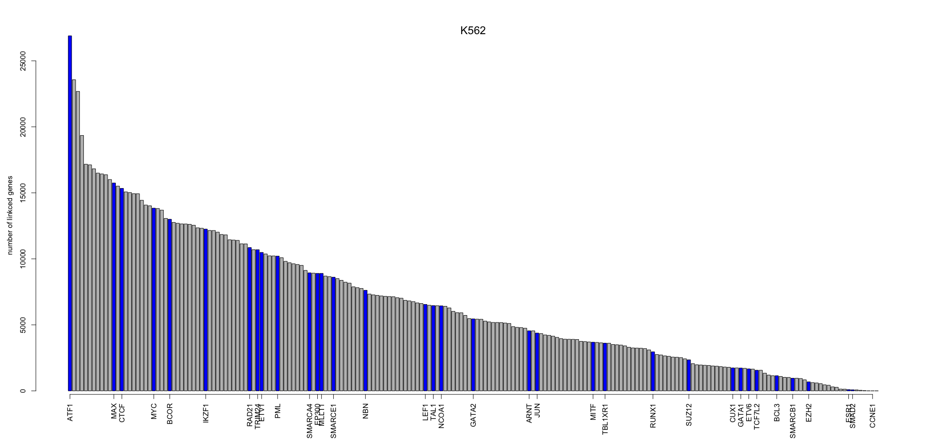

Slide 23
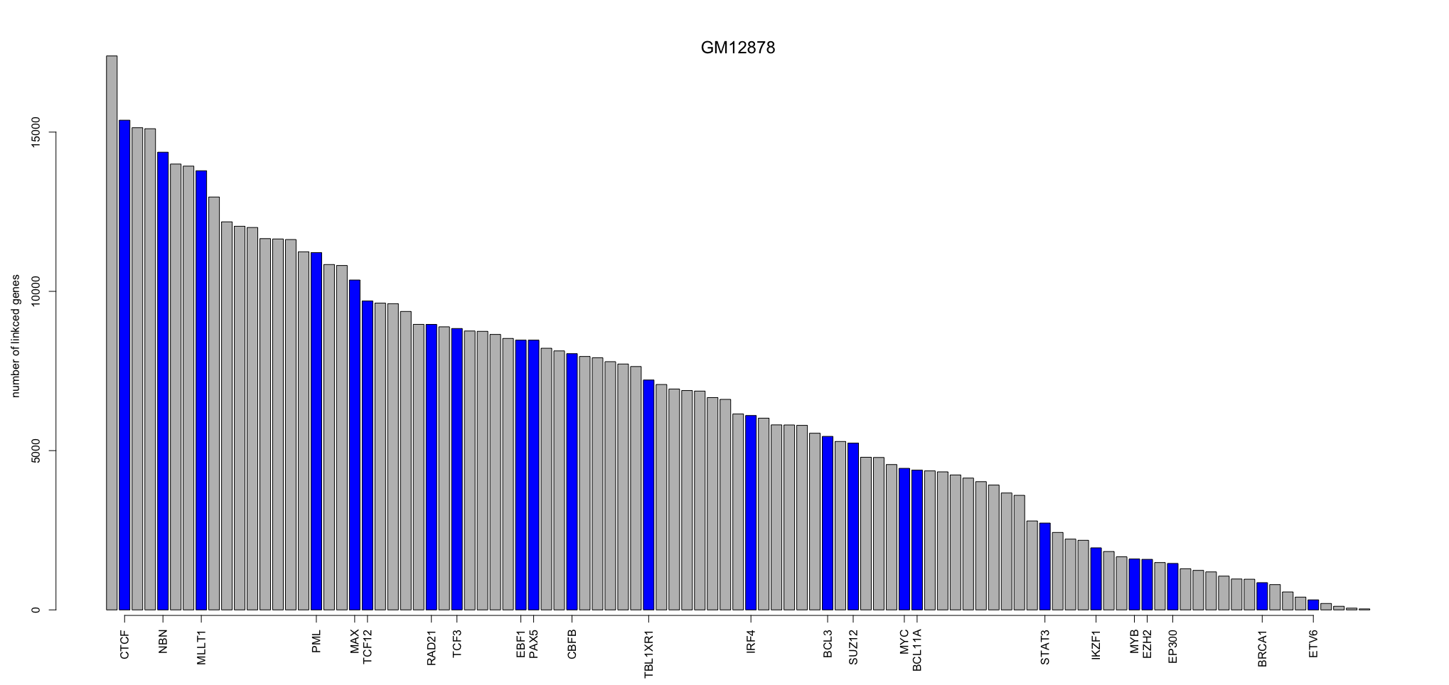

Slide 24
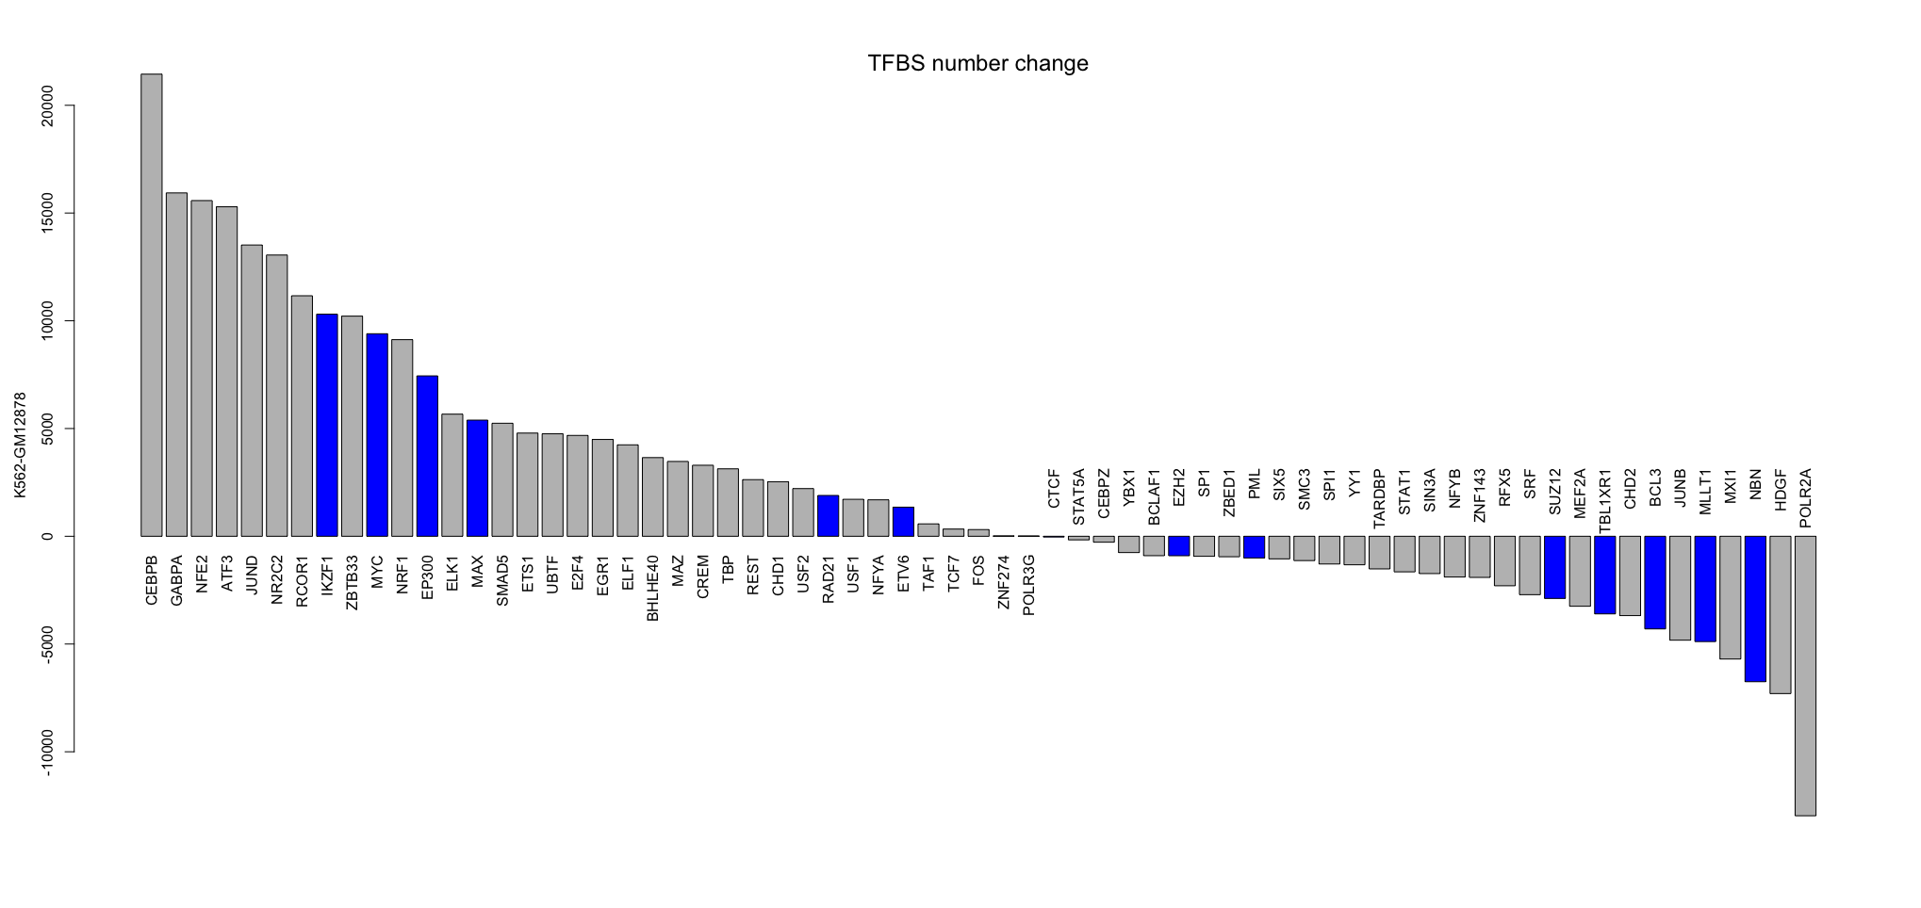

Slide 25
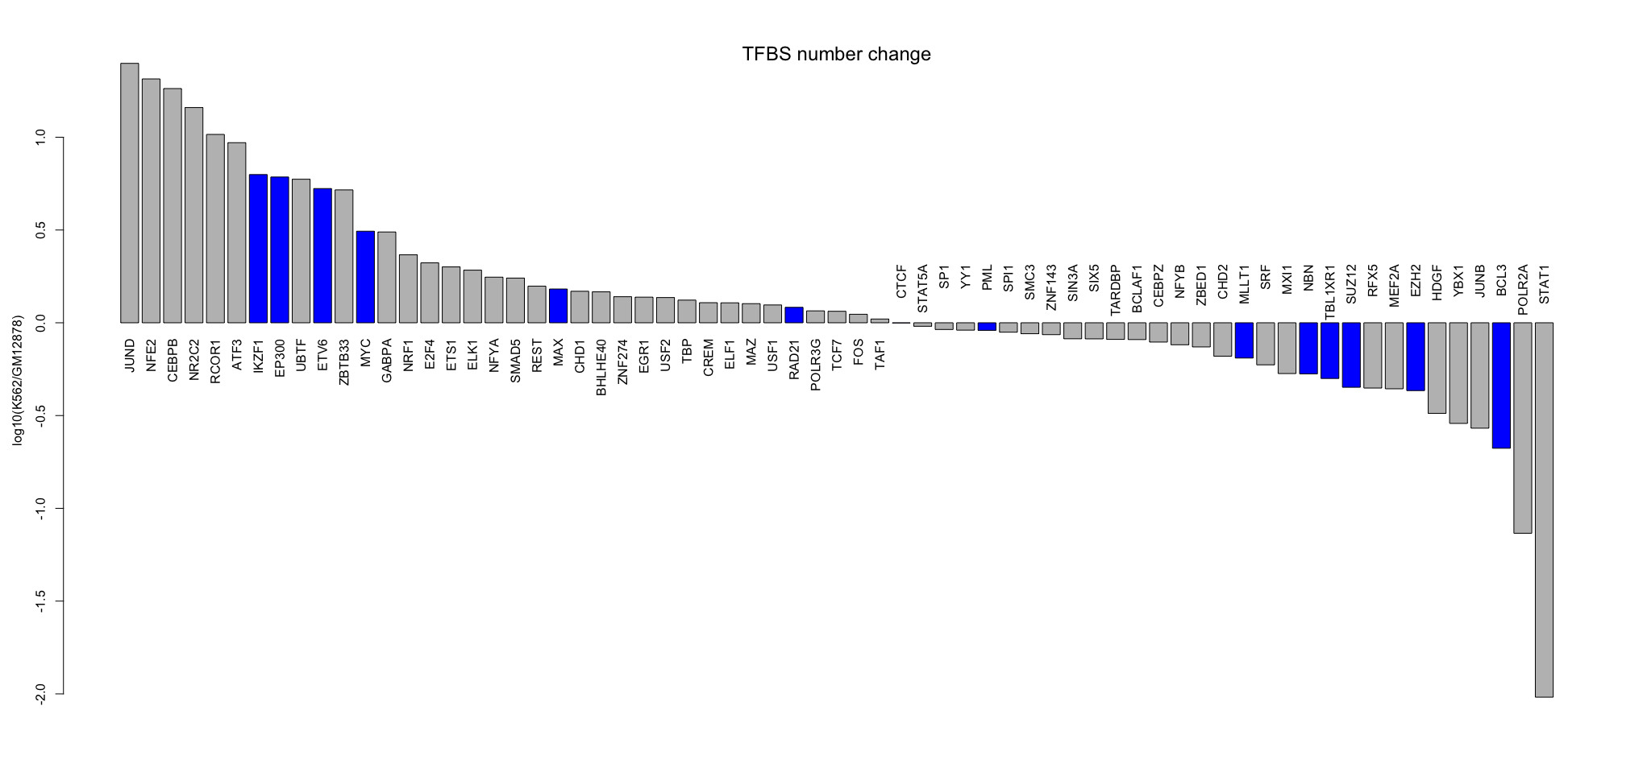
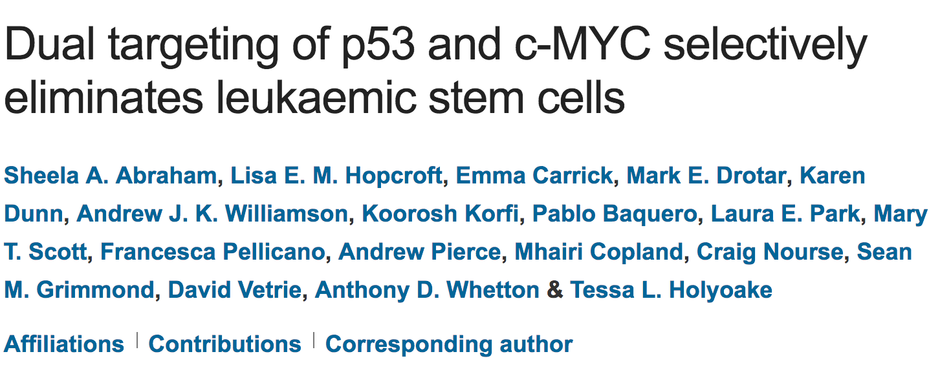

Slide 26
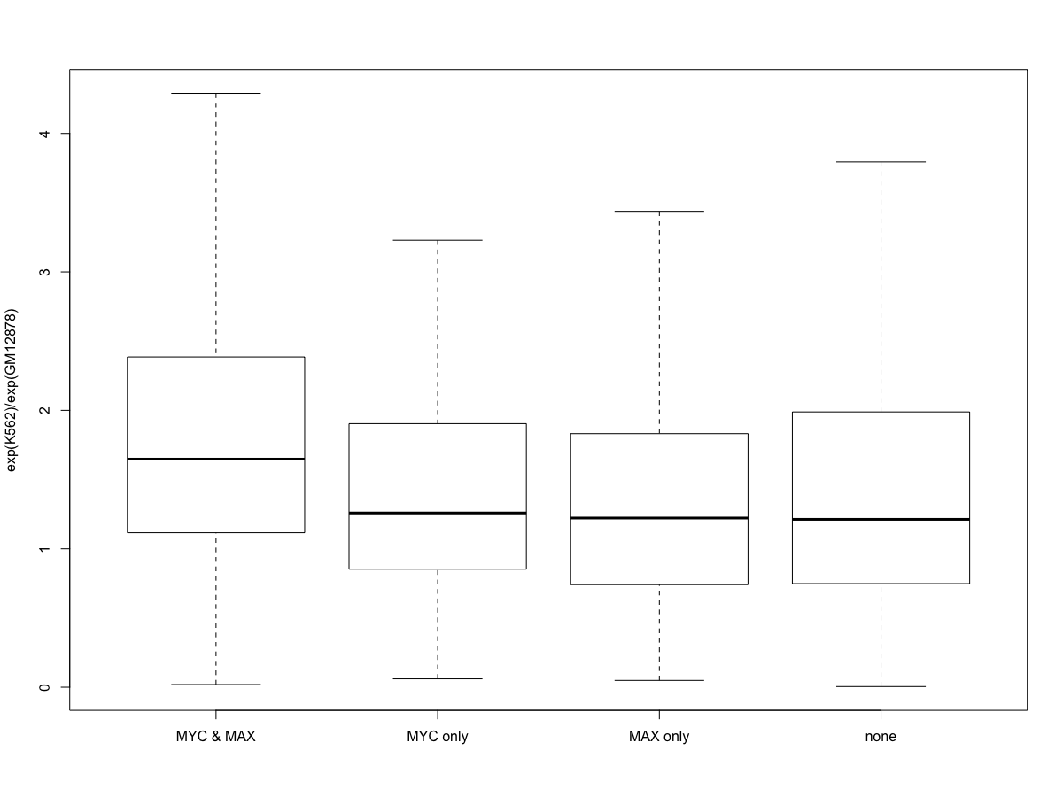

Slide 27
