Slide 1
Germline Variants

Slide 2
Overall AF, deleterious variants ExAC
Clinvar only: 0.007, 1/150 indiv.
MAF < 0.005, Pathogenic, likely pathogenic, risk factor
Best estimate: 0.012, 1/85 indiv.
MAF < 0.005, TSL:1, high impact impact mutations ensembl
Upper limit: 0.044, 1/23 indiv.
MAF < 0.005, TSL:1,2,3, high+moderate impact mutations ensembl

Slide 3
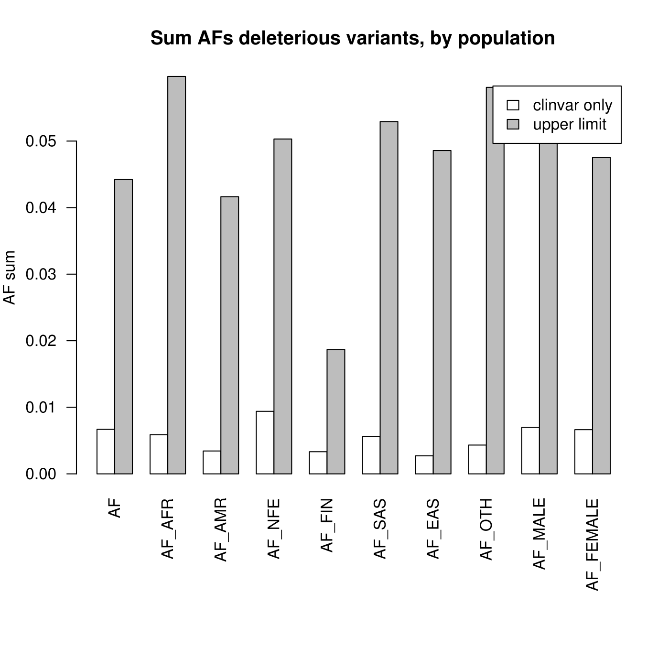

Slide 4
ExAC deleterious germline mutations
ExAC deleterious germline variants:
*19% higher frequency of deleterious mutations vs. NFE, 35% higher vs. overall AF, 220% higher vs. FIN.
AF (overall) | African American (AFR) | Non-Finnish European (NFE) | Finnish European (FIN)
0.0442 | 0.0597 | 0.0503 | 0.0187
1/23 indiv. | 1/17* indiv | 1/20 indiv | 1/54 indiv.

Slide 5
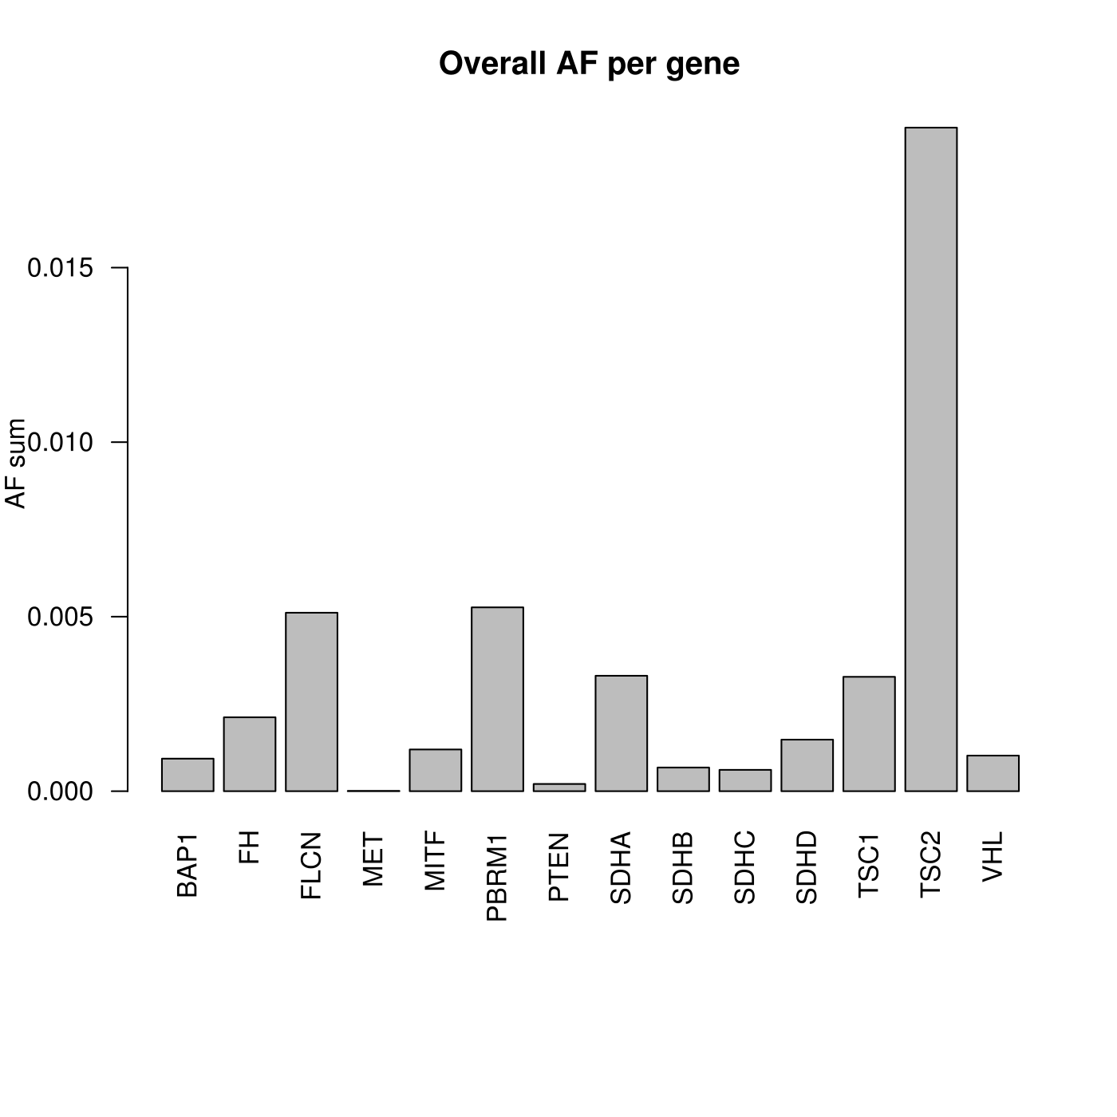

Slide 6
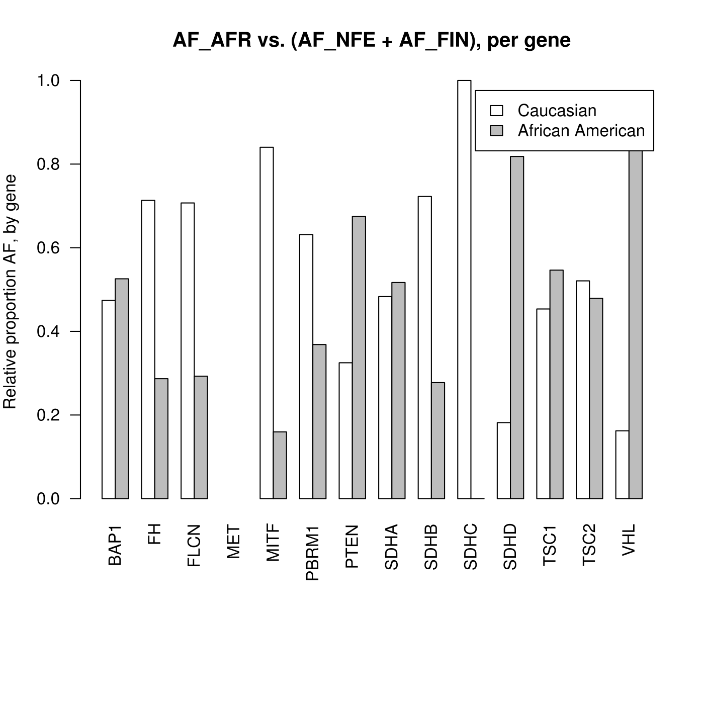

Slide 7
Gene/mutation plots

Slide 8
Other approaches to disparity
Variant level disparity (rs149617956 -- MITF):
NFE: 0.0019 (1/510 indiv.) AFR: 0.0006 (1/1510 indiv.)
Gene level disparity (VHL):
NFE: 0.0008 (1/1270 indiv.) AFR: 0.0053 (1/190 indiv.)
Other Populations (separated via PCA) + Gender:
Latino (AMR), East Asian (EAS), South Asian (SAS), Male, Female

Slide 9
Study format: observational
Case-control study: two groups (cases and controls), differing in outcome (cancer/cancer-type), compared according to causal factors (variants).
OR:
Retrospective cohort study: group with exposure (variant), group without exposure (without variant), how many per group develop outcome (cancer/cancer-type).

Slide 10
Cochrane: confounding and adjustment
List confounding/prognostic factors + how we measure them.
Document balance between comparator groups.
Design features: matching or restriction to subgroups (e.g. high BP indivs).
Analysis features: stratification or regression modelling (propensity scores or covariates).
http://handbook.cochrane.org/chapter_13/13_5_2_2_confounding_and_adjustment.htm

