Slide 1
Essential Genes,
Germline LOFs

Slide 2
Essential Gene Lists
Two essential gene lists:
Based on protein truncating variants (PTVs) in ExAC (SHet score).
-- Continuous measure (threshold top 25%).
http://biorxiv.org/content/early/2016/09/16/075523
Based on viability of mouse knockouts (IMPC/MGI lethal/subviable).
-- Binary measure.
http://www.nature.com/nature/journal/vaop/ncurrent/pdf/nature19356.pdf

Slide 3
Comparison Groups
Control Group | Study Group
ExAC, 1KG | PCAWG germline
Randomized mutation set | PCAWG somatic

Slide 4
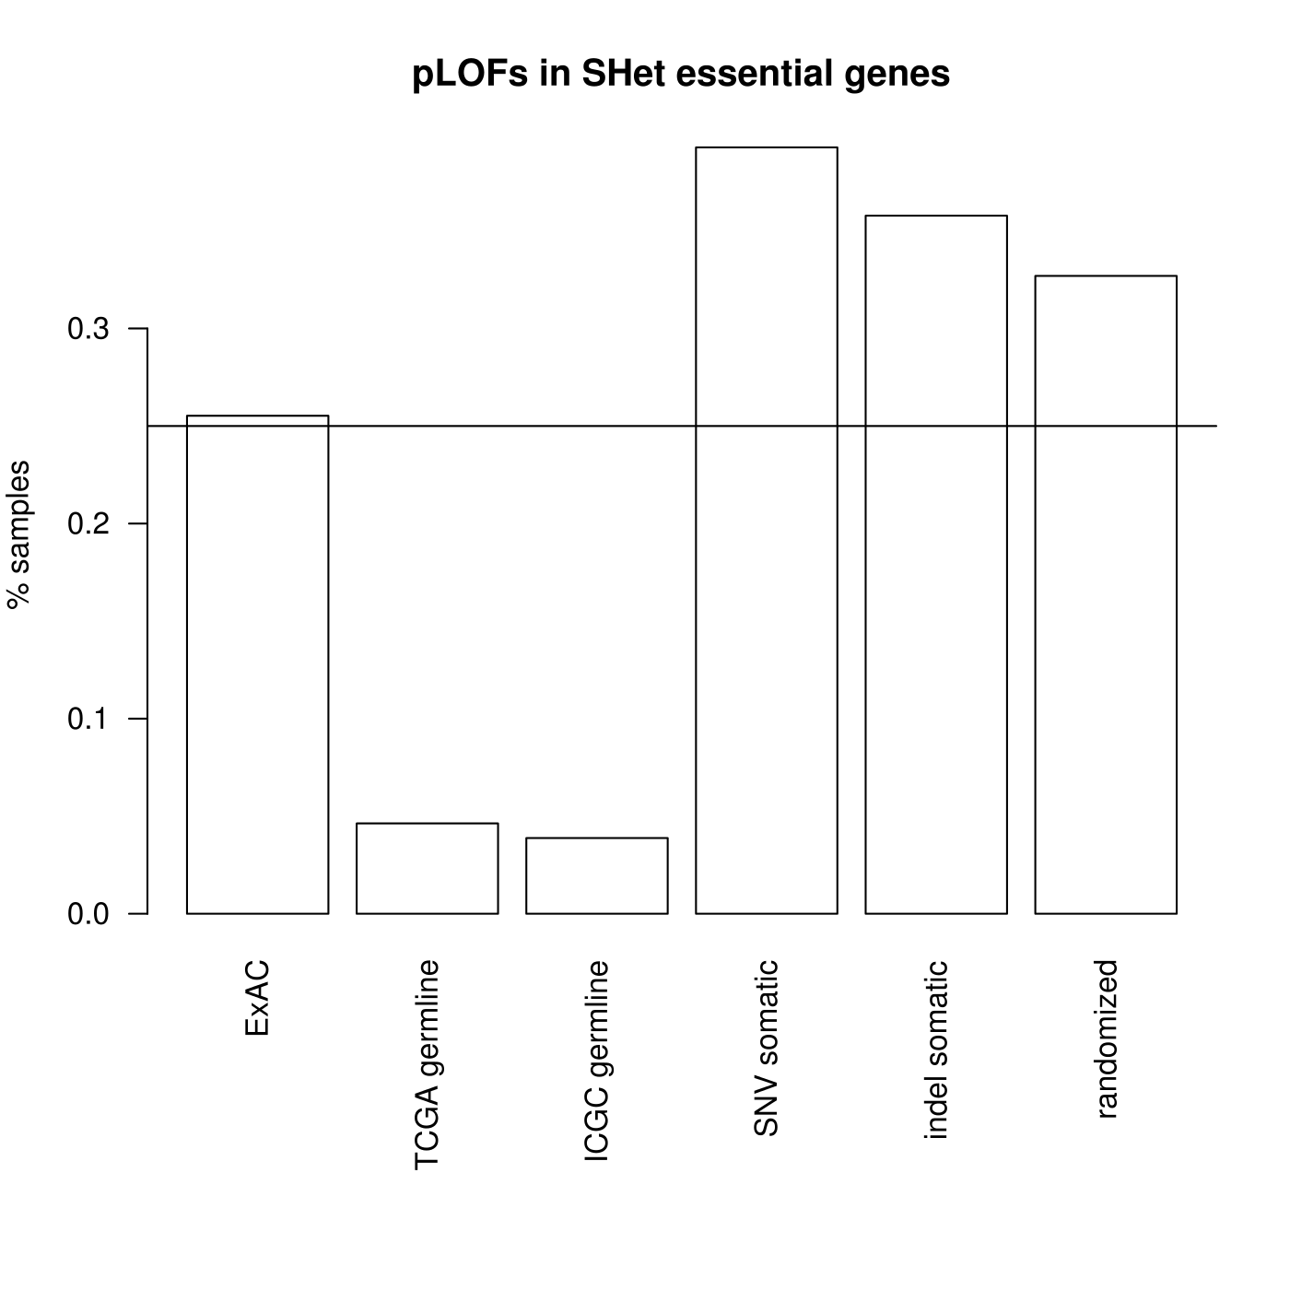
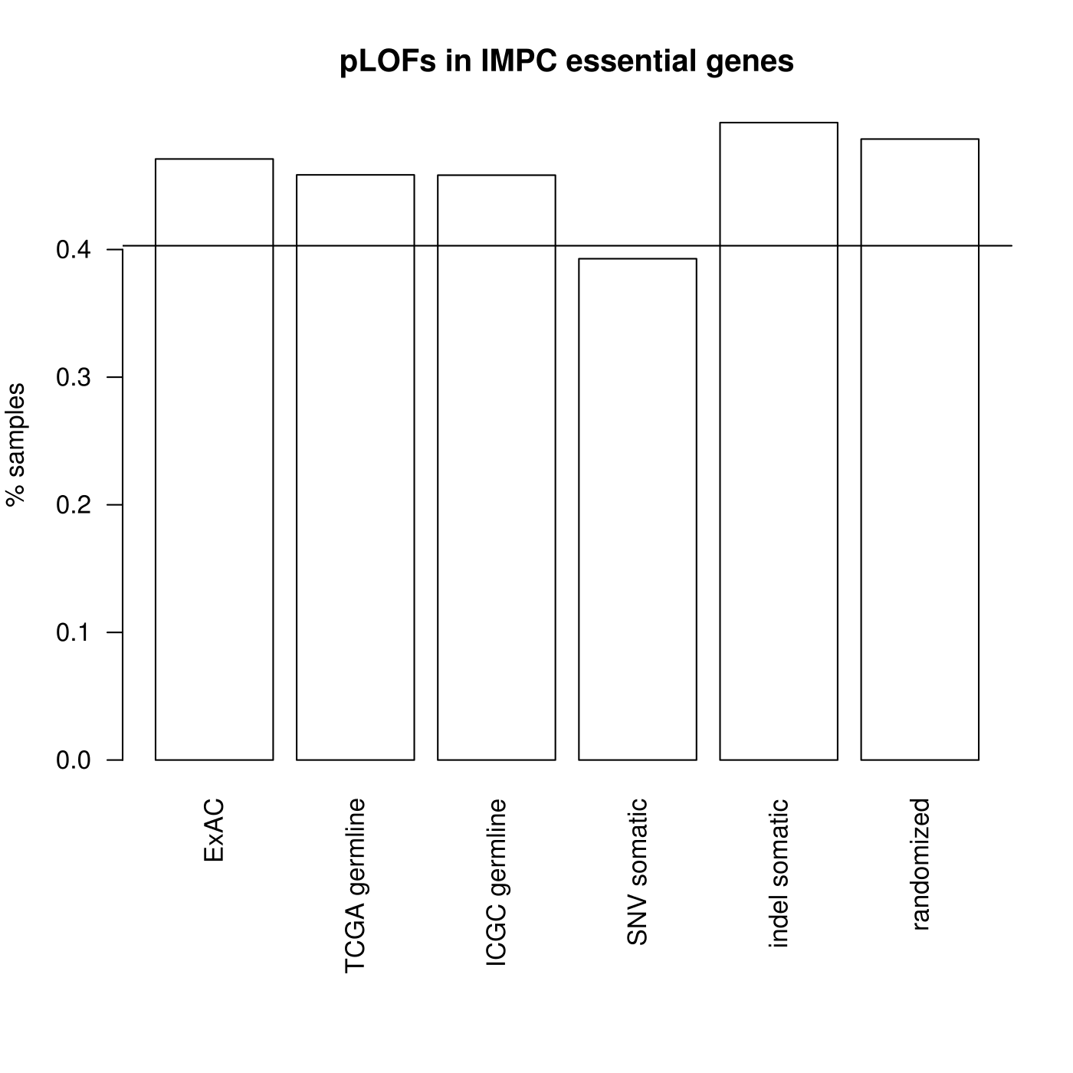
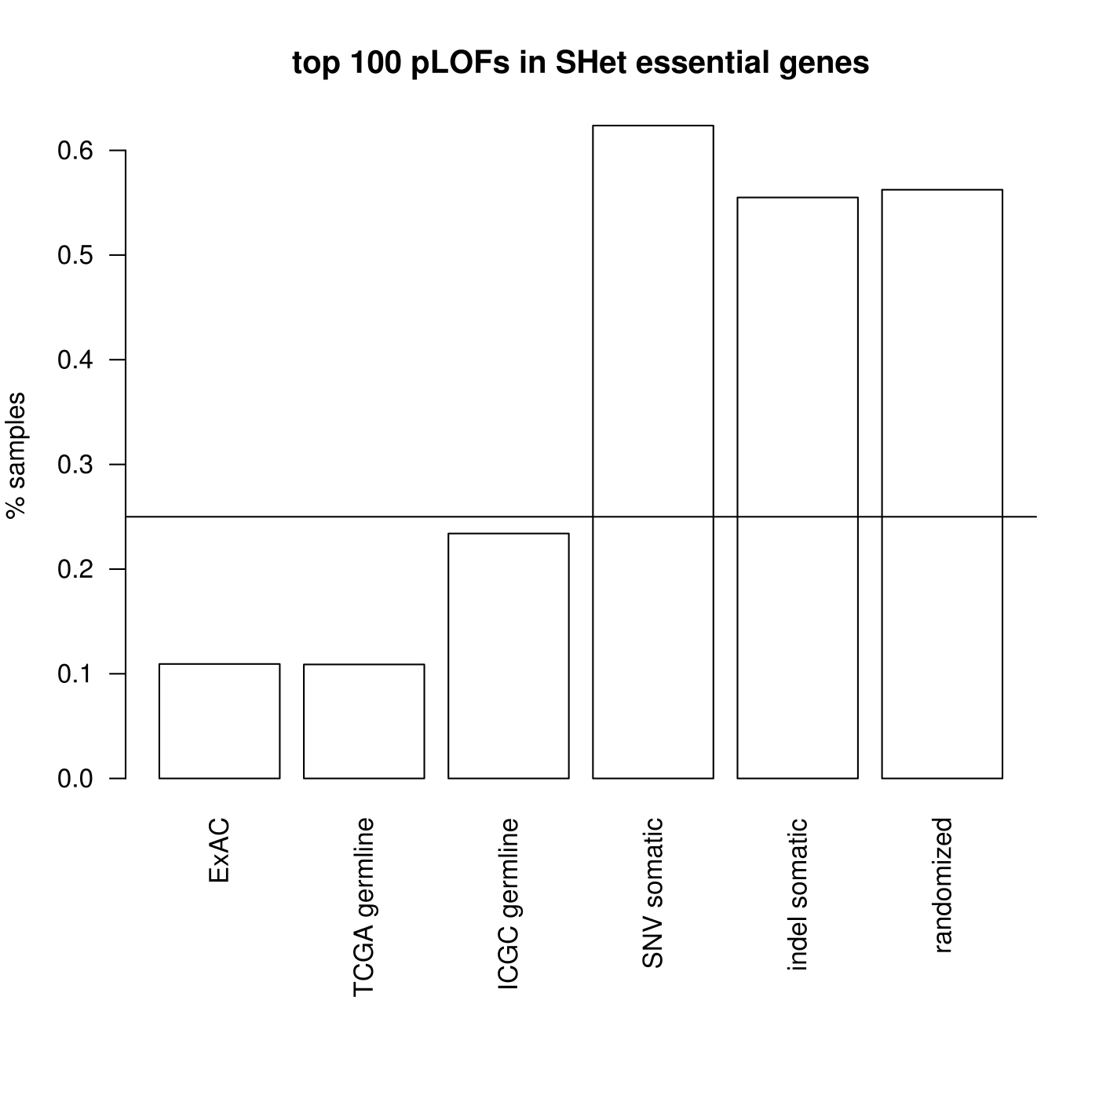
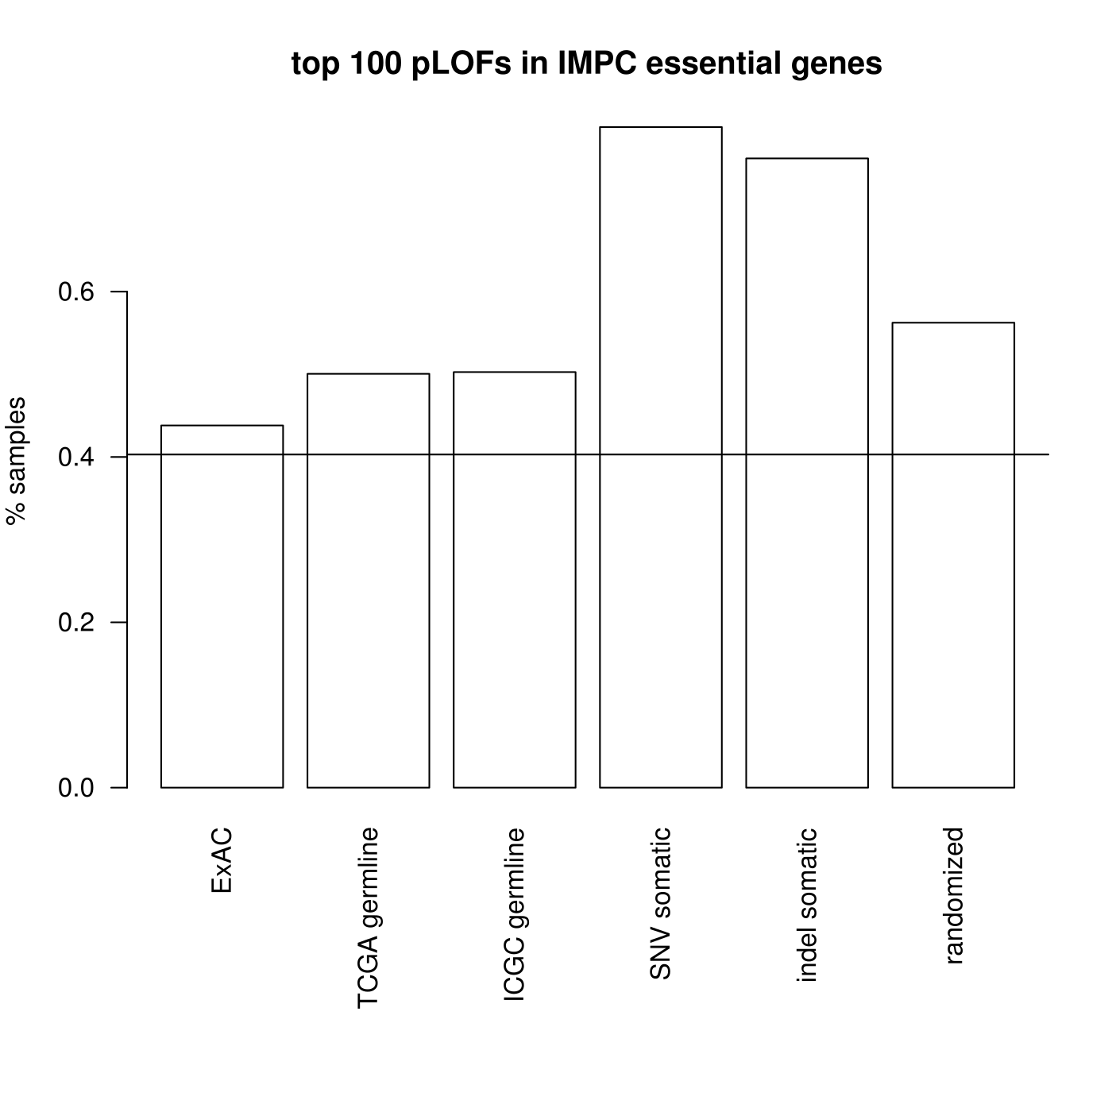
Essential gene skew, (IMPC list)

Slide 5
Essential gene skew, (ExAC PTV list)

Slide 6
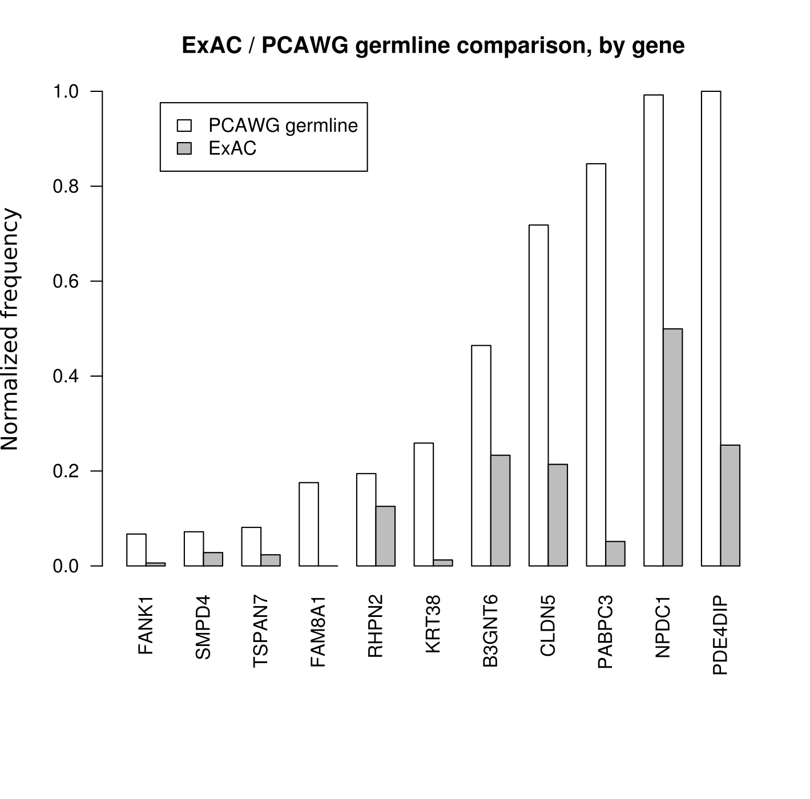
Germline LOFs (PCAWG germline vs. ExAC)

Slide 7
Germline LOF gene functions
PDE4DIP: Anchors cAMP pathway components to centrosome.
NPDC1: Neural proliferation and differentiation control protein.
PABPC3: Poly-A binding protein - mRNA translation and stability.
CLDN5: Vascular tight junctions, cell motility, implicated in cancer metastasis.
B3GNTC: Mucin production, GI tract, mucin alterations common in GI cancers.
KRT38: Keratin. Hair and nails. (? function)

Slide 8
Germline LOF gene functions
RHPN2: Rhophilin. Adhesion/cancer invasiveness.
FAM8A1: Unfolded protein response. Apoptosis.
TSPAN7: Tetraspanin - cell development, activation, growth and motility.
SMPD4: Sphingolipid, activated by TNF. Putative role in apoptosis.
FANK1: Tumor cell apoptosis. Interaction with RYBP1 (tumor supressor).

