Slide 1
Clonal Fitness

Slide 2
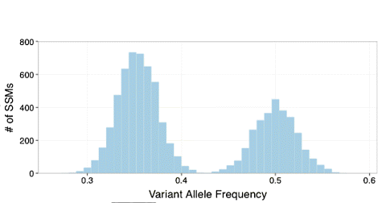
Calling Subclones

Slide 3
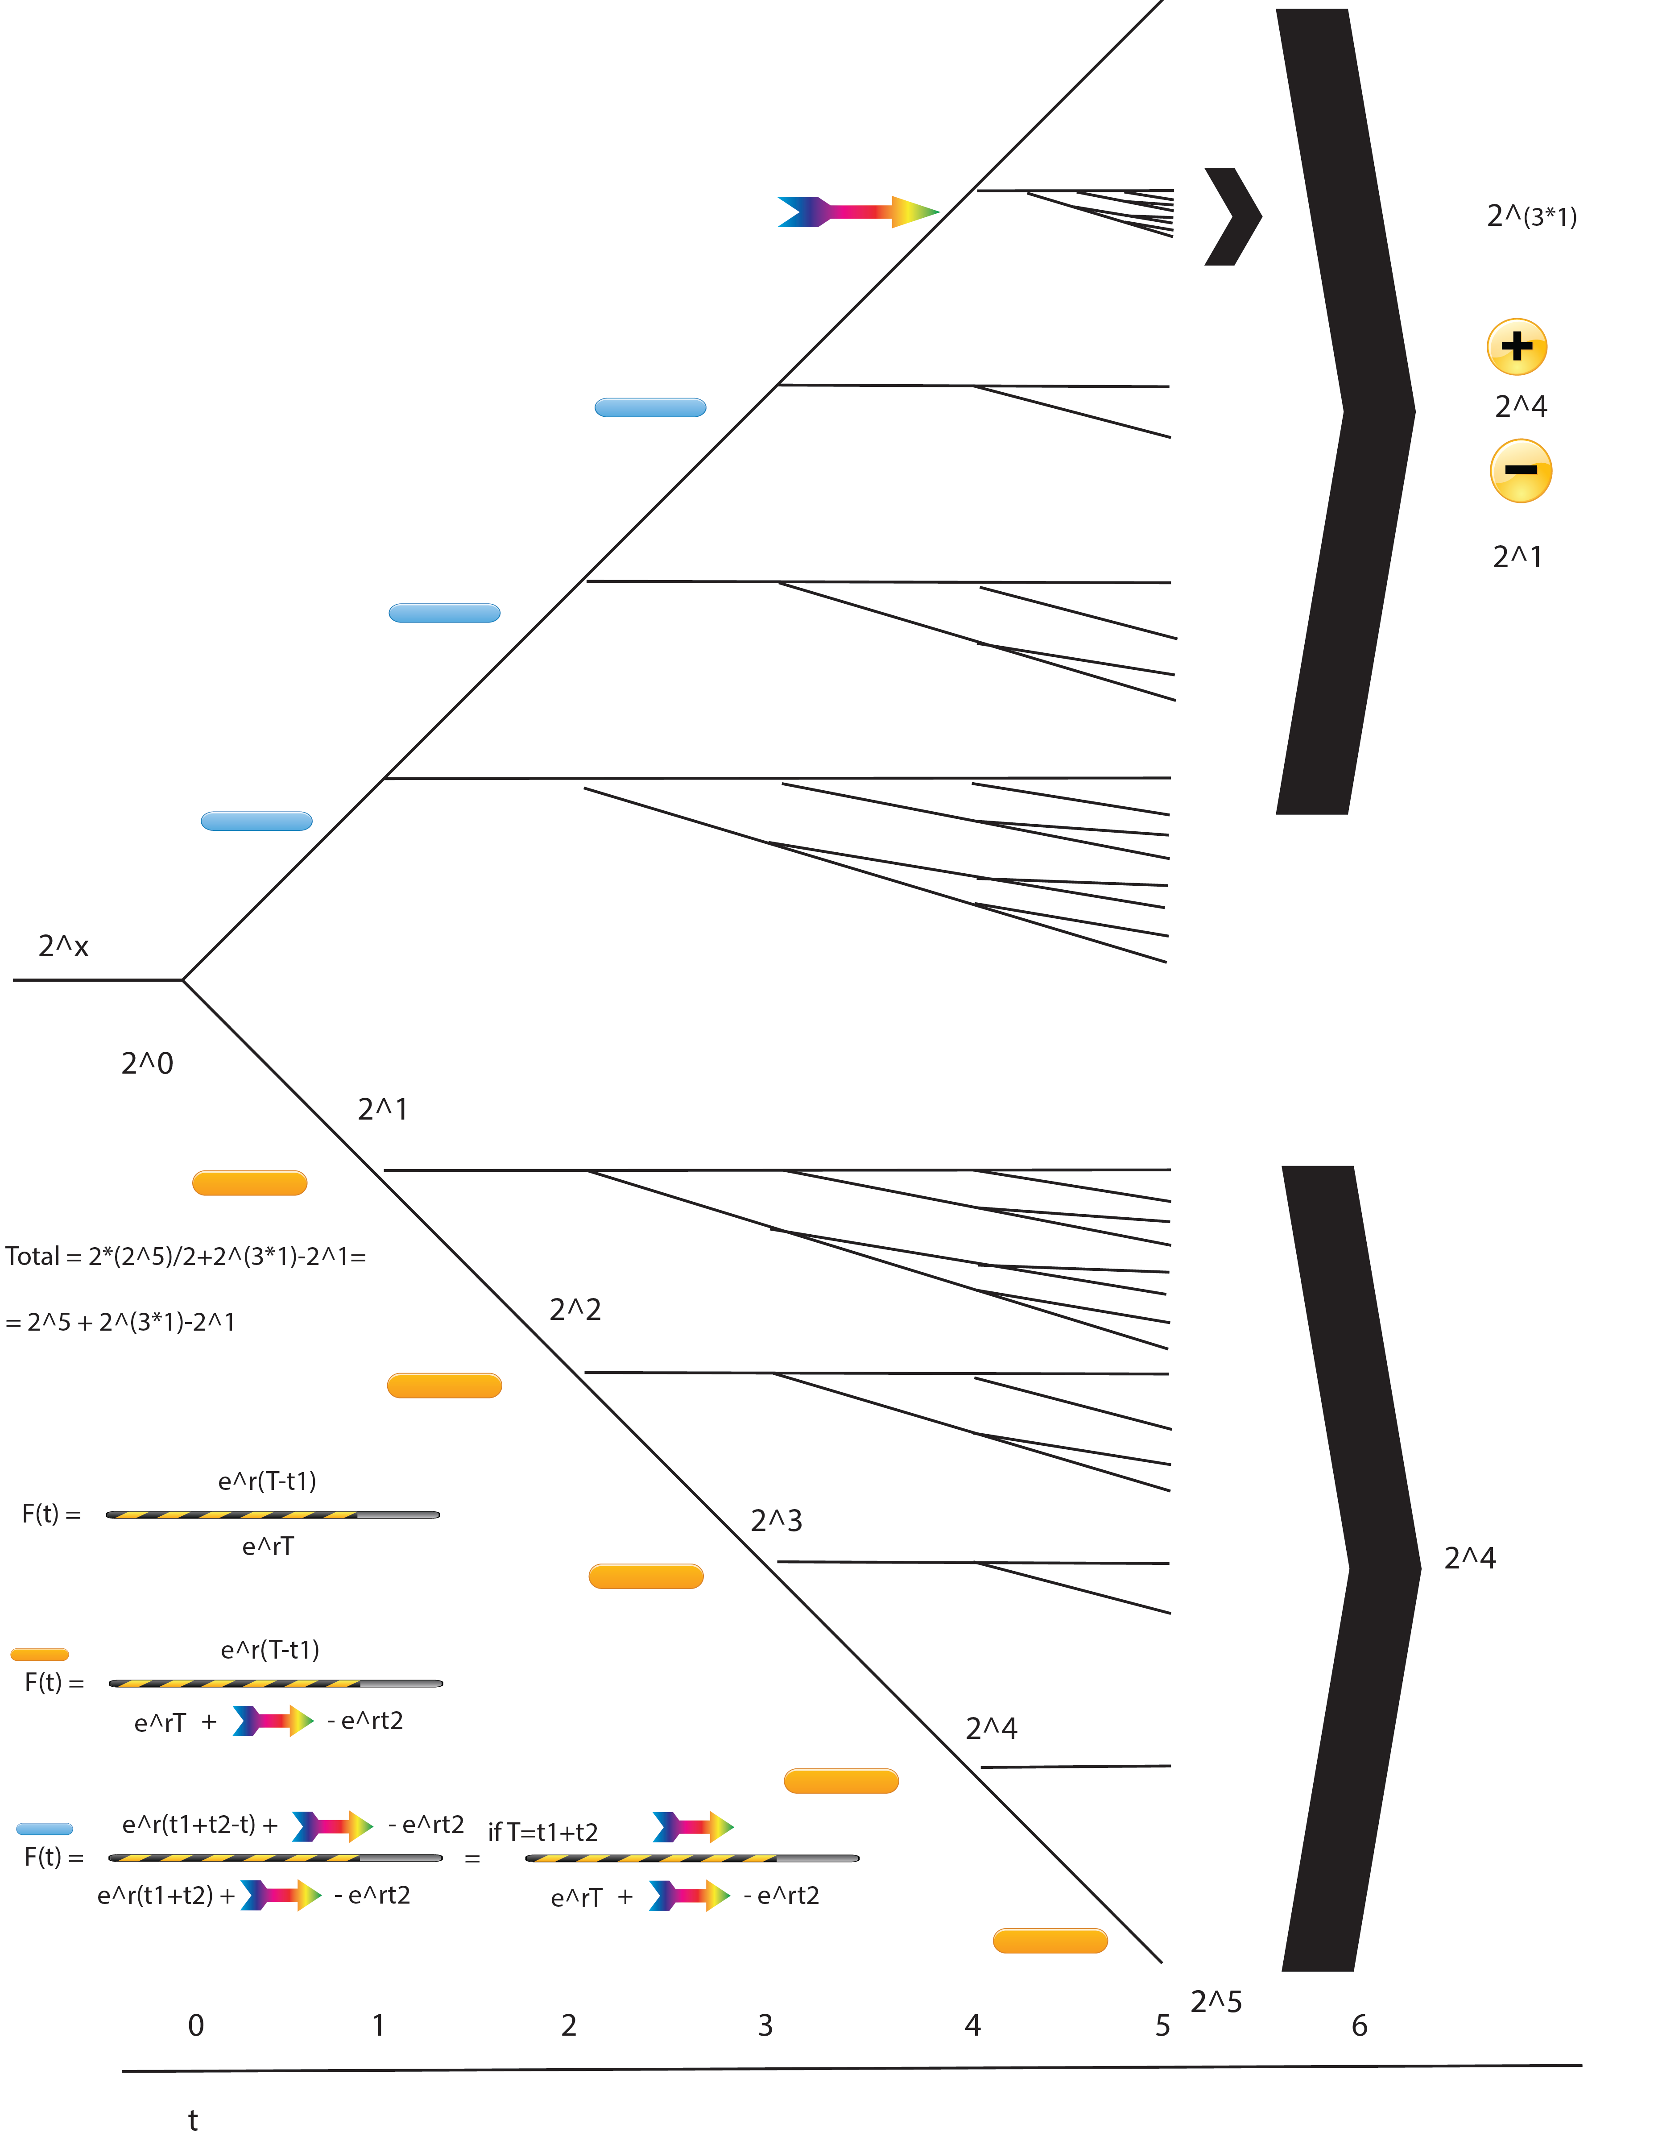

Slide 4
Calling Subclones
Early Hitchhiked Mutations with Fitness r
New Fitness Mutations (NFM)
with fitness K*r
Mutations with fitness r
Subclone With Higher Fitness

Slide 5
T=t1+t2, t1 the moment of driver mutation

Slide 6
Green mutations with lower Freq

Slide 7
Hitchhiked mutations with higher Freq

Slide 8
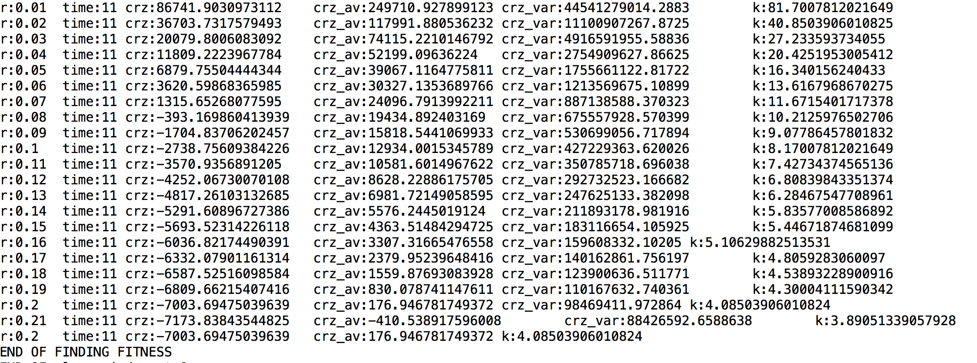
Finding Fitness
To do
- Refine the model (eg add stats)
- Run on Will’s simulation data
- Run on Prostate Cancer VCFs

