Slide 1
Uncovering Earth’s virome David Paez-Espino, Emiley A. Eloe-Fadrosh, Georgios A. Pavlopoulos, Alex D. Thomas, Marcel Huntemann, Natalia Mikhailova, Edward Rubin, Natalia N. Ivanova & Nikos C. Kyrpides
Nature 536, 425–430 (25 August 2016) doi:10.1038/nature19094
Jclub
Dan Spakowicz

Slide 2
Summary
Viruses are the most abundant biological entities (est 10^31 particles, ~2200 genomes sequenced)
5 Tb of publicly available metagenomic sequence data
3,042 geographically diverse samples
includesVenter’s ocean sampling
No viral enrichment
Found >125,000 partial DNA viral genomes, 2.1GB virus data
increased the number of known viral genes by 16-fold
2.79 x10^6 proteins, 75% of which have no homologs in cultured viruses
Using CRISPR spacers and transfer RNA matches to link viral groups to microbial host(s), we doubled the number of microbial phyla known to be infected by viruses, and identified viruses that can infect organisms from different phyla

Slide 3
Methods
Integrated Microbial Genomes with Microbiome Samples (IMG/M) database (JGI)
Limited to assembled and annotated datasets
Search collection of assembled viral contigs > 5kb (5.1 x10^6)
WGS only – no RNA viruses
Bait: exclusively viral proteins + 1800 manually identified metagenomic viral contigs

Slide 4
Extended Data Figure 1: Detailed workflow for the identification of viral sequences from metagenomic data.
Notes:
a, Overview of the acquisition and filtering of viral protein families in two rounds and their use for the identification of metagenomic viral contigs larger than 5 kb. In the first round, proteins from 2,300 double-stranded DNA viruses were grouped into 16,000 protein families, which were aligned to generate Hidden Markov Models (HMMs). These HMMs were used in combination with analysis of k-mer composition and phylogenetic analysis of DNA- dependent RNA polymerase genes to identify 1,843 high-confidence metagenome viral contigs.
b, c, These contigs were validated by manual analysis (b) and the proteins from this set were combined with the isolate viral proteins to generate a final set of 25,000 viral protein families (c).
d, HMMs generated from alignment of these protein families were used to identify 125,842 metagenomic viral contigs. Processing steps detailed in b–d are described in the Methods. The final mVCs were then grouped and assigned to their hosts via CRISPR–Cas spacer matches and viral tRNA matches against isolate microbes (not shown in this figure).

Slide 5
Identification of metagenomic viral sequences and habitat distribution
D Paez-Espino et al. Nature 1–6 (2016) doi:10.1038/nature19094
Notes:
a, Number of metagenomic viral contigs compared to isolate viral genomes.
b, Accumulation curves showing the protein cluster growth with increased sampling
c, Distribution of metagenomic viral contigs (blue), isolate phages (red) and isolate eukaryotic viruses (green) by length and coverage with viral protein families.

Slide 6
Extended Data Figure 5 | Viral group clustering method
single-linkage hierarchical clustering (SLC) with different combinations of AAI and AF values to validate the clustering approach
Notes:
a), Parameters used in the clustering of viral sequences. We used all 5,042 reference isolate viral genomes (iVGs) to group them using single-linkage hierarchical clustering (SLC) with different combinations of AAI and AF values to validate the clustering approach. The thresholds for AAI and AF were set at 90% and 50%, respectively, (boxed in purple) and were selected based on the accurate grouping of iVGs that was in agreement at the genus level, and the vast majority at the species level, according to the ICTV classification system (Supplementary Information). Further, these thresholds reduced the number of total connections (green line referred to secondary y axis) compared with lower AAI thresholds, without altering the total number
of singletons and viral groups created (red and light green bars referred to primary y axis, respectively), as well as the average number of members per viral group (shown at the bottom of the figure). b, Size distribution of viral groups. Distribution of the 66,696 viral genomes clustered into 18,470 viral groups. Number of viral members (spanning from 2 to 365) per viral groups is shown.

Slide 7
Host–virus connectivity
Inferred from CRISPR
Known assignments
Inferred from tRNA
D Paez-Espino et al. Nature 1–6 (2016) doi:10.1038/nature19094
Notes:
a, Total number of host assignments to metagenomic viruses with three approaches.
B) Phylogenetic distribution of bacterial and archaeal hosts. metagenomic viral contigs (red), and isolate viruses (grey).

Slide 8
Expanded host-range specificity identifies viral generalists
Notes:
a, Proportion of viral groups connected with predicted hosts at various taxonomic levels.
b, Three proto-spacers encoded on mVCs identified in human oral metagenomic samples that were linked to CRISPR spacers from hosts from distinct phyla, Actinomycetes sp. oral taxon 180 (Actinobacteria) and Streptococcus plurextorum DSM 22810 (Firmicutes). c, Seven proto-spacers encoded on two nearly identical mVCs deriving from independent faecal samples, and linked to CRISPR spacers from Roseburia inulinivorans DSM 16841 (Lachnospiraceae family), Eubacterium rectale ATCC 33656 (Eubacteriaceae family), and Ruminococcus sp. SR 1/5 (Ruminococcaceae family) (details in Supplementary Information).

Slide 9
Viral distribution patterns in marine and human samples
Notes:
a, b, Hierarchical clustering of viral groups and singletons across marine
(a) and human samples (b).
The groups don’t overlap much

Slide 10
Habitat distribution of metagenomic viruses
Notes:
a, Distribution of viral groups and singletons (red and blue bubbles, respectively) against the number of habitats. Bubble size (inset) reflects the number of samples containing viral sequence. b, Distribution of viral sequences per habitat type and environmental category. Pie charts size and the number inside show viral groups and singletons per habitat type grouped into four environmental categories; values are given in units of 103. c, Pairwise connection between habitat types based on shared viral sequences; d, Distribution of viral sequences across human body sub-sites and across habitat types. Red dots indicate viral groups and singletons exclusive for each sub-site.

Slide 11
Global distribution of viral diversity
Notes:
The presence of the same viral groups or singletons across samples (circles) is represented by connecting lines. Only samples over 10 pixels apart and sharing 2 or more viral groups or singletons are shown. The colours of the circles indicate the habitat type. a, Connections between marine samples. Transparency of the lines reflects the number of shared viral groups. b, Connections between non-marine samples of the same habitat type. Connections between different habitat types are shown in Extended Data Fig. 10. Equirectangular projection of the world map is used as background image (http://visibleearth.nasa.gov/view.php?id=57752).

Slide 12
Let’s look for viruses everywhere!
Cancer genomes
The Cancer Genomics Cloud (CGC), powered by Seven Bridges, is one of three pilot systems funded by the National Cancer Institute to explore the paradigm of colocalizing massive genomics datasets, like The Cancer Genomics Atlas (TCGA), alongside secure and scalable computational resources to analyze them.
The CGC makes more than a petabyte of multi-dimensional data available immediately to authorized researchers. You can add your own data to analyze alongside TCGA using predefined analytical workflows or your own tools. Every execution is fully reproducible, and collaborating with your team is simple and secure.

Slide 13
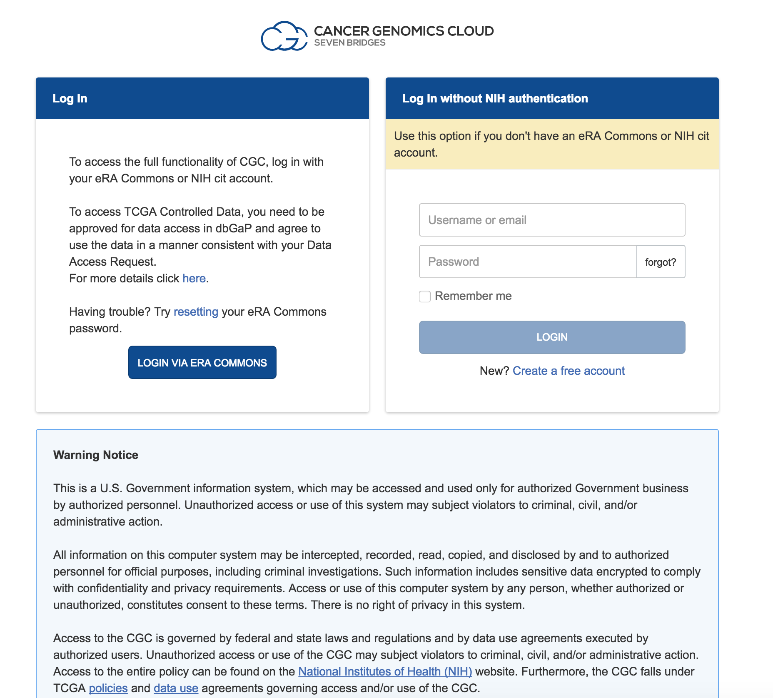
Login via eRA commons

Slide 14
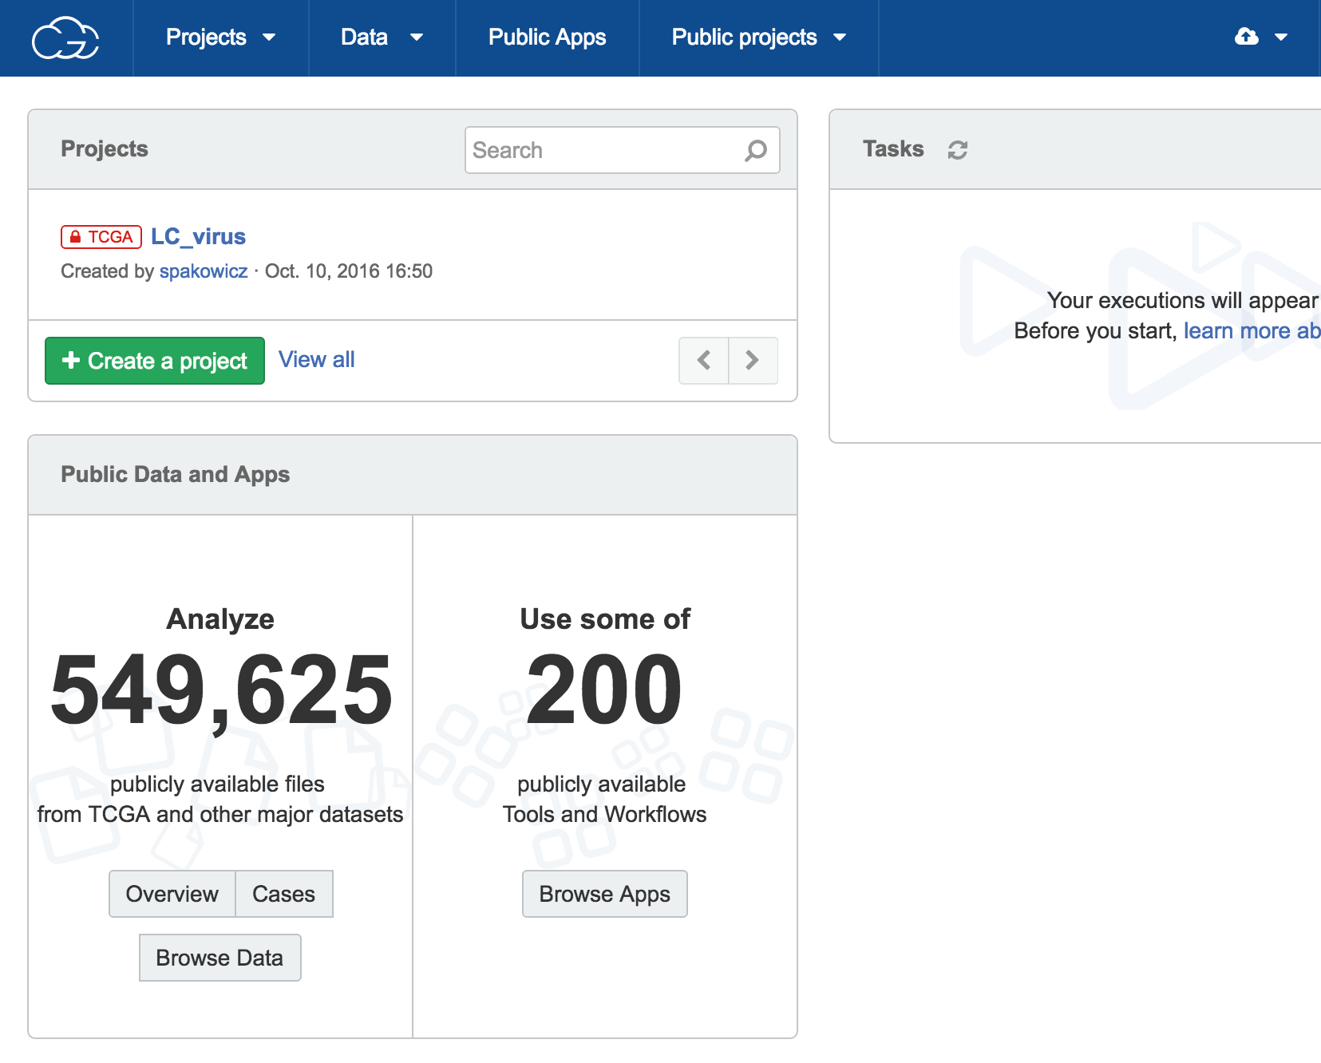
Automagically detects TCGA access

Slide 15
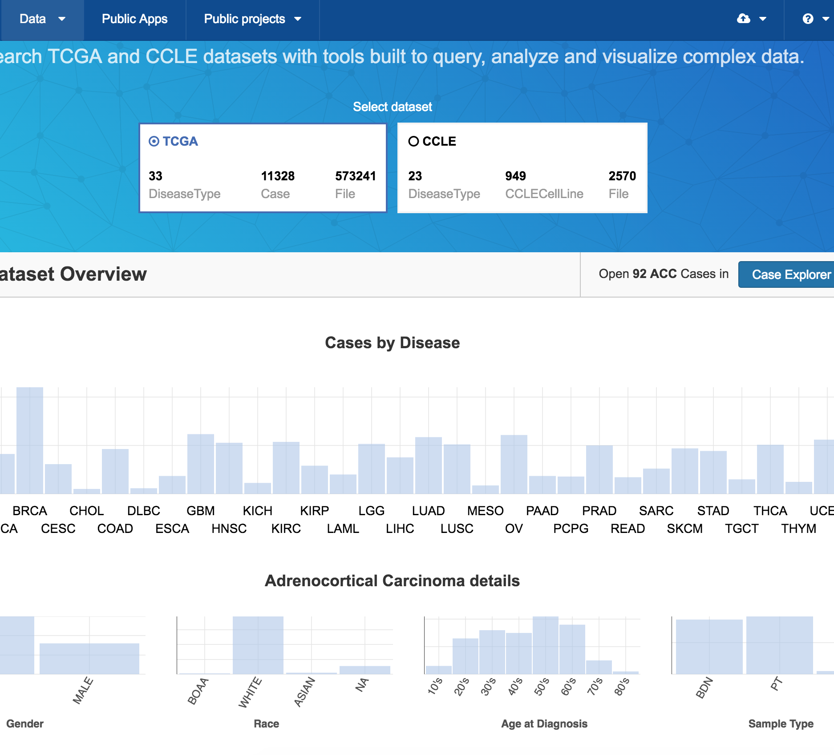
Browse data types

Slide 16
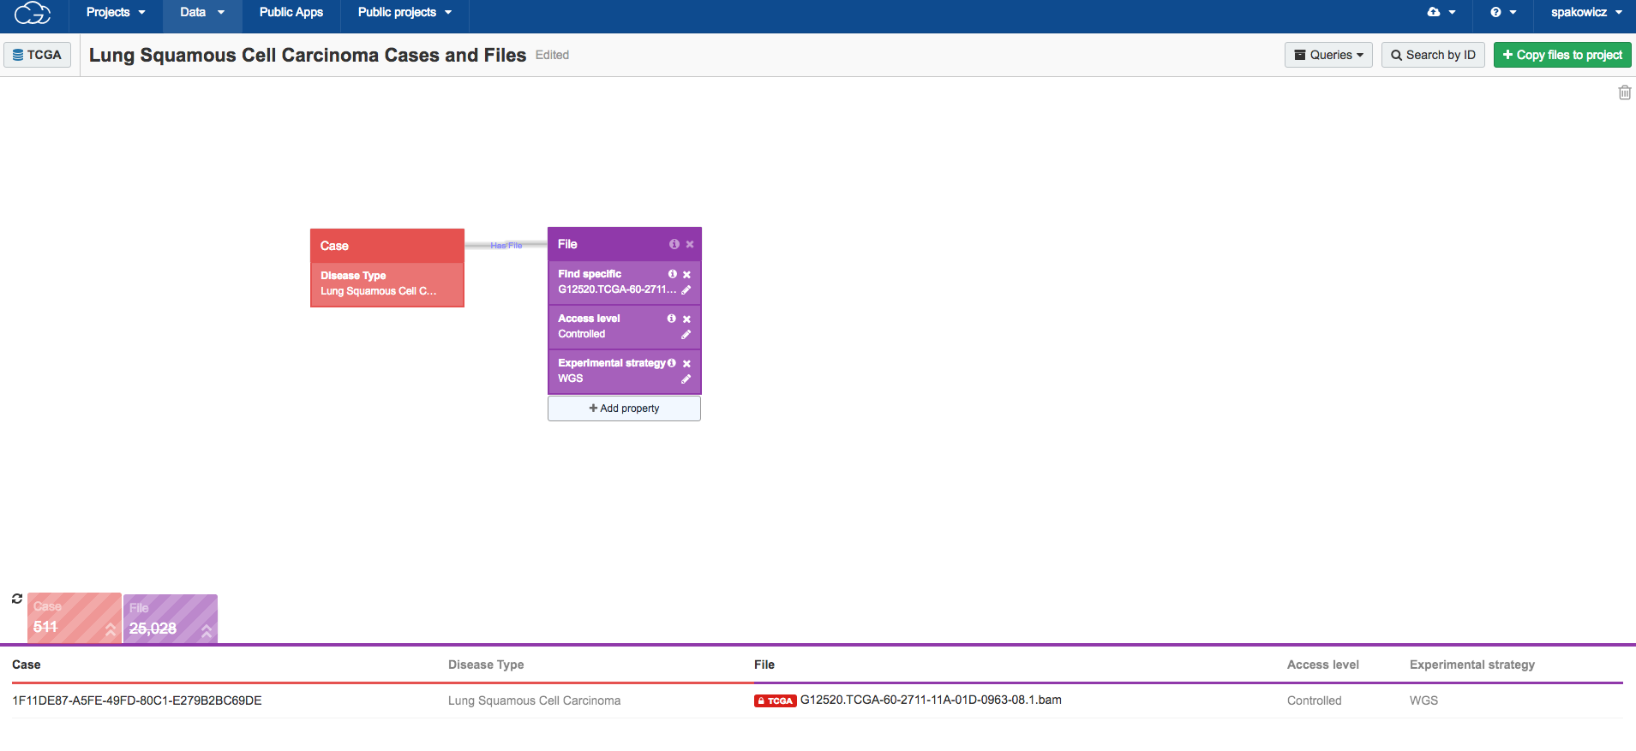
Filter by lots of criteria

Slide 17
downloadable

Slide 18
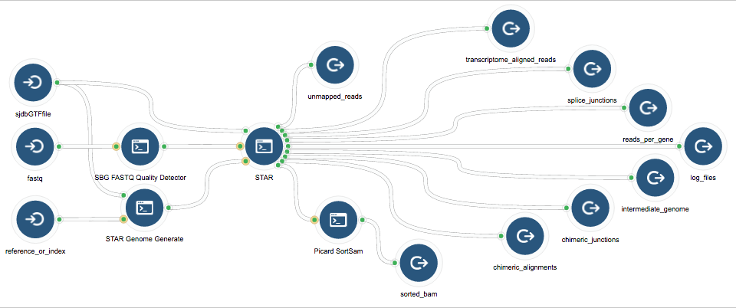
STAR RNAseq workflow
Predefined workflows

Slide 19
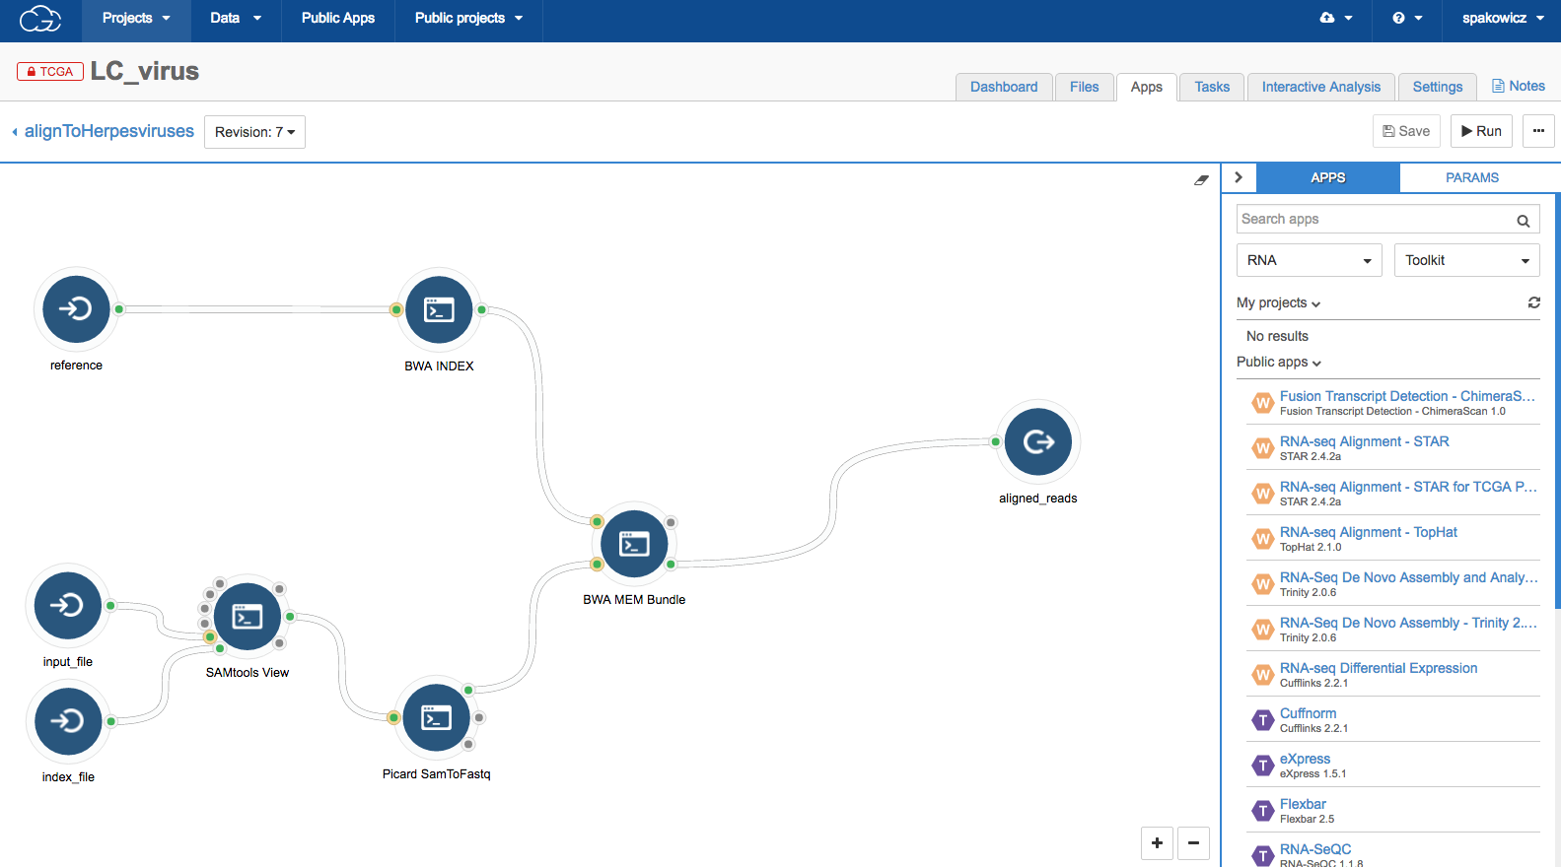
Build your own workflow

Slide 20
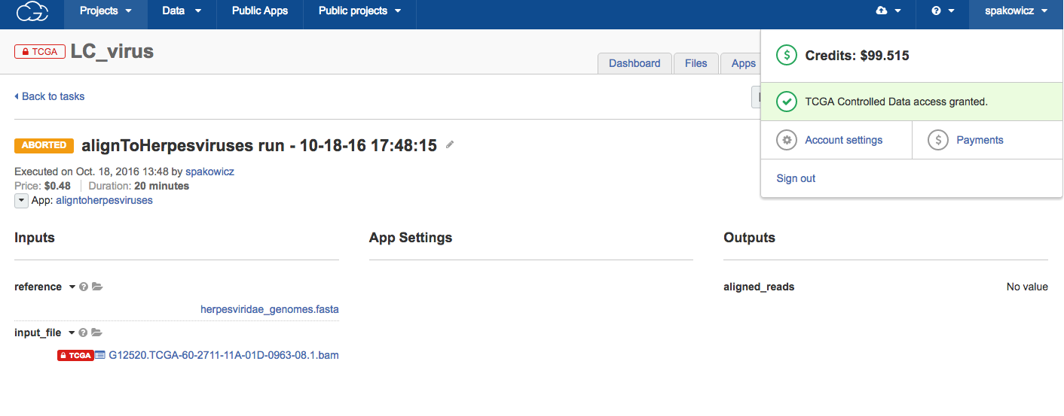
Ran for 20 min, cost $0.50

Slide 21
The end

Slide 22
ExceRpt on mock reads of herpesvirus genomes
input | 59356
successfully_clipped | NA
failed_quality_filter | 3209
failed_homopolymer_filter | 28
calibrator | NA
UniVec_contaminants | 426
rRNA | 0
reads_used_for_alignment | 55693
genome | 24
gencode_sense | 0
gencode_antisense | 0
not_mapped_to_genome_or_libs | 55669
repetitiveElements | 3
endogenous_gapped | 7
input_to_exogenous_miRNA | 55610
exogenous_miRNA | 49
input_to_exogenous_rRNA | 55610
exogenous_rRNA | 0
input_to_exogenous_genomes | 55610
exogenous_genomes | 48896

Slide 23
Extended Data Figure 2: Identification of metagenomic viral contigs via binning and DNA-dependent RNA polymerase alignment.
Notes:
Extended Data Figure 2 | Identification of metagenomic viral contigs via binning and DNA-dependent RNA polymerase alignment. a–c, Three distinct metagenomic examples of tetranucleotide Emergent Self Organizing Maps (ESOM) as a binning method for identification
of candidate viral sequences in metagenome data sets. Tetranucleotide binning of metagenomic samples (full list in Supplementary Table 1) was used to identify highly divergent viral sequences, which were left undetected using viral protein families generated from isolate viruses. Each dot on the maps represents a 10 kb fragment of a metagenomic scaffold longer than 20 kb. ‘Bubbles’ (ESOM structures) correspond to fragments with similar tetranucleotide composition probably originating from the same genome. Red dots represent viral sequences detected by viral protein families generated for isolate viruses; white dots represent highly divergent viral sequences with no hits to viral protein families.
a, ESOM of freshwater sample (combined assembly of freshwater microbial communities from Lake Mendota and Trout Bog Lake, IMG identifier 3300000553) shows 2 putative viral sequences previously unidentified (IMG scaffold identifiers 10001161 and 10001271). b, ESOM of marine sample (marine microbial communities from Delaware Coast, sample from Delaware MO Spring March 2010, IMG identifier 3300000116) shows 2 putative viral sequences sequences (IMG scaffold identifiers c10000689 and c10000429). c, ESOM of hydrothermal vent sample (black smokers hydrothermal plume microbial communities from Abe, Lau Basin, Pacific Ocean, IMG identifier 3300001681) showing 2 viral sequences (IMG scaffold identifiers 10000222 and 10000095). Metagenome samples can be found in IMG using IMG identifiers and
‘Quick Search’ or ‘Genome Search’ tools; metagenome scaffolds can be using scaffold identifier and ‘Scaffold Search’ tool on the respective ‘Microbiome Details’ page. d, e, DNA-dependent RNA polymerase genes of likely viral origin from metagenomic sequences longer than 5 kb. d, Hidden Markov Models (HMMs) were built for sequences corresponding to α, β, and β' subunits of bacterial DNA-dependent RNA polymerase for a representative set of 2,551 cellular organisms (archaea, bacteria, and eukaryotes) and viruses. These models were used to search the proteins encoded by metagenomic contigs longer than 5 kb and the proteins with hits were aligned against the HMMs. A total of 7,437 nearly full-length metagenomic sequences were combined with 2,551 reference sequences to reconstruct the phylogenetic tree using FastTree tool. Two distinct branches on this tree were separated from the sequences from cellular organisms and included RNA polymerase genes from eukaryotic viruses (green box) and putative phage sequences with domain structure similar to that of bacterial RNA polymerase (red box, marked with double asterisk). Only 122 out of the 400 contigs in the eukaryotic viral RNA polymerase branch were captured by isolate protein families. e, Detailed view of the RNA polymerase tree branch with putative phage sequences. Metagenome contigs detected as viral by viral protein families and by spacer hits are marked with a square or circle next to it. Gene structure for selected contigs (IMG chromosomal neighbourhood view) is shown in the boxes. In the examples, genes are coloured based on predicted function category (using Clusters of Orthologous Genes prediction) and are specified in the figure. White-coloured genes correspond to those with hypothetical or unknown function.

Slide 24
Extended Data Figure 2: Identification of metagenomic viral contigs via binning and DNA-dependent RNA polymerase alignment.

