Slide 1
Essential Genes,
Germline LOFs

Slide 2
Essential Gene Lists
Two essential gene lists:
Based on protein truncating variants (PTVs) in ExAC (SHet score).
-- Continuous measure (threshold top 25%).
http://biorxiv.org/content/early/2016/09/16/075523
Based on viability of mouse knockouts (IMPC/MGI lethal/subviable).
-- Binary measure.
http://www.nature.com/nature/journal/vaop/ncurrent/pdf/nature19356.pdf

Slide 3
Comparison Groups
Control Group | Study Group
ExAC, 1KG | PCAWG germline
Randomized mutation set | PCAWG somatic

Slide 4
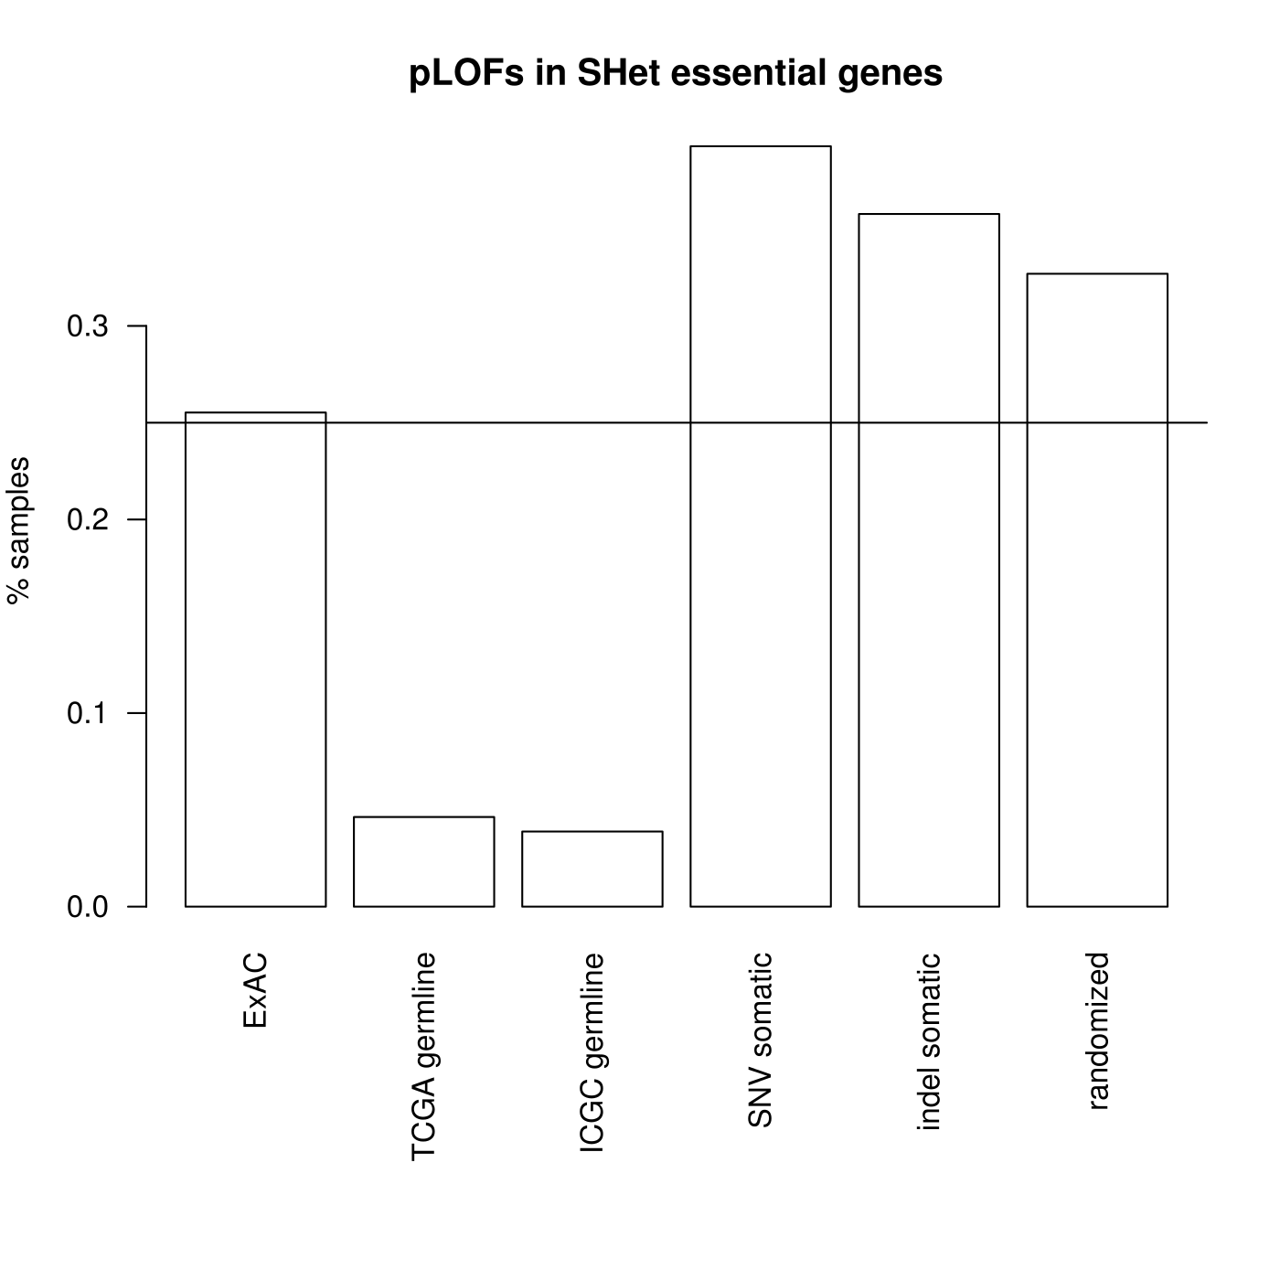
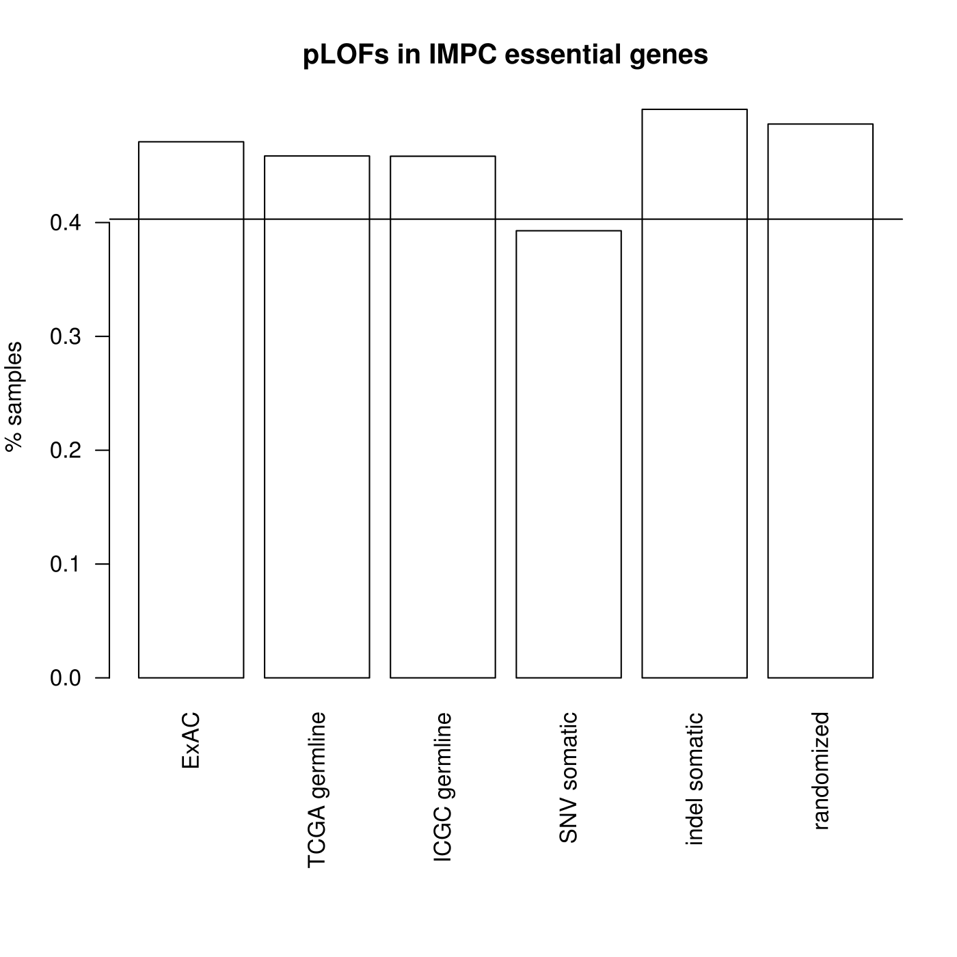
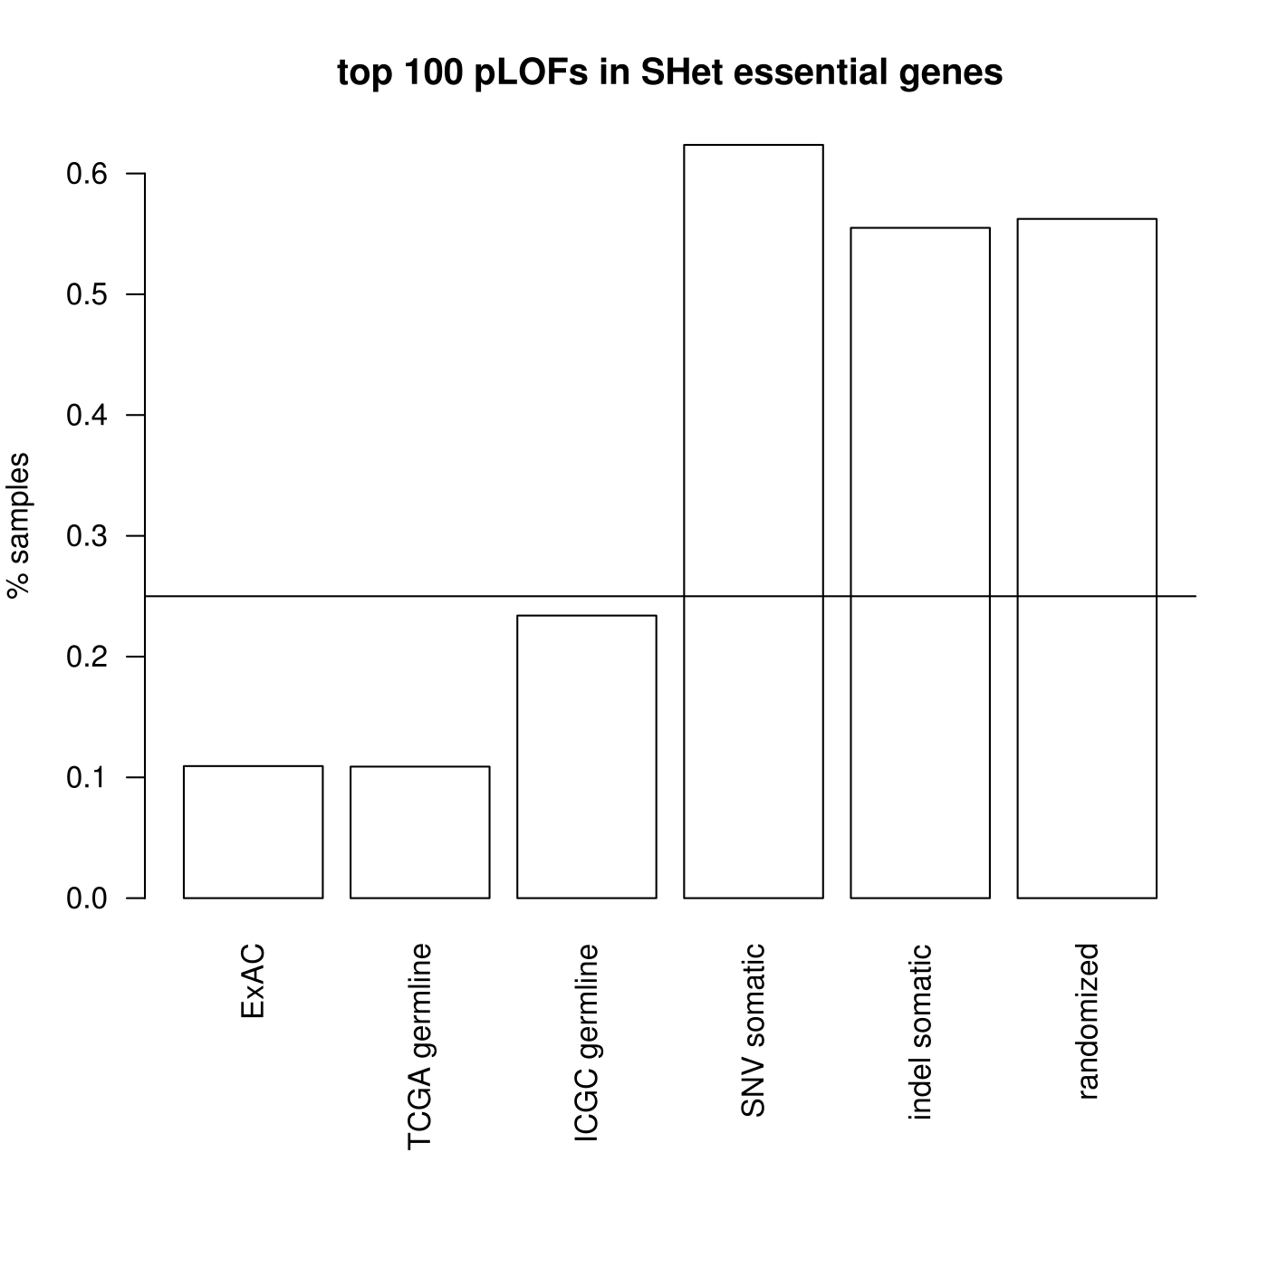
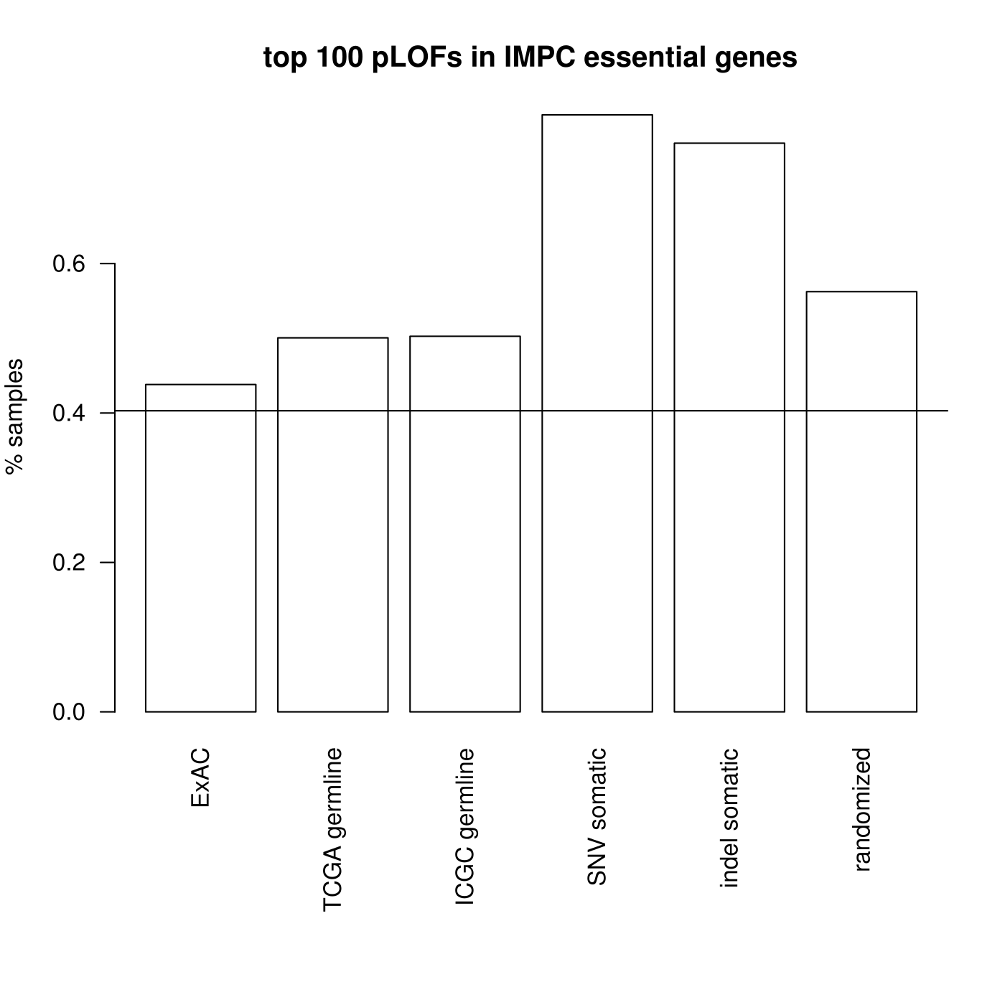
Essential gene skew, (IMPC list)

Slide 5
Essential gene skew, (ExAC PTV list)

Slide 6
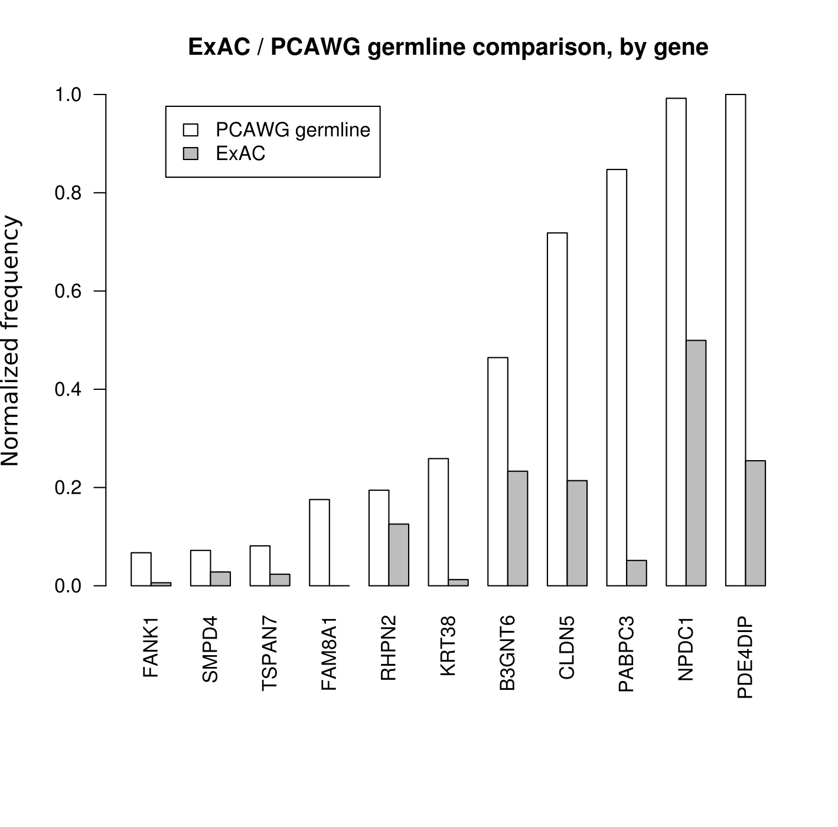
Germline LOFs (PCAWG germline vs. ExAC)

Slide 7
Germline LOF gene functions
PDE4DIP: Anchors cAMP pathway components to centrosome.
NPDC1: Neural proliferation and differentiation control protein.
PABPC3: Poly-A binding protein - mRNA translation and stability.
CLDN5: Vascular tight junctions, cell motility, implicated in cancer metastasis.
B3GNTC: Mucin production, GI tract, mucin alterations common in GI cancers.
KRT38: Keratin. Hair and nails. (? function)

Slide 8
Germline LOF gene functions
RHPN2: Rhophilin. Adhesion/cancer invasiveness.
FAM8A1: Unfolded protein response. Apoptosis.
TSPAN7: Tetraspanin - cell development, activation, growth and motility.
SMPD4: Sphingolipid, activated by TNF. Putative role in apoptosis.
FANK1: Tumor cell apoptosis. Interaction with RYBP1 (tumor supressor).

Slide 9
Candisp2

Slide 10
Candisp2 -- ExAC/1KG as preliminary study
ExAC deleterious germline variants:
*19% higher frequency of deleterious mutations vs. NFE, 35% higher vs. overall AF, 220% higher vs. FIN.
AF (overall) | African American (AFR) | Non-Finnish European (NFE) | Finnish European (FIN)
0.0442 | 0.0597 | 0.0503 | 0.0187
1/23 indiv. | 1/17* indiv | 1/20 indiv | 1/54 indiv.

Slide 11
Candisp2 -- strata of disparity
Variant level disparity (rs149617956 -- MITF):
NFE: 0.0019 (1/510 indiv.) AFR: 0.0006 (1/1510 indiv.)
Gene level disparity (VHL):
NFE: 0.0008 (1/1270 indiv.) AFR: 0.0053 (1/190 indiv.)
Other Populations (separated via PCA) + Gender:
Latino (AMR), East Asian (EAS), South Asian (SAS), Male, Female

Slide 12
Study format: observational
Case-control study: two groups (cases and controls), differing in outcome (cancer/cancer-type), compared according to causal factors (variants).
OR:
Retrospective cohort study: group with exposure (variant), group without exposure (without variant), how many per group develop outcome (cancer/cancer-type).

Slide 13
Cochrane: confounding and adjustment
List confounding/prognostic factors + how we measure them.
Document balance between comparator groups.
Design features: matching or restriction to subgroups (e.g. high BP indivs).
Analysis features: stratification or regression modelling (propensity scores or covariates).
http://handbook.cochrane.org/chapter_13/13_5_2_2_confounding_and_adjustment.htm

