Slide 1
RAMPAGE for ENCODE-Cancer
Michael Rutenberg-Schoenberg

Slide 2
RAMPAGE
Method to determine transcription starts sites
Dual selection for 5’ ends:
Biotin labeling of 5’ RNA cap (m7-guanosine)
Addition of sequencing primer dependent on non-templated C’s added at the end of RT + “template switching”
Paired-end sequencing to improve mapping

Slide 3
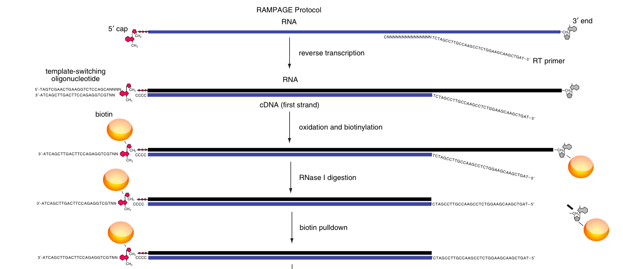

Slide 5
ENCODE RAMPAGE processed files
Signal tracks of inferred TSS (bigWig, 1nt resolution)
IDR peaks (combined from 2 technical, 2 biological replicates)
Not sure of peak calling method
Quantifications on IDR annotation

Slide 6
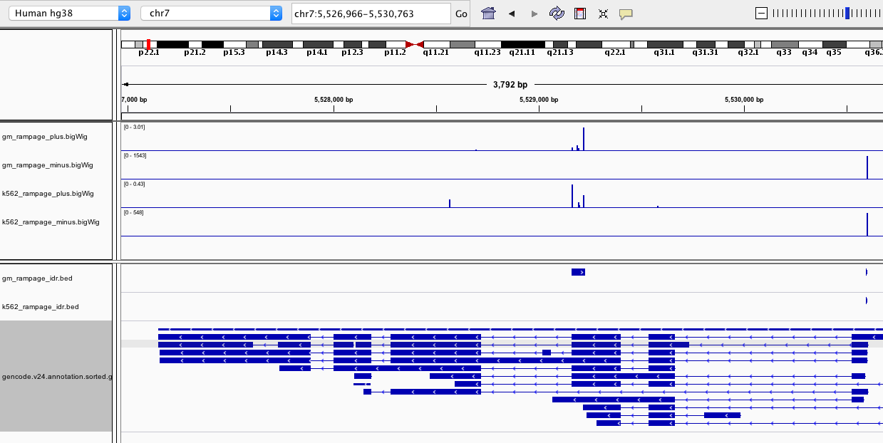
ACTB

Slide 7
Overlap of RAMPAGE peaks
K562
GM12878
3139
5751
3964

Slide 8
What to do with these data?
Better identification of active promoters?
Test these annotations instead of annotated promoters for recurrence analysis?
Prediction of differential TSSs?
Probably somewhat difficult

Slide 9
Other RNA data types
Subcellular RNA fractions
Nuclear
Chromatin
Nucleolus
Probably not high quality, but can do some differential analysis
CAGE
Similar to rampage/for TSS identification
RNA-PET
Tries to identify 5’ and 3’ ends from RNA (probably not as good as CAGE or RAMPAGE for TSS identification)

