Slide 1
Genetic basis of CML and genetic characteristics of K562
10 October 2016

Slide 2
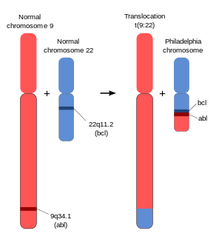
The formation of the BCR-ABL fusion gene initiates CML
Wildtype ABL promotes cell survival and proliferation but depends on growth signals
A chromosomal translocation creates the BCR-ABL fusion gene, which is present in >90% of CML patients
The BCR-ABL fusion gene is constitutively active due to trans-autophosphorylation
promotes cell survival and proliferation in a growth-factor-independent manner
Figure from wiki; knowledge from Nature Reviews Cancer 5, 172-183 (March 2005) | doi:10.1038/nrc1567 Mechanisms of BCR–ABL in the pathogenesis of chronic myelogenous leukaemia

Slide 3
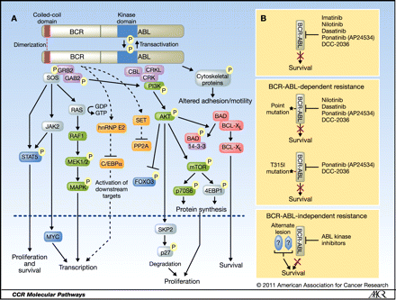
The BCR-ABL pathway
Important survival and proliferation pathways activated by BCR-ABL include RAS, SHP2 and PI3K–AKT, MAPK
Gleevac (Imatinib) is an initially-effective therapy in CML patients that specifically inhibits BCR-ABL
Resistance to imatinib most commonly comes from point mutations in the kinase domain of BCR–ABL
Shows that BCR-ABL is truly the most important CML driver
Second-line, third-line anti-BCR-ABL agents exist
Thanks MRS for the figure!
From Targeting the BCR-ABL Signaling Pathway in Therapy-Resistant Philadelphia Chromosome-Positive Leukemia

Slide 4
Further genetic and epigenetic changes drive progression of CML into blast phase
CML is indolent for 3-4 years, then it becomes more aggressive, presumably due to further genetic and epigenetic changes but these are incompletely characterized
The Cancer Cell Line Encyclopedia identifies 112 SNPs, DNPs, and indels in K562
These include 7 affected genes that are among Vogelstein’s 125 cancer drivers from Cancer Genome landscapes
GENE | Type of Mutation in K562 | Vogelstein classification of role in cancer
CBL | missense | Cell Survival
FGFR3 | 2 nt deletion in 3'UTR | Cell Survival
HNF1A | intronic insertion | Cell Fate
MAP3K1 | in-frame deletion | Cell Survival
NOTCH1 | missense | Cell Fate
PDGFRA | Splice_Site_SNP | Cell Survival
TP53 | Frame_Shift_Ins | Cell Survival
Fun fact: since the CCLE only includes SNPs, DNPs, and indels, their profile for K562 doesn’t include BCR-ABL

