Slide 1
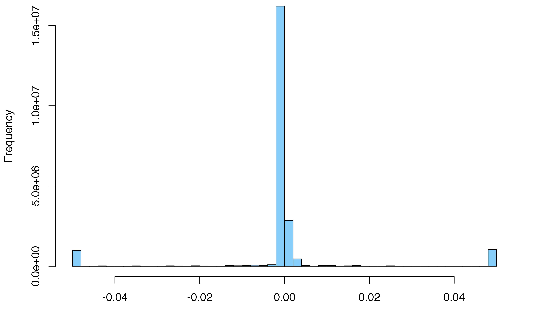
Distribution of all fractional errors*
4.4% of values < -0.05
4.6% of values > 0.05
Fractional_error = [RPKM_{calculated} - RPKM_{true}] / RPKM_{true}
*for single-exon genes

Slide 2
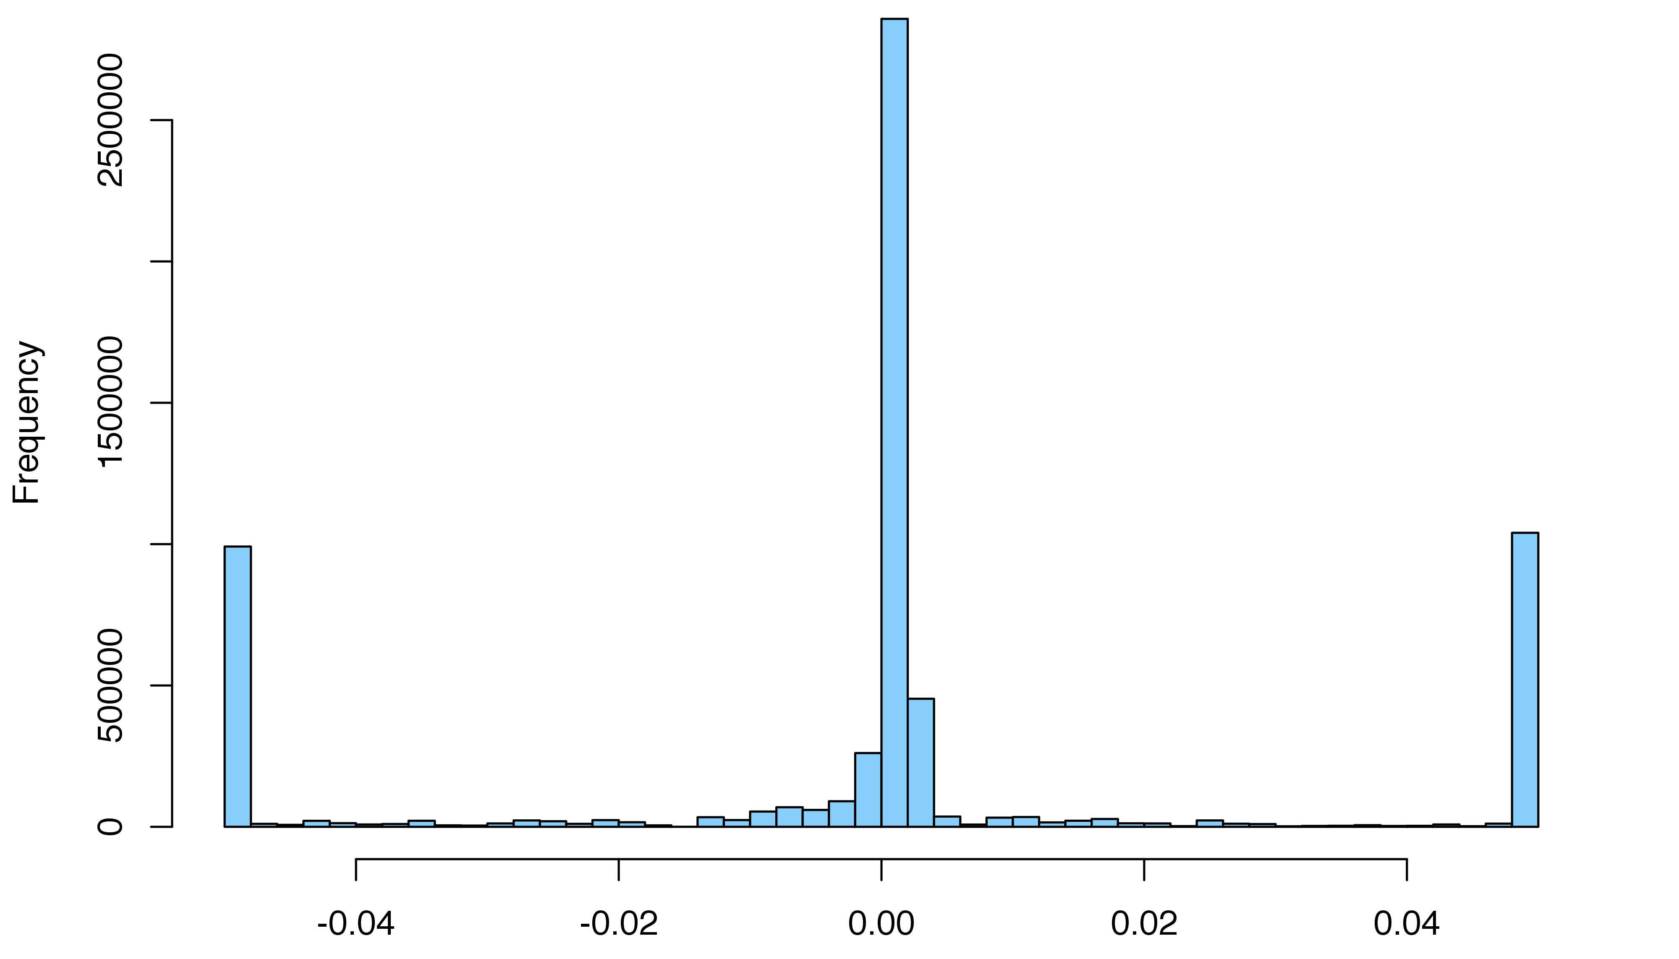
Distribution of all non-zero fractional errors
15.3% of values < -0.05
15.9% of values > 0.05
Fractional_error = [RPKM_{calculated} - RPKM_{true}] / RPKM_{true}

Slide 3
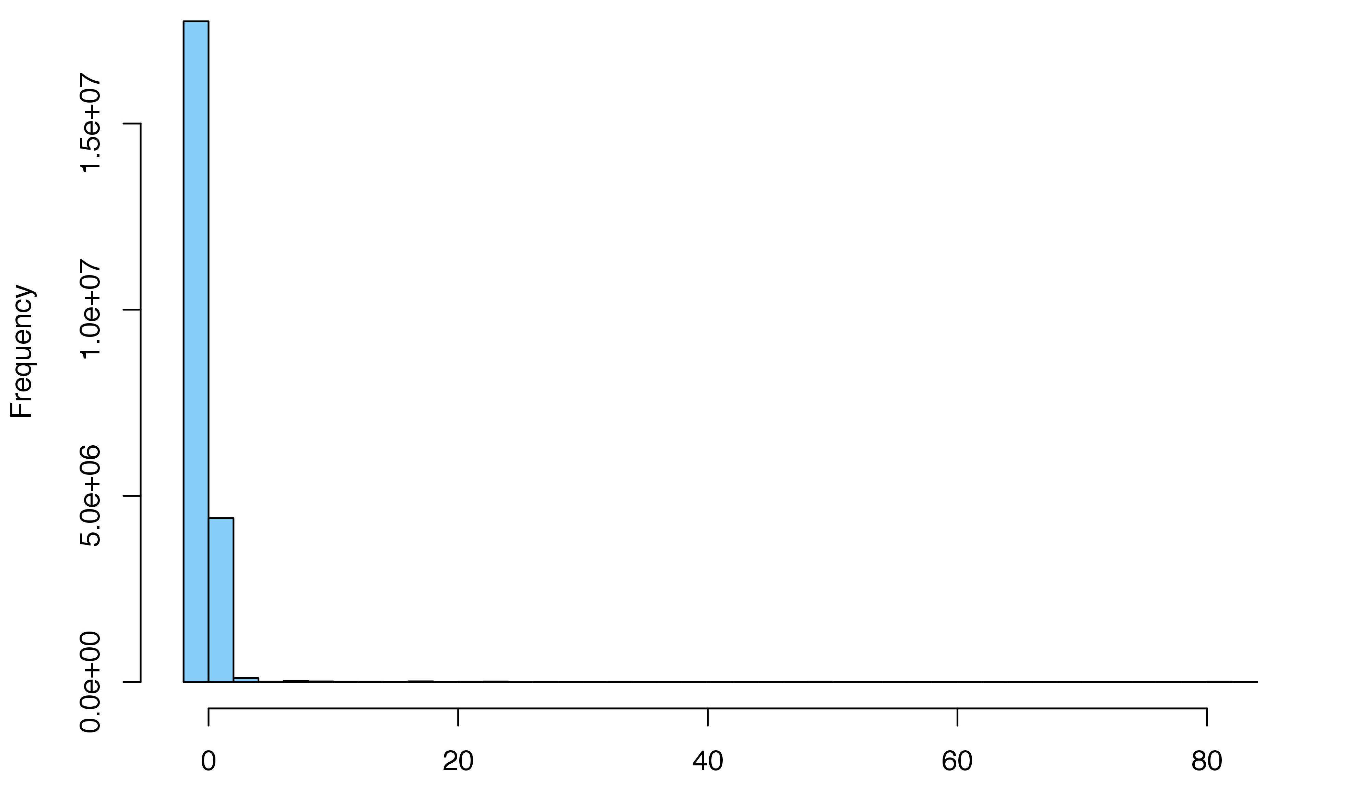
The substantial errors in calculated values are very large over-estimates
Fractional_error = [RPKM_{calculated} - RPKM_{true}] / RPKM_{true}

Slide 4
Specific genes are the culprits (not samples)
genes
samples

Slide 5
Potential causes of outlier error rates
single-exon genes (often associated w/pgenes) → duplications → low mappability scores
low mappability scores? → check using intersect bed w/encode in UCSC Genome Browser. Genome browser has a track for mappability → first download and check w/intersect bed?
exon lengths from same genome build? In any case GTEx is reporting in GENE read counts
With BAM file as input, GTEx uses RNA-SeQC: “Expression levels were produced at the gene and exon level in RPKM units using RNA-SeQC”
→ Black box & confounding factors (GC bias, mapability, uniqueness, etc)
Misc Notes
Strange that processed read counts data are not available at the GTEx Portal
BAM files not available to re-compute RPKM from RNA-SeqC
GTEx: tophat/bowtie, though will be STAR 2.4.2a in v7 (CommonMind= STAR)
PsychENCODE currently processing all to be uniform?

