Slide 1
Leveraging the Wisdom of Crowds to Predict the Impact of Genetic Variants
Jaroslav Bendl

Slide 2
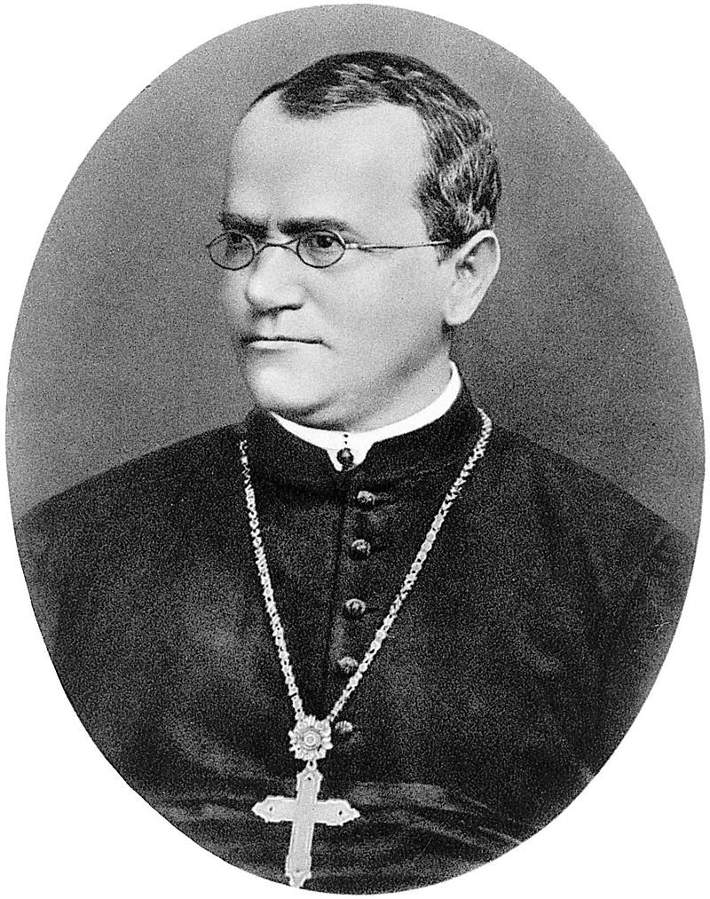
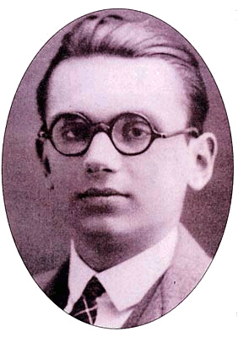
Background
Gregor Mendel
Kurt Gödel
Brno
http://loschmidt.chemi.muni.cz
2

Slide 3
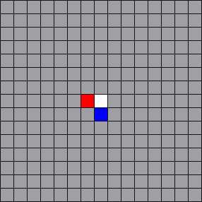
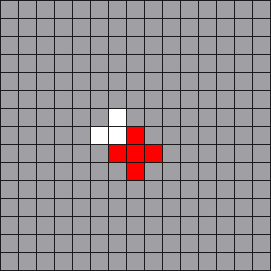
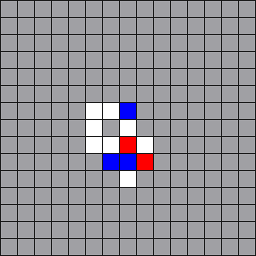
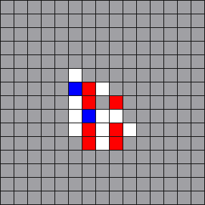
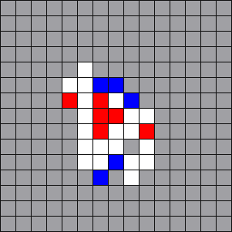
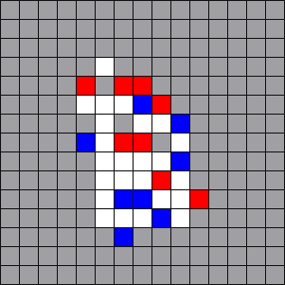
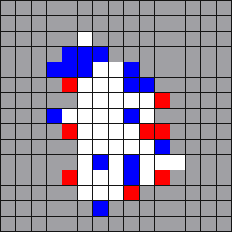
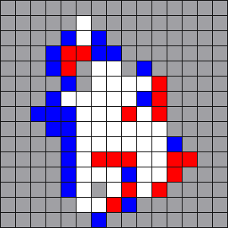
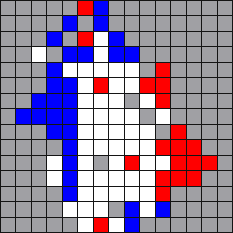
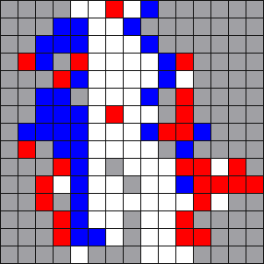
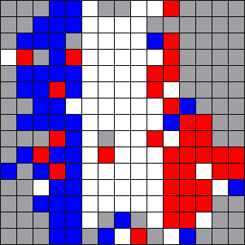
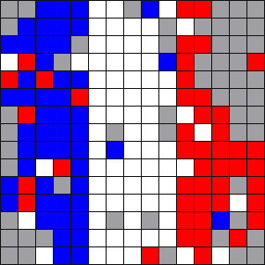
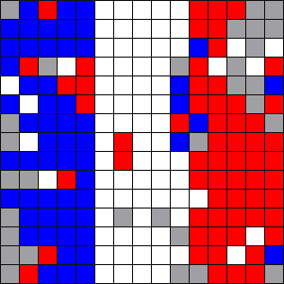
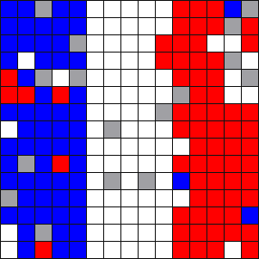
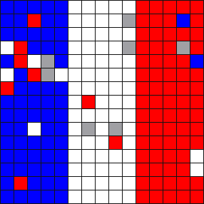
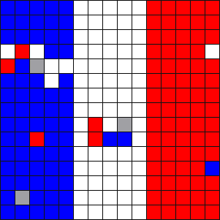
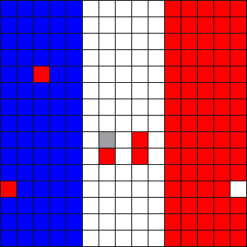
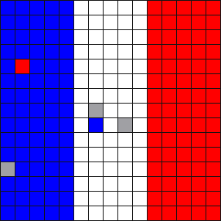
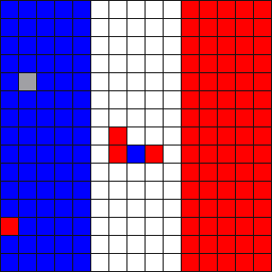
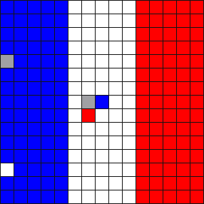
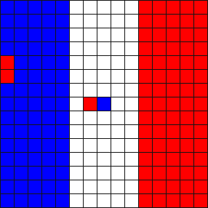
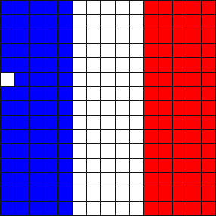
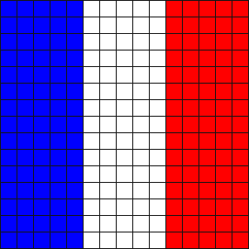
Background
Brno University of Technology · Faculty of Information Technology
2006-2009 Bachelor’s degree studies
Thesis: Cellular automaton in dynamic environment
2009-2011 Master’s degree study
Thesis: Instruction-based cellular automata
2011-2016 Doctoral’s degree study
Thesis: Prediction of the effect of amino acid substitutions
Scheduled date of defense October 10
3

Slide 4
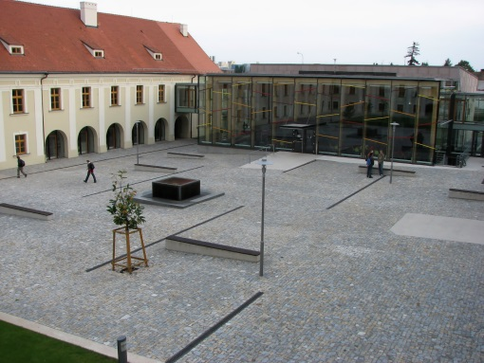
Background
Loschmidt Laboratories · Masaryk University
Research: protein engineering, metabolic engineering, bioinformatics
International Center for Clinical Research · St Anne’s Hospital
Research: cardiology, neurology, biomolecular and cellular engineering
4

Slide 5
Concept of wisdom of crowds
Average of 800 guesses = 1,187 pounds Actual weight of the cow = 1,190 pounds
Weight?
James Surowiecki: The Wisdom of Crowds
5

Slide 6
Criteria of wise crowds
Diversity
Decentralization
Independence
Aggregation
James Surowiecki: The Wisdom of Crowds
6

Slide 7
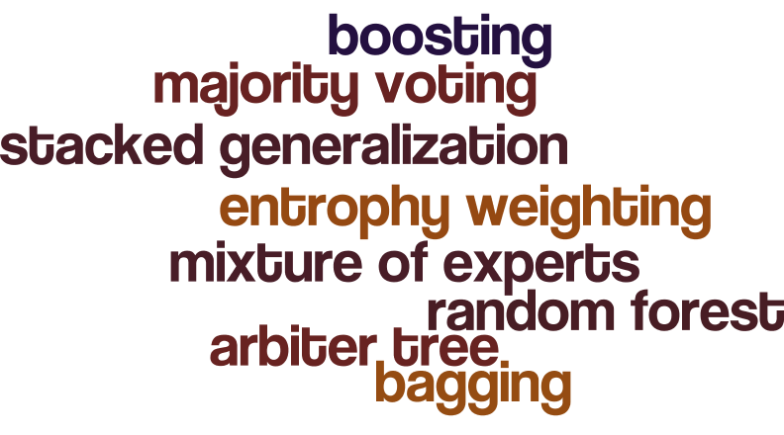
Ensemble-based methods
James Surowiecki: The Wisdom of Crowds
7

Slide 8
Monogenní choroby
Version 1
Version 2
http://loschmidt.chemi.muni.cz/predictsnp
8

Slide 9
PredictSNP idea
Prioritization of disease-related mutations
http://loschmidt.chemi.muni.cz/predictsnp
9

Slide 10
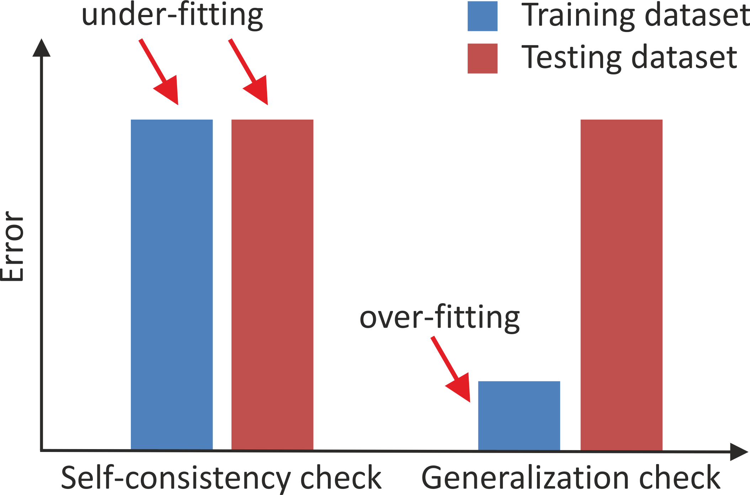
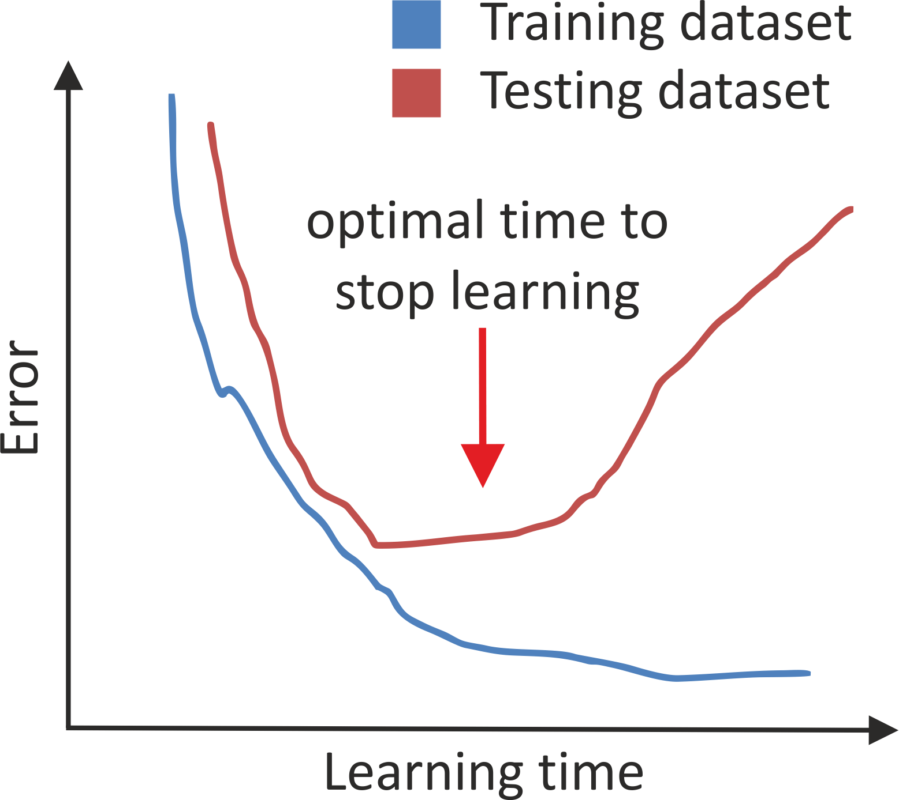
Typical pitfalls of classifiers
Under-fitting & Over-fitting
Over-learning
10

Slide 11
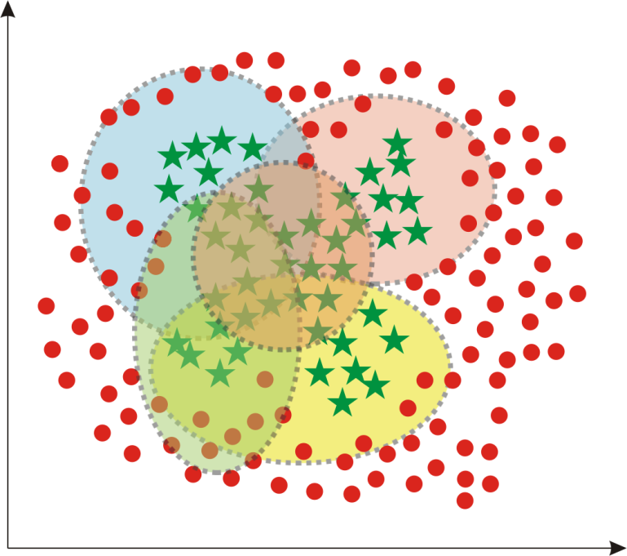
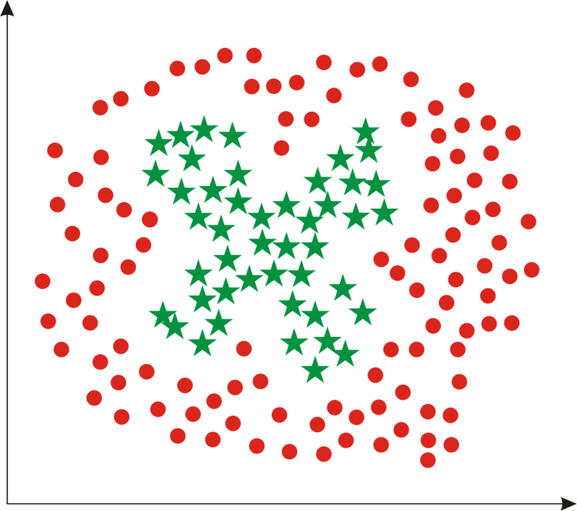
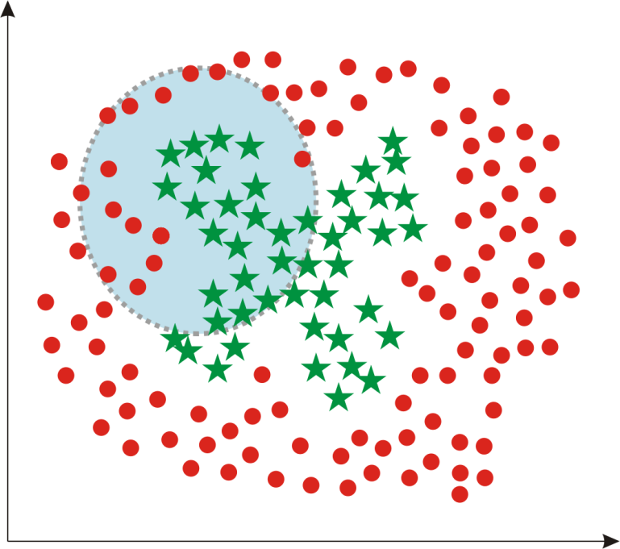
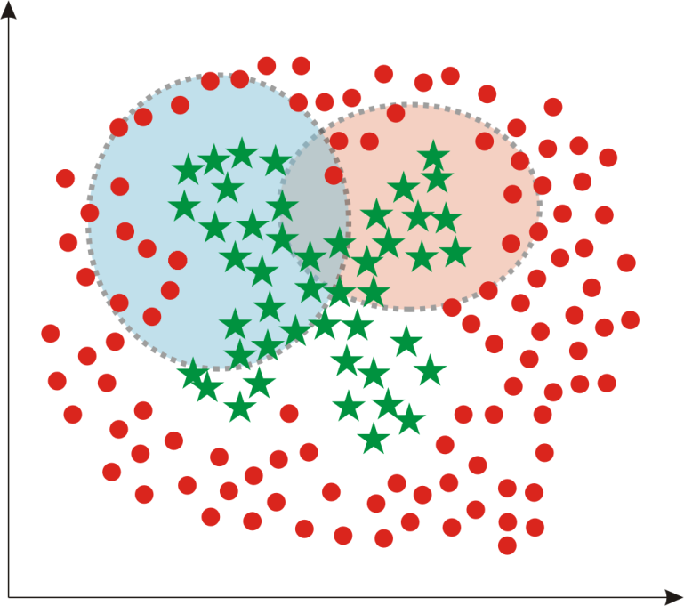
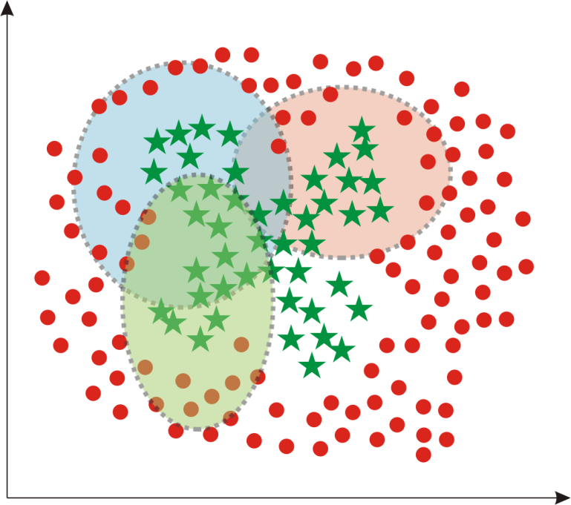
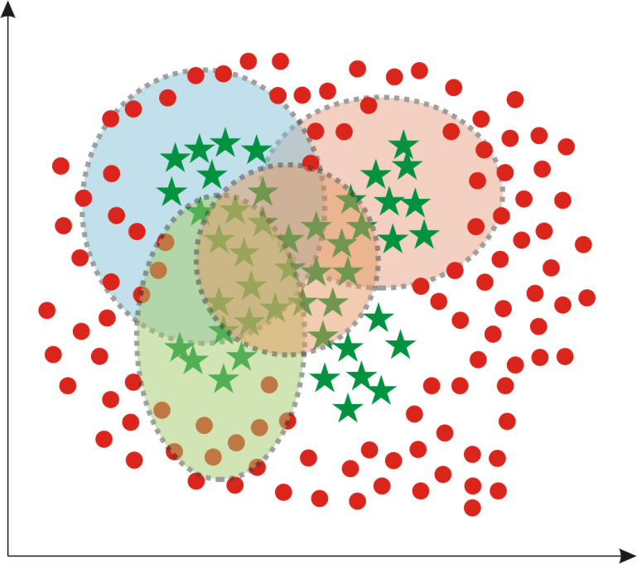
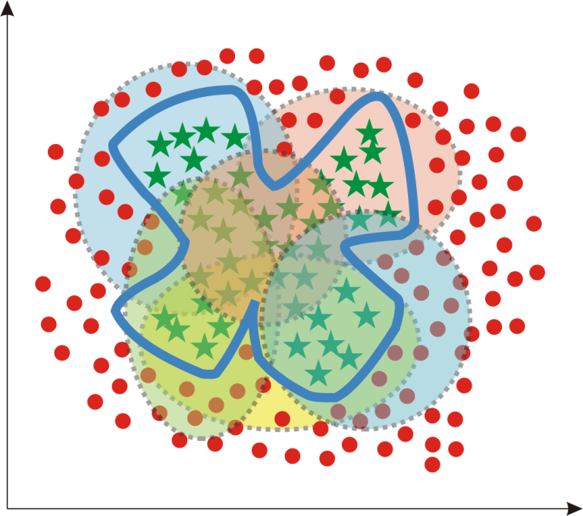
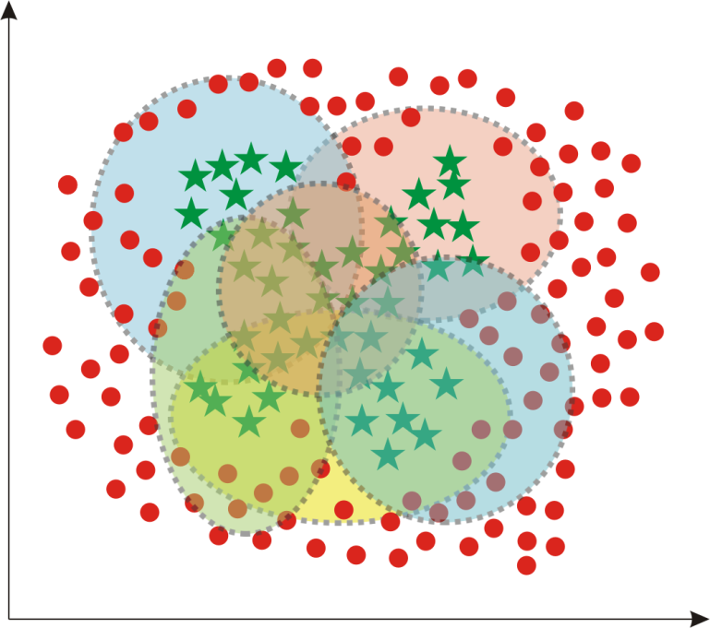
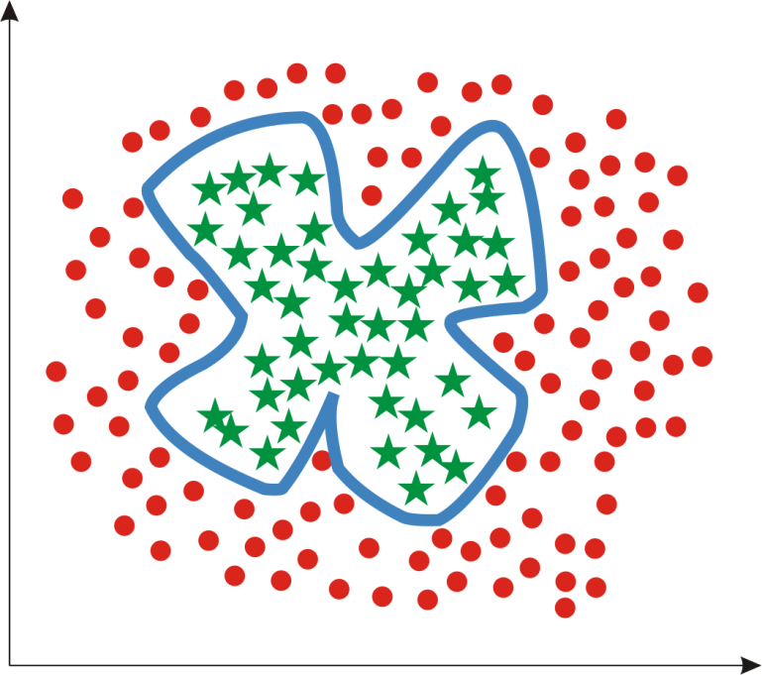
Advantage of ensemble-based systems
Complex decision boundary
Decision boundaries of constituent predictors
11

Slide 12
PredictSNP1
1
PSNP1 (PredictSNP, version 1)
Consensus classifier for prediction of the effect of amino acid substitutions
http://loschmidt.chemi.muni.cz/predictsnp

Slide 13
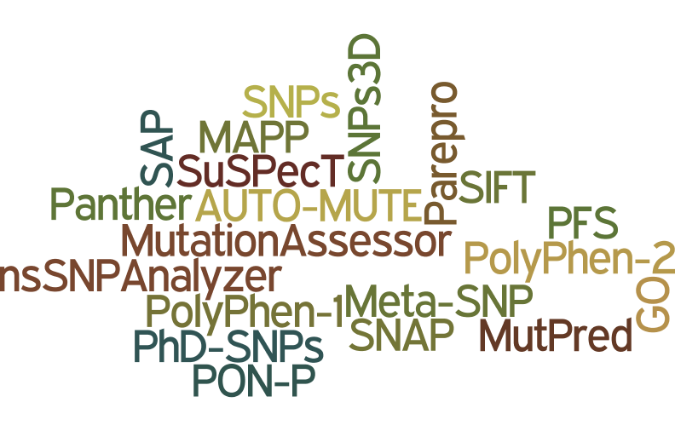
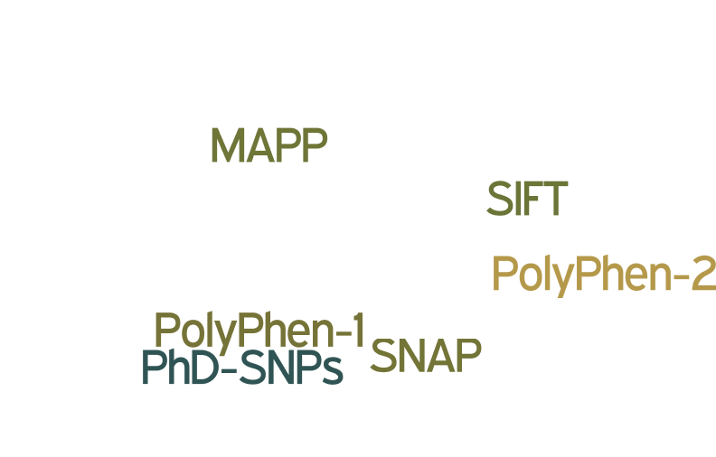
PSNP1: Selection of tools
Possibility to submit user-defined sequences
Availability of standalone version
Protein structure is not required input
6/20
13

Slide 14
PSNP1: Correlation matrix
 | MAPP | PhD-SNP | PolyPhen1 | PolyPhen2 | SIFT | SNAP
MAPP
PhD-SNP | 0.54
PolyPhen1 | 0.48 | 0.48
PolyPhen2 | 0.51 | 0.49 | 0.55
SIFT | 0.59 | 0.55 | 0.56 | 0.62
SNAP | 0.47 | 0.47 | 0.54 | 0.49 | 0.53
14
SPEARMAN CORRELATION

Slide 15
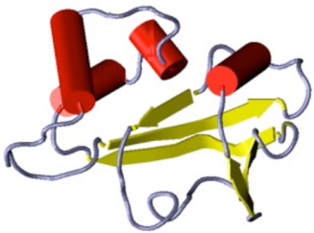
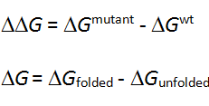
PSNP1: Principle of tools
Input
Features
Deleteriousness?
Conservation
Protein sequence
>HBA_HUMAN
MVLSPADKTNVKAAWGKVGAHAEYGAEALERMFLSFPTTKTYFPHFDLSHGSAQVKGHGKKVADALTNAVAHVDDMPNALSALSDLHAHKLRVDPVNFKLLSHCLLVTLAAHLPAETPAVHASLDKFLSVSTVLTSKYRFDLSHGSAQVKGHGKKVADALTNAVAHVDDMPNALSALSDLHAH
Secondary structure
Deleterious / neutral
+ confidence
Model
mutace
Protein mutation
Gibbs free energy
A
V
15

Slide 16
PSNP1: Compilation of datasets
MutPred dataset
HumSavar dataset
PON-P dataset
SNPs&GO dataset
Merging of datasets
242,293 mutations
HumVar dataset
Remove mutations with conflicting annotations
6,118 mutations removed
Remove duplicated mutations
136,157 mutations removed
16

Slide 17
PSNP1: Compilation of datasets
Remove overlaps
56,136 mutations removed
Training sets of integrated tools
132,030 mutations
PhD-SNP dataset
PolyPhen1
dataset
PolyPhen2
dataset
Benchmark dataset
43,882 mutations
SNAP dataset
17

Slide 18
PSNP1: Compilation of datasets
Benchmark dataset
43,882 mutations in 10,085 sequences
Training sets of integrated tools
132,030 mutations
PhD-SNP dataset
PMD dataset
3,497 mutations
in 1,189 sequences
PolyPhen1
dataset
PolyPhen2dataset
MMP dataset
11,994 mutations
in 13 sequences
SNAP dataset
18

Slide 19
PSNP1: Core of meta-predictor
 | Benchmark dataset | PMD dataset | MMP dataset
 | [normalized accuracy]
Naive Bayes | 0.74 | 0.65 | 0.68
Logistic regression | 0.76 | 0.65 | 0.67
Neural network | 0.76 | 0.65 | 0.69
Support vector machine | 0.76 | 0.66 | 0.68
Nearest neighbour | 0.68 | 0.59 | 0.60
Random forest | 0.71 | 0.64 | 0.66
Evolution strategy | 0.77 | 0.65 | 0.66
2-layer weighted consensus | 0.75 | 0.66 | 0.71
→
19

Slide 20
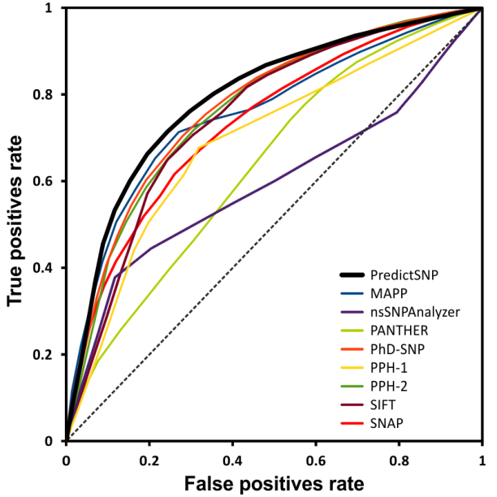
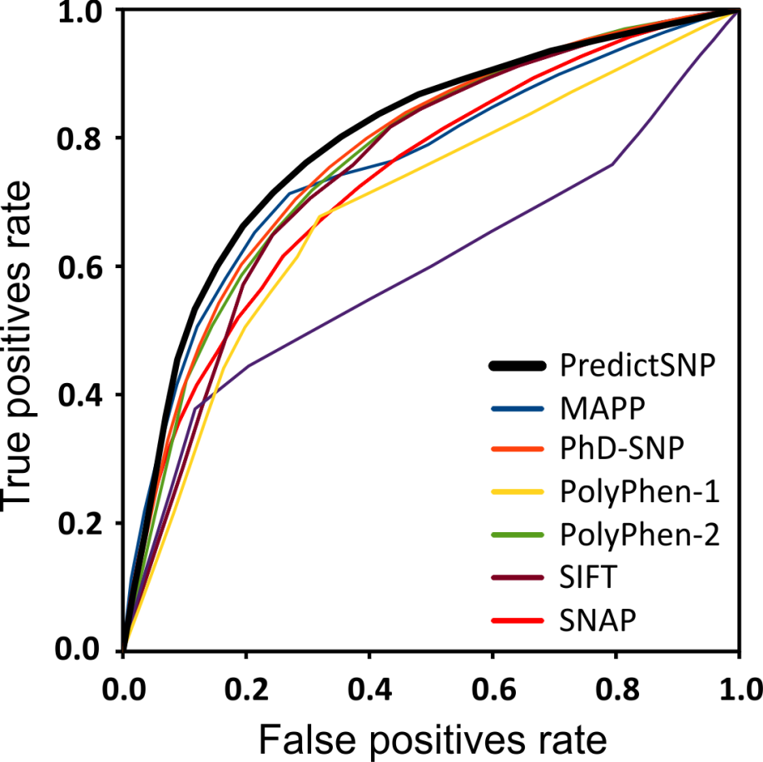
PSNP1: Performance evaluation
 | AUC
MAPP | 0.766
PhD-SNP | 0.778
PPH-1 | 0.698
PPH-2 | 0.771
SIFT | 0.763
SNAP | 0.735
PredictSNP | 0.797
←
20

Slide 21
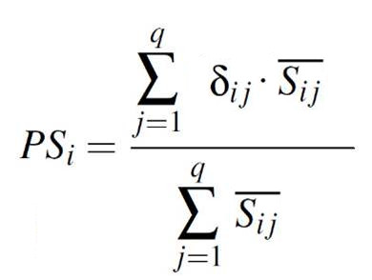
PSNP1: Consensual function
Tool’s decision, {-1,1}
-1 … predicted to be „neutral“
1 … predicted to be „deleterious“
Tool’s weigh, ‹0,1›
0 … tool’s decisions were incorrect for all similar mutations during testing → 0% success rate
1 … tool’s decisions were correct for all similar mutations during testing → 100% success rate
Overall score, ‹-1,1›
-1 … all tools predict that mutation is neutral
0 … tools provide contradictory predictions (equally) +1 … all tools predict that mutation is deleterious
21

Slide 22
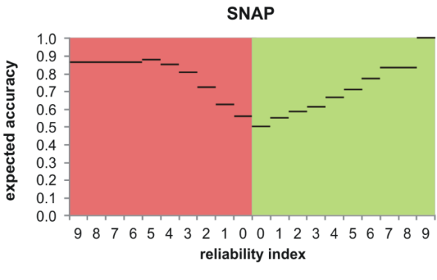
PSNP1: Calculation of tool’s confidence
Example of conversion: score -> weight (SNAP)
Prediction: deleterious
Weight: 0.88
Accuracy
Reliability index
22

Slide 23
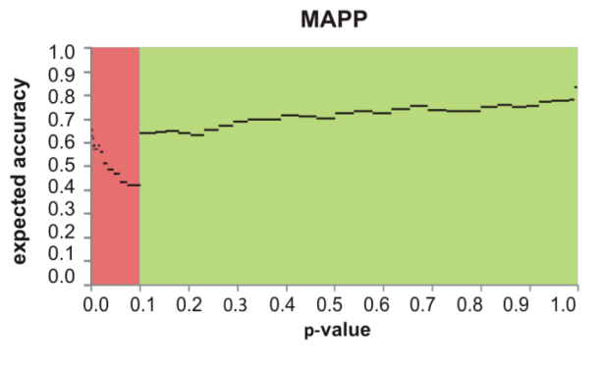
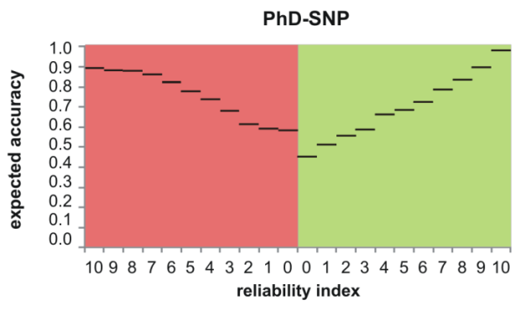
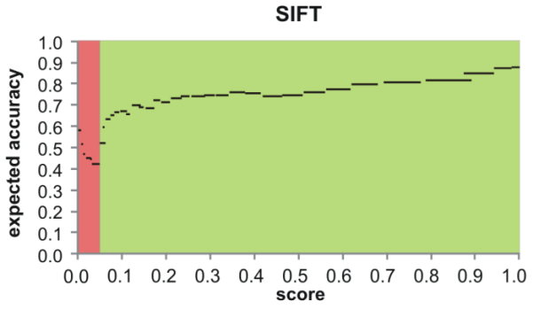
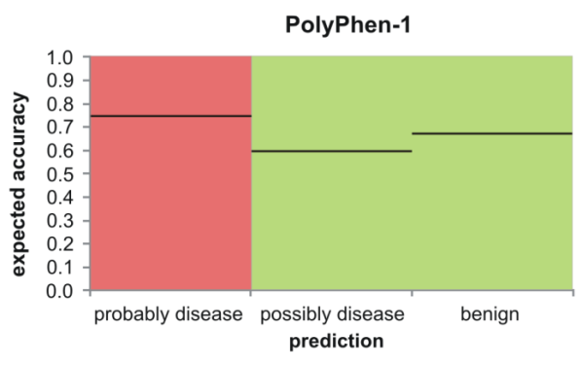
PSNP1: Calculation of tool’s confidence
23

Slide 24
PSNP1: Overfitting issue
Difference: 11.5%
24

Slide 25
PSNP1: Input interface
http://loschmidt.chemi.muni.cz/predictsnp
25

Slide 26
PSNP1: Output interface
http://loschmidt.chemi.muni.cz/predictsnp
26

Slide 27
PSNP1: Summary
Bendl Jaroslav, Stourac Jan, Salanda Ondrej, Pavelka Antonin, Wieben Eric, Zendulka Jan, Brezovsky Jan, Damborsky Jiri (2014) PredictSNP: robust and accurate consensus classifier for prediction of disease-related mutations. PLoS Comput Biol 10: e1003440.
Unique users | > 1,000
Unique protein sequences | > 10,000
Unique mutations | > 100,000
27

Slide 28
PSNP1: Summary
Bendl J, Stourac J, Salanda O, Pavelka A, Wieben ED, Zendulka J, Brezovsky J, Damborsky J (2014) PredictSNP: robust and accurate consensus classifier for prediction of disease-related mutations. PLoS Comput Biol 10: e1003440.
Bendl Jaroslav
Stourac Honza
Salanda Ondrej
Pavelka Antonin
Wieben Eric
Zendulka Jaroslav
Brezovsky Jan
Damborsky Jiri
28

Slide 29
PredictSNP1
2
PSNP2 (PredictSNP, version 2)
Consensus classifier for prediction of the effect of nucleotide substitutions
http://loschmidt.chemi.muni.cz/predictsnp
29

Slide 30
PSNP2: Motivation
Genes / mutations underlying about 50% of all Mendelian phenotypes are still unknown.
Should we focus on non-coding regions?
Genome region | Diseases
MIR | Autosomal dominant deafness
Long ncRNA | Polydactyly, type E
Short ncRNA | Microcephalic osteodysplastic primordial dwarfism
Enhancer CNC | Holoprocencephaly
30
Makrythanasis, P. & Antonarakis, S.E. Clin. Genet. 84, 422–428 (2013)

Slide 31
PSNP2: Selection of tools
Availability of precalculated results or standalone version
Higher level of complexity
6/15
31

Slide 32
PSNP2: Principles of integrated tools
 | Principle of prediction | Training dataset
CADD | Logistic regression | Artificial
DANN | Neural networks | Artificial
FATHMM | SVM | HGMD, 1KG (MAF≥1%)
GWAVA | Random forest | HGMD, 1KG (MAF≥1%)
FunSeq2 | Expert system / conservation + functional annotations
FitCons | Expert system / conservation + functional annotations
32

Slide 33
PSNP2: Categories of mutations
Mutations are divided into five categories
33

Slide 34
PSNP2: Training & testing dataset
ClinVar database 158,850 mutations
VariSNP database 5,784,332 mutations
ClinVar database
158,850
Remove benign / likely bening mutations
Remove mutations present in ClinVar, COSMIC or NHGRI GWAS
Deleterious mutatations 33,356 mutations
Neutral mutations 5,591,761 mutations
Remove mutations with missing predictions
Final dataset

Slide 35
PSNP2: Training & testing dataset
Sources of mutations: deleterious - ClinVar, neutral: VariSNP
Split on training & testing set: training set does not contain mutations employed for training of integrated tools
 | Category |  | Size Training set | Size Testing set
1 | Non-exonic | Regulatory | 1,056 | 358
2 | Non-exonic | Splicing | 1,998 | 1,582
3 | Exonic | Nonsynonymous | 14,028 | 2,692
4 | Exonic | Synonymous | 818 | 816
5 | Exonic | Nonsense | 1,068 | 1,068
35

Slide 36
PSNP2: Optimal thresholds
Integrated tools do not provide binary predictions (neutral / deleterious)
→ users have a problem with interpretation of results
Distribution of numeric results is different for individual categories
→ usage of universal threshold is not a good idea
Category
Type
Category | Accuracy
 | universal threshold | optimal threshold
1 | 0.52 | 0.76
2 | 0.68 | 0.69
3 | 0.73 | 0.73
4 | 0.83 | 0.95
5 | 0.64 | 0.65
regulatory
deleterious
Score
splicing
neutral
nonsynonymous
Threshold
synonymous
general
nonsense
optimal
Category
36

Slide 37
PSNP2: Optimal thresholds
Category
regulatory
Score
splicing
nonsynonymous
synonymous
nonsense
Type
deleterious
Score
neutral
Threshold
optimal
general
IMPROVEMENT OF OPTIMAL THRESHOLD OVER GENERAL THRESHOLD
5%
37

Slide 38
PSNP2: Consensus predictions
INPUT
CATEGORY: REGULATORY
MODEL
OUTPUT
FATHMM | ✓
CADD | ✓
DANN | ✓
GWAVA | ✗
FUNSEQ2 | ✗
Chromosome
Position
Type
Deleterious?
Confidence? ‹0, 1›
chr1: 12051 A / T
chr1: 35411 C / G
CATEGORY: SPLICING
MODEL
OUTPUT
FATHMM | ✓
CADD | ✓
DANN | ✓
GWAVA | ✓
FUNSEQ2 | ✓
Deleterious?
Confidence? ‹0, 1›
ANNOVAR
Get genomic region
38

Slide 39
PSNP2: Performance evaluation
Significant difference in prediction accuracy between tools (stdev = 0.1)
AVERAGE IMPROVEMENT
13%
Prediction accuracy measured on the testing dataset
Dataset | CADD | DANN | FATHMM | FitCons | FunSeq2 | GWAVA | RANGE | PSNP2
1. | 0.82 | 0.76 | 0.82 | 0.52 | 0.66 | 0.70 | 0.52 – 0.82 | 0.86
2. | 0.64 | 0.69 | 0.69 | 0.55 | 0.69 | 0.63 | 0.57 – 0.69 | 0.75
3. | 0.68 | 0.73 | 0.74 | 0.50 | 0.64 | 0.61 | 0.50 – 0.74 | 0.76
4. | 0.83 | 0.95 | 0.81 | 0.50 | 0.96 | 0.59 | 0.50 – 0.96 | 0.96
5. | 0.62 | 0.65 | 0.71 | 0.62 | 0.67 | 0.63 | 0.62 – 0.71 | 0.72
Sum | 0.69 | 0.73 | 0.74 | 0.53 | 0.70 | 0.58 | 0.53 – 0.74 | 0.79
39

Slide 40
PSNP2: Performance evaluation
AUC: SUMMARY
CADD | 0.73
GWAVA | 0.61
FATHMM | 0.76
FitCons | 0.51
FunSeq2 | 0.67
DANN | 0.74
PredictSNP2 | 0.83
True positives rate
AUC: AVERAGE IMPROVEMENT
0.16
False positives rate

Slide 41
PSNP2: Comparison of predictors
Nucleotide-based predictors
Amino-acid-based predictors
Accuracy
Accuracy
Integrated tools | 0.51 - 0.74
PredictSNP2 | 0.76
Integrated tools | 0.66 - 0.76
PredictSNP1 | 0.76
41

Slide 42
PSNP2: Input
Supported versions of genome: reference chromosome 35-38 (including subversions)
Supported types of input: web form, file
Supported formats: VCF, GVF, HGVS, <PredictSNP>
Throughput: 2 users / 50 mutations per second
http://loschmidt.chemi.muni.cz/predictsnp2
42

Slide 43
PSNP2: Output
http://loschmidt.chemi.muni.cz/predictsnp2
43

Slide 44
PSNP2: Summary
Bendl J, Musil M, Stourac J, Zendulka J, Damborsky J, Brezovsky J (2016) PredictSNP2: A Unified Platform for Accurately Evaluating SNP Effects by Exploiting the Different Characteristics of Variants in Distinct Genomic Regions. PLoS Comput Biol, 12: e1004962.
Unique users | > 250
Submissions | > 800
http://loschmidt.chemi.muni.cz/predictsnp2
44

Slide 45
PSNP2: Summary
Bendl J, Musil M, Stourac J, Zendulka J, Damborsky J, Brezovsky J (2016) PredictSNP2: A Unified Platform for Accurately Evaluating SNP Effects by Exploiting the Different Characteristics of Variants in Distinct Genomic Regions. PLoS Comput Biol, 12: e1004962.
Bendl Jaroslav
Musil Milos
Stourac Honza
Zendulka Jaroslav
Damborsky Jiri
Brezovsky Jan
http://loschmidt.chemi.muni.cz/predictsnp2
45

Slide 46
PredictSNP1
Automated Design of Site-Specific Mutations and Smart Libraries in Protein Engineering
http://loschmidt.chemi.muni.cz/predictsnp
46

Slide 47
HSW: Input
http://loschmidt.chemi.muni.cz/hotspotwizard
47

Slide 48
HSW: Types of analysis
Functional hot spots
Stability hot spots (flexibility)
Stability hot spots (evolution)
Correlated hot spots
http://loschmidt.chemi.muni.cz/hotspotwizard
48

Slide 49
HSW: Functional hot spots
Criteria #1: evolutionary-variable positions
http://loschmidt.chemi.muni.cz/hotspotwizard
49

Slide 50
HSW: Functional hot spots
Criteria #1: evolutionary-variable positions
http://loschmidt.chemi.muni.cz/hotspotwizard
50

Slide 51
HSW: Functional hot spots
Criteria #2: surrounding the access tunnel or located inside the catalytic cavity
catalytic cavity
ligand
tunnel
http://loschmidt.chemi.muni.cz/hotspotwizard
51

Slide 52
HSW: Functional hot spots
Criteria #2: surrounding the access tunnel or located inside the catalytic cavity
http://loschmidt.chemi.muni.cz/hotspotwizard
52

Slide 53
HSW: Functional hot spots
Criteria #2: surrounding the access tunnel or located inside the catalytic cavity
mutation
http://loschmidt.chemi.muni.cz/hotspotwizard
53

Slide 54
HSW: Functional hot spots
Criteria #2: surrounding the access tunnel or located inside the catalytic cavity
mutation
http://loschmidt.chemi.muni.cz/hotspotwizard
54

Slide 55
HSW: Functional hot spots
Criteria #3: residue should not be essential for function
essential residues
ligand
http://loschmidt.chemi.muni.cz/hotspotwizard
55

Slide 56
HSW: Stability hot spots (flexibility)
Functional hot spots
Stability hot spots (flexibility)
Stability hot spots (evolution)
Correlated hot spots
http://loschmidt.chemi.muni.cz/hotspotwizard
56

Slide 57
HSW: Stability hot spots (flexibility)
Criteria: residues located in structurally flexible regions
flexible regions
http://loschmidt.chemi.muni.cz/hotspotwizard
57

Slide 58
HSW: Stability hot spots (flexibility)
Criteria: residues located in structurally flexible regions
hot spots
http://loschmidt.chemi.muni.cz/hotspotwizard
58

Slide 59
HSW: Stability hot spots (evolution)
Functional hot spots
Stability hot spots (flexibility)
Stability hot spots (evolution)
Correlated hot spots
http://loschmidt.chemi.muni.cz/hotspotwizard
59

Slide 60
HSW: Stability hot spots (evolution)
Criteria: wild-type amino acid is less frequently occurring in the alignment than other amino acid
http://loschmidt.chemi.muni.cz/hotspotwizard
60

Slide 61
HSW: Stability hot spots (evolution)
Criteria: wild-type amino acid is less frequently occurring in the alignment than other amino acid
http://loschmidt.chemi.muni.cz/hotspotwizard
61

Slide 62
HSW: Correlated hot spots
Functional hot spots
Stability hot spots (flexibility)
Stability hot spots (evolution)
Correlated hot spots
http://loschmidt.chemi.muni.cz/hotspotwizard
62

Slide 63
HSW: Correlated hot spots
Criteria: pair of residues must be correlated
R → D
K → E
W → V
http://loschmidt.chemi.muni.cz/hotspotwizard
63

Slide 64
HSW: Analysis of results
http://loschmidt.chemi.muni.cz/hotspotwizard
64

Slide 65
HSW: Library design
2 approaches to library design
RAPHYD: Limited set of amino acids
SWIFTLIB: Limited library size
Calculation of parameters of library
http://loschmidt.chemi.muni.cz/hotspotwizard
65

Slide 66
HSW: RAPHYD
Aim: prediction of deleteriousness of amino acid mutations
Input: sequence alignment & phylogenetic tree
Features from AA-Index: forward selection & backward elimination
Training dataset: 5,282 mutations in 7 proteins
Testing dataset: 7,496 mutations in 4 proteins
Accuracy
66

Slide 67
HSW: Summary
Bendl J*, Stourac J*, Sebestova E, Vavra O, Musil M, Brezovsky J, Damborsky J (2016) HotSpot Wizard 2.0: automated design of site-specific mutations and smart libraries in protein engineering. Nucleic Acids Research 44: W479-W487
Unique users | > 500
Submissions | > 1,000
http://loschmidt.chemi.muni.cz/hotspotwizard
67

Slide 68
HSW: Summary
Bendl J, Stourac J, Sebestova E, Vavra O, Musil M, Brezovsky J, Damborsky J (2016) HotSpot Wizard 2.0: automated design of site-specific mutations and smart libraries in protein engineering. Nucleic Acids Research 44: W479-W487
Bendl Jaroslav
Stourac Honza
Sebestova Eva
Vavra Ondrej
Musil Milos
Brezovsky Jan
Damborsky Jiri
http://loschmidt.chemi.muni.cz/hotspotwizard
68

Slide 69
PredictSNP1
Computational Design of Thermostable Multiple-Point Mutants
http://loschmidt.chemi.muni.cz/predictsnp
69

Slide 70
Energy-based approach
Evolution-based approach
Conservation and correlation analysis
Back-to-consensus analysis
∆∆G prediction: fast tool
∆∆G prediction: fast tool
Bioinformatics
∆∆G prediction: slow tool
Interaction analysis
Interaction analysis
Antagonistic effect prediction
Multiple-point mutant design
Multiple-point mutant design
Structure and activity check
Structure and activity check
Experimental
Stability determination
Stability determination
Combined mutant
70

Slide 71
FireProt: Energy-based approach
Energy-based approach
Rate4Site & Commulator → approximately 25% residues removed
Conservation and correlation analysis
71

Slide 72
FireProt: Energy-based approach
Rate4Site & Commulator → approximately 25% residues removed
Energy-based approach
FoldX, ∆∆G < -1 kcal∙mol⁻¹ → hundreds of stabilizing mutations
Conservation and correlation analysis
∆∆G prediction: fast tool
72

Slide 73
FireProt: Energy-based approach
Rate4Site & Consurf approximately 25% residues removed
FoldX, ∆∆G < -2 kcal∙mol⁻¹ → hundreds of stabilizing mutations
Analysis of all pairs of mutations
Energy-based approach
Rosetta, ∆∆G < -2 kcal∙mol⁻¹ → tens of stabilizing mutations
Haloalkane dehalogenase DhaA
Results for one mutant enzyme → 1-10 energy-based substitutions
Remove mutations discarding important interactions
Conservation and correlation analysis
∆∆G prediction: fast tool
∆∆G prediction: slow tool
Interaction analysis
Antagonistic effect prediction
Multiple-point mutant design
73

Slide 74
FireProt: Evolution-based approach
Evolution-based approach
M1L
Results for one mutant enzyme → 1-10 back-to consensus substitutions
N10D
M28L
Back-to-consensus analysis
∆∆G prediction: fast tool
Interaction analysis
Multiple-point mutant design
Evolution-based mutant
74

Slide 75
Energy-based approach
Evolution-based approach
Conservation and correlation analysis
Back-to-consensus analysis
∆∆G prediction: fast tool
∆∆G prediction: fast tool
Bioinformatics
∆∆G prediction: slow tool
Interaction analysis
Interaction analysis
Antagonistic effect prediction
Multiple-point mutant design
Multiple-point mutant design
Structure and activity check
Structure and activity check
Experimental
Stability determination
Stability determination
Combined mutant
75

Slide 76
FireProt: Dataset from ProTherm
PDB ID | Protein | Number of mutations |  |  | positions
 |  | total | stabilizing | destabilizing
2LZM | Lysozyme | 155 | 25 | 130 | 80
1BNI | Barnase | 124 | 4 | 120 | 54
1LZ1 | Lysozyme | 85 | 19 | 66 | 42
1VQB | Gene V | 60 | 6 | 54 | 24
2CI2 | Chymotrypsin inhibitor | 56 | 3 | 53 | 39
1CSP | Cold shock protein | 40 | 20 | 20 | 24
2RN2 | Ribonuclease HI | 38 | 21 | 17 | 12
1BVC | Myoglobin | 36 | 5 | 31 | 21
1RN1 | Ribonuclease T1 | 33 | 6 | 27 | 23
4LYZ | Lysozyme | 29 | 10 | 19 | 18
Total |  | 656 | 119 | 537 | 337
76

Slide 77
FireProt: Threshold optimization
Tools: FoldX, Rosetta, ERIS, CUPSAT
Goal: the highest precision, i.e. $\frac{TP}{TP+FN}$
Tool | Threshold [kcal/mol]
 | 2.5 | 2.0 | 1.5 | 1.0 | 0.5 | 0.0 | -0.5 | -1.0 | -1.5 | -2.0 | -2.5
FoldX | 0.23 | 0.25 | 0.27 | 0.32 | 0.39 | 0.51 | 0.63 | 0.67 | 0.60 | 0.67 | 0.50
Rosetta | 0.26 | 0.28 | 0.31 | 0.35 | 0.42 | 0.49 | 0.59 | 0.65 | 0.71 | 0.76 | 0.75
ERIS | 0.29 | 0.31 | 0.33 | 0.34 | 0.38 | 0.39 | 0.40 | 0.39 | 0.43 | 0.36 | 0.36
CUPSAT | 0.21 | 0.22 | 0.24 | 0.27 | 0.29 | 0.29 | 0.27 | 0.20 | 0.14 | 0.09 | 0.03
Tool | Threshold [kcal/mol]
 | 2.5 | 2.0 | 1.5 | 1.0 | 0.5 | 0.0 | -0.5 | -1.0 | -1.5 | -2.0 | -2.5
FoldX | 0.23 | 0.25 | 0.27 | 0.32 | 0.39 | 0.51 | 0.63 | 0.67 | 0.60 | 0.67 | 0.50
Rosetta | 0.26 | 0.28 | 0.31 | 0.35 | 0.42 | 0.49 | 0.59 | 0.65 | 0.71 | 0.76 | 0.75
ERIS | 0.29 | 0.31 | 0.33 | 0.34 | 0.38 | 0.39 | 0.40 | 0.39 | 0.43 | 0.36 | 0.36
CUPSAT | 0.21 | 0.22 | 0.24 | 0.27 | 0.29 | 0.29 | 0.27 | 0.20 | 0.14 | 0.09 | 0.03
Tool | Threshold [kcal/mol]
 | 2.5 | 2.0 | 1.5 | 1.0 | 0.5 | 0.0 | -0.5 | -1.0 | -1.5 | -2.0 | -2.5
FoldX | 0.23 | 0.25 | 0.27 | 0.32 | 0.39 | 0.51 | 0.63 | 0.67 | 0.60 | 0.67 | 0.50
Rosetta | 0.26 | 0.28 | 0.31 | 0.35 | 0.42 | 0.49 | 0.59 | 0.65 | 0.71 | 0.76 | 0.75
ERIS | 0.29 | 0.31 | 0.33 | 0.34 | 0.38 | 0.39 | 0.40 | 0.39 | 0.43 | 0.36 | 0.36
CUPSAT | 0.21 | 0.22 | 0.24 | 0.27 | 0.29 | 0.29 | 0.27 | 0.20 | 0.14 | 0.09 | 0.03
77

Slide 78
FireProt: Threshold optimization
Tool | Predicted to be stabilizing | Experimentally measured effect
 |  | stabilizing | destabilizing
FoldX | 30 | 20 | 10
Rosetta | 21 | 16 | 5
FireProt | 6 | 6 | 0
Energy-based approach
Back-to-consensus | 6 | 4 | 2
FireProt | 5 | 4 | 1
Evolution-based approach
78

Slide 79
FireProt: Summary
Bednar D, Beerens K, Sebestova E, Bendl J, Khare S, Chaloupkova R, Prokop Z, Brezovsky J, Baker D, Damborsky J, 2015. FireProt: Energy- and Evolution-Based Computational Design of Thermostable Multiple-Point Mutants. PLoS Computational Biology 11: e1004556
Fibroblast growth factor
ΔT_{M} = + 15°C
Haloalkane dehalogenase
ΔT_{M} = + 24°C
γ-hexachlorocyclohexane dehydrochlorinase
ΔT_{M} = + 21°C
FGF2
LinA
DhaA
79

Slide 80
FireProt: Summary
Bednar D, Beerens K, Sebestova E, Bendl J, Khare S, Chaloupkova R, Prokop Z, Brezovsky J, Baker D, Damborsky J, 2015. FireProt: Energy- and Evolution-Based Computational Design of Thermostable Multiple-Point Mutants. PLoS Computational Biology 11: e1004556
Bednar David
Beerens Koen
Sebestova Eva
Bendl Jaroslav
Khare Sagar
Prokop Zbynek
Baker David
Brezovsky Jan
Damborsky Jiri
80

Slide 81
Optimization of metabolic pathways

Slide 82
Enzyme stochiometry: TCP pathway
Conversion to glycerol
3 enzymes, 5 steps, inhibition
16 parameters, 7 equations
DhaA haloalkane
dehalogenase
HheC haloalcohol
dehalogenase
EchA epoxide
hydrolase
82

Slide 83
Enzyme stochiometry: TCP pathway
DhaA : HheC : EchA
1.8 : 1.8 : 1.8 mg
DhaA : HheC : EchA
0.4 : 2.3 : 0.5 mg
SUM 5.4 mg
-41%
SUM 3.2 mg
83

Slide 84
Enzyme stochiometry
Dvorak P, Kurumbang NP, Bendl J, Brezovsky J, Prokop Z, Damborsky J, 2014. Maximizing the Efficiency of Multienzyme Process by Stoichiometry Optimization. ChemBioChem 15: 1891–1895
Dvorak Pavel
Kurumbang Nagendra
Bendl Jaroslav
Brezovsky Jan
Prokop Zbynek
Damborsky Jiri
84

Slide 85
Enzyme stochiometry
Kurumbang NP, Dvorak P, Bendl J, Brezovsky J, Prokop Z, Damborsky J, 2014. Computer-Assisted Engineering of the Synthetic Pathway for Biodegradation of a Toxic Persistent Pollutant. ACS Synthetic Biology 3: 172–181
85

Slide 86
Summary
Developed tools and strategies
Medicine: PredictSNP1, PredictSNP2
Protein engineering: HotSpotWizard 2, FireProt
Metabolic engineering: Stoichiometry optimization
Involvement of machine- and ensemble-learning techniques
Validation of results on grid infrastructure: 8,000 CPU-days / year
Acknowledgement
http://loschmidt.chemi.muni.cz/hotspotwizard

