Slide 1
Variations in E miner
LS

Slide 2
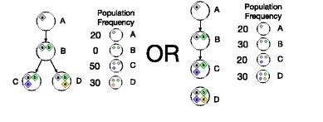
Two ways of comparison
Mutations of High vs Low Frequency
  Divide mutations into 3 groups based on Frequency
  Compare Group 1 (Highest Freq) to Group 3 (Lowest Frequency)
Mutations of Early vs Late Clones
  Parse the Subclonal tree
  Compare Parent to Children mutations
A vs (C & D)
A vs D

Slide 3
Compare different functional, clonal properties across cancer types
Funseq scores
Aloft scores
Change in signatures correlation and Entropy
Regions of
  Immune genes
  Tumor suppressor genes (TSG)
  DNA repair genes
  Oncogenes
Speculate on Fitness

Slide 4
Average Funseq scores
Early vs Late Clones

Slide 5
Average Funseq scores
Early vs Late Clones

Slide 6
Pancancer Funseq Scores

Slide 7
Aloft average scores I

Slide 8
Aloft average scores II

Slide 9
Signatures: correlations C₁~C₂

Slide 10
Signatures: change in E C₁ > C₂

Slide 11
Signatures changes for from transitions high medium and low Frequencies

Slide 12
Pancancer
 | Early | Fitness
Aloft | + | -
TSG | ~= | +
Immune | - | +
DNA Repair | + | ~-
OncoGenes (General) | ~- | ++

Slide 13
Per Cancer type

Slide 14
Future variations
Estimate fitness
Relate findings to clinical results
  survival rate
  time of death

Slide 15
Signatures across Tumor Evolution
- Mutation Impact
Var 8/2

Slide 16
Previously on paper E

Slide 17
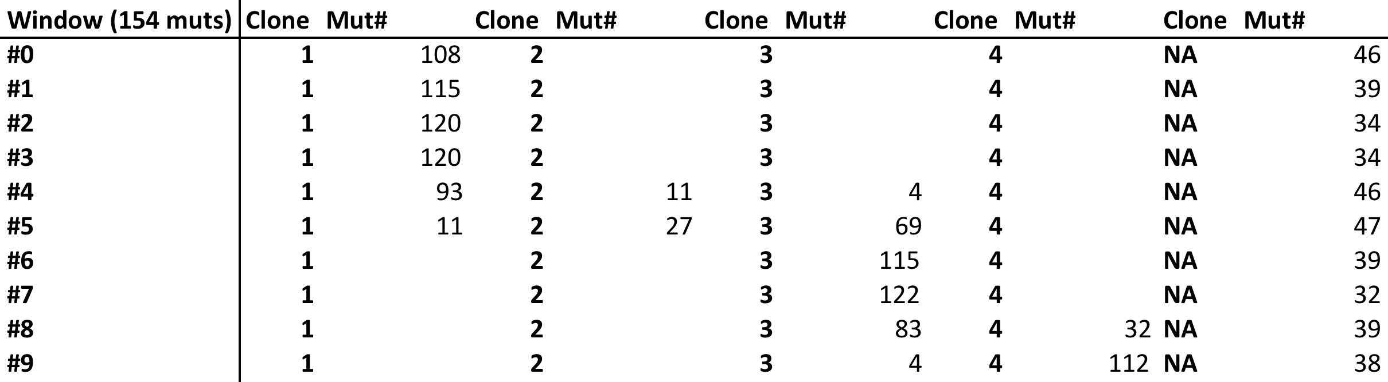
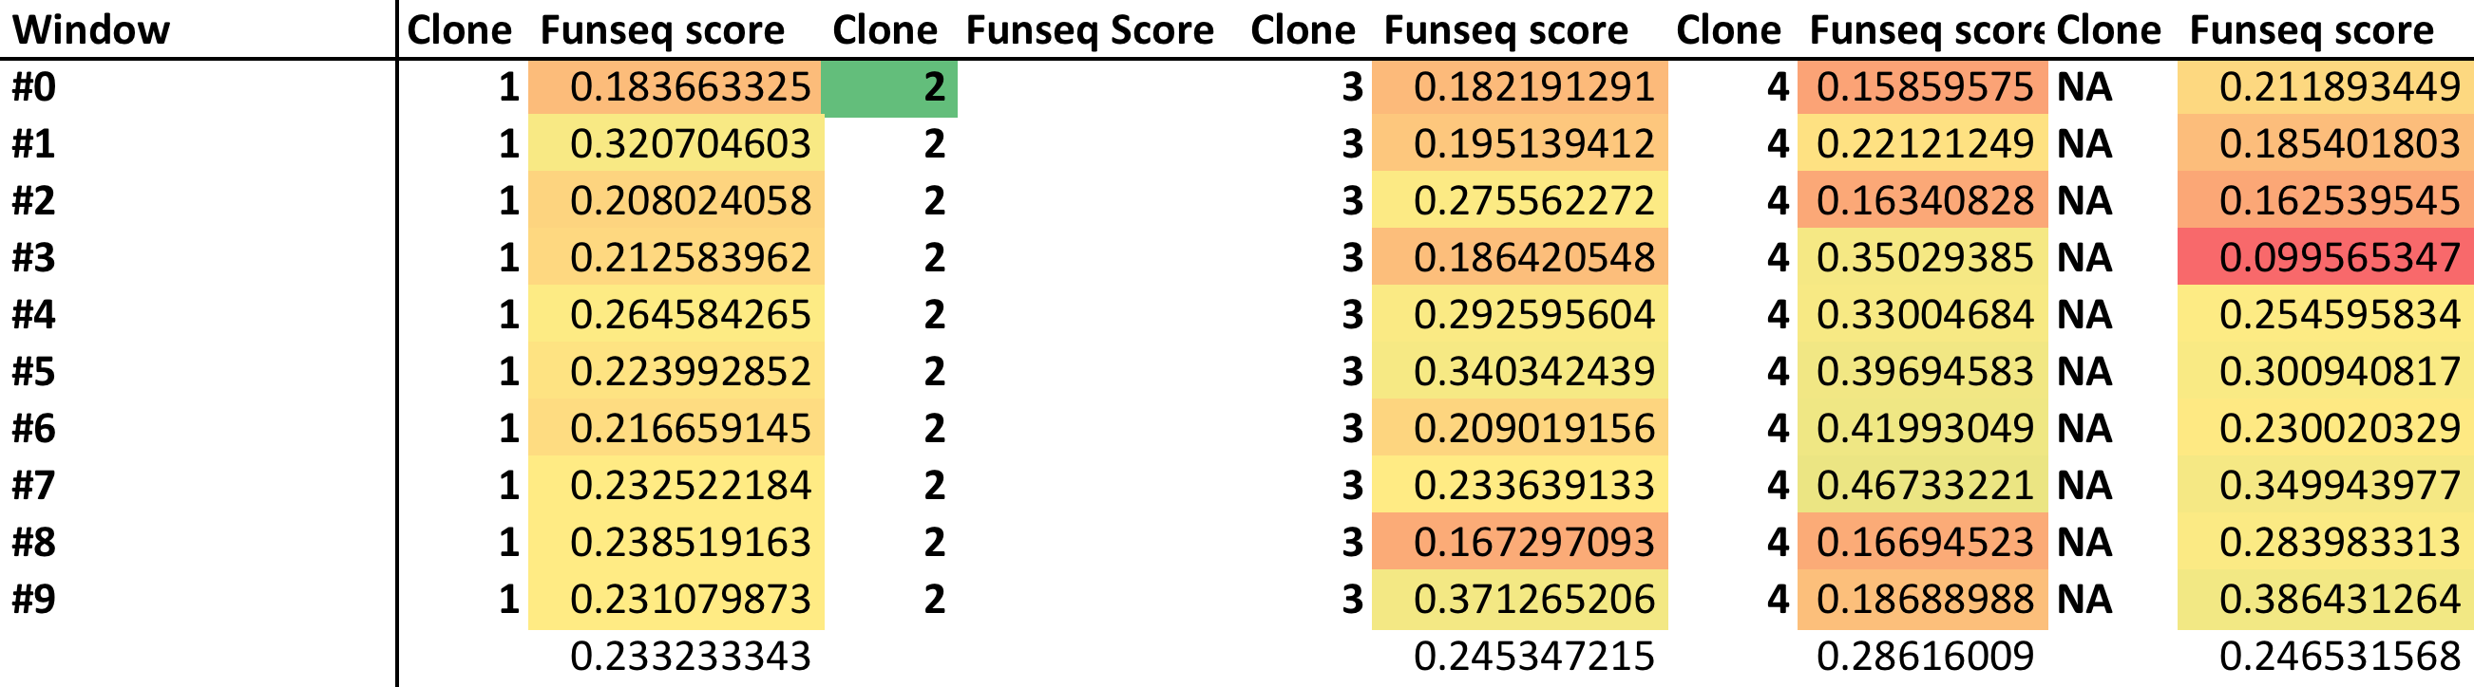
Funseq Score (non coding)

Slide 18
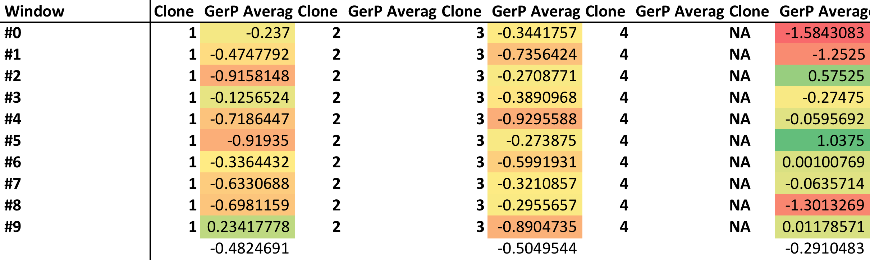
Gerp Scores

Slide 19
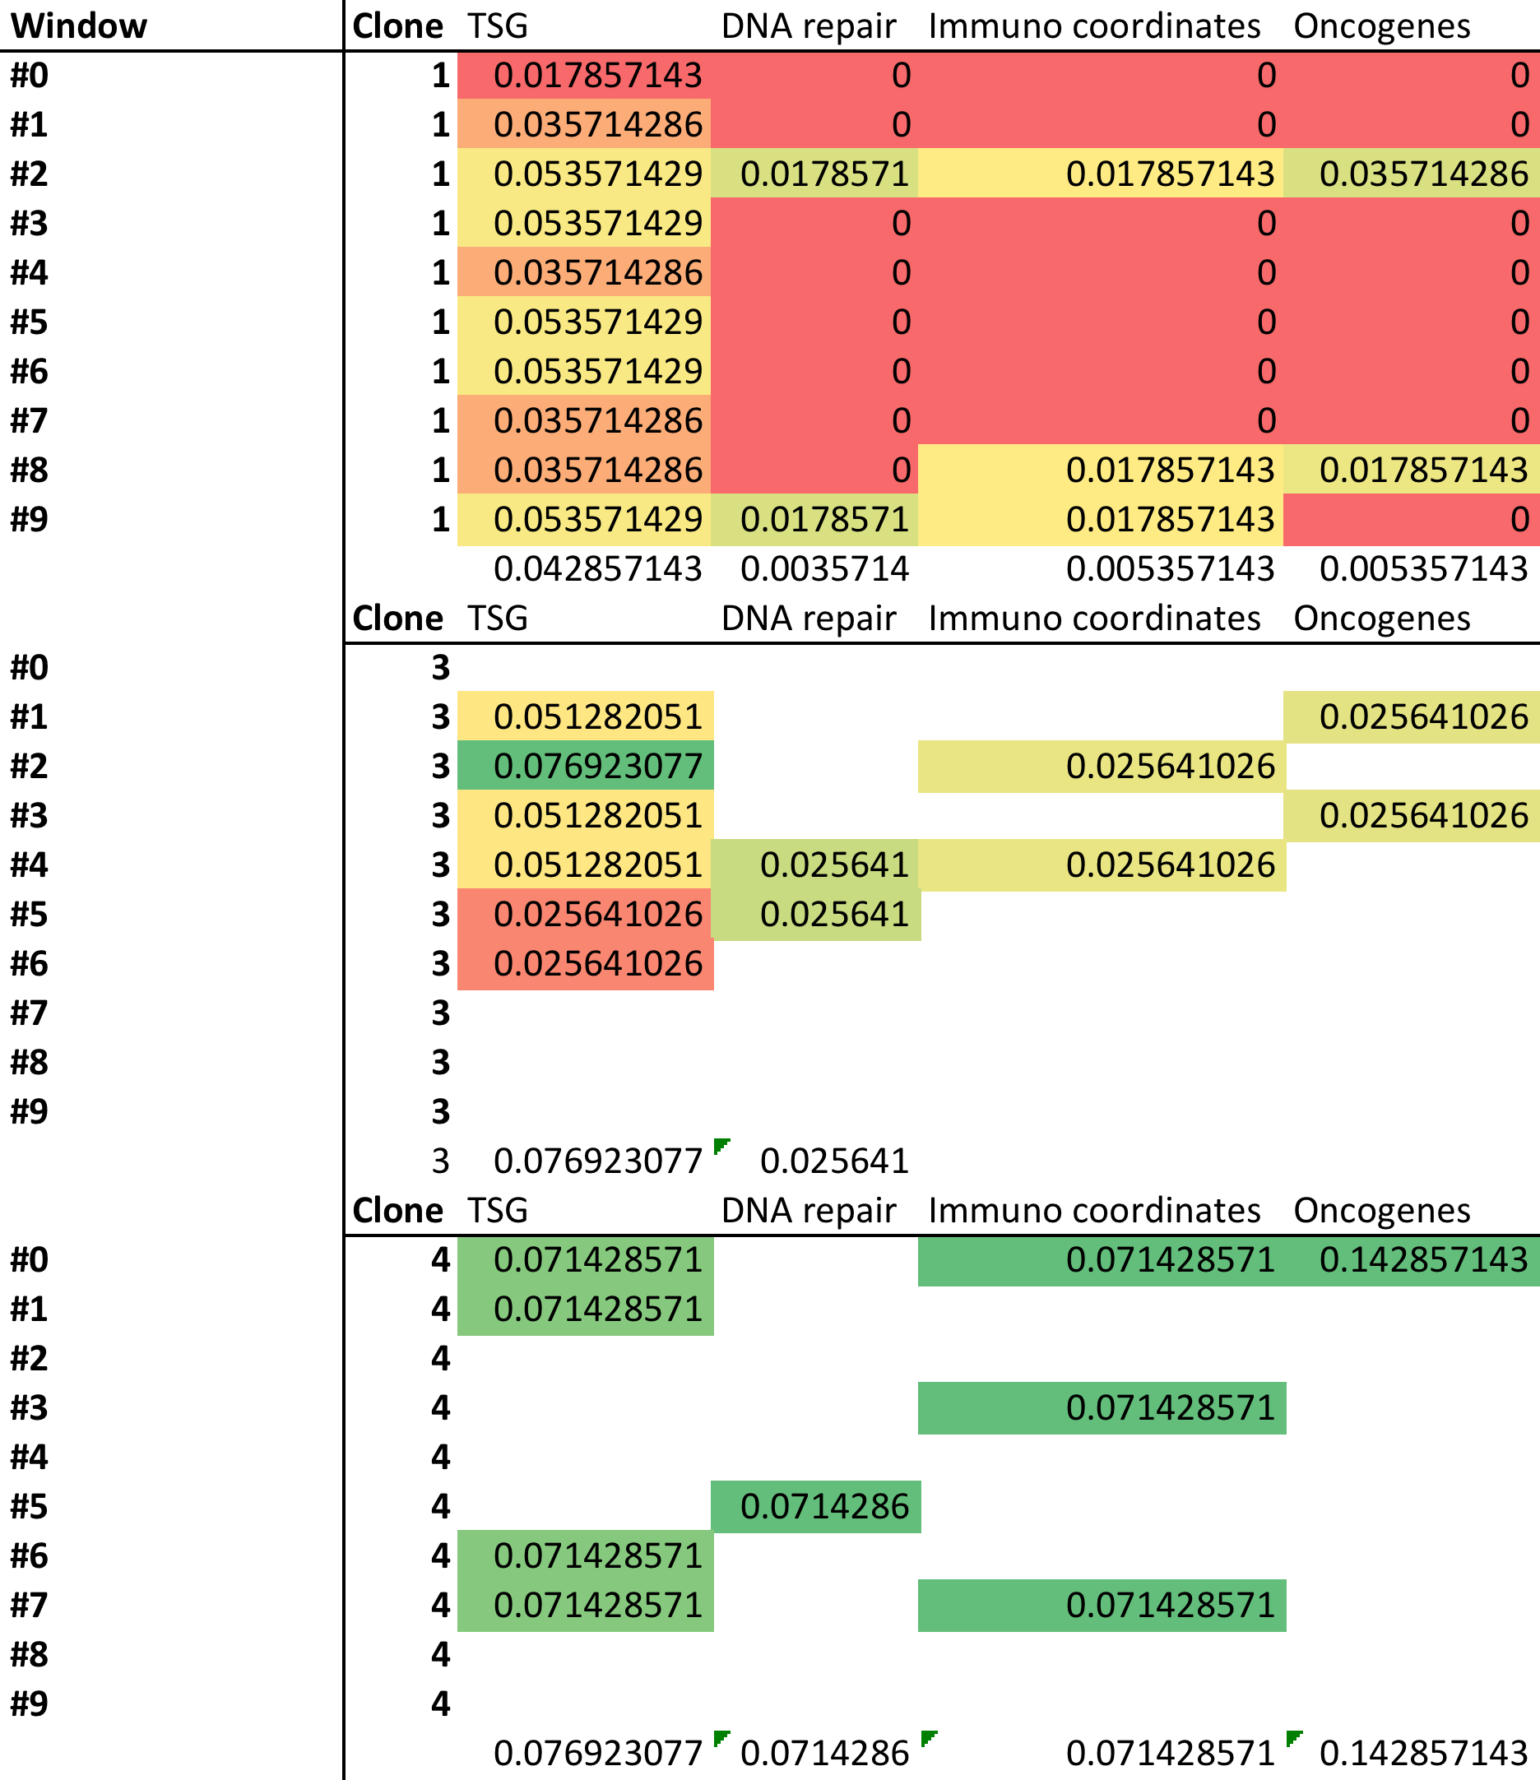
Region Scores

Slide 20
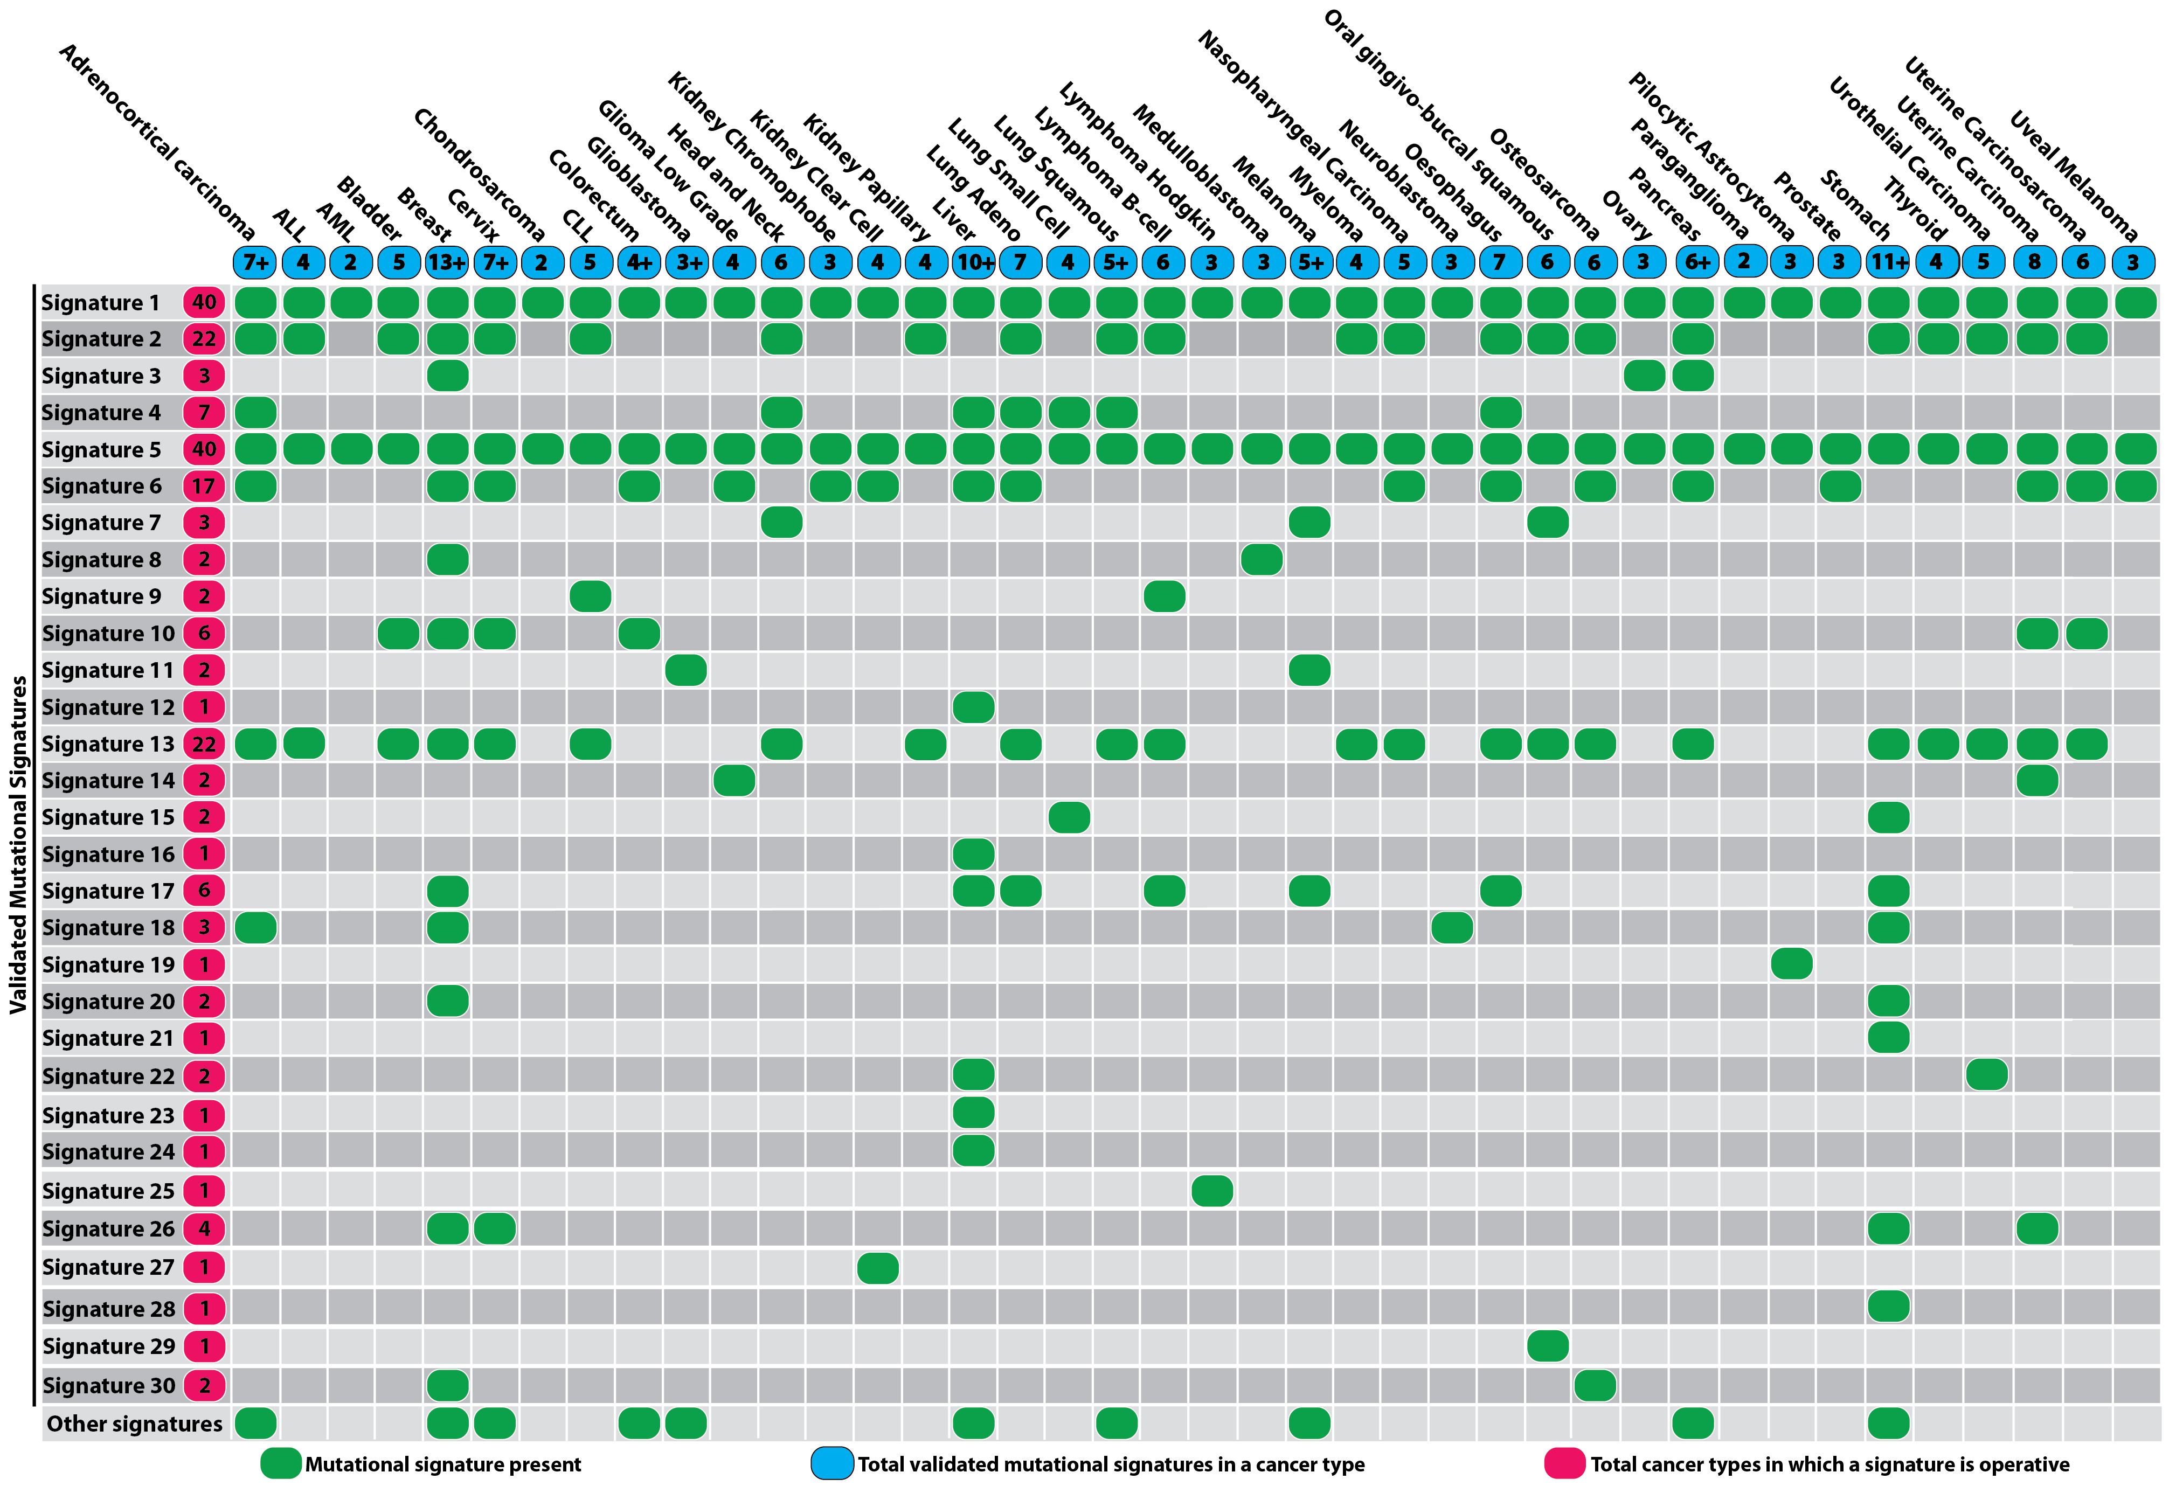
30 Signatures

Slide 21
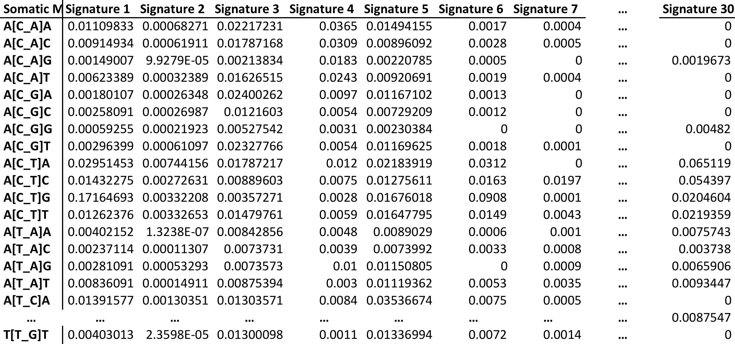
Signature probabilities

Slide 22
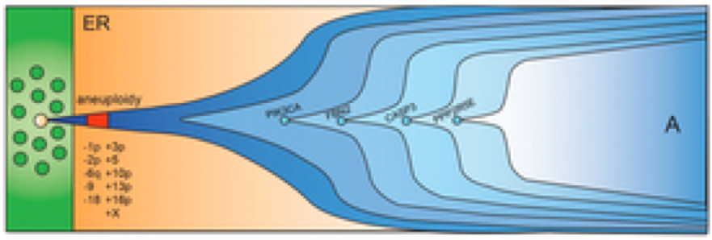
Identify Signatures within
Sliding time window T
Time window T
Frequency t
Fr(t)
Time y
Time x
T= x – t = t - y and x < t < y

Slide 23
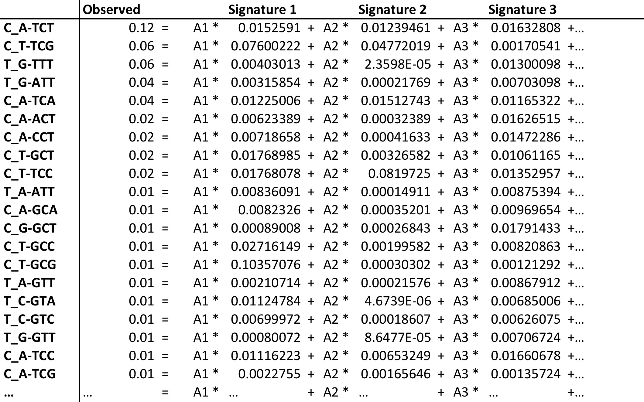
Solving a regression problem with constraints
Solve with Quadratic programming where A>=0, B=0 AND A1+A2+…A30=1

Slide 24
With package QuadProg in r
Patient 007aab66-2f07-459d-8952-3041d6ea24a8_sigs
Clone 2
Clone 1

Slide 25
Prioritize mutations based on change in Signatures
Frequency t
Fr(t)
Time T_{M}-n muts
Time T_{M}+k muts
Mutation M
Group A
Group B
Group A:n previous mutations
Group B: k following mutations

Slide 26
Basically compare any two groups of mutations A vs B
Deconvolute both groups as a mix of 30 signatures
Regress the mutational probabilities of group B into group’s A signatures (obtain R and p values)
Measure the change in entropy for signature prevalence

Slide 27
Mutational impact on r (P. correlation) and δE
Patient: 1f8d8720-30ca-4057-90f7-a34b8383eafe
Correlation:
Bin_{X} vs Bin_{X-1}
Mut Freq
Mut dE:
Bin_{X} vs Bin_{X-1}
Ordered mutations based on Mut Freq
T (now) <- T₀

Slide 28
Change vs Win0 (fut. germline)
Patient : 003819bc-c415-4e76-887c-931d60ed39e7
Mutational Windows based on mut freq
Time
Patient : 1f8d8720-30ca-4057-90f7-a34b8383eafe

