Slide 1
Gene-level normalized expression matrices (one per tissue)
Reads must:
- fall exclusively within exons or span them (i.e. not align into introns)
- contain no more than six non reference bases
- not map equally well to another locus
Genes must:
- have at least 10 samples with
- RPKM > 0.1 and
- raw read counts greater than 6
Covariate correction -- Includes:
known covariates (ex: gender, genotyping platform)
hidden covariates (PEER factors)
Selecting eQTL (Matri eQTL, FastQTL)
significant gene/snp pairs

Slide 2
Correlations btwn PEER factors & known covariates (adipose tissue)
GTEx Consortium. "The Genotype-Tissue Expression (GTEx) pilot analysis: Multitissue gene regulation in humans." Science. (2015)

Slide 3
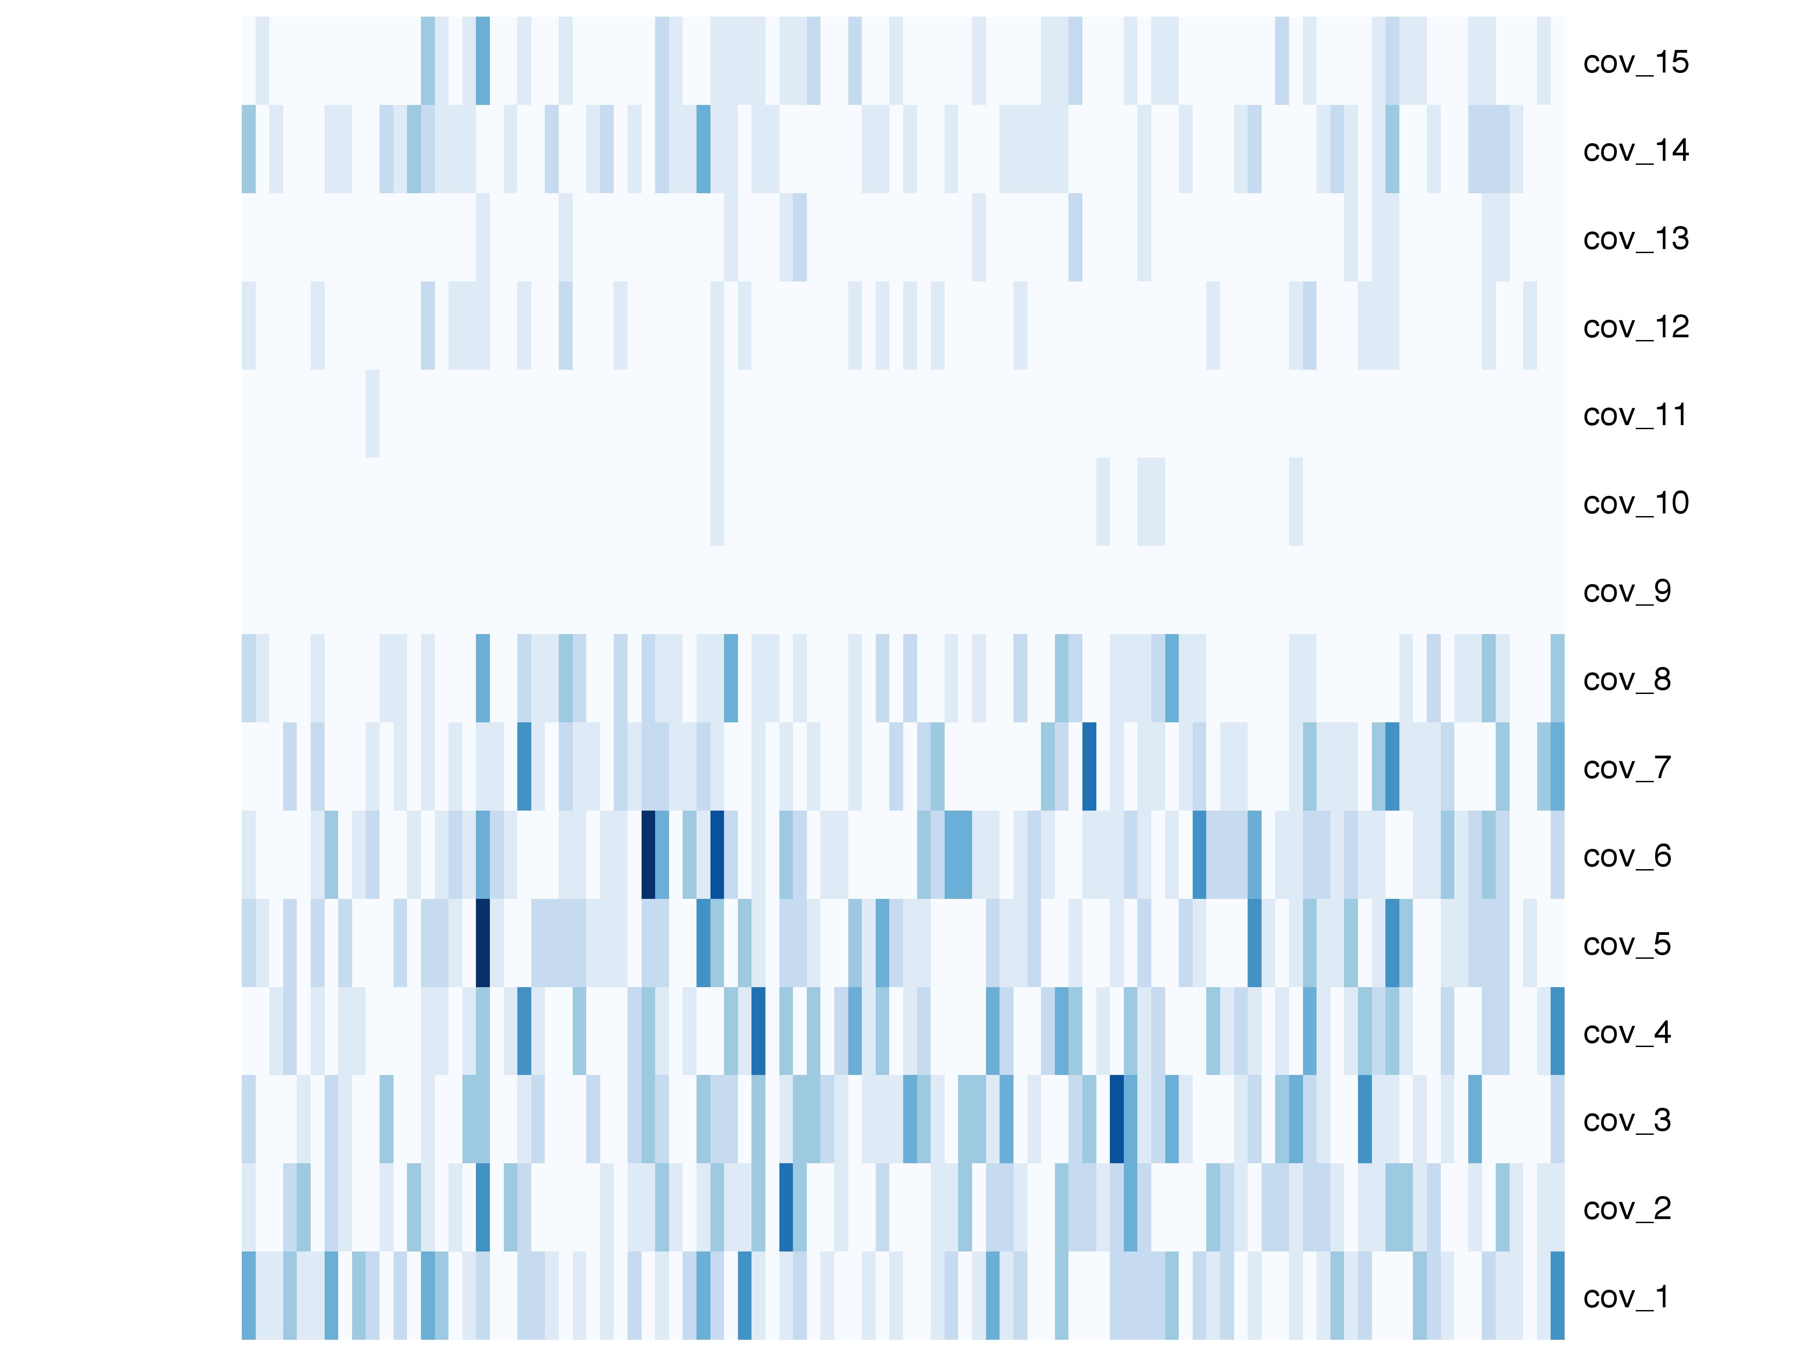
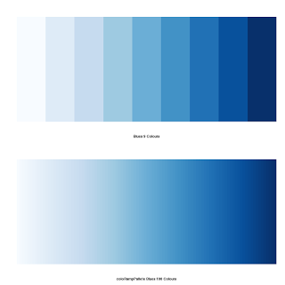
Absolute deviations: |reported-computed|
0.019
0
96 samples
Notes:
Abs_none

Slide 4
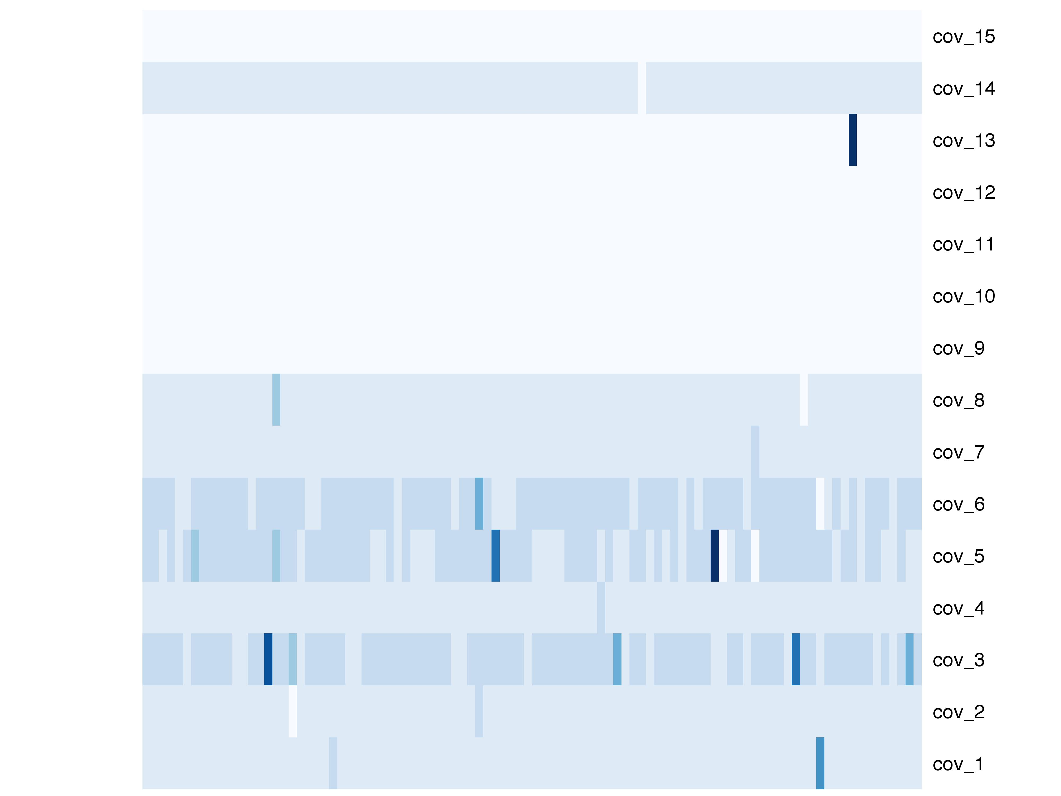
Percentage deviations
29.4%
0.08%
96 samples
Notes:
Prcntg_none

Slide 5
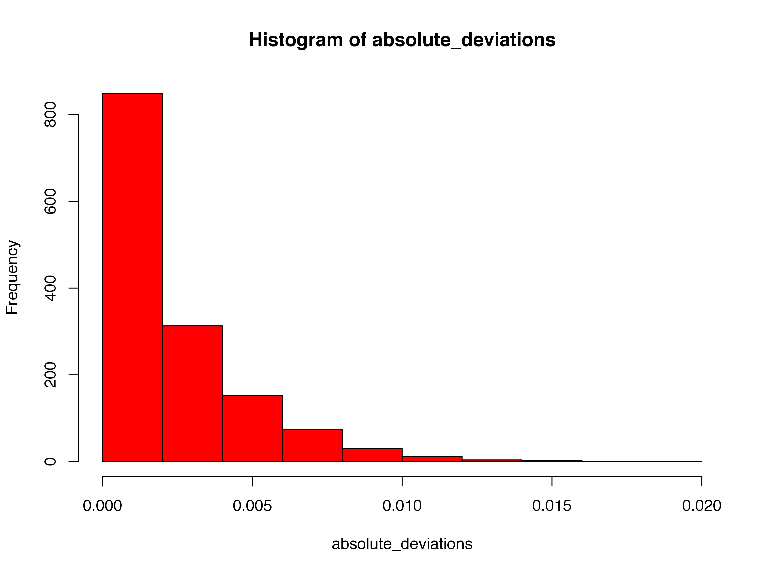
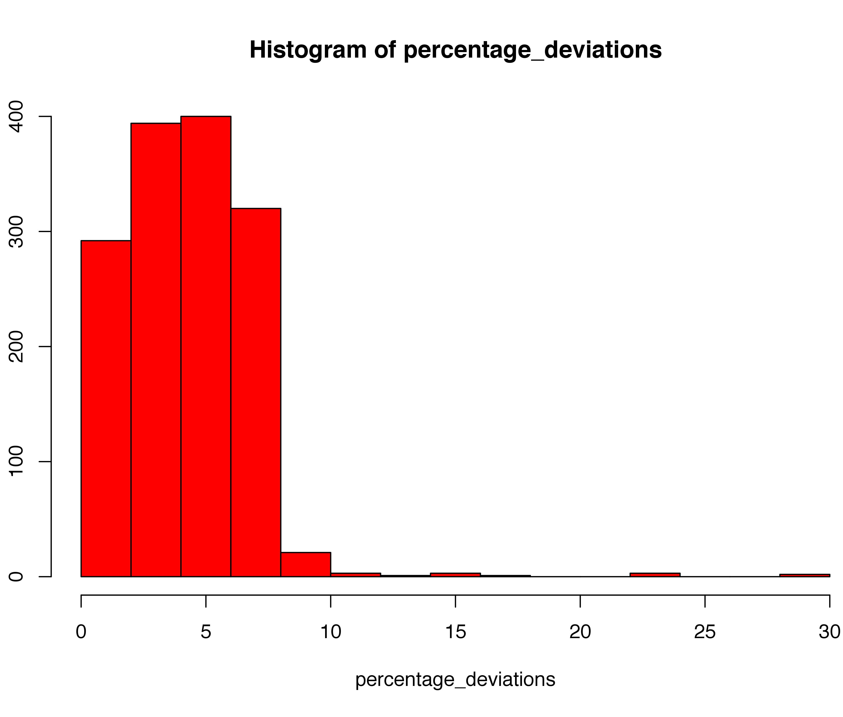

Slide 6
Potential Confounding Factors
PEER factors are generated using the top 1000 expressed genes per tissue
PEER version differences (not specified in original paper)
Known covariates somehow included?
Parameters -- gamma distributed for noise & weight factors not reported (a black-box!)
Number of PEERs is determined by N (number of samples per tissue)

