Slide 1
In search of evolutionary patterns in gene regulatory network using ChIP-Seq data
Jinrui

Slide 2
Gene regulatory network (GRN)
  A collection of regulatory interactions btw transcription factors (TFs) and other genes
How regulatory interactions evolved
  Duplicate TFs, then create new interactions
  Gain or lost of interactions btw existing TFs and other genes

Slide 3
Identification of regulatory interaction btw TF and its target genes
  TF binding within 1kb to the TSS

Slide 4
Datasets I’ve got
Worm
  360 bed files
  200 TFs
  15 developmental stages
Fly
  305 bed files
  261 TFs
  34 developmental stages

Slide 5
Worm developmental stages
  EM yAd ME L4-yAd L4-YA EE L4 L2 L1 YA Em E L3 YA+4 LE

Slide 6
Fly developmental stages
  E12-24 E2-4 E0-12 E4-20 L1 E4-14 pup AF+3 AF E20-24 W3L E18-24 AM E0-10 Adult WPP E0-8 Pupae E1-6 E8-12 WPP+48 E4-8 E0-4 E2-24 L3 E4-24 WPP+12 E0-14 E8-16 E0-24 E0-16 E16-24 E12-16 WPP+90

Slide 7
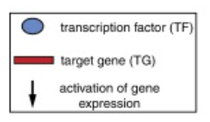
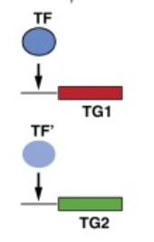
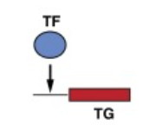
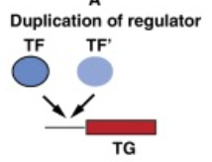
TF duplication as a driving force of GRN
Model: novel regulatory interactions by duplicate TF

Slide 8
Quantifying conservation of regulatory interaction for TF paralogs
  # of commonly regulated genes/total target genes of the two paralogs in a developmental stage

Slide 9
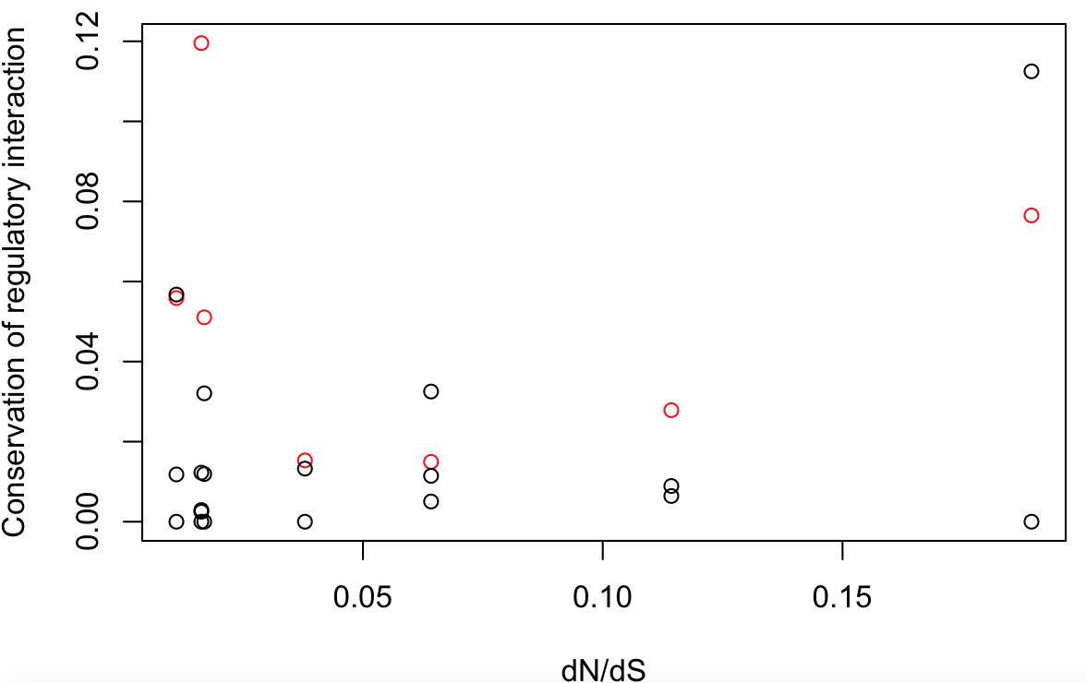
Regulatory conservation btw TF paralogs
In worm,
Black: conservation within individual developmental stage
Red: conservation in pooled developmental stages

Slide 10
Regulatory conservation btw TF paralogs
Technical noises need to be considered

Slide 11
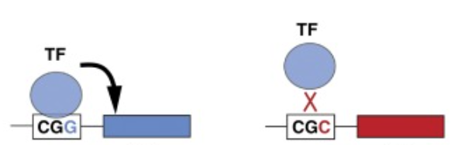
Regulatory divergence btw TF orthologs
Model: both TF and cis-regulatory modules may mutate
<=>

Slide 12
Quantifying conservation of regulatory interaction
  Orthologous (1-to-1) TFs btw worm, fly: unc-86, acj6
  unc-86 potentially regulates 5,153 genes, of which 1,213 has orthologs in fly
  acj6 potentially regulates 4,172 genes, and 1,239 has orthologs in worm
  466 orthologous pairs are common targets
  Conservation level of regulatory interactions: 466/(1213+1239-466) = 0.23

Slide 13
unc-86 acj6 5153 1213 466 4172 1239 466
lin-39 Dfd 2487 665 44 696 217 44
mes-2 E(z) 6566 1655 343 2717 720 343
nhr-6 Hr38 4747 1071 89 766 273 89
nhr-23 Hr46 6247 1331 701 4649 1612 701
mml-1 Mio 229 36 15 1366 495 15
ceh-9 NK7.1 688 73 19 2157 728 19
ceh-34 Six4 3923 755 294 3484 1214 294
egl-13 Sox102F 3247 776 201 3333 923 201
xbp-1 Xbp1 6231 1574 963 5424 1887 963
nhr-67 dsf 222 57 18 2205 804 18
daf-16 foxo 10782 1618 856 5219 1618 856
nhr-25 ftz-f1 6958 1329 459 3110 1053 459
elt-1 grn 3215 470 75 1230 397 75
unc-62 hth 6017 808 9 179 28 9
pag-3 sens 2080 335 70 1806 622 70
sma-9 shn 7769 1194 469 3430 1226 469
hif-1 sima 1142 214 33 1219 414 33
fkh-2 slp2 349 65 23 2660 924 23

Slide 14
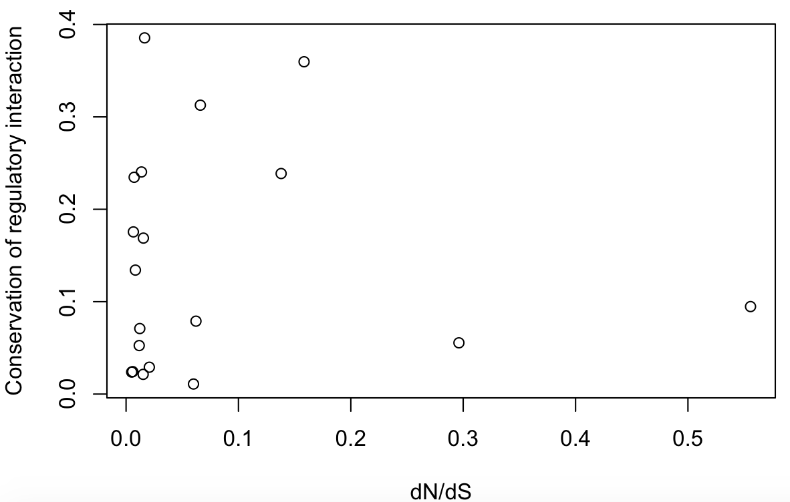
Regulatory conservation btw TF orthologs

Slide 15
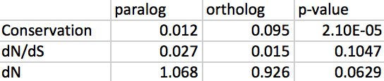
TF duplications contribute substantially to GRN complexity, probably due to less selection constraints on TF and their potential targets
TF paralogs tend to be used for different developmental stages

Slide 16
Future work
Refine the evolutionary study with new processed ChIP-Seq data
Add functional study using the RNA-Seq data of TF deletion lines
  Are TF paralogs/TFs at hot region redundant when regulating same gene at a developmental stage?
  Is gene expression perturbation accumulated or diminished alone GRN?

