Slide 1
STARR-seq in K562 cells may relate to some tissues but not so much to prostate tissue
By Will Meyerson
Encode & Cancer
20 Sept 2016

Slide 2
STARR-seq experimentally links enhancer sequence variation to altered gene expression
Take a cell, keeping its cytoplasm and the transcription factors in that cytoplasm
Add extra-chromosomal DNA plasmids that include an artificially mutated enhancer
Analyze how variations in the mutant enhancers influence the expression level of a reporter gene on the plasmid
Whatever influence is to be found is presumably mediated through differential TF binding

Slide 3
We would like to use STARR-seq performed in K562 cells for variant prioritization in prostate and possibly other cancers – but is this valid?
K562 cells are a highly-passaged and highly studied chronic myelogenous leukemia cell line
Some aspects of gene regulation are universal, so there should be some information to glean from K562 cells that extends to other cells
But the quality of that information depends on how much K562 cells are similar in the relevant ways to other tissues of interest

Slide 4
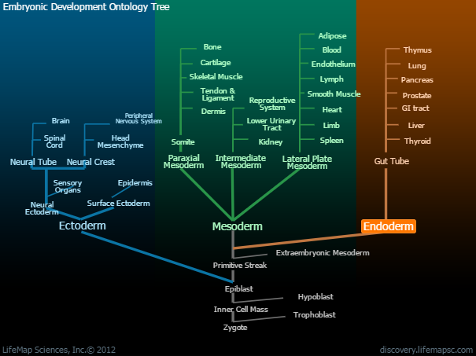
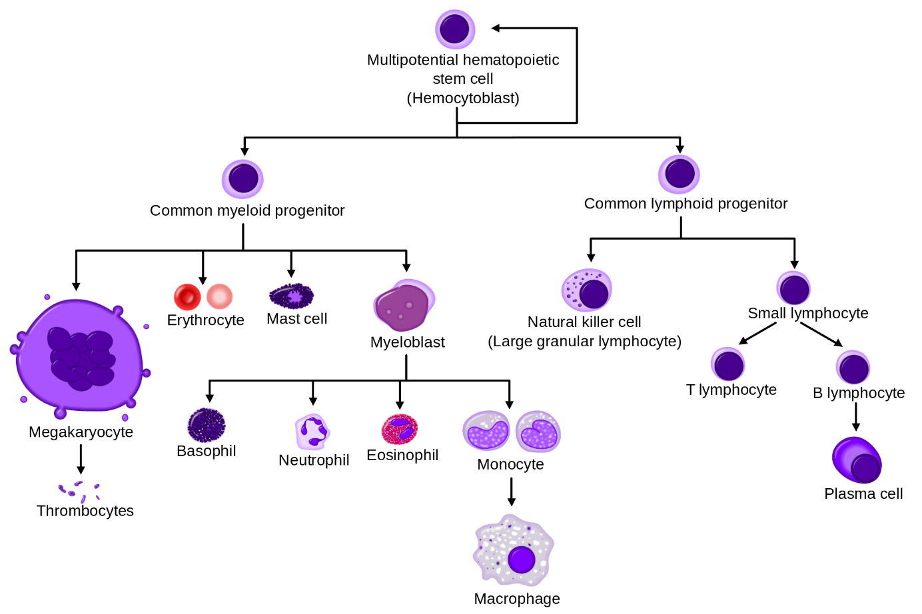
One way to define similarity between cell types is their distance apart on the development family tree. K562 is a myeloid blood cell.
Encode: “[K562] grows well, is transfectable, and represents the mesoderm linage”
Prostate is of Endoderm lineage
http://discovery.lifemapsc.com/in-vivo-development/endoderm
https://en.wikipedia.org/wiki/Hematopoietic_stem_cell

Slide 5
Similarity in TF expression between cell types offers a more mechanistically-informed notion of similarity.
Remember that STARR-seq relies on cellular transcription factors but not cellular chromatin structure
Approach:
ENCODE K562 RPKMS by transcript, summed to make RPKMs by gene
GTEx median RPKMs by gene from 53 tissue types
List of 1,559 TFs from AnimalTFDB
Used the 1,492 genes with the same names shared in all three databases
Spearman rank correlation test of K562 and GTEx RPKMs for 1,492 TFs

Slide 6
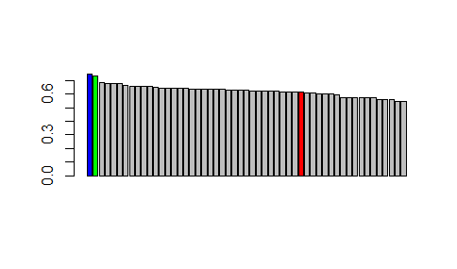
By Spearman rank correlation, two thirds of GTEx tissues are more similar to K562 than is Prostate, but not by much
TF expression in K562 is well-correlated with TF expression in EBV-positive lymphocytes and whole blood. This is intuitive because all three share a common progenitor cell.
The next few well-correlated tissues have no obvious embryonic relation to myeloid cells.
Cells...EBV.transformed.lymphocytes | 0.74646
Whole.Blood | 0.730887
Spleen | 0.68618
Adrenal.Gland | 0.68123
Pancreas | 0.679358
Liver | 0.675168
Lung | 0.662555
Stomach | 0.659718
Small.Intestine...Terminal.Ileum | 0.65605
Esophagus...Mucosa | 0.655231
Cells...Transformed.fibroblasts | 0.654568
Artery...Coronary | 0.653682
Artery...Aorta | 0.646449
Heart...Left.Ventricle | 0.645526
Adipose...Visceral..Omentum. | 0.645161
Esophagus...Muscularis | 0.643825
Colon...Transverse | 0.643747
Esophagus...Gastroesophageal.Junction | 0.639051
Minor.Salivary.Gland | 0.638708
Thyroid | 0.638044
Muscle...Skeletal | 0.636297
Adipose...Subcutaneous | 0.63584
Heart...Atrial.Appendage | 0.633962
Ovary | 0.631701
Colon...Sigmoid | 0.630387
Nerve...Tibial | 0.627358
Uterus | 0.626907
Fallopian.Tube | 0.625944
Breast...Mammary.Tissue | 0.625551
Cervix...Endocervix | 0.623068
Cervix...Ectocervix | 0.622164
Artery...Tibial | 0.620352
Pituitary | 0.616404
Bladder | 0.61571
Vagina | 0.614635
Prostate | 0.614271
Testis | 0.607806
Brain...Spinal.cord..cervical.c.1. | 0.605489
Skin...Not.Sun.Exposed..Suprapubic. | 0.603986
Kidney...Cortex | 0.603238
Skin...Sun.Exposed..Lower.leg. | 0.598674
Brain...Substantia.nigra | 0.595272
Brain...Amygdala | 0.576655
Brain...Hypothalamus | 0.576475
Brain...Hippocampus | 0.576104
Brain...Putamen..basal.ganglia. | 0.574175
Brain...Nucleus.accumbens..basal.ganglia. | 0.57182
Brain...Caudate..basal.ganglia. | 0.570919
Brain...Cortex | 0.56281
Brain...Frontal.Cortex..BA9. | 0.562794
Brain...Anterior.cingulate.cortex..BA24. | 0.557765
Brain...Cerebellar.Hemisphere | 0.549676
Brain...Cerebellum | 0.547224
The cell type with the greatest presumed similarity to K562 – namely, myeloid lineage cells – was not sequenced as part of GTEx.
All correlations > 0.5

Slide 7
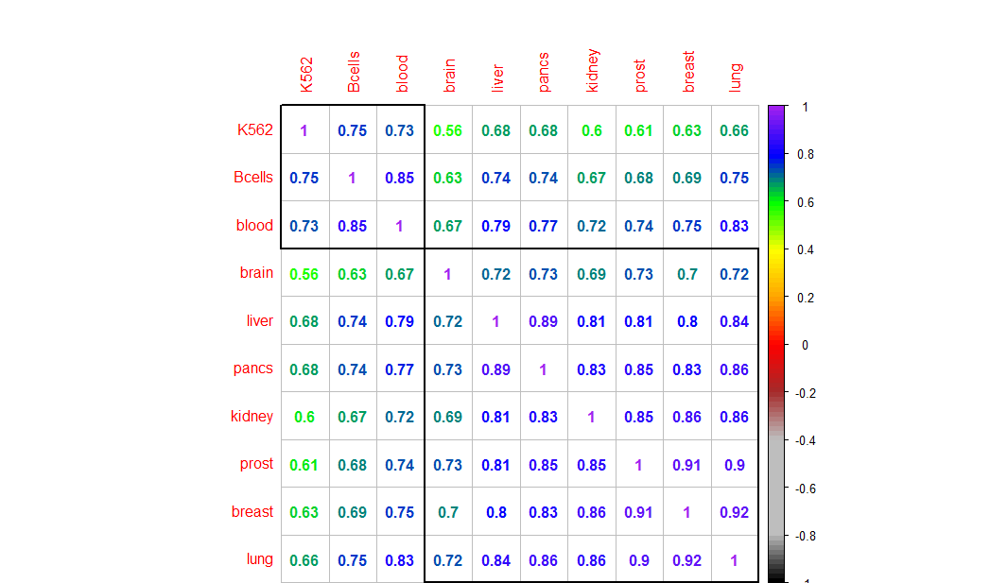
Spearman rank correlations of TF expression between K562 and selected GTEx tissues are somewhat lower than correlations between GTEx tissues
Explanation 1: Myeloid cells are much more specialized than other cells. If true, this would make K562 a poor choice for understanding other cell types.
Alternatively, these differences could arise from:
2. Batch effects of ENCODE vs GTEx
3. The difference between cancerous vs normal tissues
4. The difference between cell lines vs tissue

Slide 8
Questions to Consider
Predict STARR-seq in other cell types vs predict real biology in other cell types
Normal tissue vs Cancer

Slide 9
Conclusion
Some tissues are more similar to K562 than are others
K562 is quite similar to B-cells, but since ENCODE already has another B-cell line, B-cells might not be K562’s comparative advantage
All tissues have > 0.5 correlation of rank TF expression with K562
There remains a judgment call as to how similar is similar enough

Slide 10
WM would like to acknowledge
Michael Rutenberg-Schoenberg for extensive discussions and preparedness to present this talk in my absence and for Skype assistance
Dan Spakowicz [+MRS] for Skype assistance

