Slide 1
ICGC Pan Cancer Mutational Signatures (PCAWG 7)
--
Preliminary Results
Members of the
IGCG Pan Cancer Analysis Working Group on Mutational Signature (PCAWG 7)
Cambridge MA, 2016 Sep 19

Slide 2
Main results
Definitive catalog of mutation signatures based on 25,000 tumors
  De facto standard for years to come
  Consensus of multiple signature analysis pipelines vetted on synthetic data
  In-depth assessment by highly experienced team
Differences in signature contributions across cancer types and geography and likely causal mechanisms
New conceptual framework for understanding the causal mechanisms and taxonomy of mutation signatures
Numbers of mutations contributed by each signature to each tumor; assignment of signatures to each mutation
Relationships between signature activity and an exhaustive compendium of structural and biological features in 5,000 cancer genomes
New insights into the mutational processes that cause neoplastic transformation, based on analysis of the mutation signatures that cause driver mutations in the 25,000 tumors

Slide 3
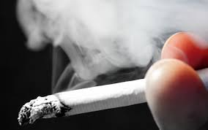
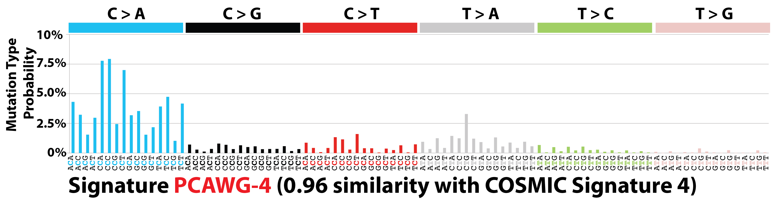
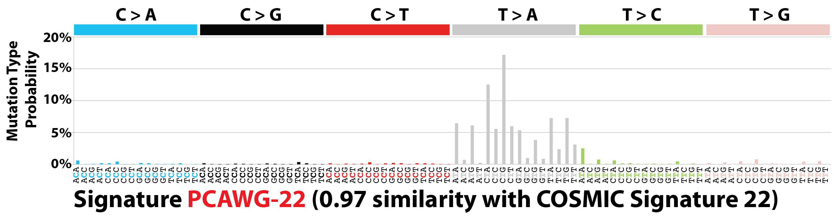
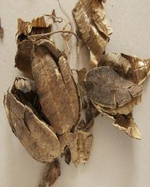
Reminder: signatures due to exogenous exposures
Signature 4
Tobacco smoking
Signature 22
Aristolochic acid (AA)

Slide 4
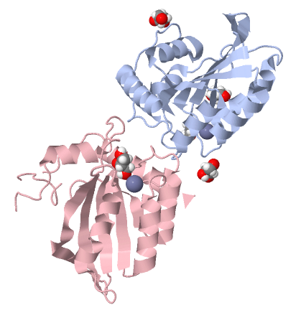
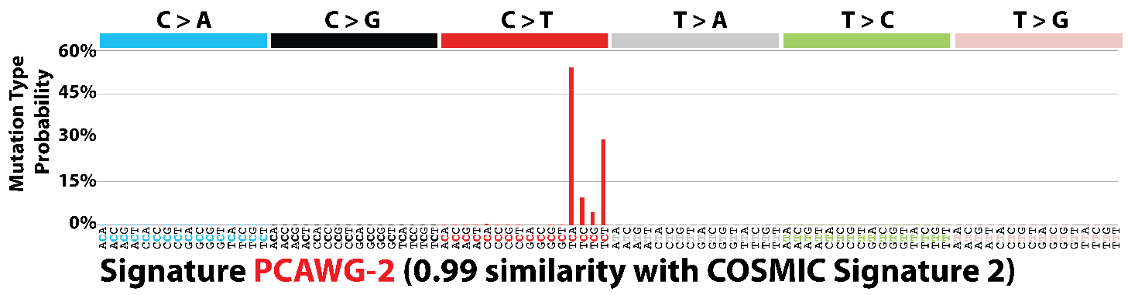
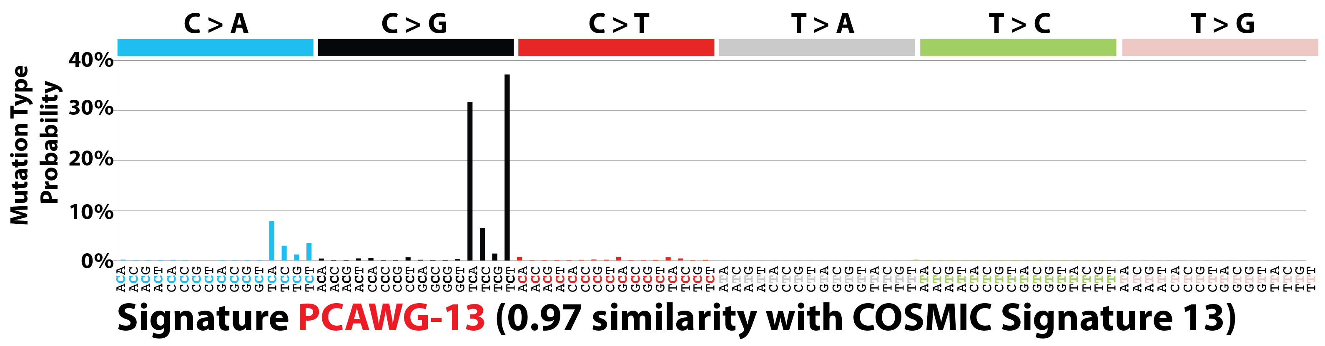
Reminder: signatures due to endogenous mechanisms
Signatures 2 and 13
APOBEC
C > T
C > G

Slide 5
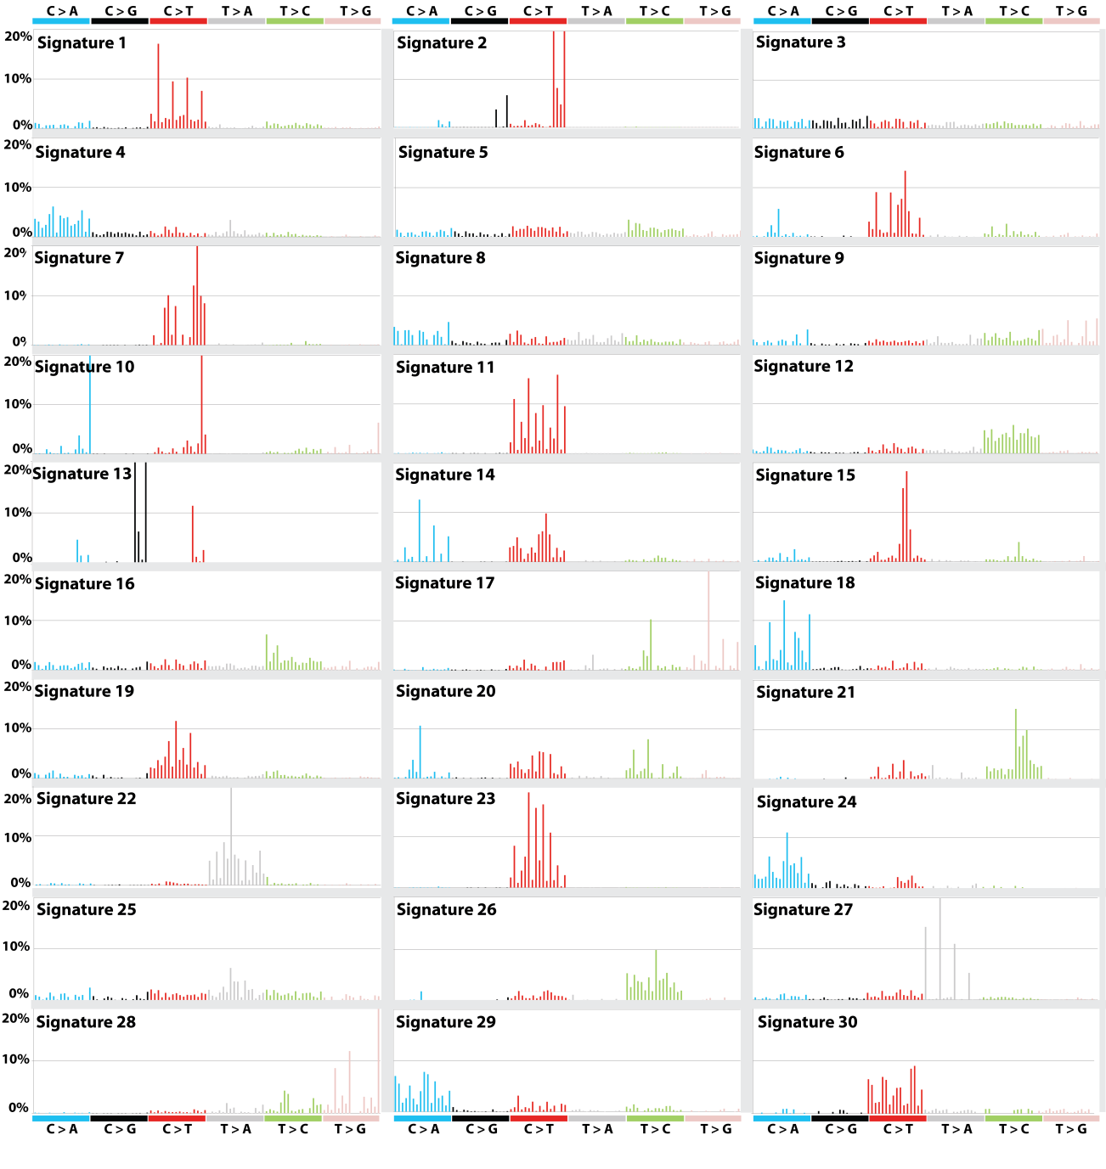
30 recognized
Signatures
PCAWG+
(25,000,
~50
Signatures)
http://cancer.sanger.ac.uk/cosmic/signatures

Slide 6
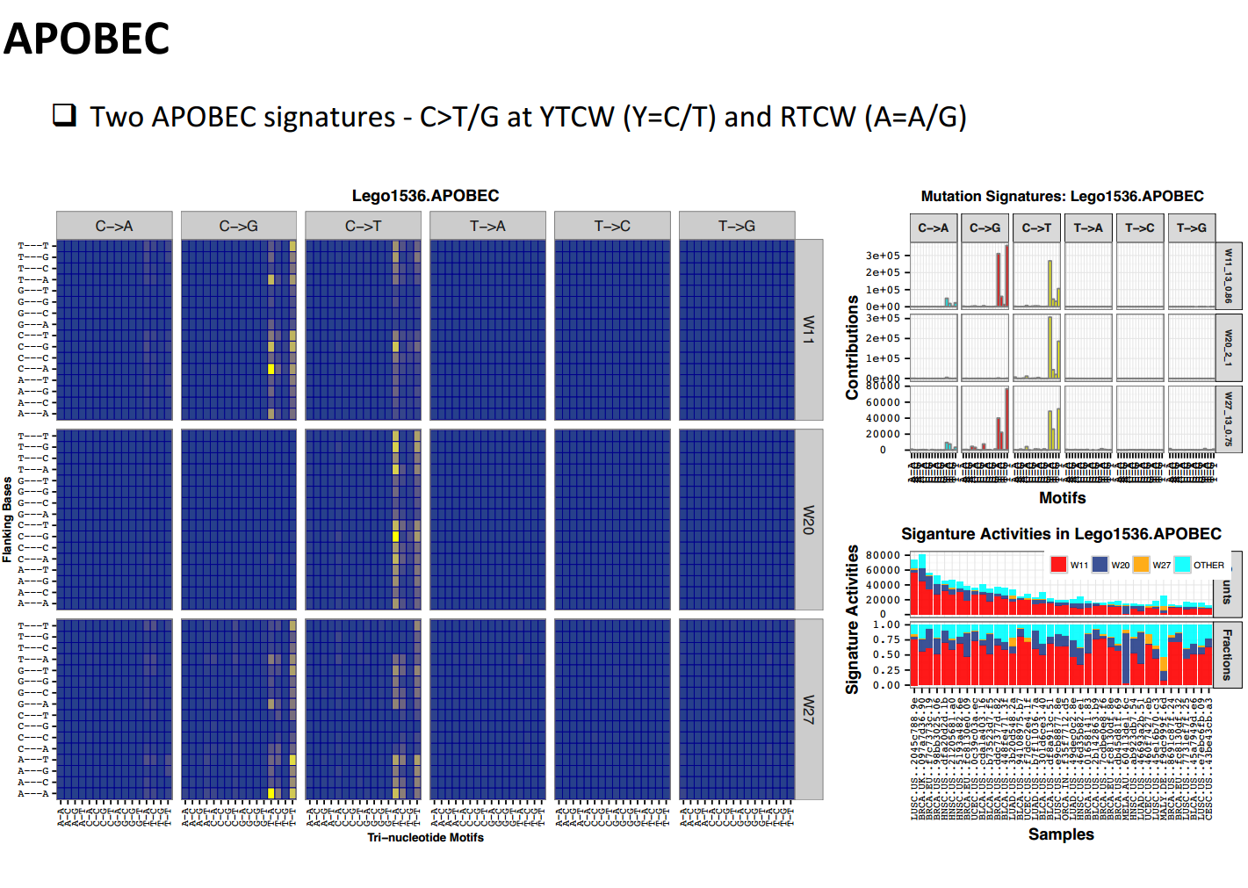
Additional information: -2, +2 nucleotides, indels, SVs

Slide 7
Reminder: signatures due to endogenous mechanisms – why 2 signtures?
Signatures 2 and 13
APOBEC
C > T
C > G

Slide 8
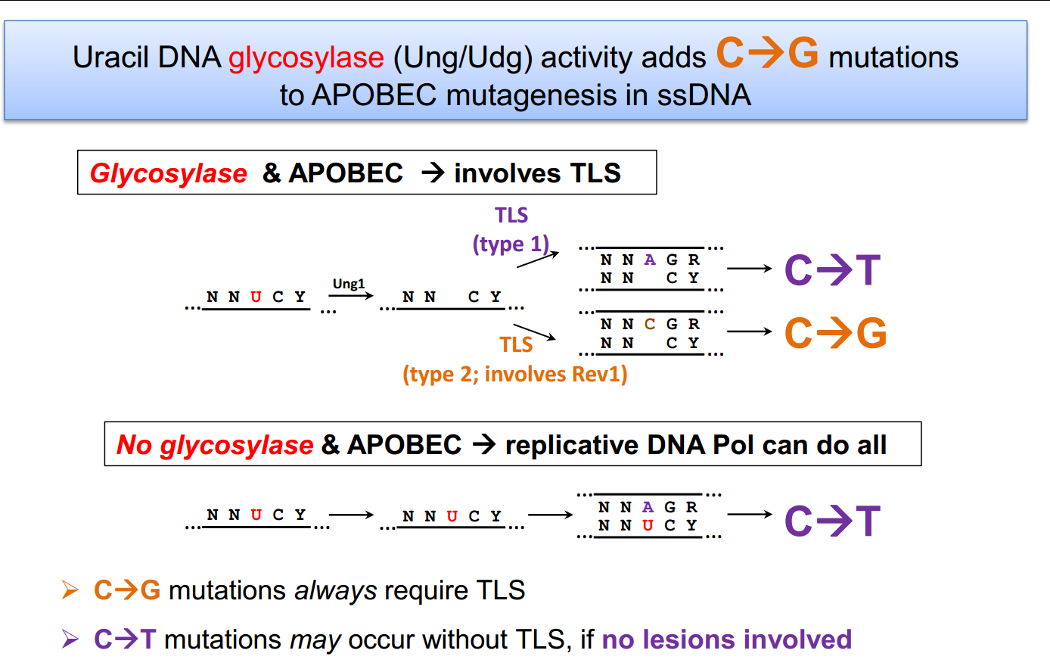
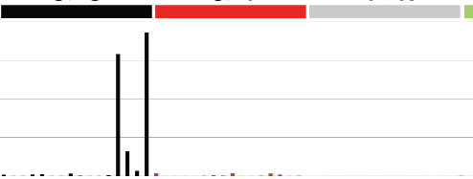
Mechanisms creating 2 APOBEC signatures
C → G
Sig 2
C → T
C → G
Sig 13
C → T
Sig 2
C → G
C → T

Slide 9
Conceptual framework

Slide 10
Each mutational process generates a mutational signature
Mutational
process
Mutational signature

Slide 11
In principle, each mutational process is constituted of three potential biological components which can influence the mutational signature
DNA modification
Mutational
process
DNA repair
DNA replication
Mutational signature
Mutational signature

Slide 12
Each of the three biological components can be functioning “normally” or “abnormally” to influence the mutational signature
DNA modification
Normal or abnormal
Mutational
process
DNA repair
Normal or abnormal
DNA replication
Normal or abnormal
Mutational signature
Mutational signature

Slide 13
There are multiple ways in which each of the three components can contribute to a mutational signature
DNA modification
Addition of chemical group to base
Removal of chemical group from base
DNA repair
Removal of modification
Removal of modified base
Removal of mismatched base
Removal of modified nucleotide
Defective function of the above
DNA replication
Normal replication
Replication across modified base
Replication across abasic site
Other replication
Defective replication machinery
Mutational signature
Mutational signature

Slide 14
There are multiple ways in which each of the three components can contribute to a mutational signature
DNA modification
deamination of 5-methyl cytosine
deamination of cytosine
8-oxo guanine modified bases
benzo[a]pyrene diol epoxide adducts
aristolochic acid adducts
DNA repair
Mismatch repair/defective mismatch repair
Nucleotide excision repair (transcription coupled/not)
Base excision repair
Homologous recombination repair/defective HR
DNA replication
Polymerase epsilon/mutated polymerase epsilon
Error prone polymerases
Mutational signature
Mutational signature

Slide 15
Although we often say a signature is due to one component eg “signature 1 is due to 5-methyl cytosine deamination” this is shorthand and formally we should always include mention of all three components
DNA modification
deamination of 5-methyl cytosine
deamination of cytosine
8-oxo guanine adducts
benz[a]pyrene diol epoxide adducts
aristolochic acid adducts
DNA repair
Mismatch repair/defective mismatch repair
Nucleotide excision repair (transcription coupled/not)
Base excision repair
Homologous recombination repair/defective HR
DNA replication
Polymerase epsilon/mutated polymerase epsilon
Error prone polymerases
Mutational signature
Mutational signature

Slide 16
Mechanisms creating 2 APOBEC signatures
C → G
Sig 2
C → T
C → G
Sig 13
C → T
Sig 2
C → G
C → T

Slide 17
Two out of three components of mutational processes A and B are different from each other but generate signatures 2 and 13
Mutational process B
Mutational process A
DNA modification
APOBEC deamination
APOBEC deamination
DNA repair
-
BER>abasic site
DNA replication
POLE/D
(“Replicative”)
REV1 (TLS)
Mutational signature
Sig 2
Sig 13

Slide 18
Assignment of (causal) signatures to individual mutations
Landscape / topography

Slide 19
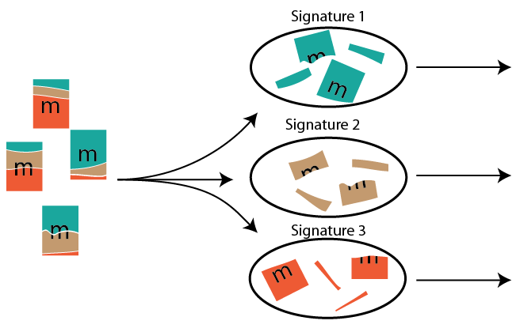
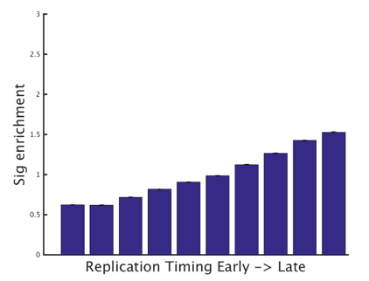
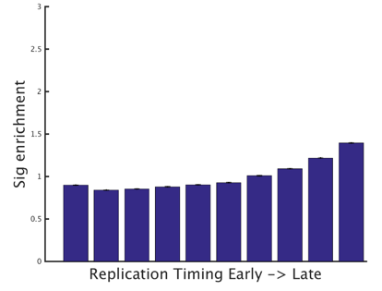
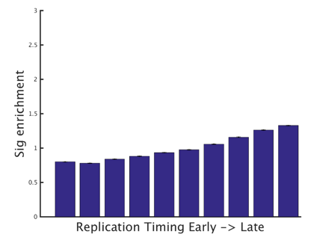
Probabilistic assignment of mutations allows signature-specific profiles
Signature-specific
Genomic profiles
(e.g. replication timing)
Individual mutations
Assigned to signatures
Individual mutations

Slide 20
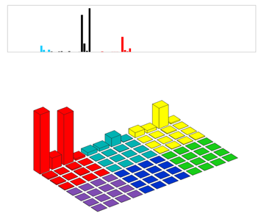
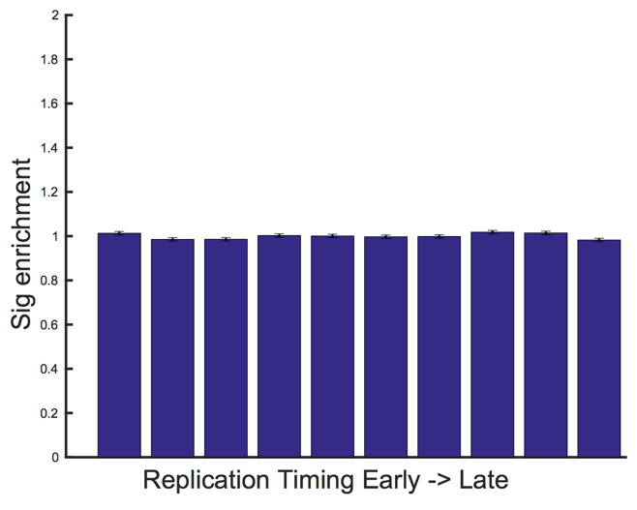
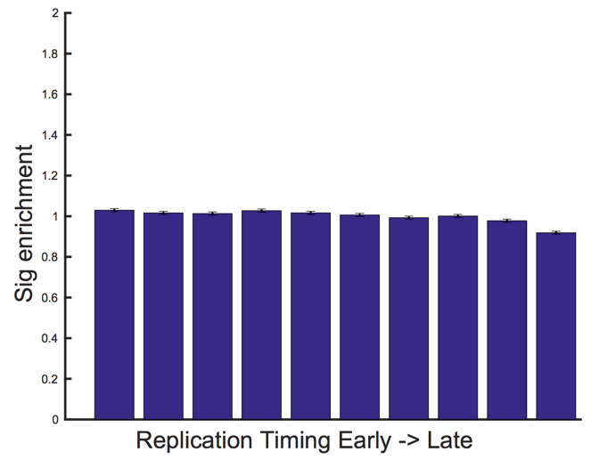
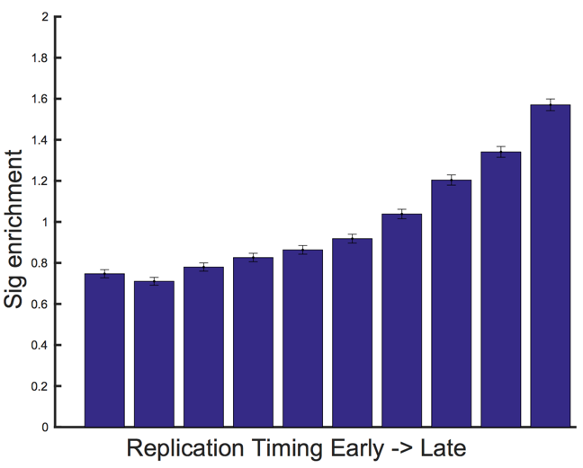
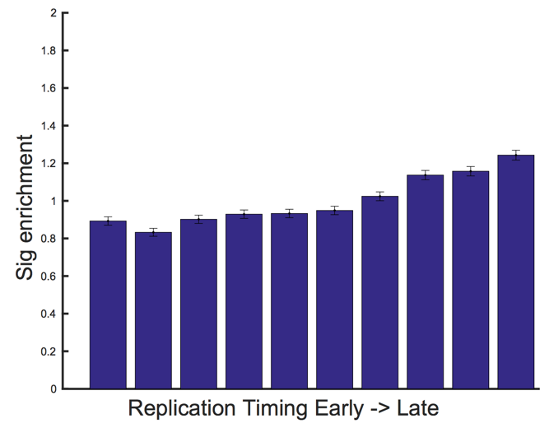
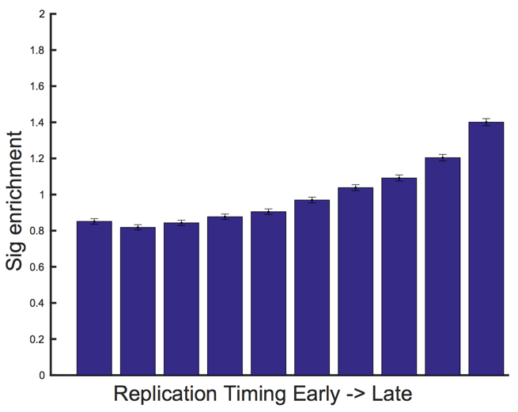
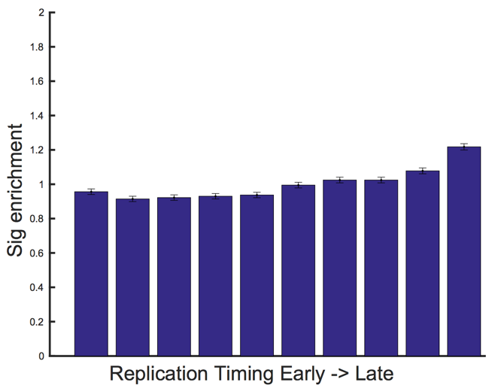
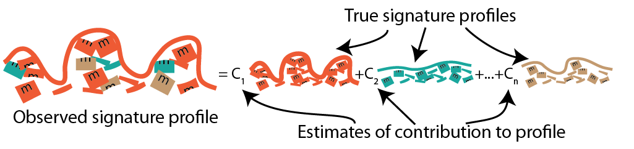
A further linear correction minimizes cross-signature contamination
Sig 13
Linear correction reduces cross-signature contamination of profiles
Breast
Esophagus
Lung
Adeno-carcinoma
Slope from cross-signature contamination

Slide 21
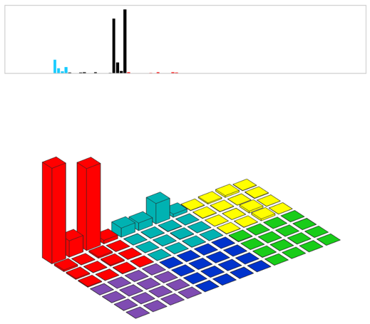
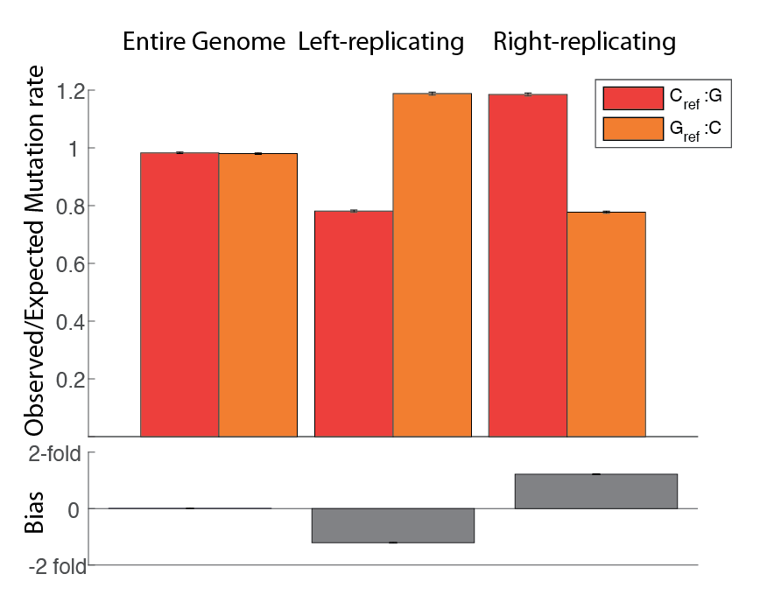
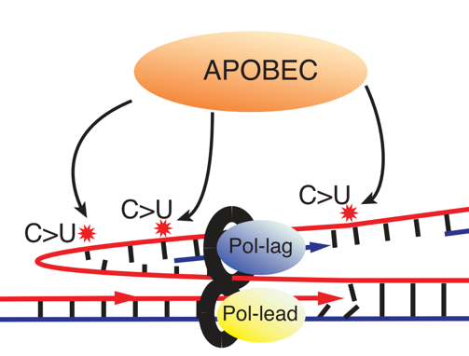
Replicative Strand Bias
APOBEC-associated COSMIC13 enriched at lagging-strand template cytosines

Slide 22
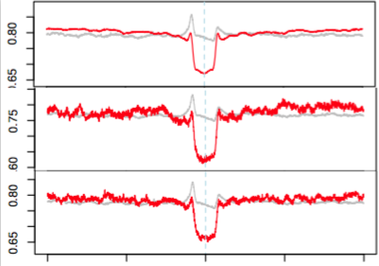
Nucleosome positions relative to mutation
Signature16 (unknown causes)
Strong depletion of mutations at nucleosomes in 3 cancer types
Red = Actual
Gray = Expected
LIVC
Nucleosome Signal
LUSC
HNSC
Interval Around the Mutation

Slide 23
What mutation signatures cause driver mutations?

Slide 24
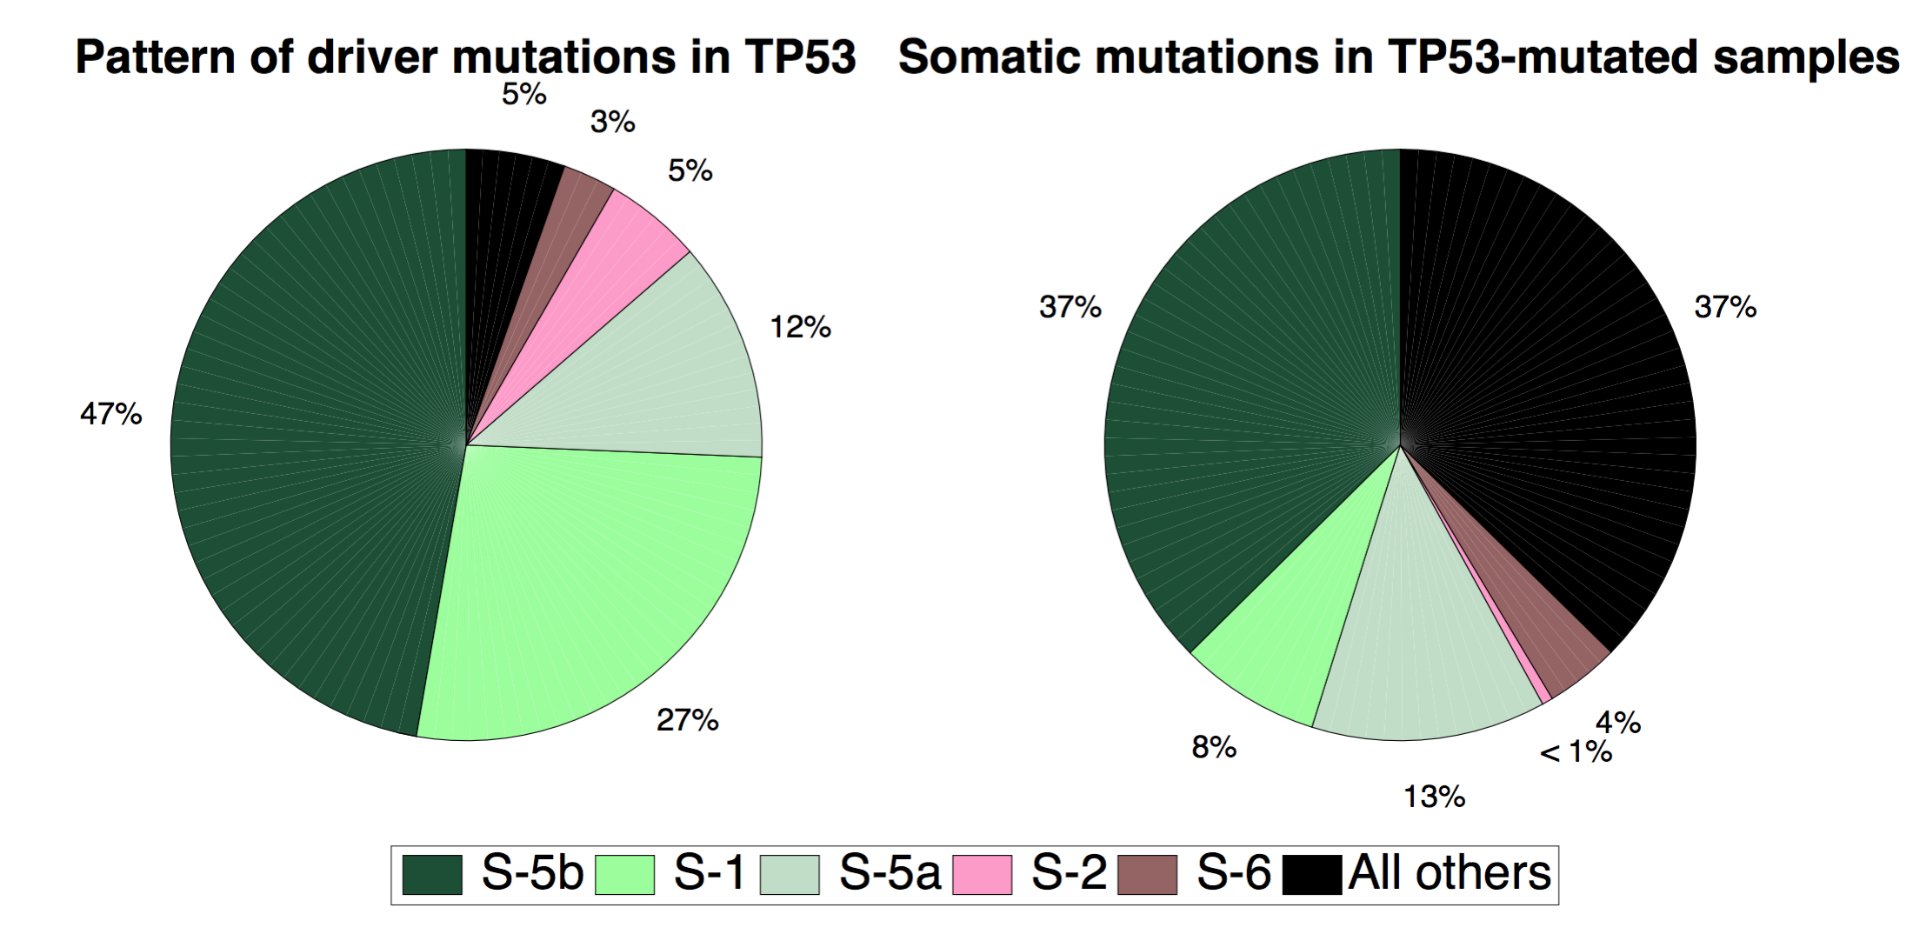
Typical: TP53 drivers in stomach cancer
Causes of driver mutations in TP53
Causes of all somatic mutations in TP53 mutated tumors

Slide 25
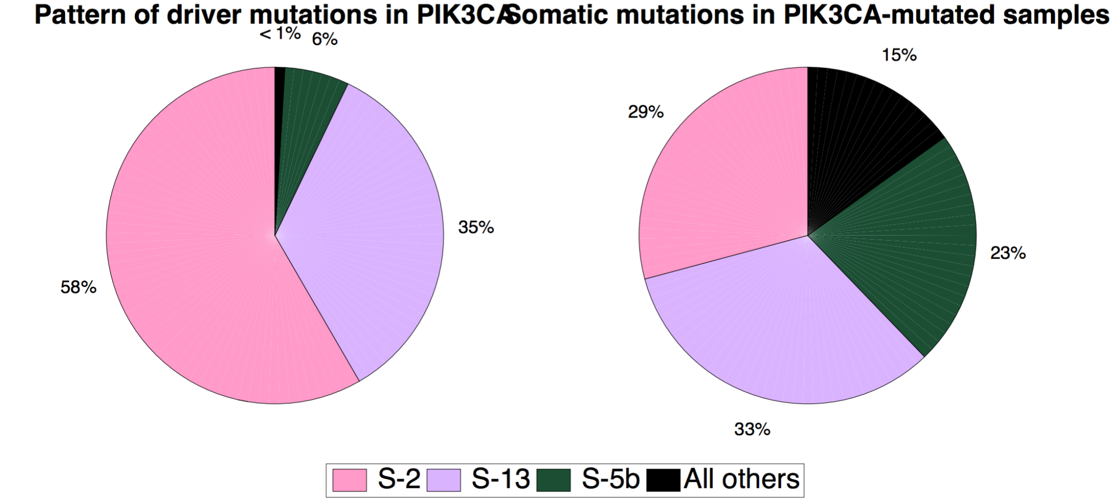
Atypical: PIK3CA drivers in cervical cancer
Causes of driver mutations in PIK3CA
Causes of all somatic mutations in PIK3CA mutated tumors

Slide 26
Contributors
Mutation Signature Discovery and Activity Assignment
Ludmil Alexandrov
Kyle Covington
Jaegil Kim
John McPherson
Ville Mustonen
Landscape and assignment of signatures to mutations
Nick Haradhvala
Mike Lawrence
Sandro Morganella
Paz Polok
Sabari Radhakrishnan
Mutagenesis mechanisms
Dmitry Gordenin
Marat Kazanov
Les Klimczak
Kin Chan
Steven A. Roberts
Natalie Saini
David Fargo
Shamil Sunyaev
Other
Gaddy Getz
Serena Nik-Zainal
David Wheeler
Teh Bin Tean
Nuria Lopez Bigas
Arnoud Boot
Mi Ni Huang
Akihiro Fujimoto
Hidewaki Nakagawa
Signatures responsible for drivers
Inigo Martincorena
Co-Leaders
Steve Rozen
Mike Stratton

Slide 27
End

Slide 28
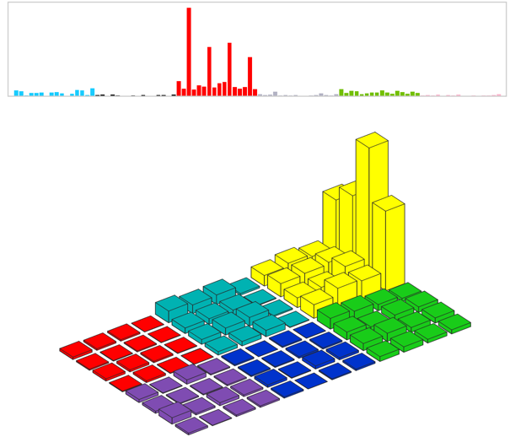
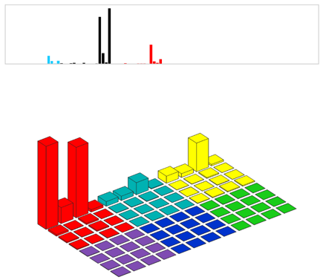
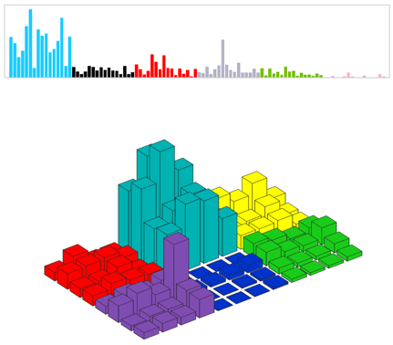
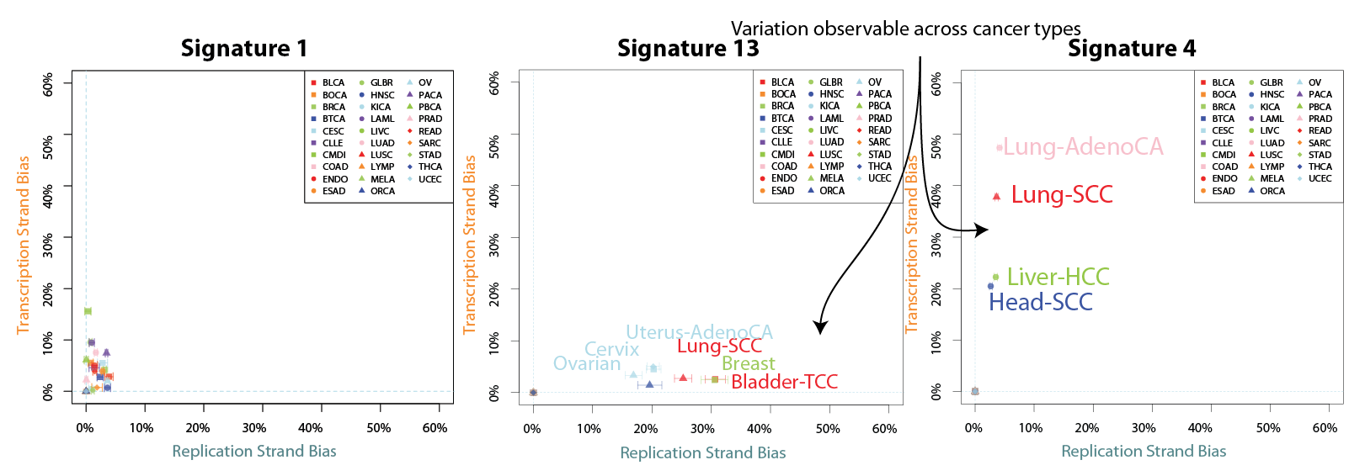
*Variation across 15 cell lines captured by error bars

Slide 29
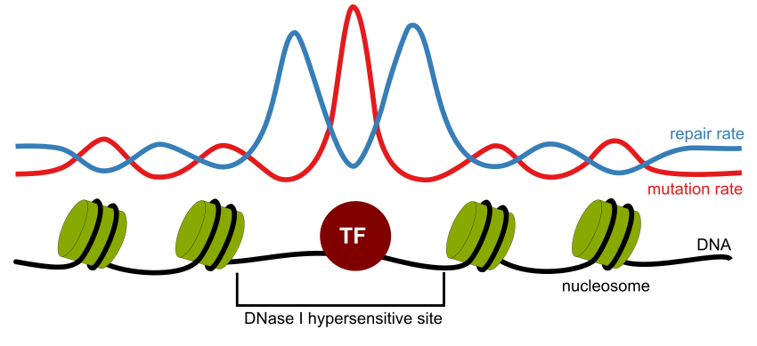
Impact of DNA-binding proteins (including transcription factors and nucleosomes) on local mutation rate variation

Slide 30
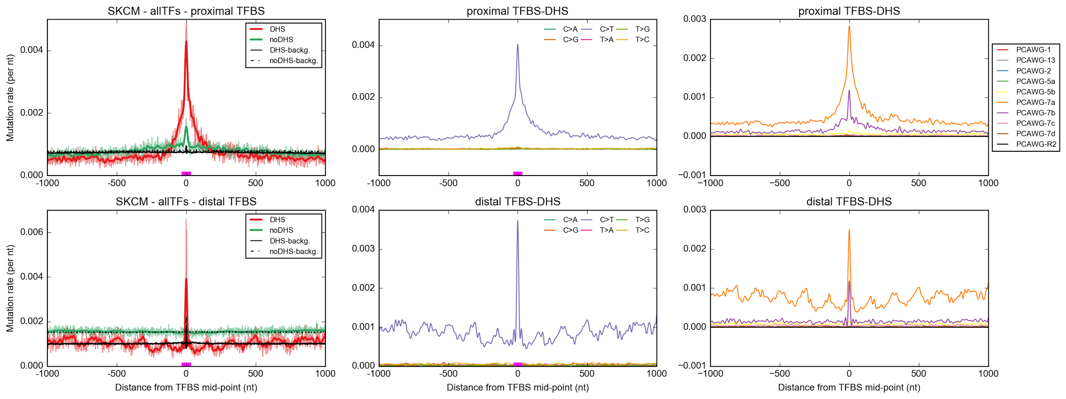
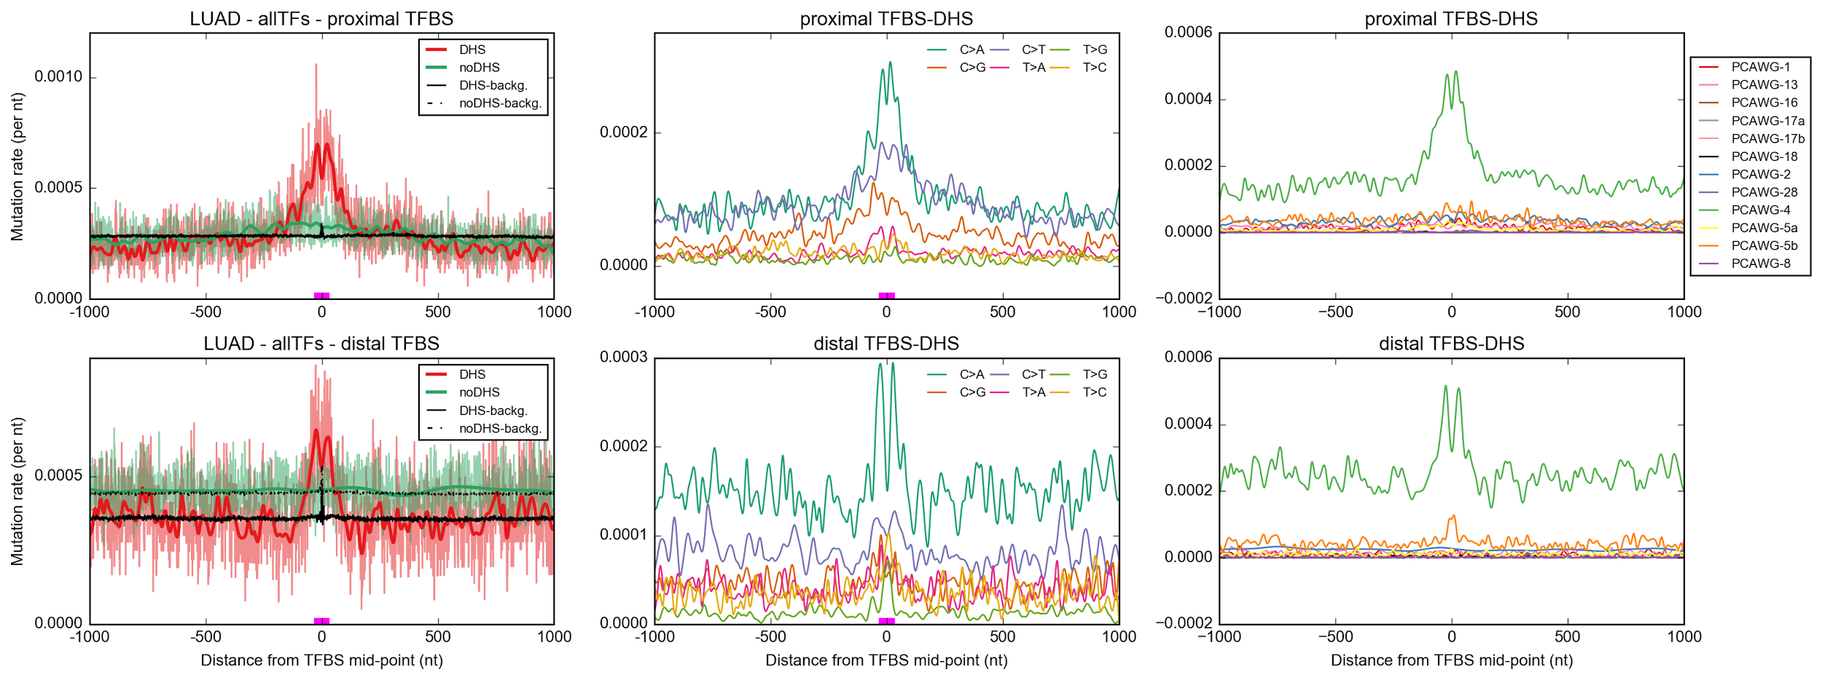
Increased mutation rate at TFBS and nucleosome positions in melanoma and lung adenocarcinoma due to reduced NER
UV signature
Smoking signature
Which other mutational processes, in addition to impaired NER, contribute for an increased mutation rate at TFBS/nucleosome regions?

Slide 31
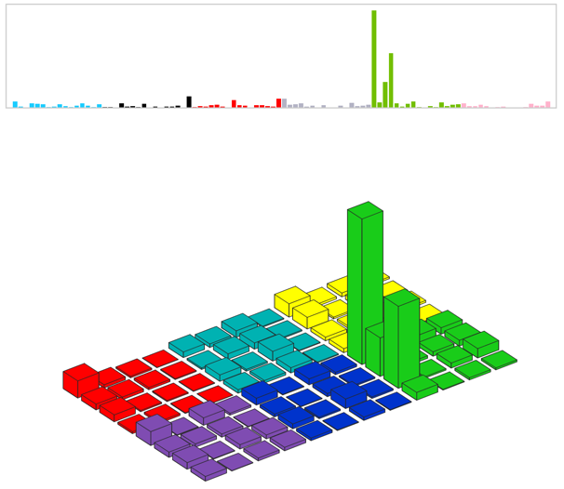
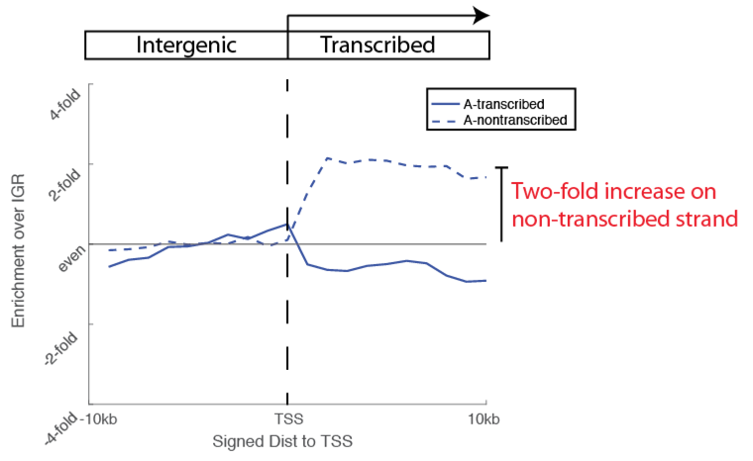
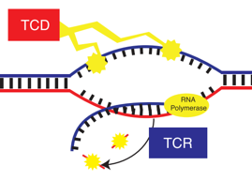
Transcription-coupled damage signature isolated

Slide 32
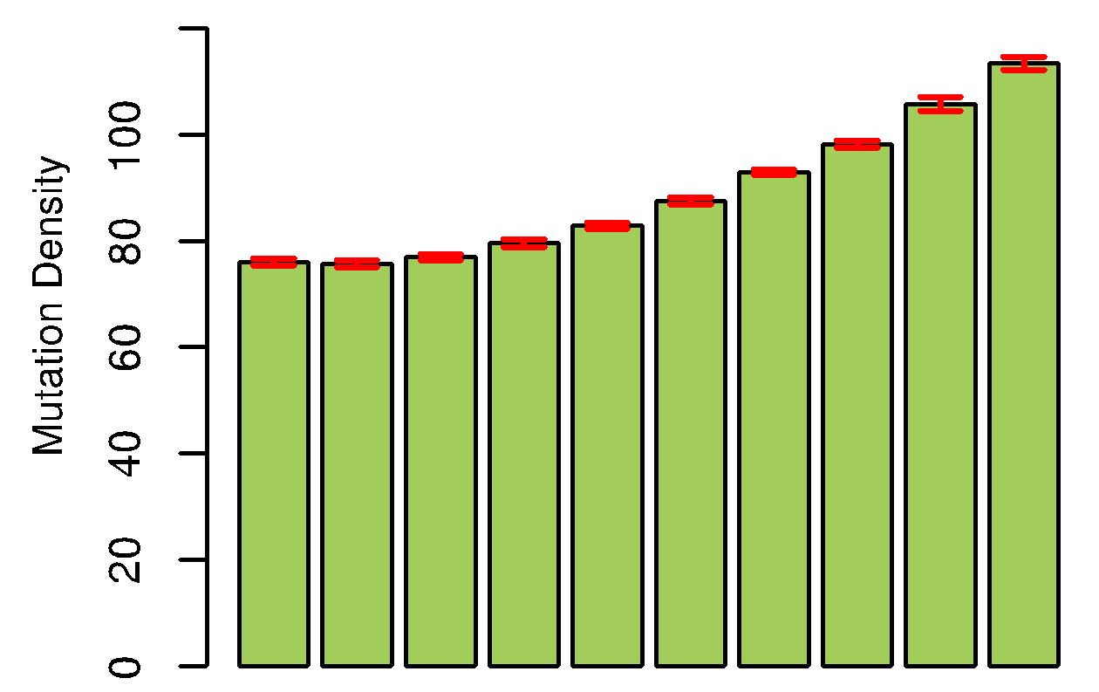
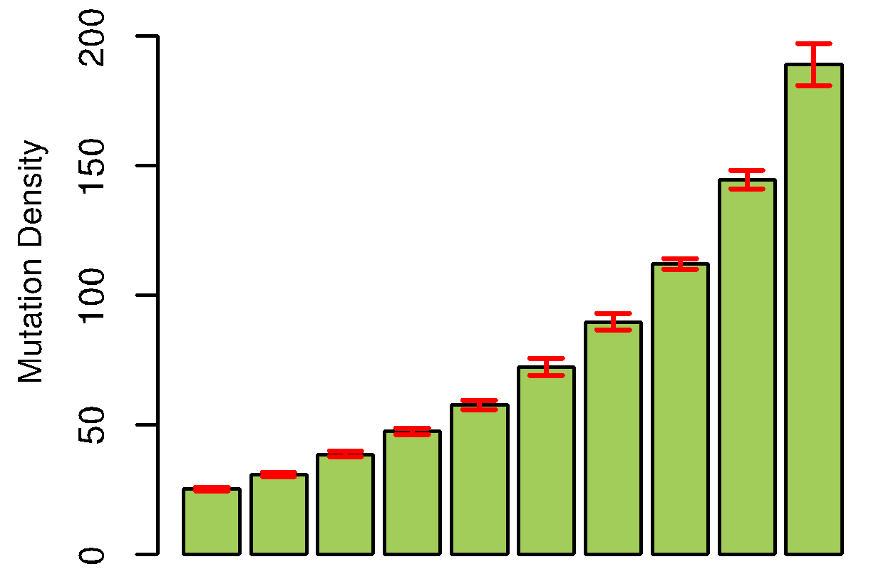
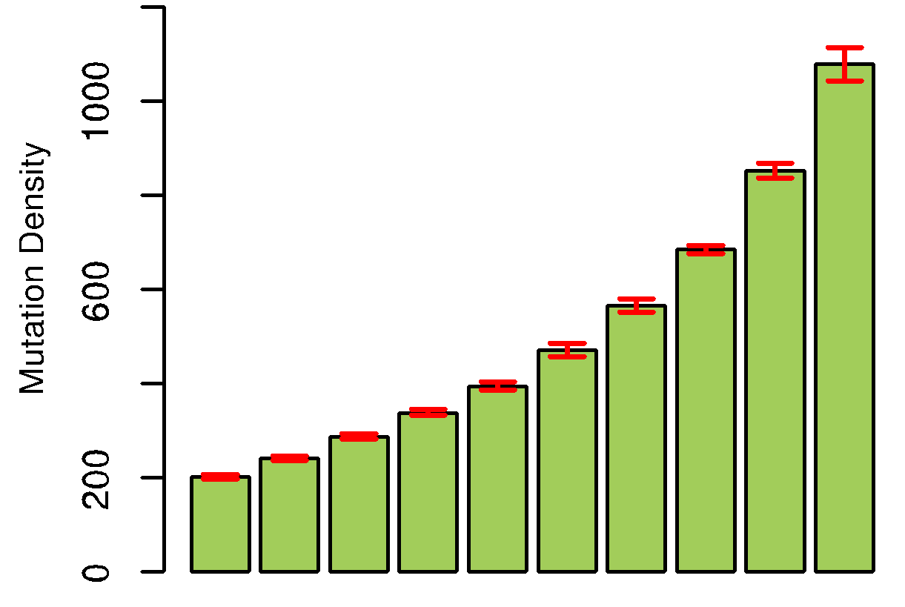
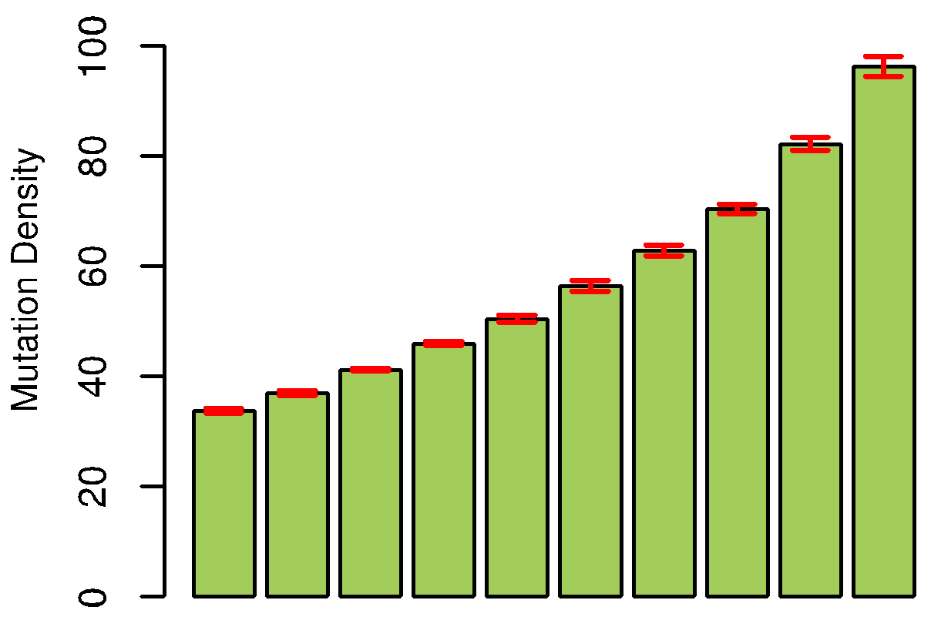
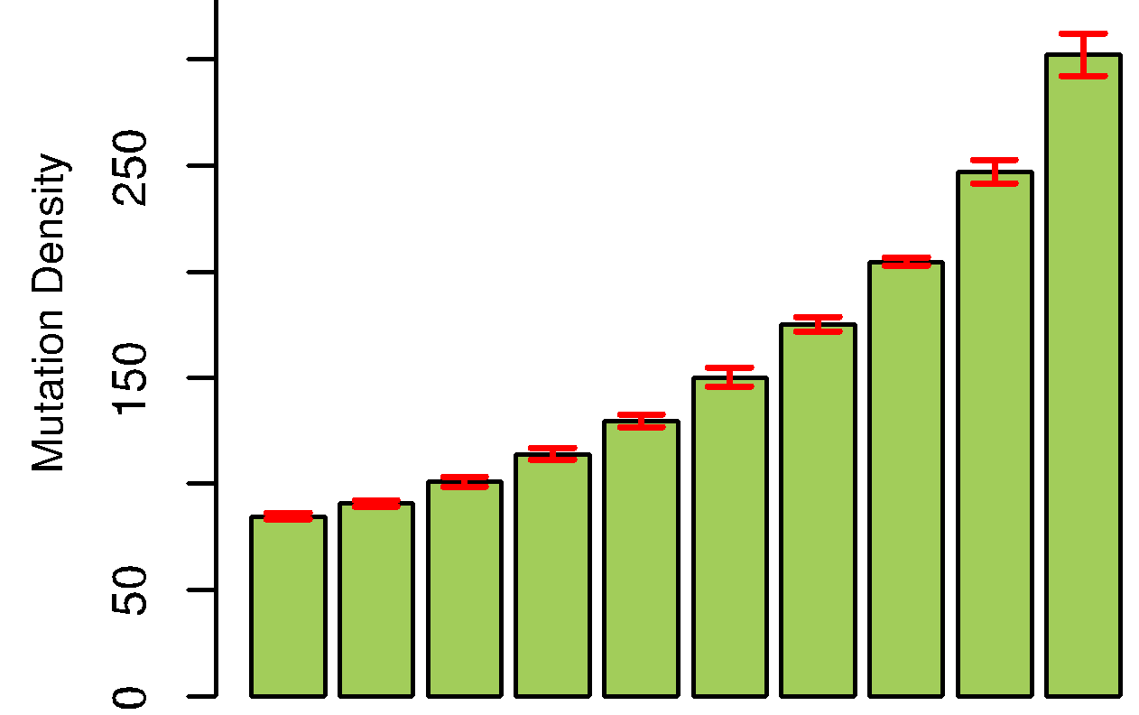
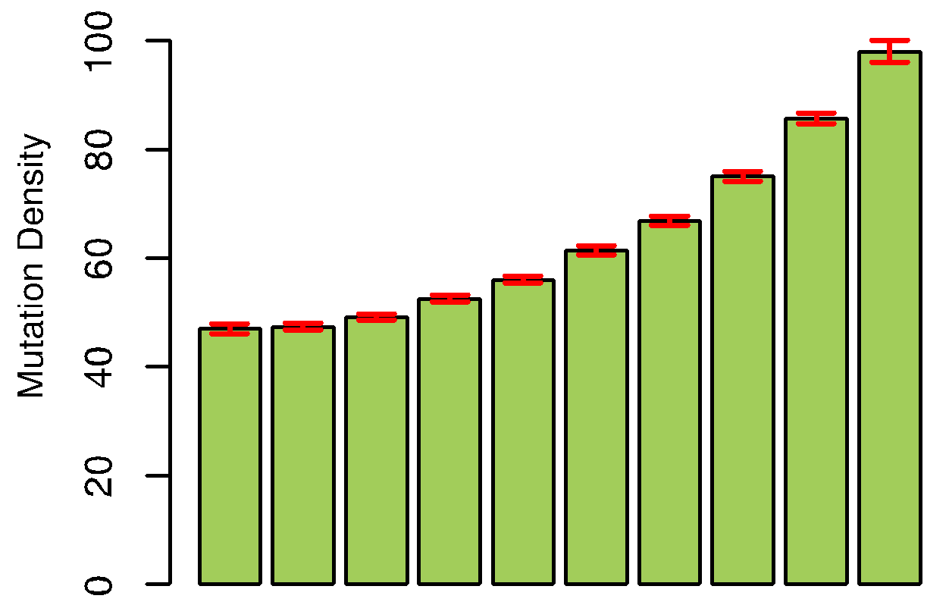
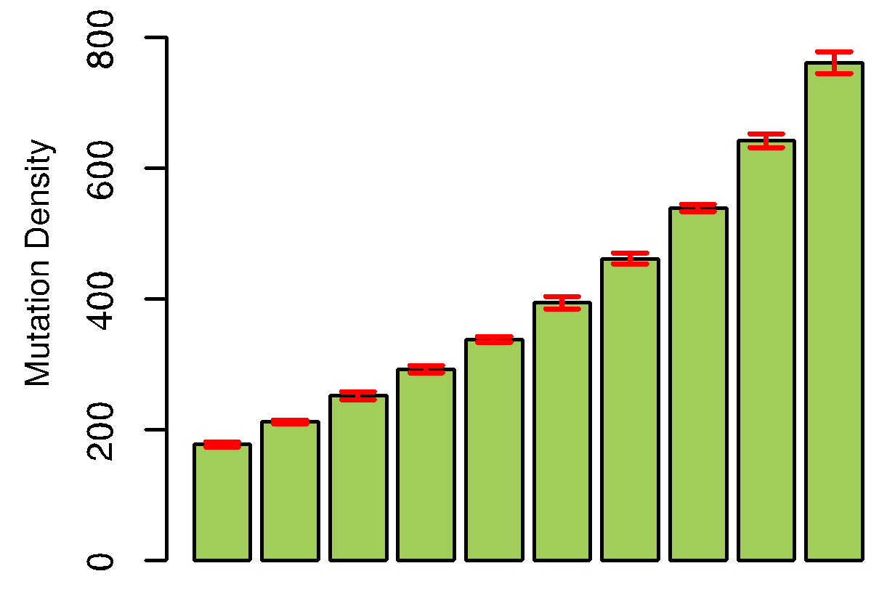
Replication timing concordance across tumor types
Signature1 (Age-related)
Signature4 (Smoking-related)
BRCA
HNSC
LUSC
GLBR
LIVC
•Error bars are used to show the confidence intervals across 15 cell lines
LUAD
PRAD
Early
Late

