Slide 1
ENCODE & Cancer BMR modeling
JZ & DL & LL & AG

Slide 2
Property of mutation count data: overdispersion
Consequence of overdispersion: false positive and false negative
Source of mutation rate heterogeneity:
  patient effect - LARVA
  External genomic feature effect - NIMBUS
  Context effect – ultimate model?

Slide 3
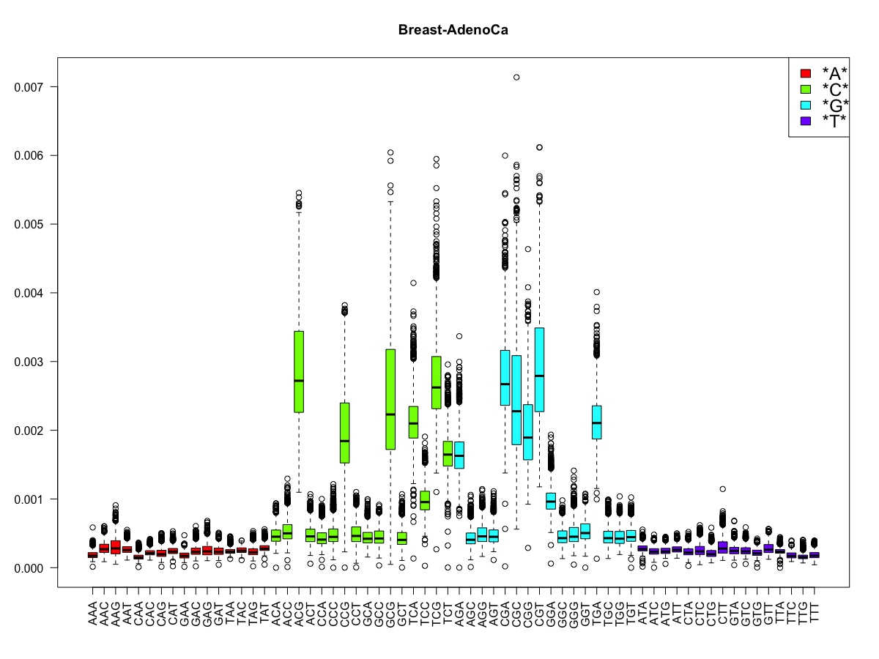

Slide 4
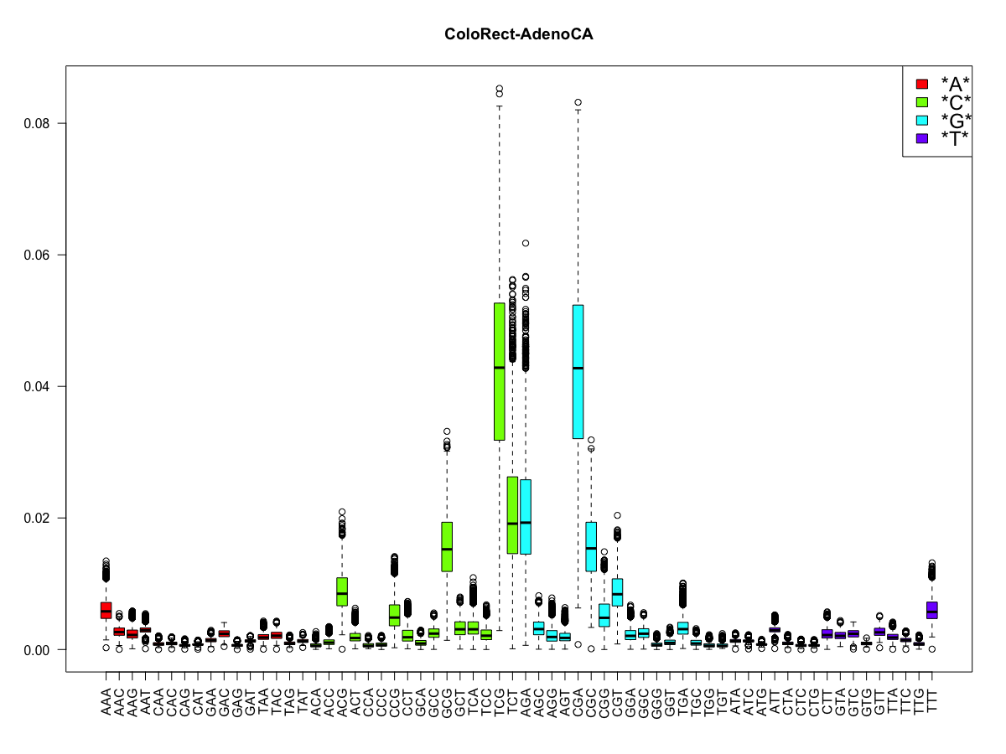

Slide 5
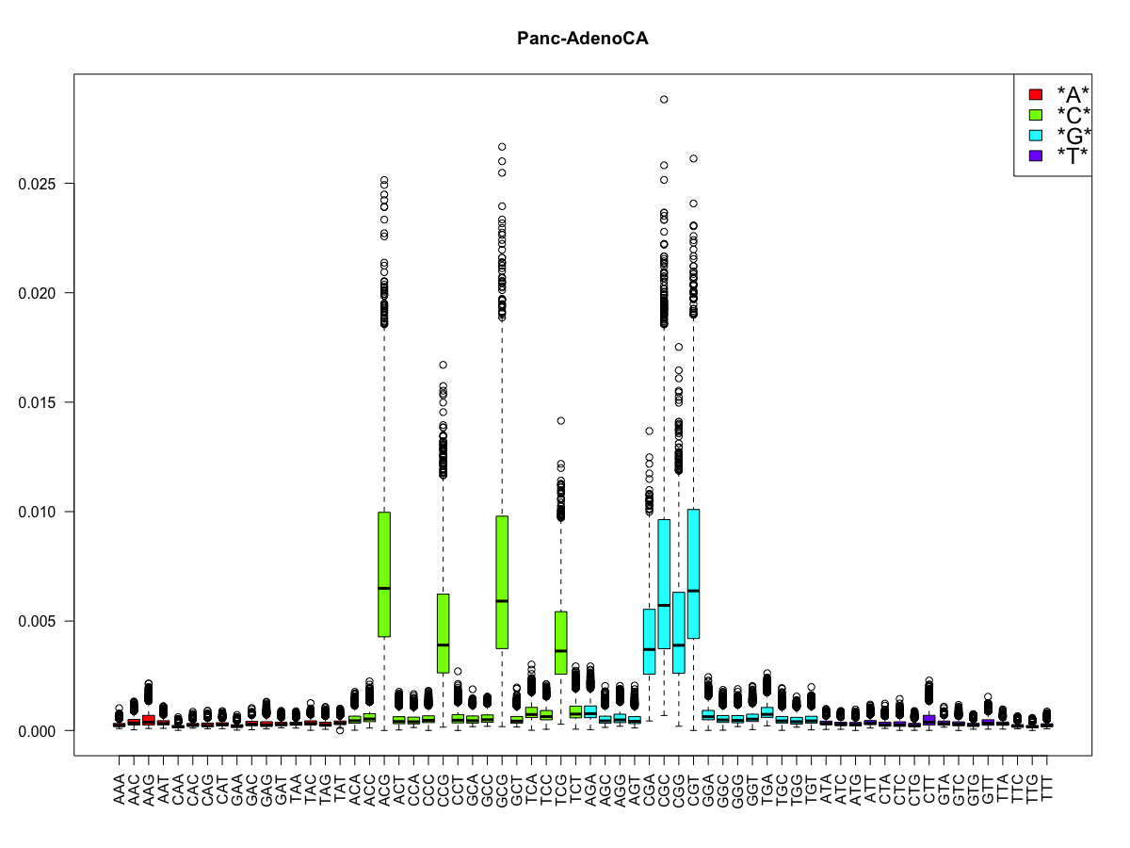

Slide 7
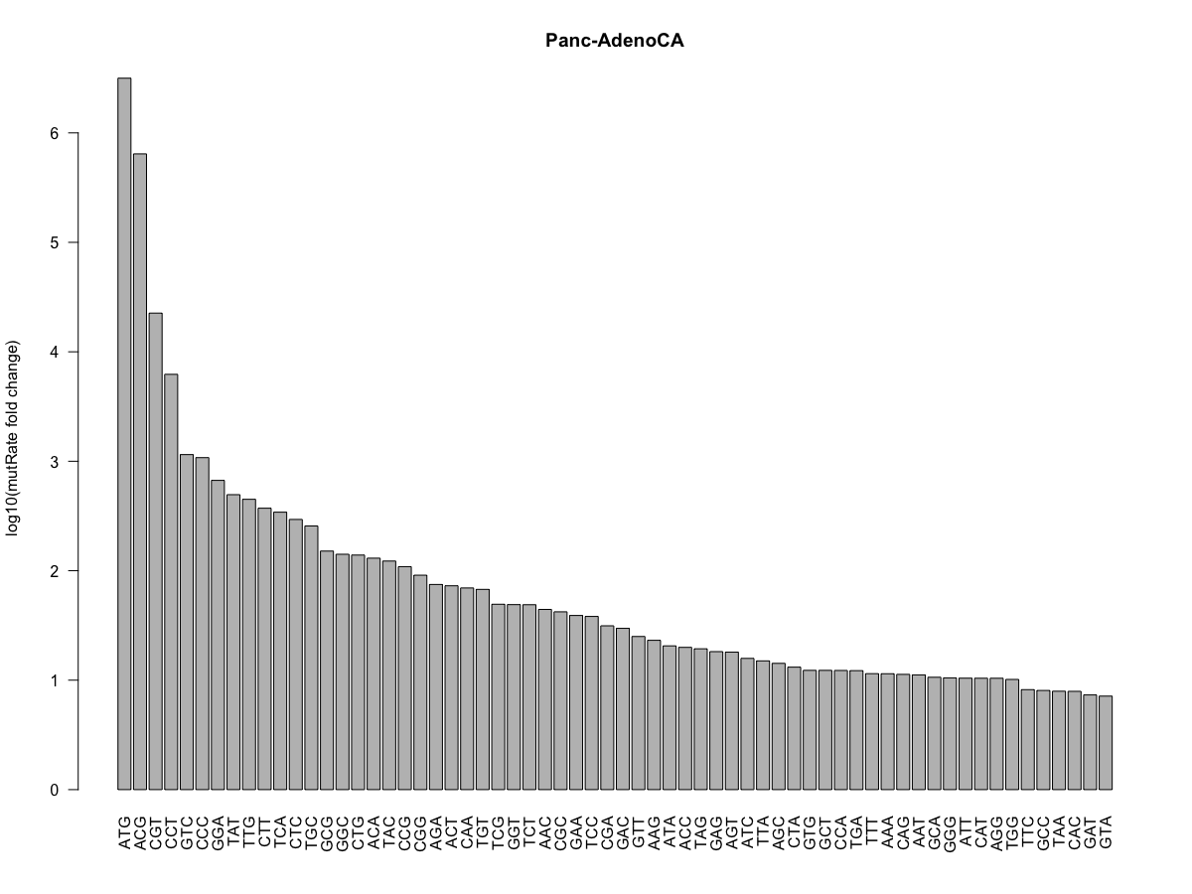

Slide 8
Original model:
y_{i}: number of mutations at the ith position on the genome after pooling the samples
x_{i1},x_{i2}, …,x_{ik}: covariates for the ith position on the genome
Current model: for a 3mer model
y_{i,j}: number of mutations at the ith position on the genome of the jth category
x_{i1},x_{i2}, …,x_{ik}: covariates for the ith position on the genome
Question: how to calculate the P values from so many categories?

Slide 9
AGTCAAGTT…...........ACGATCCAGTGGAGT
TGTCAAAGT…...........ATGATCCAGTGGATT
For the category AGT:
L1= 3, Y1=1
L2=2, Y2=1
AGTCAAGTT…...........ACGATCCAGTGGAGT
a target region to be tested
Collected from our BMR estimator, for a target region with length l
What is the distribution of sum of NBI with arbitrary parameters?

Slide 10
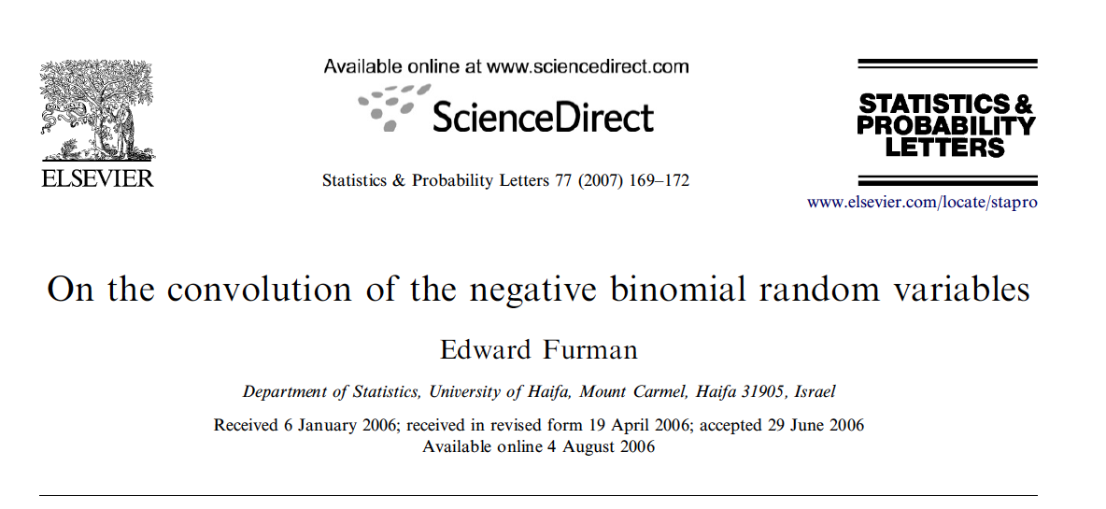
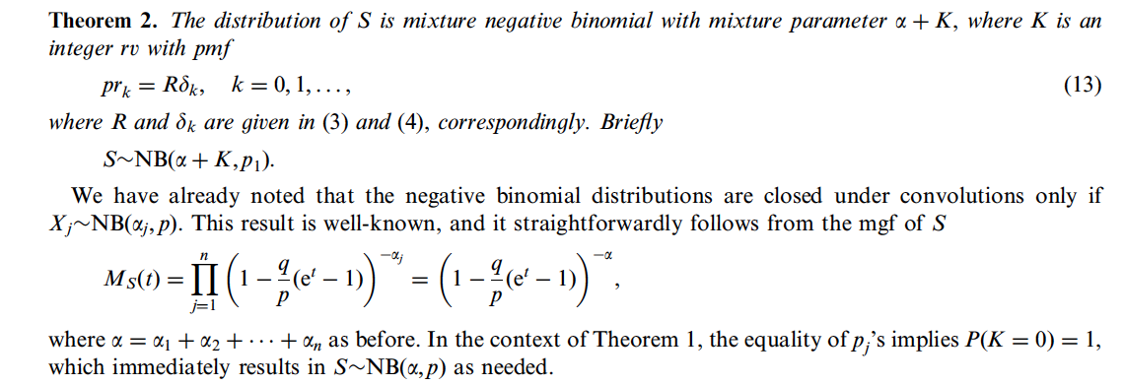
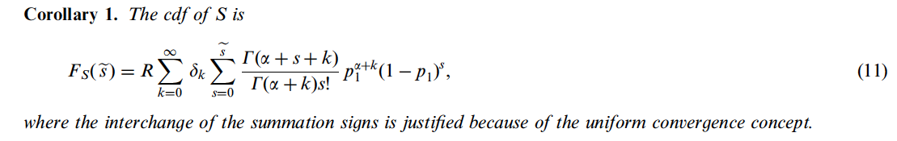

Slide 11
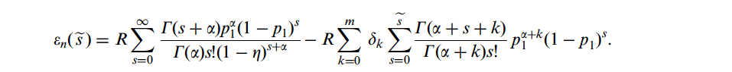
Pros: fast, run time independent of variant count
Cons: unknown precision
Forever working but slow algorithm: convolution
Especially easy for count data
Y = X1+X2+…+Xl, l may be very large
Question: what if L is very huge? Like a gene with more than 5kb
Rethinking of negative binomial distribution:

Slide 12
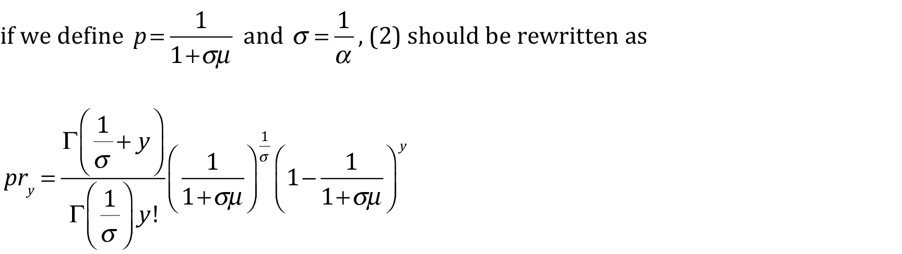
Negative binomial distribution can be extended by relaxing r
r: can be any continuous value, not just integer
AGTCAAGTT…...........ACGATCCAGTGGAGT
a target region to be tested
The number of 3mers are fixed no matter how long the sequence is!

Slide 13
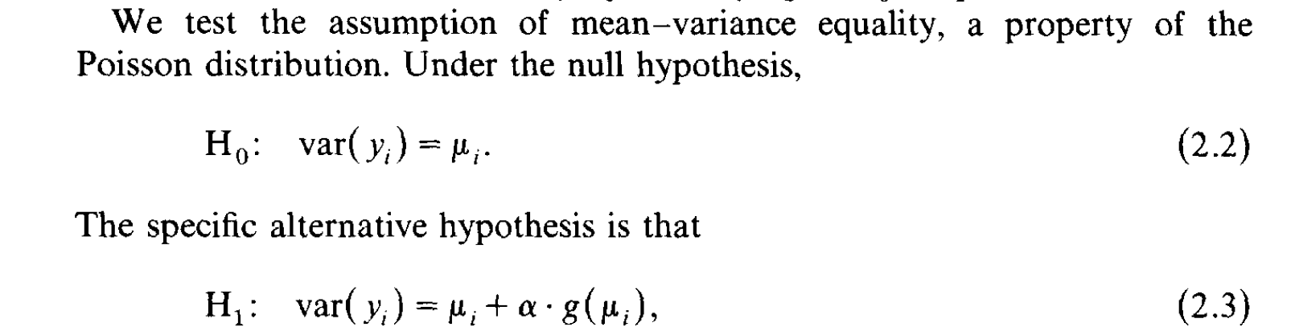
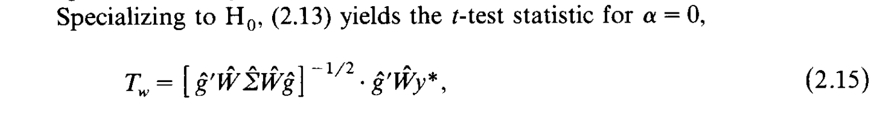
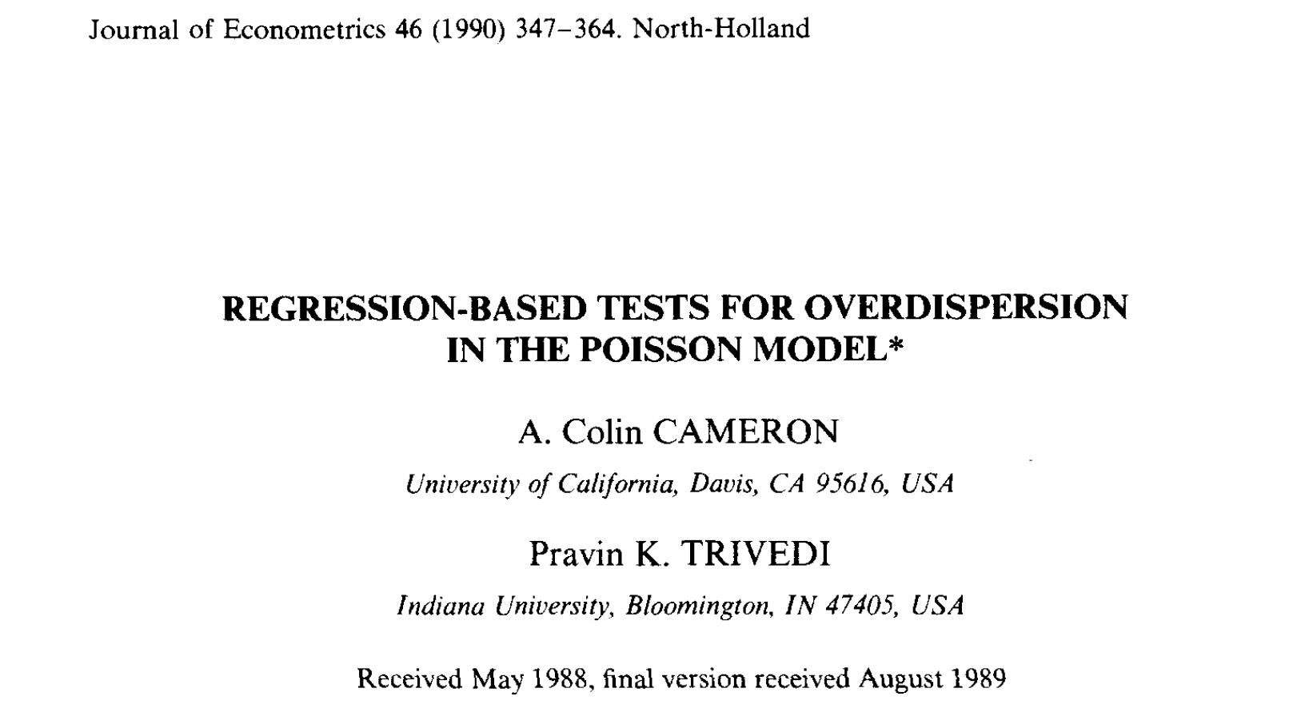
What is negative about negative binomial distribution?
Can only handle overdispersion?
How about in cases where some 3mers are not that heterogeneous?

Slide 14
Chop the genome into bins
Count the kmer bases & kmer variants
Final Burden Test
Full Poisson Regression
Feature selection
Poisson Regression with selected features
Overdispersion Test
NBI regression with selected features
Merge parameters
Convolution

Slide 15
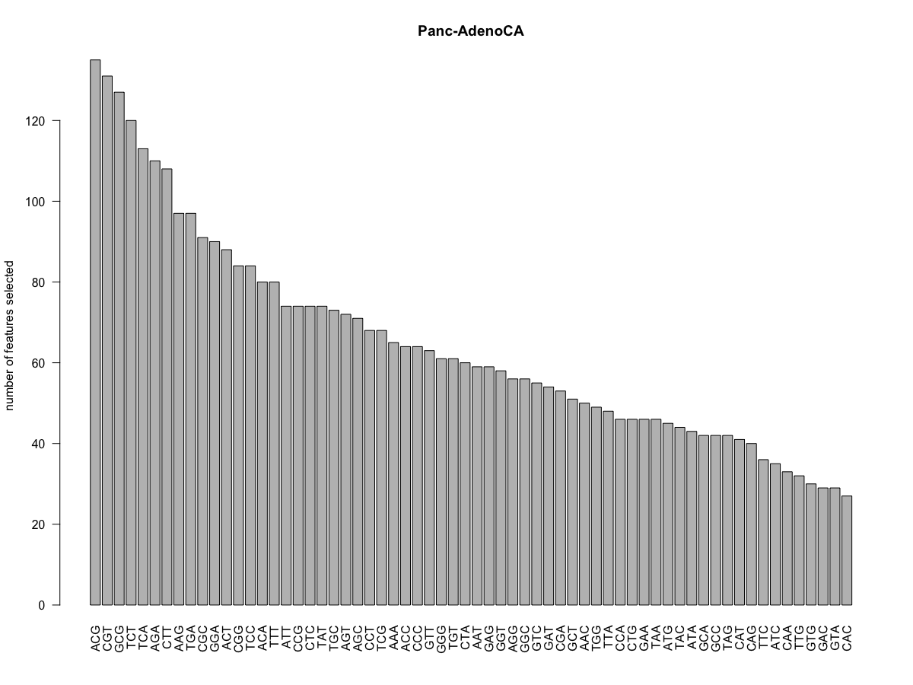
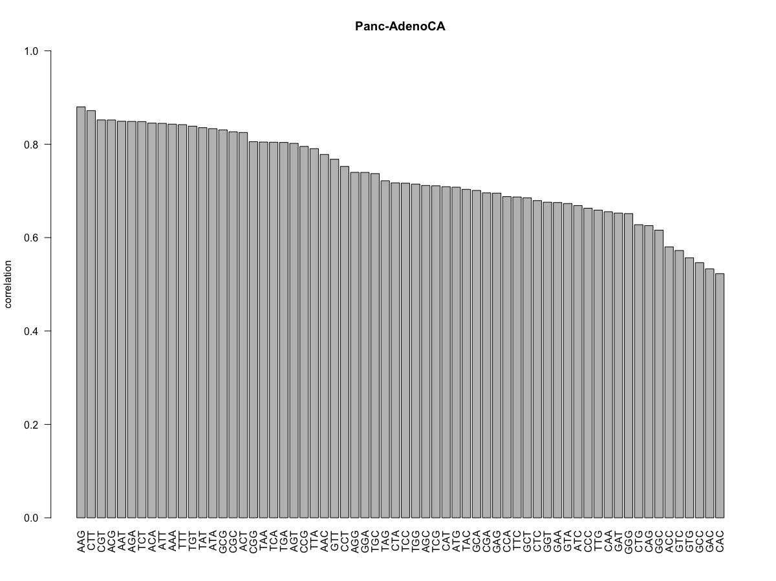
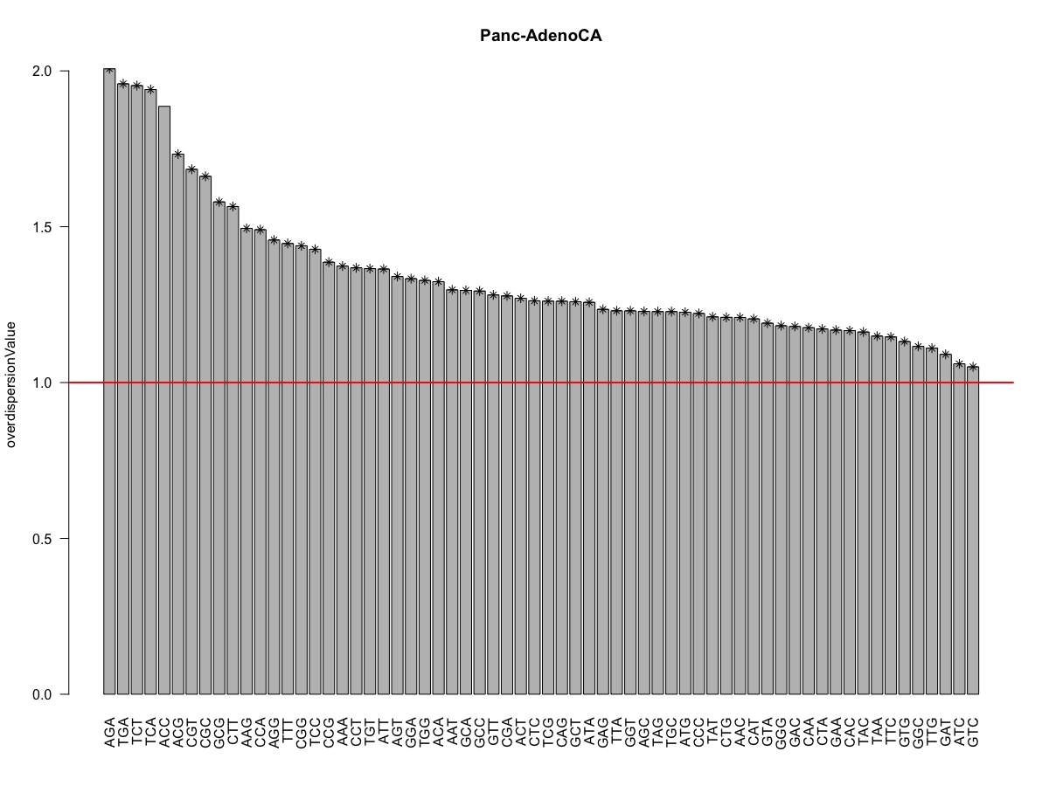

Slide 16
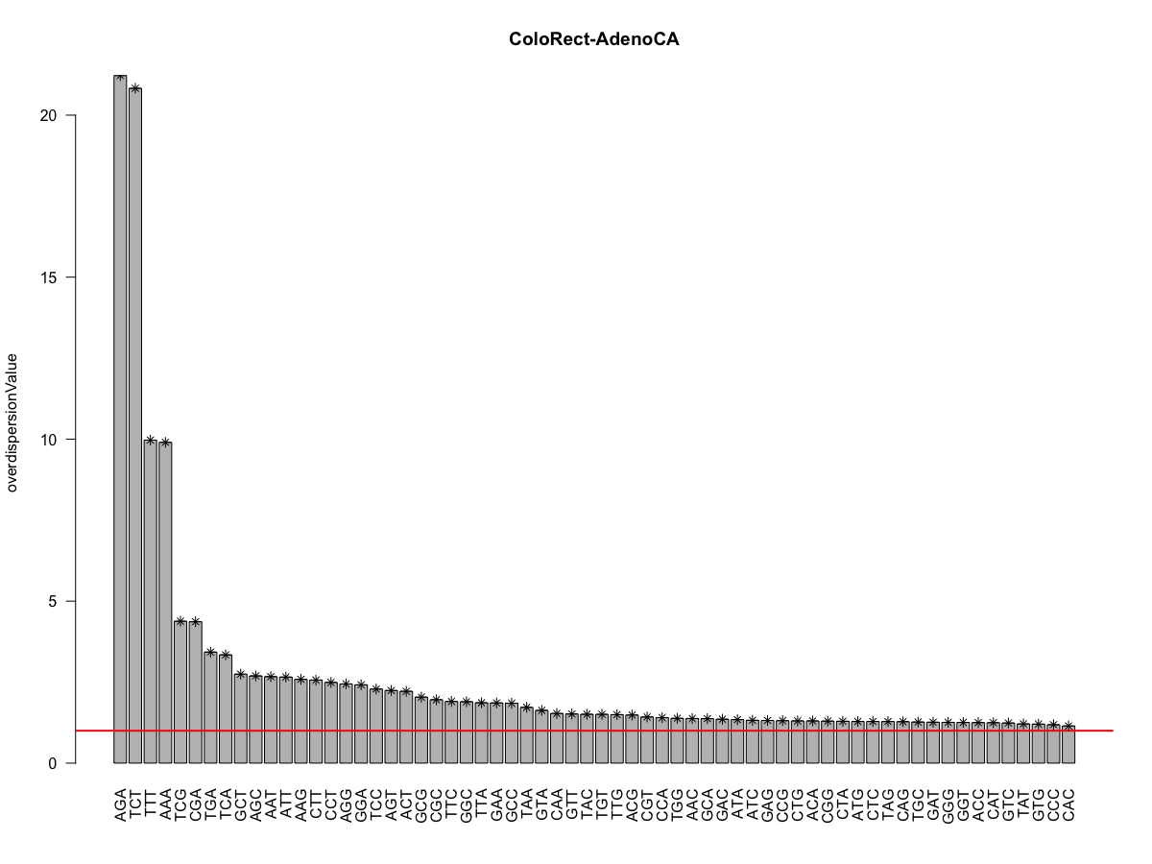

Slide 17
