Slide 2
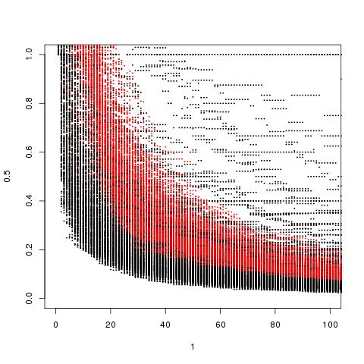
More fit subclones fall from their maximum prevalence more slowly (except these wispy cases – few cells?)
This should mean that more fit subclones will have a sharper VAF peak
Next slide I would like to actually see the VAF distributions – with and without noise
It may be that most of the width of the VAF distribution has to do with the number of mutations two subclones already had
If you had more mutations to begin with, then you;

Slide 3
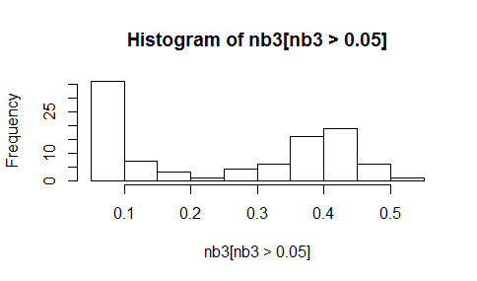
The mutations that get counted as “subclone B” by callers are the ones on the right centered around 0.4
Subclones B will have a bigger hump at the left than the less-fit Subclone A, but this will never show up in analyses
In addition, Subclone B will have a slighter wider peak because of previous slide

Slide 4
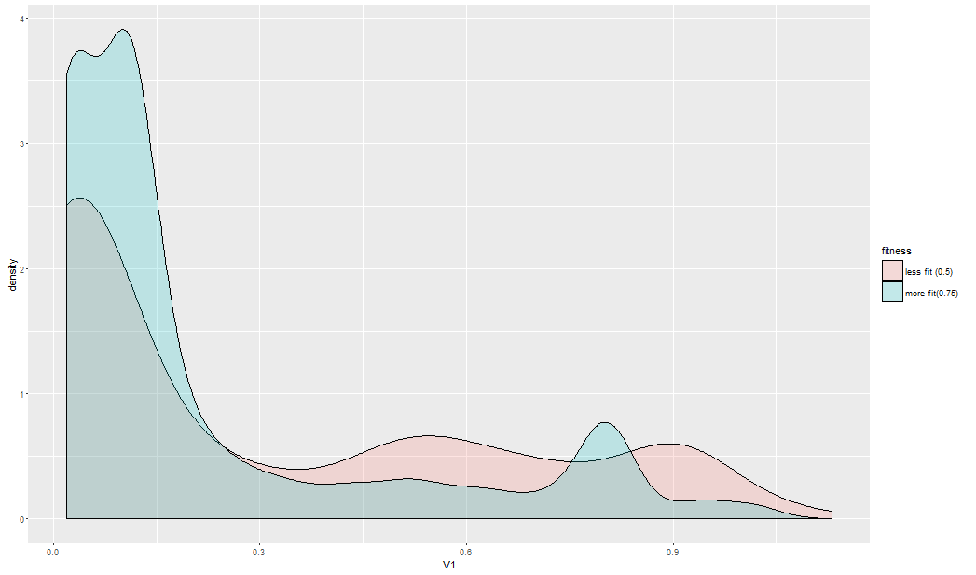
Full-width half-max

Slide 5
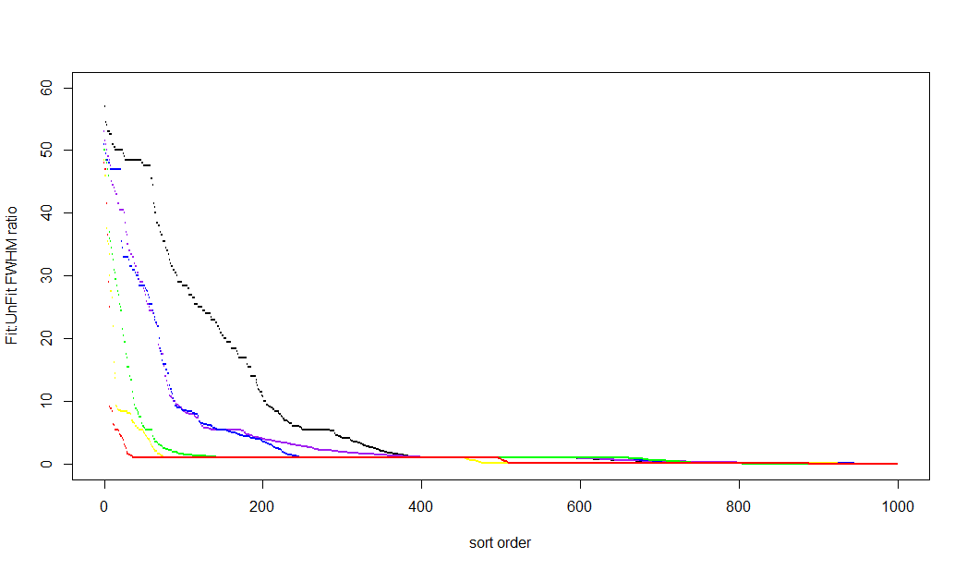
Increasingly Fit Subclones are less likely to have wider VAF peaks

