Slide 1
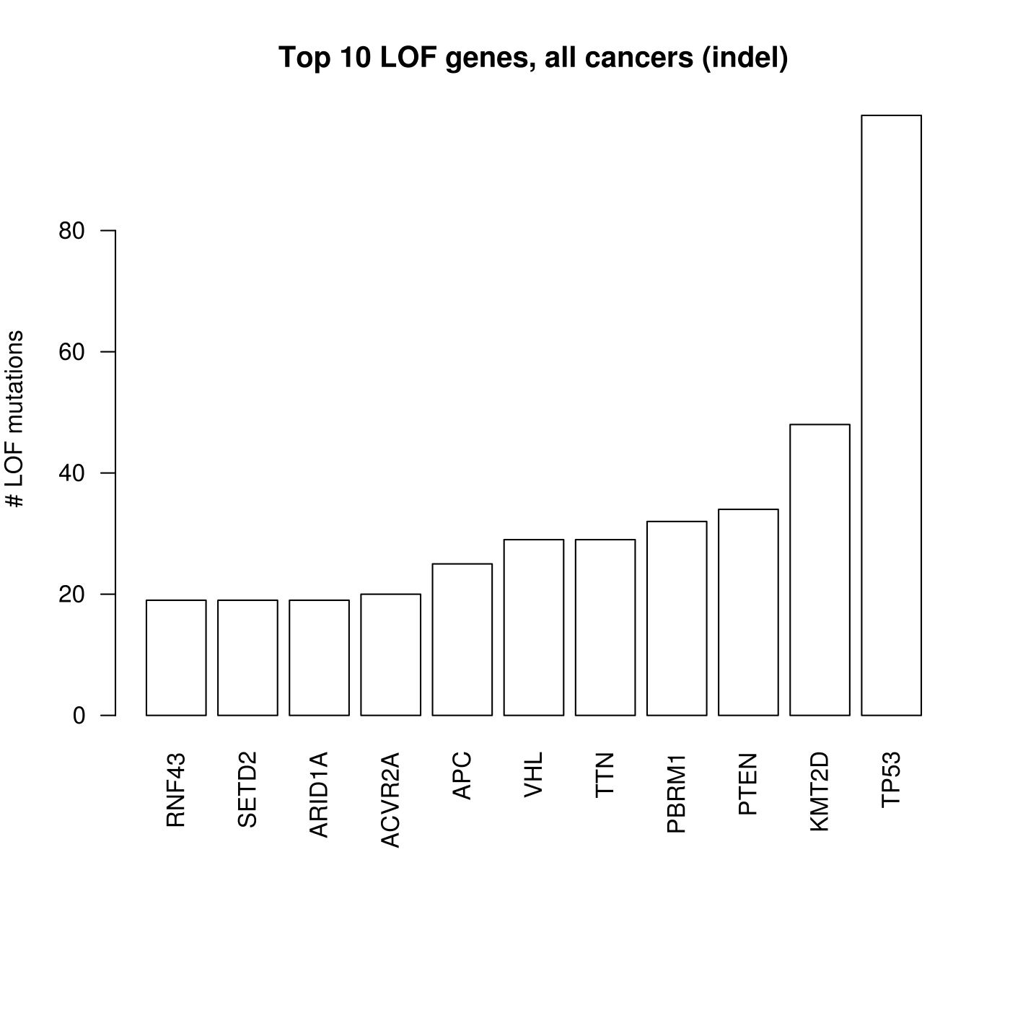
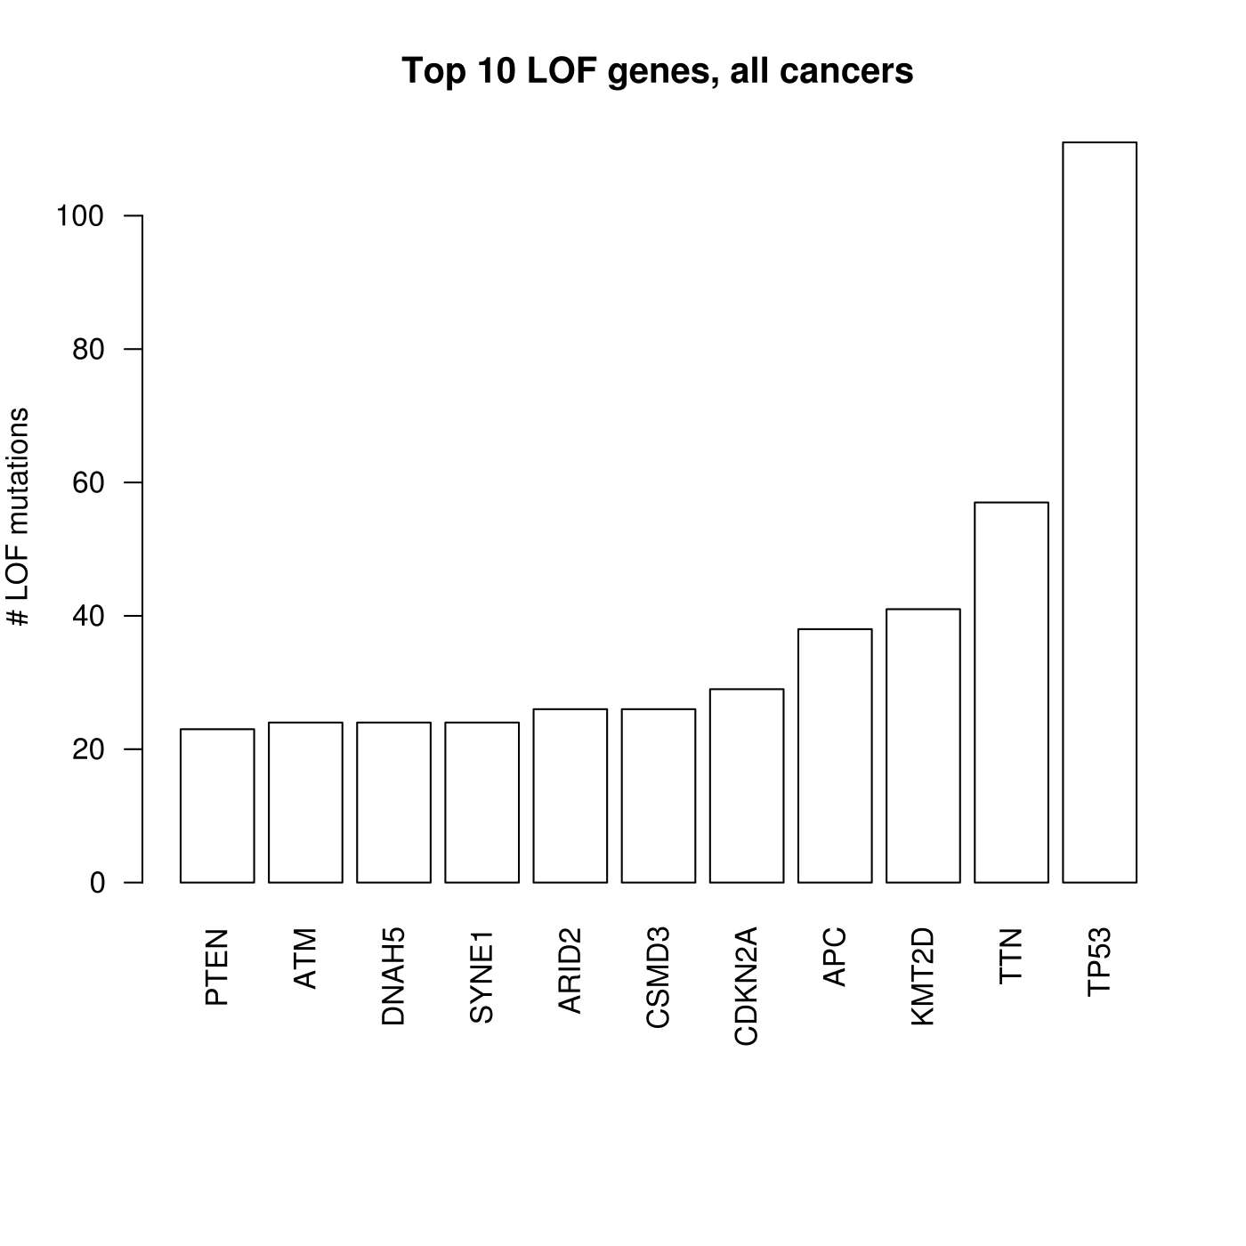
indel
SNP

Slide 2
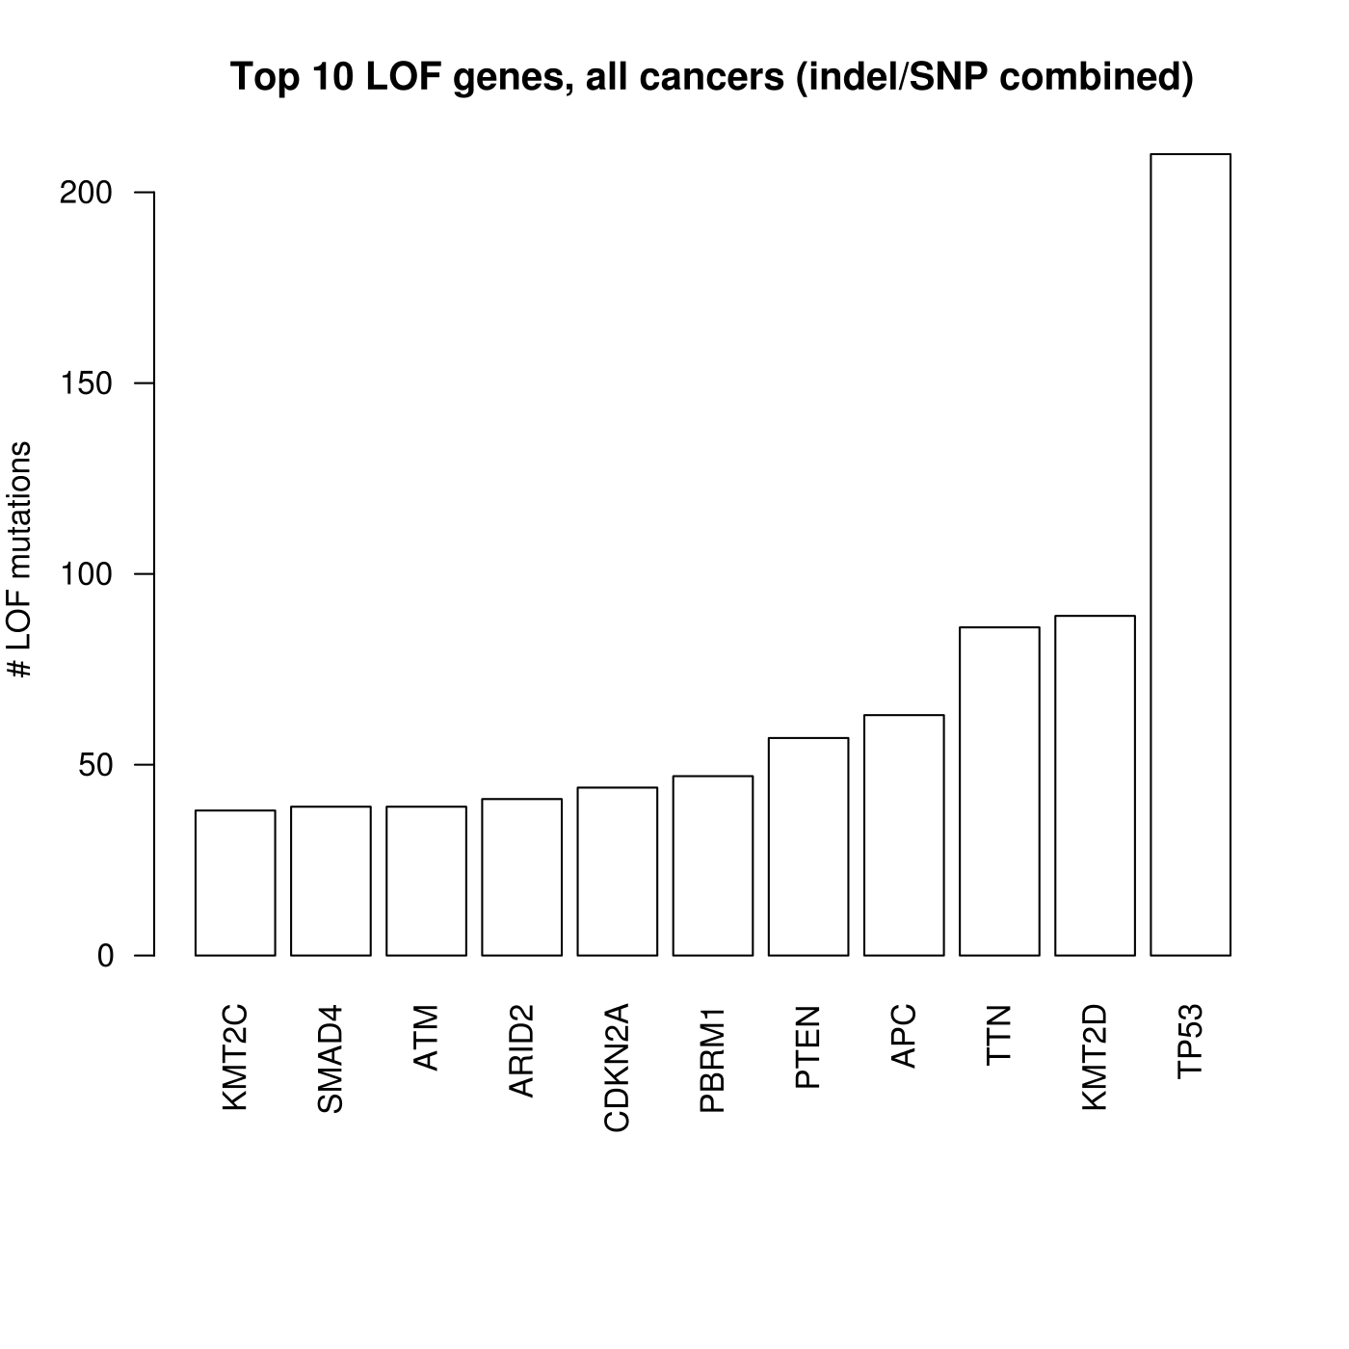

Slide 3
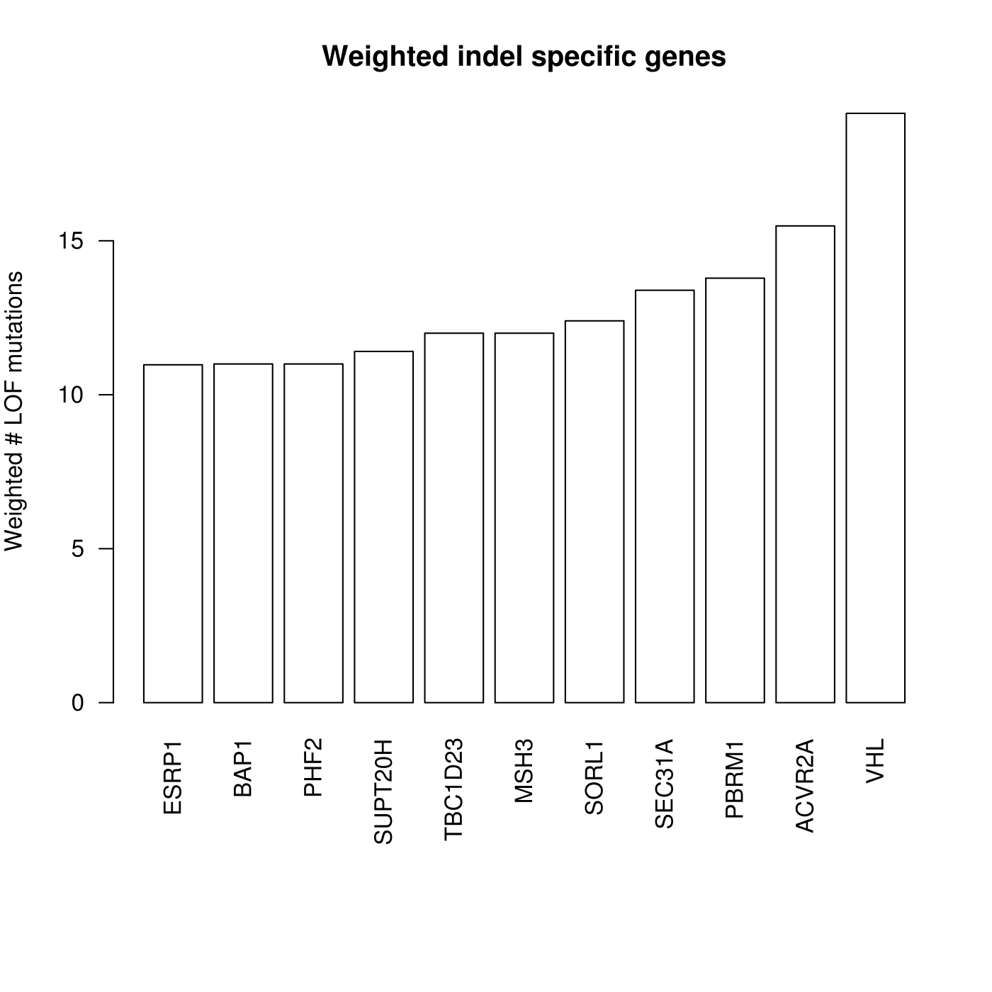
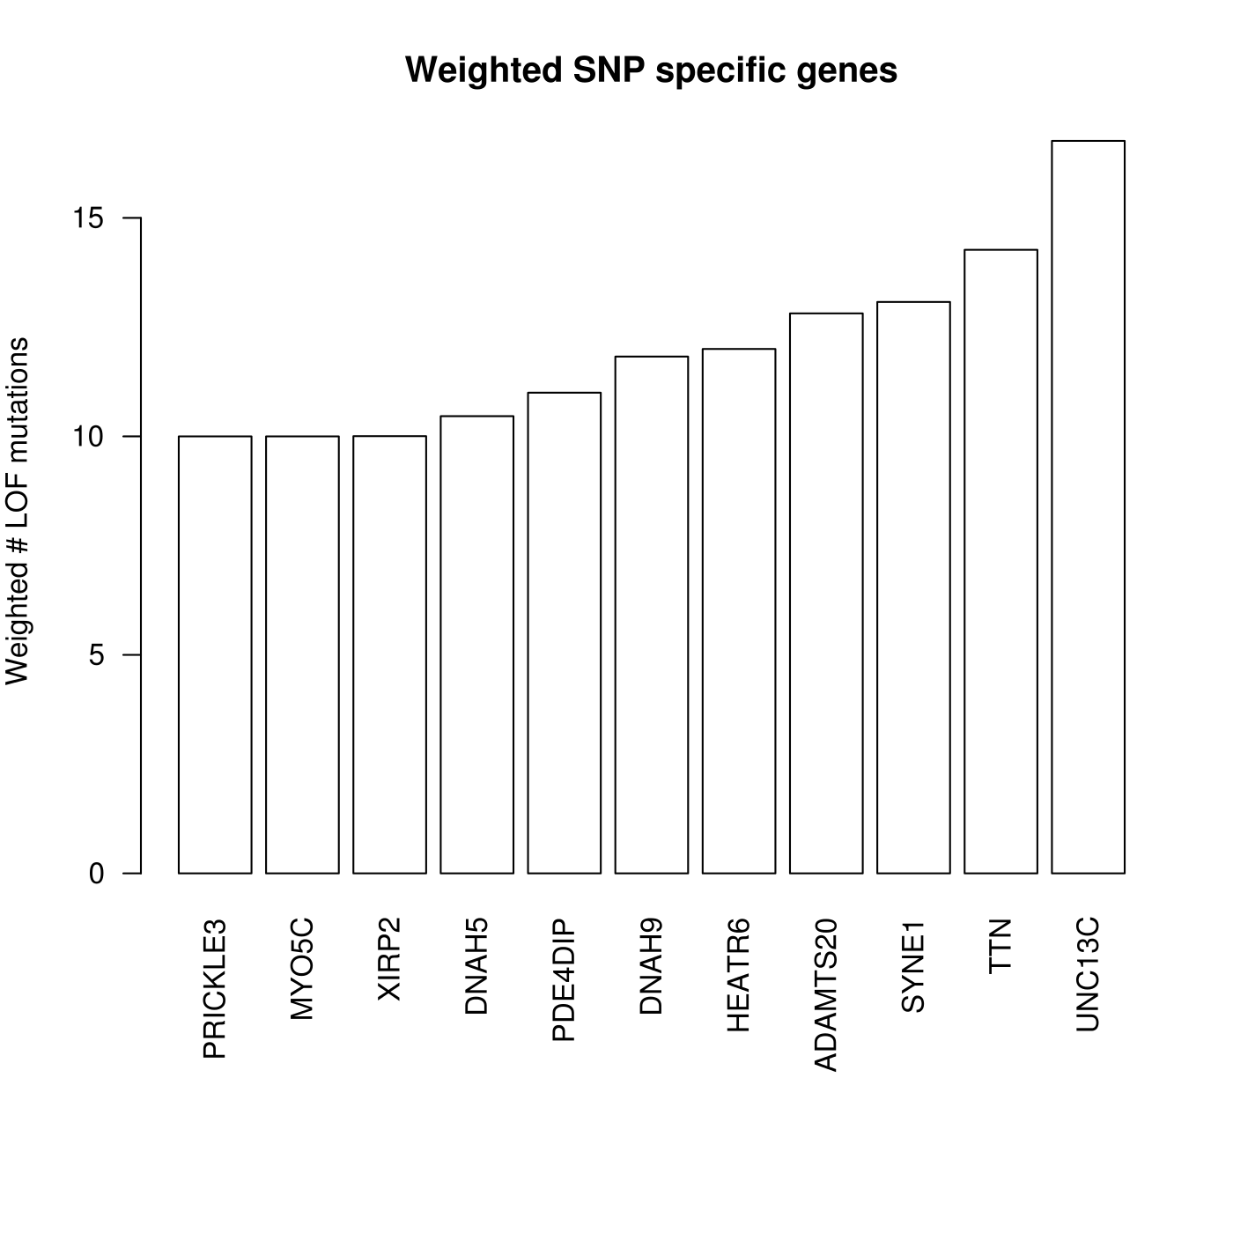
Indel specific genes / SNP specific genes

Slide 4
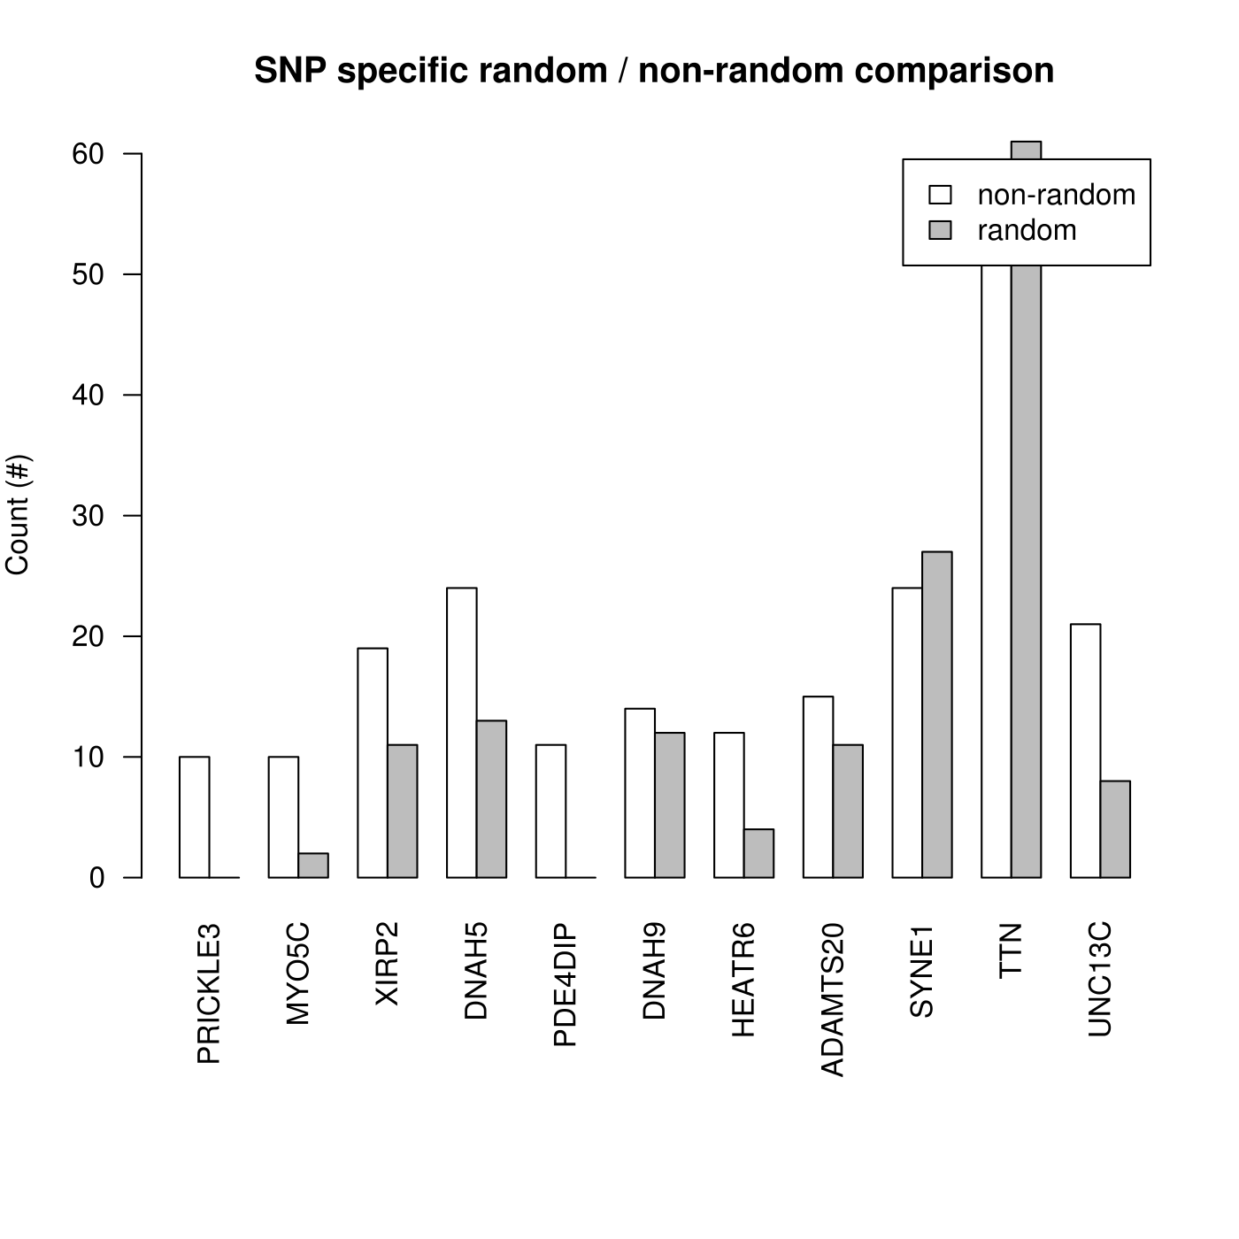

Slide 5
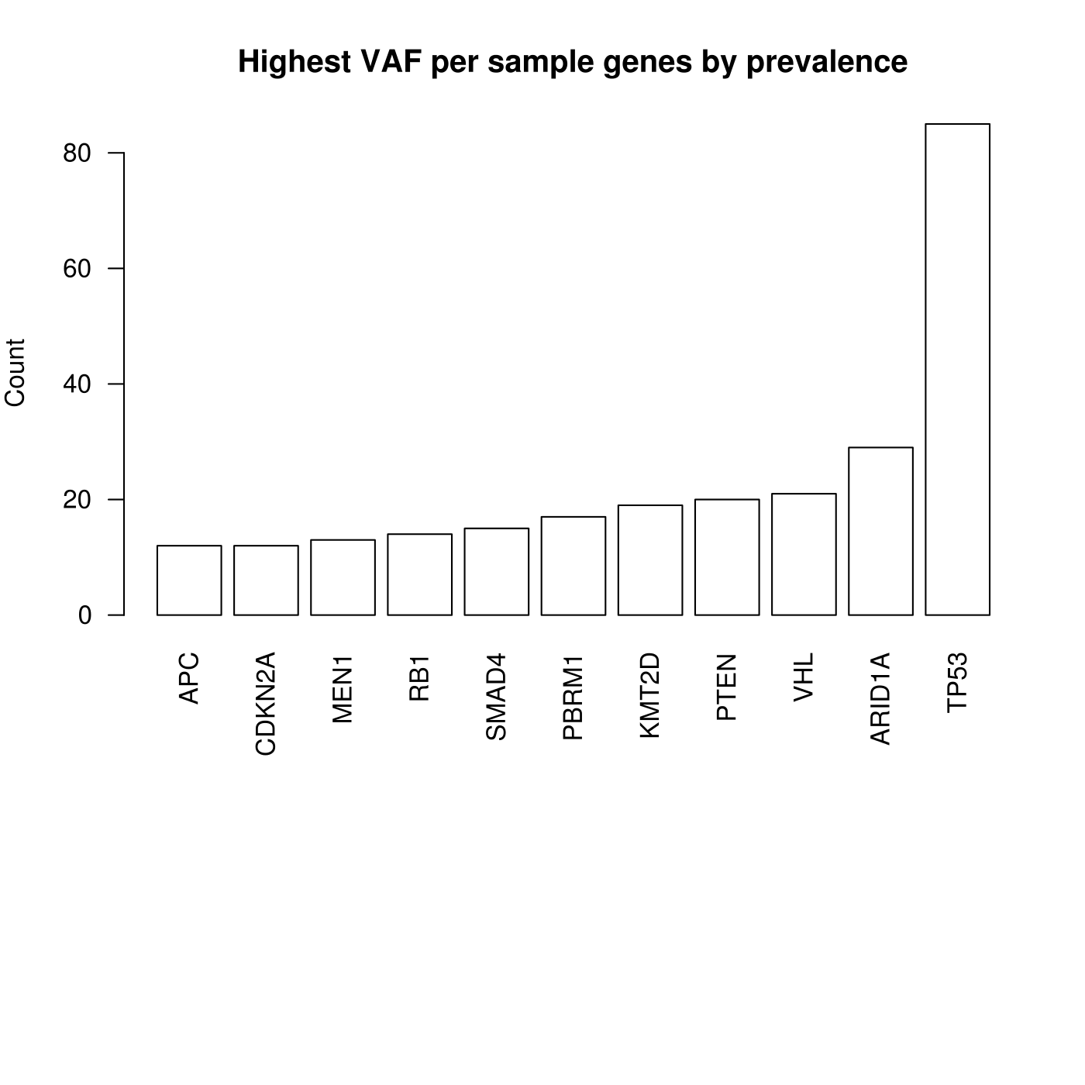
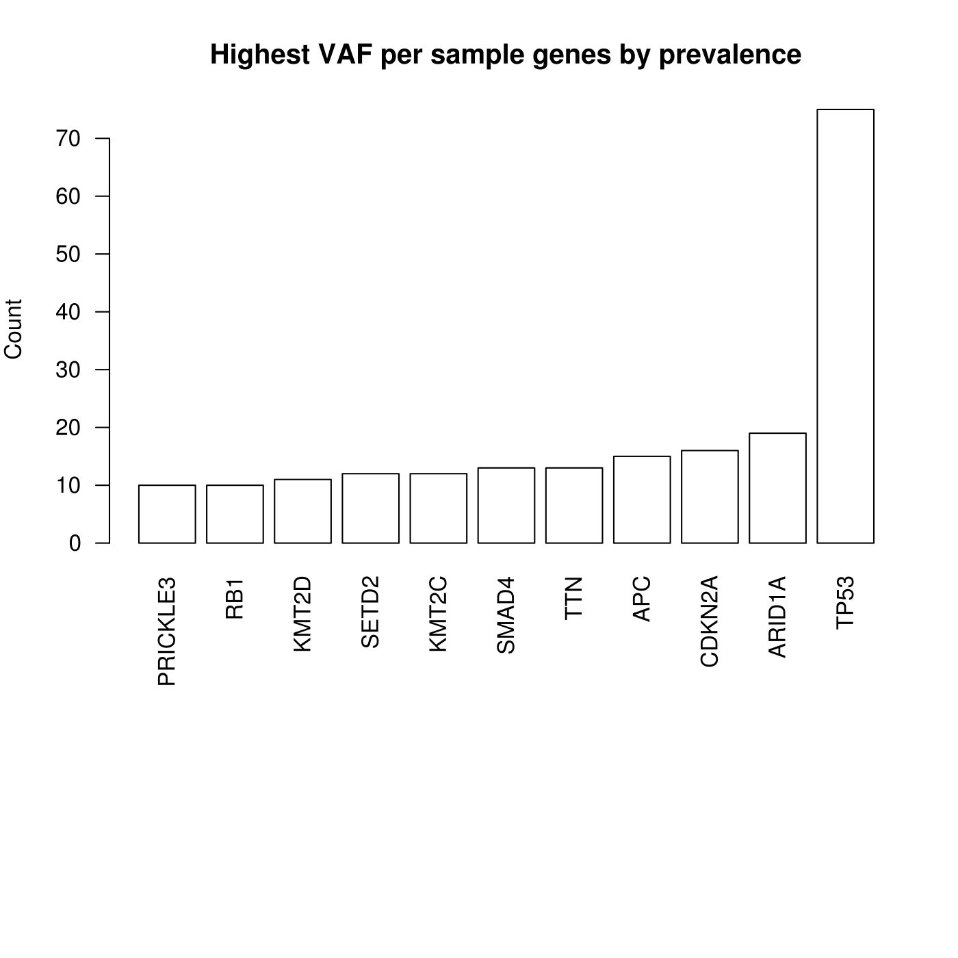
indel
SNP

Slide 6
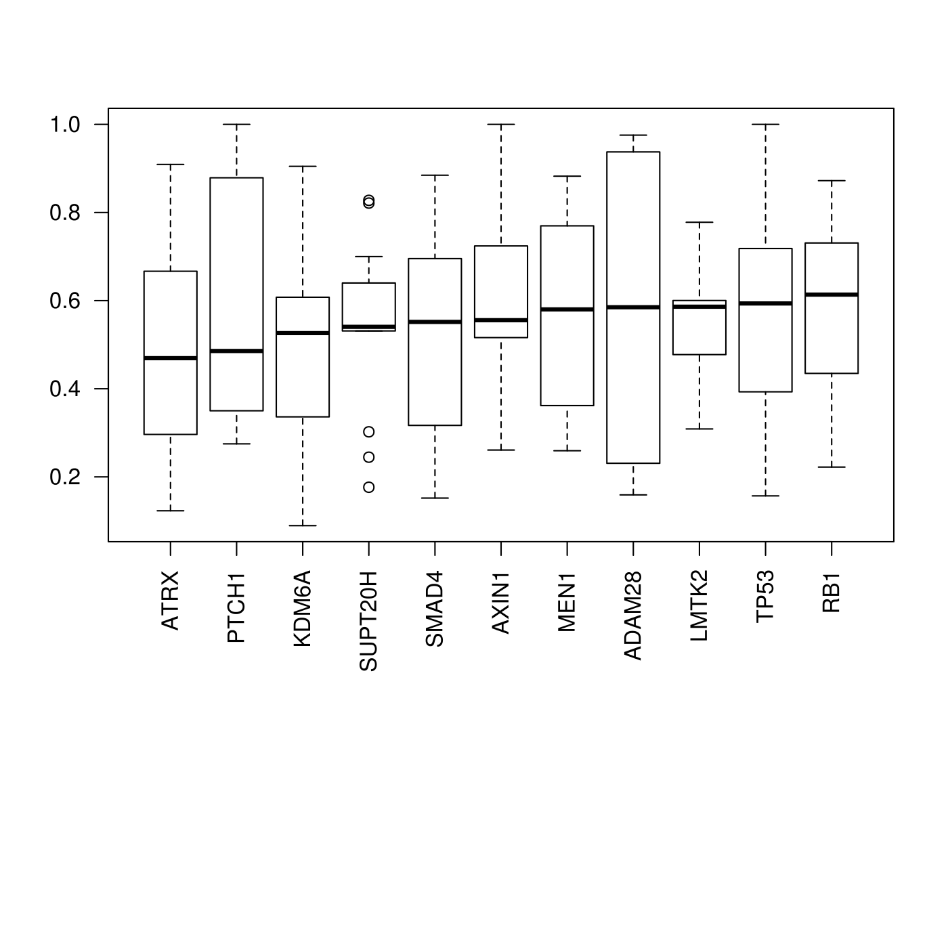
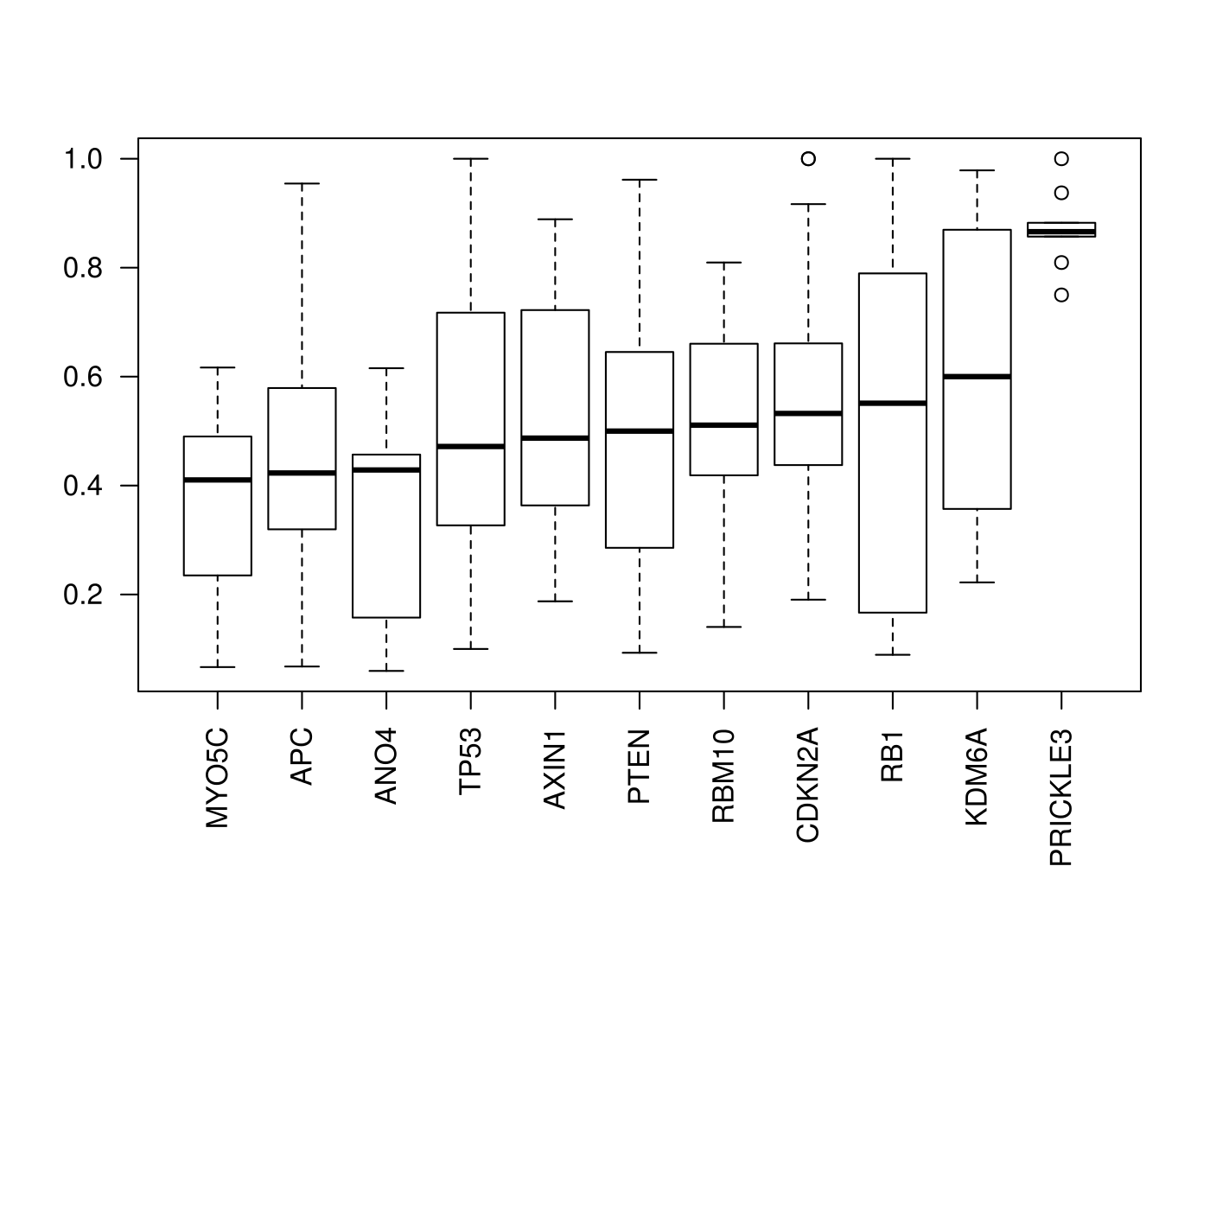
VAF for pLOFs, ordered by mean VAF
indel
SNP

Slide 7
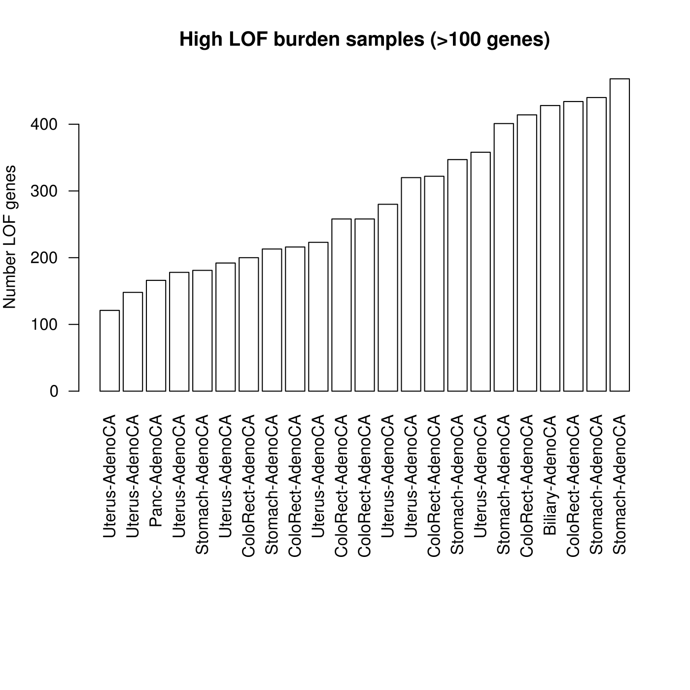
High pLOF burden samples (indels only)

Slide 8
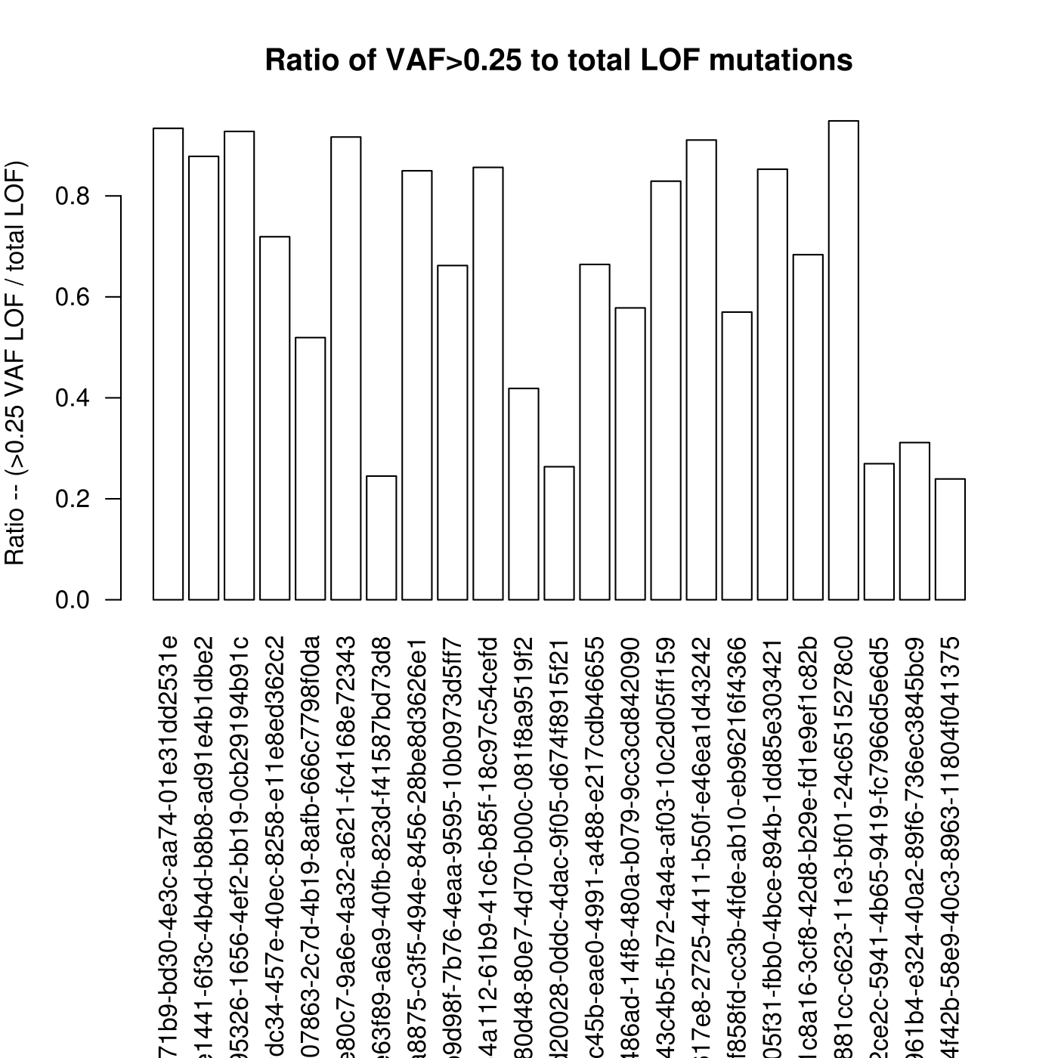

Slide 9
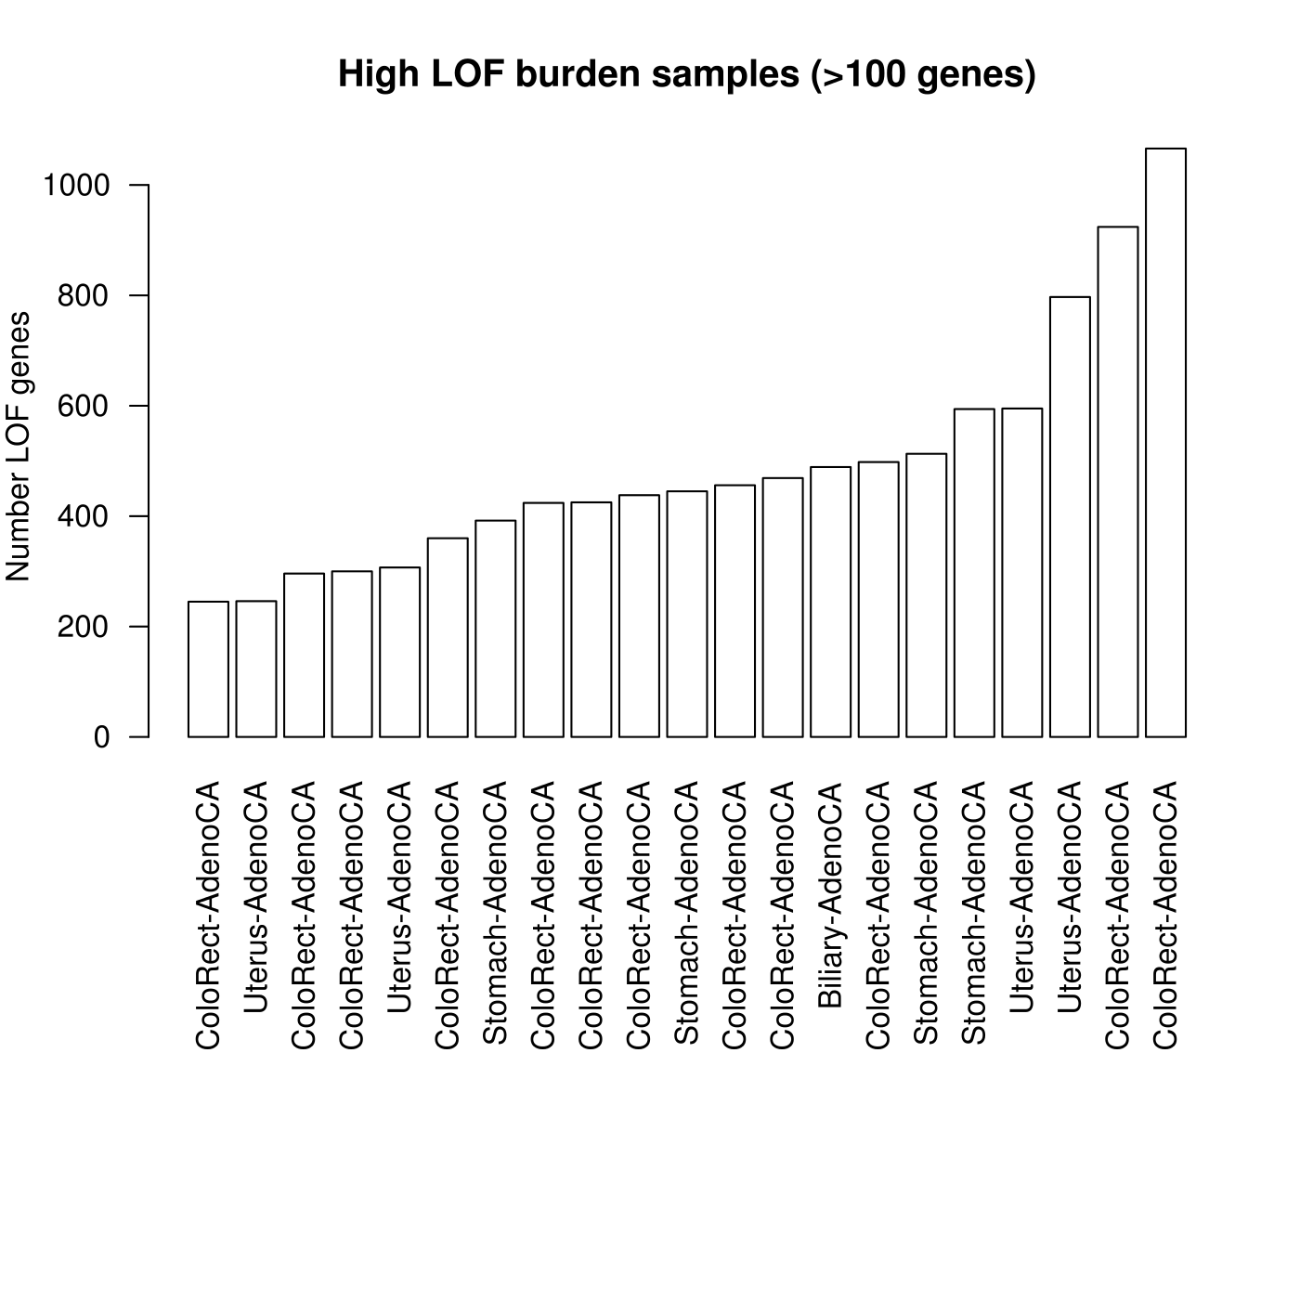
High pLOF burden samples
(indels + SNPs combined)

Slide 10
High Mutational Burden Samples
2349 samples with at least 1 pLOF mutation.
457 samples w/ greater 10 pLOFs
47 cancers with > 100 pLOF events.
Greatest has 1066 pLOF genes.

Slide 11
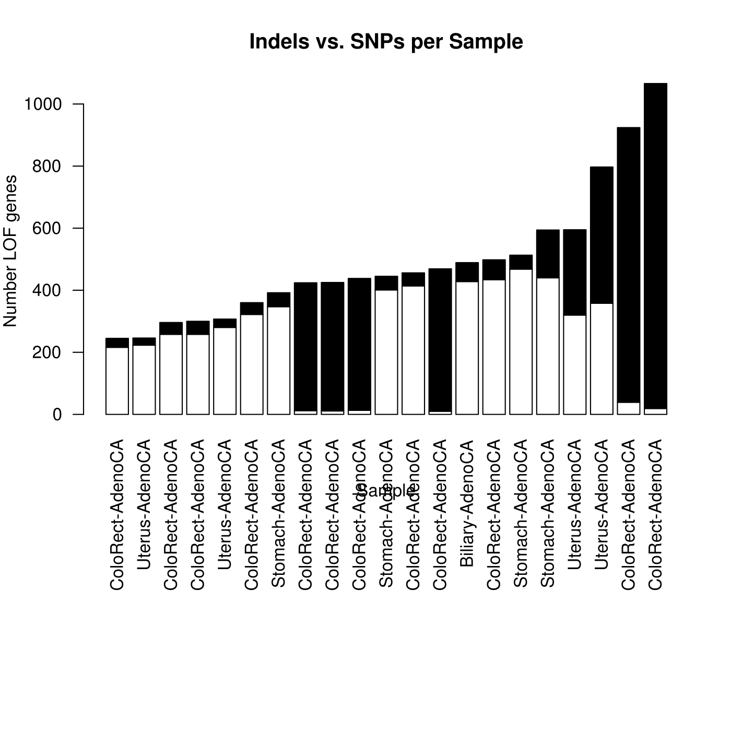
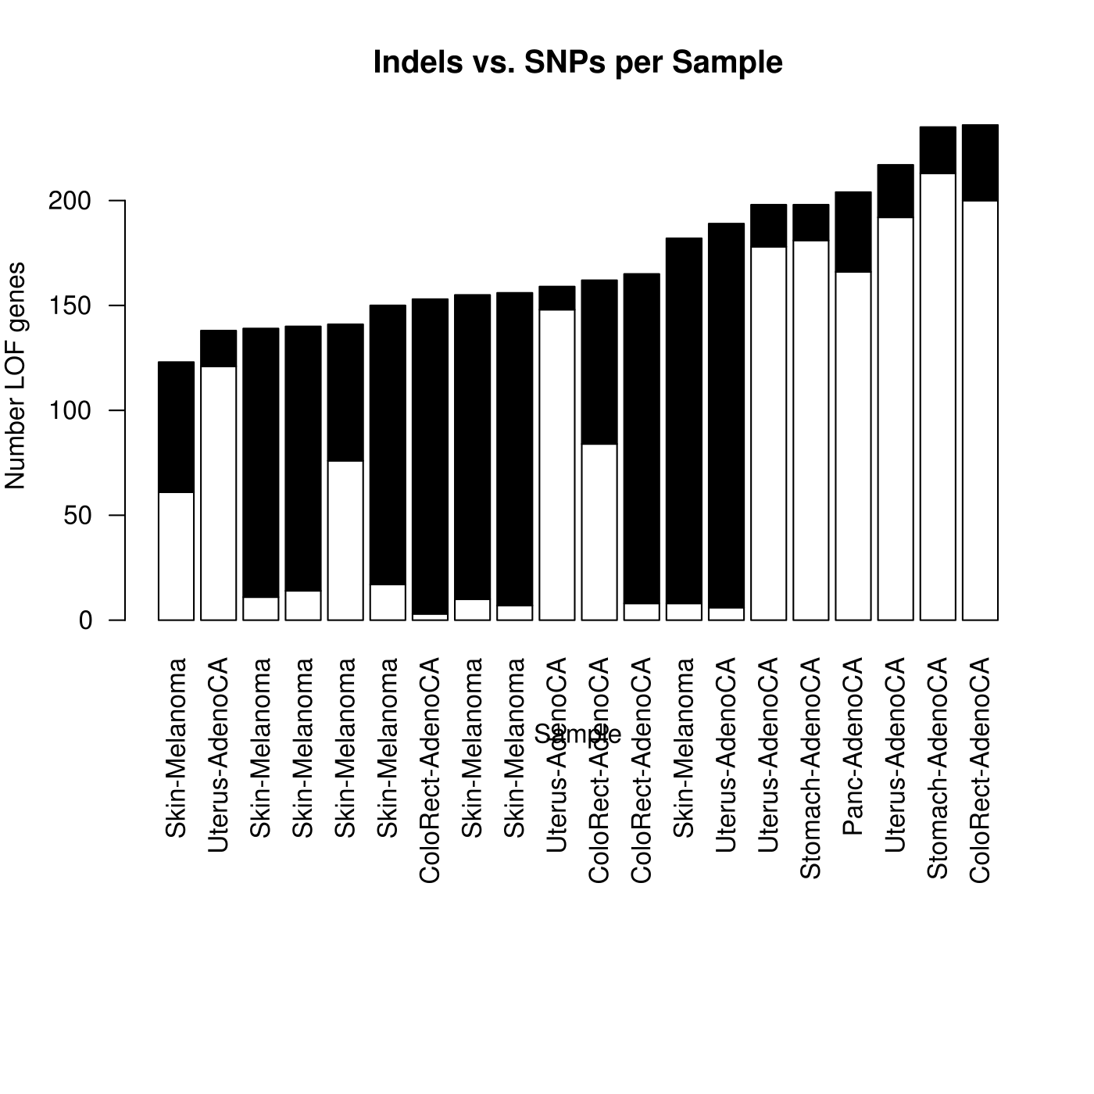
Proportion SNPs vs. indels by sample
SNPs -- black, indels -- white

Slide 12
Indel Bias / SNP Bias
457 samples w/ greater 10 pLOFs
Indel biased (>80% indels)
52
SNP biased (>80% SNPs)
115

Slide 13
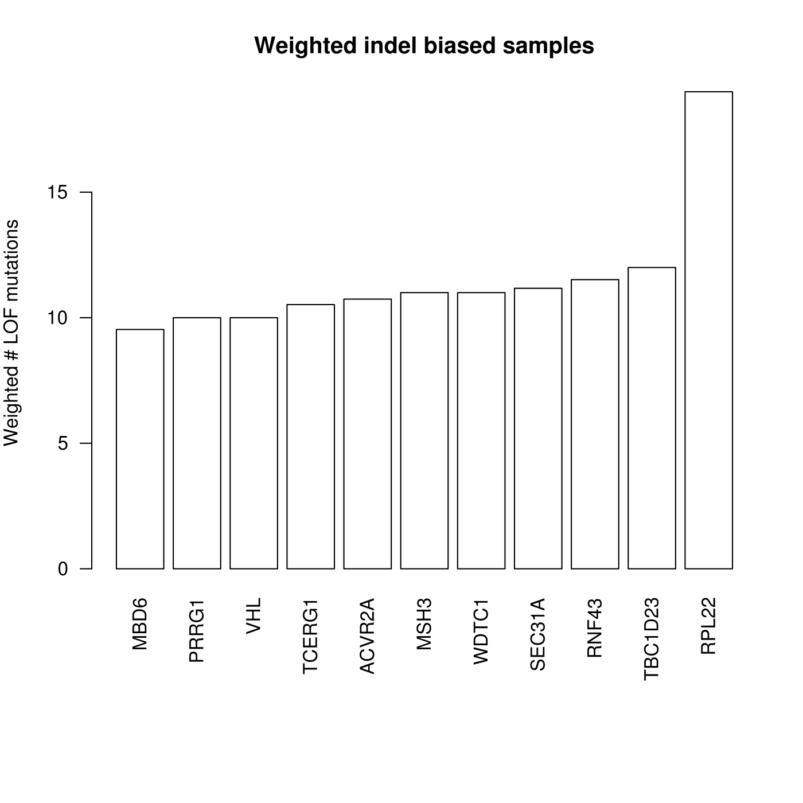
Chan, Clement TY, et al. "Reprogramming of tRNA modifications controls the oxidative stress response by codon-biased translation of proteins." Nature communications 3 (2012): 937.

