Slide 1
Aim and deliverables for the functional impact paper
decipher over all functional burdening in cancer genomes in the PCAWG project.
Avg cancer has ~10 drivers & ~5000 mutations. What is the overall burdening of the many passengers in different cancers
Look at Overall variation burden observed in various genomic elements (coding & noncoding) in different PCAWG cohorts.
Comparison between real and simulated data to highlight genomic elements with significant burden from passangers in different cohorts
This work will provide comprehensive functional annotations across all of pcawg & use of FunSeq & aloft score)
Coding and noncoding functional impact score distribution across pan-cancer cohorts.
Enrichment/depletion of high impact passengers (other than drivers) in gene block/neighborhood
Correlating of passenger burdening with downstream gene expression changes
Framework to evaluate structural variation impact score
Comparison between somatic and germline variation burdening
Investigate influence of germline mutational burden on the somatic genome variation profile
Decipher the the differential passenger burdening in various cohorts (how it relates to mechanism)
Relate to diferent Signature, Ageing, sub-clonality & other clinical information
Any other suggestions ?

Slide 2
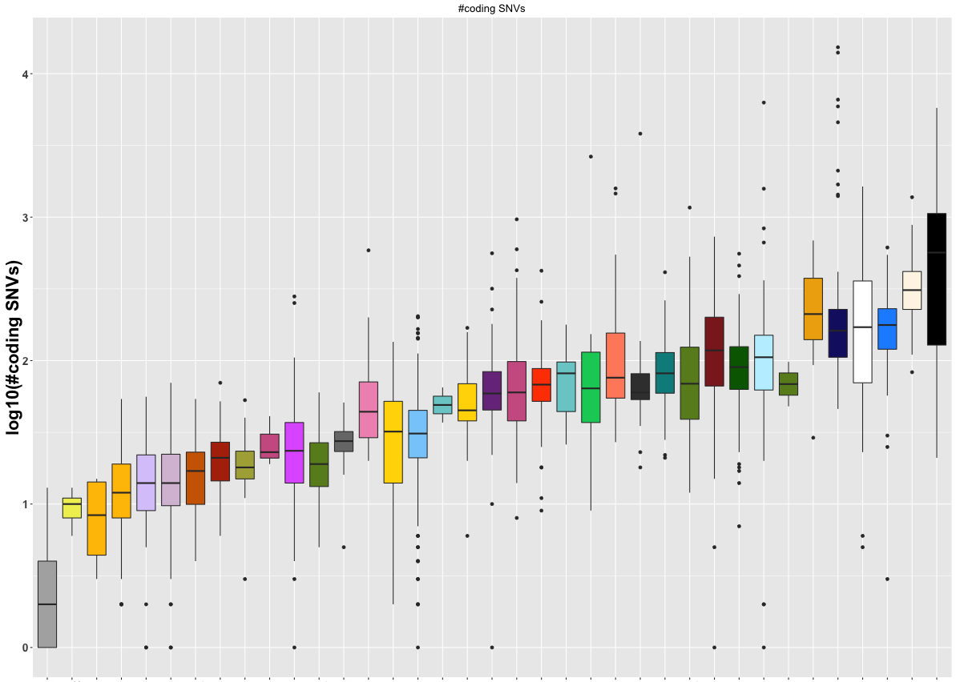
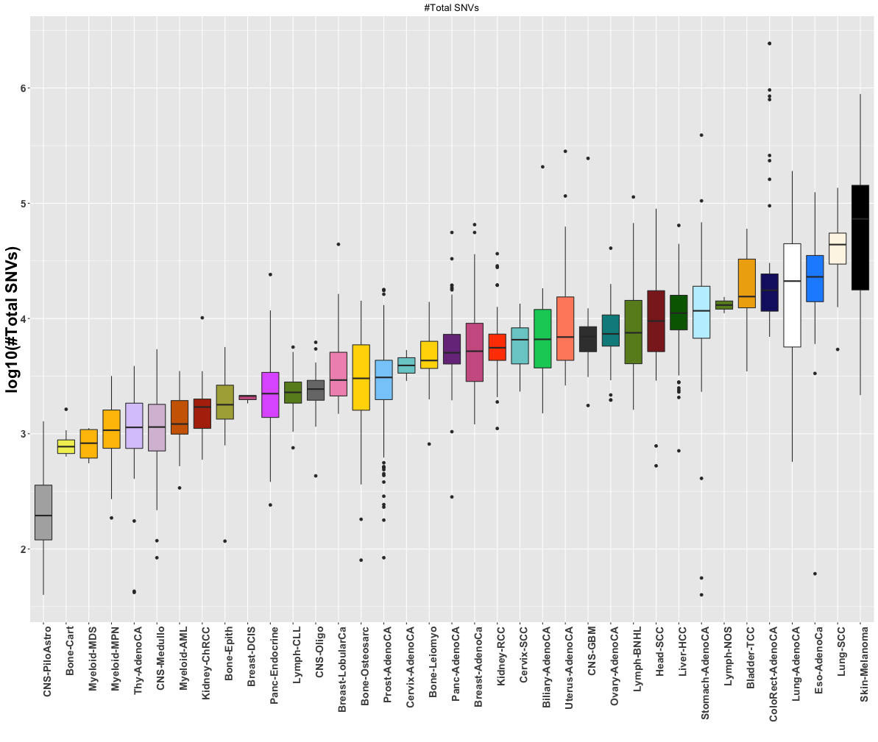
A b=ackdrop
PCAWG SNV annotation overview

Slide 3
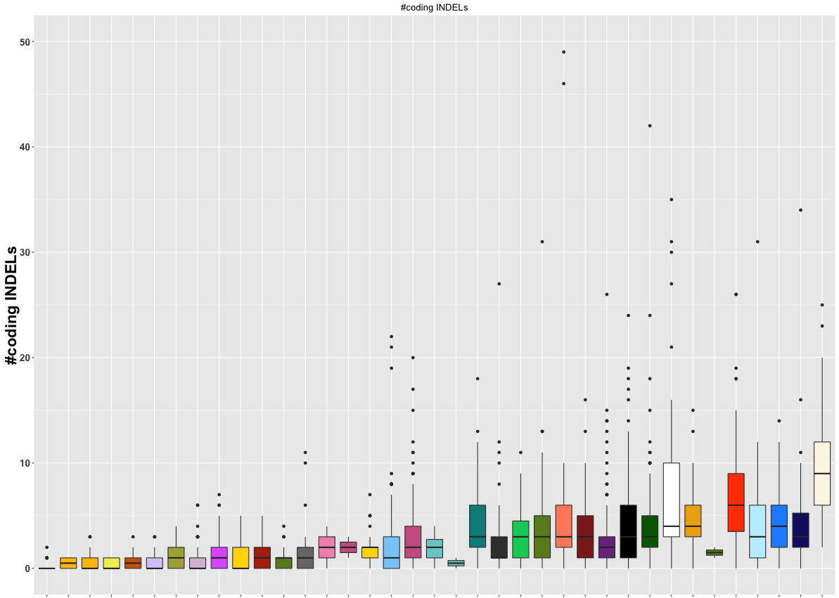
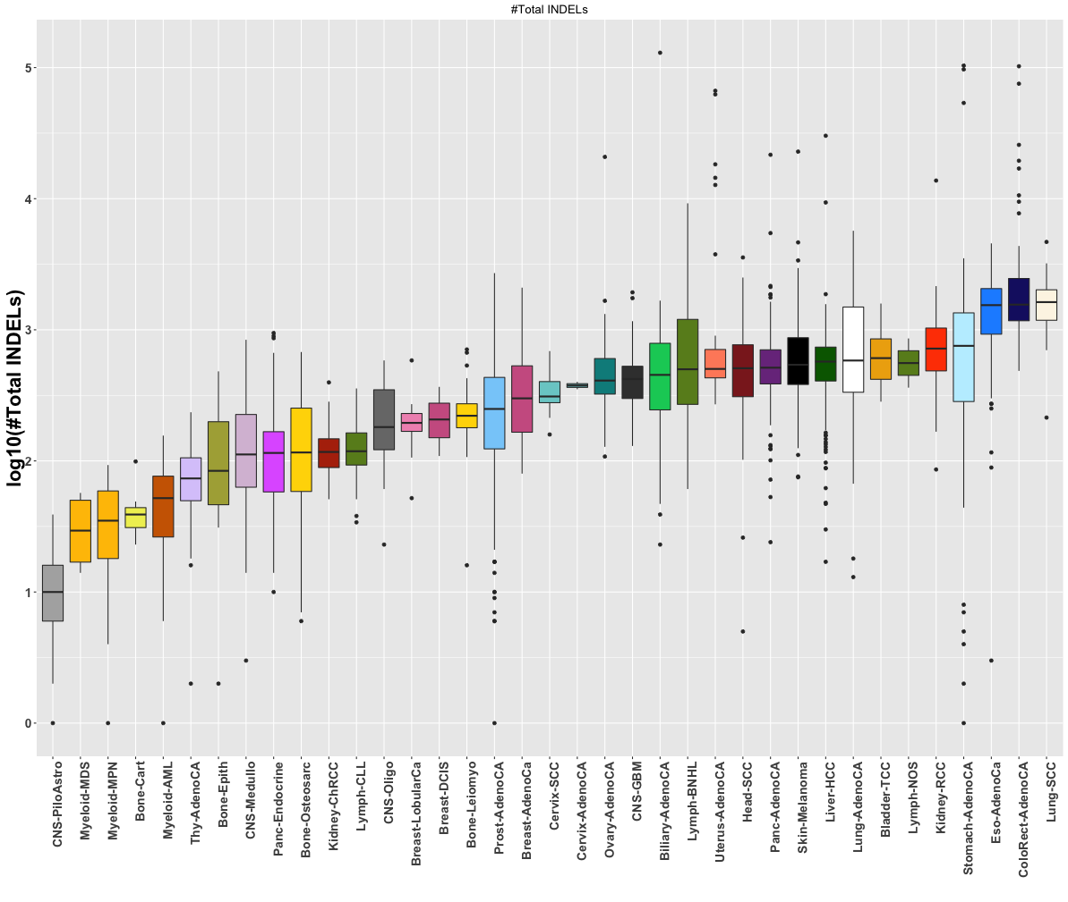
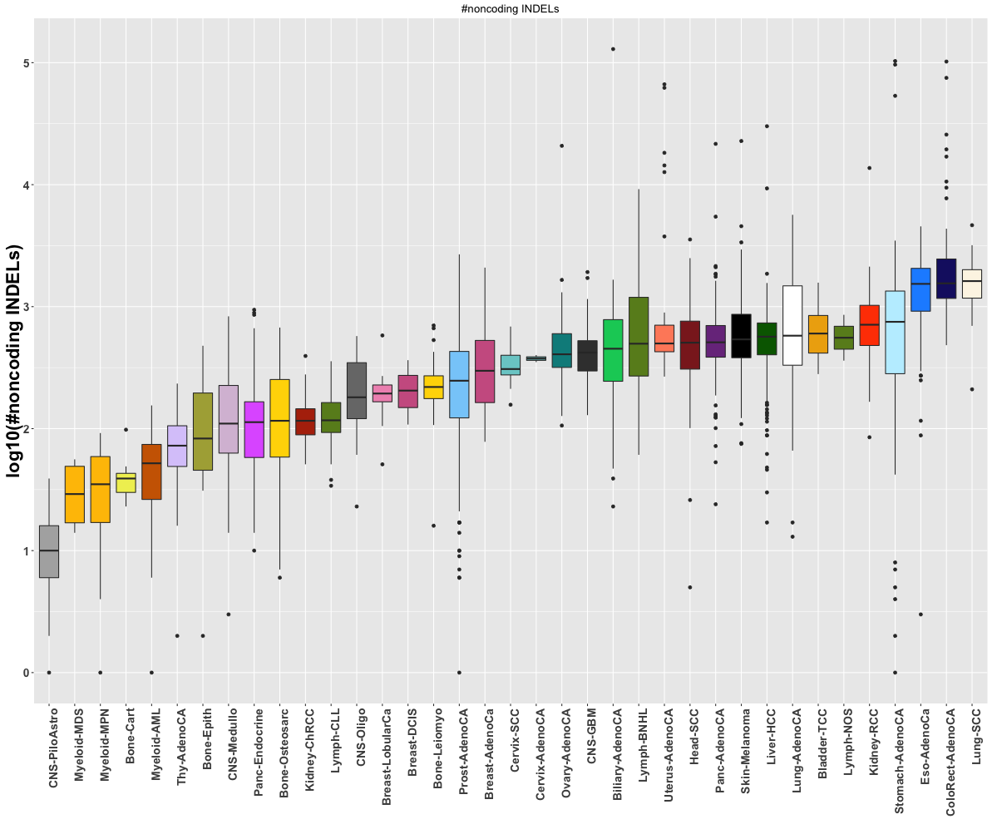
A backdrop PCAWG INDEL annotation overview

Slide 4
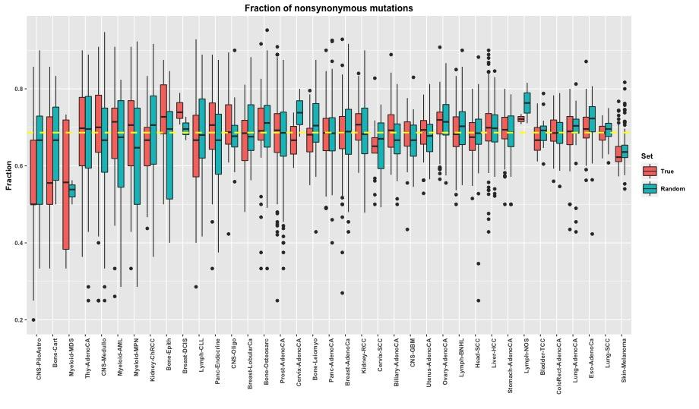
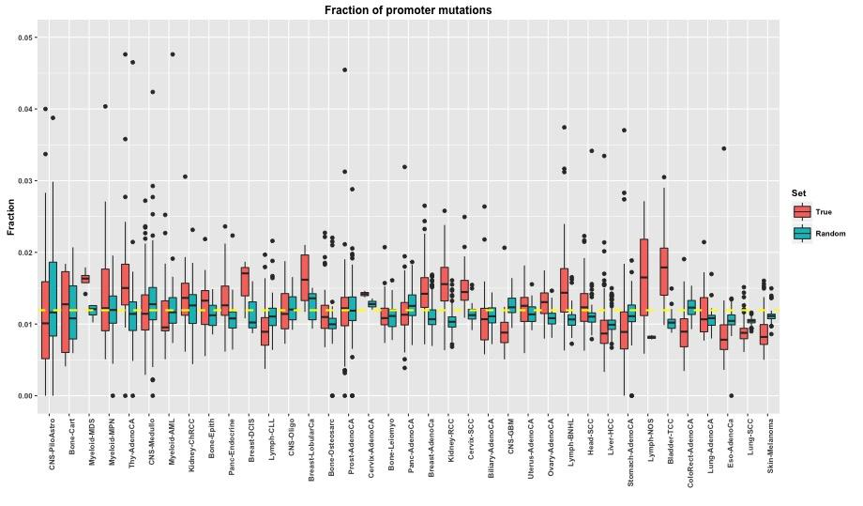
Comparison between original and randomized data set

Slide 5
Funseq score v random for a gneome

Slide 6
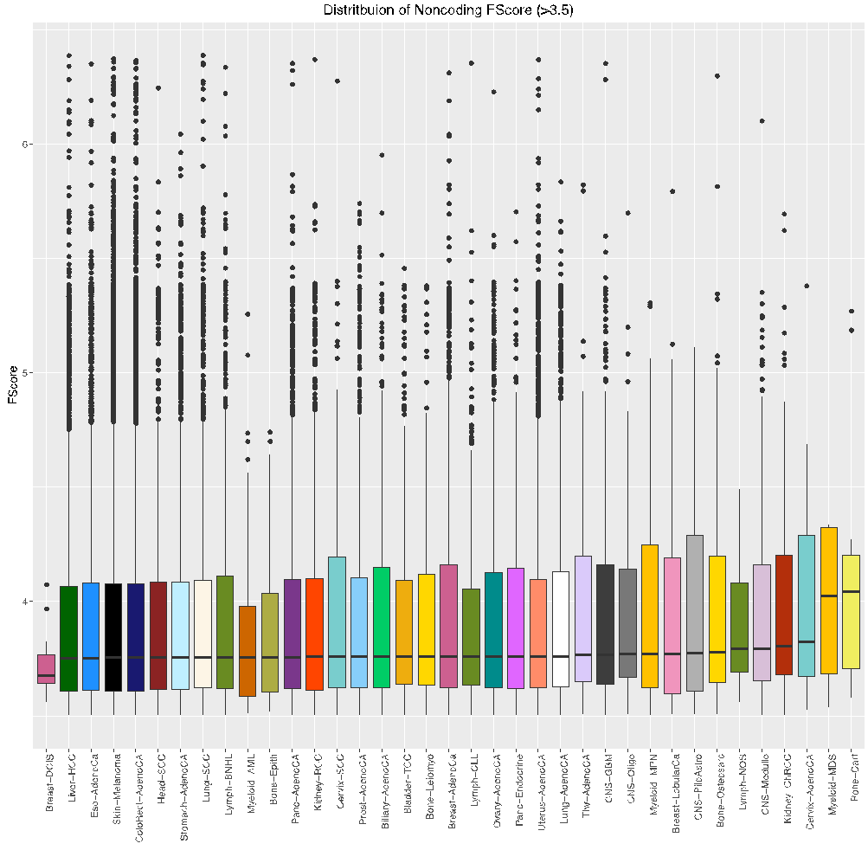

Slide 7
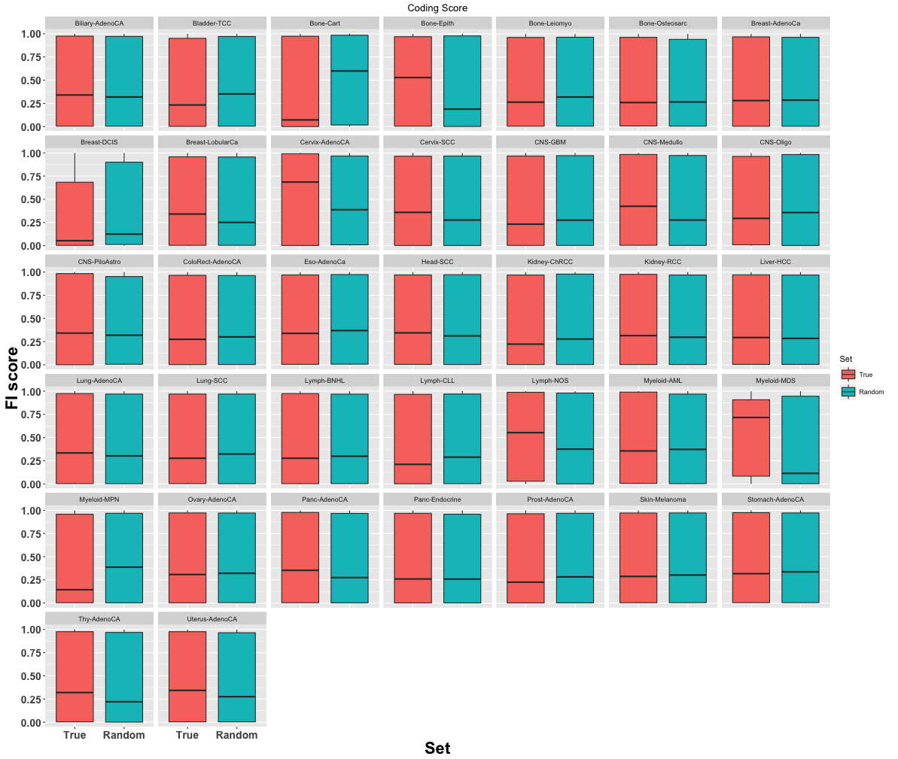
Functional impact score distribution of nonsynonymous SNVs

Slide 8
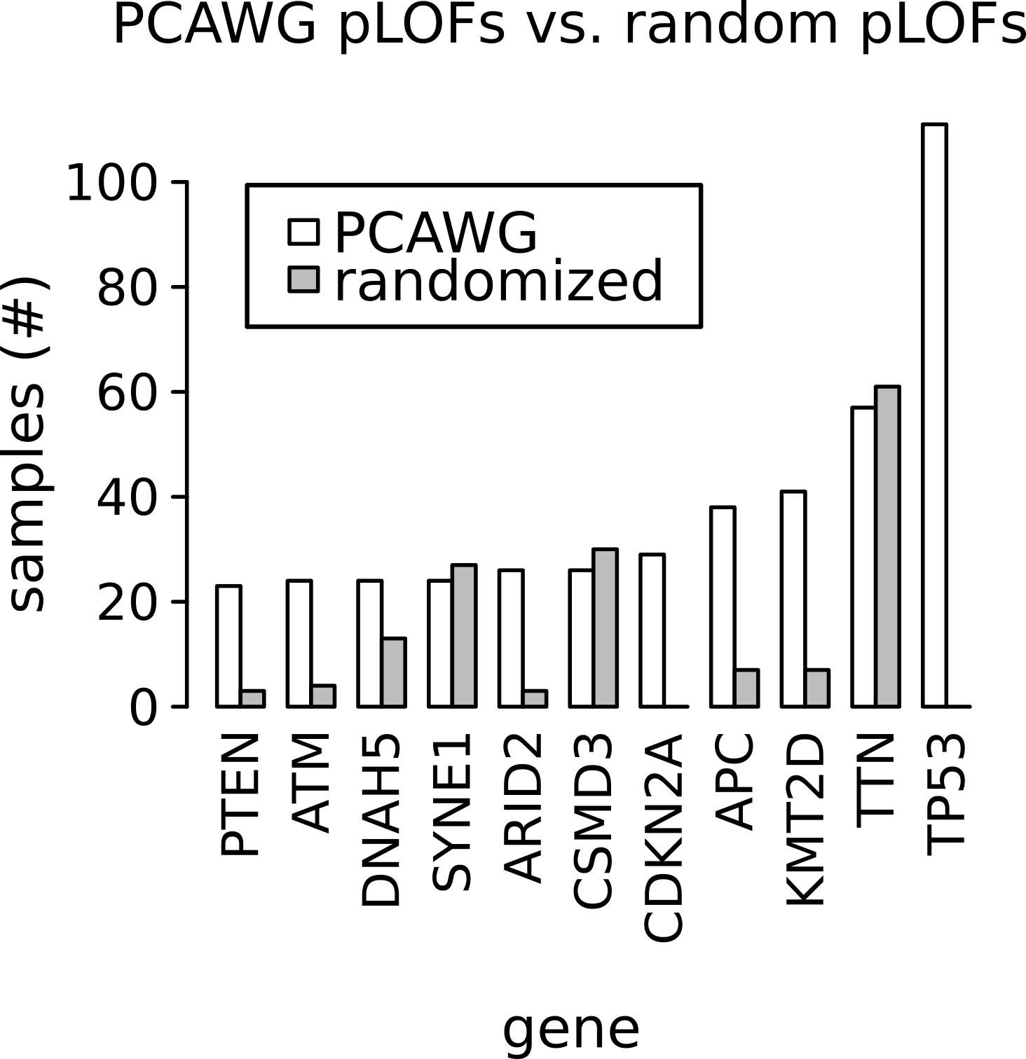
Loss of Function inducing SNVs in the PCAWG data

Slide 9
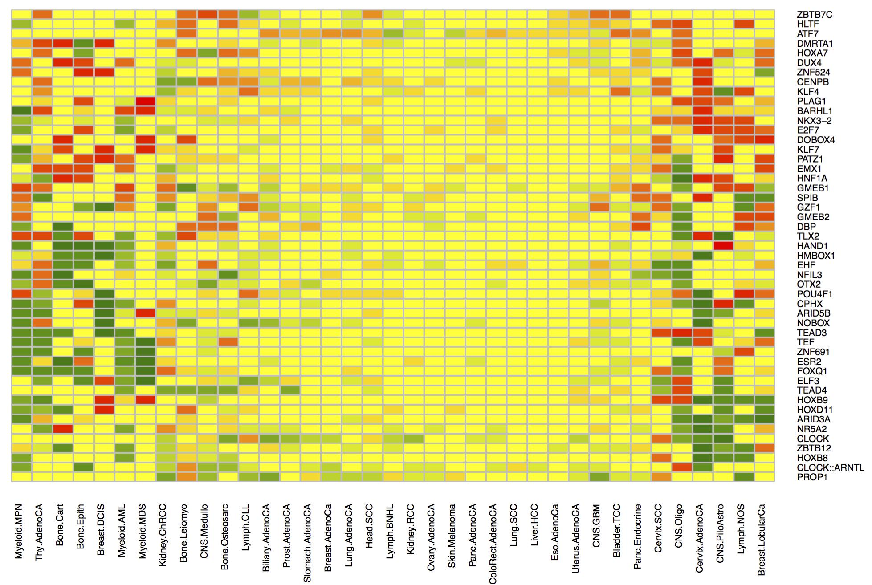
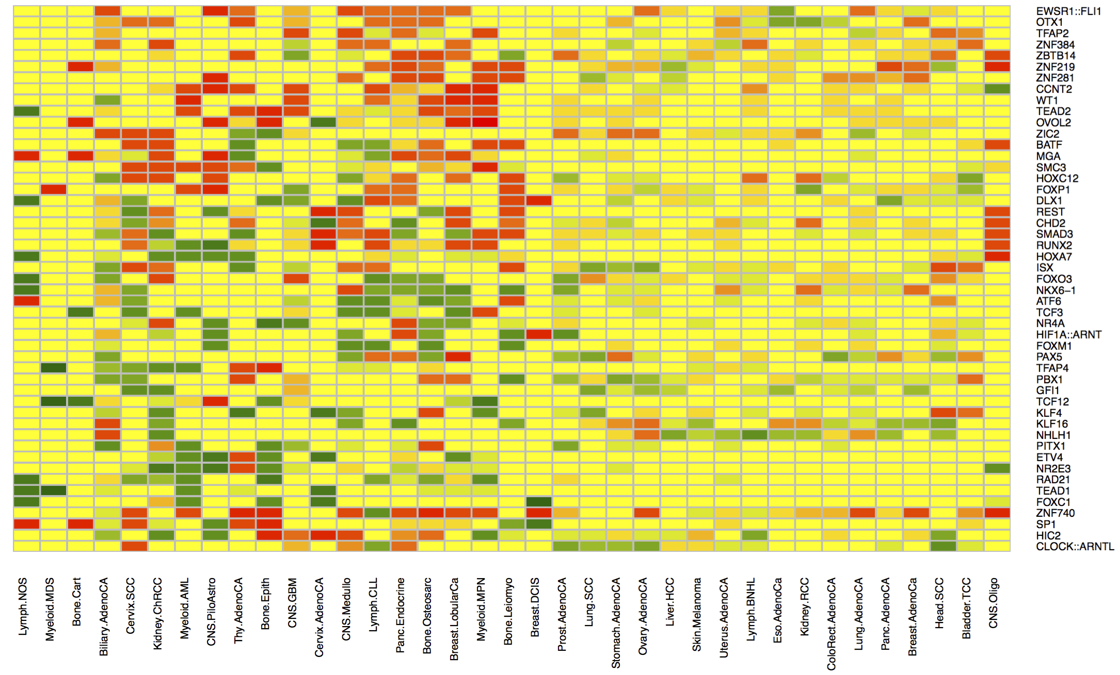
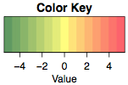
Functional burden of SNVs influencing TF motifs
Motif Breaking
Motif Gaining

Slide 10
Extra Slides

Slide 11
