Slide 1
Improved(?) iCLIP peak calling by remapping multi-mapped reads
Tianxiao Li
Mentor: Mengting Gu

Slide 2
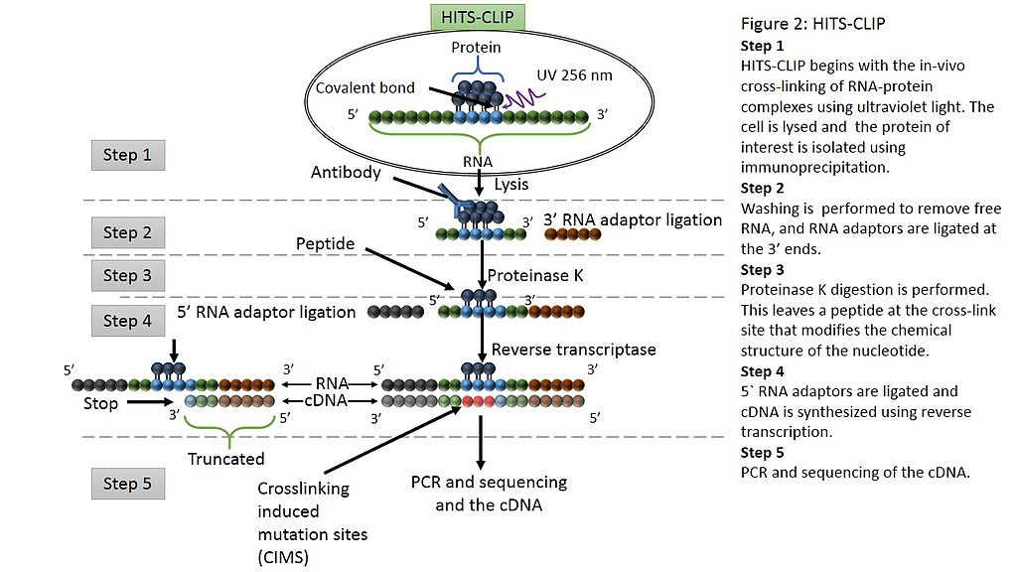
CLIP (CrossLinking-ImmunoPercipitation)
By Bluewhale22 - Own work, CC BY-SA 3.0, https://commons.wikimedia.org/w/index.php?curid=31434082

Slide 3
CLIP (CrossLinking-ImmunoPercipitation)
Limitations of traditional CLIP:
Truncated reads discarded
Require further analysis to capture high resolution binding sites (e.g. CIMS)

Slide 4
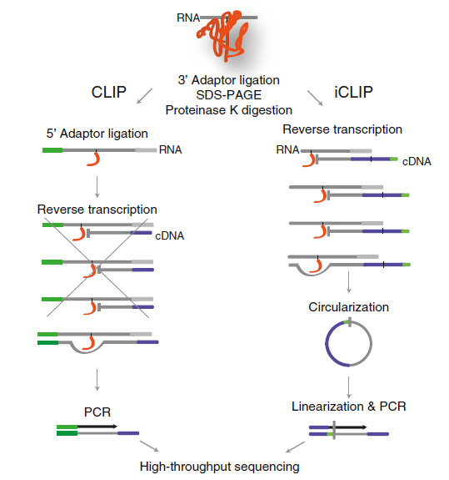
iCLIP
Sugimoto Y, König J, Hussain S, et al. Analysis of CLIP and iCLIP methods for nucleotide-resolution studies of protein-RNA interactions[J]. Genome biology, 2012, 13(8): 1.

Slide 5
iCLIP
Advantages of iCLIP:
Truncated reads retained
High-resolution binding regions could be identified (Theoretically, reads will be truncated at the crosslinking position)

Slide 6
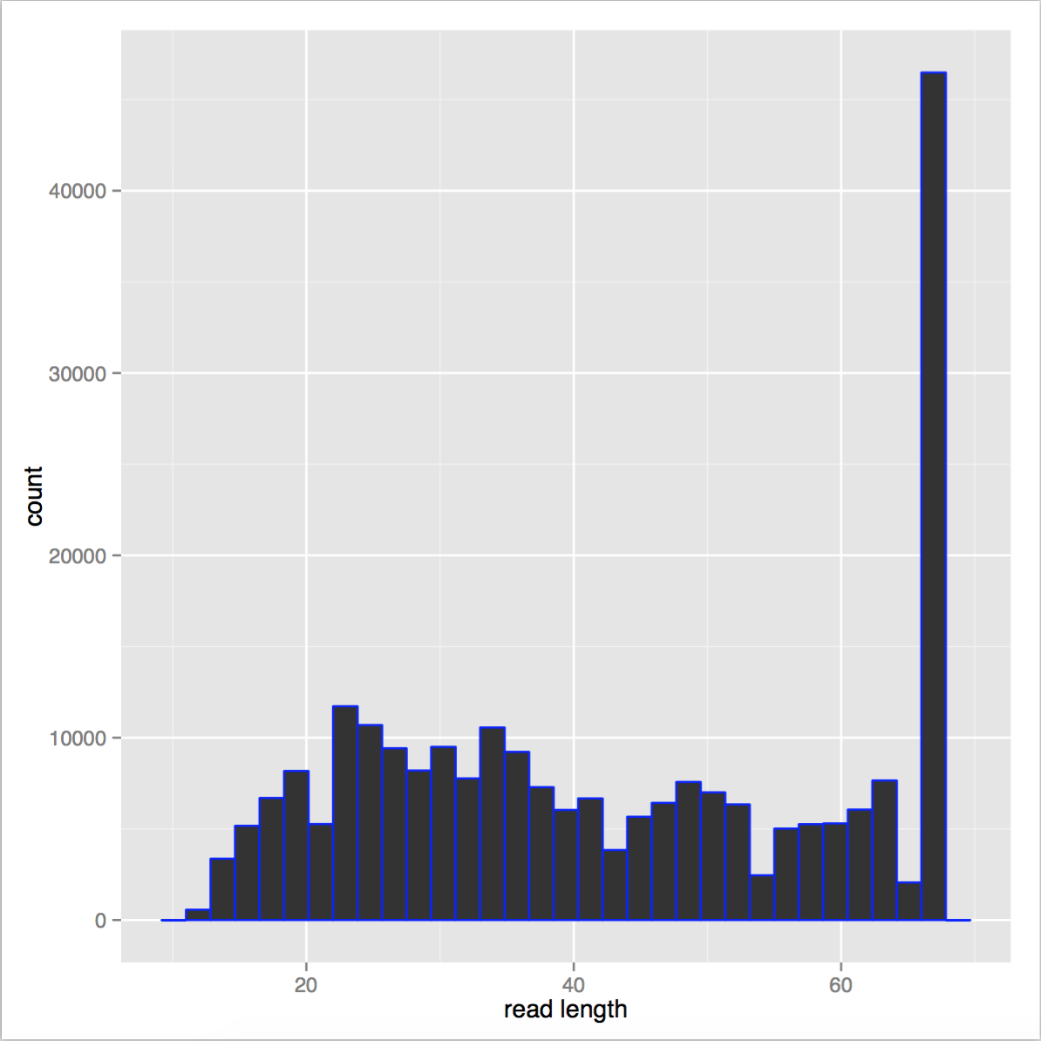
Read length distribution
iCLIP_mSRSF1_P19_mSRSF1-LAP_Mm_NNNCCACNN_20140206_lane3_8

Slide 7
Mapping of truncated reads to readthrough reads
Segment the genome into bins of 300nt, discard the bins with <50 reads count
Calculate the offset of start/middle/end positions of truncated reads (<66nt) relative to the overlapping longer reads (≥66nt)
Hauer C, Curk T, Anders S, et al. Improved binding site assignment by high-resolution mapping of RNA-protein interactions using iCLIP[J]. Nature communications, 2015, 6.

Slide 8
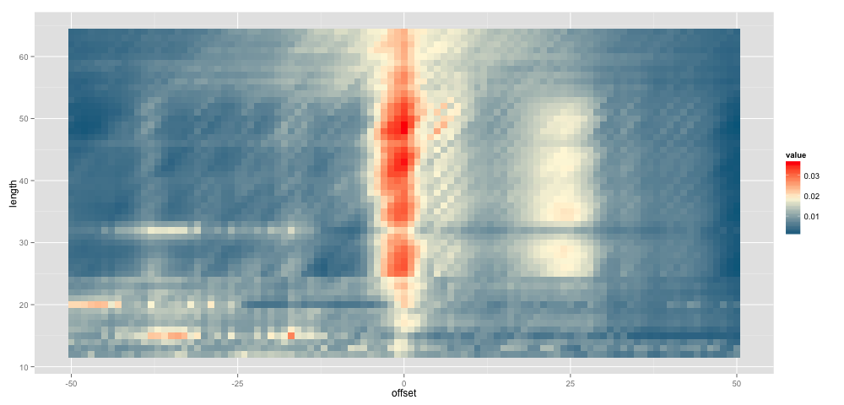
Heatmap of overlapped reads
Start site,
iCLIP_mSRSF1_P19_mSRSF1-LAP_Mm_NNNCCACNN_20140206_lane2_8.start_start

Slide 9
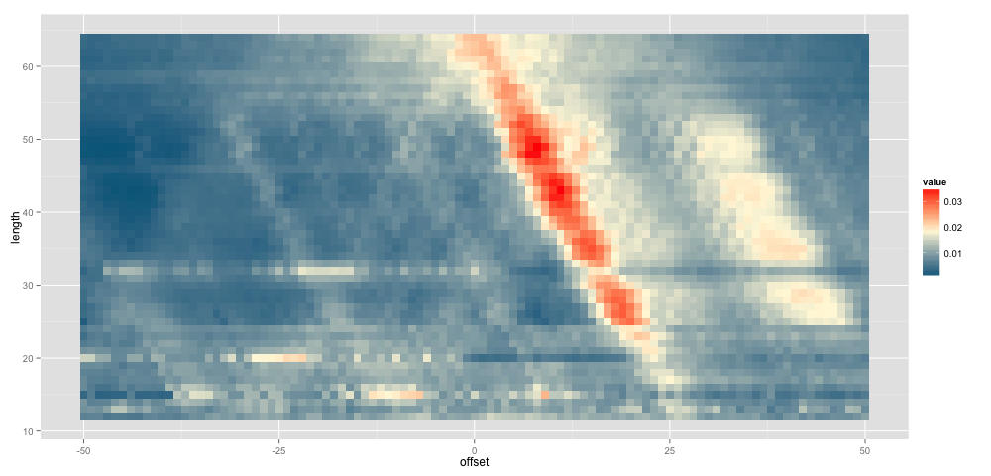
Heatmap of overlapped reads
Middle site,
iCLIP_mSRSF1_P19_mSRSF1-LAP_Mm_NNNCCACNN_20140206_lane2_8.start_start

Slide 10
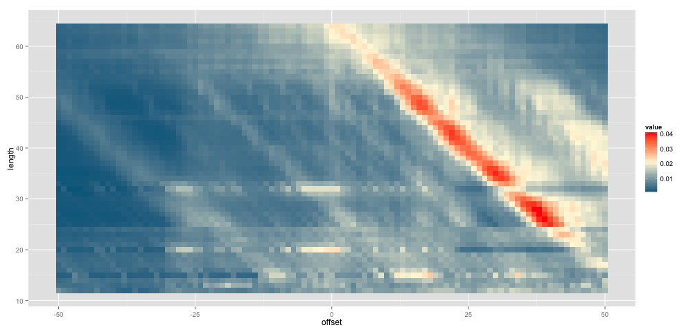
Heatmap of overlapped reads
End site,
iCLIP_mSRSF1_P19_mSRSF1-LAP_Mm_NNNCCACNN_20140206_lane2_8.start_start

Slide 11
Multi-mapped reads
RBP | Uniquely-mapped | Multi-mapped
iCLIP_mSRSF1_P19_mSRSF1-LAP_Mm_NNNCCACNN_20140206_lane2_8 | 1744350 | 949696 (35.2%)
iCLIP_mSRSF1_P19_mSRSF1-LAP_Mm_NNNCCACNN_20140206_lane3_8 | 122295 | 121158 (49.8%)
iCLIP_mSRSF1_P19_mSRSF1-LAP_Mm_NNNGGTCNN_20140206_lane2_7 | 3080632 | 1575670 (33.8%)
iCLIP_mSRSF1_P19_mSRSF1-LAP_Mm_NNNGGTCNN_20140206_lane3_7 | 755256 | 598296 (44.2%)

Slide 12
Objectives
Multi-mapped reads constitute a large proportion of overall reads
Assigning multi-mapped reads to specific genomic positions may improve the accuracy of peak detection

Slide 13
Remap multi-mapped reads using Expectation Maximization

Slide 14
Remap multi-mapped reads using Expectation Maximization
Notes:
pi is the probability of event m
p(zi|pi) = sum(pi_j*p(zi=j)), p(zi=j) = pi_j/sum(pi_j’)

Slide 15
Remap with Expectation Maximization

Slide 16
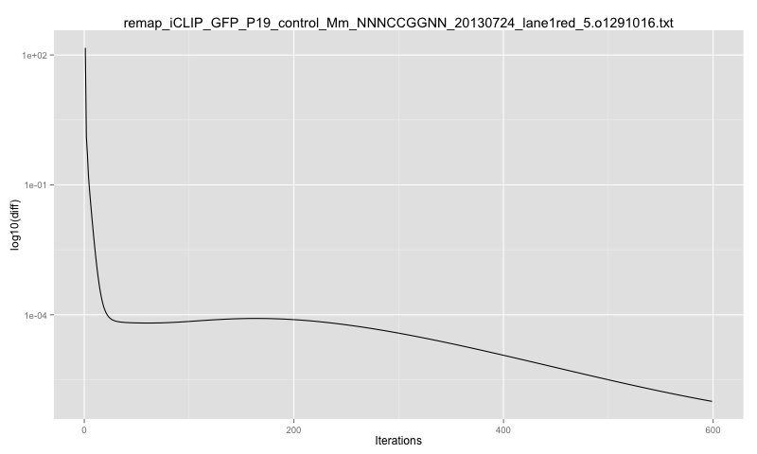
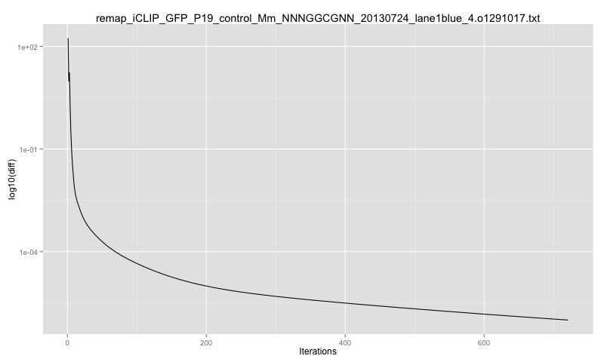

Slide 17
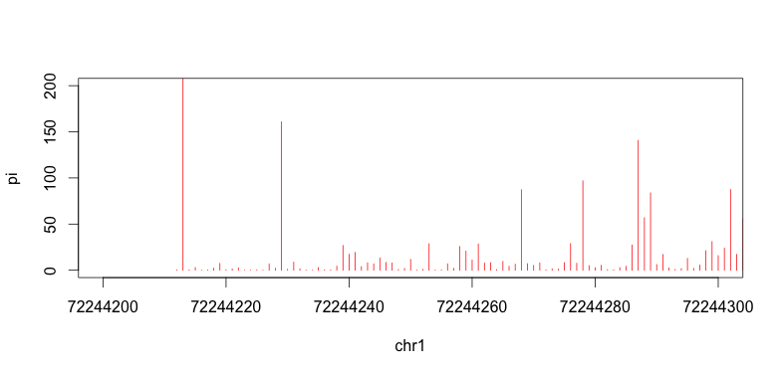
Distribution of remapped signals
reads count

Slide 18
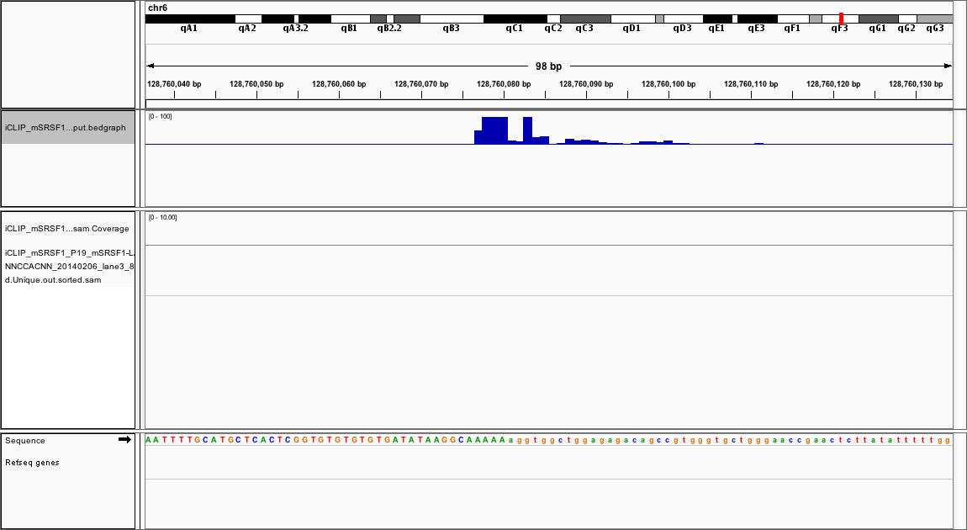
New signals generated after remapping
Notes:
signals generated merely by remapped multi-mapped reads

Slide 19
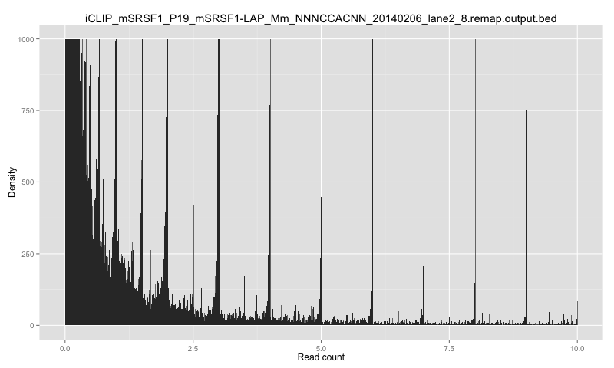
Histogram of remapping results
Notes:
most of the read counts are integral, much larger than non-integral values

Slide 20
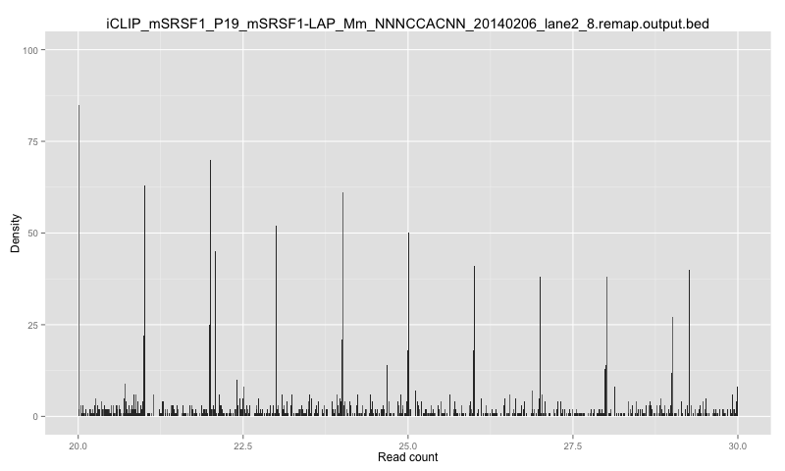
Histogram of remapping results

Slide 21
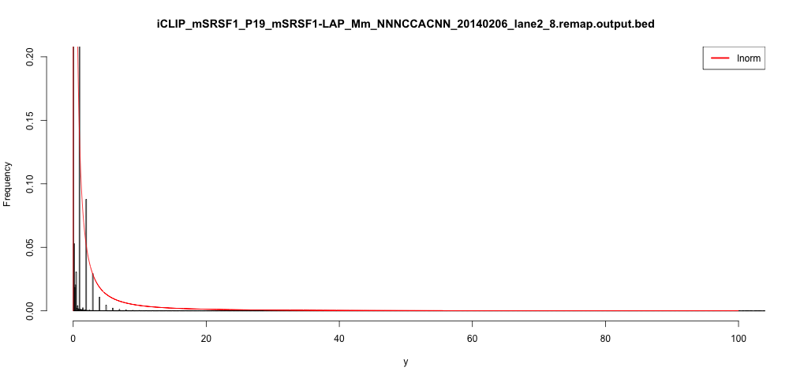
Histogram of remapping results
Notes:
The fit distribution does not successfully represent the data
Output are “discrete”, cannot be fit by a continuous distribution

Slide 22
Assign reads to specific positions

Slide 23
Reads retained after reassignment
RBP | Multi-mapped reads | Retained reads
iCLIP_mSRSF1_P19_mSRSF1-LAP_Mm_NNNCCACNN_20140206_lane2_8 | 949696 | 379543 (40.0%)
iCLIP_mSRSF1_P19_mSRSF1-LAP_Mm_NNNCCACNN_20140206_lane3_8 | 121158 | 49697 (41.0%)
iCLIP_mSRSF1_P19_mSRSF1-LAP_Mm_NNNGGTCNN_20140206_lane2_7 | 1575670 | 859630 (54.6%)
iCLIP_mSRSF1_P19_mSRSF1-LAP_Mm_NNNGGTCNN_20140206_lane3_7 | 598296 | 210409 (35.2%)

Slide 24
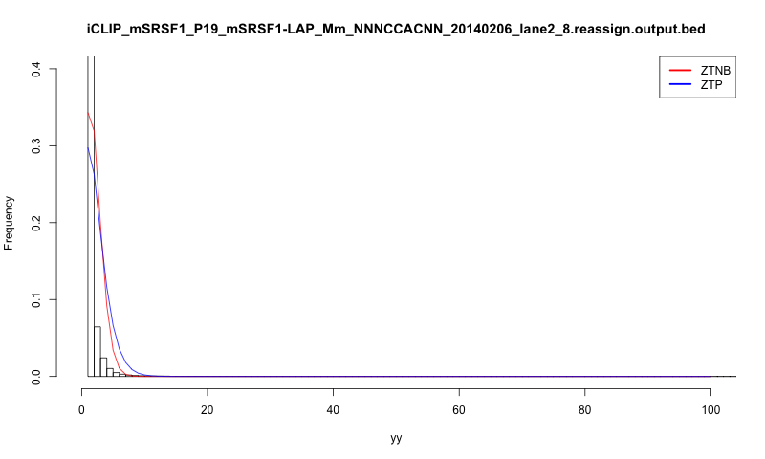
Histogram after reassignment
Notes:
Try to find a distribution that models the reads count
Piranha: fit a distribution for all reads count data, the distribution is regarded as the background noise
regions with P-value under the threshold are identified as binding peaks
ZTNB fits better than ZTP, try piranha

Slide 25
Peak calling and motif analysis
Piranha (Negative Binomial), P < 0.01
RBP | Uniquely-mapped | Remapping
SRSF1 | 26408 | 25777
SRSF2 | 15391 | 13119
SRSF3 | 142881 | 107935
SRSF4 | 35980 | 38318
SRSF5 | 38867 | 31894
SRSF6 | 97512 | 84695
SRSF7 | 98672 | 93527

Slide 26
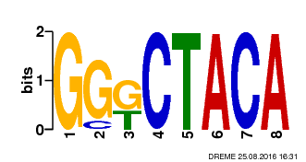
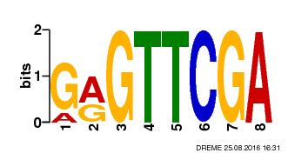
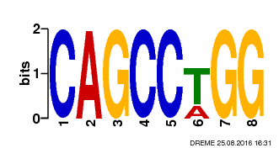
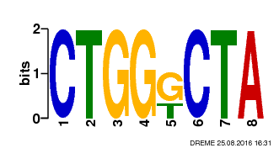
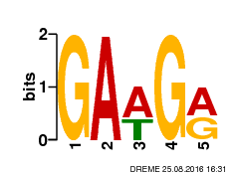
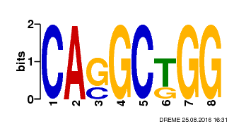
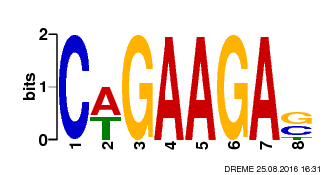
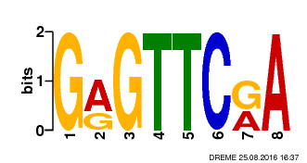
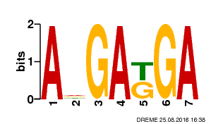
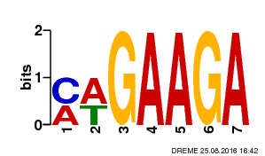
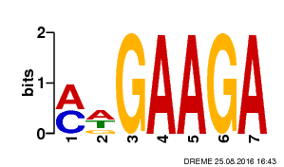
RBP | Uniquely-mapped | Remapping
SRSF1 | 888/26408 P = 3.2e-185 | 1020/25777 P = 2.5e-233
SRSF2 | 529/15391 P = 3.9e-82 | 488/13119 P = 1.1e-111
SRSF3 | 69880/142881 P = 7.1e-840 | 51129/107935 P = 5.2e-575
SRSF4 | 1126/35980 P =2.3e-168 | 1150/38318 P = 1.8e-225
SRSF5 | 2252/38867 P = 3.7e-259 | 1462/31894 P = 2.2e-321
SRSF6 | 16469/97512 P = 3.6e-705 | 13457/84695 P = 1.4e-551
SRSF7 | 14304/98672 P = 1.8e-585 | 11182/93527 P = 1.7e-567
Notes:
Fischer’s exact test (count motif occurrence in negative inputs <- generated by random shuffling)
RGTTCGA is enriched in almost all samples. Probably a bias. Discarded.
1.No significant improvement in sequence conservation
2.”Enriched” motifs are usually not so enriched
3.Motifs discovered do not correspond for the two methods

Slide 27
Problems
Sequencing bias (RGTTCGA, discarded)
False discovery for large datasets
Discovered motifs are not enriched nor corresponding
Notes:
2. with large datasets: high positive count & negative count, very large data size -> still significant, but cannot distinguish from real motifs from false discoveries

Slide 28
Peak calling and motif analysis
Piranha (Negative Binomial), P < 0.001
RBP | Uniquely-mapped | Remapping
SRSF1 | 13036 | 14000
SRSF2 | 4252 | 5381
SRSF3 | 36344 | 38562
SRSF4 | 21461 | 25629
SRSF5 | 13190 | 15662
SRSF6 | 37232 | 43732
SRSF7 | 50666 | 53900

Slide 29
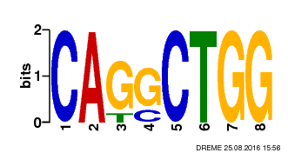
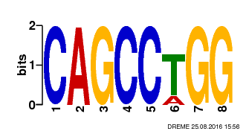
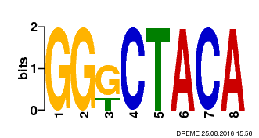
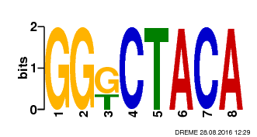
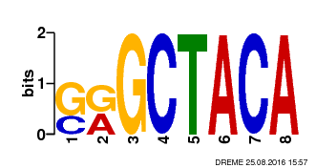
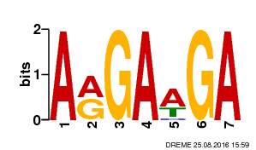
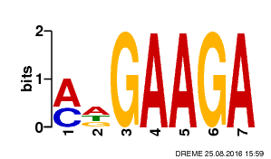
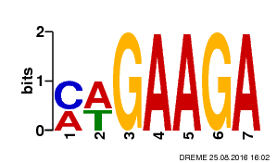
RBP | Uniquely-mapped | Remapping
SRSF1 | 788/13036 P = 7.3e-144 | 909/14000 P = 1.4e-194
SRSF2 | 226/4252 P = 7.4e-55 | 283/5381 P = 2.8e-80
SRSF3 | 36344 | 38562
SRSF4 | 874/21461 P = 1.1e-155 | 928/25629 P = 2.2e-196
SRSF5 | 761/13190 P = 9.5e-171 | 1117/15662 P = 1.4e-253
SRSF6 | 5054/37232 P = 5.5e-257 | 6366/43732 P = 1.2e-225
SRSF7 | 5837/50666 P = 5.2e-303 | 6326/53900 P = 2.7e-336
Notes:
RGTTCGA is enriched in almost all samples. Probably a bias. Discarded.
SRSF3: too heterogeneous (large positive counts/large negative counts v.s. small positive counts/small negative counts, very different sequence)

Slide 30
Problems
How to evaluate motif discovery?
Positive motif counts?
P-value? (Fisher’s exact test)
Prior knowledge (not available)
Higher read counts do not relate with more credential peaks
Use a different distribution?
Expression levels?

Slide 31
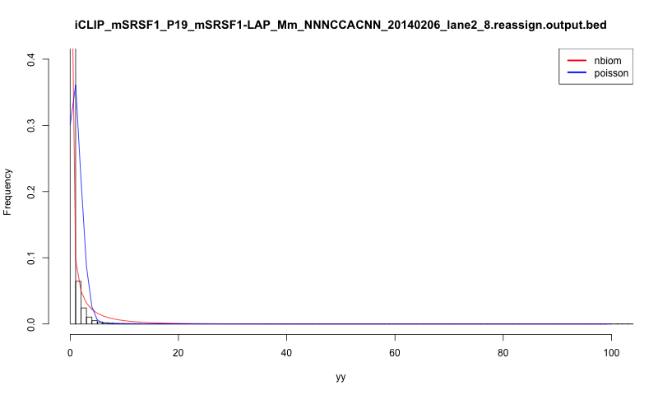
Use different distribution?
Notes:
Characteristic of the read count data (not binned, which is usually the case for Piranha): extremely large amount of 1s, not in standard NB or Poisson (where 0s are significantly more abundant than any other values)
subtract the read counts with 1
1.Fit well but does not make sense
2.Regions with larger read counts will still be identified as peaks

Slide 32
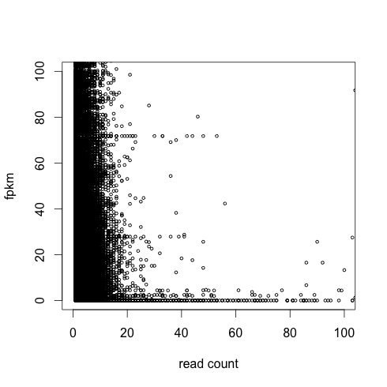
Correlation of expression & read count

Slide 33
Peak calling and motif analysis
Piranha (ZTNB regression with expression), P < 0.01
RBP | Uniquely-mapped | Remapping
SRSF1 | 25074 | 24160
SRSF2 | 3454 | 1602
SRSF3 | 114780 | 148586
SRSF4 | 43704 | 35002
SRSF5 | 27266 | 40740
SRSF6 | 87838 | 100438
SRSF7 | 109973 | 101085
Notes:
Influence of RNA expression is heterogeneous across samples

Slide 34
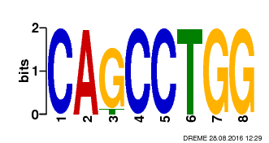
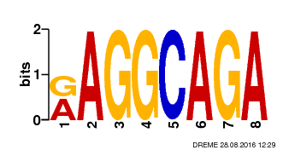
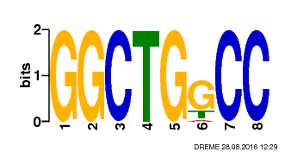
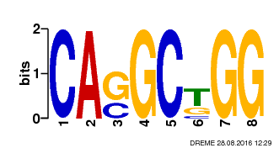
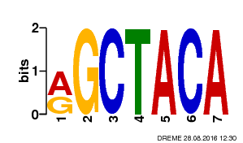
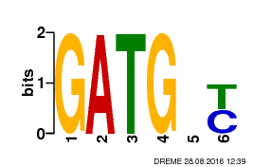
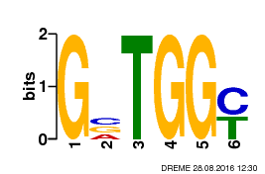
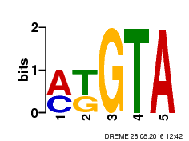
RBP | Uniquely-mapped | Remapping
SRSF1 | 941/25074 P = 1.5e-173 | 1117/24160 P = 6.6e-232
SRSF2 | 82/3454 P = 1.1e-20 | 223/1602 P = 2.9e-54
SRSF3 | 69922/114780 P = 1.4e-831 | 51197/148586 P = 1.5e-559
SRSF4 | 1237/43704 P = 7.2e-171 | 1095/35002 P = 3.6e-244
SRSF5 | 1970/27266 P = 2.9e-284 | 1265/40740 P = 4.1e-264
SRSF6 | 21950/87838 P = 4.4e-321 | 16142/100438 P = 2.5e-286
SRSF7 | 27172/109973 P = 2.7e-420 | 29685/101085 P = 9.7e-485
Notes:
RGTTCGA is enriched in almost all samples. Probably a bias. Discarded.
SRSF3: too heterogeneous (large positive counts/large negative counts v.s. small positive counts/small negative counts, very different sequence)

Slide 35
Conclusions
Sequence conservation slightly improved after remapping (not significant)
Read counts DOES NOT necessarily relate to peak quality in iCLIP datasets (need more sophisticated statistical methods)

Slide 36
Further thoughts
Hidden Markov Model?
Filter out enriched regions
Implement HMM on enriched regions
More sophisticated statistical methods?
Negative Dirichlet prior (enforce sparseness)
Methods to evaluate peak qualities?
Cluster the peaks before motif analysis
Secondary structure features
Notes:
1. single-nucleotide resolution of reads counts (not binned) feature significantly amount of 1s (), hard to model with distribution -> maybe could be improved after binning and further analysis
1.1 Are the emission probability uniform across the genome?
1.2 Signals are sparse in most regions
2. Dirichlet: not likely to cluster together (not mature)
3. Distinguish different binding preferences

Slide 37
Merci

