Slide 1
PCAWG-PaperE

Slide 2
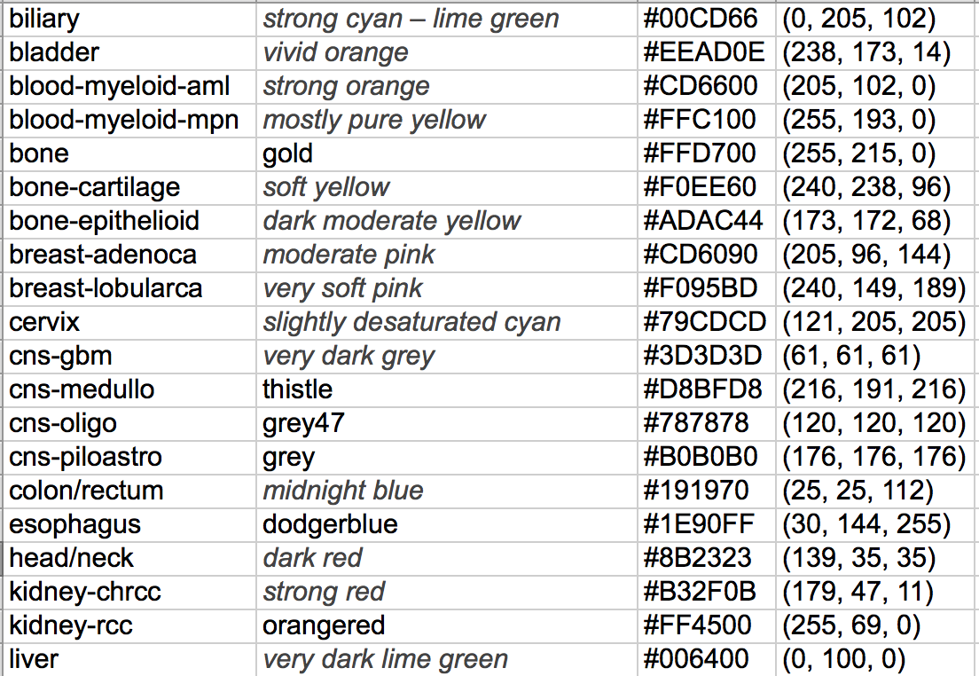
PCAWG official colors assignment

Slide 3
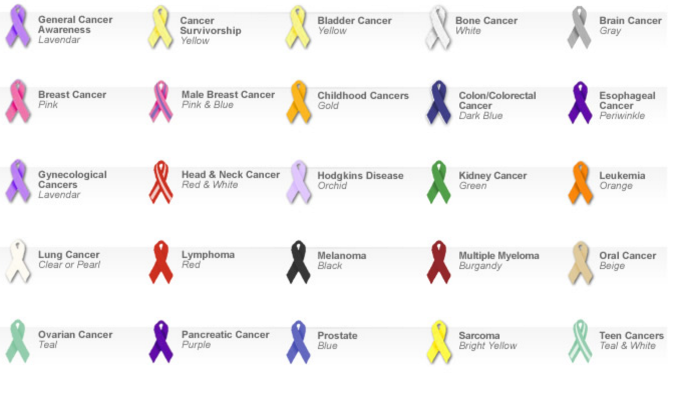
Colors of cancer awareness ribbons
http://mikespinstripeblog.blogspot.com/

Slide 4
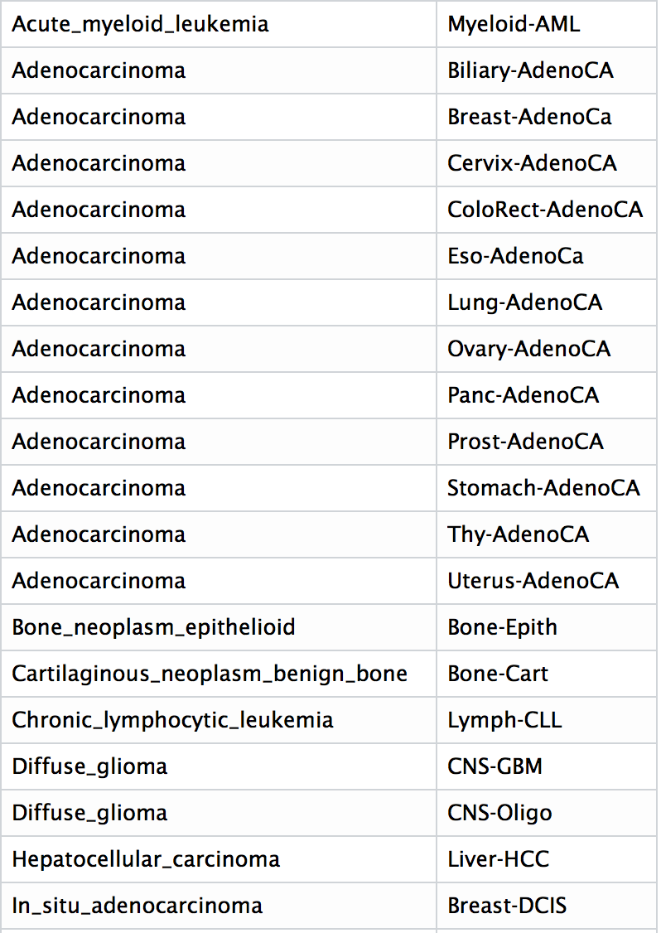
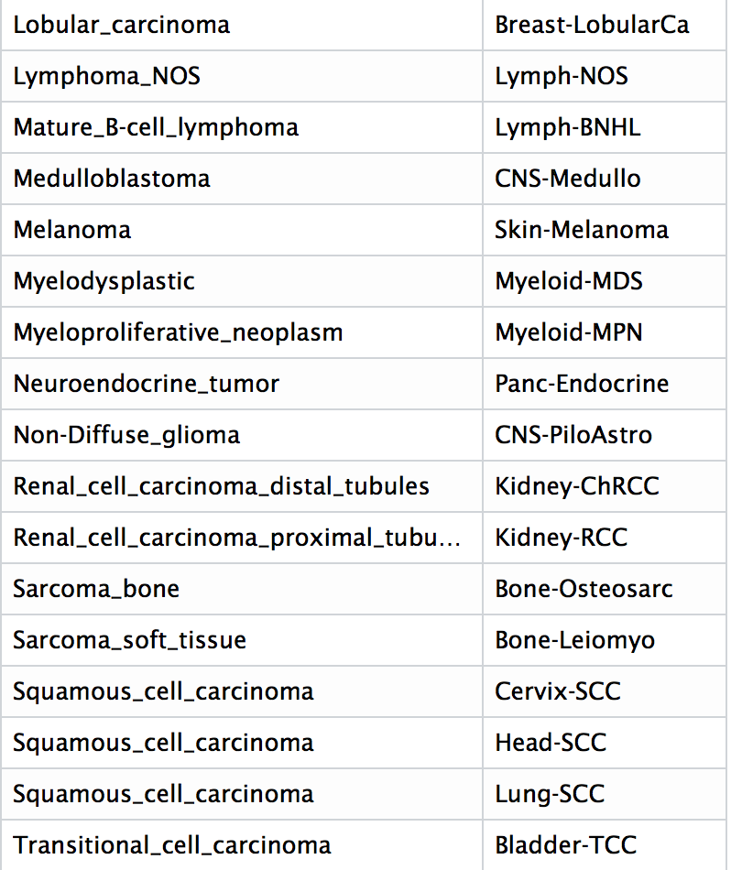
Plot by cancer type, not subtype

Slide 5
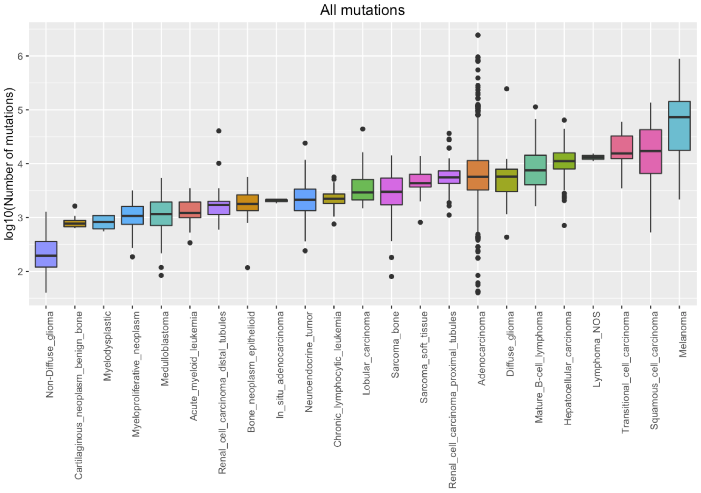

Slide 6
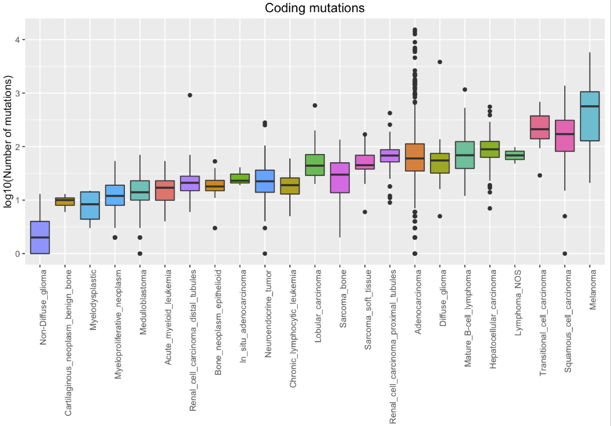

Slide 7
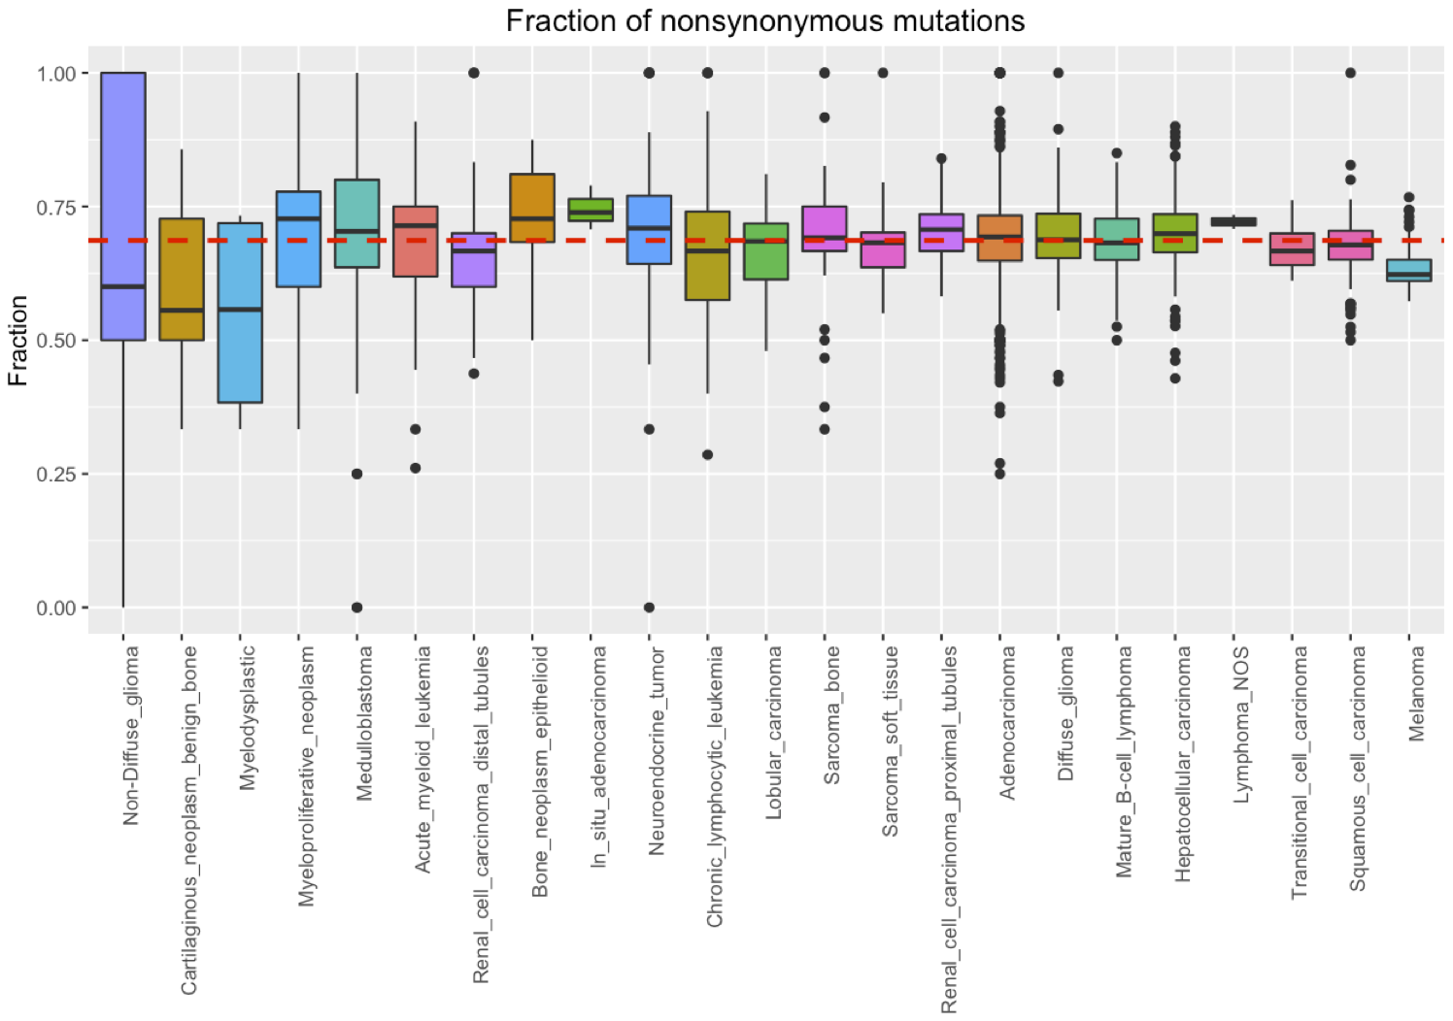

Slide 8
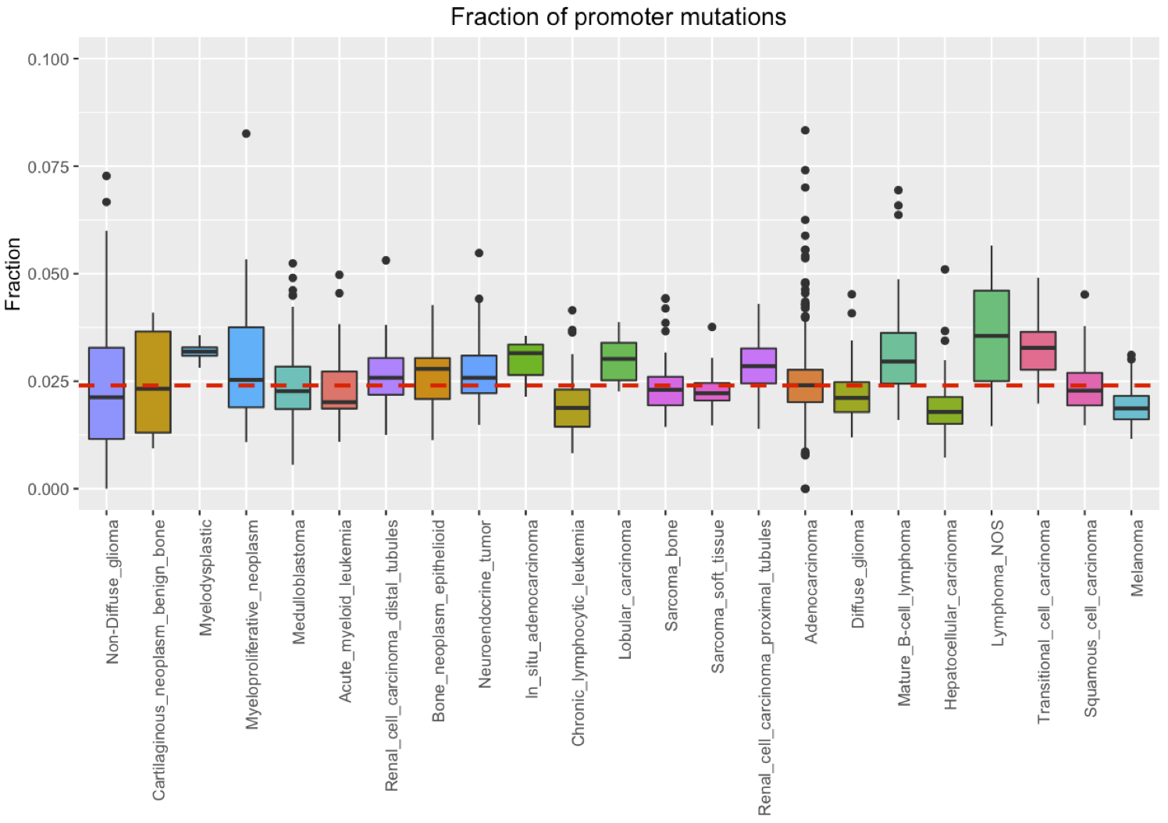

Slide 9
