Slide 1
ALoFT / PCAWG

Slide 2
Outline
Randomized data set / normalization for gene length
Highly LOF burdened samples / VAF
Anticorrelation between LOF genes

Slide 3
Randomized data set / normalization for gene length

Slide 4
Randomization vs. PCAWG
Randomized LOF mutations: 15587
PCAWG LOF mutations: 15435

Slide 5
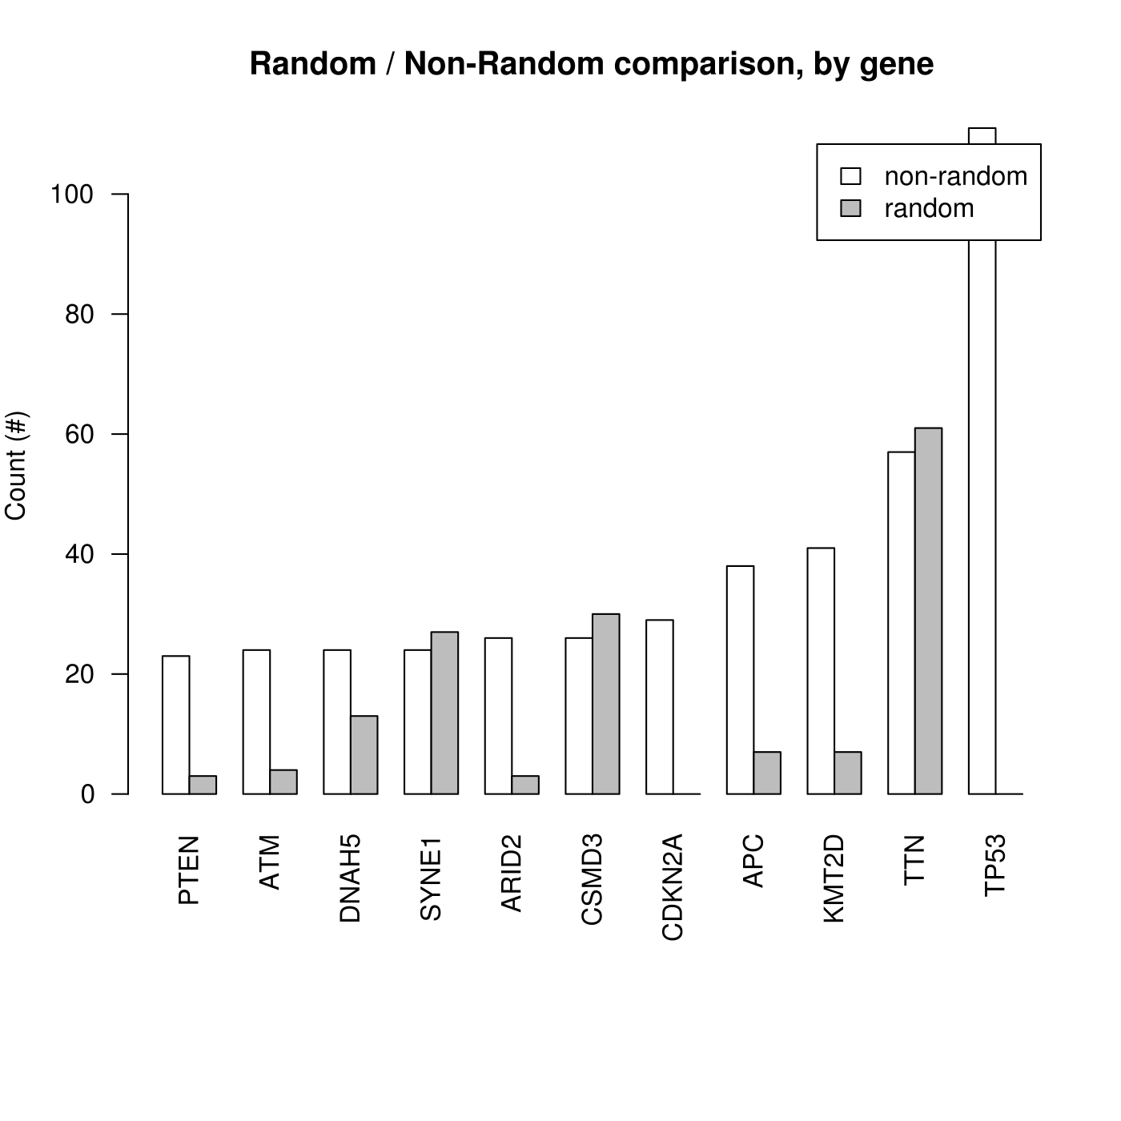

Slide 6
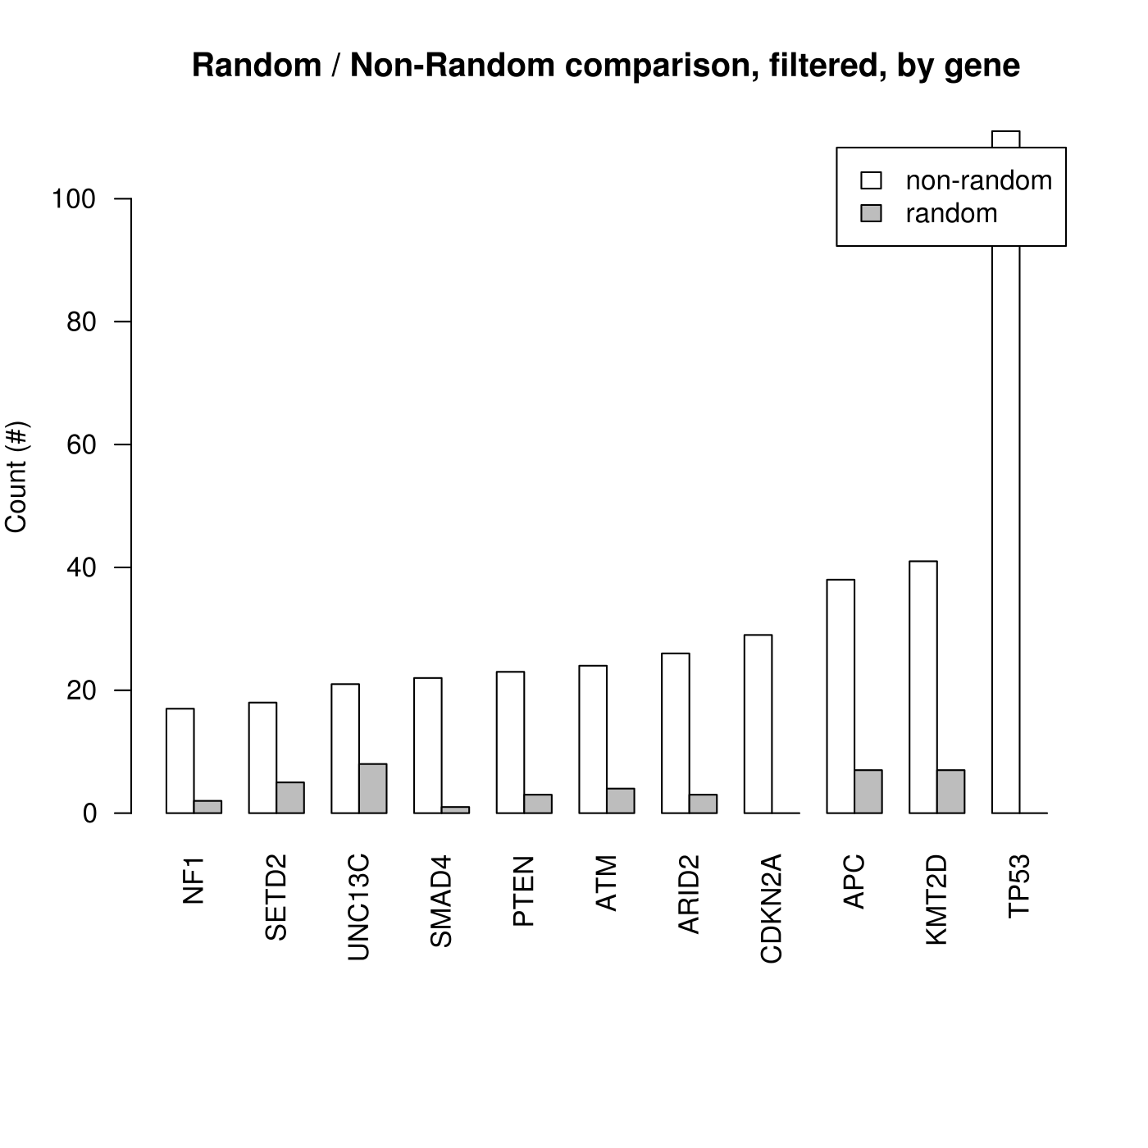

Slide 7
Long genes
SYNE1: This gene encodes a spectrin repeat containing protein expressed in skeletal and smooth muscle, and peripheral blood lymphocytes, that localizes to the nuclear membrane.
TTN: This gene encodes a large abundant protein of striated muscle. It has also been identified as a structural protein for chromosomes.
DNAH5: Dynein heavy chain, ciliary defects.
CSMD3: ?? Transmembrane protein.

Slide 8
Long genes
Gene length alone not explanatory -- studies which correct for gene length, still may find significant results.
2 additional factors:
1. Germline gene expression:
“It is known that the germline mutation rate is somewhat lower in genes that are highly expressed in the germline, due to a process termed transcription-coupled repair.”
2. Replication timing:
“Late-replicating regions have much higher mutation rates, possibly due to depletion of the pool of free nucleotides.”
Lawrence, Michael S., et al. "Mutational heterogeneity in cancer and the search for new cancer-associated genes." Nature 499.7457 (2013): 214-218.

Slide 9
Other genes -- possible tumor suppressors?
TP53: This gene encodes a tumor suppressor protein containing transcriptional activation, DNA binding, and oligomerization domains.
KMT2D: The protein encoded by this gene is a histone methyltransferase that methylates the Lys-4 position of histone H3.
APC: This gene encodes a tumor suppressor protein that acts as an antagonist of the Wnt signaling pathway.
CDKN2A: This ARF product functions as a stabilizer of the tumor suppressor protein p53.
ARID2: Chromatin remodelling, ligand-dependent transcriptional activation by nuclear receptors.
ATM: This protein is an important cell cycle checkpoint kinase.

Slide 10
Other genes -- possible tumor suppressors?
PTEN: This gene was identified as a tumor suppressor that is mutated in a large number of cancers at high frequency.
SMAD4: Accumulates in the nucleus and regulates the transcription of target genes. TGF-beta signalling.
UNC13C: May play a role in vesicle maturation during exocytosis as a target of the diacylglycerol second messenger pathway.
SETD2: This protein is a histone methyltransferase that is specific for lysine-36 of histone H3, and methylation of this residue is associated with active chromatin.
NF1: This gene product appears to function as a negative regulator of the ras signal transduction pathway.

Slide 11
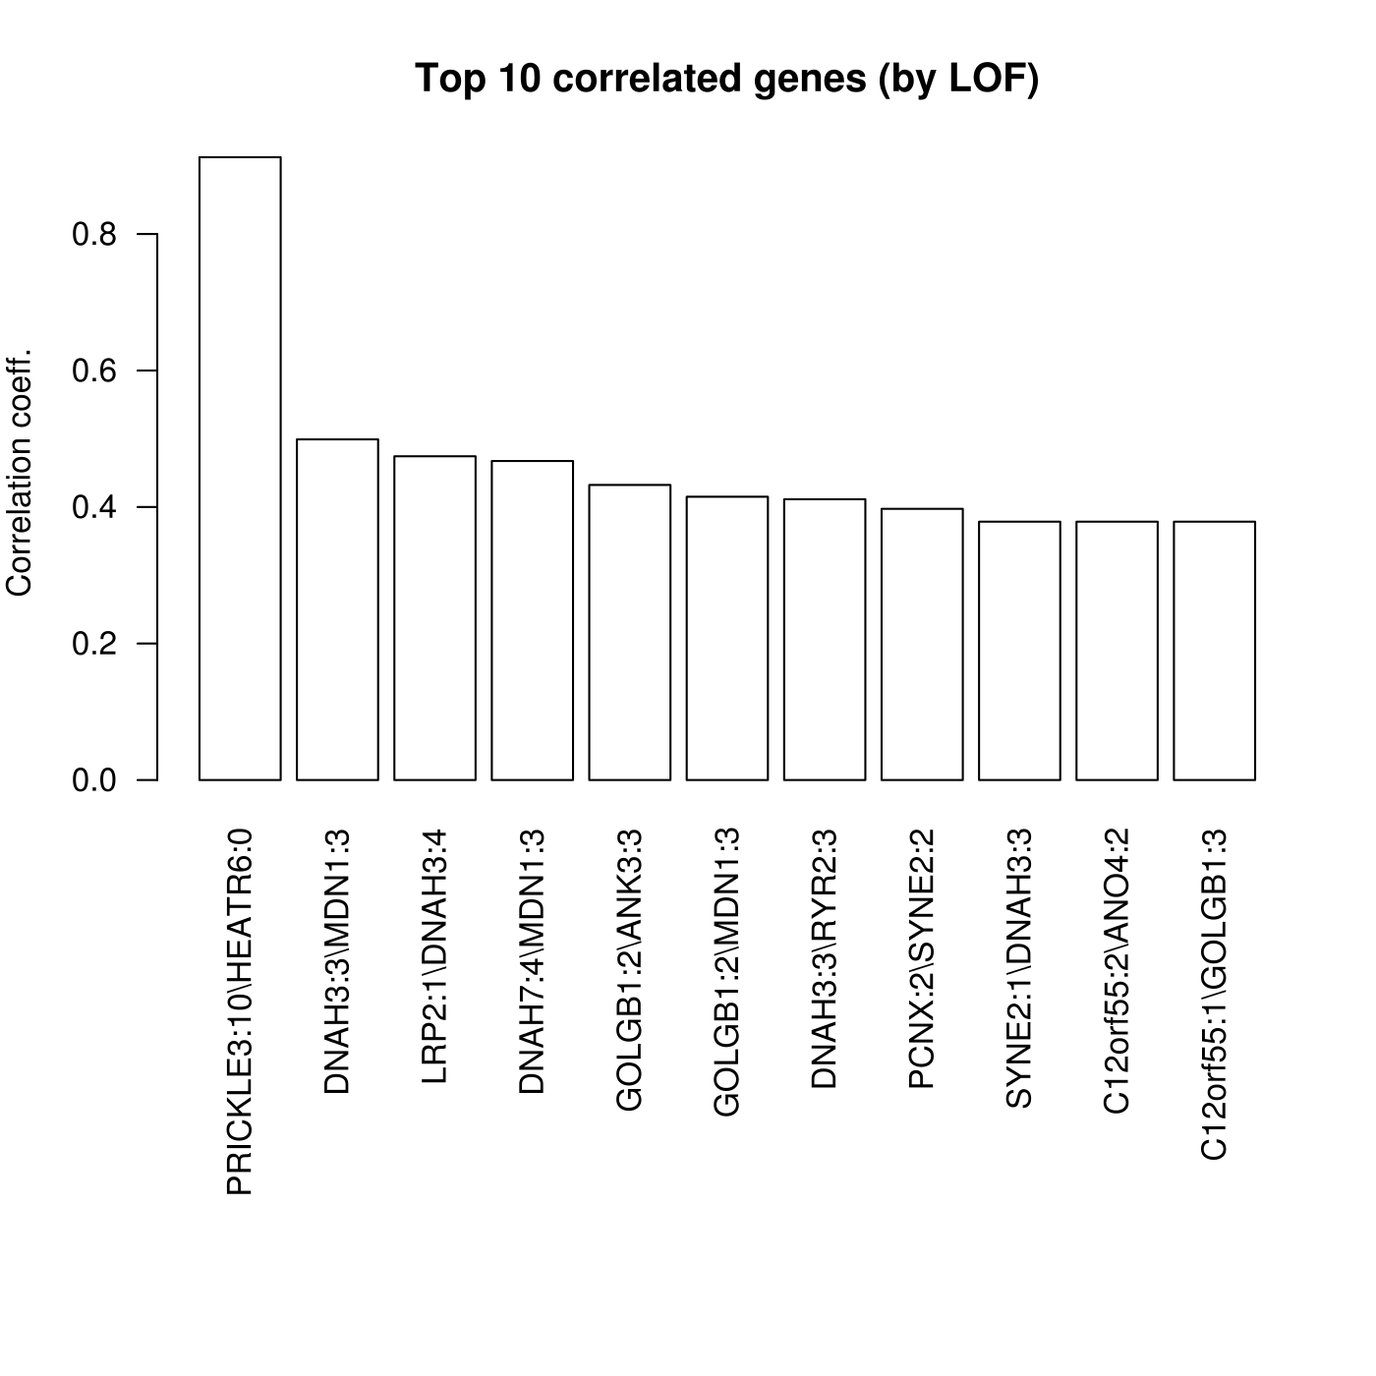
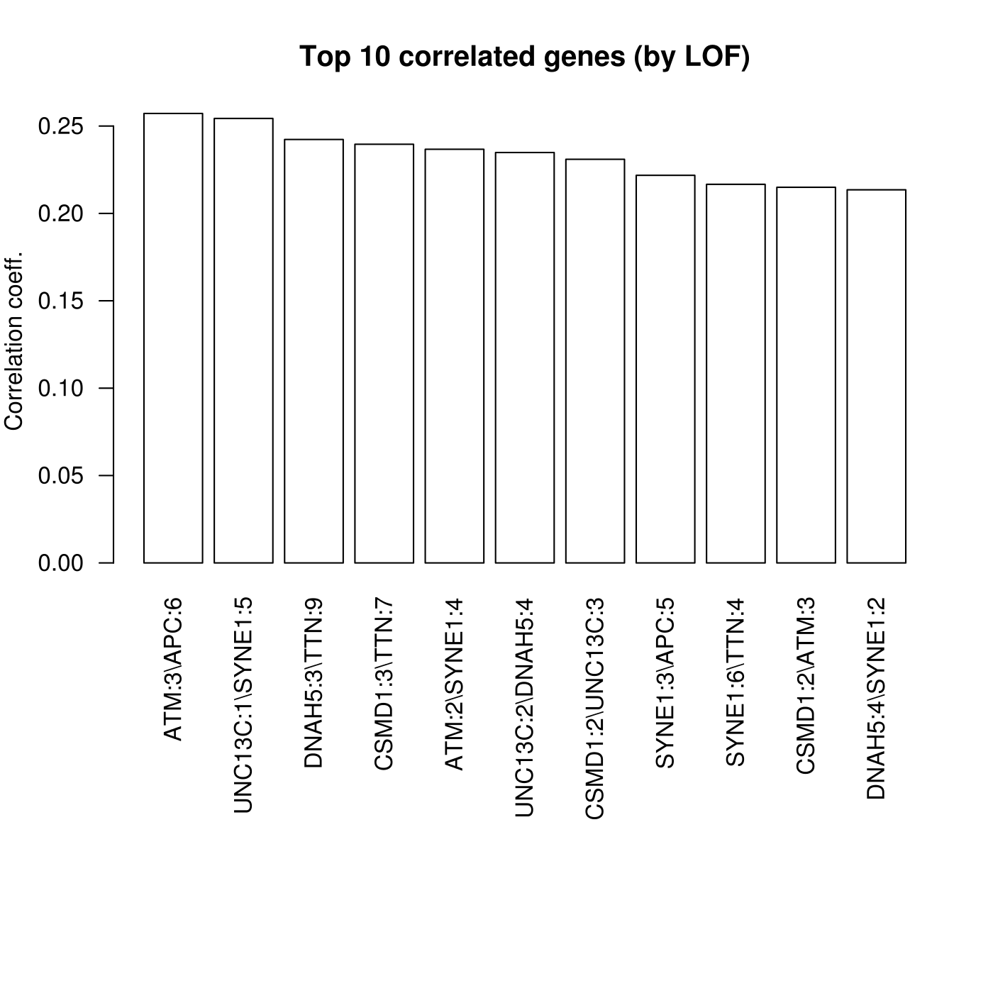

Slide 12
Highly mutated samples / VAF

Slide 13
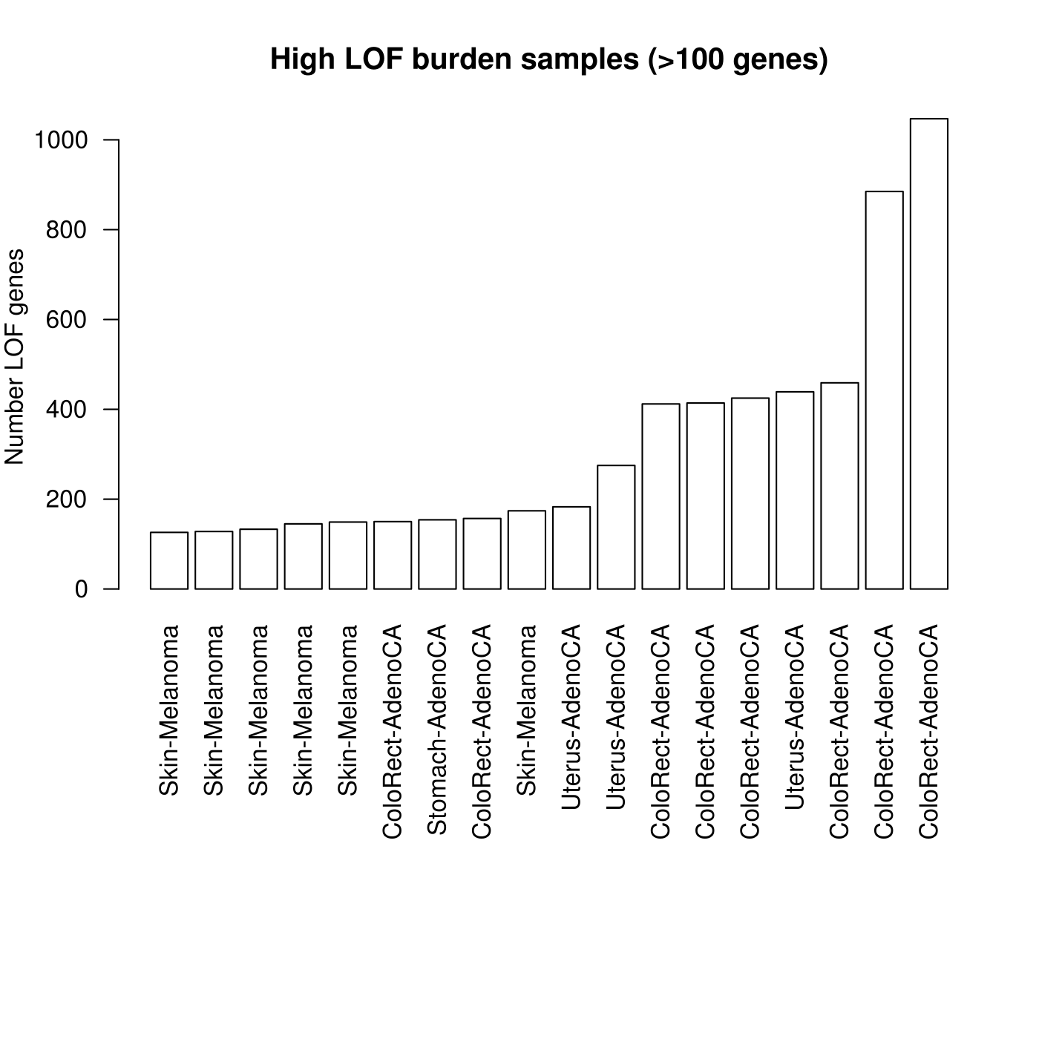

Slide 14
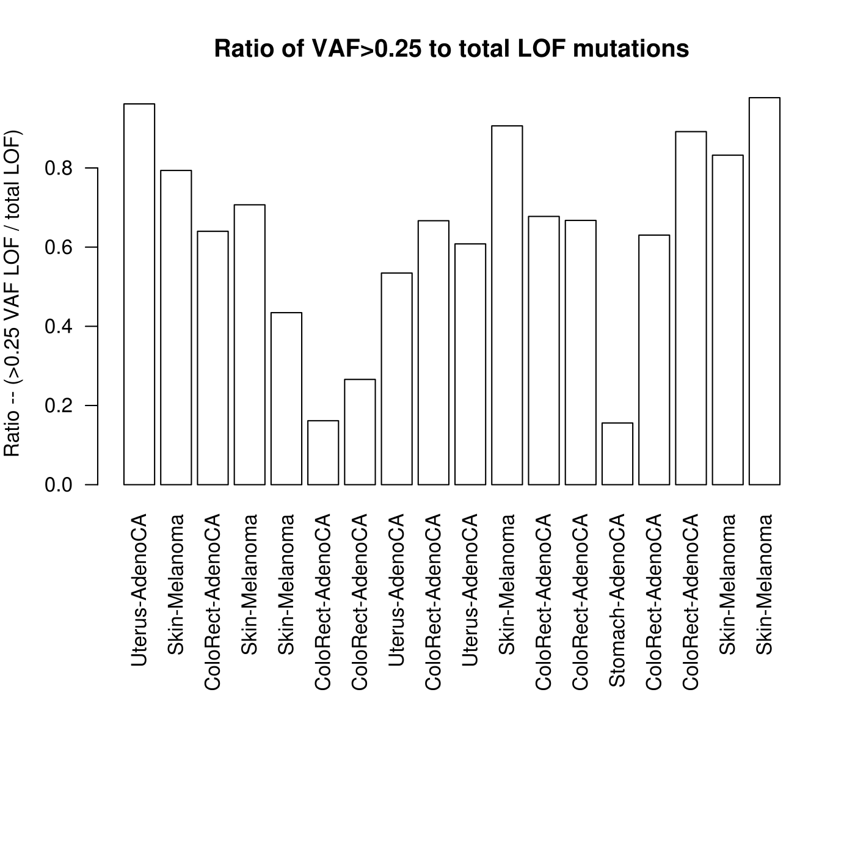

Slide 15
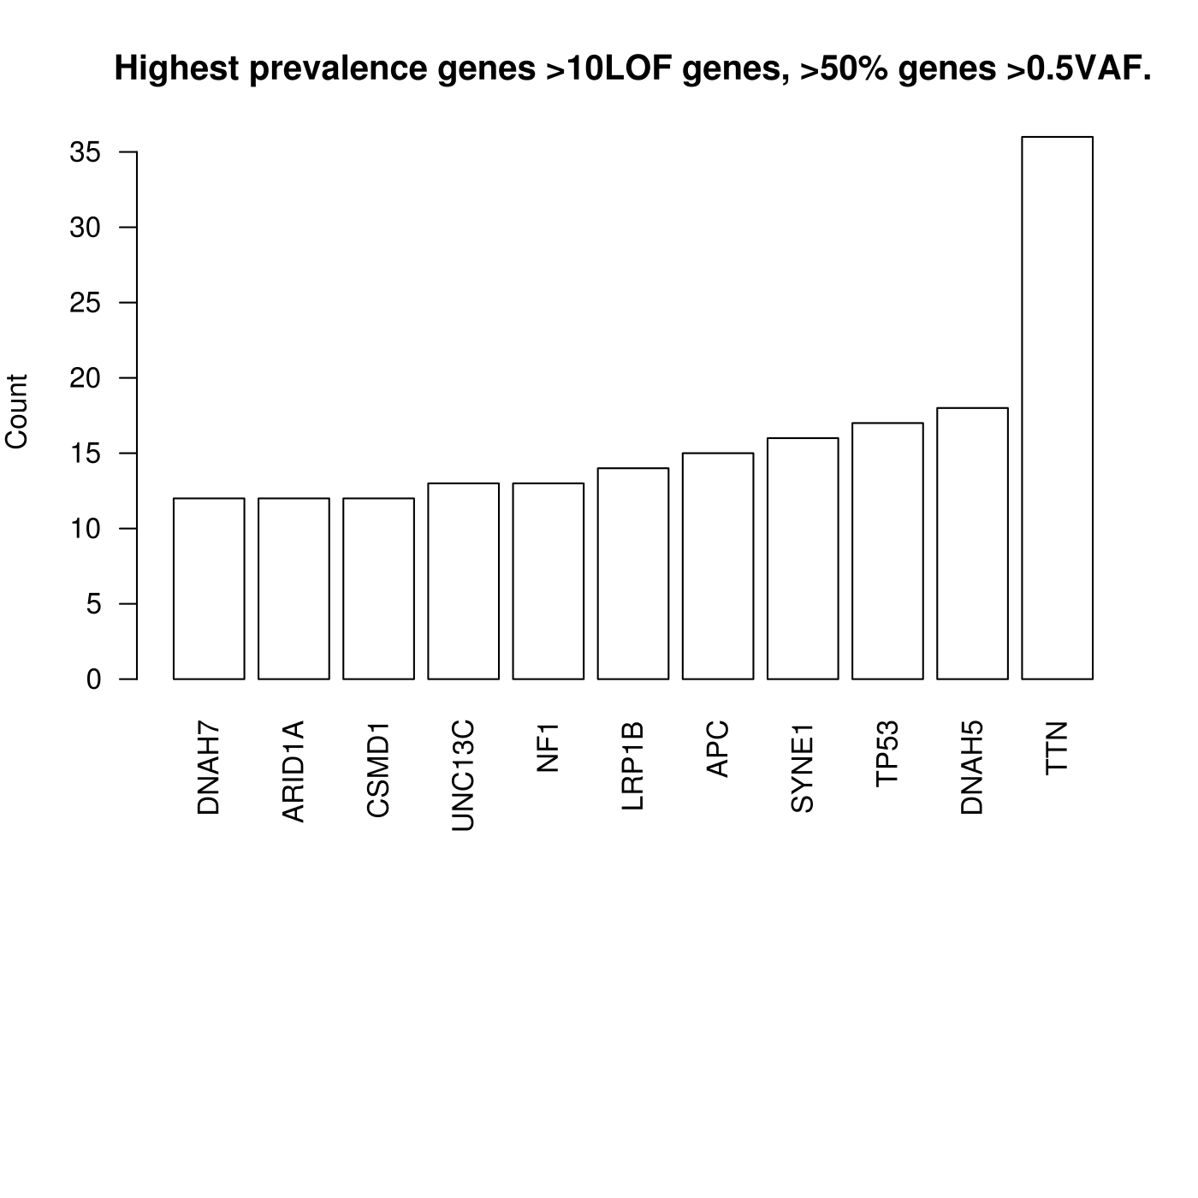

Slide 16
Regarding Titin
“TTN is the largest polypeptide encoded by the human genome and has been extensively studied as a component of the muscle contractile machinery. However, it is expressed in many cell types and has other functions that are compatible with a role in oncogenesis. The role of TTN as a cancer gene is currently a mathematically based prediction and will require direct biological evaluation.”
Greenman, Christopher, et al. "Patterns of somatic mutation in human cancer genomes." Nature 446.7132 (2007): 153-158.
Machado C, Andrew DJ. D-Titin: a giant protein with dual roles in chromosomes and muscles. J. Cell Biol. 2000;151:639–652.
Machado C, Sunkel CE, Andrew DJ. Human autoantibodies reveal Titin as a chromosomal protein. J. Cell Biol. 1998;141:321–333.]
21. Zastrow MS, Flaherty DB, Benian GM, Wilson KL. Nuclear Titin interacts with A- and B-type lamins in vitro and in vivo. J. Cell Sci. 2006;119:239–249.

Slide 17
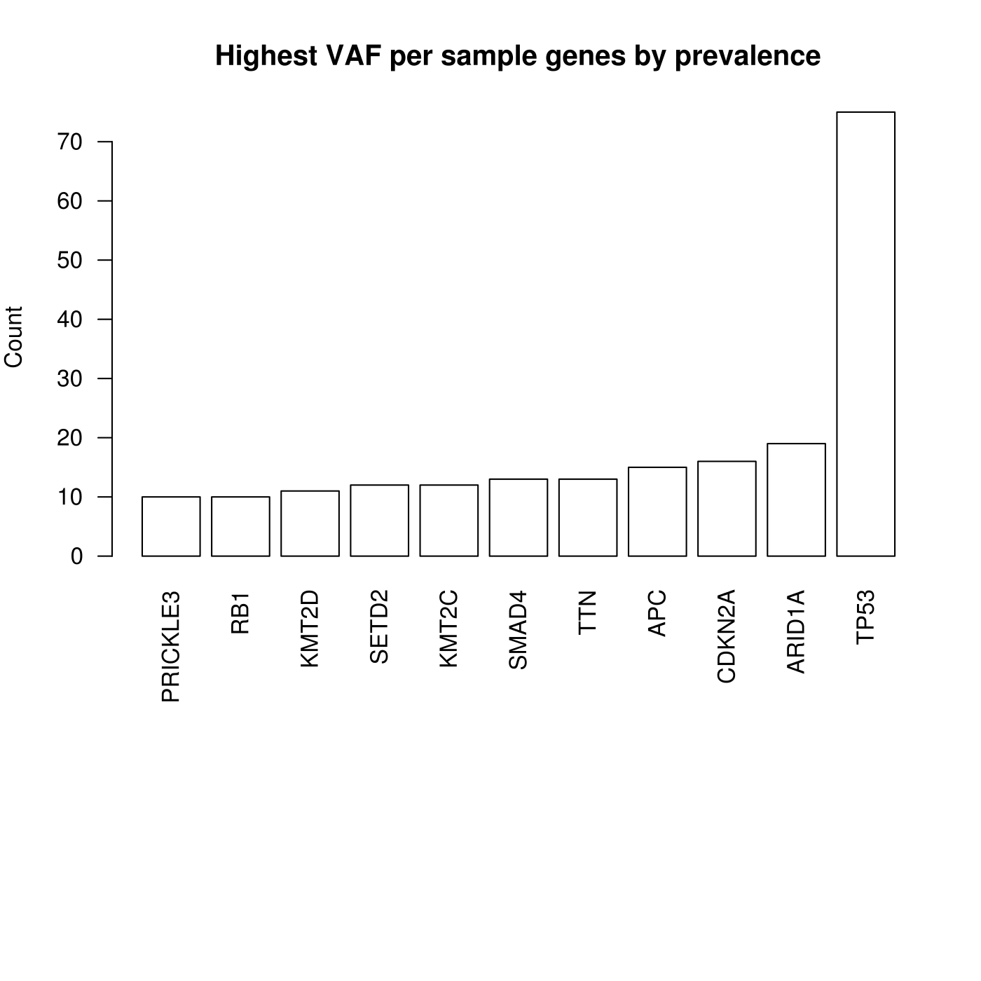

Slide 18
Anticorrelated pLOF genes

Slide 19
