Slide 1
Landscape of somatic mutations in inflammatory breast cancer whole-genome sequences
Xiaotong Li

Slide 2
Mutation rate of TP53 in IBC
Our current IBC somatic variants set (20 samples)
“Analysis of all pooled IBC samples showed the mutation rate of TP53 is 66%”^{[1]}
including: 31 IBC patients by targeted NGS (3230 exons of 182 cancer genes)
 | # Mutations | # Samples | % Samples
Coding | 1 | 1 | 5%
Noncoding | 6 (Intro & UTR) | 3 | 15%

Slide 3
Mutation rate of TP53 in Non-IBC
Same variants calling pipeline & filters
Our current Non-IBC somatic variants set (23 samples)
TP53 mutations prevalence in breast cancer
~25% (3450/13608 samples)^{[1]}
~37%^{[2]}
 | # Mutations | # Samples | % Samples
Coding | 0 | 0 | 0
Noncoding | 1 | 1 | 4.35%

Slide 4
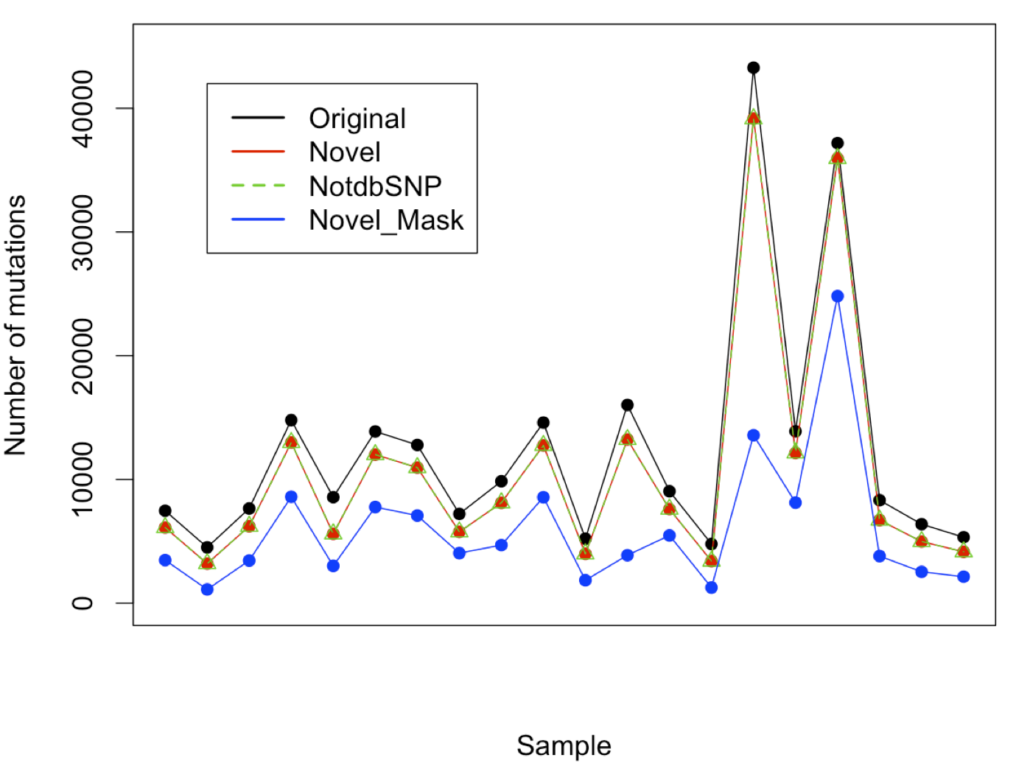

Slide 5
Mutation rate of TP53 in IBC
Filters | # Mutations | # Samples | % Samples
Novel & Mask | 1 | 1 | 5%
Novel (NotdbSNP) | 7 | 7 | 35%
Original (No filters) | 11 | 11 | 55%
“Analysis of all pooled IBC samples showed the mutation rate of TP53 is 66%”^{[1]}
including: 31 IBC patients by targeted NGS (3230 exons of 182 cancer genes)

