Slide 1
ALoFT PCAWG Slides

Slide 2
Background / Stats
ALoFT classifies LOF mutations as dominant/recessive/tolerant.
Poor applicability to cancer, so assume 2 functional classes: [dominant, recessive] and [tolerant]
Total samples with at least 1 LOF event = 2270
Total LOF events is 28426
390 samples have only a single LOF event

Slide 3
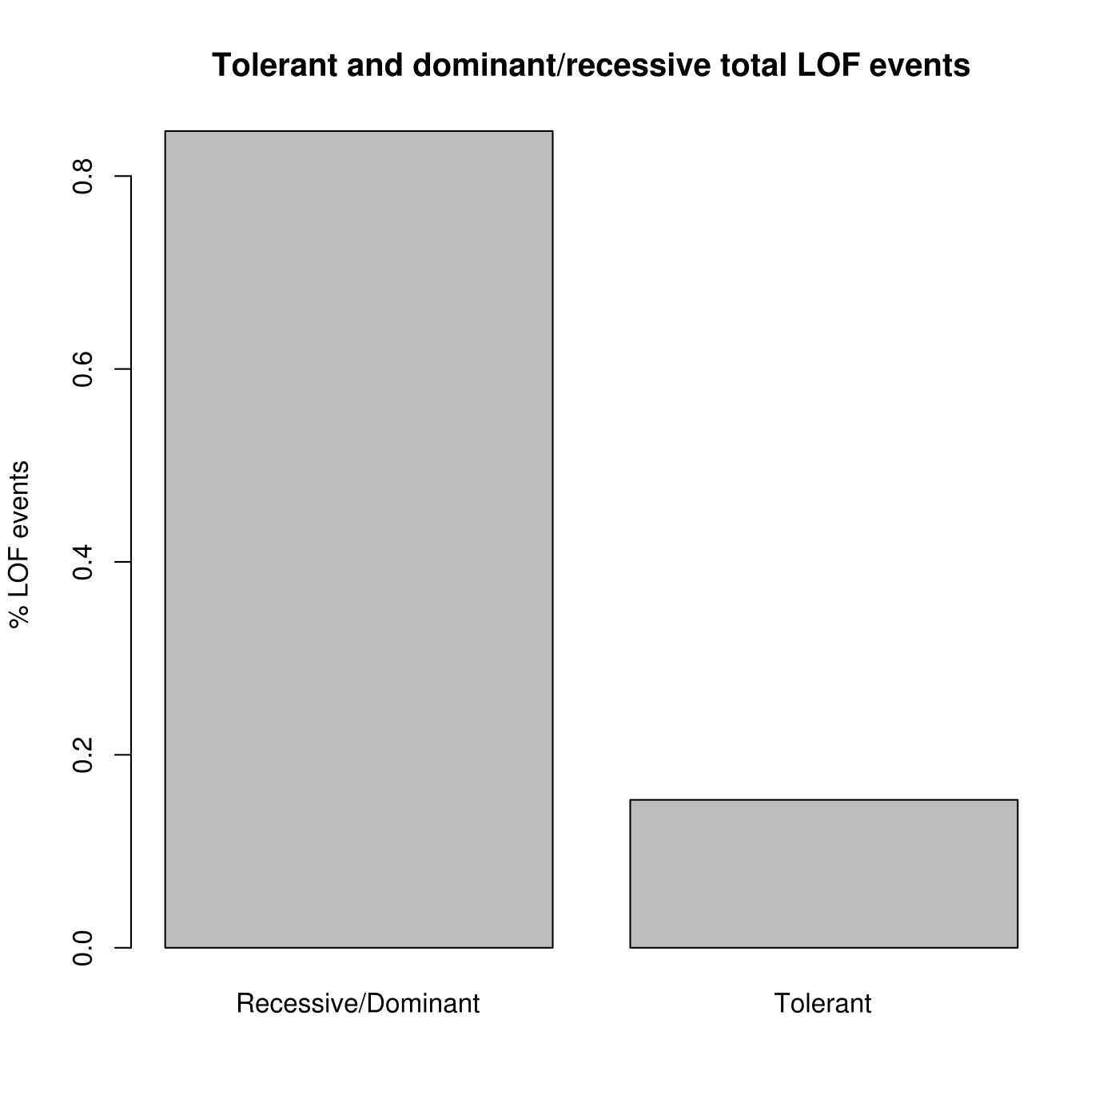

Slide 4
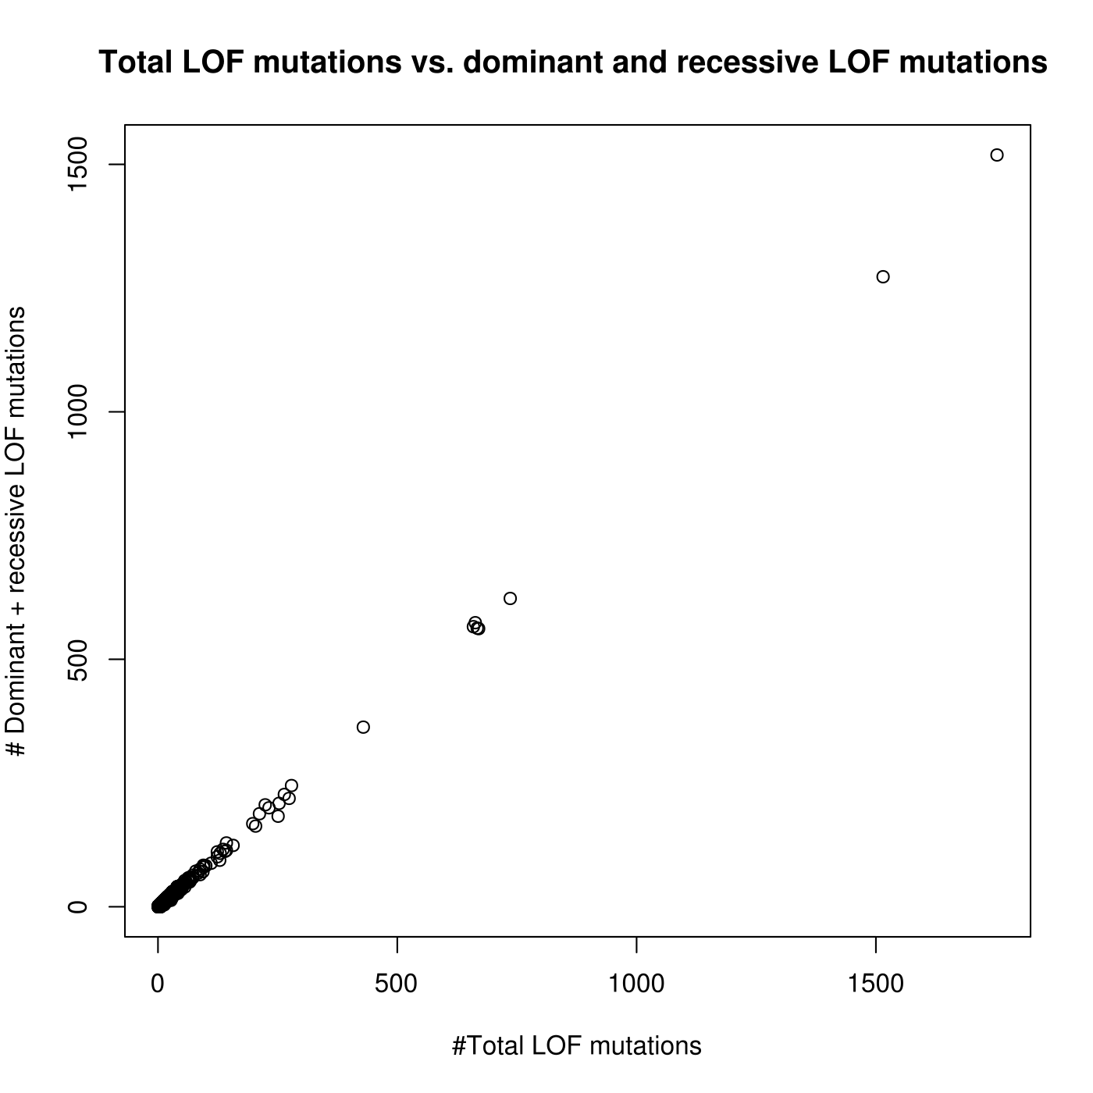

Slide 5
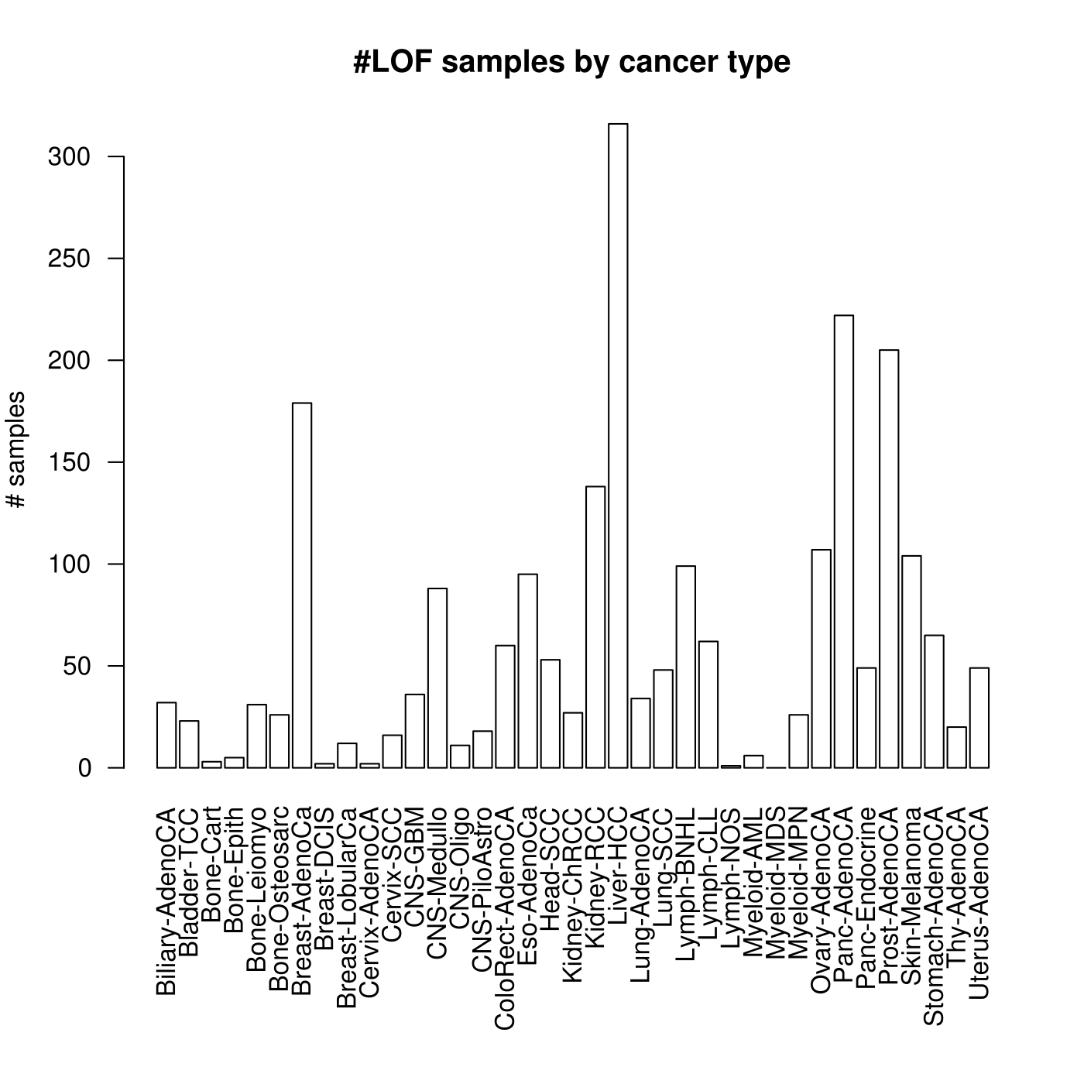

Slide 6
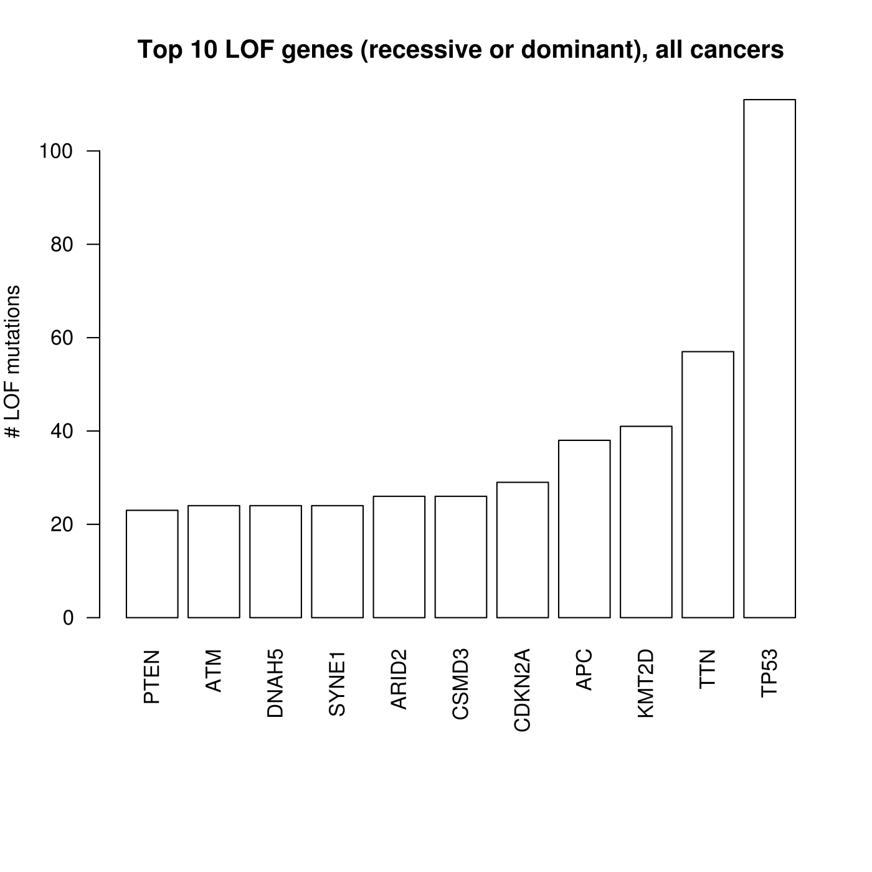

Slide 7
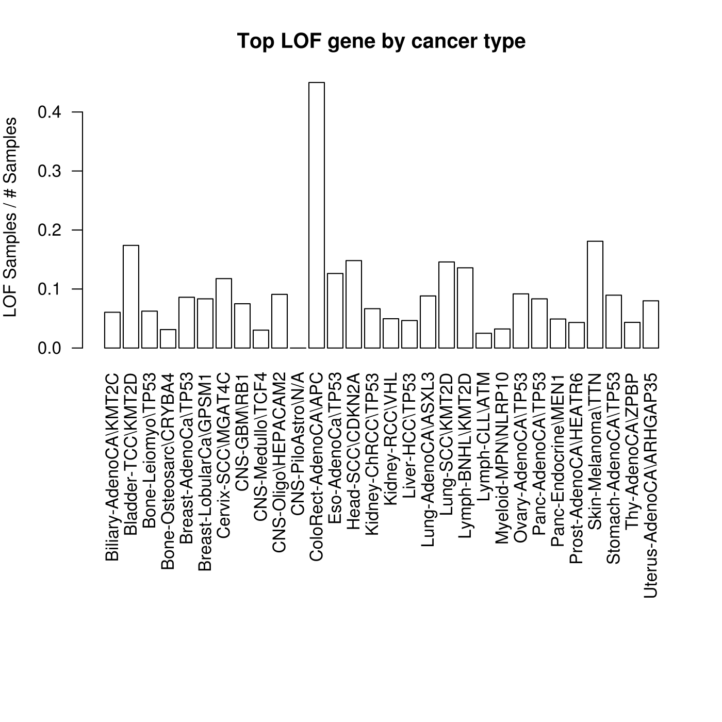
ALoFT PCAWG Slides

Slide 8
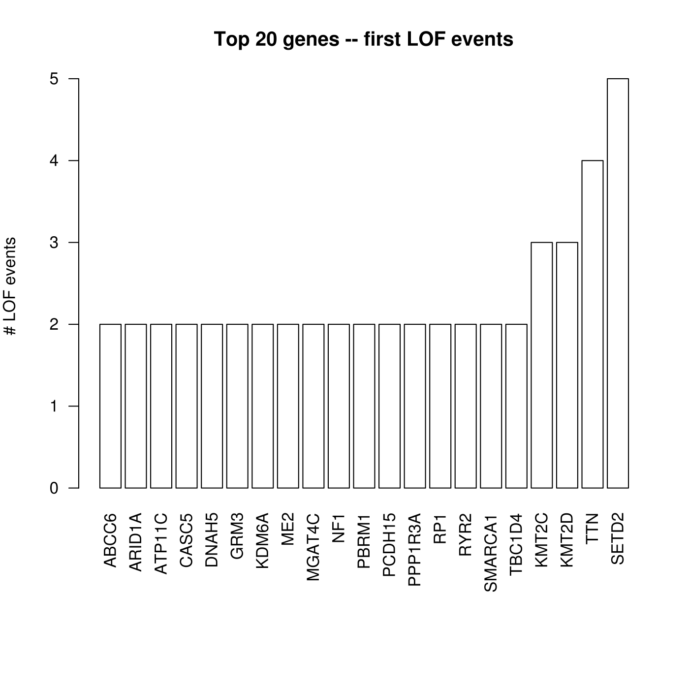
ALoFT PCAWG Slides

Slide 9
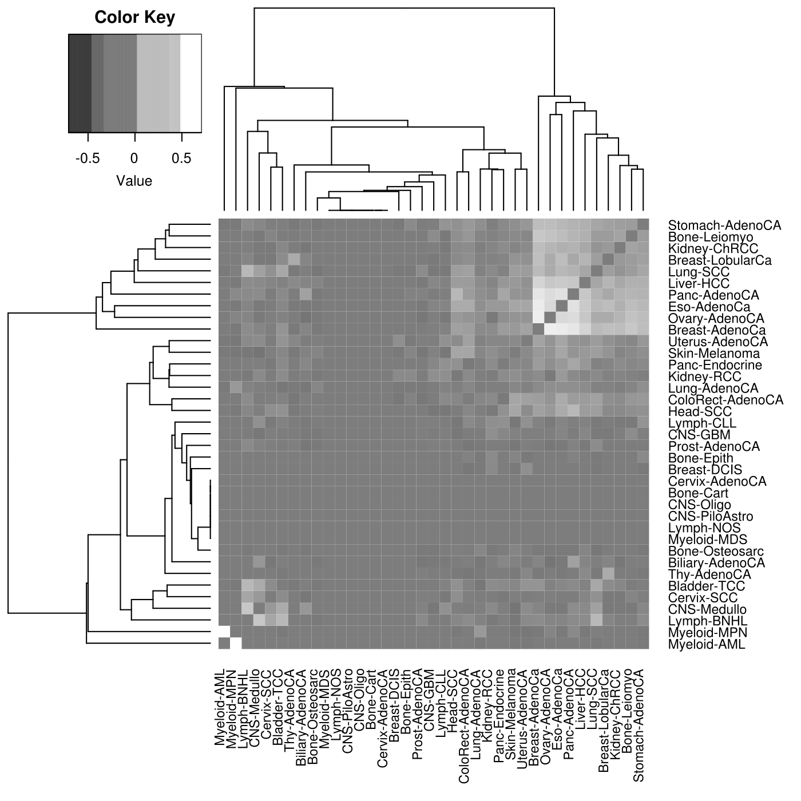

Slide 10
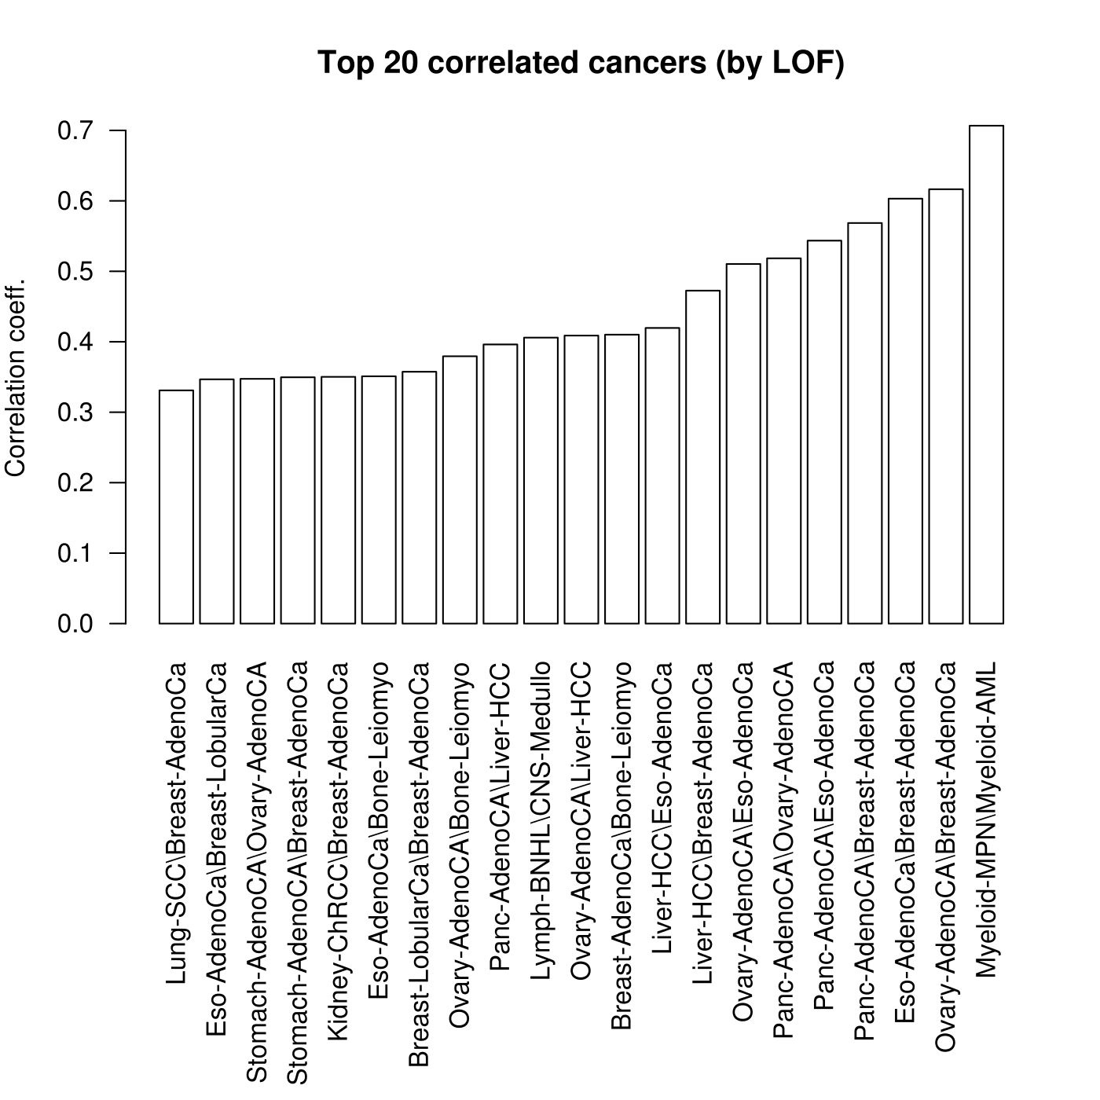

Slide 11
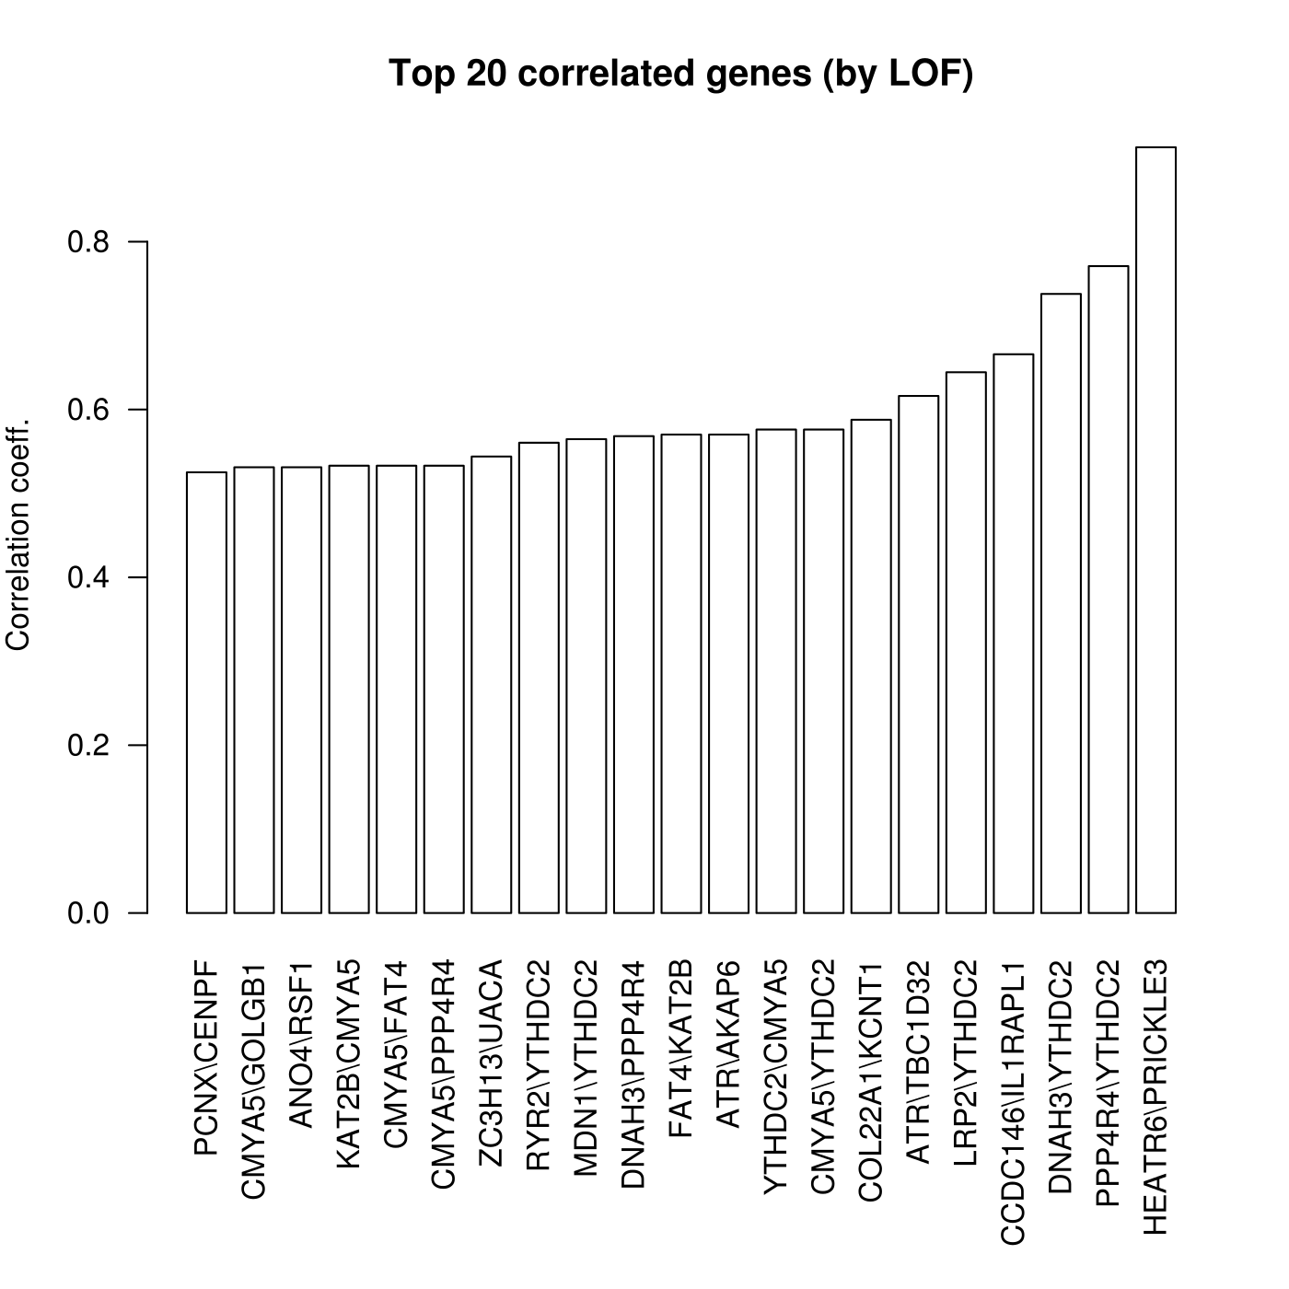
>5 samples
HEATR6 /
PRICKLE3
YTHDC2
TH

Slide 12
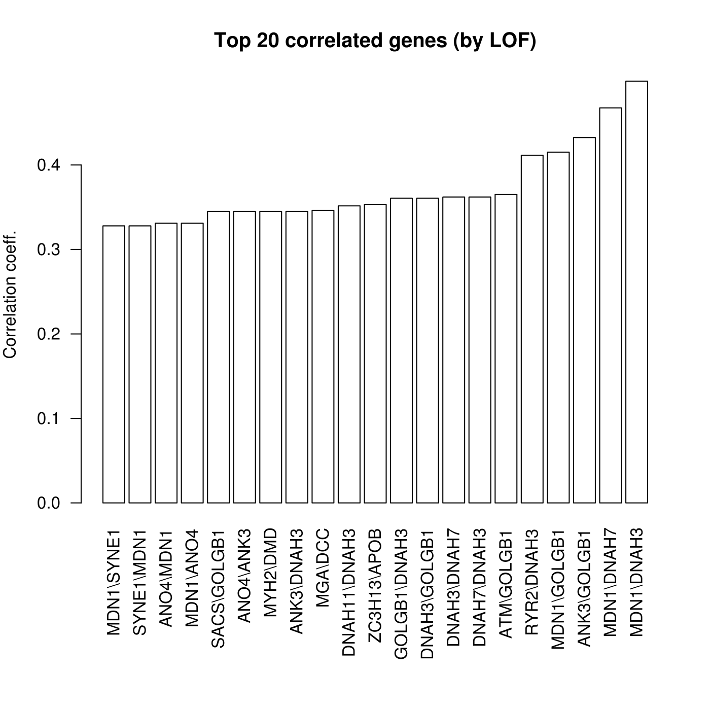
>10 samples
MDN1
GOLGB1

Slide 13
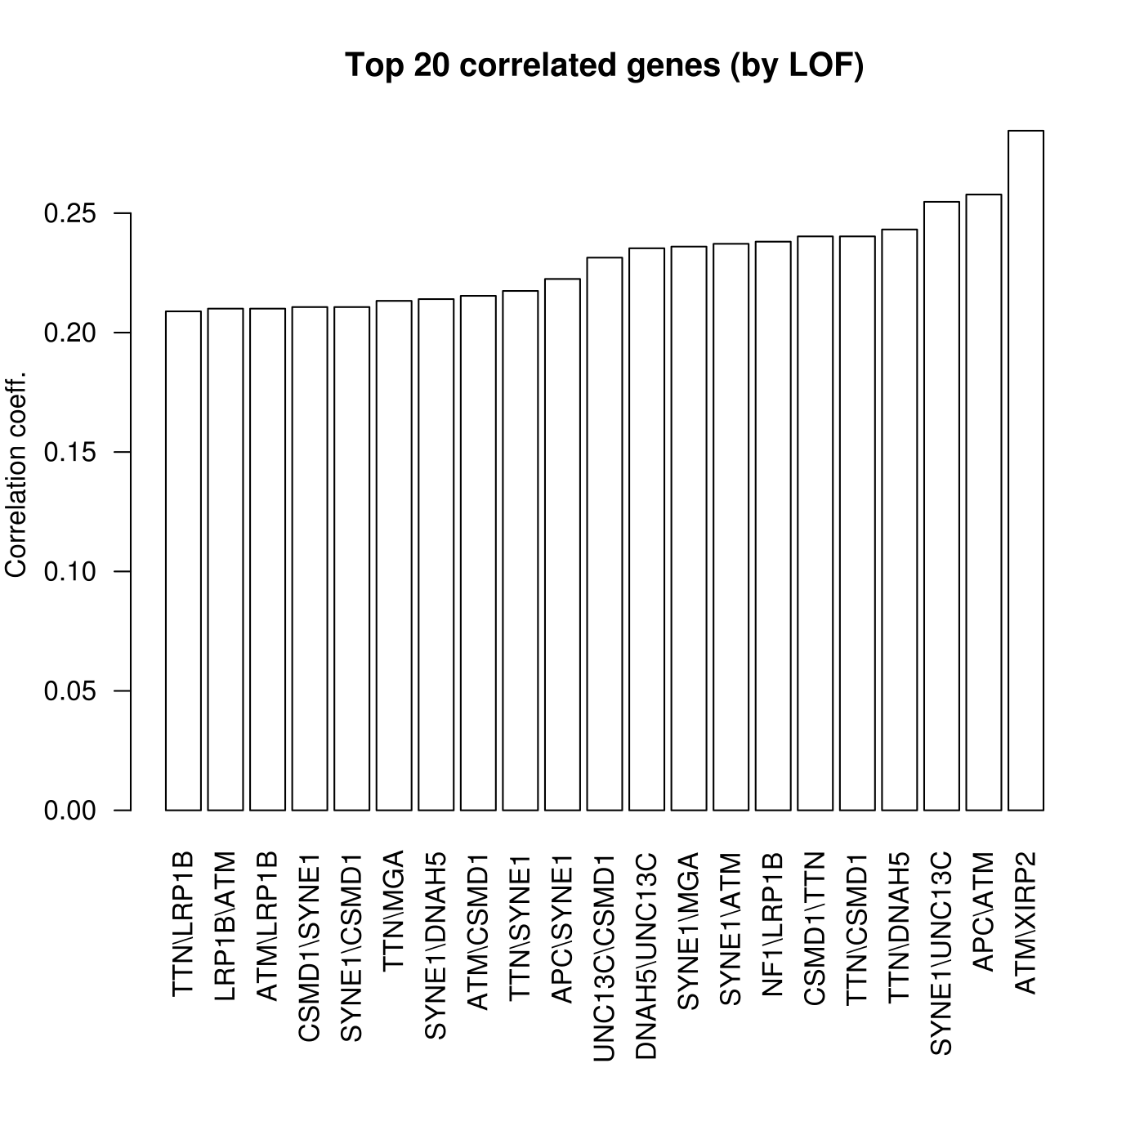
>15 samples
TTN
SYNE1

Slide 14
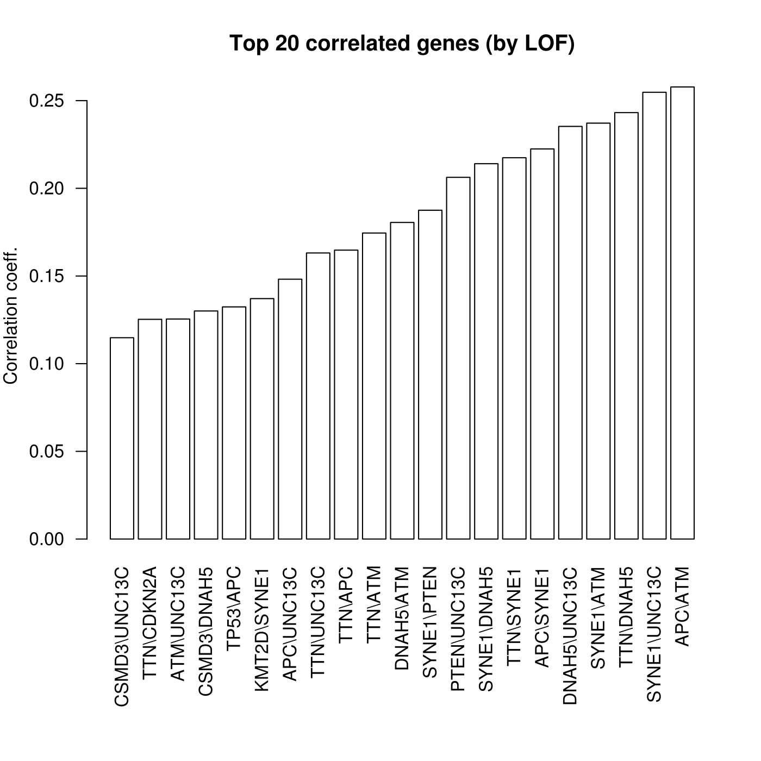
>20 samples
UN13C
ATM

