Slide 1
Predicting Functional uORFs
Patrick McGillivray, Russell Ault, Mayur Pawashe, Rob Kitchen, Suganthi Balasubramanian

Slide 2
History of contribution to the project
Suganthi Balasubramanian (2013 -- 2015 departure).
Mayur Pawashe (2013 -- 2014 departure).
Russell Ault (Summer 2013 -- 2014 departure).
Patrick McGillivray (Summer 2014 -- present).
Rob Kitchen (Spring 2015 -- 2016 departure).

Slide 3
Outline
Background
Method
Method Validation/Verification
Method Application

Slide 4
Background

Slide 5
Background
Ribosome footprinting experiments can identify translation start sites.
Some of these translation start sites, are upstream of the CDS.
What is the role of these upstream open reading frames (uORFs)?
Translational control?
Short peptides?
How prevalent are these translated uORFs?
Guo, Huili, et al. "Mammalian microRNAs predominantly act to decrease target mRNA levels." Nature 466.7308 (2010): 835-840.

Slide 6
Background: uORF structure
Start codon in 5’UTR, stop codon before CDS.
Start codon in 5’UTR, out of frame stop codon within CDS
5’ extension.

Slide 7
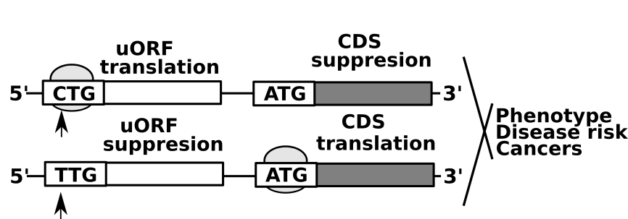
Background: uORF variation

Slide 8
Background: objectives/hypotheses
Hypothesis: there are many more translated uORFs, than are identified through ribosome profiling studies.
Can we predict what uORFs are translated, based on ribosome profiling footprinting studies?
What are the attributes, of translated uORFs?
Hypothesis: uORFs have meaningful regulatory function, and changes in uORF structure will affect protein level.
Is variation affecting uORFs, associated with measurable change in function, especially through translation?

Slide 9
Background: similar studies
Thousands of novel translated open reading frames in humans inferred by ribosome footprint profiling.
“A new method that uses ribosome footprint data to accurately infer translated sequences.”
“riboHMM; a model to identify translated CDSs by leveraging both the total abundance and the codon periodicity structure in RPFs.”
2442 novel translated upstream open reading frames.
Raj, Anil, et al. "Thousands of novel translated open reading frames in humans inferred by ribosome footprint profiling." eLife 5 (2016): e13328.
Genome-Wide Search for Translated Upstream Open Reading Frames in Arabidopsis Thaliana
5360 potentially translated uORFs in 2051 genes
Hu, Qiwen, et al. "Genome-Wide Search for Translated Upstream Open Reading Frames in Arabidopsis Thaliana." IEEE transactions on nanobioscience 15.2 (2016): 148-157.
Predicting functional upstream open reading frames in Saccharomyces cerevisiae
398 novel functional uORFs
Bryant, Christopher H., et al. "Predicting functional upstream open reading frames in Saccharomyces cerevisiae." BMC bioinformatics 10.1 (2009): 1.

Slide 10
Raj, Anil, et al. "Thousands of novel translated open reading frames in humans inferred by ribosome footprint profiling." eLife 5 (2016): e13328.

Slide 11
Our novel contributions
Using machine learning, identify a list of predictive active/translated uORFs (180 000), much larger than those identified through ribosome profiling experiments, or other predictive studies.
Prioritization of attributes of translated uORFs, based on machine learning.
Provide evidence that variation in the uORF start site may result in either increase or decrease in protein translation.
Validation using Battle et al. data., PCAWG SNPS, 1000 Genomes SNPs.

Slide 12
Method

Slide 13
Ribosome profiling data sets
Gao et al. -- HEK 293 -- lactimidomycin + puromycin
Gao, Xiangwei, et al. "Quantitative profiling of initiating ribosomes in vivo."Nature methods 12.2 (2015): 147-153.
Fritsch et al. -- THP-1 -- puromycin
Fritsch, Claudia, et al. "Genome-wide search for novel human uORFs and N-terminal protein extensions using ribosomal footprinting." Genome research22.11 (2012): 2208-2218.
Lee et al. -- HEK 293 -- lactimidomycin
Lee, Sooncheol, et al. "Global mapping of translation initiation sites in mammalian cells at single-nucleotide resolution." Proceedings of the National Academy of Sciences 109.37 (2012): E2424-E2432.

Slide 14
Approach: ribosome profiling experiments

Slide 15
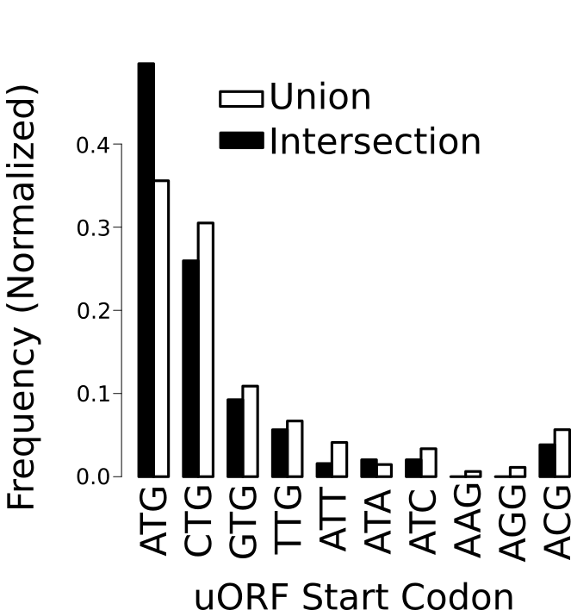
Start Codon Abundance -- uORFs

Slide 16
Methodology

Slide 17
Machine Learning Method: Naive Bayes
Discretization using MDLP algorithm (entropy minimization).
Set1 ={1,2,3,4,5,21,38,49,83,84}
Alternative 1: Set1.1 {1,2,3,4,5} ⋃ Set1.2 {21,38,49,83,84}
Alternative 2: Set 1.1 {1,2} ⋃ Set1.2 {3,4,5,21,38,49,83,84}
Following attribute discretization (Naive Bayes):
P(pos)p(A|pos)p(B|pos) == X
P(neg)p(A|neg)p(B|neg) == Y

Slide 18
89 features:
etc...
GTEX RNA expression GERP conservation score Kozak context score uORF Length | # start codons ∆G mRNA 1000 Genomes SNPs/length % codons (A,T,G,C)

Slide 19
Kolmogorov Smirnov significance/statistic
*all p values <<< 0.05

Slide 20
Attributes as discriminators

Slide 21
Method Verification/Validation

Slide 22
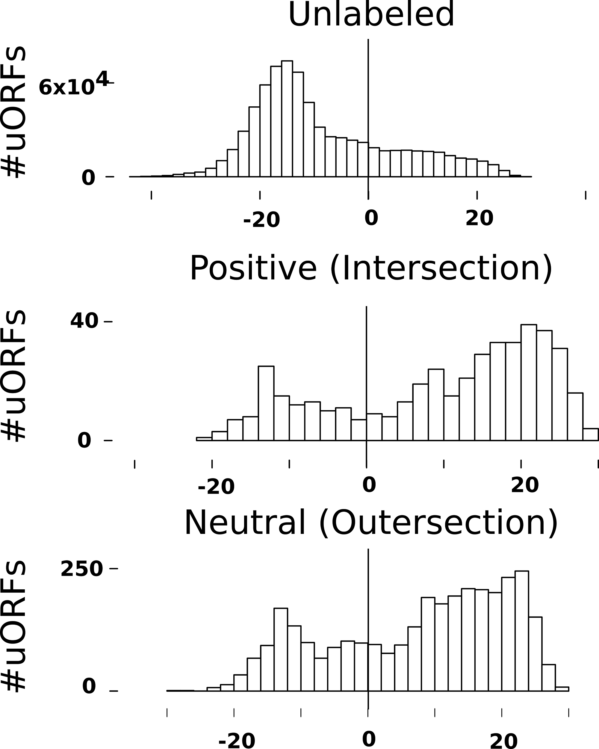
Score Distributions + Thresholding

Slide 23
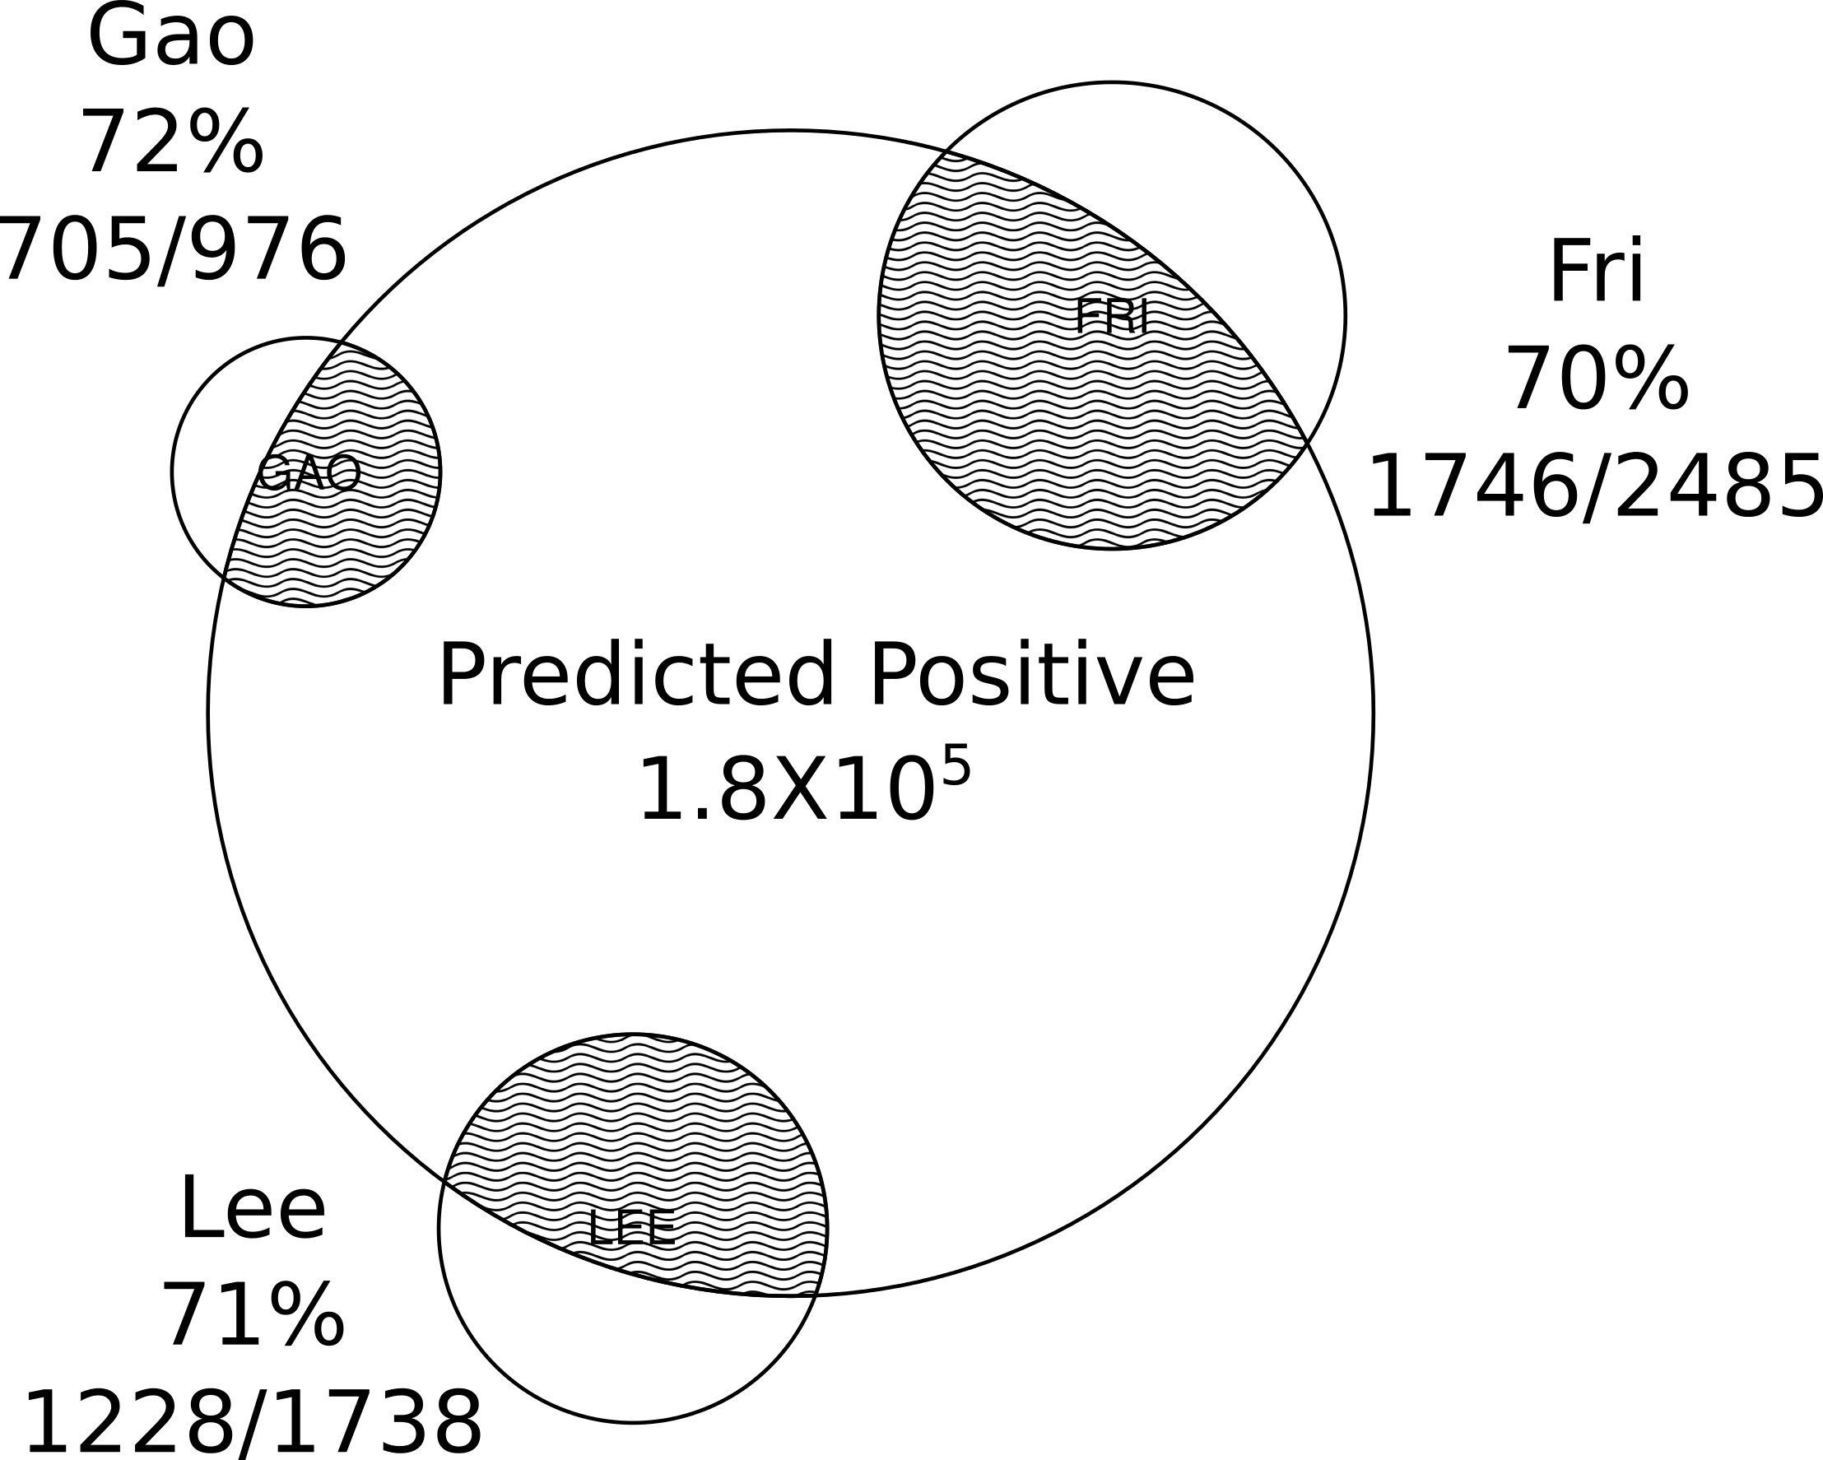
Percentage predicted as positive

Slide 24
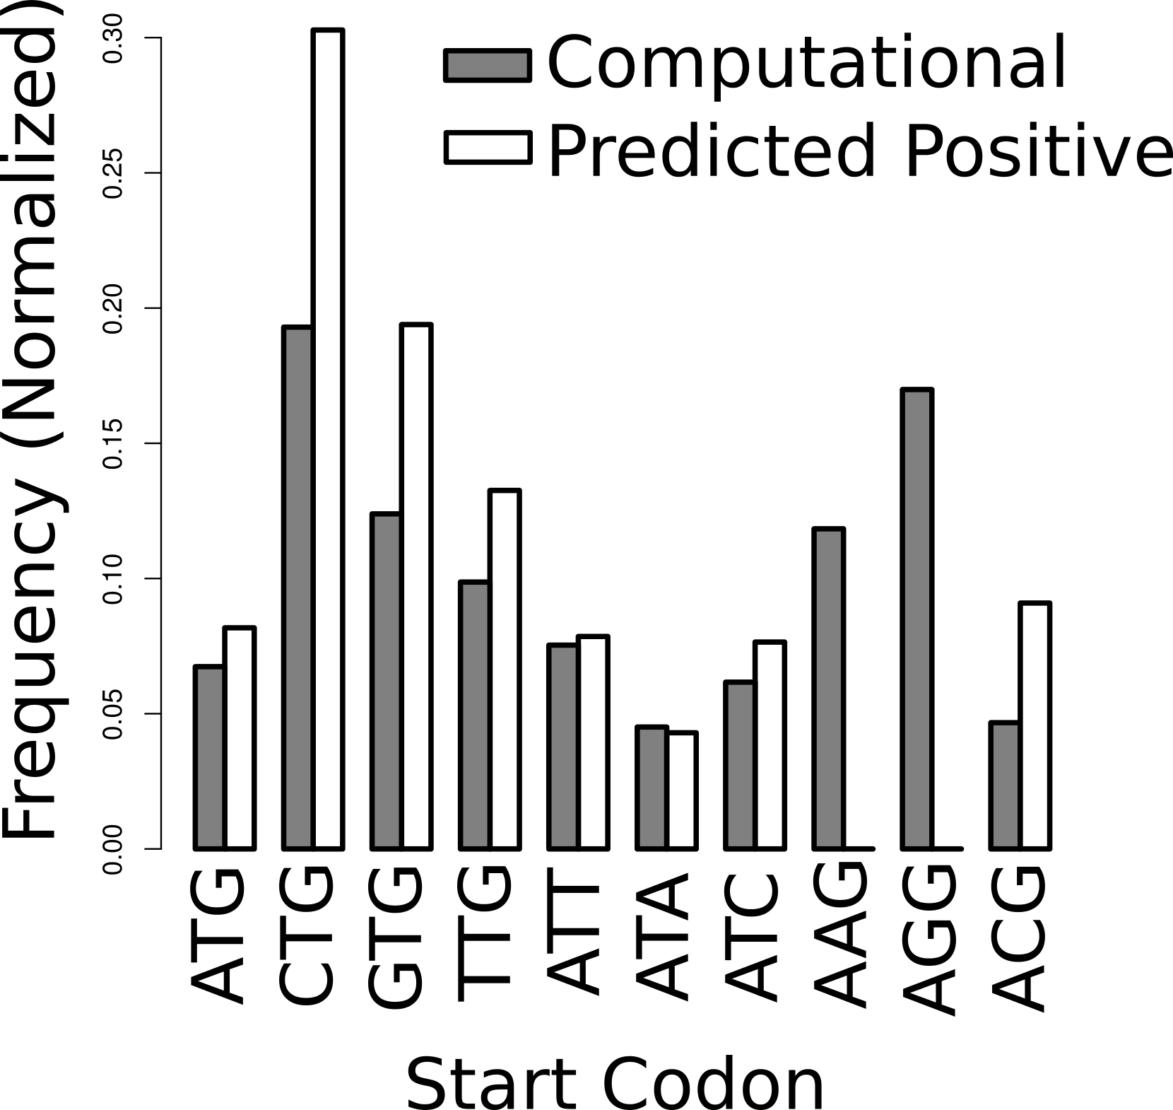
Predicted Positives by Start Codon

Slide 25
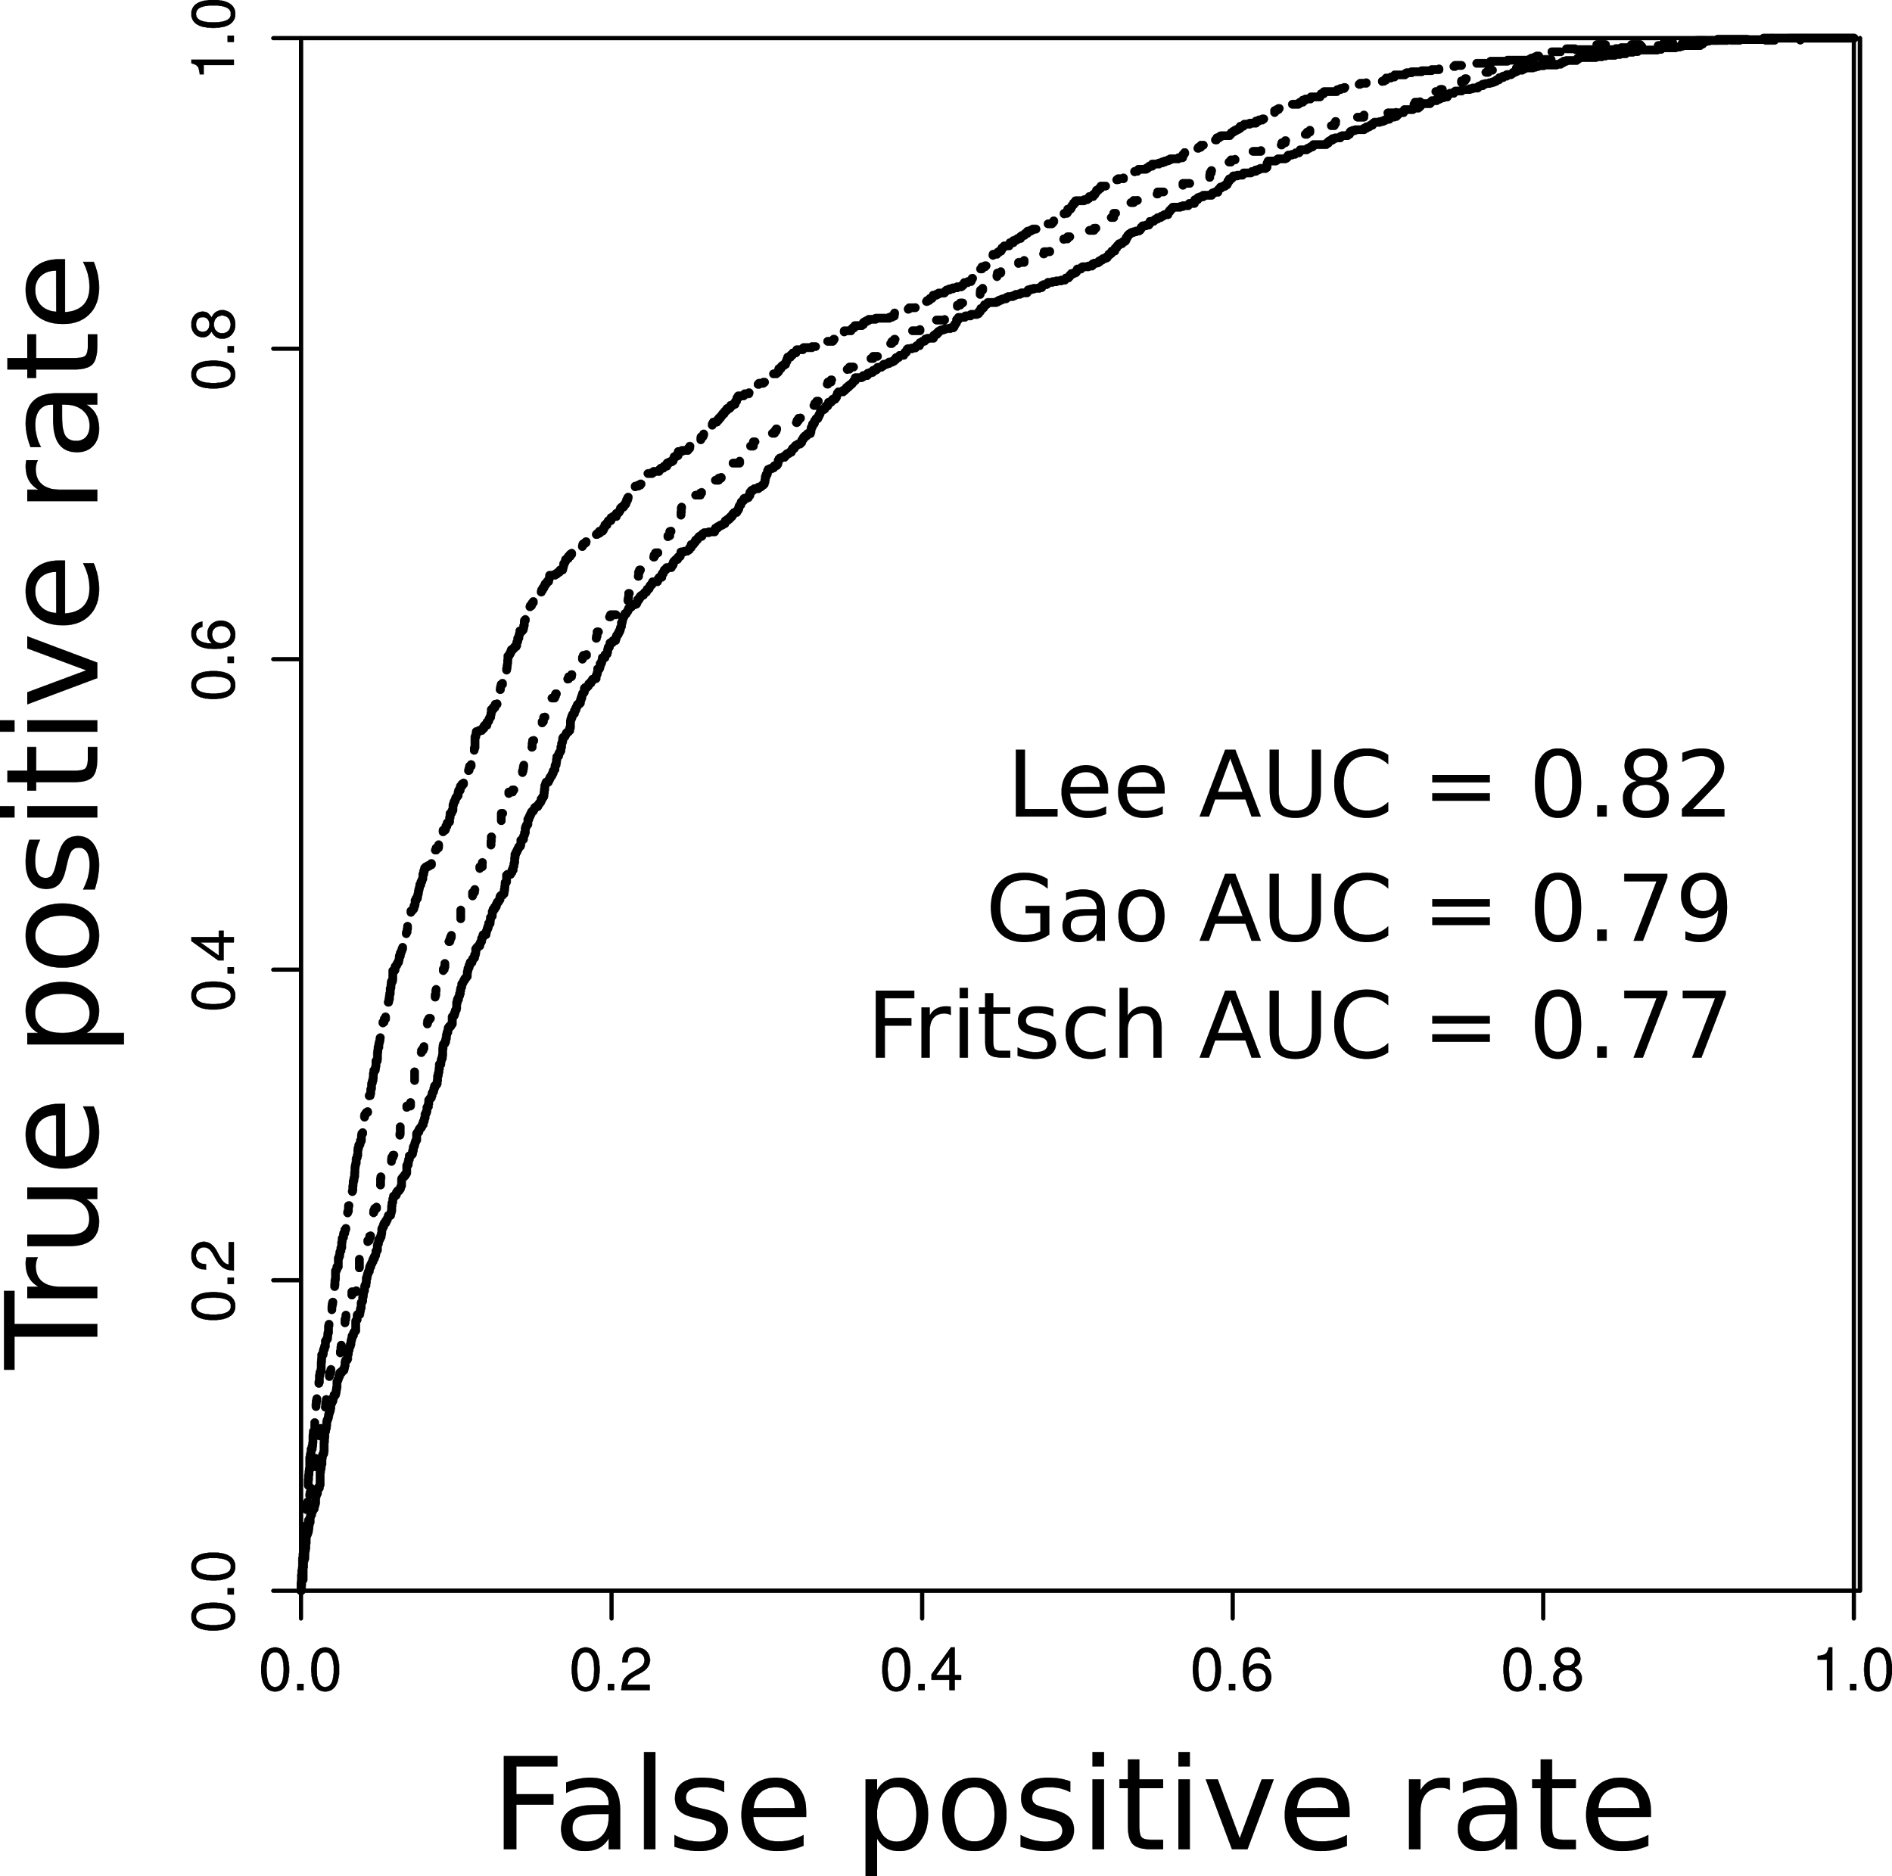
Pairwise validation

Slide 26
End result
The total set of possible (computationally derived) uORFs in the human genome is associated with a score.
180000 of these uORFs are associated with a positive score.
This list of scored uORFs, may be cross referenced with human variants (healthy and disease).

Slide 27
Method Application

Slide 28
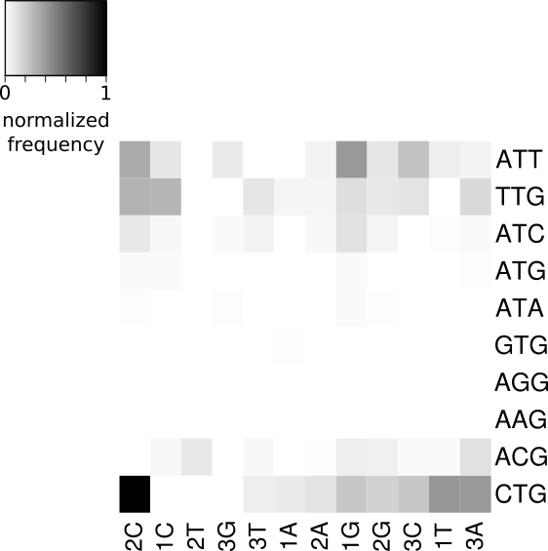
Start codon interruptions: 1000 Genomes SNVs

Slide 29
uORF ID | SNP | Location | Score | Freq. | Gene | Transcripts Affected | Disease Process (PMID)
ENST00000435422.3.uORF_CTG.11 | rs13170573 | 155754192 | 12.3 | 0.47 | SGCD | 28/80 | OSA (25474115)
ENST00000526686.1.uORF_TTG.4 | rs1461496 | 122929624 | 10.3 | 0.68 | HSPA8 | 3/72 | CHF/asthma (20300519, 22370858)
ENST00000228872.4.uORF_CTG.8 | rs34330 | 12870695 | 21.5 | 0.66 | CDKN1B | 4/9 | Various cancers (17908995)
ENST00000355739.4.uORF_ATG.13 | rs751402 | 103498198 | 15.0 | 0.71 | ERCC5 | 3/45 | Gastric cancer (27228234)
ENST00000302418.4.uORF_ACG.1 | rs12251445 | 32345345 | 23.9 | 0.31 | KIF5B | 1/7 | Exercise response (18984674)
ENST00000270139.3.uORF_GTG.2 | rs2850015 | 34697264 | 24.2 | 0.78 | IFNAR1 | 2/16 | Malaria susceptibility (25445652)
ENST00000270139.3.uORF_GTG.4 | rs2850015 | 34697264 | 23.1 | 0.78 | IFNAR1 | 2/16
ENST00000406438.3.uORF_ATT.1 | rs1563634 | 18218804 | 9.0 | 0.68 | SMCR8 | 1/3 | Cancer risk (19432957)
ENST00000462284.1.uORF_ATC.1 | rs937283 | 69202164 | 19.2 | 0.34 | MDM2 | 15/20 | Epithelial cancer (26261649)
ENST00000310823.3.uORF_CTG.2 | rs12692386 | 9695906 | 21.5 | 0.58 | ADAM17 | 4/8 | Vascular disease (24853957)

Slide 30
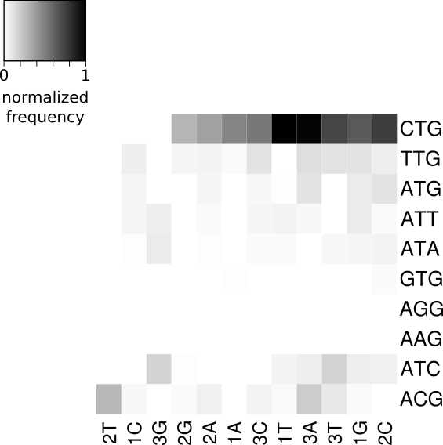
Start codon interruptions: PCAWG somatic mutation

Slide 31
uORF ID | Location | Score | Cancer Type | Gene Name | Transcripts Affected | Gene relation to carcinogenesis
ENST00000371142.4.uORF_ACG.2 | 98346749 | 28.4 | Lung | TM9SF3 | 2/3 | Invasiveness of gastric/colonic cancer
ENST00000371142.4.uORF_ACG.1 | 98346749 | 28.1 | Lung | TM9SF3 | 2/3
ENST00000254480.5.uORF_ACG.2 | 47823347 | 26.9 | Lung | SMARCC1 | 3/8 | Recurrence/aggressiveness colonic + prostate CA
ENST00000254480.5.uORF_ACG.1 | 47823347 | 26.8 | Lung | SMARCC1 | 3/8
ENST00000000233.5.uORF_ACG.2 | 127228421 | 26.7 | Stad | ARF5 | 1/3 | ARF proteins invasiveness cancers
ENST00000250894.4.uORF_ACG.1 | 1756190 | 26.5 | Lung | MAPK8IP3 | 1/3 | Immune response control; pancreatic cancer association
ENST00000345496.2.uORF_CTG.3 | 46221698 | 25.7 | Breast | UBE2G2 | 4/15 | Protein degradation – specifically involved in mitotic process
ENST00000358015.3.uORF_GTG.2 | 110045592 | 25.6 | Stad | RAD23B | 2/17 | DNA repair; deficient in cancer
ENST00000258341.4.uORF_ACG.1 | 182992786 | 25.5 | Lung | LAMC1 | 1/8 | Silencing LAMC1 inhibits cell invasion and progression of prostate cancer
ENST00000395686.3.uORF_GTG.1 | 53162310 | 25.4 | Breast | ERO1L | 5/20 | Over-expression -> poor prognosis in gastric cancer

Slide 32
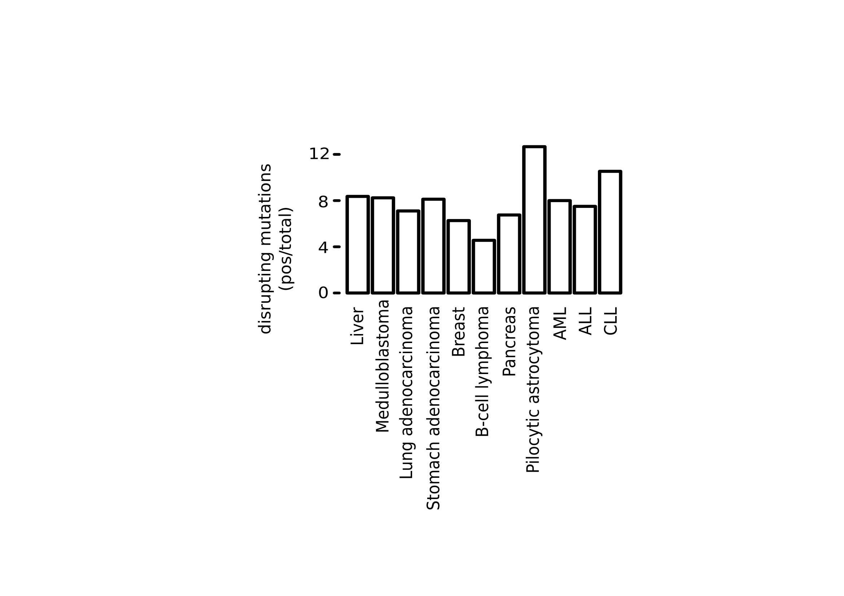
PCAWG interrupting SNPs

Slide 33
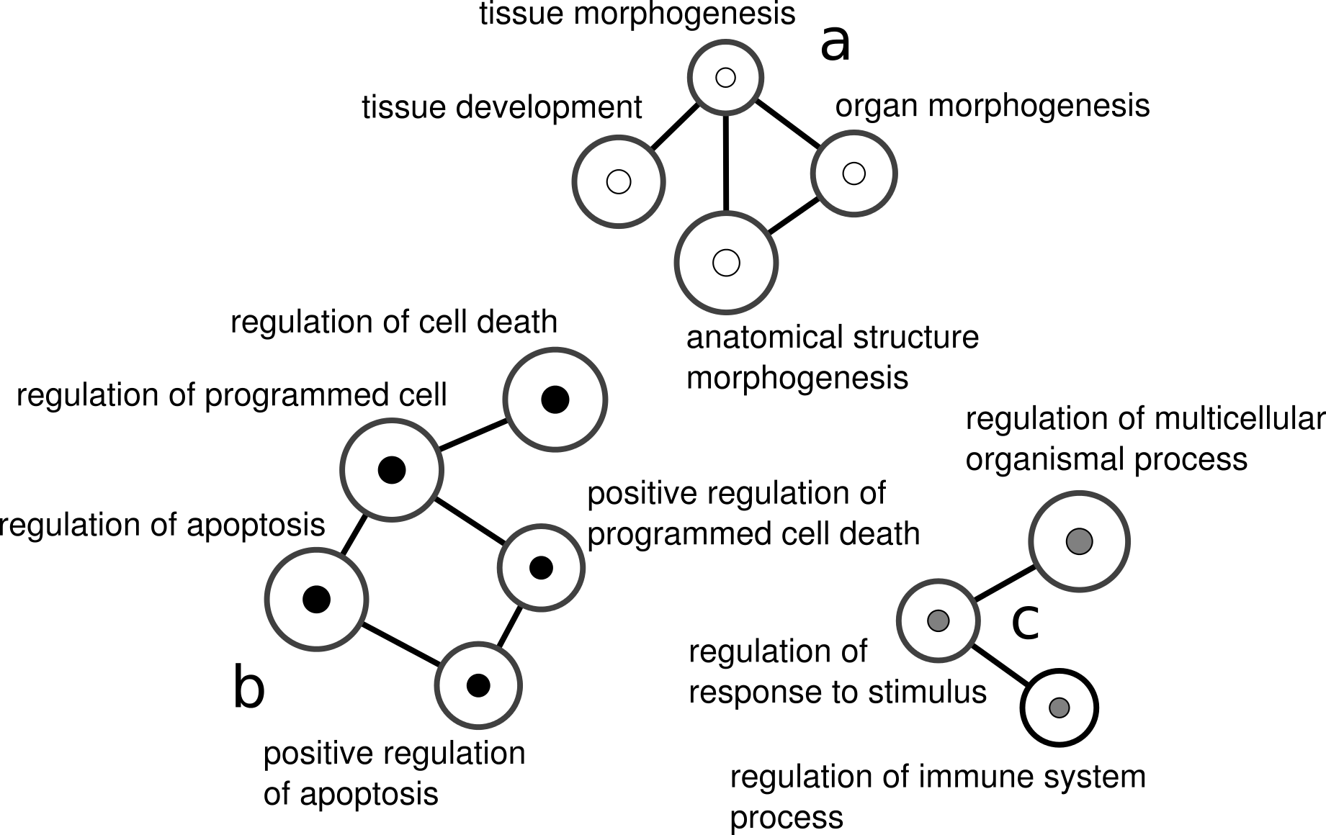
GO annotation PCAWG interrupting mutations

Slide 34
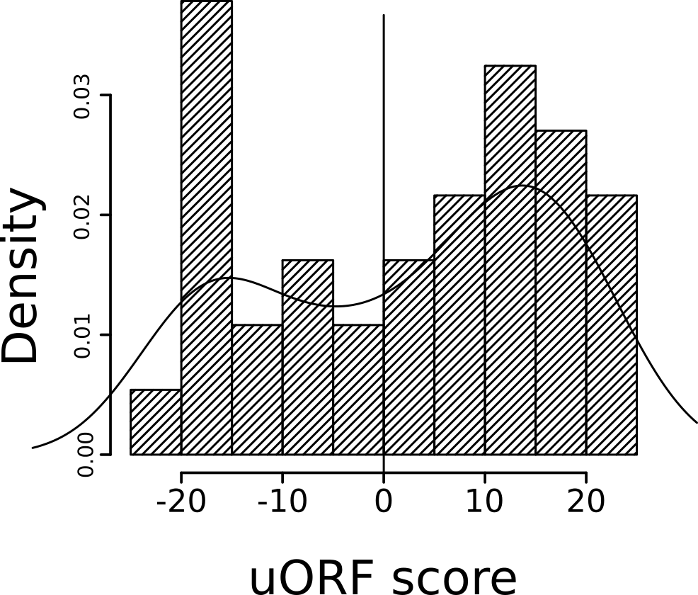
Battle et al: rQTL (ribosome occupancy)

Slide 35
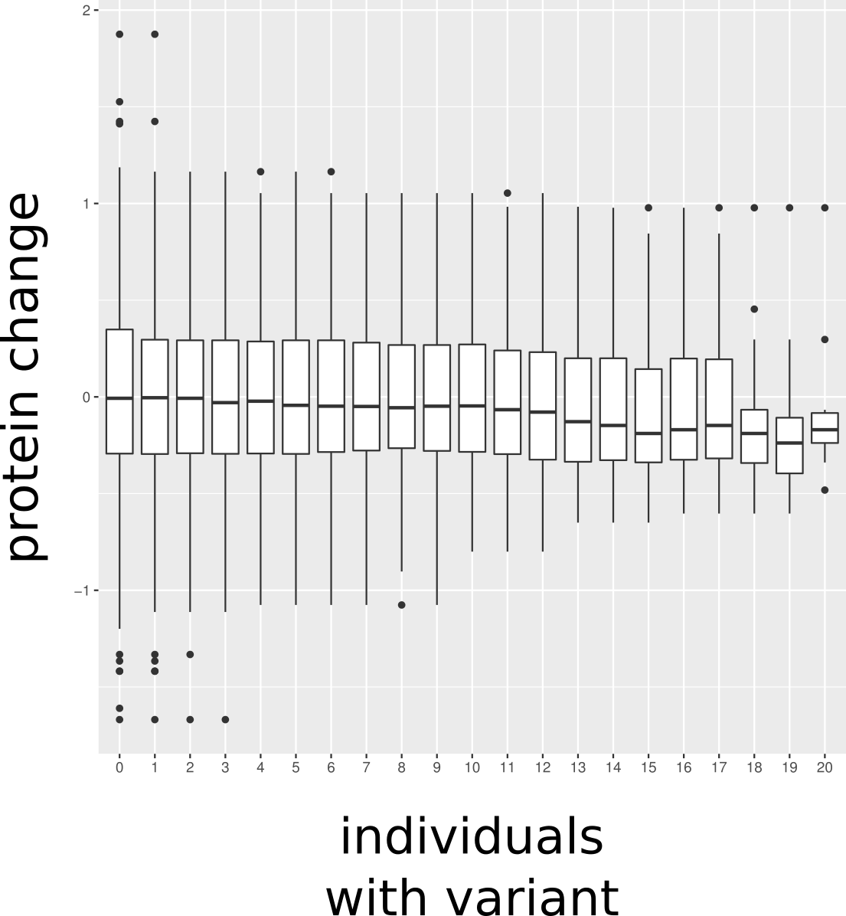
Battle et al.: start codon interrupting SNPs

Slide 36
Contributors
Suganthi Balasubramanian -- Ideas + mentorship.
Mayur Pawashe -- Extracting computational uORFs from GENCODE.
Russell Ault -- Initial uORF feature extraction. Initial machine learning algorithm.
Rob Kitchen -- Advice + ideas.
Patrick McGillivray -- Refinement of methods, application of methods, figures + documentation.

