Slide 1
Replication Timing & Mutation Rate
JZ

Slide 2
Before that: 3D Nucleome & Cancer
Paper outline:
https://docs.google.com/document/d/1uXVsyQsi46pPwH0wOXjkDKrOgnShCzdfXadnraanGJs/edit#heading=h.vs41ma38bun0

Slide 3
Hi everyone,
We’ve finally completed the enhancer-seq validation luciferase assay experiments and have some great news! The short story – it worked! Please see attached data. (I apologize for the delay as we ran into some unforeseen problems with reagents).
Long story – to begin with, we decided to test 8 different enhancer regions (the 8 regions with the highest Motif Disruption score) and synthesize the mutation that the Gerstein lab had predicted. Outside of 2 regions with high deviation, we saw high reproducibility in our biological replicates. We observed a decrease in overall luciferase signal in most of the regions, except for 1, where we actually saw a 4-fold increase in activity upon introduction of the mutant nucleotide. To give even greater confidence in the reproducibility, the biological replicates were performed with two different hands.
This looks really promising!
Best,
Vineet

Slide 4
According to Rabit prediction, ZNF687 and CEBPG are oncogenic TFs (previously unidentified) in MCF7 cell and breast cancer patients. Especially, ZNF687 is a highly amplified gene in many cancer types. Also, support by shRNA and CRISPR screen, knocking down ZNF687 and CEBPG should slow down MCF7 cell growth.
It will be great if the experimentalist could try siRNA pool knock down of ZNF687 and CEBPG in MCF7 (and T47D) under both white medium and E2 medium.
Hi, Jing: it is possible for you to host a brief Skype meeting between us and the experimentalist in Kevin Lab? My time is flexible in this week. I hope to explain to them in more detail about the attached results.
Thank you very much to everyone !

Slide 5
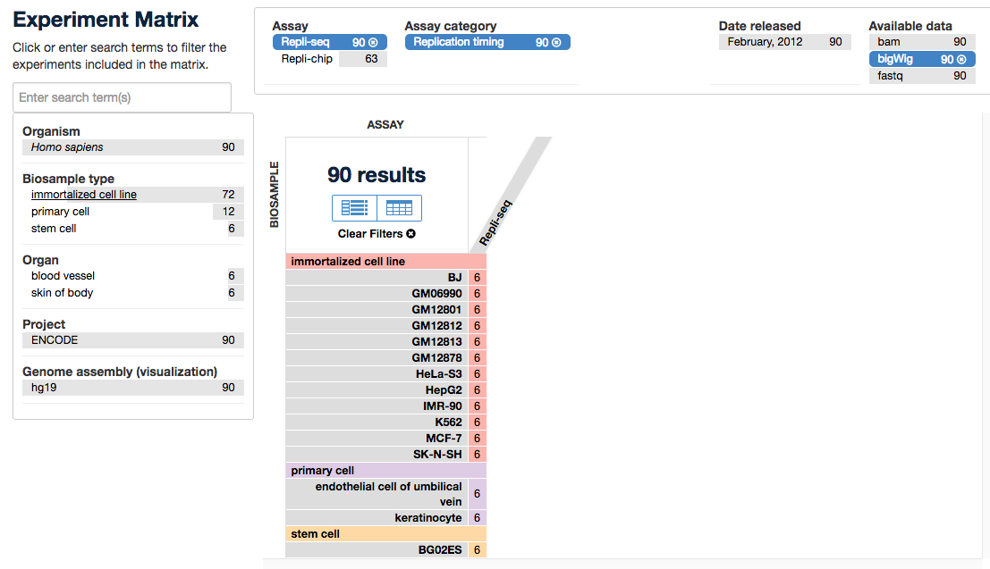
Replication timing data

Slide 6
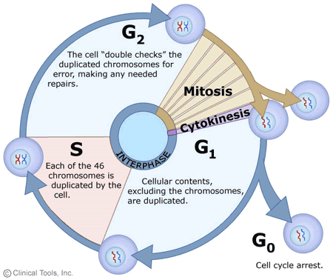
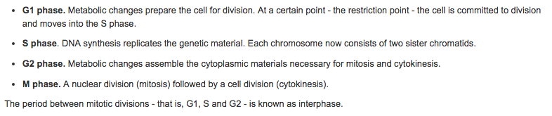

Slide 7
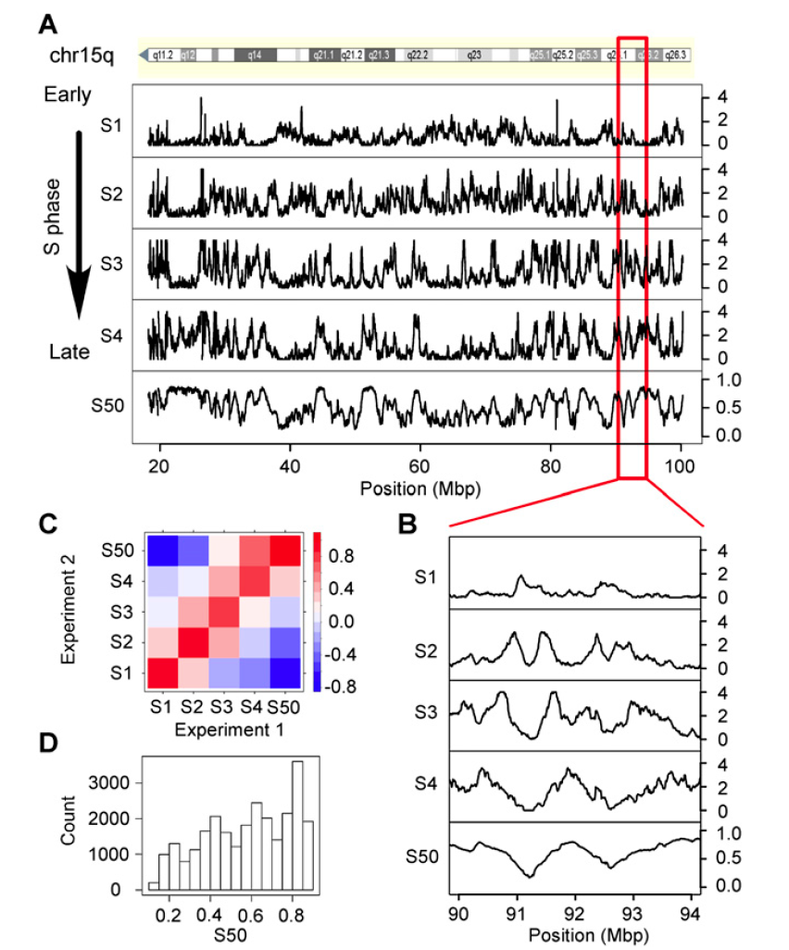
Data used in MutSigCV:
HeLa cell line
S50: the time point at which 50% of DNA has been replicated

Slide 8
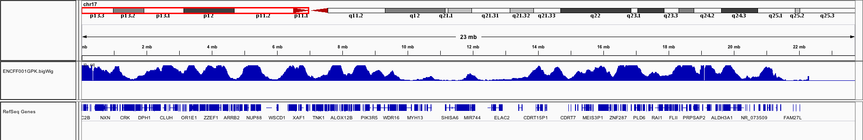
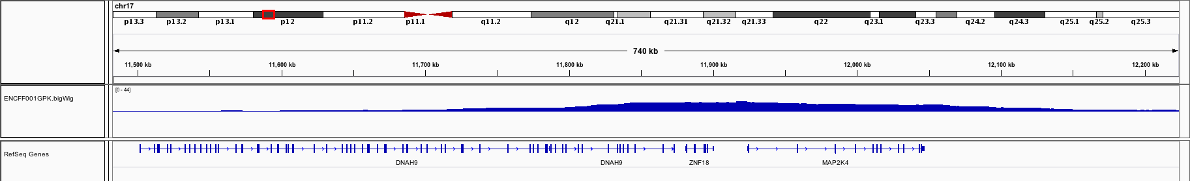

Slide 10
Perfectly grouped according to cell phase

Slide 11
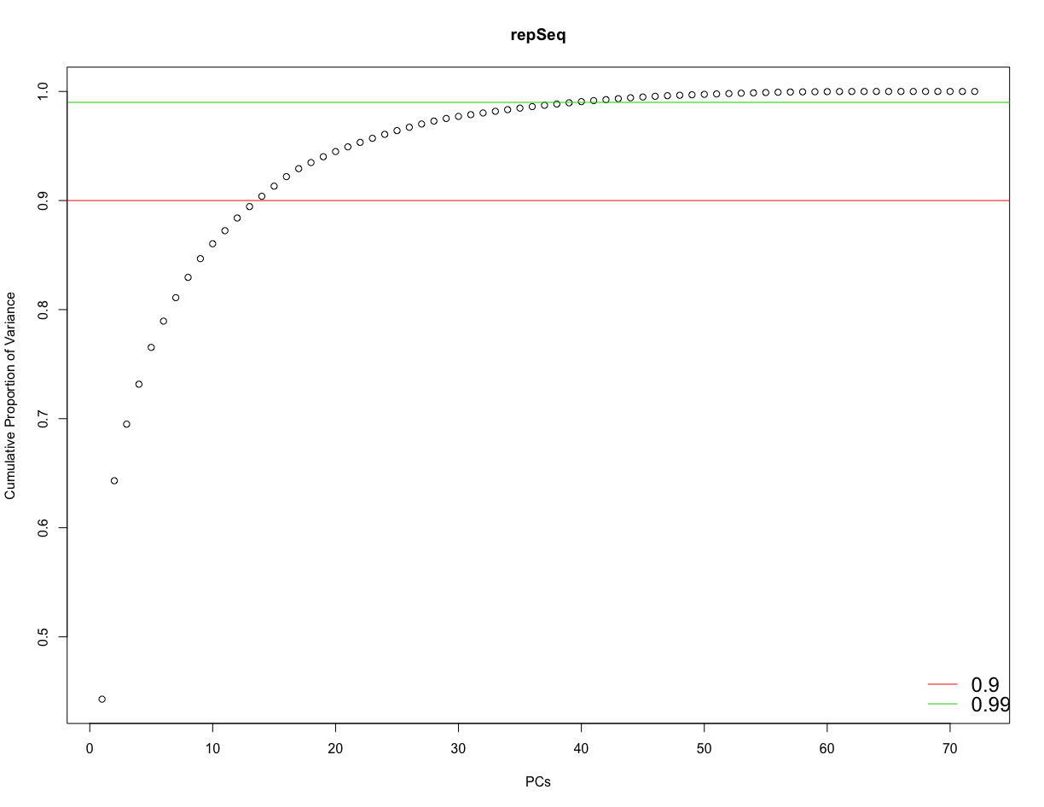

Slide 12
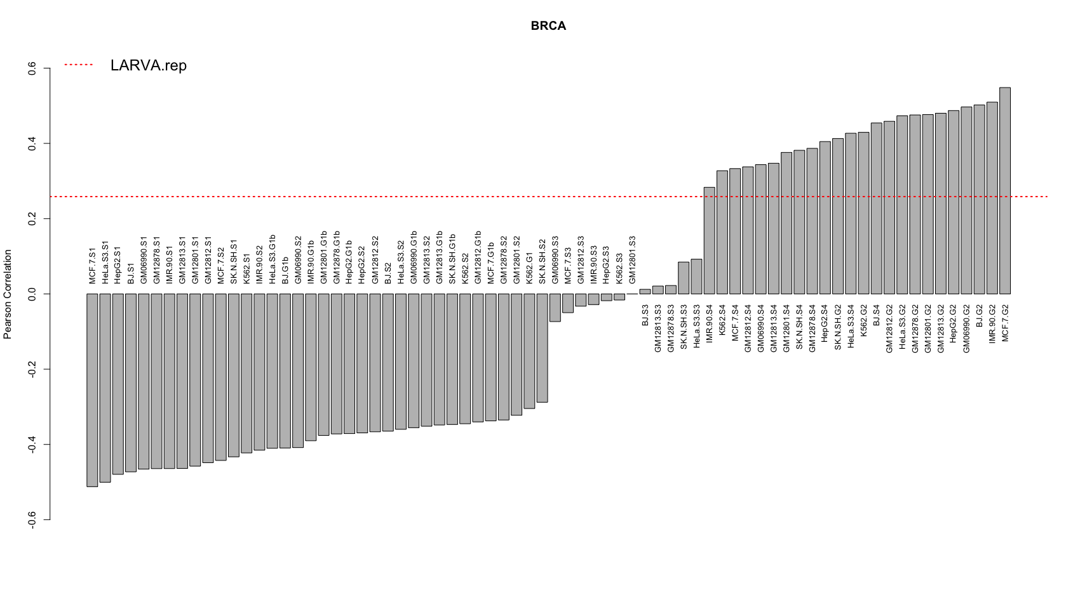

Slide 13
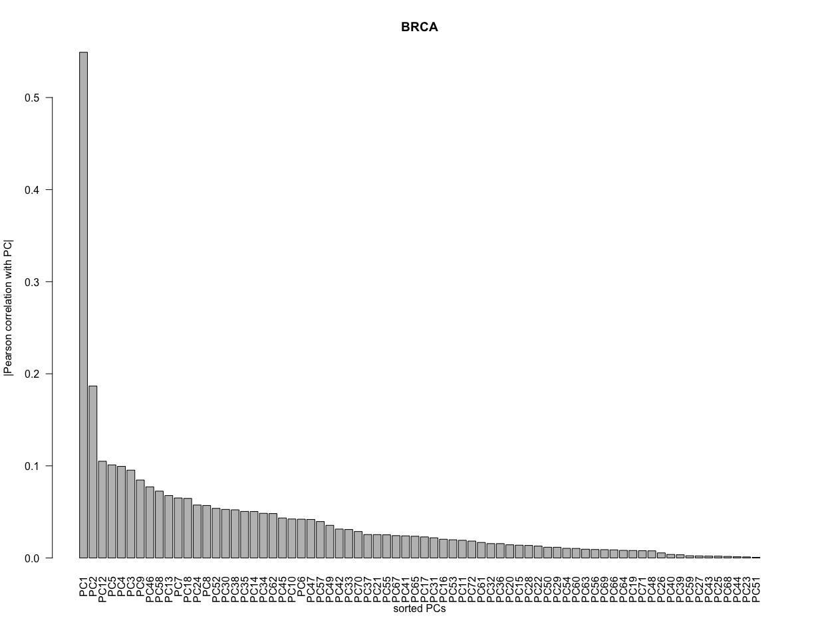

Slide 14
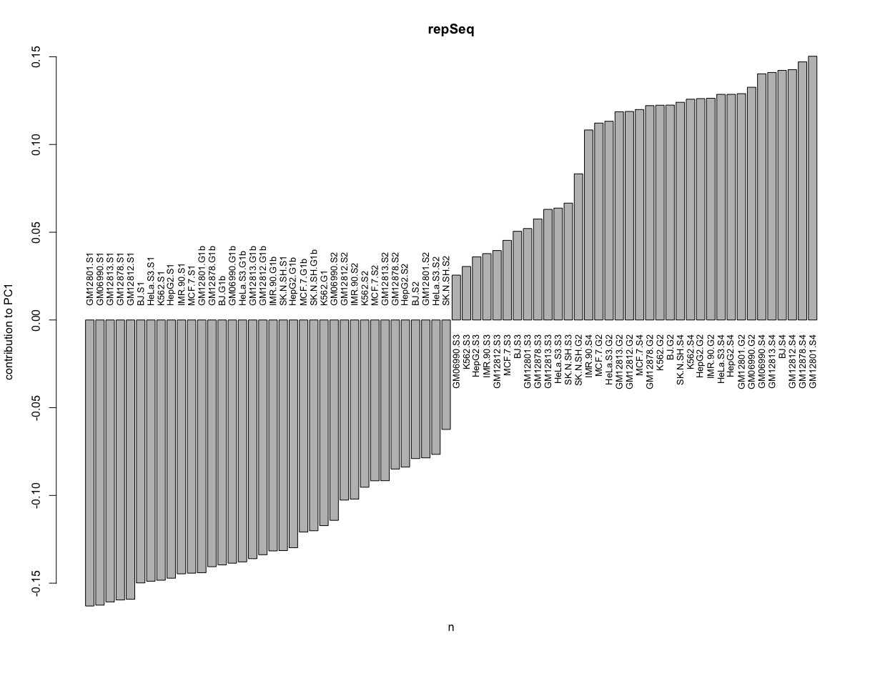

Slide 15
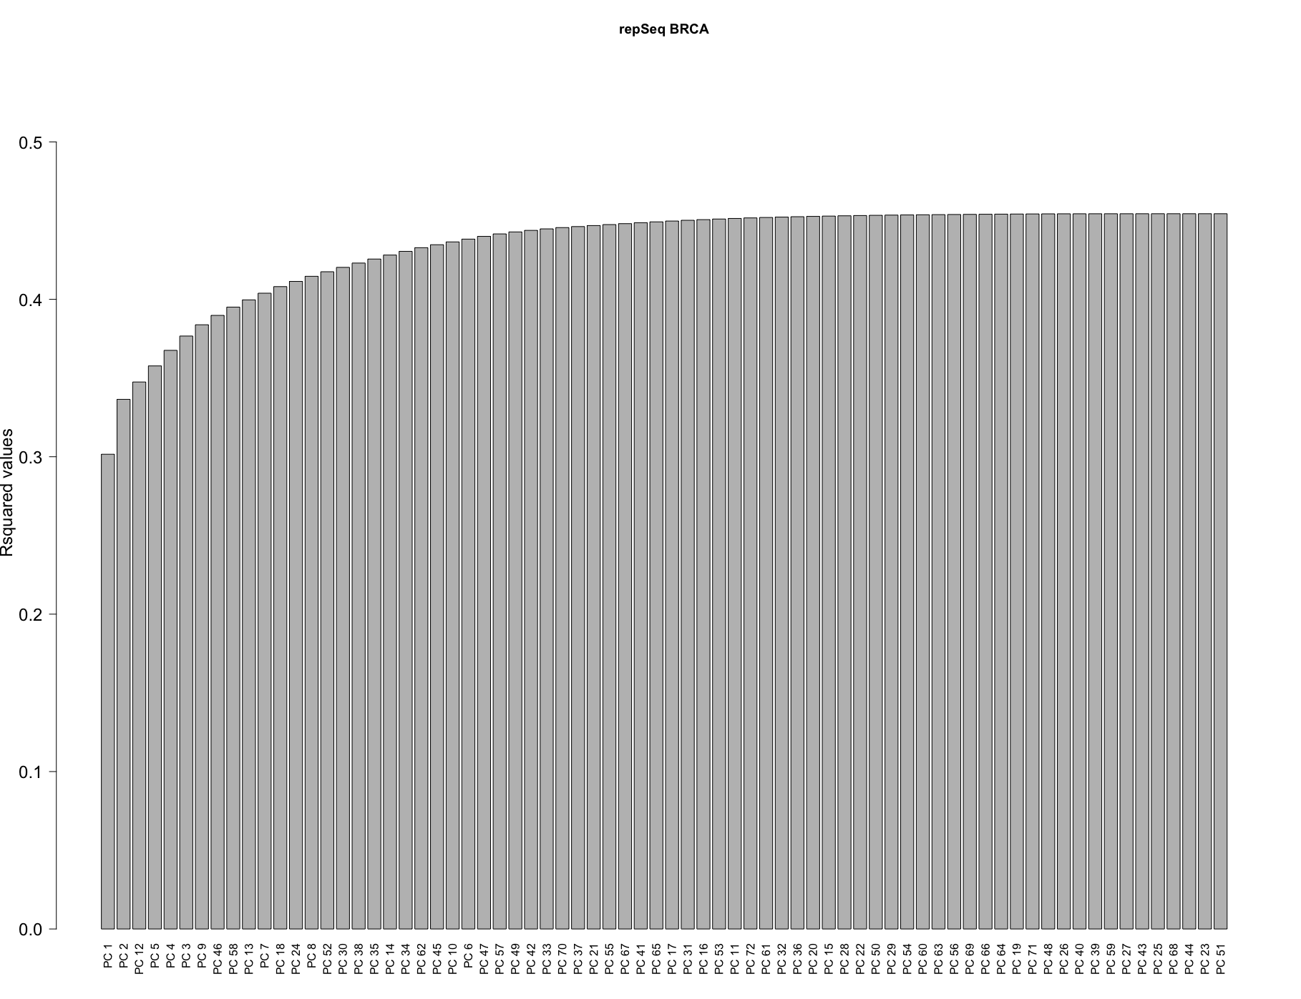

Slide 16
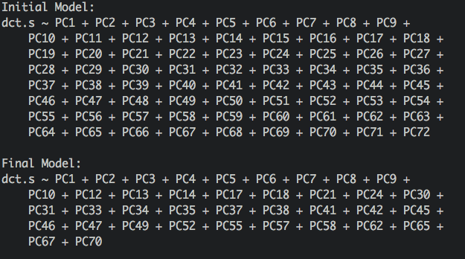

Slide 17
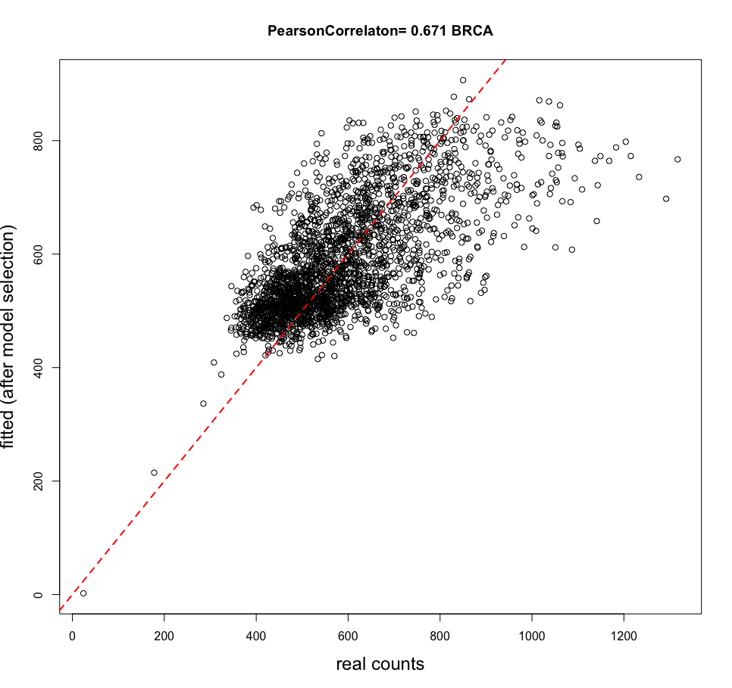

Slide 18
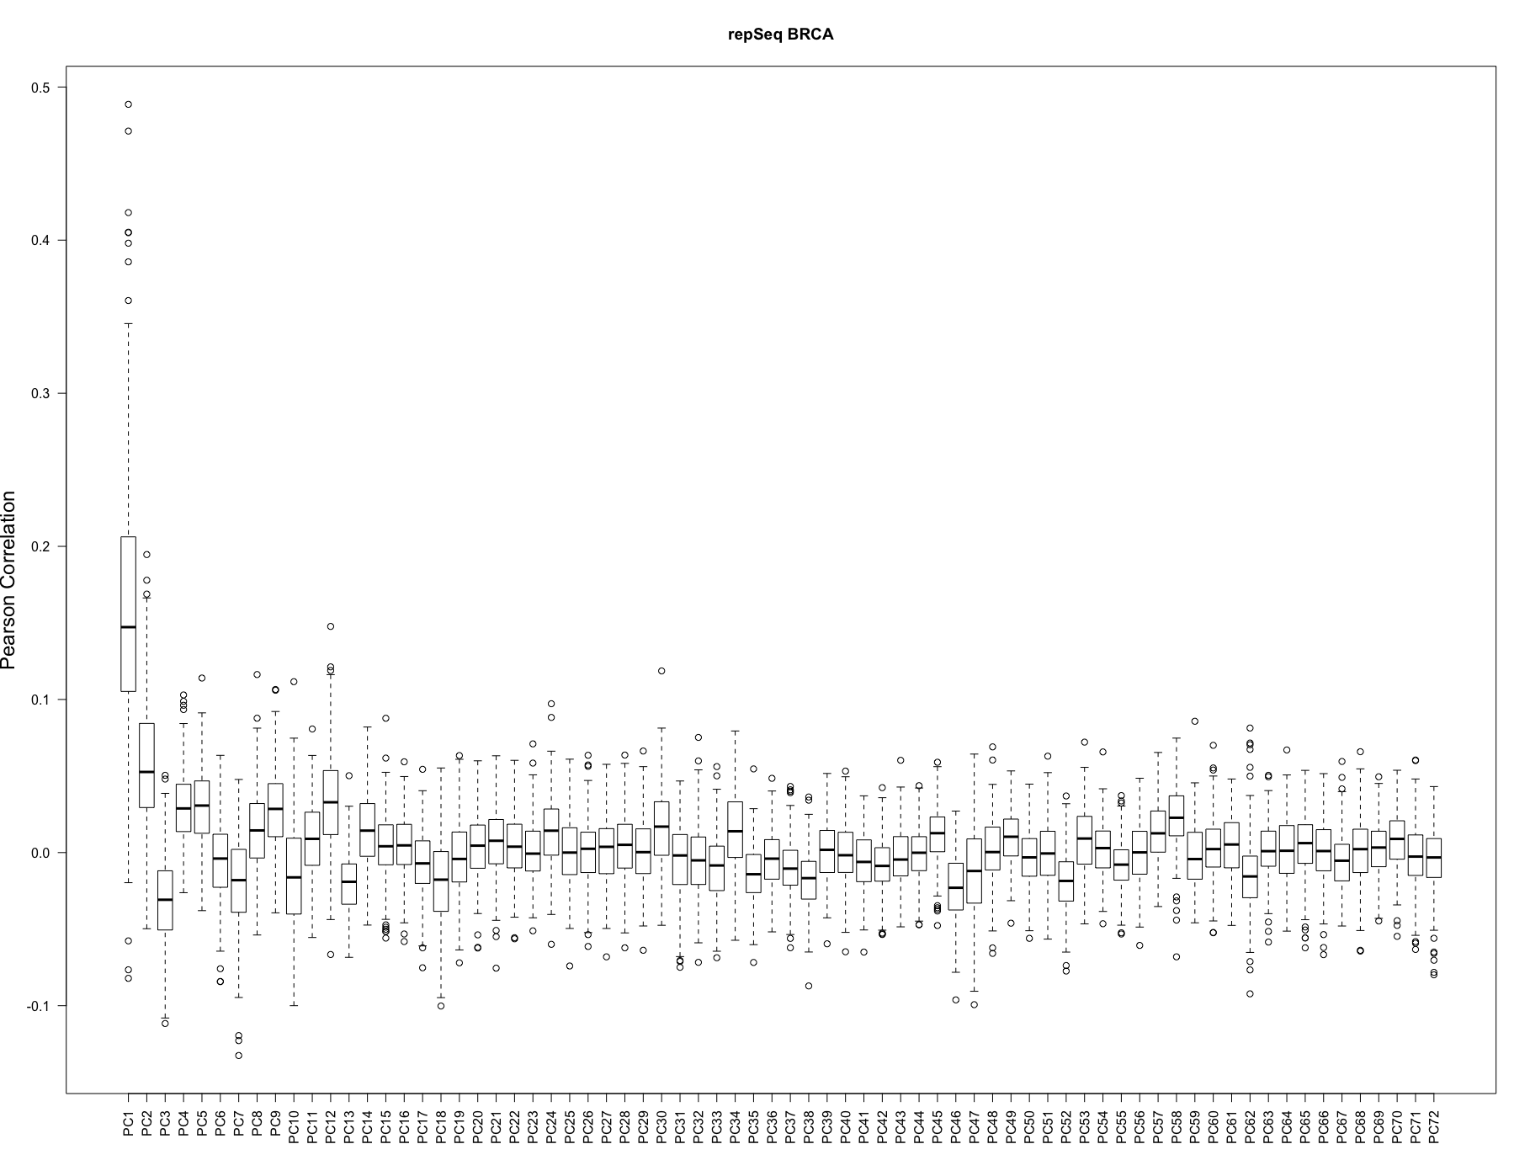

Slide 19
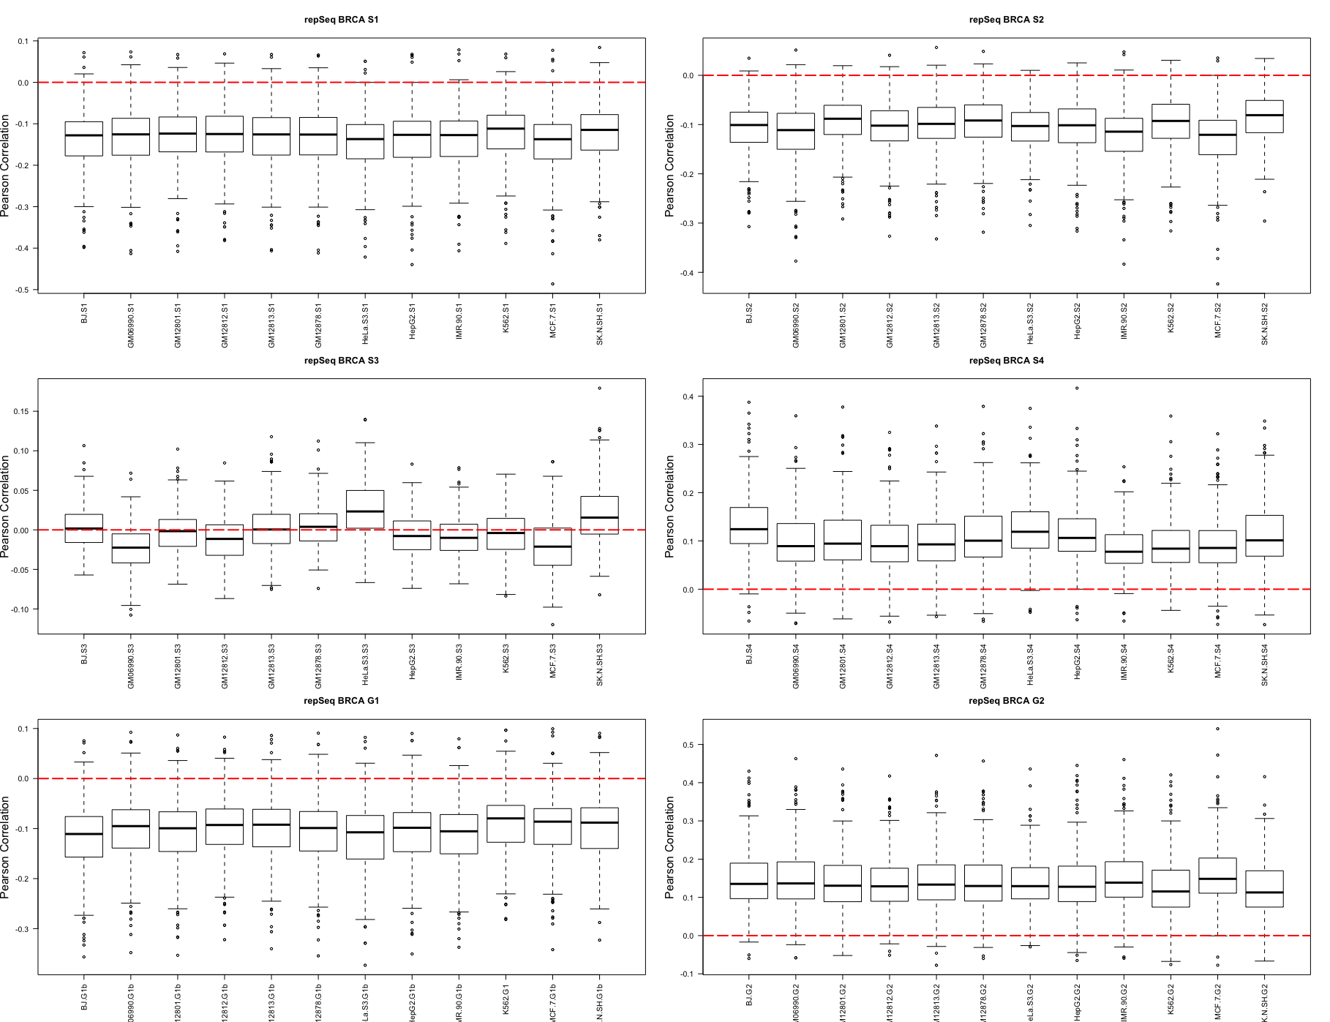

Slide 20
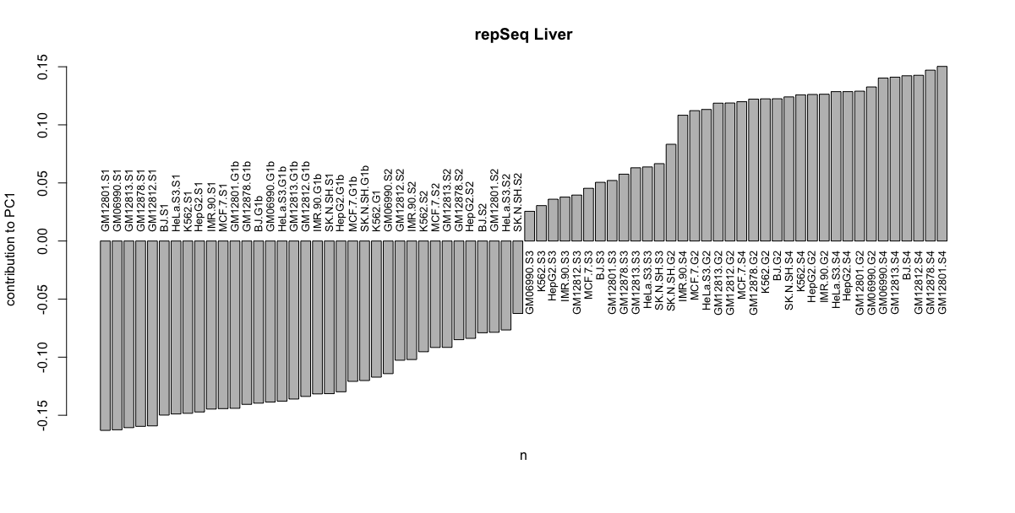

Slide 21
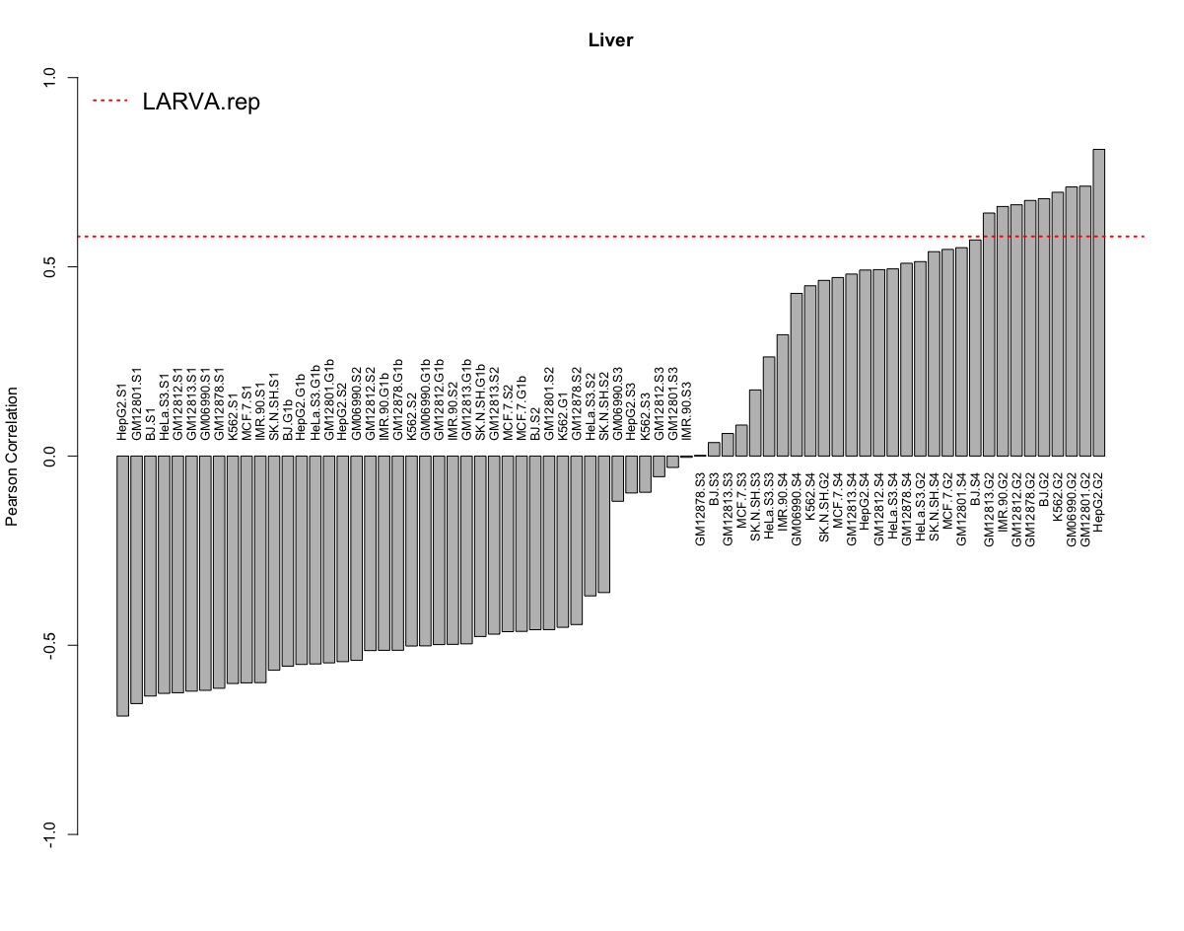

Slide 22
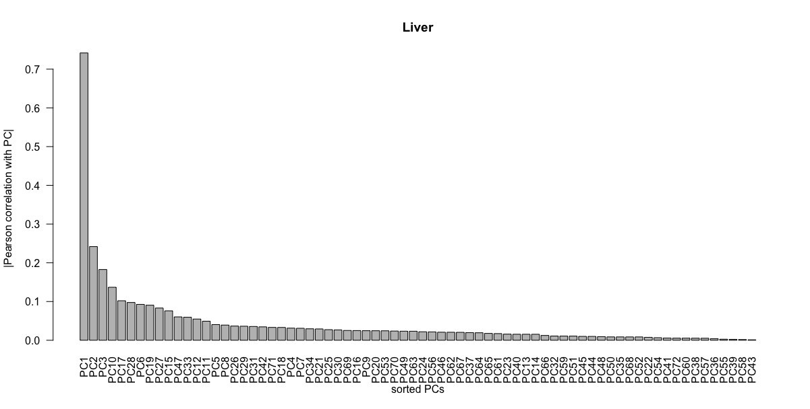

Slide 23
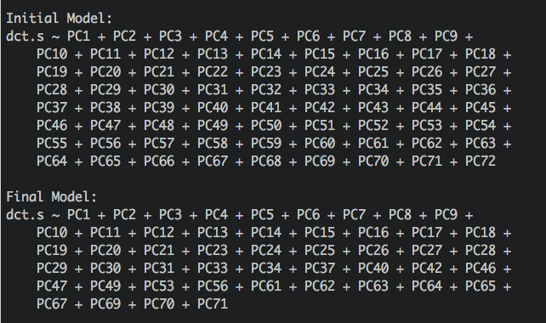

Slide 24
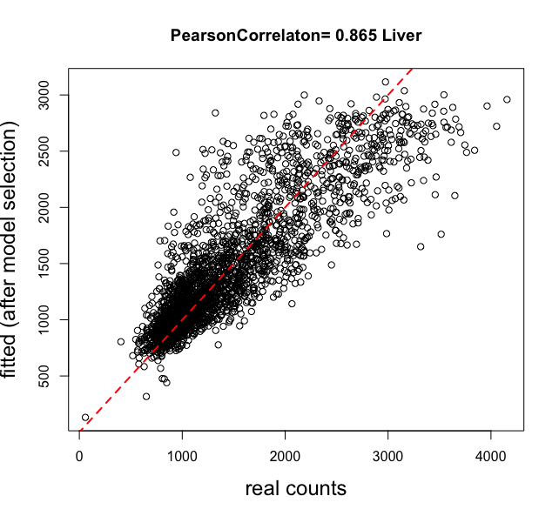

Slide 25
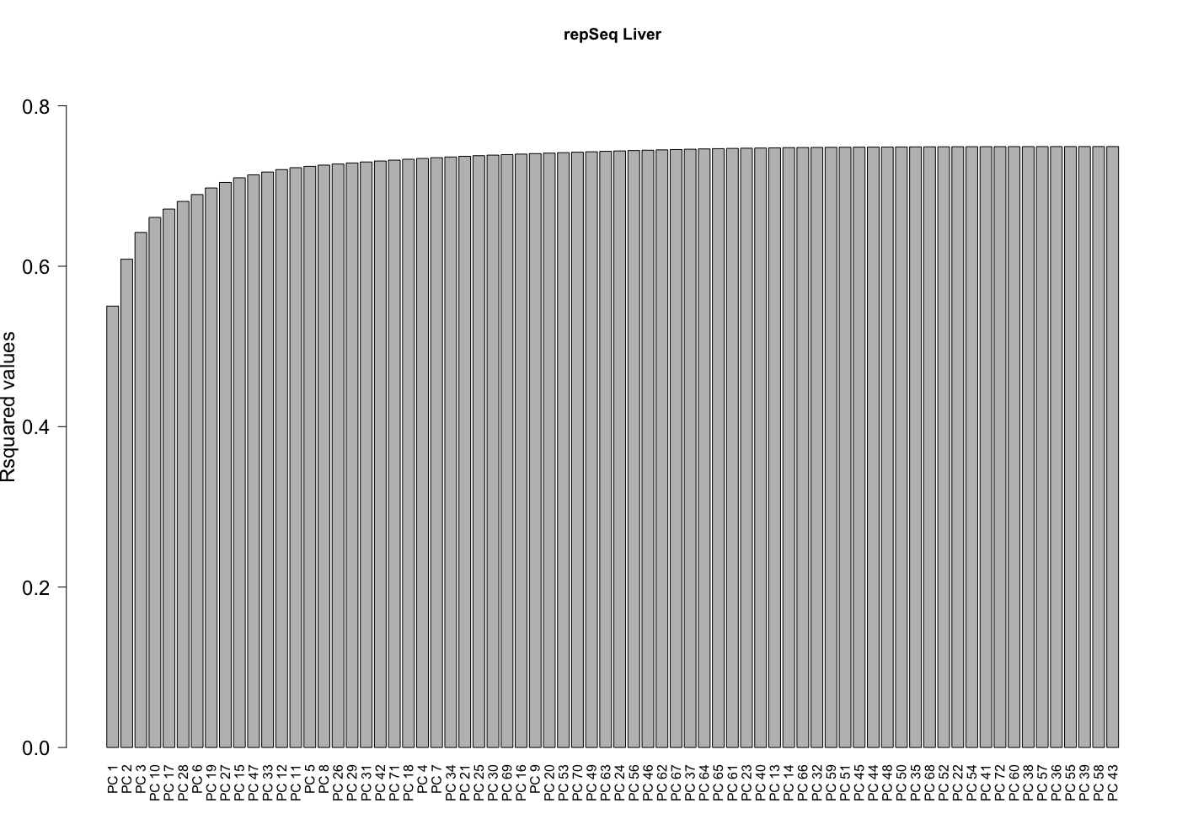

Slide 26
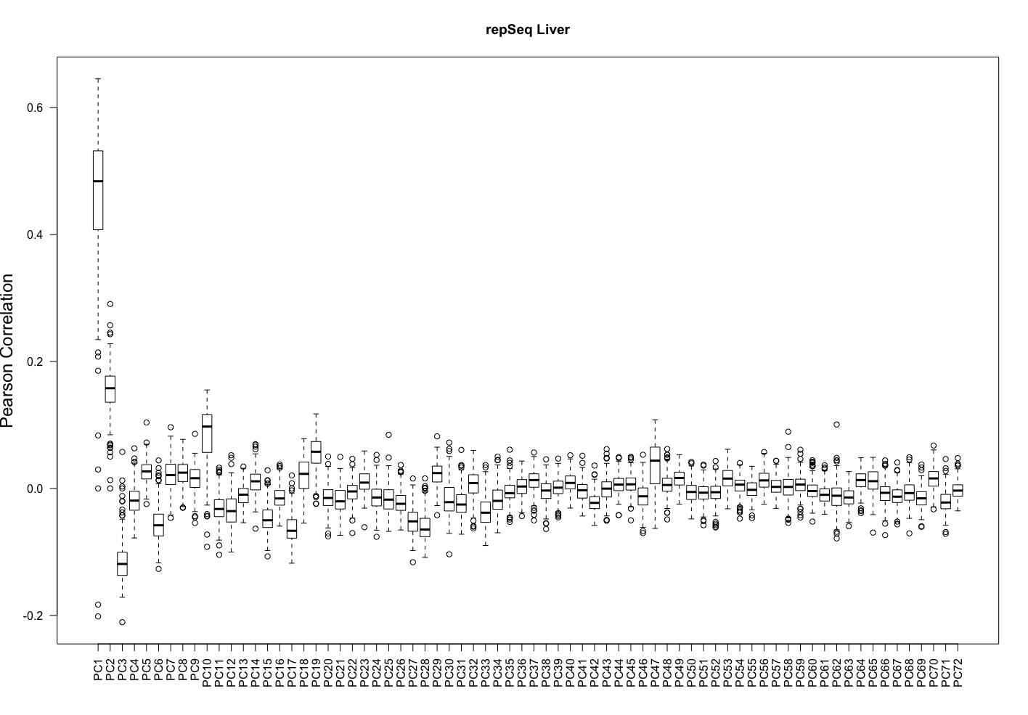

Slide 27
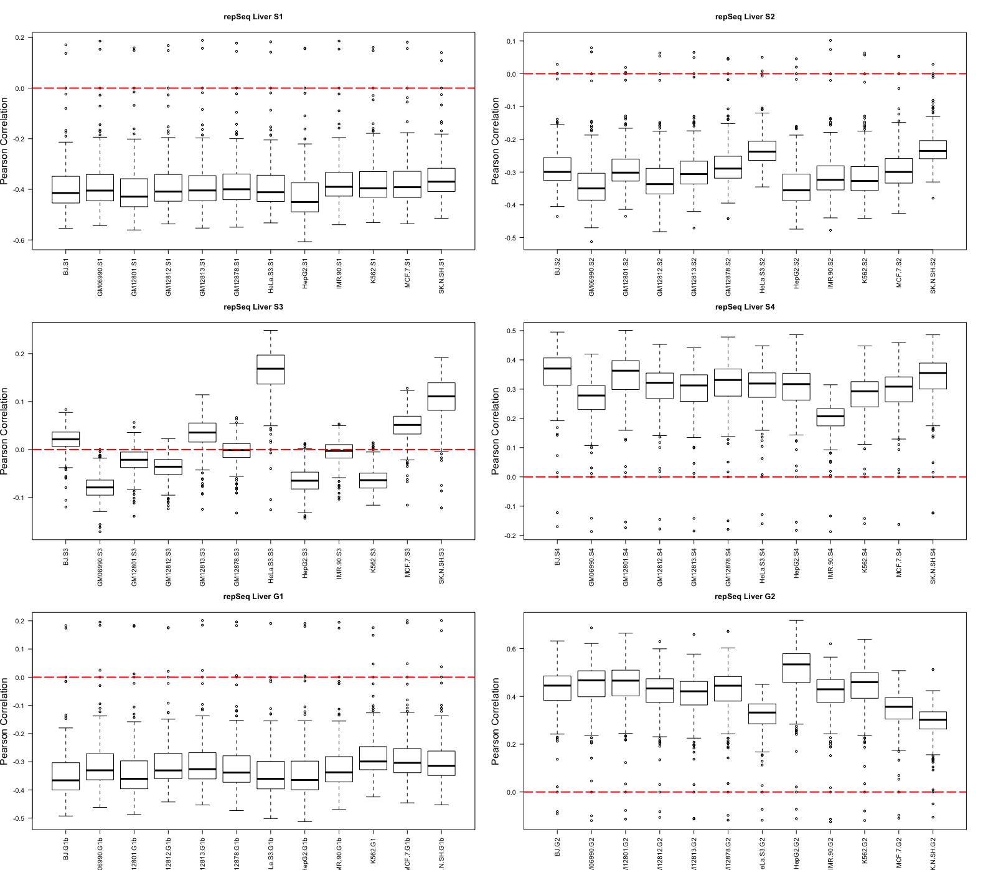

Slide 28
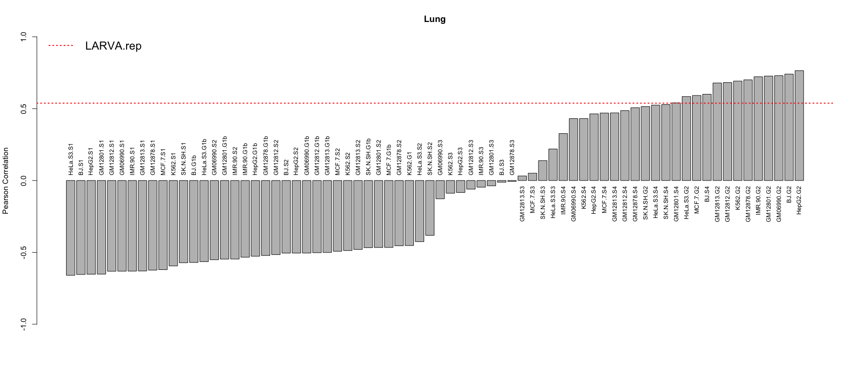
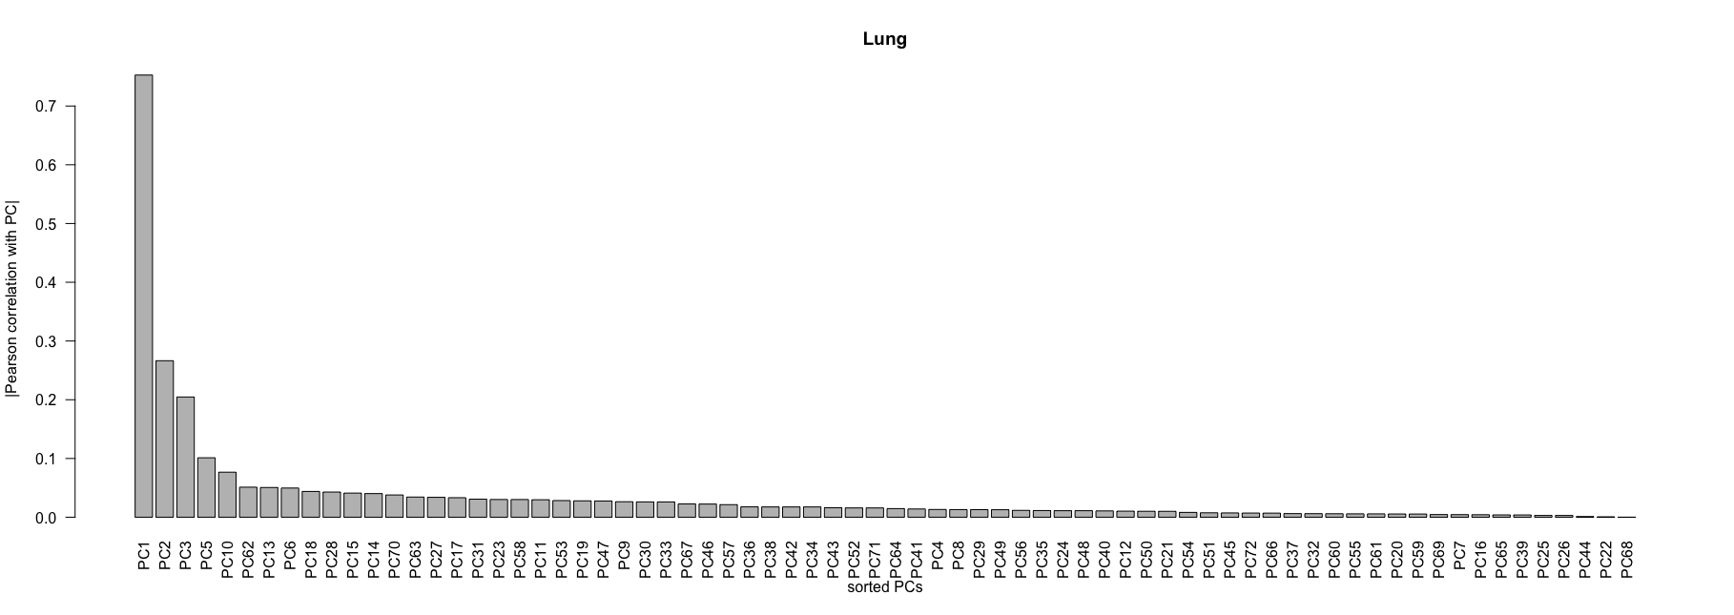

Slide 29
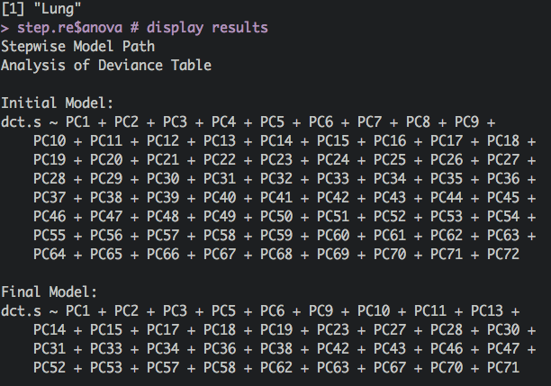

Slide 30
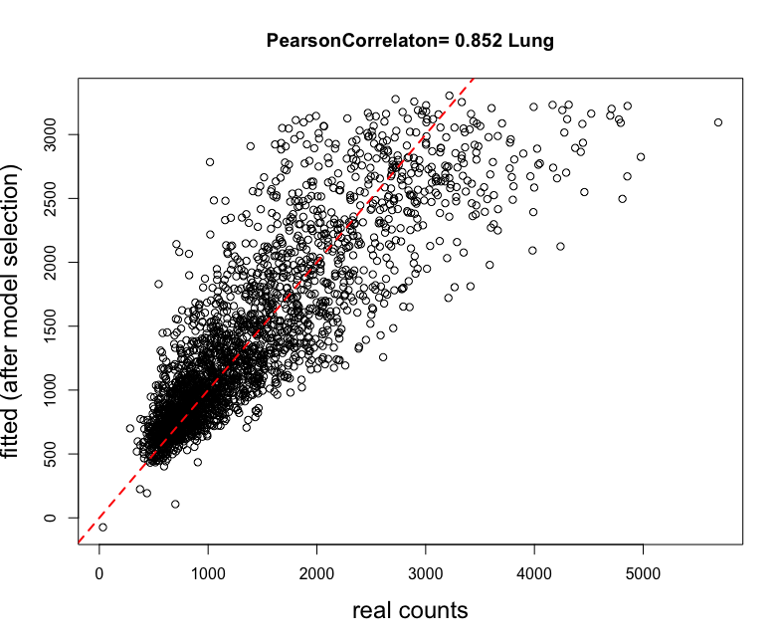

Slide 31
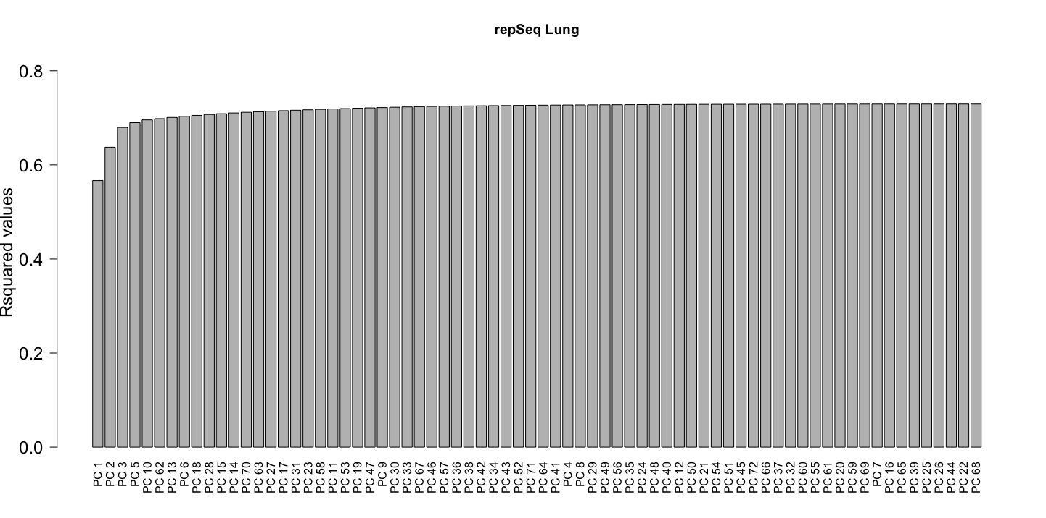

Slide 32
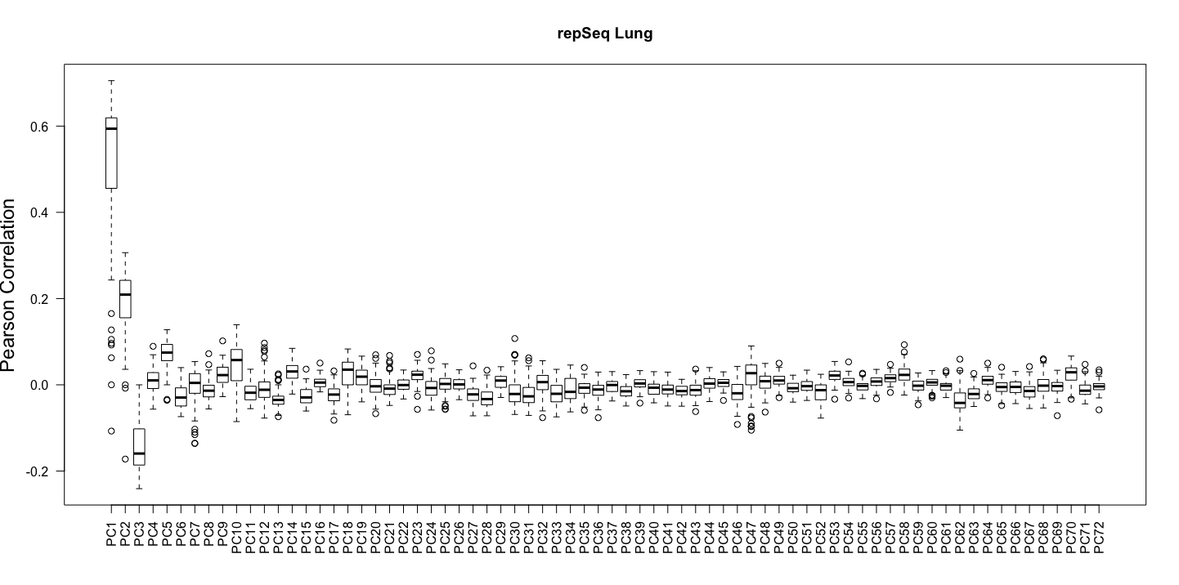

Slide 33
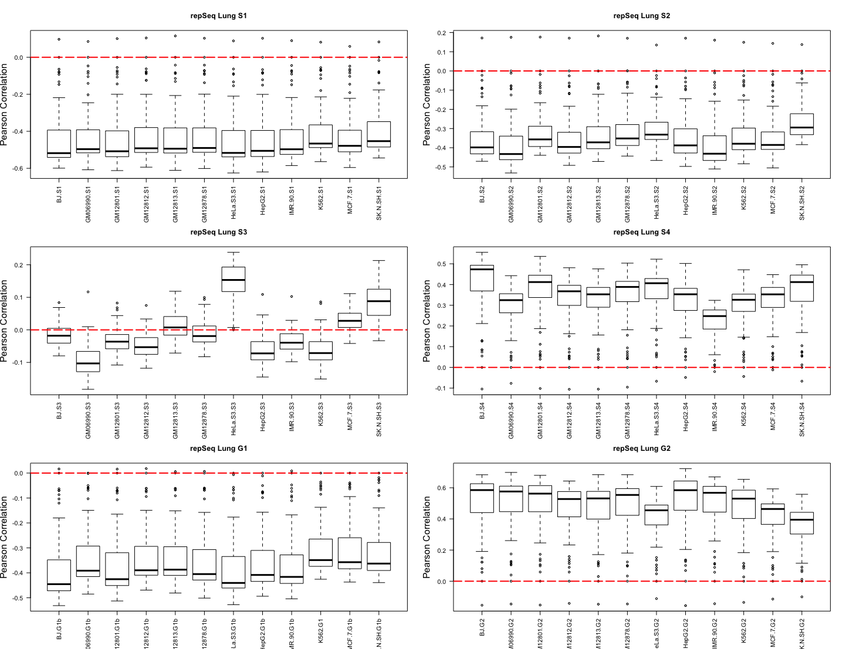

Slide 34
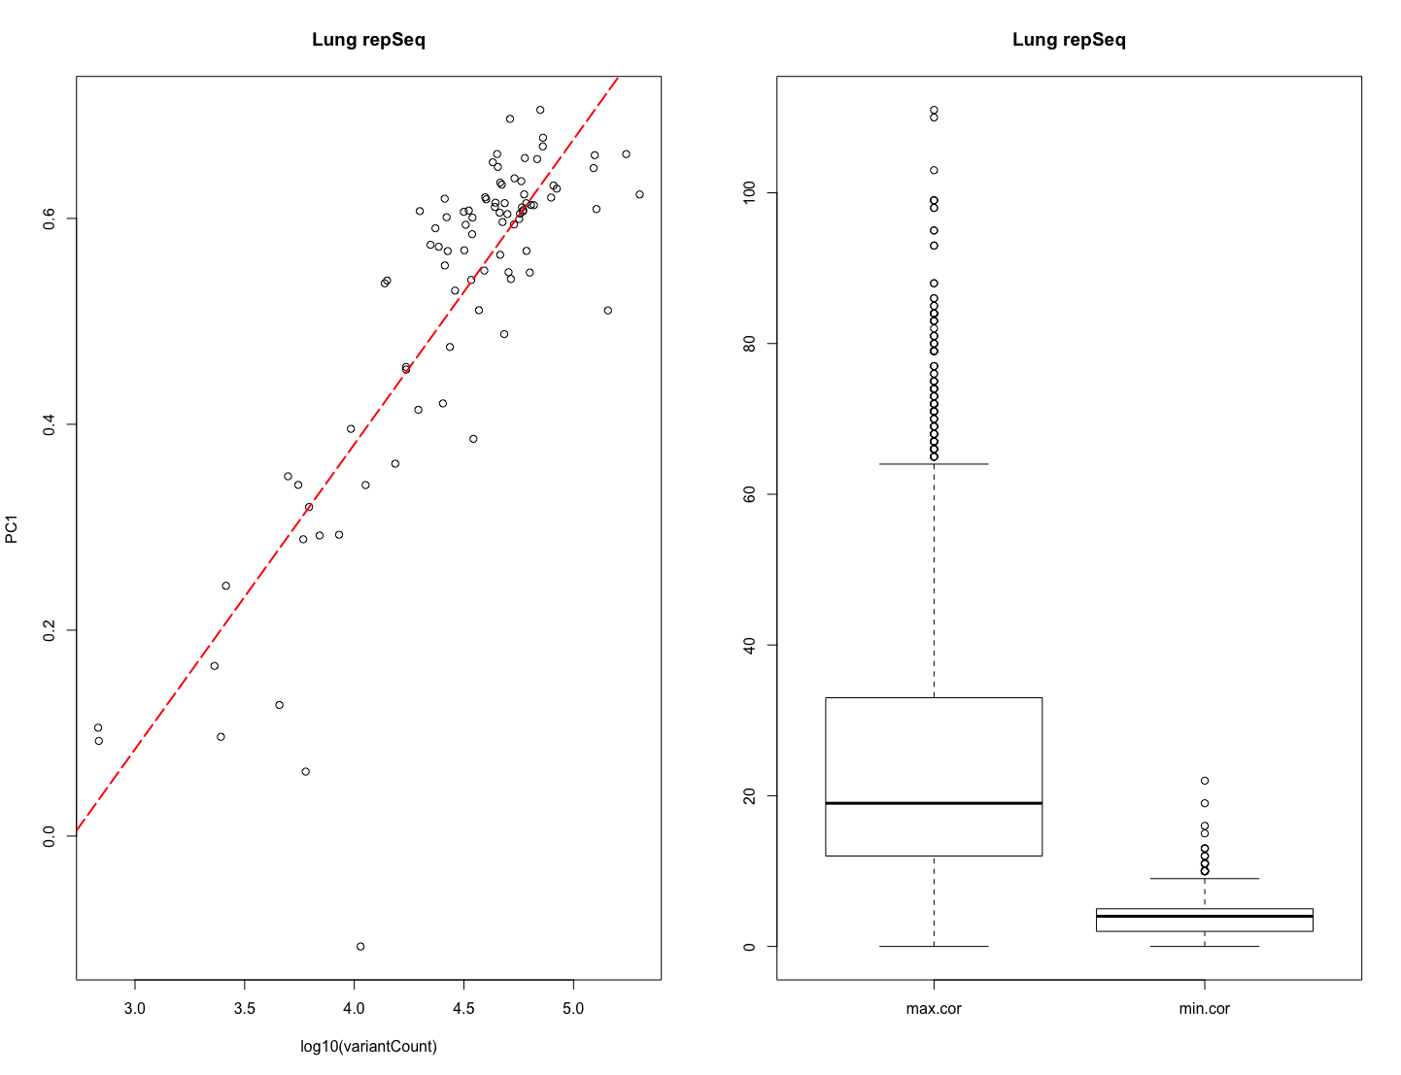

Slide 35
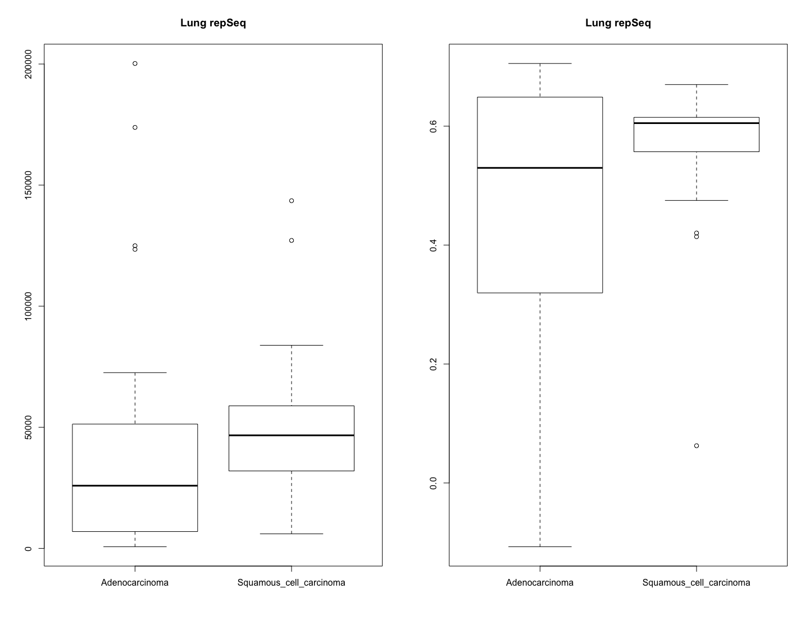

Slide 36
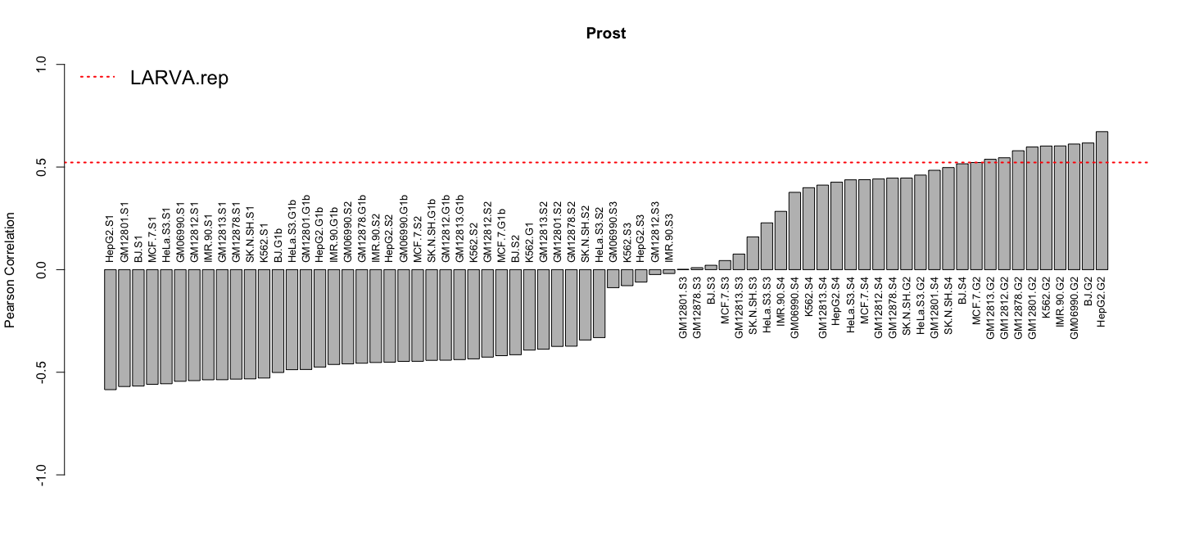
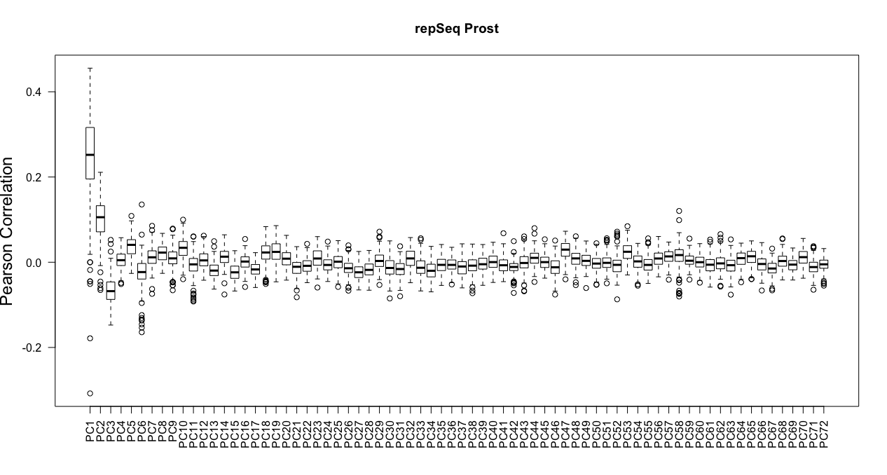

Slide 37
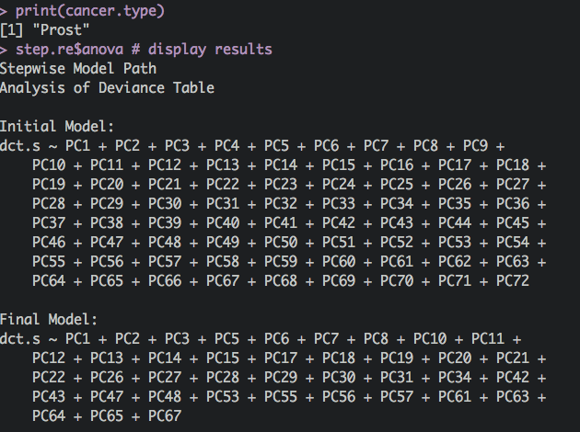

Slide 38
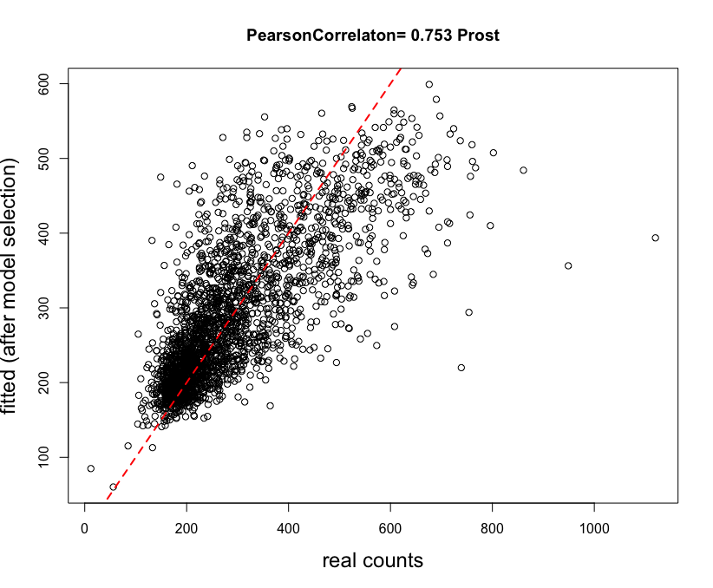

Slide 39
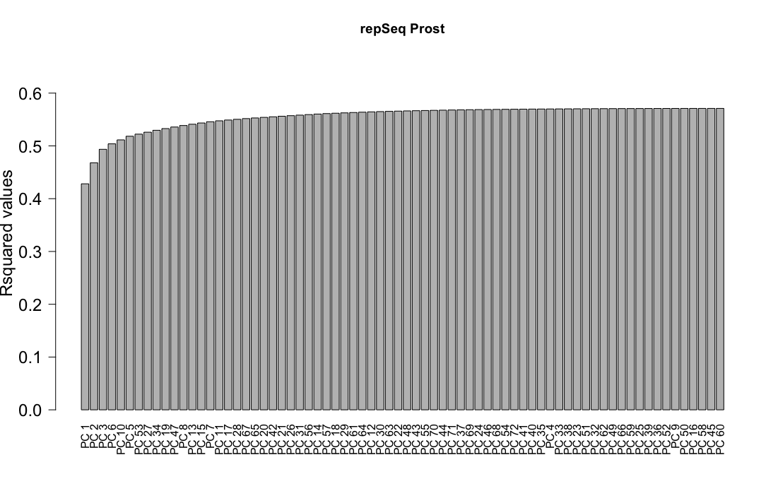

Slide 40
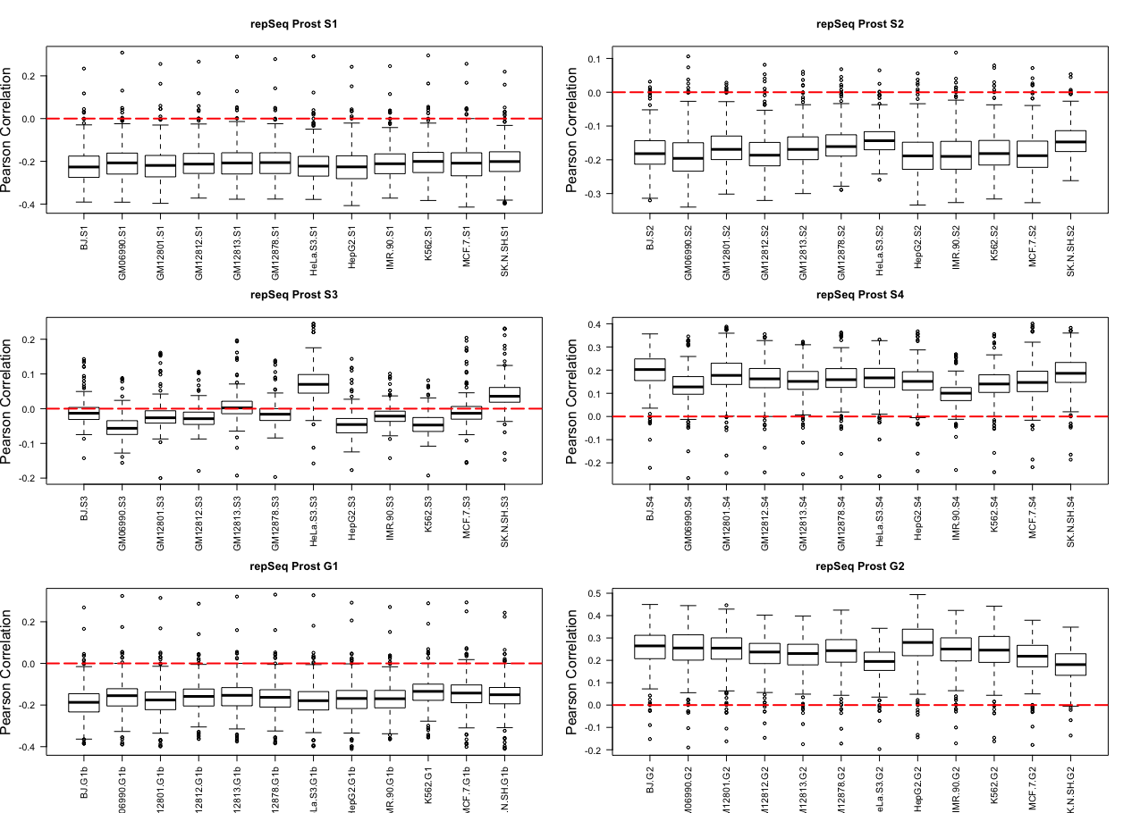

Slide 41
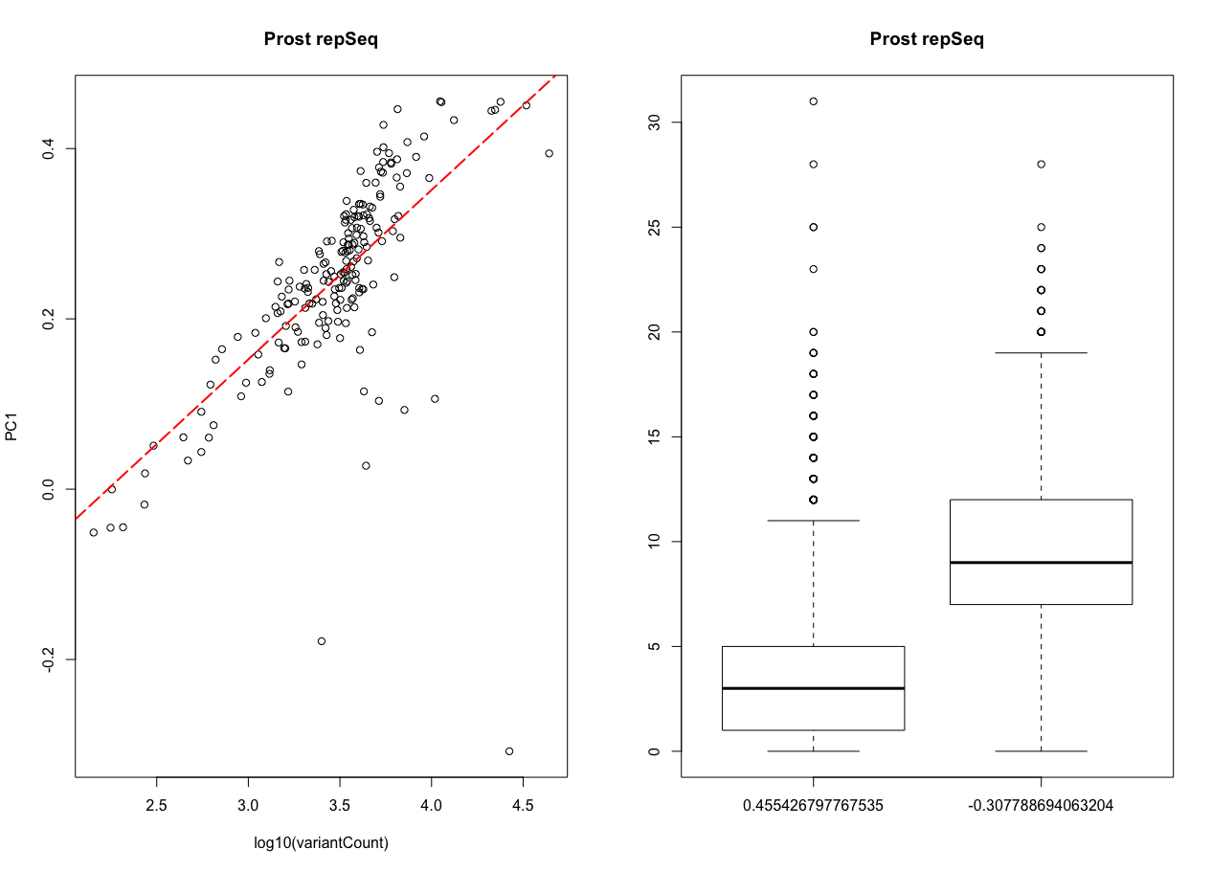

Slide 42
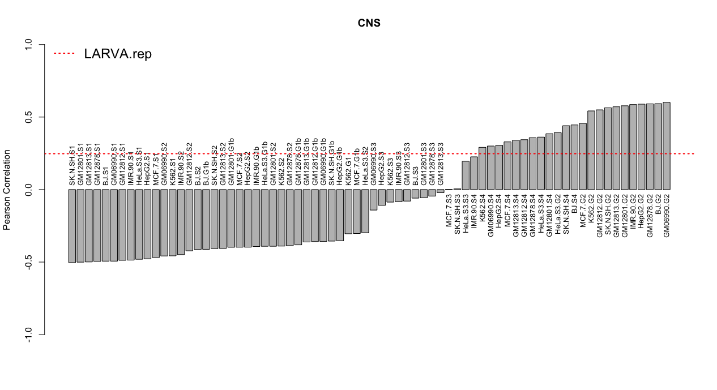

Slide 43
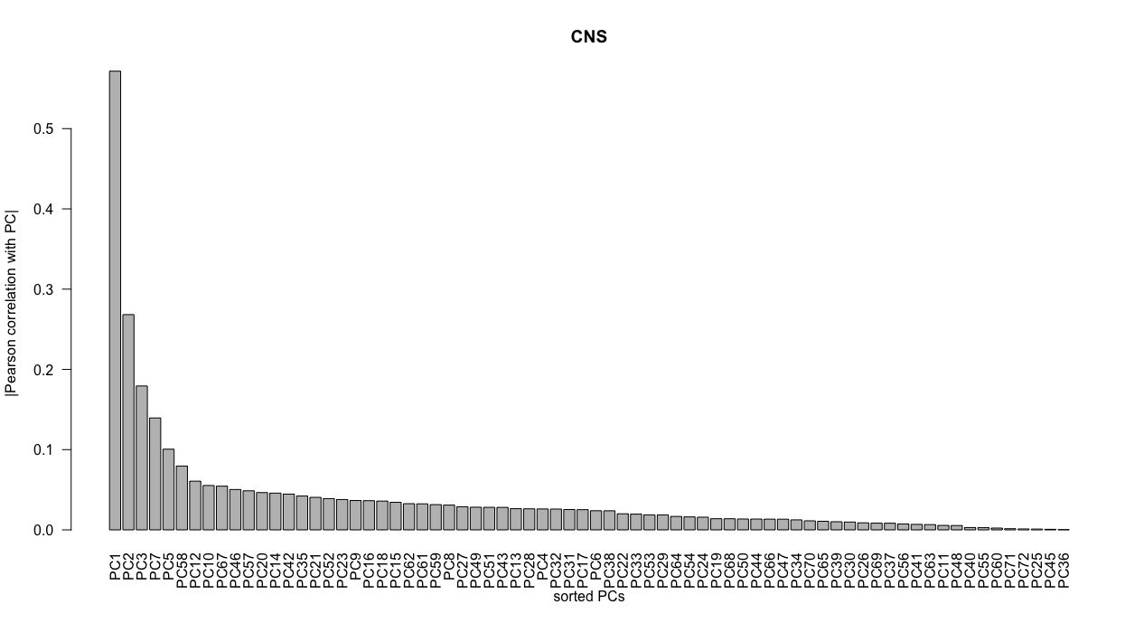

Slide 44
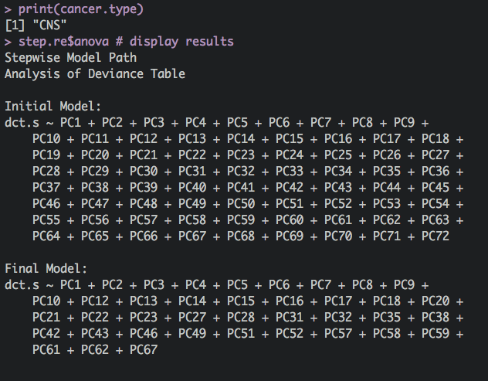

Slide 45
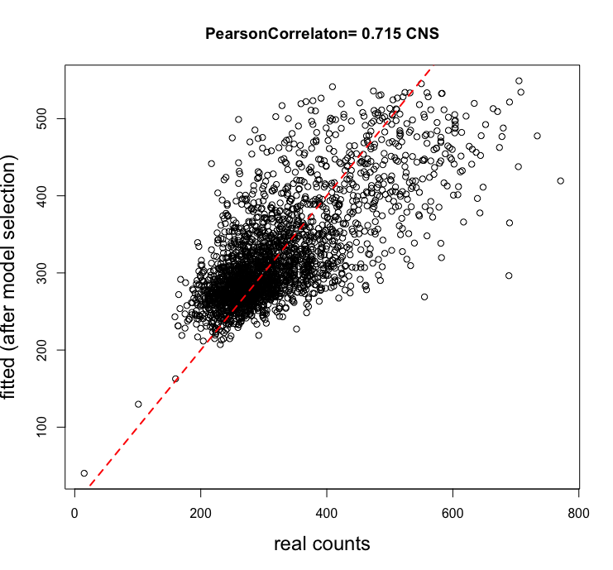

Slide 46
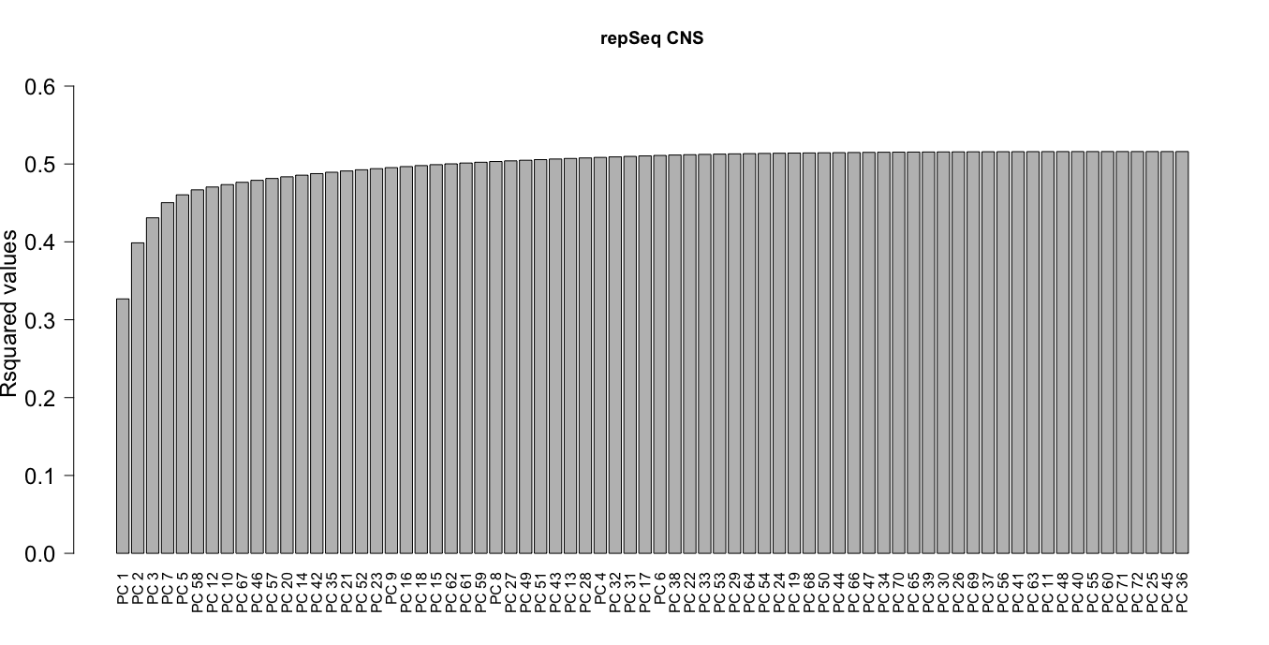

Slide 47
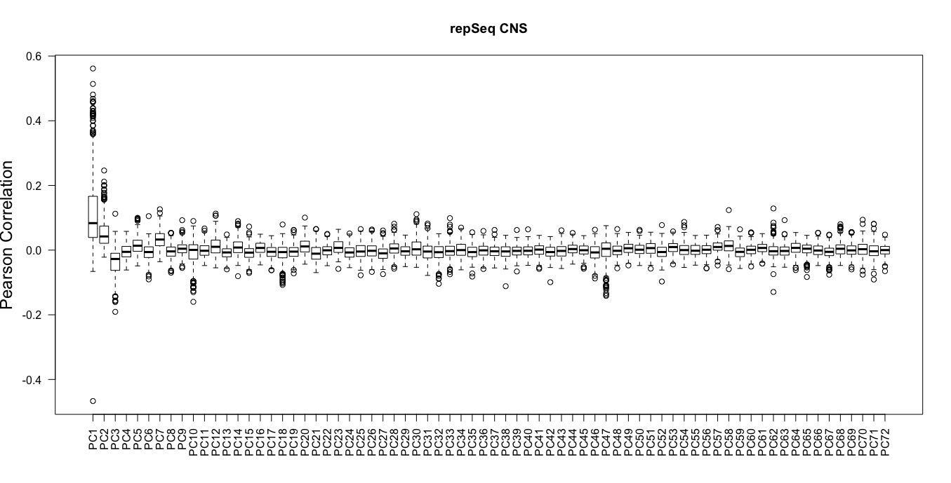

Slide 48
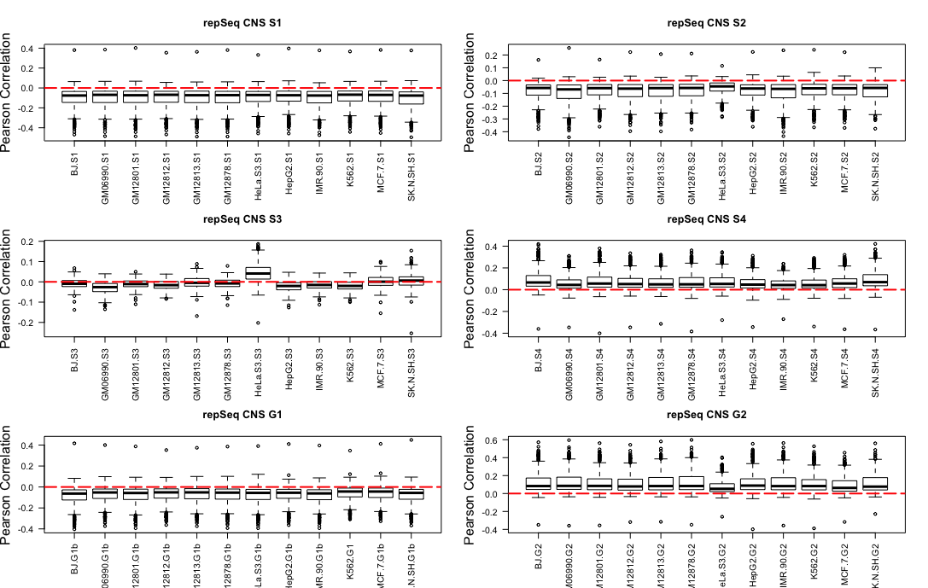

Slide 49
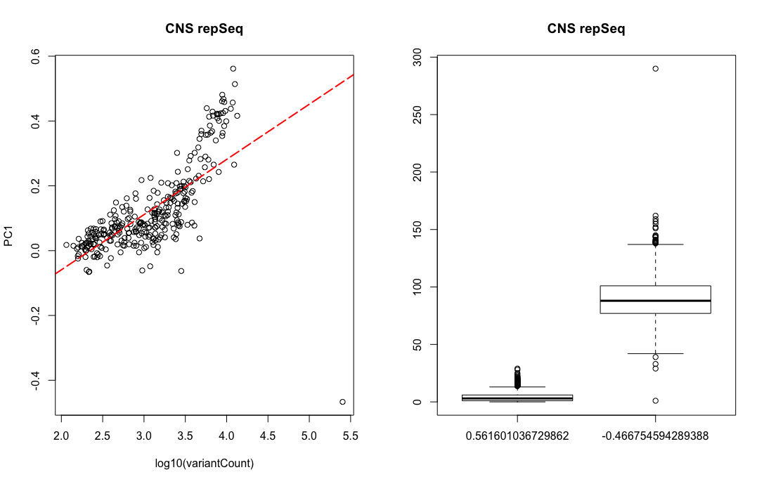

Slide 50
