Slide 1
Context: ALoFT Reviewer Comment:
“In samples with a high mutational burden, did you see if the majority of the mutations were pLOF were predicted in one class type or another? Would it be a way to distinguish between drivers and passengers as well particularly in tumors with large mutational burden?”

Slide 2
Statistics on the data set
Total number of tumor samples in PCAWG/Alexandrov set: 607
Total mutations in set: 5379366
Total categorized as LOF by ALoFT: 2885
% mutations categorized as LOF: 0.05
Total number of tumor samples with a single LOF mutation: 82
Median LOF mutations/sample: 2

Slide 3
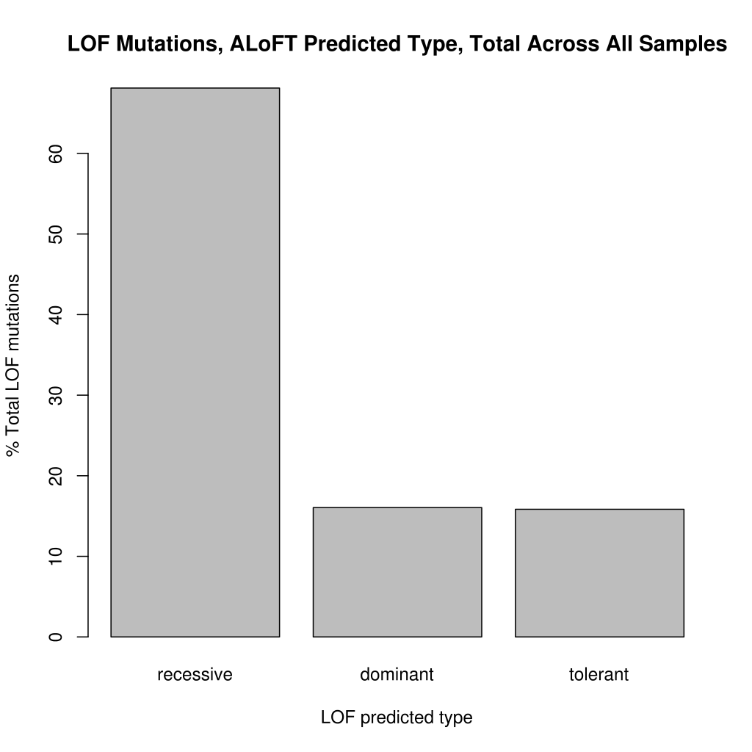

Slide 4
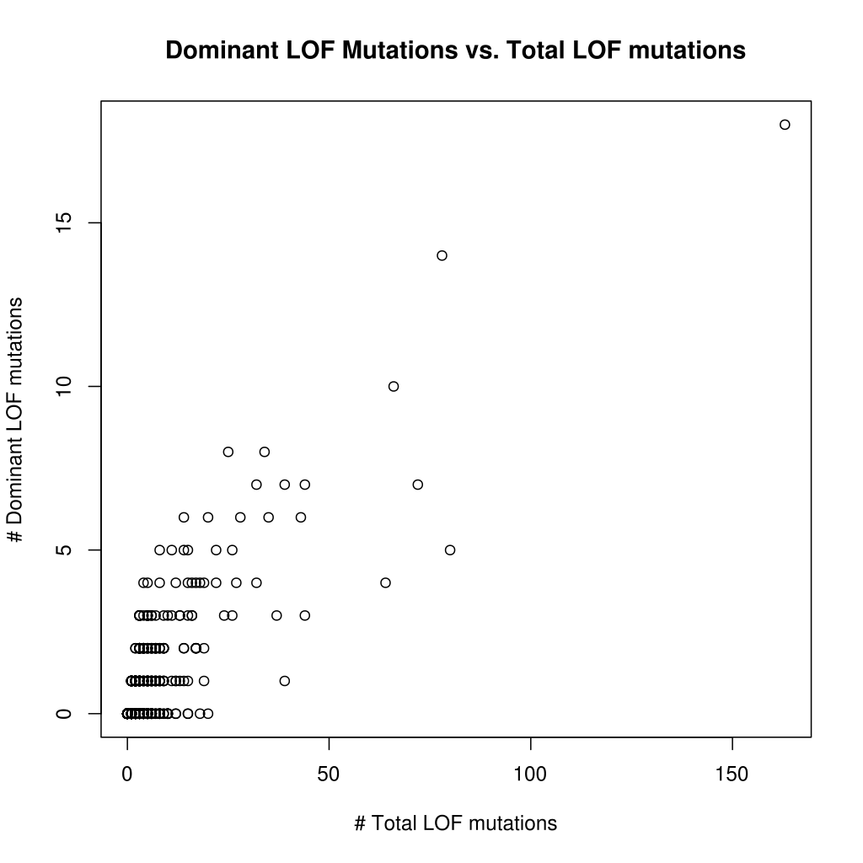

Slide 5
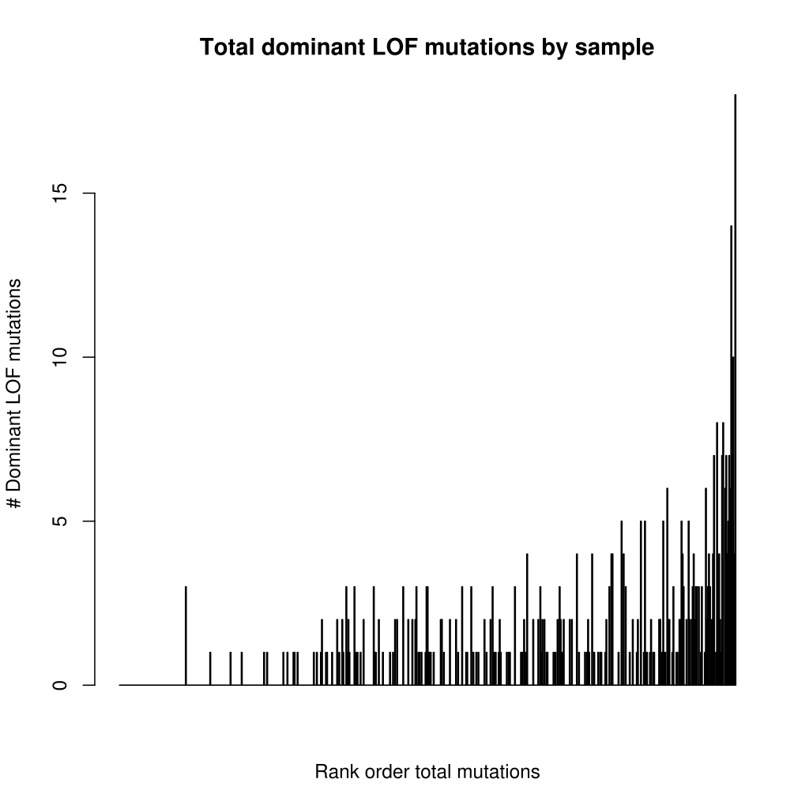

Slide 6
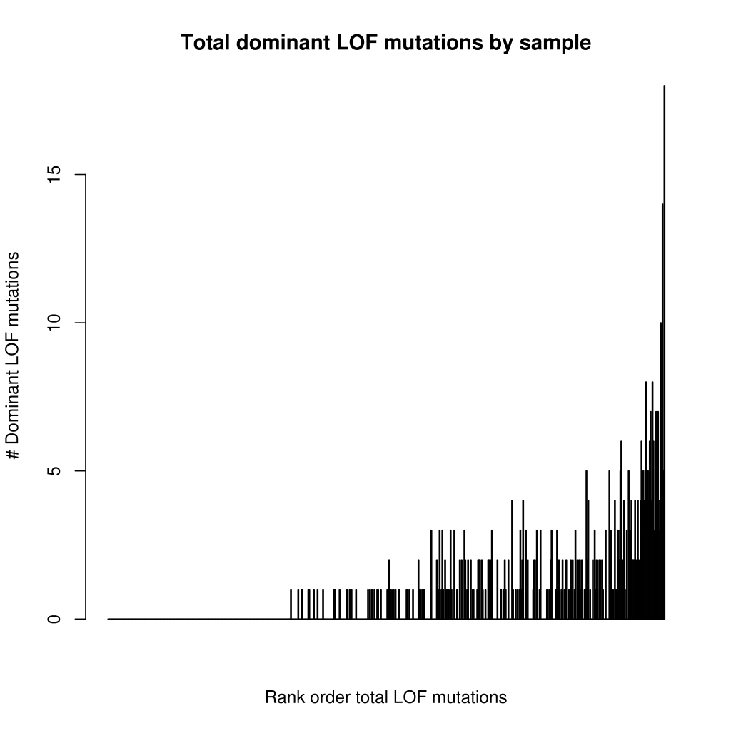

Slide 7
