Slide 1
Signatures across Tumor Evolution - Mutation Impact Var 8/2

Slide 2
Previously on “Variations in E miner”

Slide 3
Funseq Score (non coding)

Slide 4
Gerp Scores

Slide 5
Region Scores

Slide 6
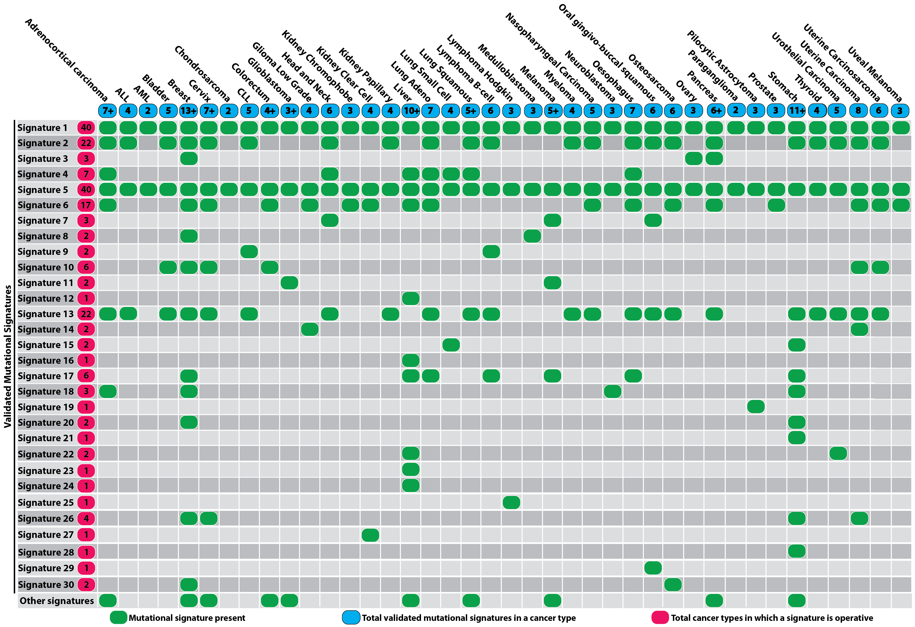
30 Signatures

Slide 7
Signature probabilities

Slide 8
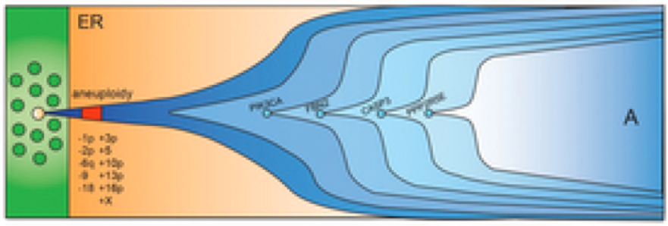
Identify Signatures within Sliding time window T
Time window T
Frequency t
Fr(t)
Time y
Time x
T= x – t = t - y and x < t < y

Slide 9
Solving a regression problem with constraints
Solve with Quadratic programming where A>=0, B=0 AND A1+A2+…A30=1

Slide 10
With package QuadProg in r
Patient 007aab66-2f07-459d-8952-3041d6ea24a8_sigs
Clone 2
Clone 1

Slide 11
Prioritize mutations based on change in Signatures
Frequency t
Fr(t)
Time T_{M}-n muts
Time T_{M}+k muts
Mutation M
Group A
Group B
Group A:n previous mutations
Group B: k following mutations

Slide 12
Basically compare any two groups of mutations A vs B
Deconvolute both groups as a mix of 30 signatures
Regress the mutational probabilities of group B into group’s A signatures (obtain R and p values)
Measure the change in entropy for signature prevalence

Slide 13
Mutational impact on r (P. correlation) and δE Patient: 1f8d8720-30ca-4057-90f7-a34b8383eafe
Correlation:
Bin_{X} vs Bin_{X-1}
Mut Freq
Mut dE:
Bin_{X} vs Bin_{X-1}
Ordered mutations based on Mut Freq
T (now) <- T₀

Slide 14
Change vs Win0 (fut. germline)
Patient : 003819bc-c415-4e76-887c-931d60ed39e7
Mutational Windows based on mut freq
Time
Patient : 1f8d8720-30ca-4057-90f7-a34b8383eafe

Slide 15
Future perspective
4 bins (Germline vs Early vs Mid vs Late) for each patient; Then compare total sums
Compare across different cancer types
To add: Mutation impact network cascades

