Slide 1
Available attributes for each miR-eQTL (SNV-miRNA pair)
(5,269 cis-miR-eQTLs for 76 mature microRNAs)
snpID
miRNA_FHS
sample size
MAF
Tvalue
Pval
h2q
BH_FDR
chr.SNP
SNP.pos
SNP.strand
SNP.func (ex: intron)
Chr.miR
miR.Start
miR.End
miR.strand
hsa_miR_name
CisMark (ie: cis or trans)
miRNA_alter_ID
miR_Type* (ex: "intron" or "Intergenic")
mutated base
wt base
abs_dist_btwn_SNP_and_miRNA(kb)
Huan, Tianxiao, et al. "Genome-wide identification of microRNA expression quantitative trait loci." Nature communications 6 (2015).

Slide 2
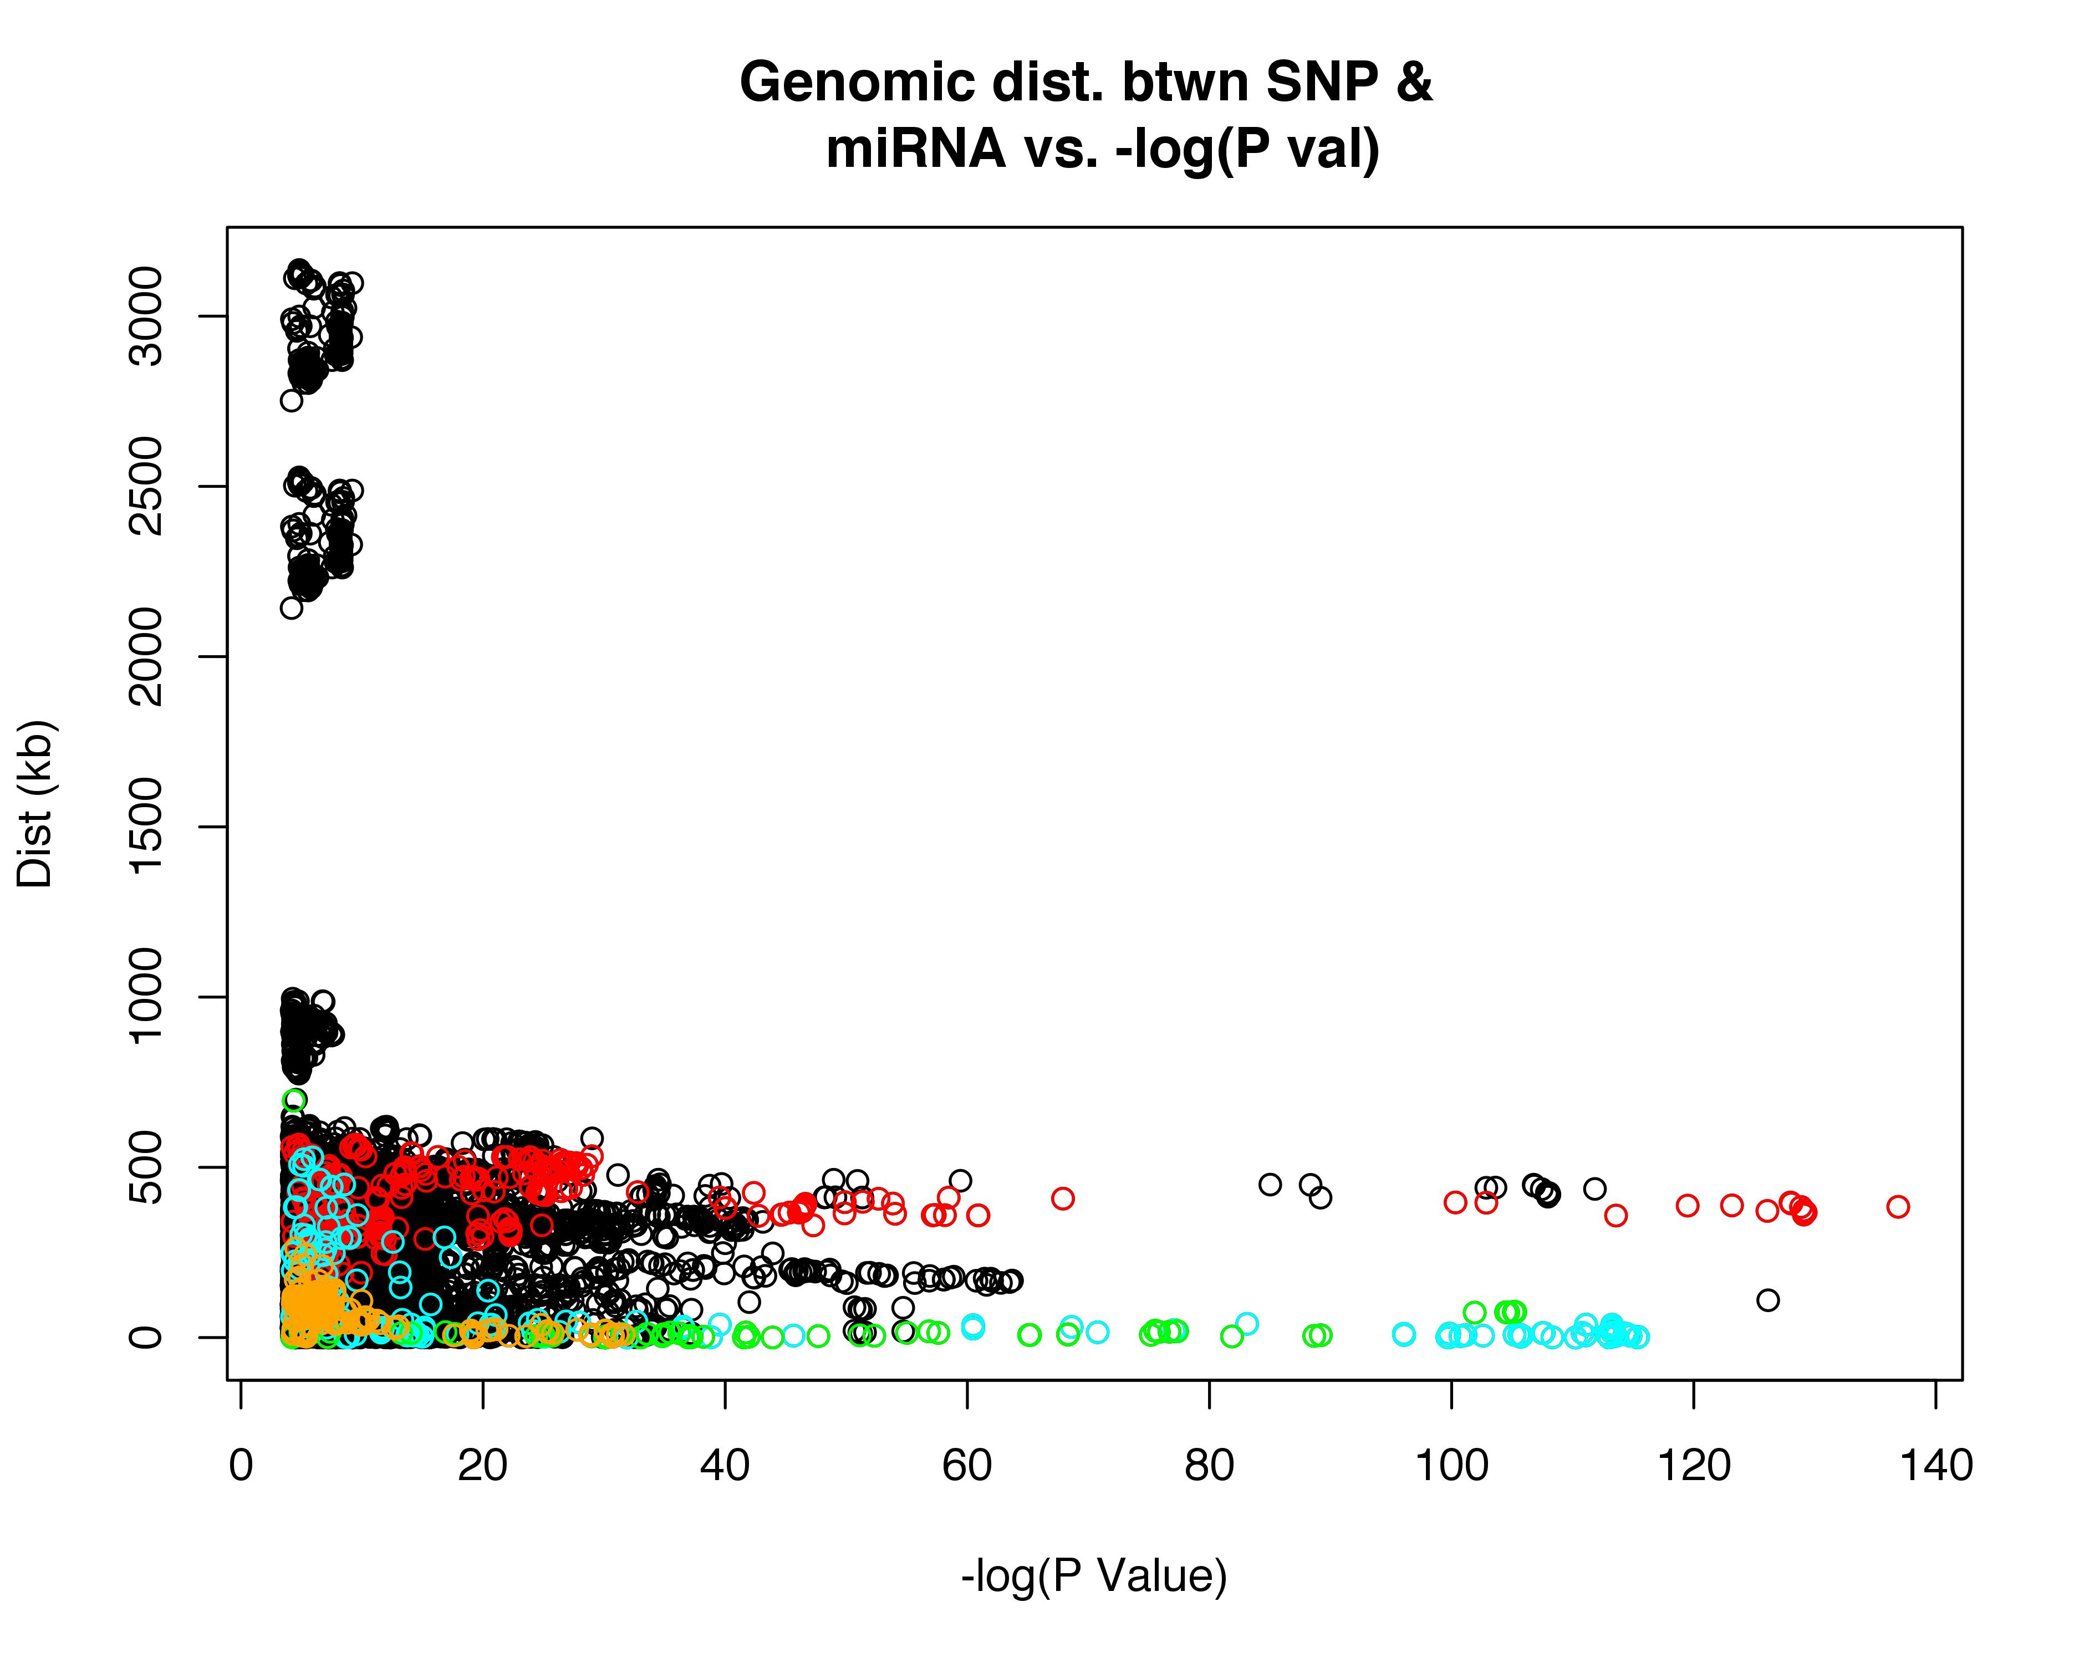
miR_100_5p miR_1303 miR_133a miR_30a_3p

Slide 3
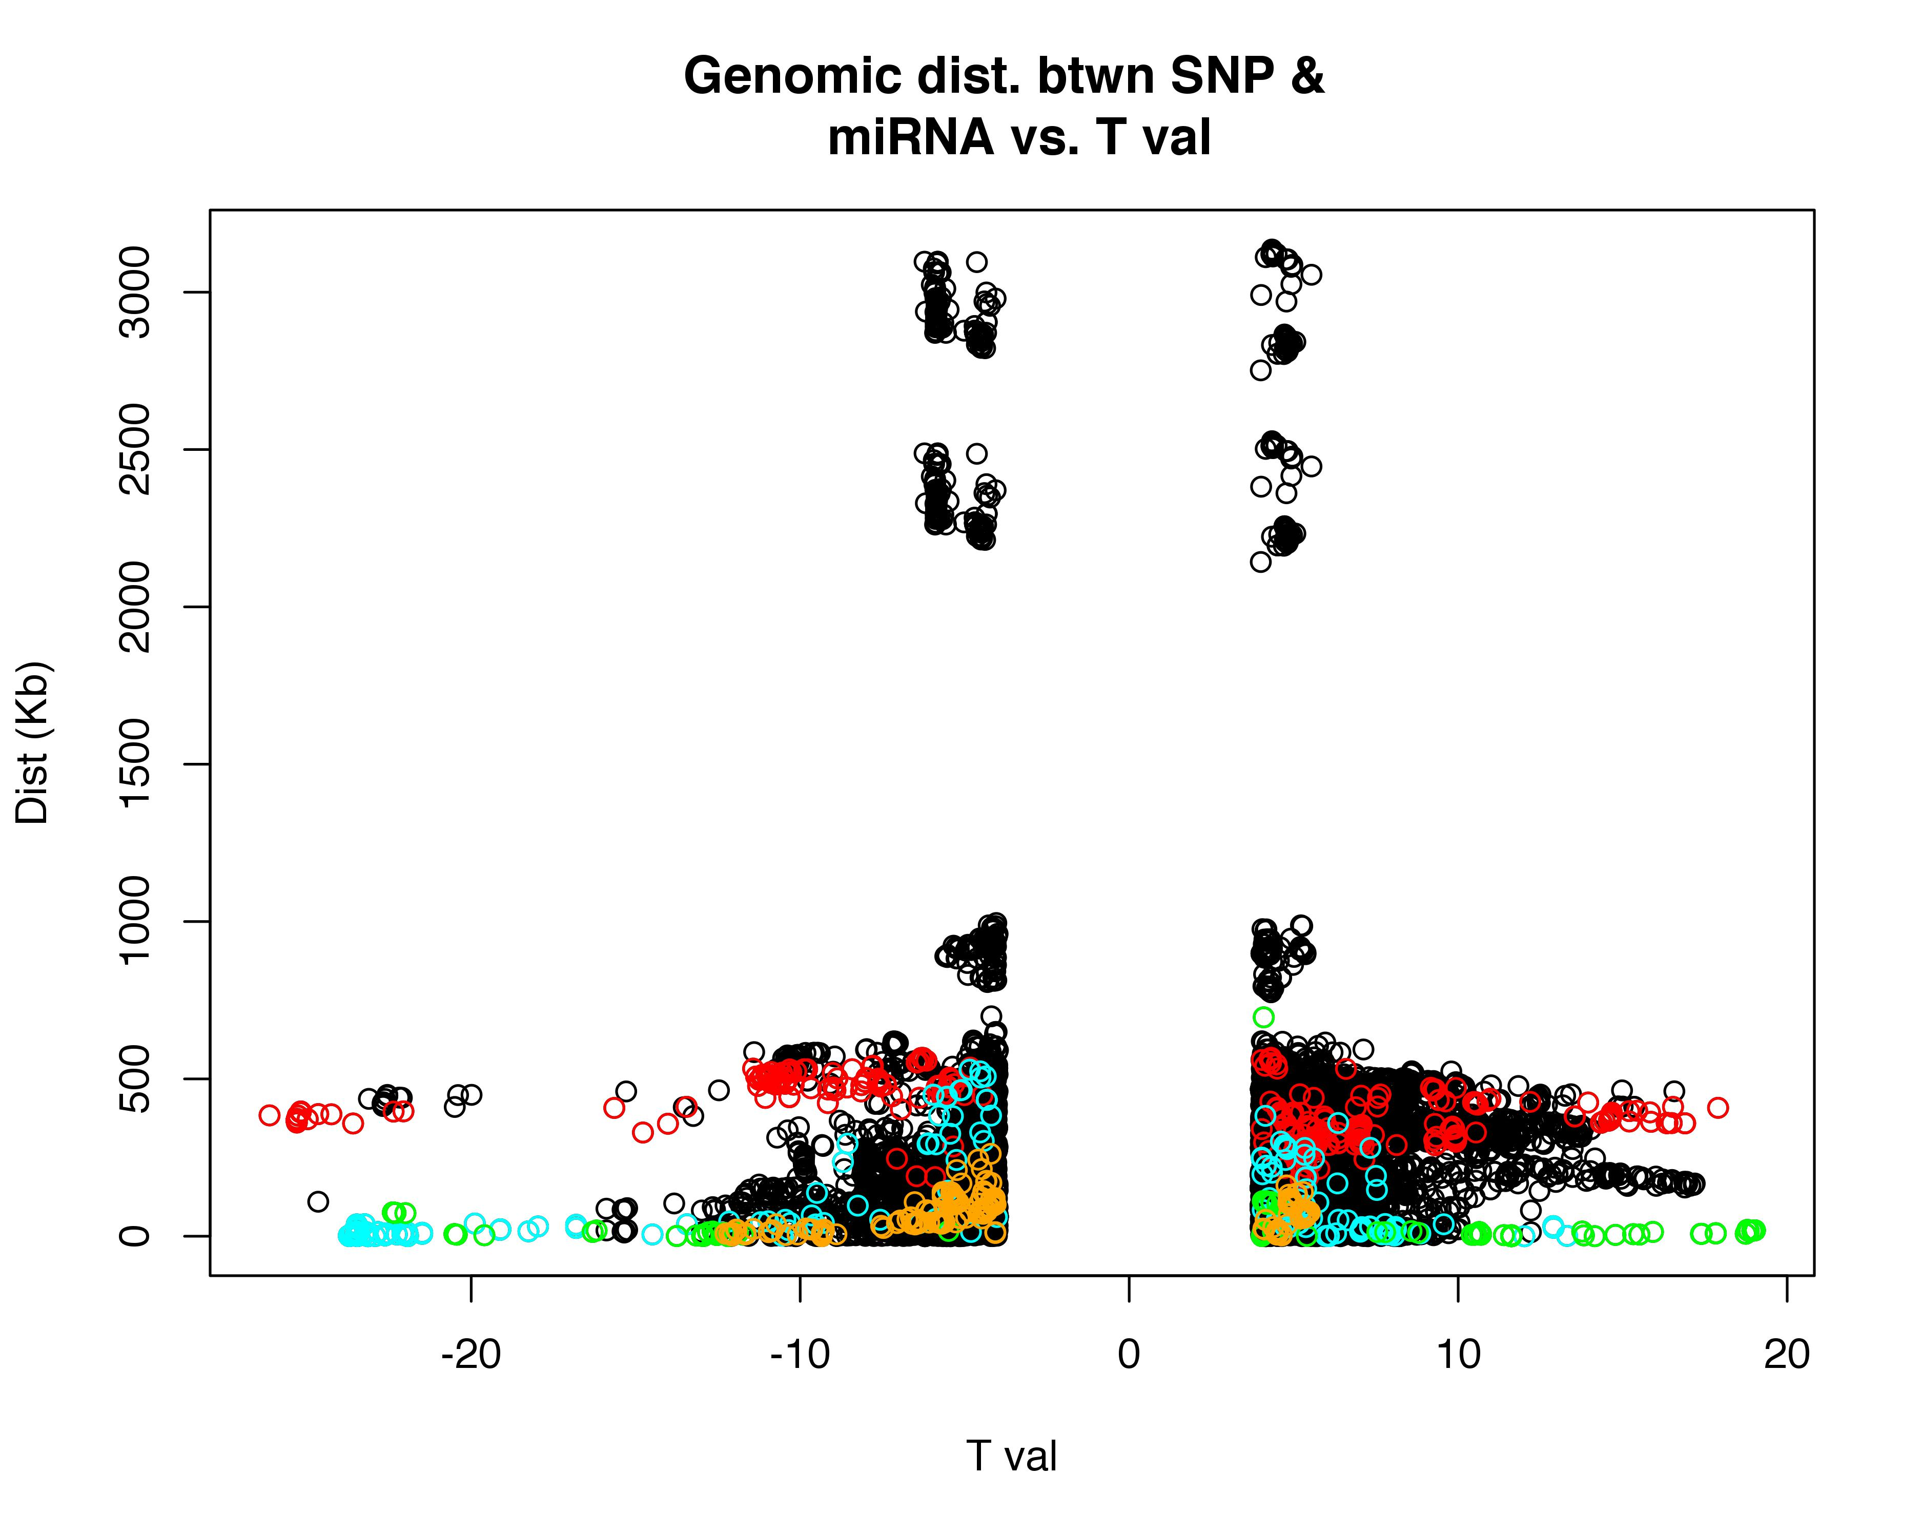
miR_100_5p miR_1303 miR_133a miR_30a_3p

Slide 4
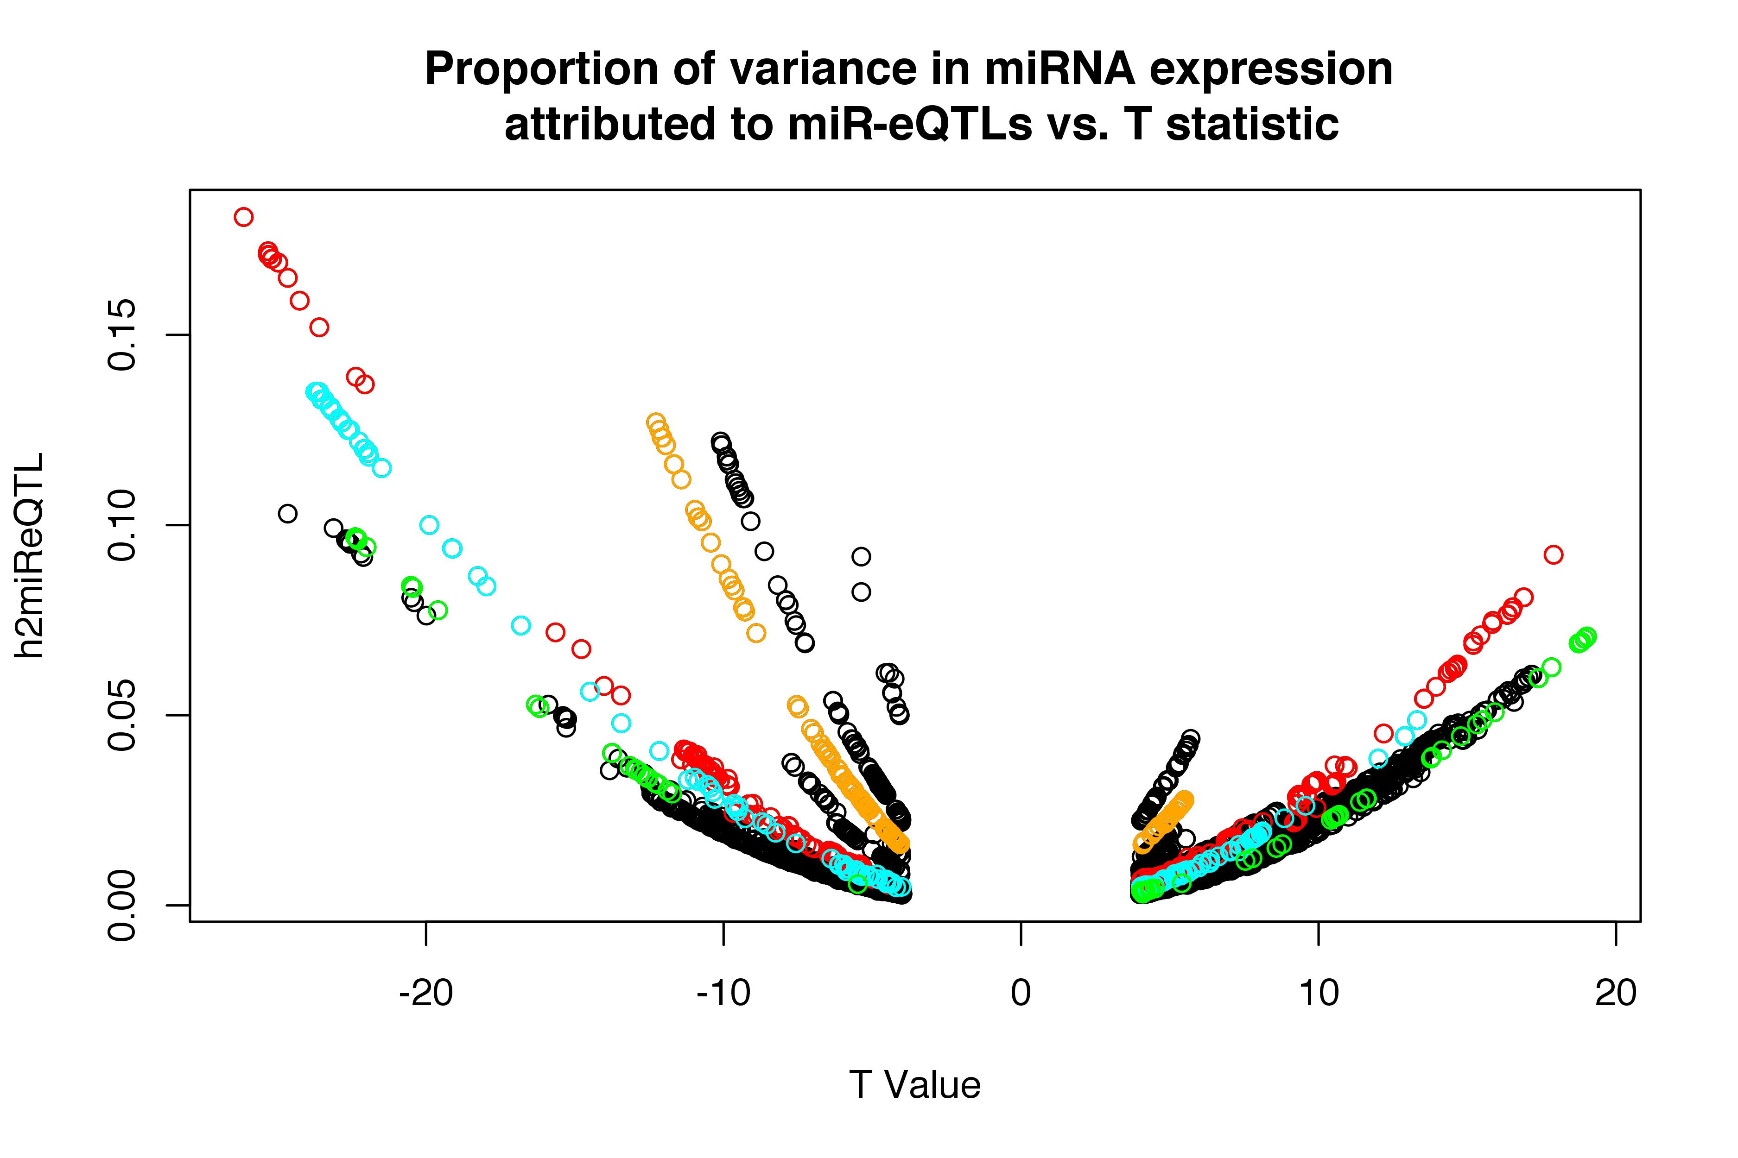
miR_100_5p miR_1303 miR_133a miR_30a_3p

Slide 5
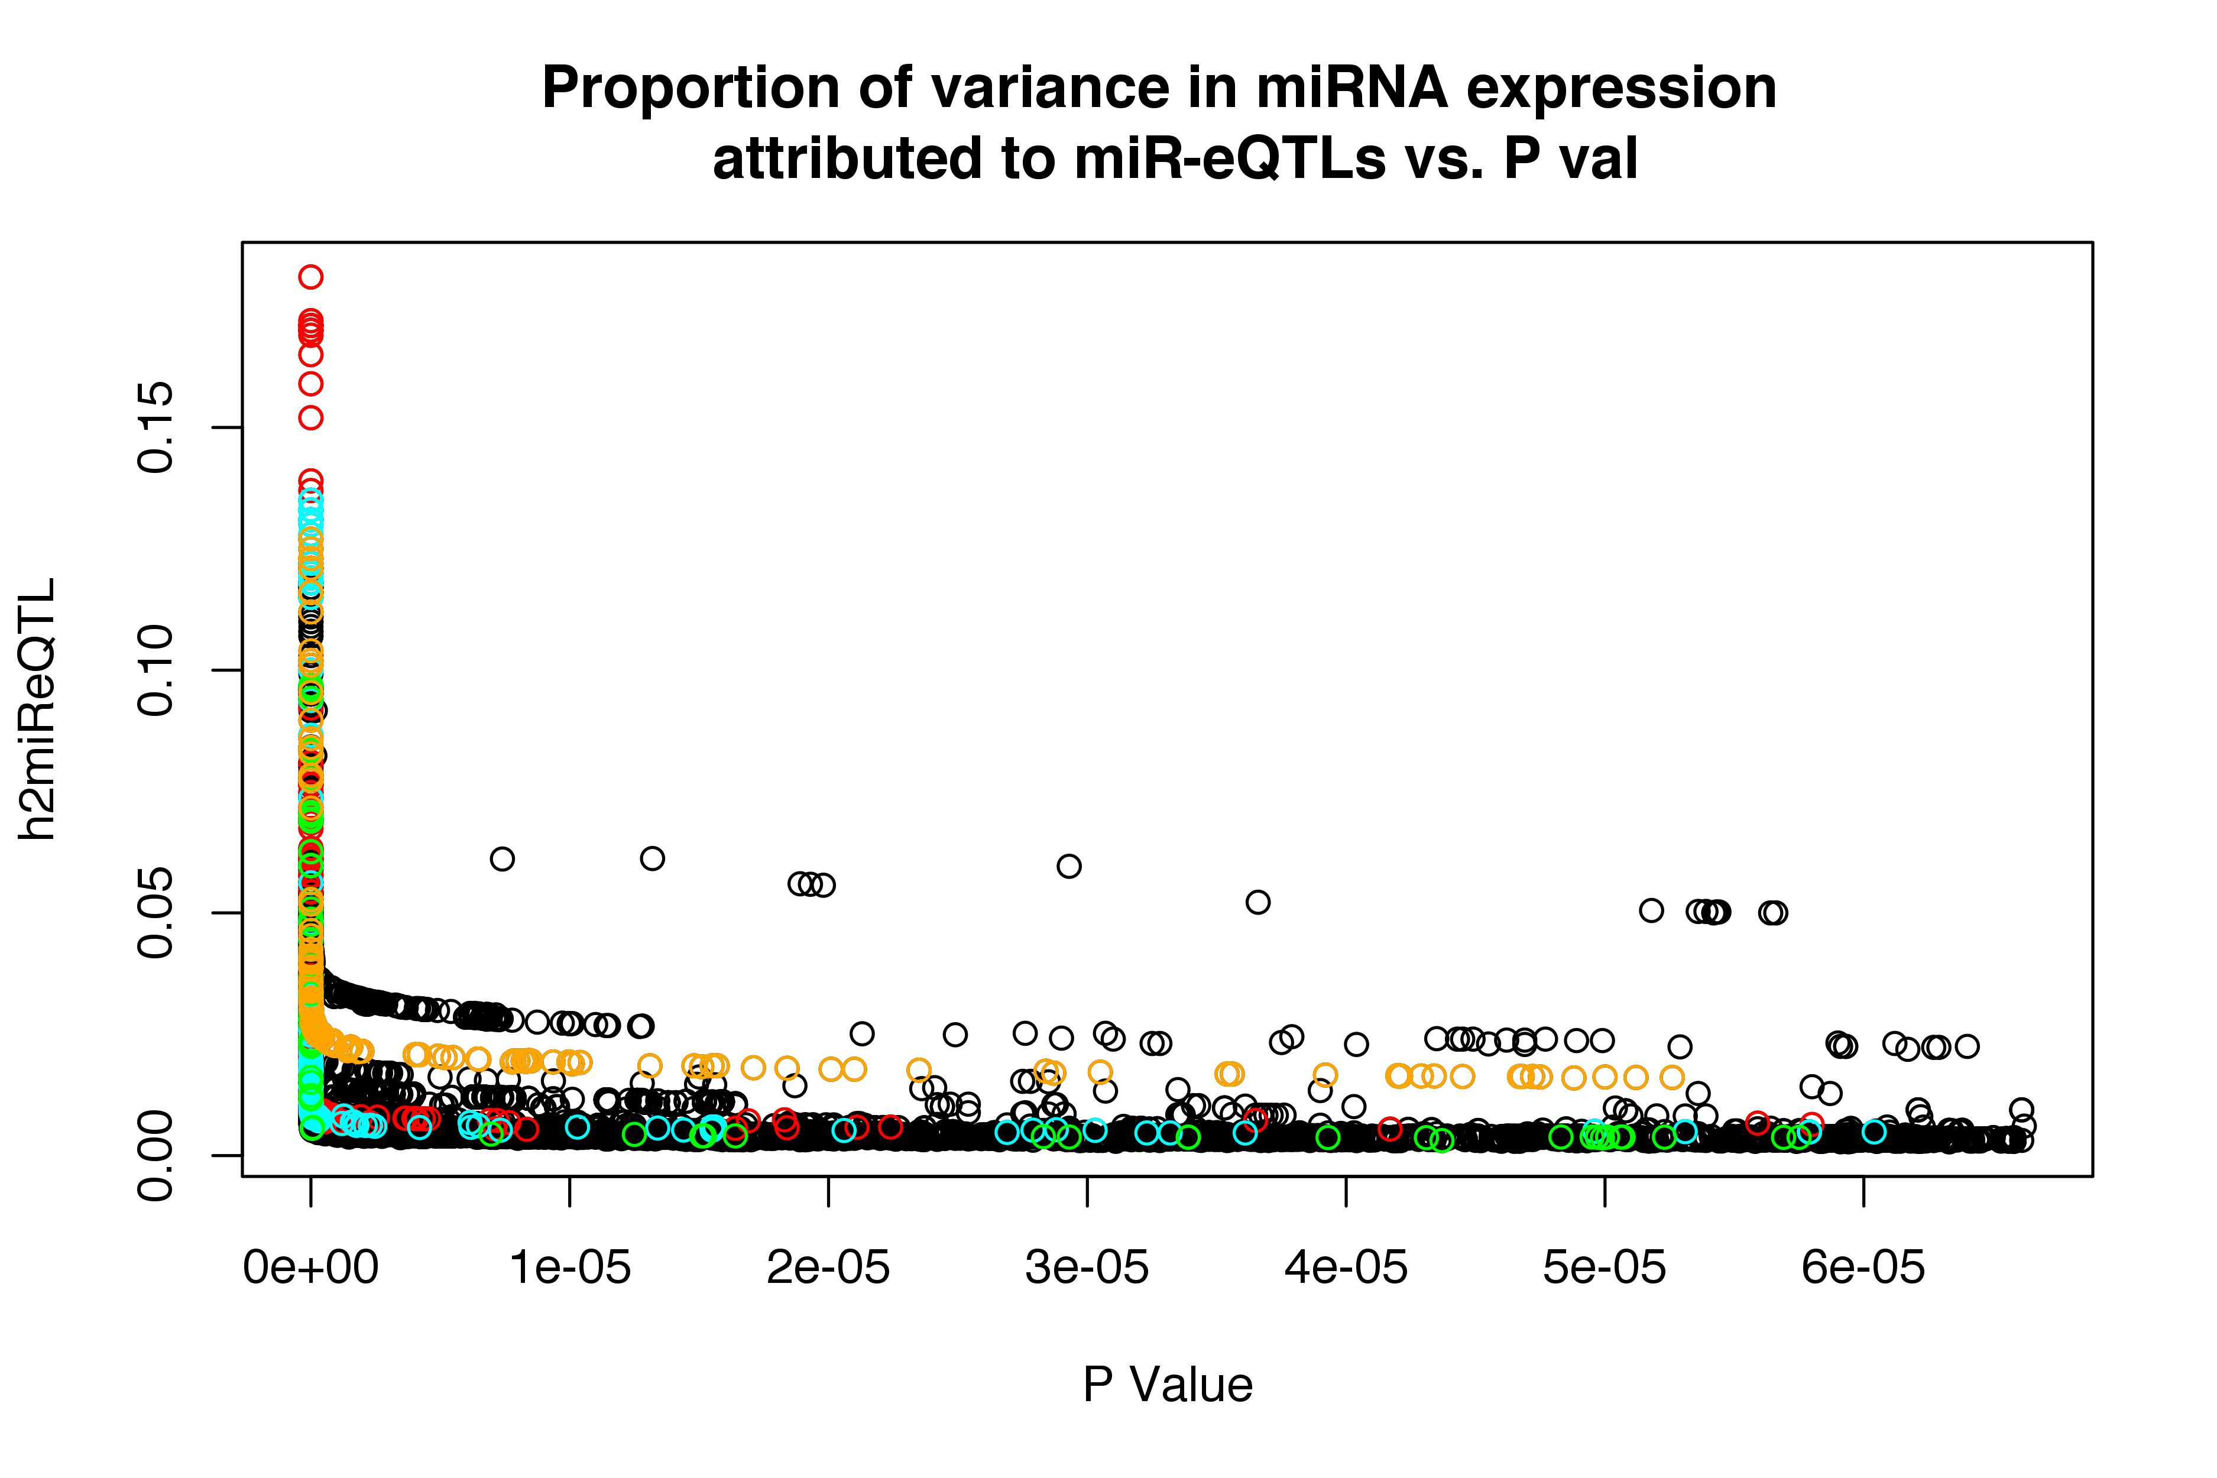
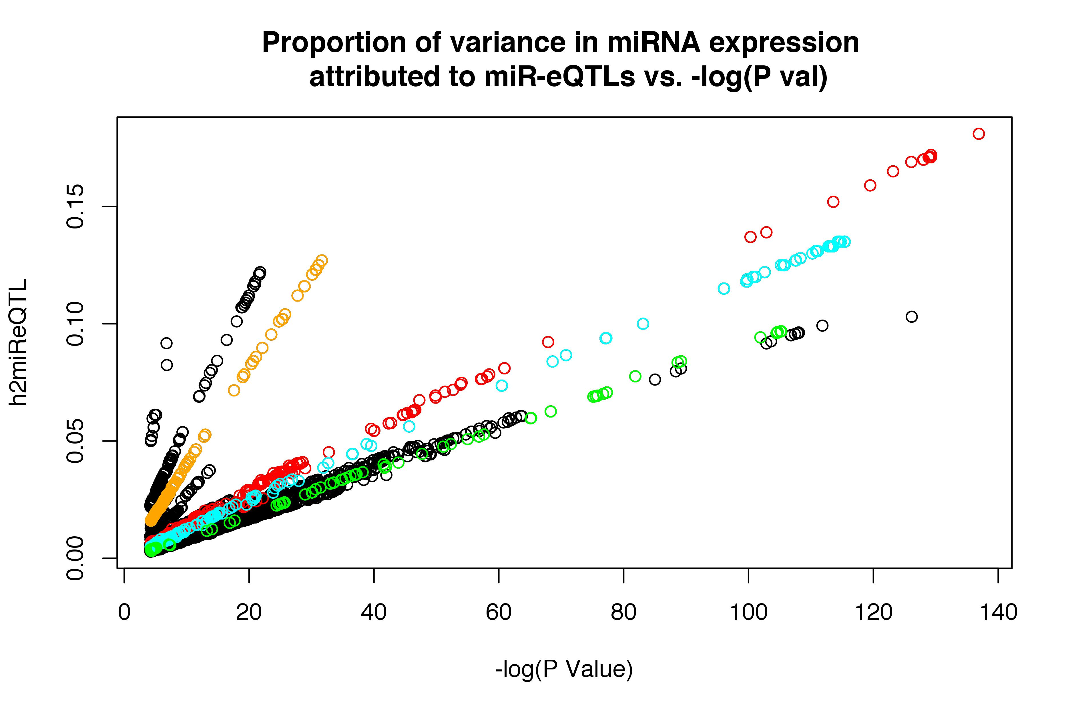
miR_100_5p miR_1303 miR_133a miR_30a_3p

Slide 6
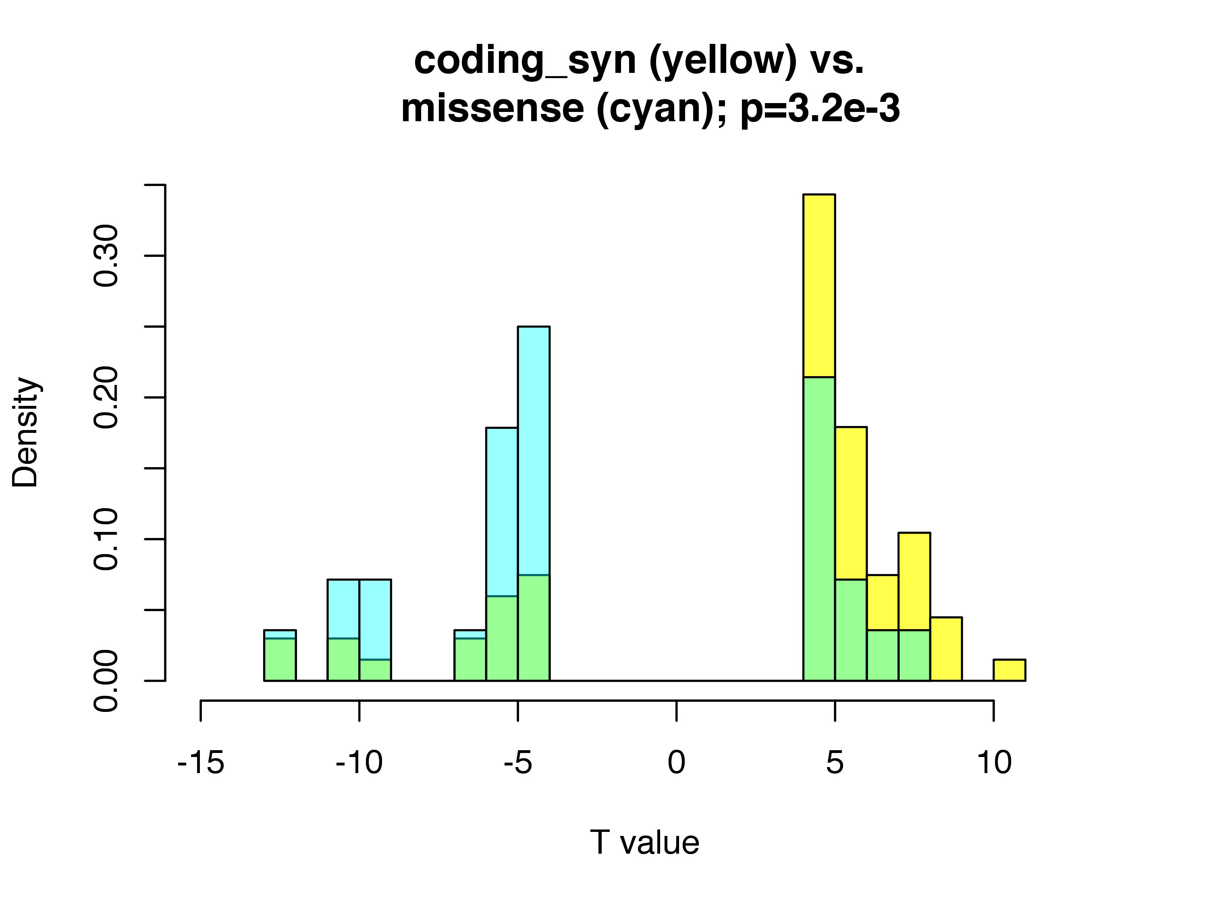

Slide 7
Huan, Tianxiao, et al. "Genome-wide identification of microRNA expression quantitative trait loci." Nature communications 6 (2015).

