Slide 1
Signatures across Tumor Evolution
- Mutation Impact
Var 8/2

Slide 2
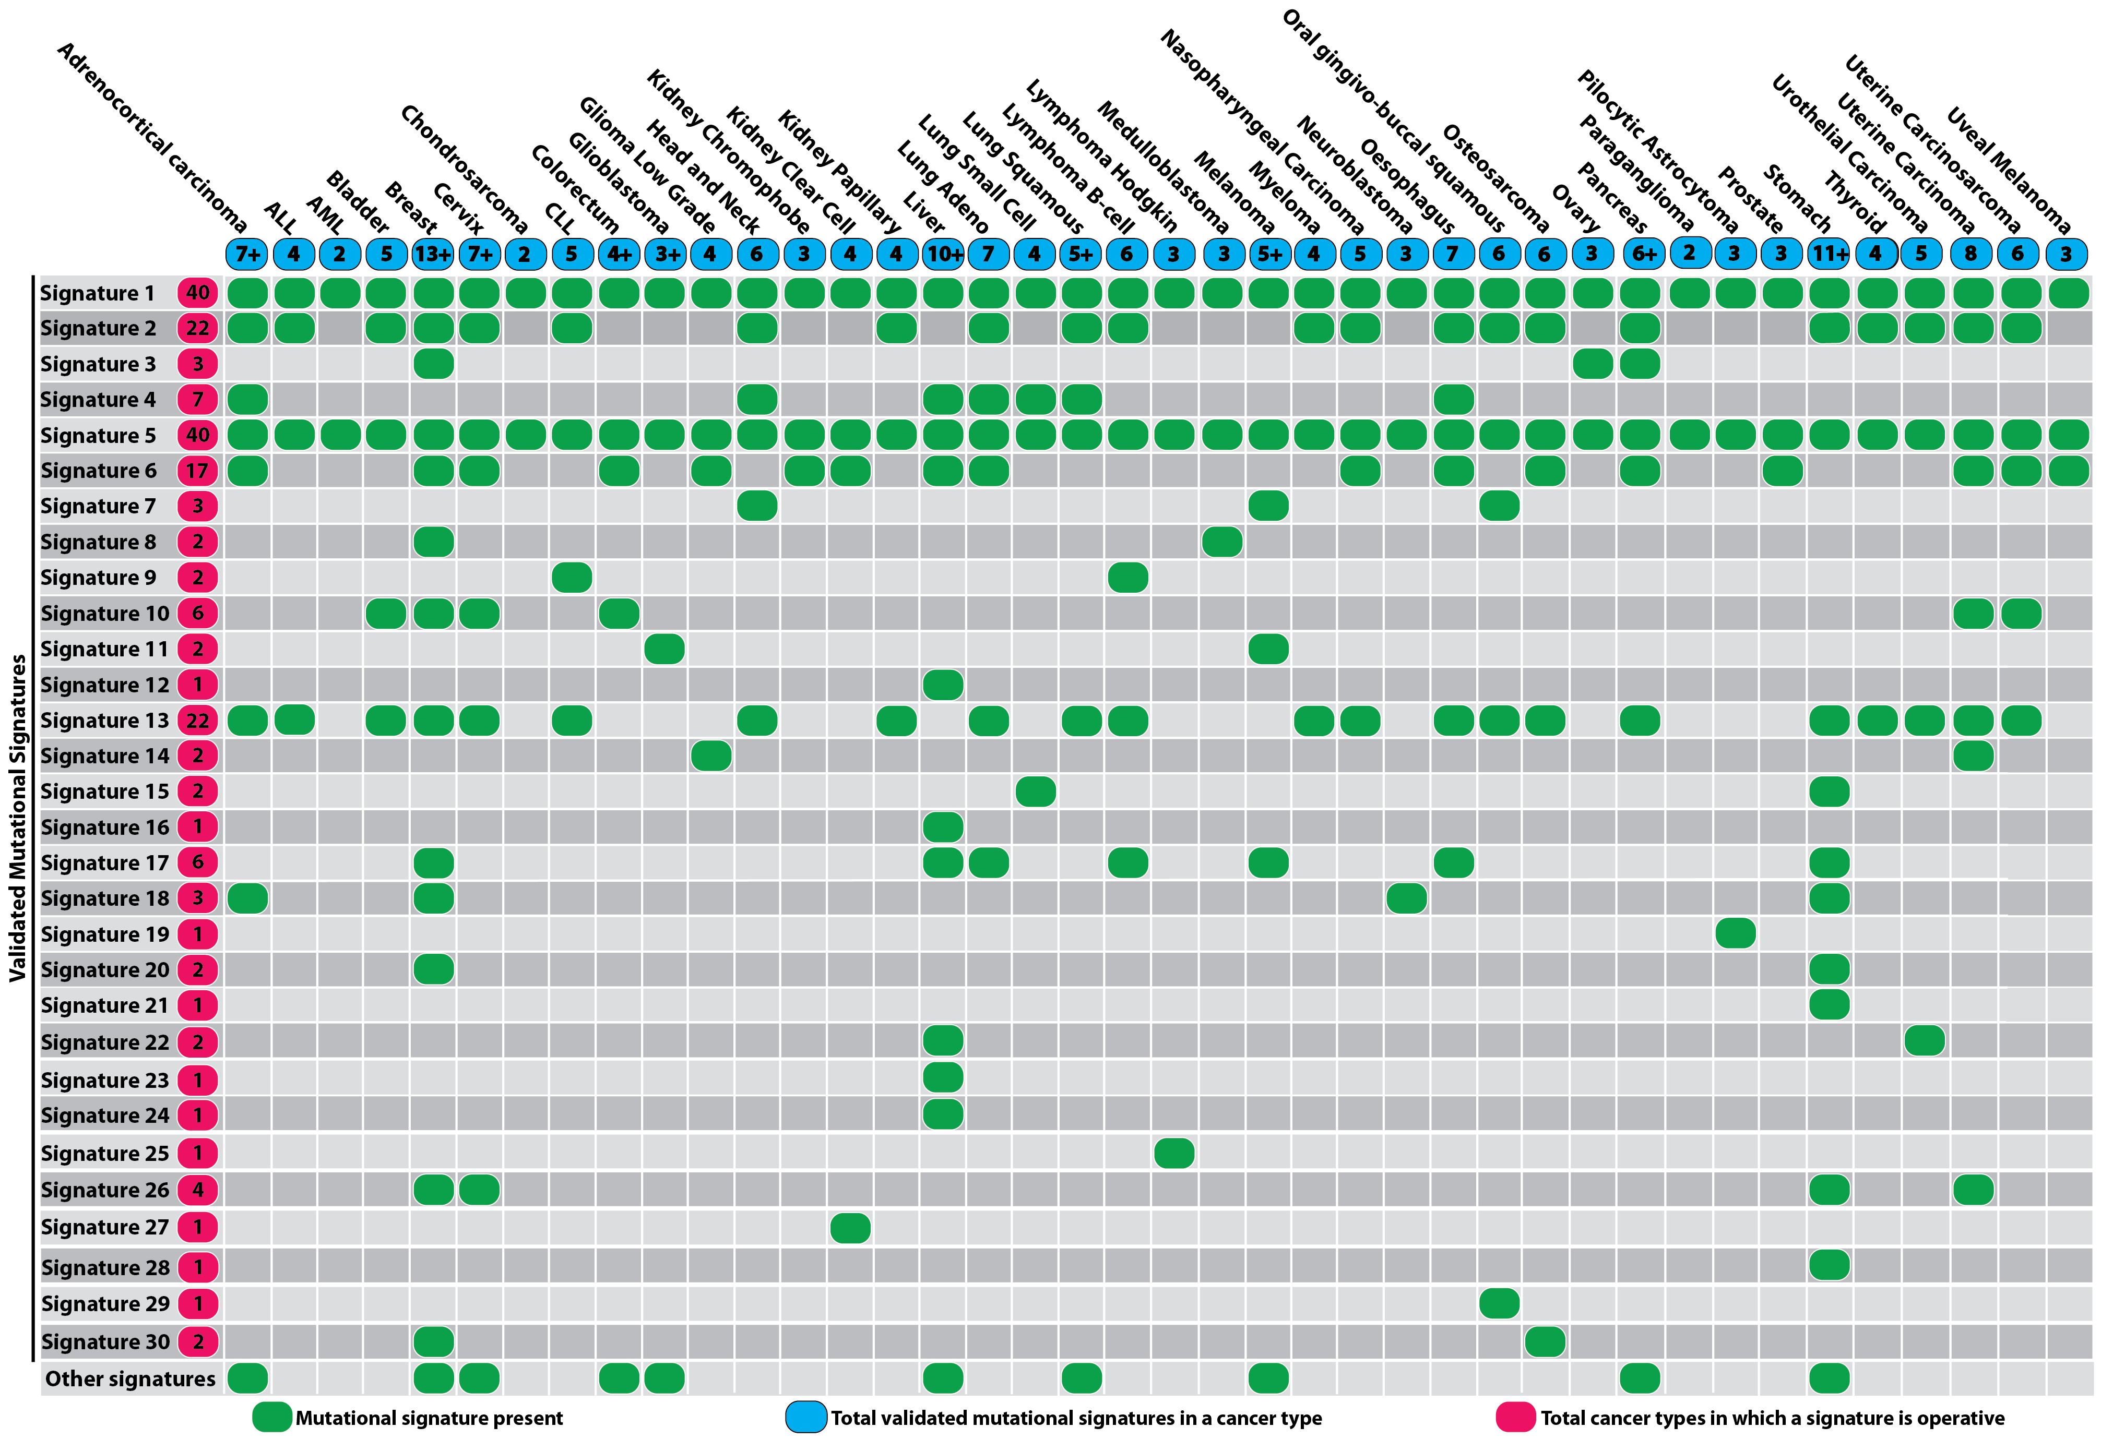
30 Signatures

Slide 3
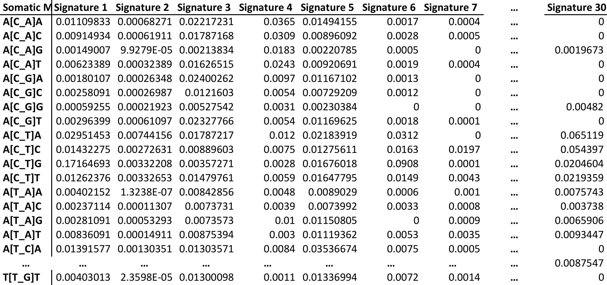
Signature probabilities

Slide 4
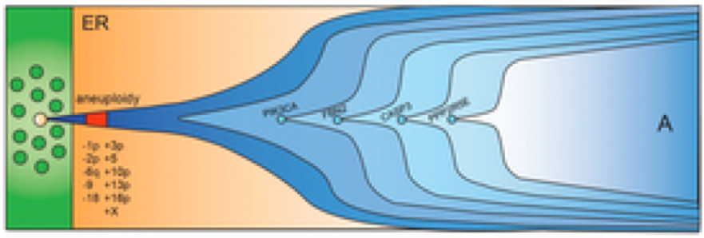
Identify Signatures within
Sliding time window T
Time window T
Frequency t
Fr(t)
Time y
Time x
T= x – t = t - y and x < t < y

Slide 5
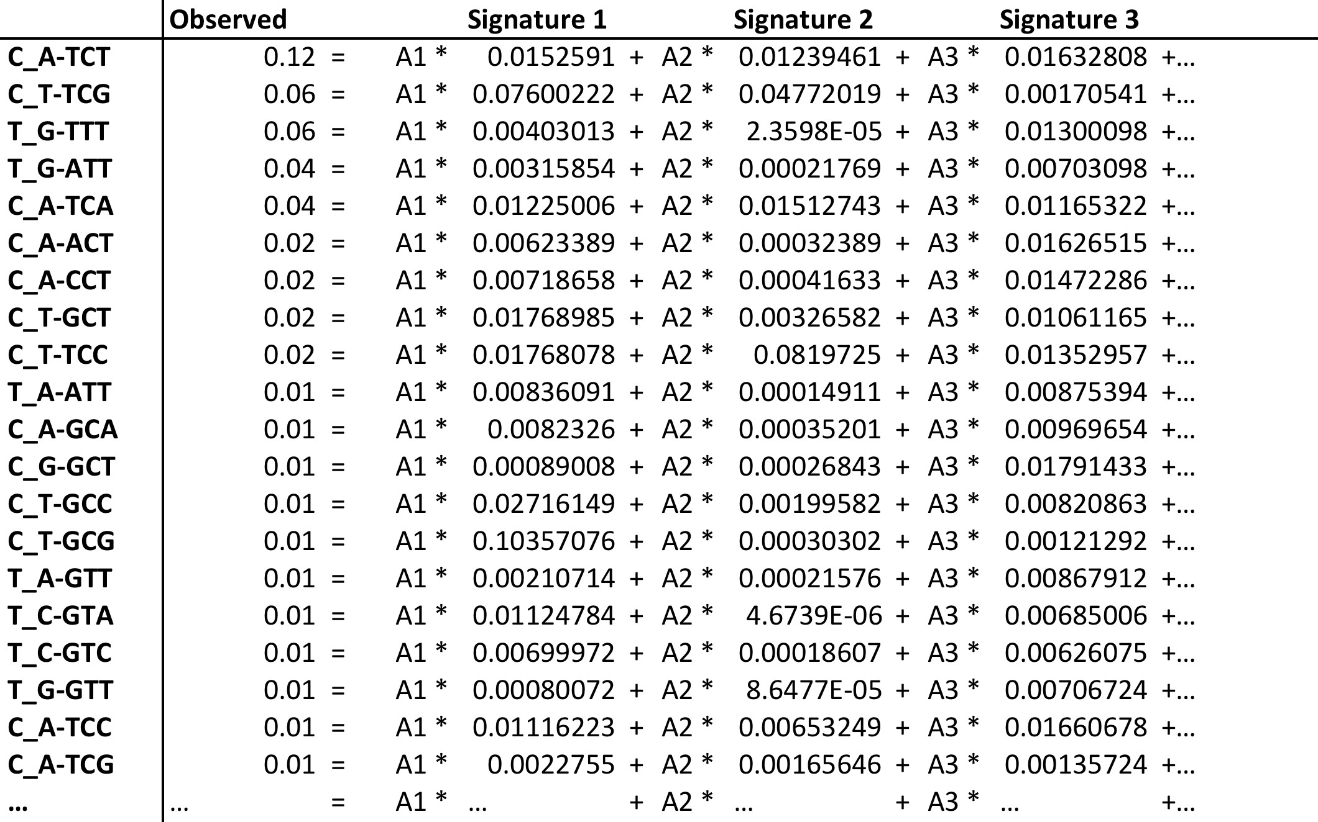
Solving a regression problem with constraints
Where A>=0, B=0 and A1+A2+…A30=1

Slide 6
With package QuadProg in r
Patient 007aab66-2f07-459d-8952-3041d6ea24a8_sigs
Clone 2
Clone 1

Slide 7
Prioritize mutations based on change in Signatures
Frequency t
Fr(t)
Time y
Time x
Mutation M
n previous mutations
k following mutations

Slide 8
Basically compare any two groups of mutations A vs B
Deconvolute both as a mix of 30 signatures
Regress the mutational probabilities of group B into group’s A signatures (obtain R and p values)
Measure the change in entropy

Slide 9
Mutational impact on r (P. correlation) and δE
Patient: 1f8d8720-30ca-4057-90f7-a34b8383eafe
Correlation:
Bin_{X} vs Bin_{X-1}
Mut Freq
Mut dE:
Bin_{X} vs Bin_{X-1}
Ordered mutations based on Mut Freq

Slide 10
Change vs Win0 (fut. germline)
003819bc-c415-4e76-887c-931d60ed39e7
Mutational Windows based on mut freq
Time
1f8d8720-30ca-4057-90f7-a34b8383eafe

Slide 11
Future perspective
4 bins (germline vs early vs middle vs late) of mutations for each patient
Compare across

