Slide 1
Variant Calling Pipeline and Analysis for 85 Liver Cancer Samples
Jayanth (Jay) Krishnan

Slide 2
Next Steps
Last time, we compared the variant calling results from mutect, strelka and the literature
Now:
Intersect Mutect and Strelka Variants
Filter Variants
Run Funseq
Run Larva
Analyze Results

Slide 3
Prior to filtering
Total Mutect Variants = 2,074,665
Total Strelka Variants = 9,961,332
Total Common Variants between Methods = 1,503,357
Common Variants/Total Mutect = 72.46%
Common Variants/Total Strelka = 15.09%
2.3% of Mutect Variants are Coding
4.4% of Strelka Variants are Coding

Slide 4
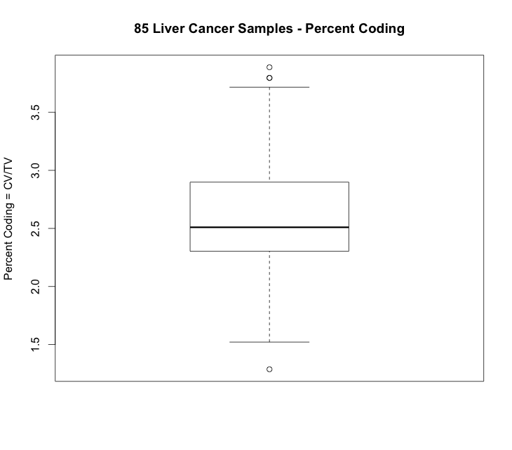

Slide 6
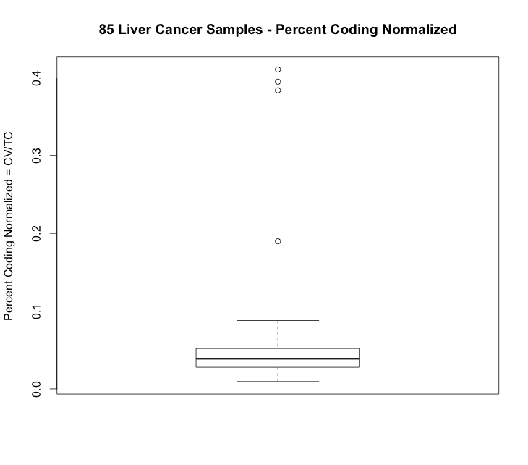

Slide 7
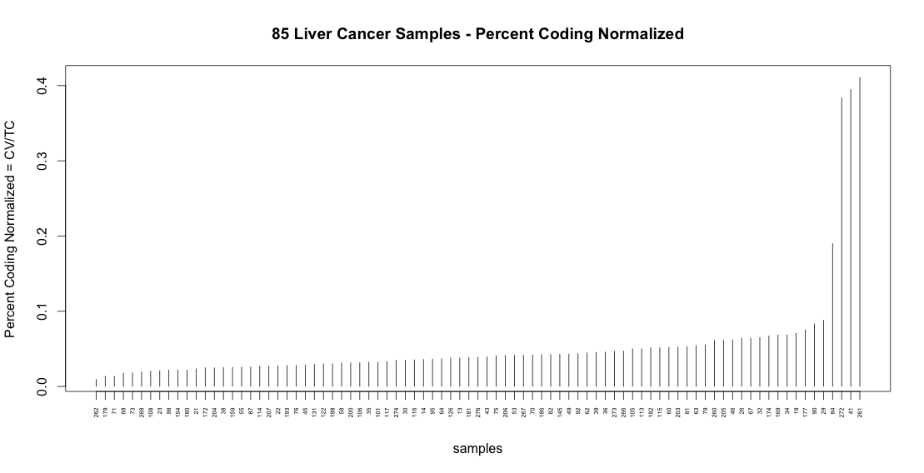

Slide 8
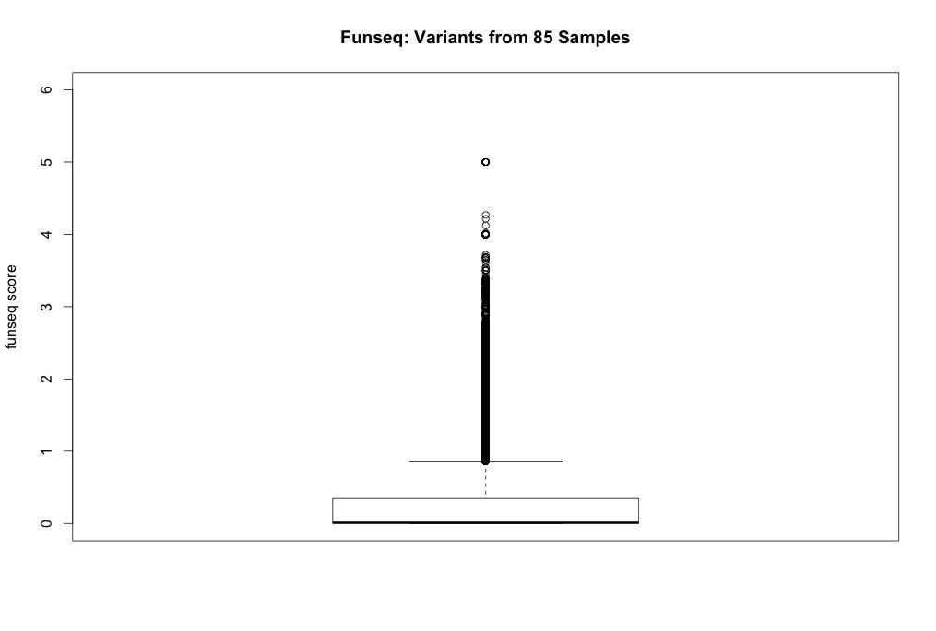

Slide 9
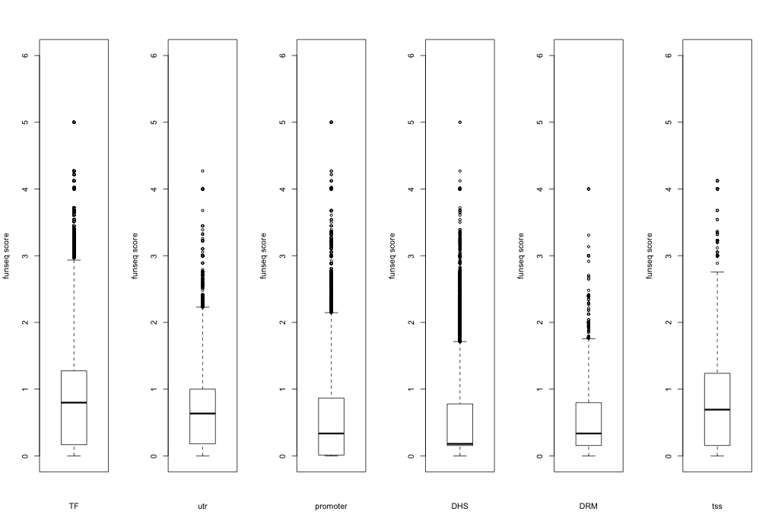
6 Noncoding Flavors of Funseq

Slide 10
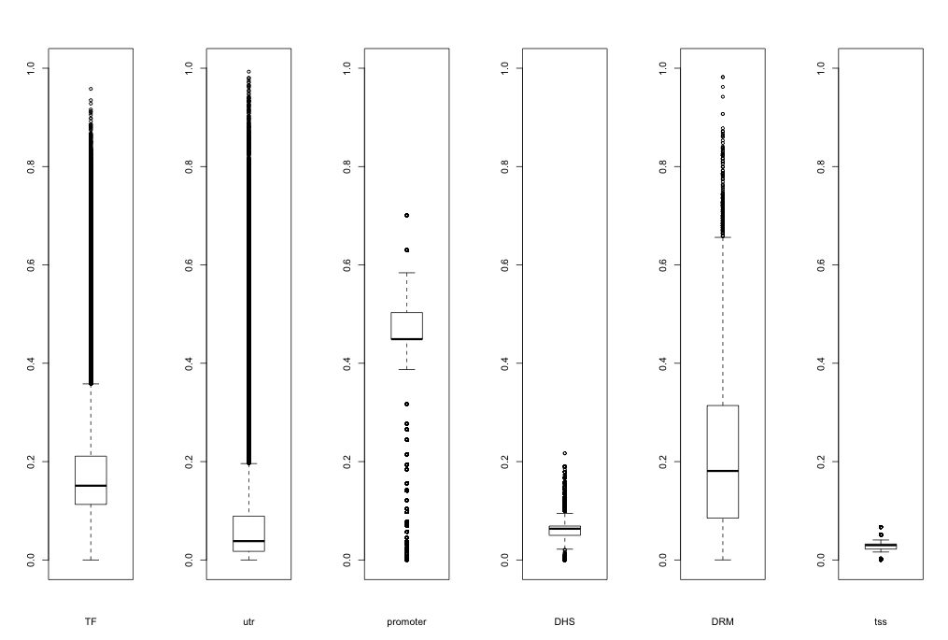
6 Noncoding Flavors of Larva (unadjusted)

Slide 11
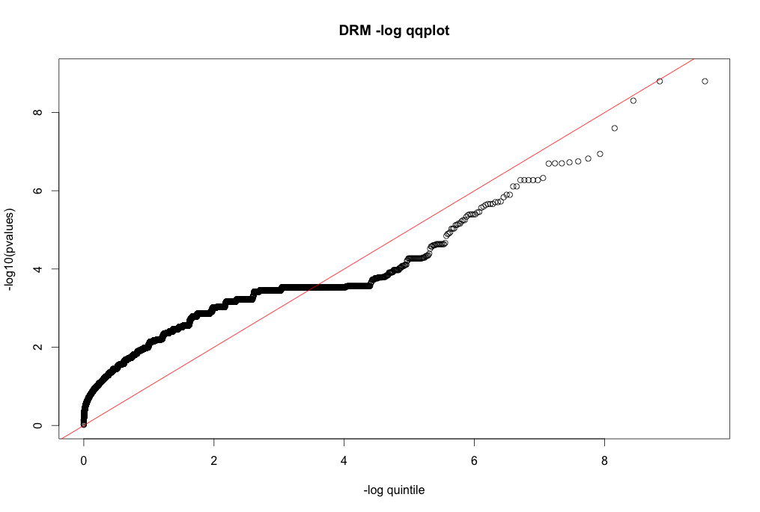

Slide 12
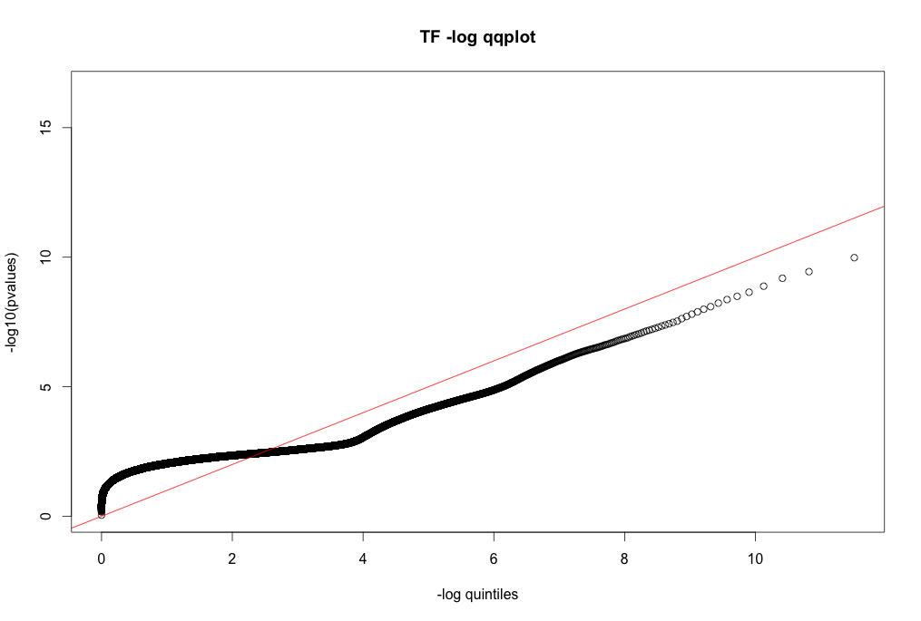

Slide 13
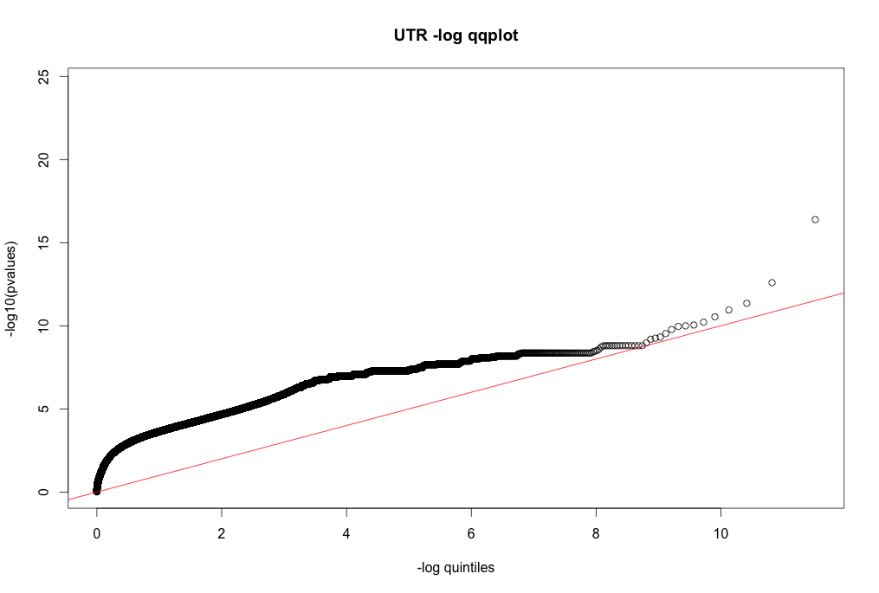

Slide 14
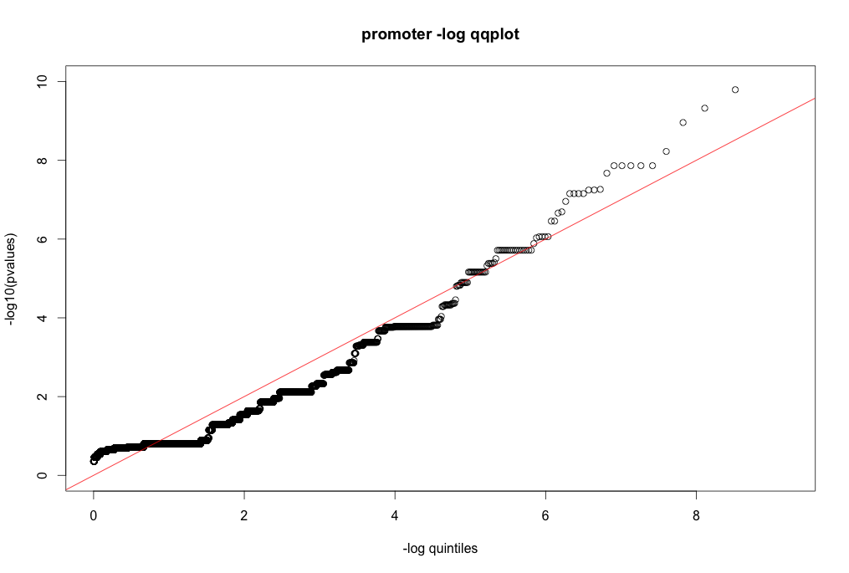

Slide 15
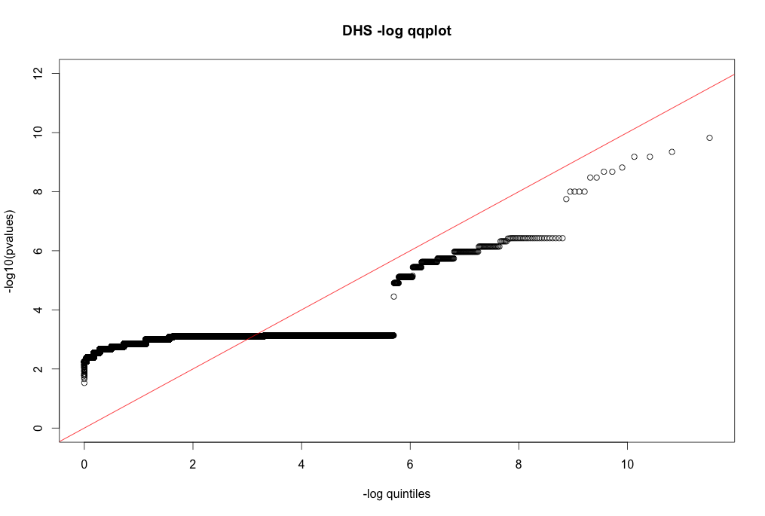

Slide 16
