Slide 1
PEC capstone
SL/DW
July 26 2016

Slide 2
Work flow
1. diff. exp. genes between normal cortex and other brain regions (GTEx) or dev. genes (Brainspan)
2. Map these genes to PEC and CMIND data, find their expression levels vs. associated SNPs (genotype), esp. eQTLs
3. Explain gene regulatory mechanisms for found eQTLs if any => reg. QTLs
Notes:
Gtex(brain vs other organ)

Slide 3
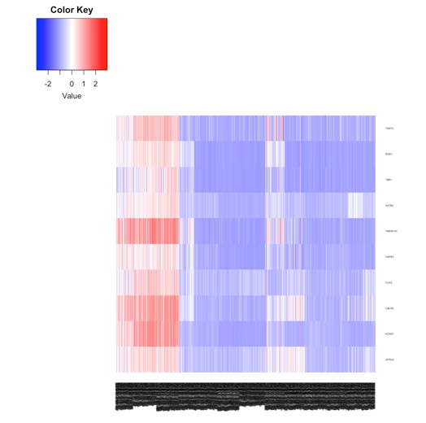
DEX brain cortex genes (vs. other regions) in GTEx V6
Cortex related samples
Other brain regions samples
p<0.008
SATB2 chr2:200134223-200322819 Cleft palate and mental retardation
(263) (285)

Slide 4
Potential SNP(s) driving SATB2 expression difference
Associated GWAS SCZ SNPs
…
rs895526
…
SATB2 -chr2:200161422-200309252 Cleft palate and mental retardation

Slide 5
Raw Genotype Calls
SNP QC using PLINK
SNP imputation using IMPUTE2
Expression
Covariates
Matrix eQTL or FastQTL
eQTLs

