Slide 1
Encyclopedia Update
July 22, 2016
Jill Moore, Michael Purcaro, Henry Pratt and Zhiping Weng
Weng Lab
UMass Medical School

Slide 2
Registry of Candidate Regulatory Elements
Candidate regulatory elements are anchored on DNase master peaks generated by Stam lab
We annotated candidate REs with information such as closest gene, enhancer-like activity, promoter-like activity etc.
Users will be able to search and filter candidate REs based on many different features
Last Call Presentation: https://docs.google.com/presentation/d/1_MZRjxWynaW_DwU9JStkQTB-SI3hmaz6a3GoJYh5YGQ/edit?usp=sharing

Slide 3
Incorporating Suggestions from Last AWG Call
Gene information: currently include closest gene (by TSS) but include additional information such as TAD boundaries and GREAT style gene assignment
Heatmaps depicting expression of nearby genes or activity of candidate REs
Incorporate methylation data

Slide 4
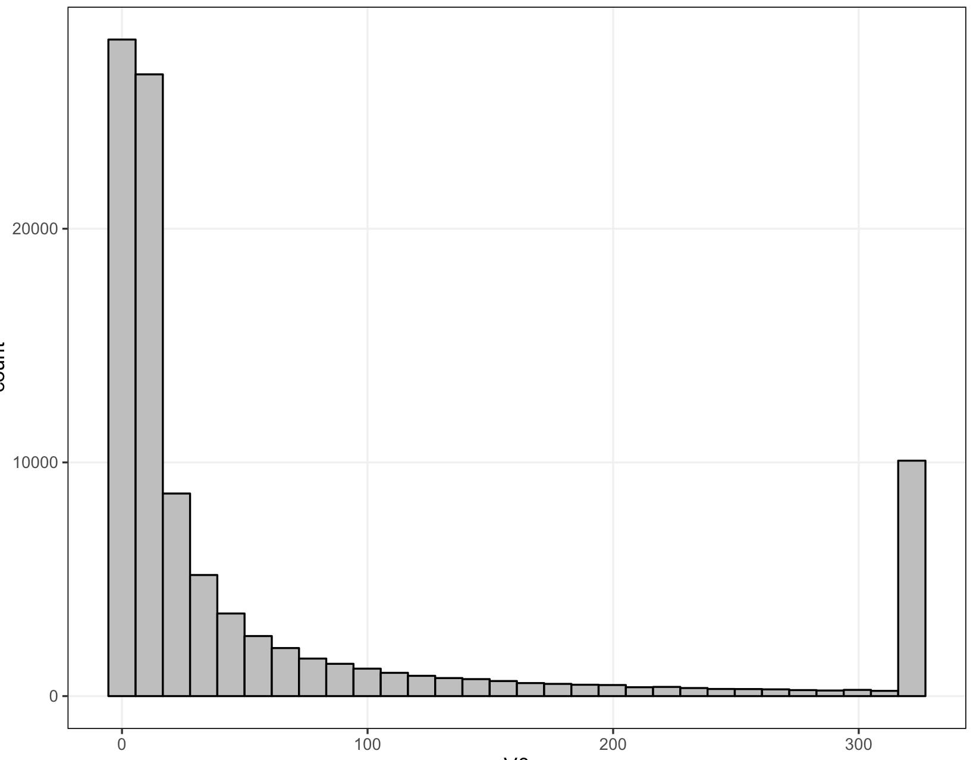
P-value Distribution of Master Peaks
Cutoff | # Peaks
All Peaks | 4,193,929
-log(P) > 10 | 2,318,714
-log(P) > 15 | 1,982,968
-log(P) > 20 | 1,767,421
100K Randomly Selected Master Peaks
-log(P-value)

Slide 5
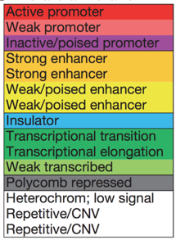
Overlap with ChromHMM States
15 State model
ENCODE Predictions (2012)
Divided candidate REs into two groups:
Proximal < 2Kb from GENCODE TSS
Distal > 2Kb from GENCODE TSS

Slide 6
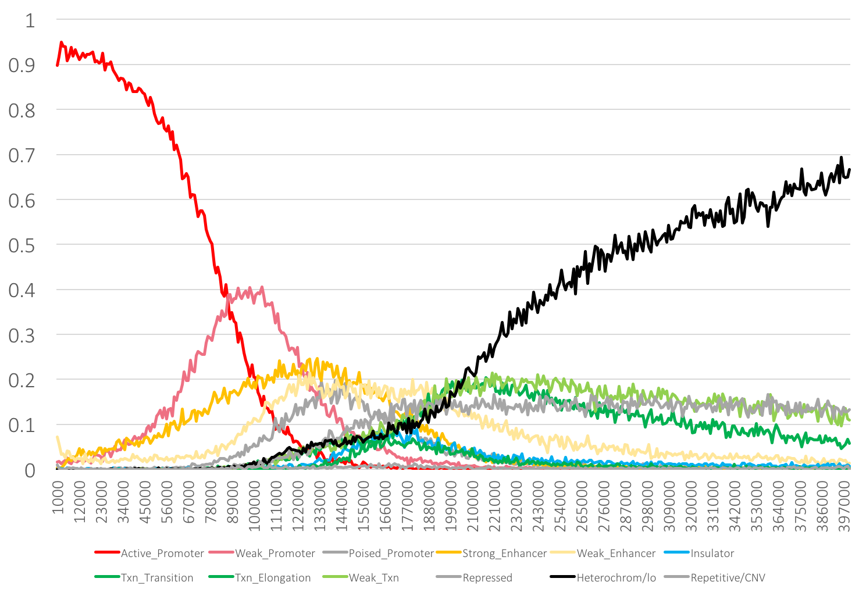
Top 400K Proximal Promoter-like Candidate Regulatory Elements
Active Promoter
Weak Promoter

Slide 7
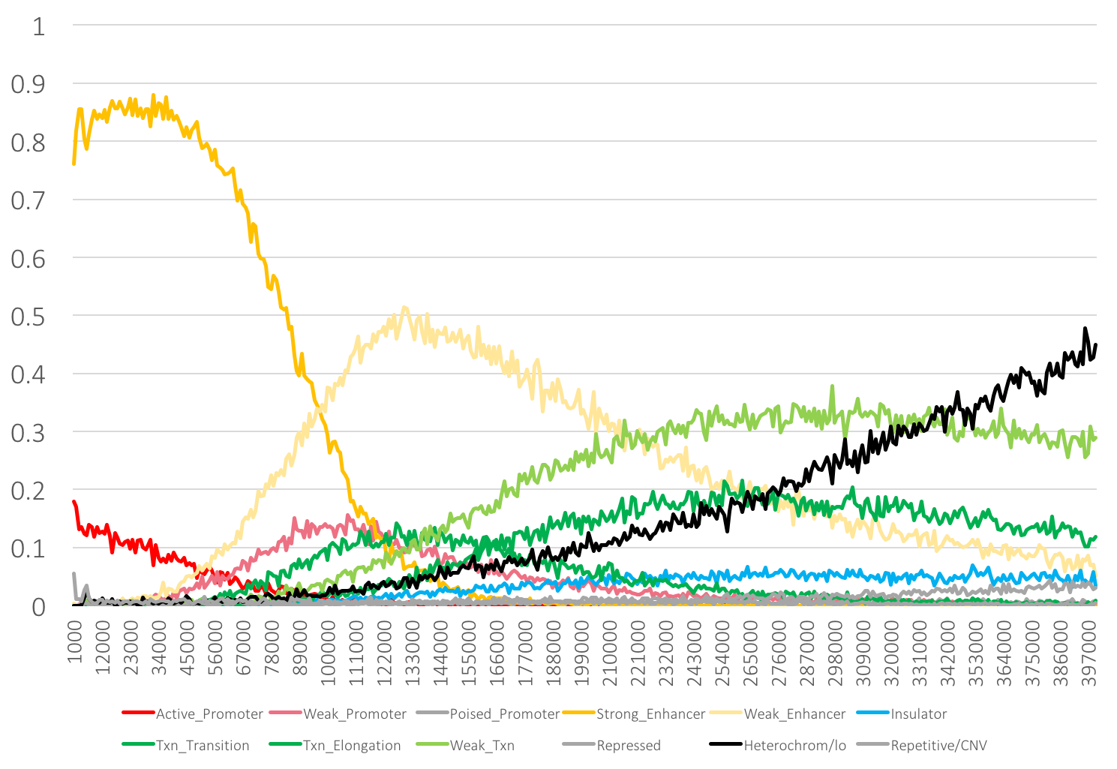
Top 400K Distal Enhancer-like Candidate Regulatory Elements
Strong Enhancer
Weak Enhancer

Slide 8
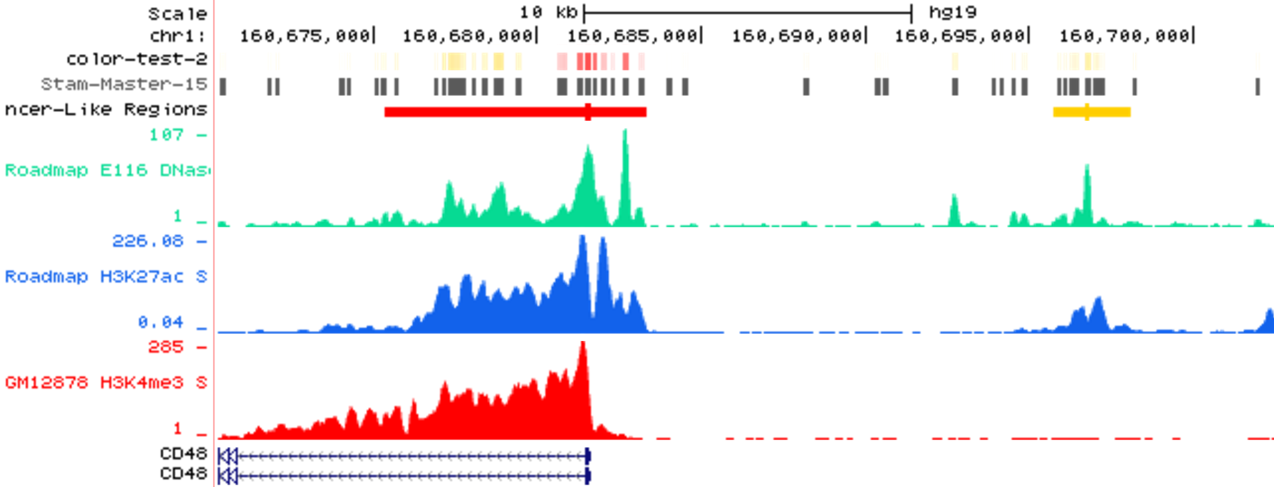
View on Genome Browser
Master Peaks
Master Peaks
V3 Enhancer-like Regions
DNase
H3K27ac
H3K4me3

Slide 9
Progress on Search & Visualization

Slide 10
Incorporating Suggestions for Visualizer
Heatmaps depicting
expression of nearby genes
activity of candidate REs
Incorporate gene expression data
Incorporate TF data
Goals:
Candidate regulatory element-centric viewer
Browse and explore candidate REs in several different ways

Slide 11
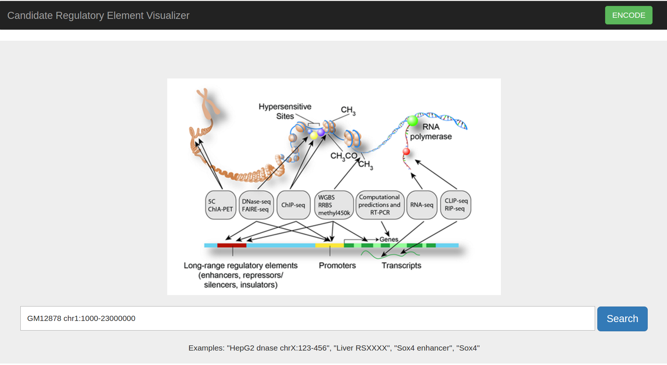
Visualizer Prototype: Search Page

Slide 12
Visualizer Prototype: Search Page: Autocomplete
Search keyword autocomplete for:
Genes
SNPs
Cell types
Tissues
TFs

Slide 13
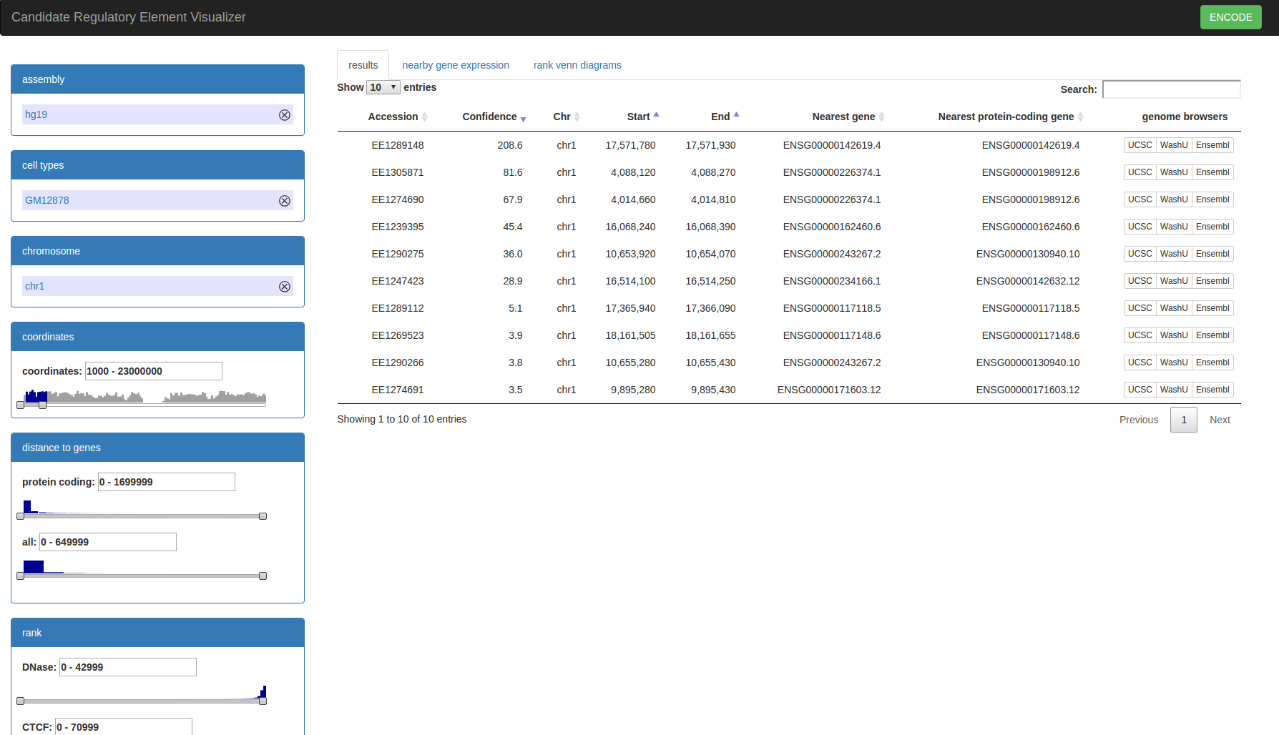
Visualizer Prototype: Results Page
Facets for:
Genome
Cell types
Genomic position
Candidate RE
Distance to nearest gene
Ranks
Results table:
Top 10 candidate REs in region
Genome browser links

Slide 14
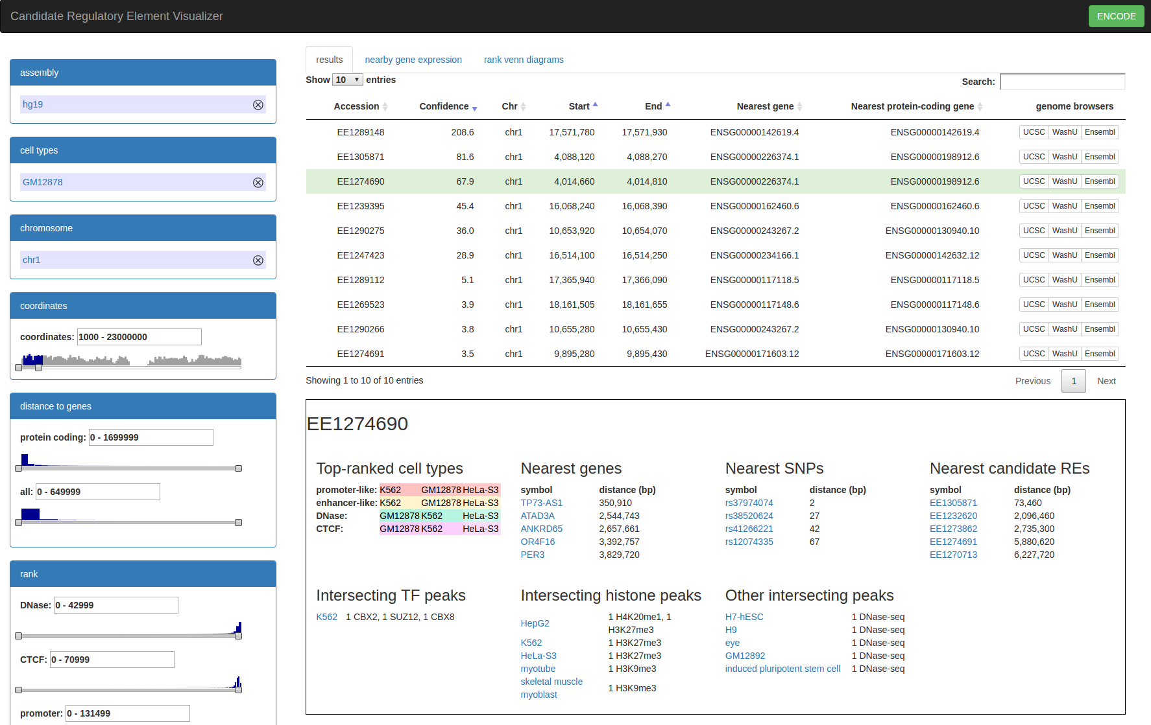
Visualizer Prototype: Candidate RE Details

Slide 15
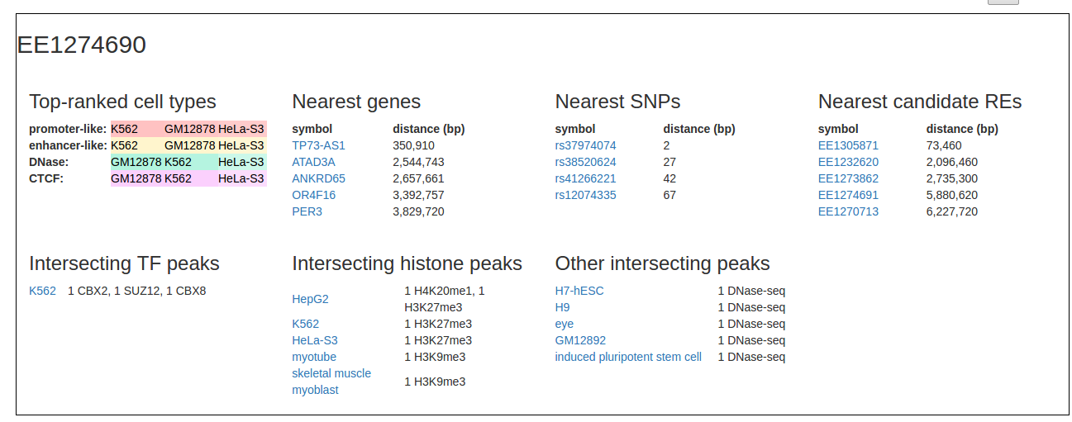
Visualizer Prototype: Candidate RE Details

Slide 16
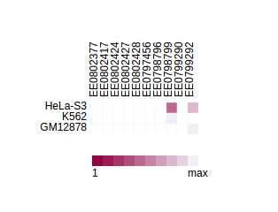
Visualizer Prototype: Heatmaps (D3)
Cell types vs Candidate Regulatory Elements
By gene expression
By enhancer-like/promoter-like/CTCF/DNase/etc. ranking

Slide 17
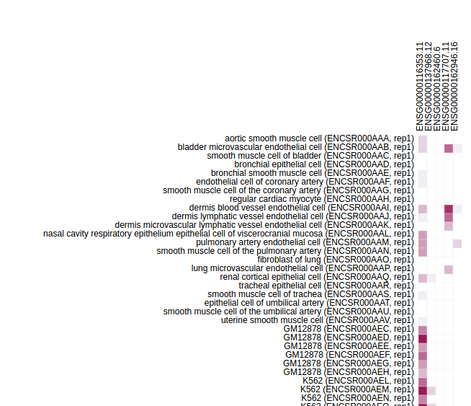
Visualizer Prototype: Gene Expression Heatmaps (D3)
Cell types vs Nearest genes in Candidate REs

Slide 18
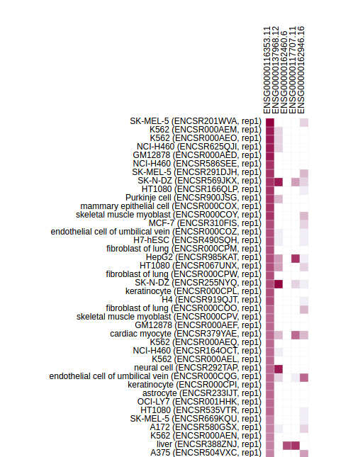
Visualizer Prototype: Gene Expression Heatmaps (D3)
Cell types vs Nearest genes in Candidate REs
D3 Heatmap → sortable!

Slide 19
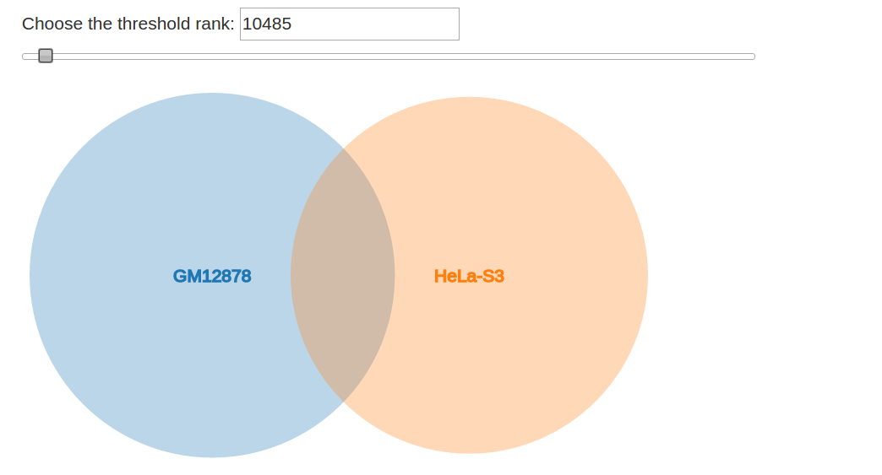
Visualizer Prototype: Candidate RE Overlap (D3)
Venn diagram for overlap of Candidate REs across cell types

Slide 20
Additional Slides

Slide 21
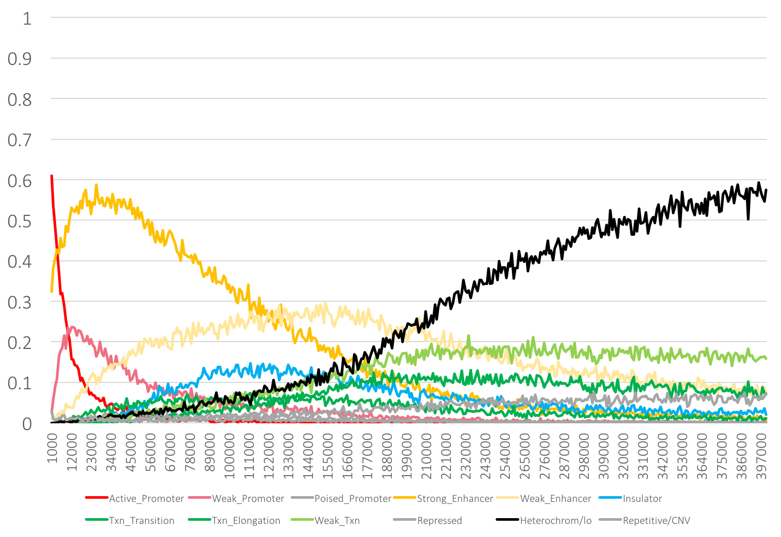
Top 400K Distal Promoter-like Candidate Regulatory Elements
Strong Enhancer
Weak Enhancer

Slide 22
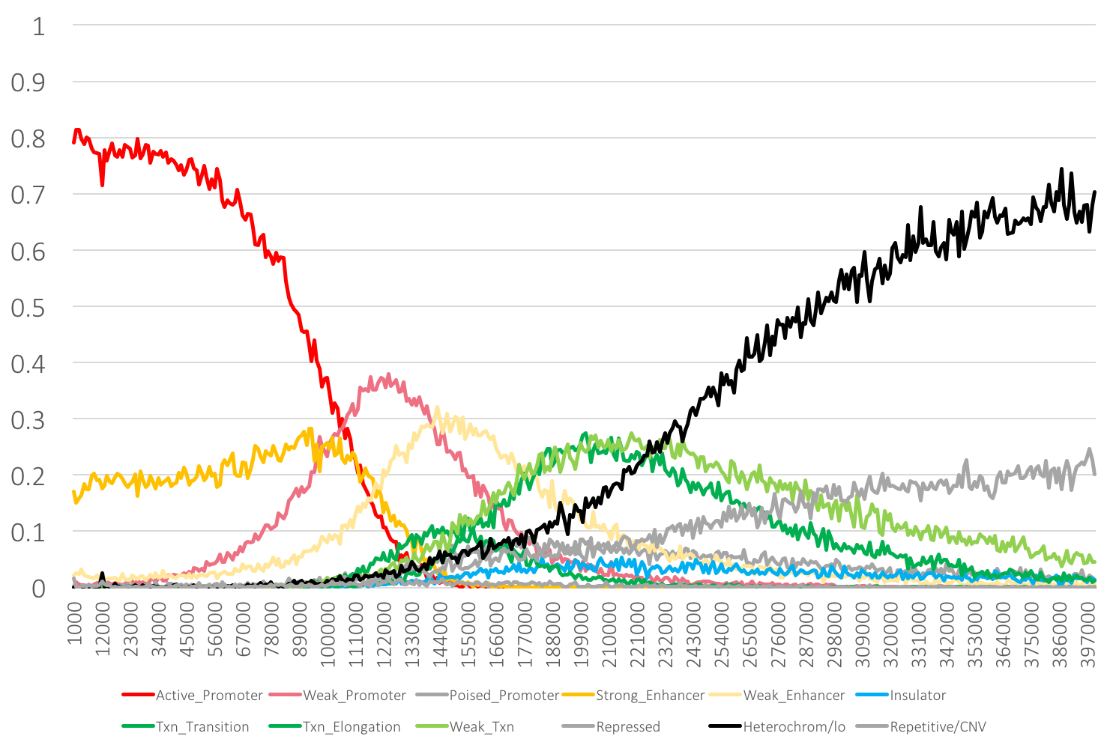
Top 400K Proximal Enhancer-like Candidate Regulatory Elements
Active Promoter
Weak Promoter

