Slide 1
VINAS: an integrative tool for Variant Impact BurdeN AnalysiS
JZ & AG & LL
ENCODE Cancer

Slide 2
First of all,
Pardon our appearance while we build for the future

Slide 3
Reflection after LARVA and NIMBus
LARVA: heterogeneity across different replication timing regions (no sample concept)
NIMBus: heterogeneity across samples and regions, more accurate mutation rate estimation by integrating multiple covariates
What is the missing part in these methods? Motivation of VINAS
  Importance difference in the local region
    Blue and yellow set of variants locate in different regions of enhancer
    Blue set should have higher P value than the yellow set
Predicted Enhancer Region
Double peak for H3K27ac
  Local context effect:
    In some cancer, like lung cancer, C->T has much higher mutation rate than A->T
  Higher resolution to dissect the mutational heterogeneity landscape

Slide 4
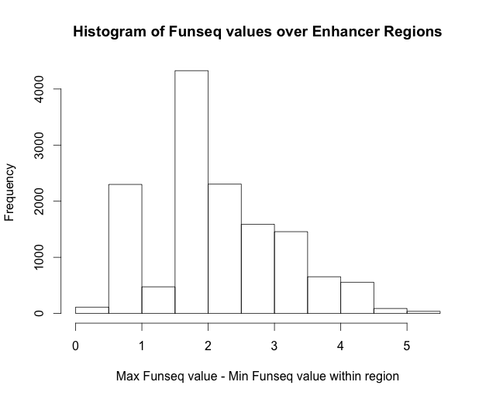
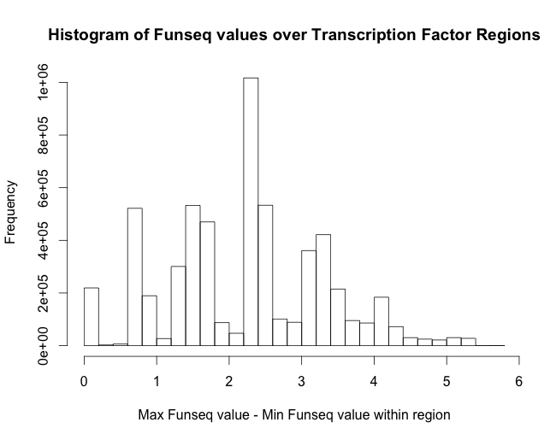
Local importance heterogeneity
Enhancers
13896 regions
Median: 1.824
Mean: 2.122
TFBS
5713276 regions
Median: 2.227
Mean: 2.206

Slide 5
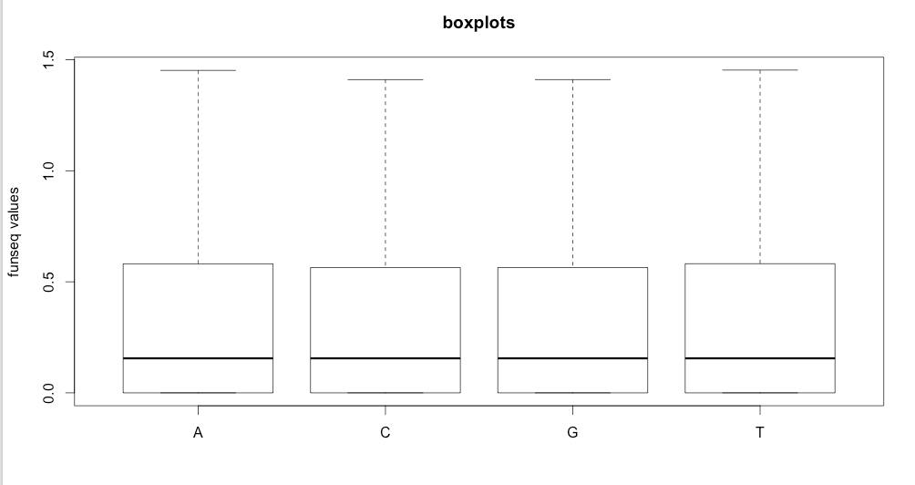
Slight difference of Funseq scores among different bases

Slide 6
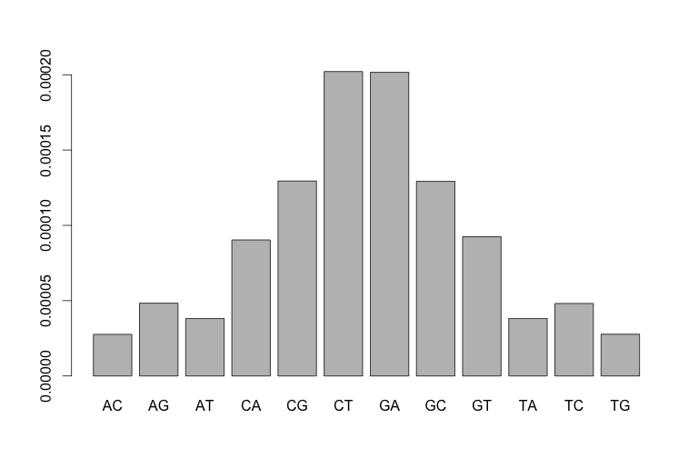
Local context effect on BMR
Model introduction: k-mer model
1mer: A->[T/C/G], G->[A/C/T], C->[A/T/G], T->[A/C/G] 4*3=12 types
3mer: 4*4*4*3 = 192 types
NAN->[T/C/G], NGN->[A/C/T], NCN->[A/T/G], NTN->[A/C/G]
5mer: 4*4*4*4*4*3 = 3072 types
NNANN->[T/C/G], NNGNN->[A/C/T], NNCNN->[A/T/G], NNTNN->[A/C/G]
Mutation rate definition:
All calculations are after blacklist region removal

Slide 7
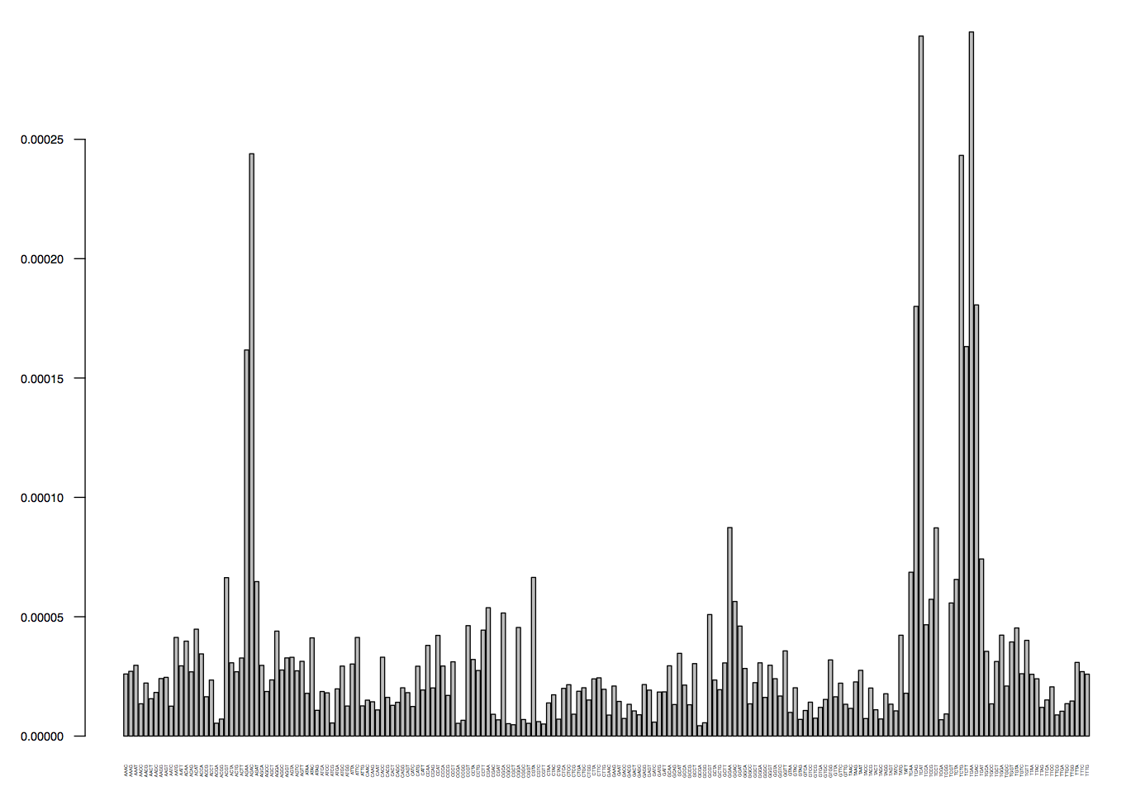
Local context effect on BMR, 3mer
Mutation rates difference up to several order

Slide 8
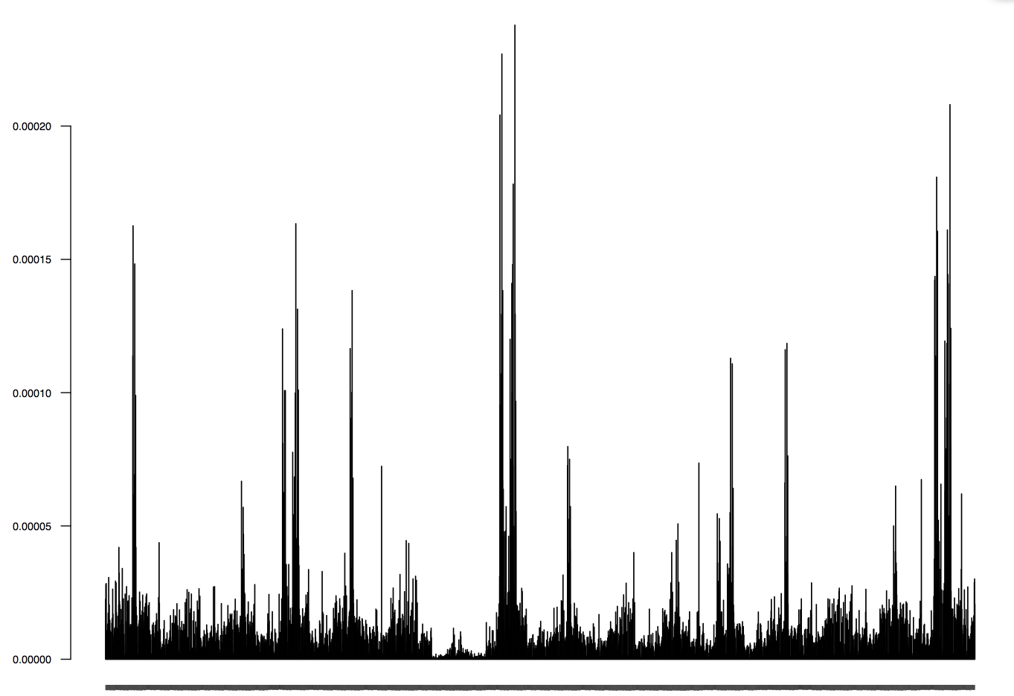
Local context effect on BMR, 5mer

Slide 9
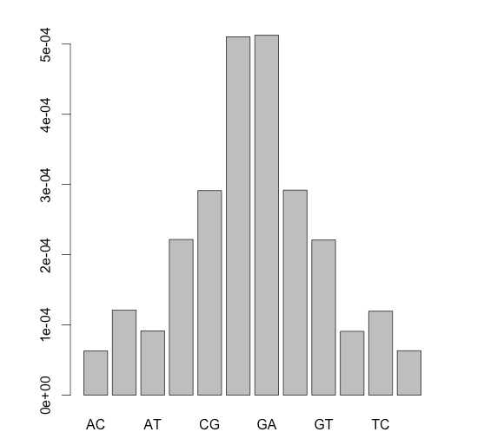
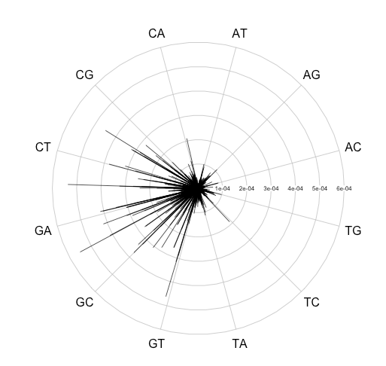
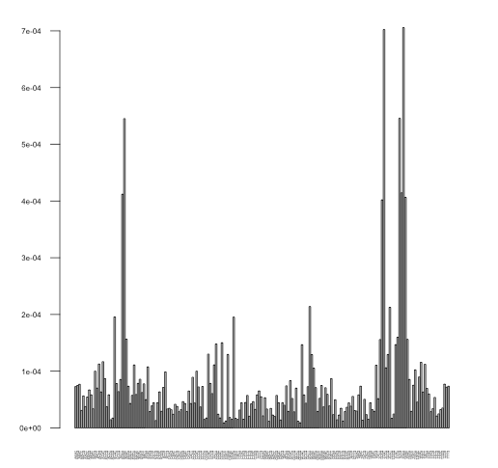
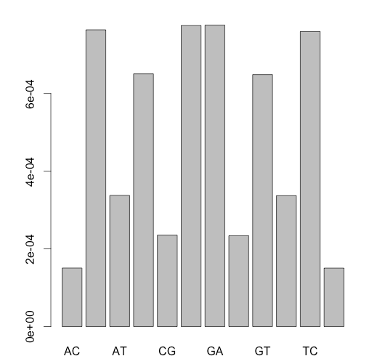
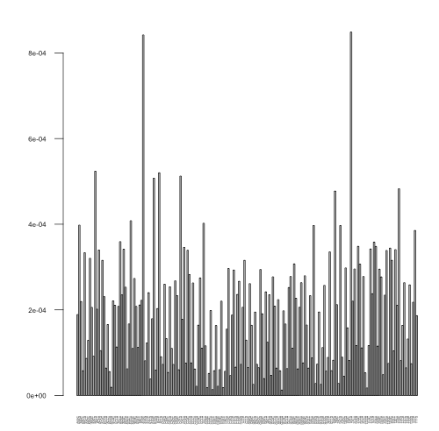
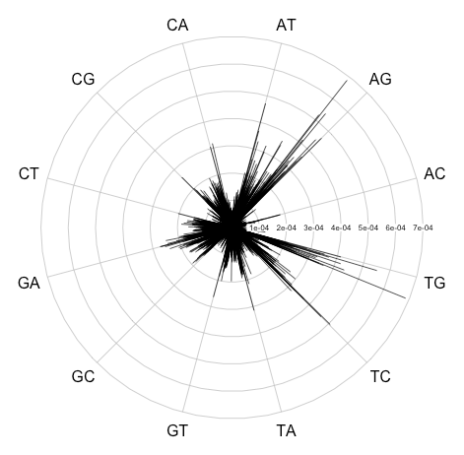
Local context effect is different among cancer types
Breast Cancer 1mer & 3mer
Liver Cancer 1mer & 3mer

Slide 10

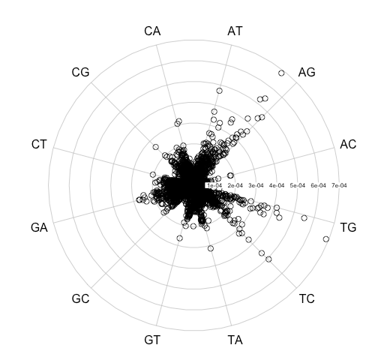
Local context effect is different among cancer types
Breast Cancer 5mer
Liver Cancer 5mer

Slide 11
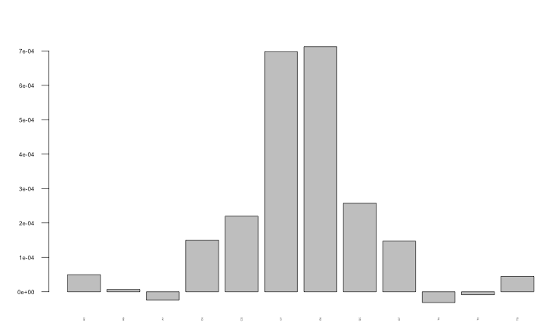
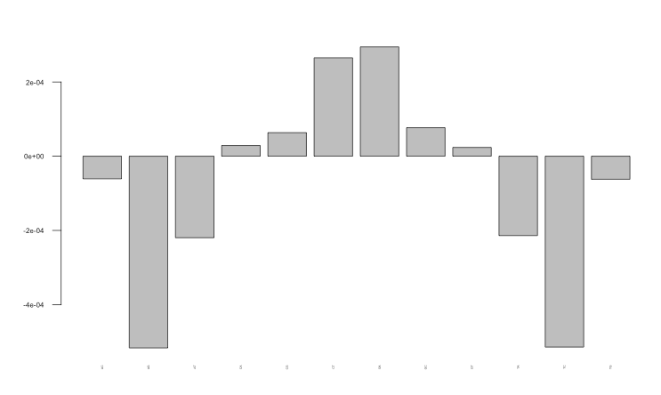
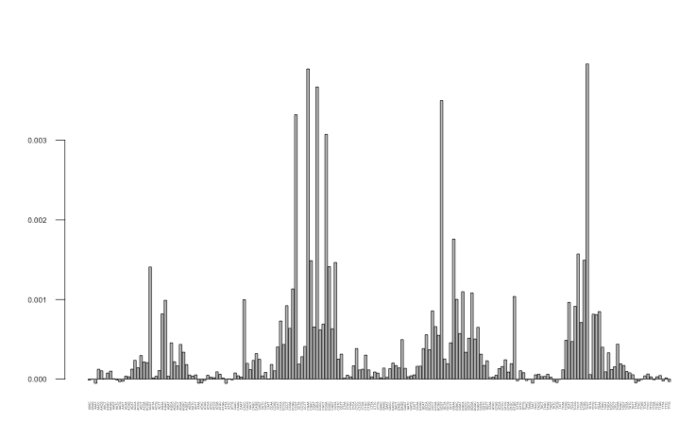
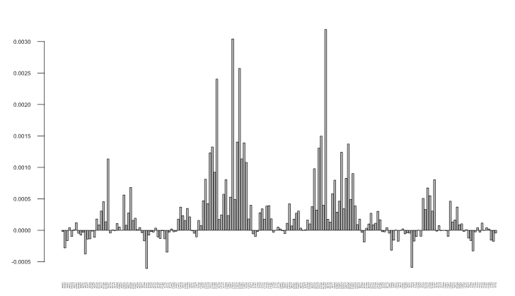
Larger Scale covariate effect also affect BMR
MutRate_CpG – MutRate_nonCpG
Breast Cancer
Liver Cancer

Slide 12
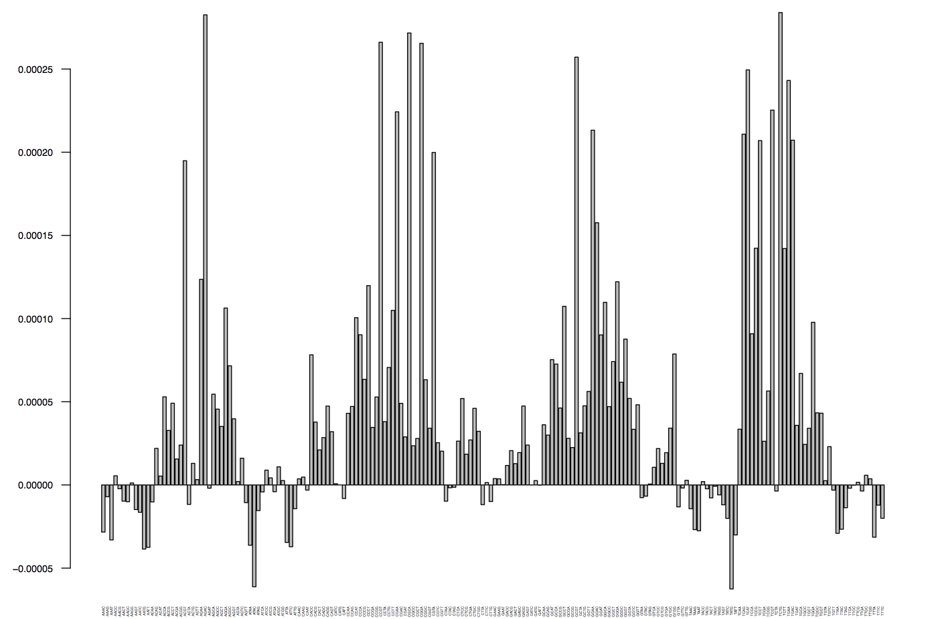
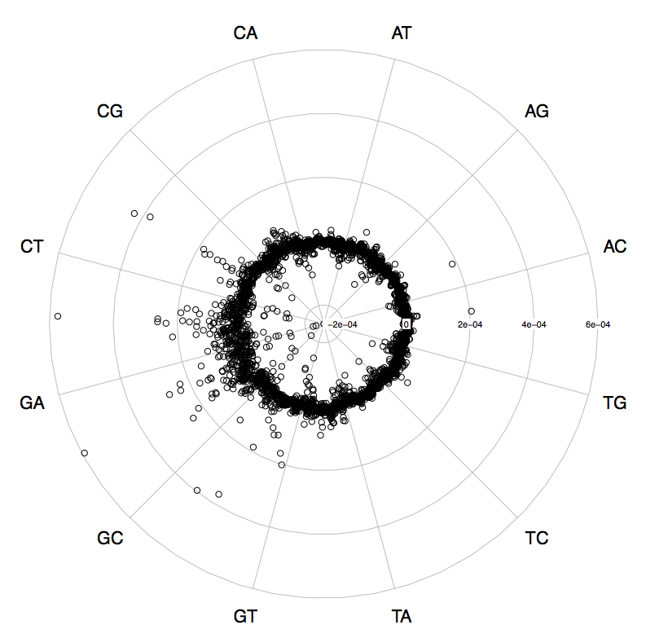
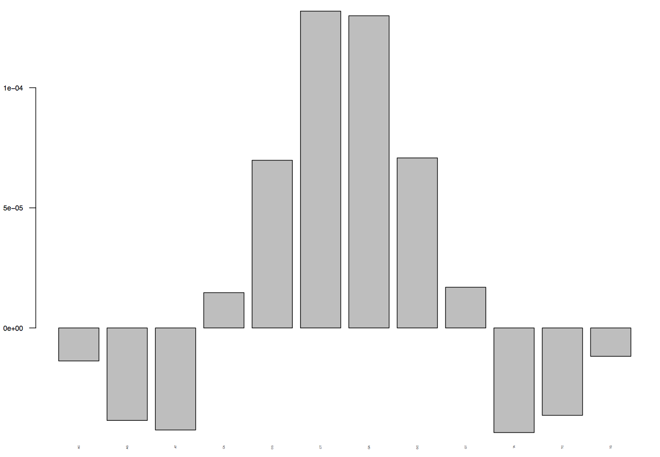
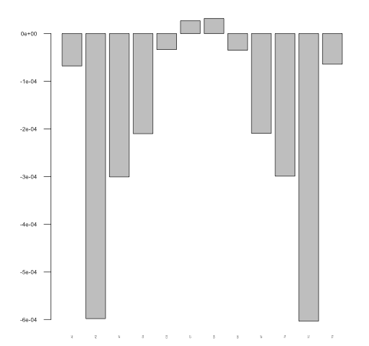
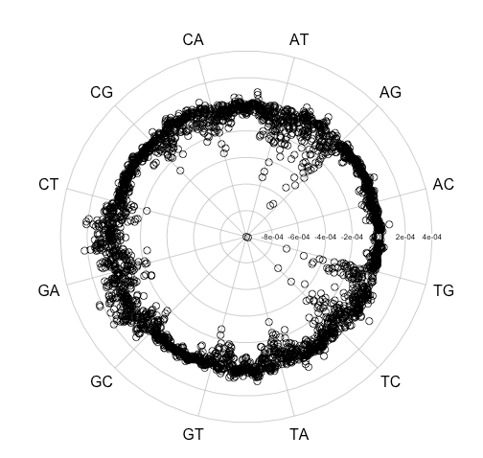
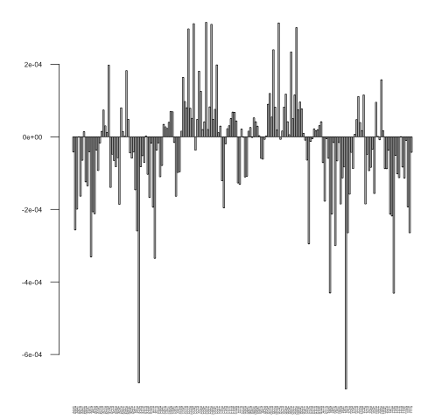
Larger Scale covariate effect also affect BMR
MutRate_top_20%GC – MutRate_bottom_20%GC
Breast Cancer
Liver Cancer
Breast Cancer

Slide 13
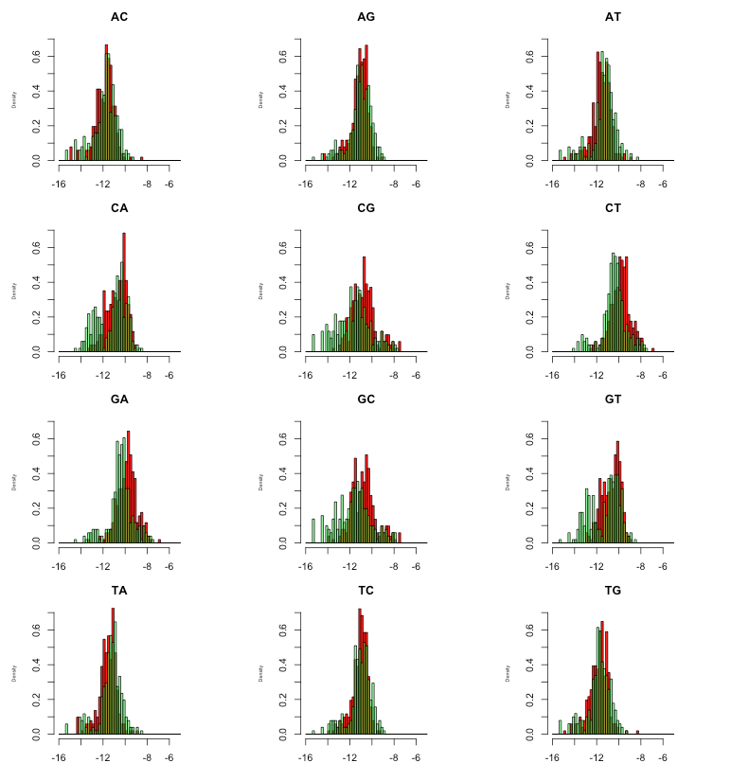
Breast Cancer
Red: top 20% GC
Green: bottom 20% GC

Slide 14
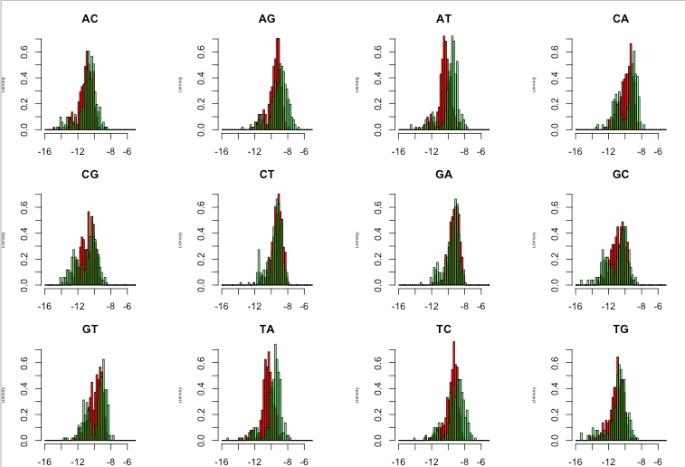
Liver Cancer
Red: top 20% GC
Green: bottom 20% GC

Slide 15
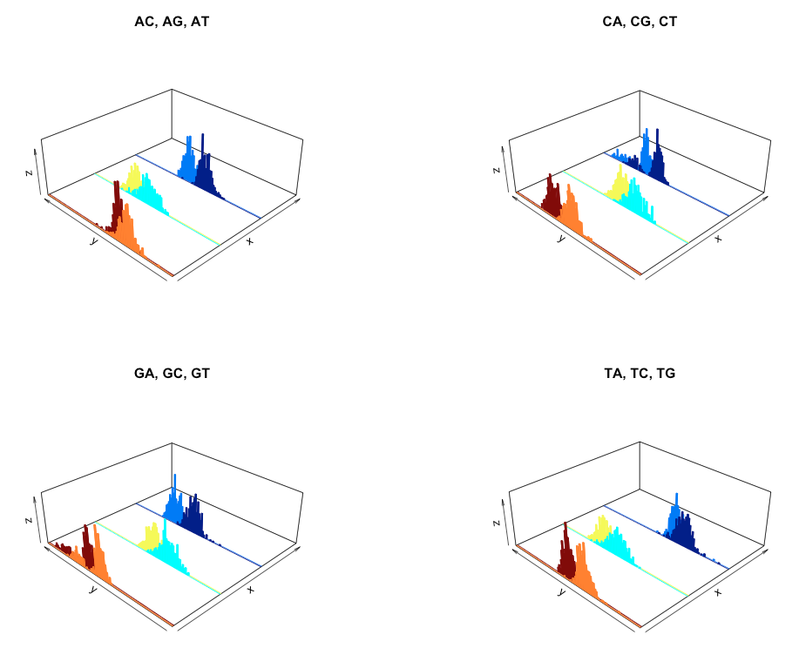
Liver GC effect

Slide 16
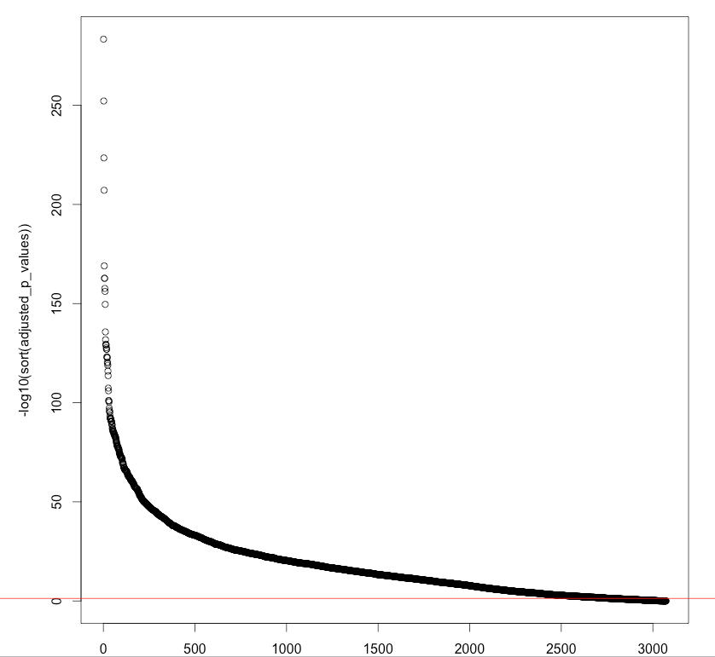
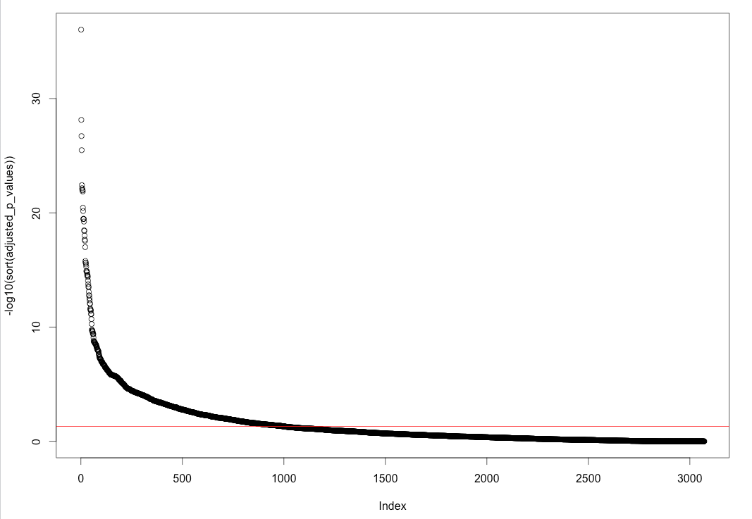
Binomial test of mutation rate of top and bottom 20 GC bins
Breast Cancer
Liver Cancer

Slide 17
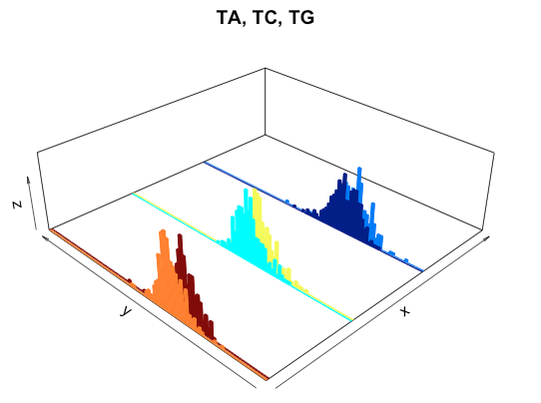
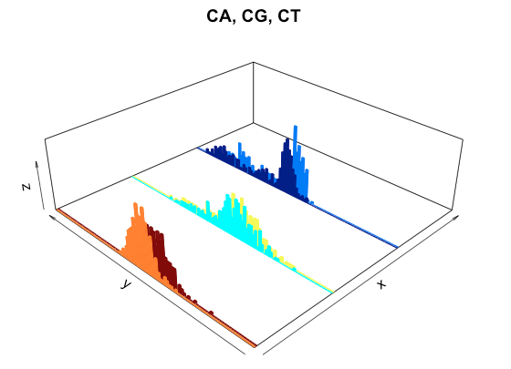
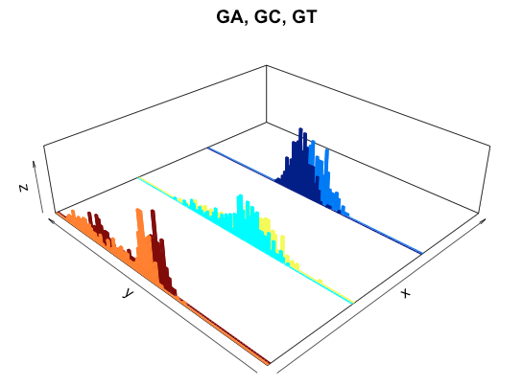
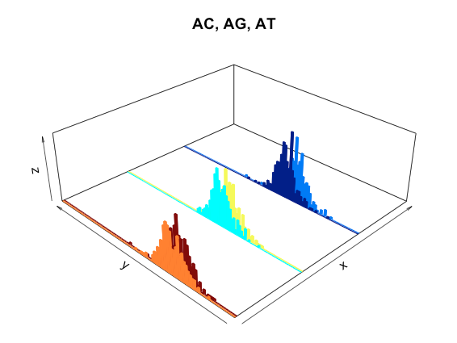
Breast Cancer, Replication Timing, 5mer

Slide 18
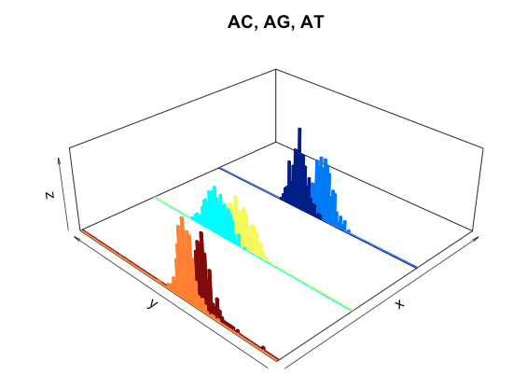
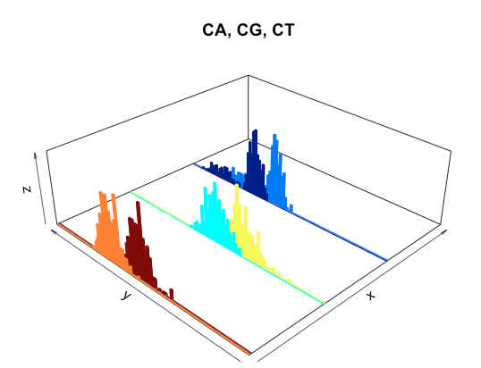
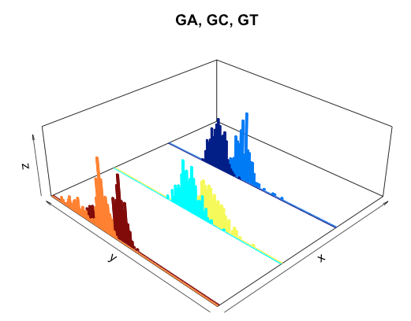
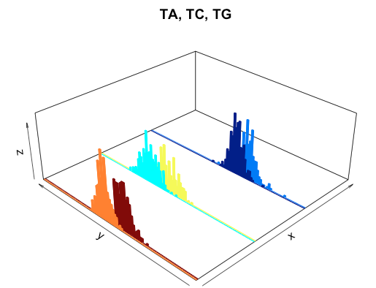
Liver Cancer, Replication Timing, 5mer

Slide 19
What is an ideal burden test tool?
Single nucleotide resolution
Automatic training data selection: no user intervetion
Handle Heterogeneities from multiple sources:
  Local context effect, AGC -> ATC …
  Large scale covariate effect: GC, chromatin accessbility, replication timing...
  Sample & cancer effect: patient specific mutation rate per cancer type
  Local variant impact effect: Funseq or other scores, like conservation

Slide 20
Our VINAS model
Two important part of VINAS:
  Background mutation rate (BMR) estimation at single nucleotide resolution: logistic regression/random forest/kNN/SVM
  Incorporate Funseq score for the impact burden analysis: weighted Bernoulli distribution P value calculation
Recall: k-mer model for BMR
  1mer: A->[T/C/G], G->[A/C/T], C->[A/T/G], T->[A/C/G] 4*3=12 types
  3mer: 4*4*4*3 = 192 types
  NAN->[T/C/G], NGN->[A/C/T], NCN->[A/T/G], NTN->[A/C/G]
  5mer: 4*4*4*4*4*3 = 3072 types
  NNANN->[T/C/G], NNGNN->[A/C/T], NNCNN->[A/T/G], NNTNN->[A/C/G]

Slide 21
Model part 1: BMR estimation
Preprocessing
  Remove positions from two blacklist regions: gap + ENCODE
  No NGN->[A/C/T] differentiation, just NGN->N*N, so 64 models for 3mer, and 1024 models for 5mer
  Logistic regression for each nucleotide for each models separately
  y_{GAT} = 0, if no mutation at a GAT site, y_{GAT} = 1 if there is a mutation at a GAT site
  X_{GAT,j} : j=1,2,…J covariates, may be chromatin accessbility, methylation, mRNA-seq
G
A
T
25nt
25nt
X_{GAT,j} : average over a 51nt window for each covariate
mRNA-seq: log10(x+psuedo_value)

Slide 22
Liver Cancer
300+ samples
3mer analysis for AAC
11 covariates from RMEC
All covariates seem to be significantly associated with mutation rate

Slide 23
Liver Cancer
300+ samples
5mer analysis for CGACG
11 covariates from RMEC
All covariates seem to be significantly associated with mutation rate

Slide 24
Liver Cancer
300+ samples
3mer analysis for AAC
Example of 5 fold cross validation

Slide 25
Liver Cancer
300+ samples
5mer analysis for CGACG
11 covariates from RMEC
Example of 5 fold cross validation

Slide 26


Model part 2: Impact Score incorporation & P value evaluation
For a specific position, it’s local context is GAT, then Y_{GAT,pos}: bernoulli distribution with mutation prob p_{GCT, pos} estimated from the logistic regression model
For any position on the genome, mutation prob can be calculated as in 1) with local context
For one target region with length n, two known vectors
Funseq score:
Mutation probability:
What is the distribution of Z? Poisson Binomial?

Slide 27
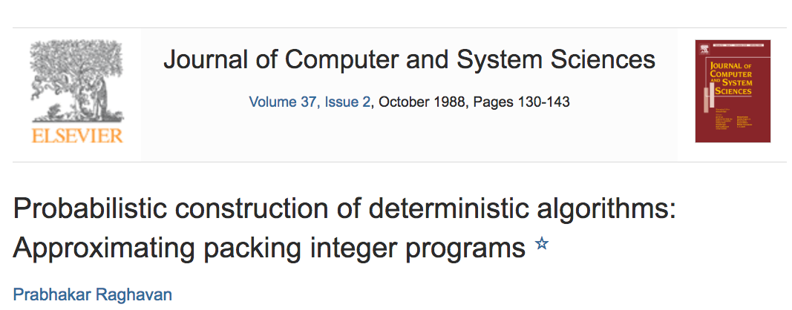
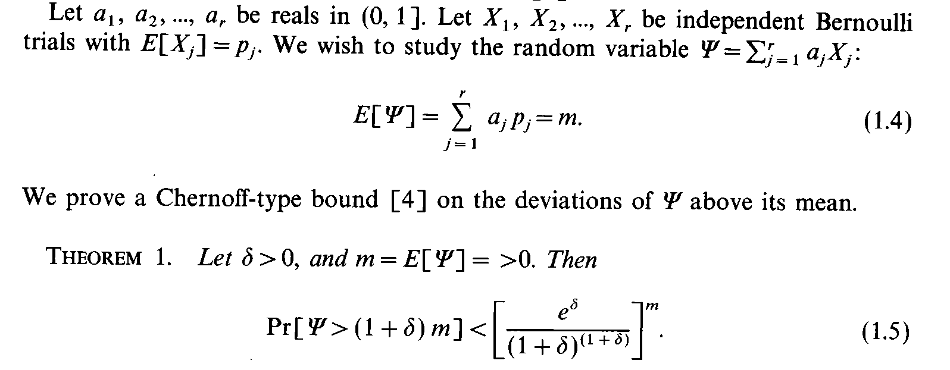

Slide 28
Model part 2: Impact Score incorporation & P value evaluation
Mathematically, calculate a P value for a weighted Bernoulli distribution
Need normalization of the Funseq score, max value set at 4 currently
Provide a upper bound of P value (more strict at this sense)
TSS sites for the protein coding genes
Gencode version 19

Slide 29
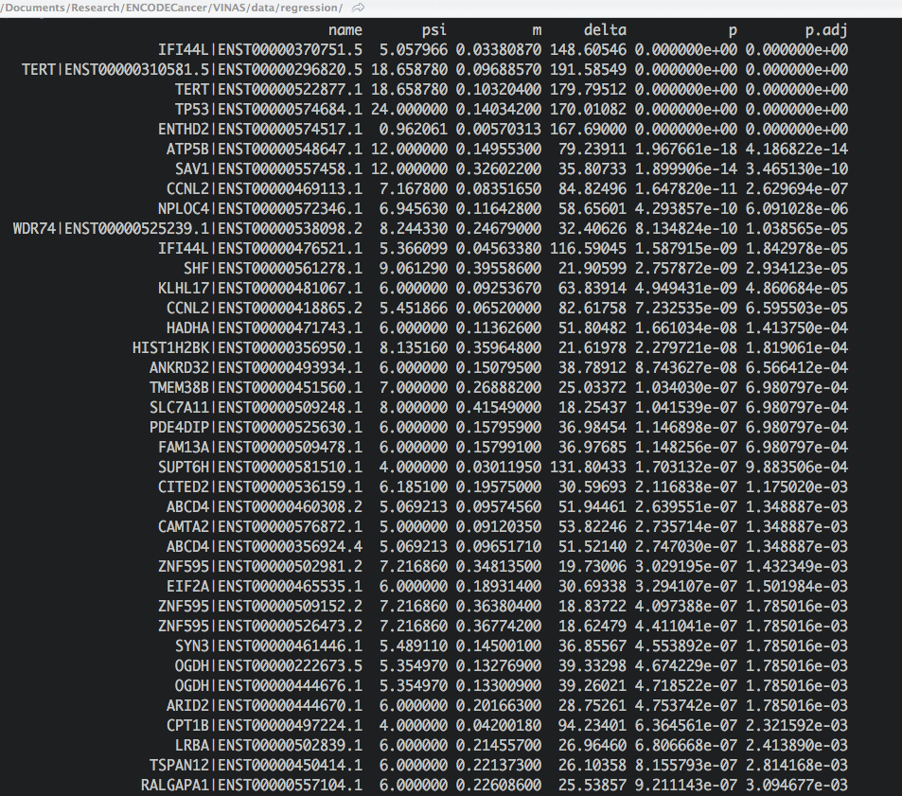

Slide 30
Conclusions
VINAS: burden + impact score
Build up a BMR model:
  local context effect + larger scale covariate effect
  Single nt resolution
  Handle covariate effect heterogeneity
Use a weighted Bernoulli distribution as the test statistic
  Chernoff type of bound for P value evaluation

Slide 31
Next Step
Covariate processing
  What covariate to incorporate? This is really big data! > 1.5 billion based to be incorporated into regression model
  Correlated features?
  Covariate bin size effect: 51bp at the moment
BMR estimation
  Prefer non-parametric model
  Complexity is a huge issue
P value calculation
  Funseq normalization

Slide 32
Acknowledgement
JZ designed the project, wrote the core code
AG & LL: local context effect and parallelize the code to all models
SKL: helpful discussion on Funseq scores

