Slide 1
Remapping short reads from iCLIP sequencing
P2 - TECH
Mengting Gu
07/19/2016

Slide 2
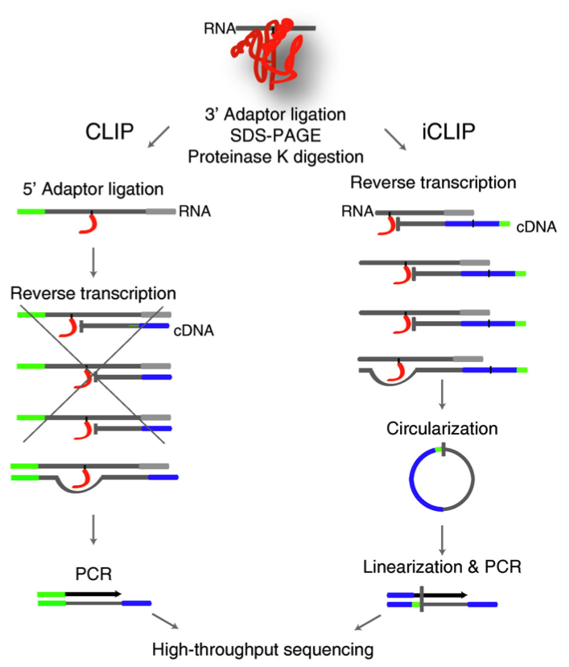
UV crosslinking and immunoprecipitation (CLIP) is developed to understand the protein-RNA interaction.
iCLIP has made improvement on traditional CLIP experiment to allow more precise interacting-site detection.
iCLIP allows short truncated reads to be sequenced through a looping process to add 5’ adapter to the truncation site
A large fraction of short reads coming from iCLIP experiment cannot get uniquely mapped
Goal: To infer the mapping position of multi-mapped reads and more accurate peak calling

Slide 3
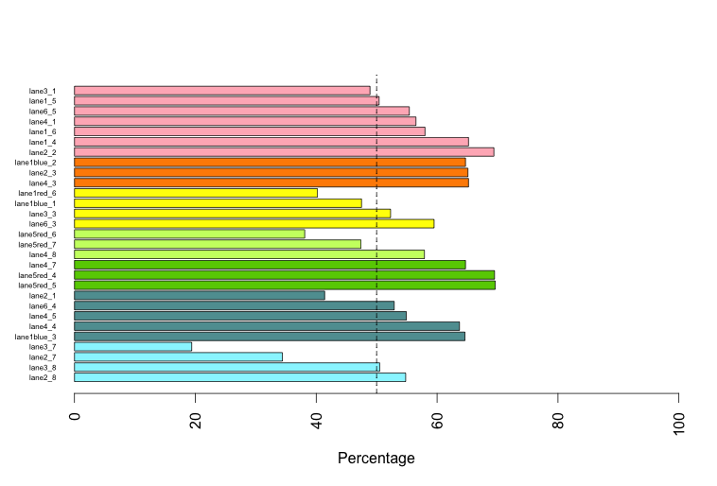
Unique mapping rate of iCLIP experiment data of SR-family proteins

Slide 4
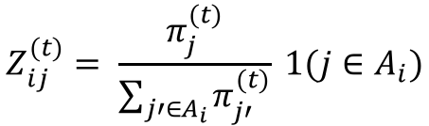
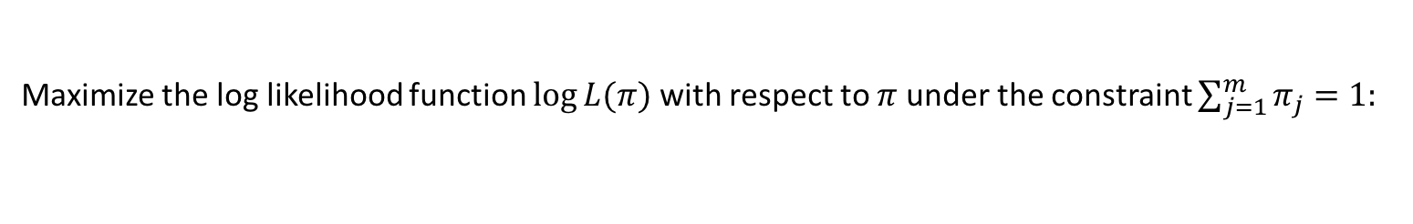
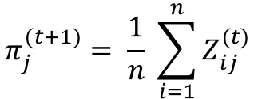
Expectation maximization remapping
Assuming an underline distribution $π$ that generates a set of observed data (reads mapping), from a set of
Unobserved latent values $Ζ$. Derive the maximum likelihood estimate of the hidden values given by:
$$Z_{ij}^{(t)}= \frac{π_{j}^{(t)}}{\sum_{j′∈A_{i}}{π_{j′}^{(t)}}} 1(j∈A_{i})$$
Maximize the log likelihood function $\log{L(π)}$ with respect to $π$ under the constraint $\sum_{j=1}^{m}{π_{j}}=1:$
$$π_{j}^{(t+1)}= \frac{1}{n} \sum_{i=1}^{n}{Z_{ij}^{(t)}}$$

Slide 5
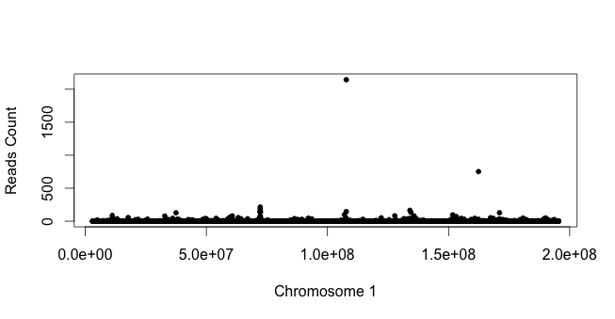
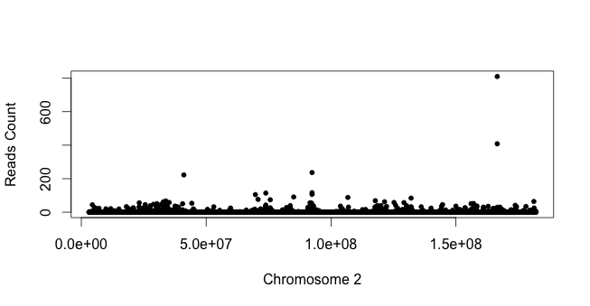

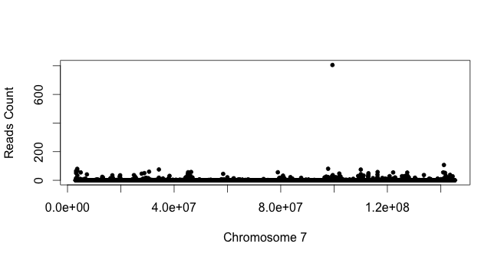

Slide 6
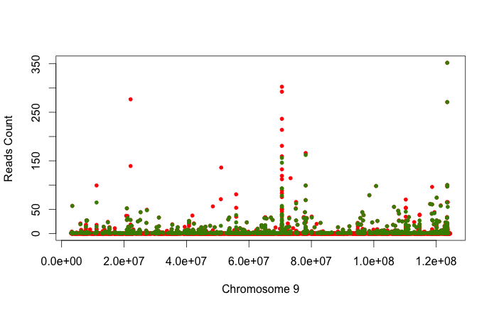
Comparison of unique mapping result and EM mapping result
EM mapping
Unique mapping

Slide 7
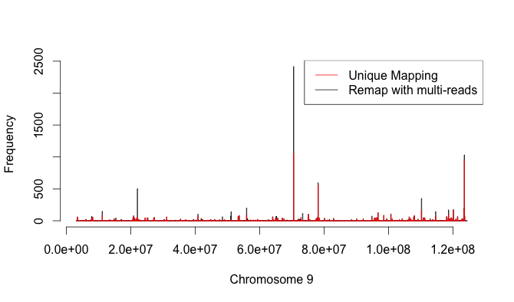
Smoothing mapping result within each bin
Smoothing within bins helps to reveal the signal from the background
Smoothing might lose some resolution

Slide 8
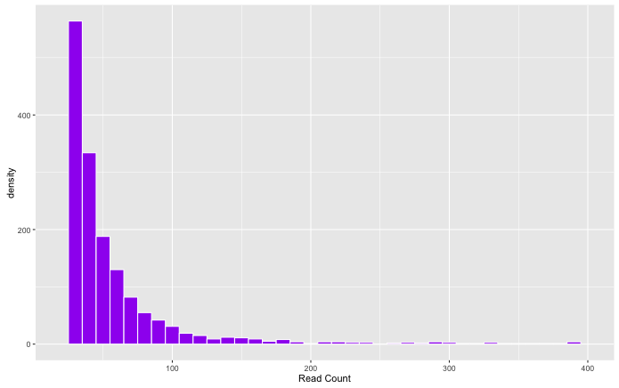
Comparison of unique mapping result and EM mapping result

Slide 9
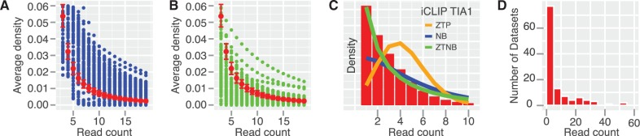
Future direction
Peak calling with RNA-seq normalized data
Significance test with modeled distribution
Motif assisted peak calling
Incorporating truncation site information

