Slide 1
Deconvoluting FunSeq Scores by Functional Element Class
FunSeq
Fun
Paper E etc
Will Meyerson
07-19-2016
Seq

Slide 2
Most noncoding SNVs of interest in Paper E map to two or more classes of functional elements

Slide 3
FunSeq provides variant-specific functional significance scores, but we are often interested in annotation-specific scores
chr17 6617579 6617580 C A 6f395380-c623-11e3-bf01-24c6515278c0 -2.6;No;.;SLC13A5:REG(0.409);.;Enhancer;Yes;.;.;.;.;SLC13A5(Promoter);.;3.0;Yes;.
(3,0) ?
(2,1) ?
(2,2)? (1,2) ?
(0,3)?
e.g: more accurately identify which individual functional elements (such as the TERT promoter) are of greatest functional significance in cancer

Slide 4
Here are my Guiding Principles for solving this problem:
Guiding principle #1: When a variant overlaps with multiple classes of functional elements, the more functionally critical functional element class deserves a greater share of the score.
Motivated method #1: We can best assess the relative functional criticality of different classes of functional elements by appealing to the distribution of FunSeq scores at positions that are uniquely annotated with a single class of functional element.
Guiding principle #2: We should not assume that FunSeq points will be conserved in the allocation of variant-level points to different classes.
Motivated method #2: We can best identify appropriate departures from conservation of FunSeq points by comparing FunSeq scores from hybridly-annotated variants with the sums of FunSeq scores of the constituent purely-annotated variants
Two kinds of departures:
2.1: Departures due to the nonlinearity of FunSeq – we want to correct for these.
2.2: Departures due to synergy (or negative synergy) between functional elements – we probably shouldn’t correct for these, but it is not initially clear how to avoid doing so

Slide 5
Simplified description of Approach [Addresses Guiding Principle #1 only]
chr17 6617579 6617580 C Enhancer;Yes;.;.;.;.;SLC13A5(Promoter);.;3.0;Yes;.
Be sure to use Output.bed not Summary.Candidates to reduce bias
Randomly sample from FunSeq scores of pure-Promoter variants:
2,1,0.5,1,2.5,…
Randomly sample from FunSeq scores of pure-Enhancer variants:
1,1,0.5,0.5,0.5, …
STEP 1.
STEP 2.
Form hybrid pairs from resampled pure-hits
(2,1)
(1,1)
(0.5,0.5)
(1,0.5)
(2.5,0.5)
Keep only the pairs that sum to within threshold (e.g. 1%) of the desired total.
STEP 3.
STEP 4.
Average the corresponding members of the retained pairs to determine the deconvoluted score for each functional element
(2,1)
(1,1)
(0.5,0.5)
(1,0.5)
(2.5,0.5)
2.25
0.75

Slide 6
Before Step 1, there are some necessary pre-processing steps to address Guiding Principle #2
STEP -5
2.5
2
1
1.5
3
…
But also take the observed scores for variants that actually map to both promoters and enhancers (and to no other functional element)
Form simulated (Promoter,Enhancer) pairs just like Step 1+2
Calculate their quantiles
25th%: 0.5 0.4
50th%: 1.1 0.9
75th%: 1.9 1.7
90th%: 2.5 2.2
95th%: 2.8 2.5
99th%: 3.4 3.0
Take their sums
3
2
1
1.5
3
…
(2,1)
(1,1)
(0.5,0.5)
(1,0.5)
(2.5,0.5)
…
STEP -4
STEP -3
Use the predicted associated simulated-pair score for thresholding in Step 3 from Simplified Approach
chr17 6617579 6617580 C Enhancer;Yes;.;.;.;.;
SLC13A5(Promoter);.;3.0;Yes;
Compute the difference between observed and simulated pairs
STEP -2
3.37
0.4: -0.1
0.9: -0.2
1.7: -0.2
2.2: -0.3
2.5: -0.3
3.0: -0.4
STEP -1
Discrepancy = -0.07 + -0.10 x ObservedPairScore
STEP 0
STEP 0.5
Regress to find a formula for calculating the discrepancy between observed and simulated pairs
-0.37
Subtract the predicted discrepancy from the observed score to get the predicted associated simulated-pair score
Plug in an observed score to the formula to get an associated predicted discrepancy

Slide 7
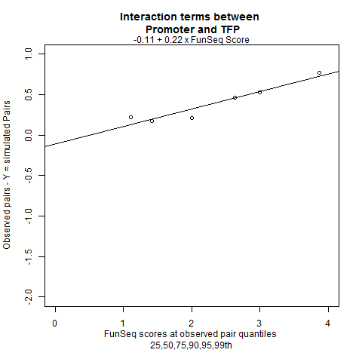
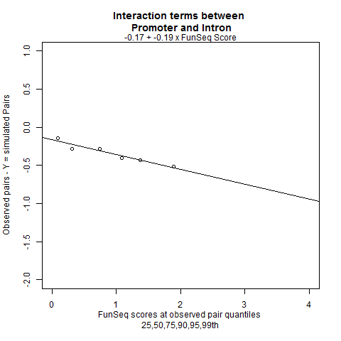
Examples of observed departures from conservation of FunSeq scores
For the 26 hybrid classes for which I have departure results, Promoter+TFP is the only hybrid where over most of the FunSeq range, simulated pairs have a lower FunSeq sum than observed hybrids, implying large functional synergy between promoters and TFPs. This may be an instance where I am accidentally correcting for Departure Type 2.2
25 of 26 plots look like the one on the left

Slide 8
Table of observed departures from conservation of FunSeq scores
Promoter | DHS | -0.08 | + | -0.09 | x | FunSeqScore
Promoter | Pseudogene | -0.5 | + | 0.11 | x | FunSeqScore
Promoter | TFP | -0.11 | + | 0.22 | x | FunSeqScore
Promoter | Intron | -0.17 | + | -0.19 | x | FunSeqScore
Promoter | Enhancer | -0.09 | + | -0.01 | x | FunSeqScore
Promoter | UTR | -0.17 | + | -0.18 | x | FunSeqScore
DHS | miRNA | -0.11 | + | -0.29 | x | FunSeqScore
DHS | miscRNA | -0.62 | + | -0.4 | x | FunSeqScore
DHS | Pseudogene | -0.13 | + | -0.59 | x | FunSeqScore
DHS | snoRNA | -0.62 | + | -0.17 | x | FunSeqScore
DHS | TFP | -1.06 | + | 0.23 | x | FunSeqScore
DHS | Intron | 0 | + | -0.16 | x | FunSeqScore
DHS | Enhancer | -0.89 | + | 0.04 | x | FunSeqScore
DHS | UTR | -0.15 | + | -0.1 | x | FunSeqScore
miscRNA | TFP | -1.03 | + | 0.05 | x | FunSeqScore
miscRNA | Intron | -0.1 | + | -0.18 | x | FunSeqScore
Pseudogene | TFP | -0.47 | + | -0.31 | x | FunSeqScore
Pseudogene | Intron | -0.32 | + | -0.03 | x | FunSeqScore
Pseudogene | Enhancer | -0.12 | + | -0.67 | x | FunSeqScore
Pseudogene | UTR | -0.23 | + | -0.08 | x | FunSeqScore
snoRNA | Intron | 0.02 | + | -0.09 | x | FunSeqScore
TFP | Intron | -0.18 | + | 0 | x | FunSeqScore
TFP | Enhancer | -0.36 | + | -0.25 | x | FunSeqScore
TFP | UTR | -0.17 | + | 0.07 | x | FunSeqScore
Intron | Enhancer | -0.03 | + | -0.06 | x | FunSeqScore
Intron | UTR | -0.14 | + | -0.71 | x | FunSeqScore
Promoter | DHS | -0.08 | + | -0.09 | x | FunSeqScore
Promoter | Pseudogene | -0.5 | + | 0.11 | x | FunSeqScore
Promoter | TFP | -0.11 | + | 0.22 | x | FunSeqScore
Promoter | Intron | -0.17 | + | -0.19 | x | FunSeqScore
Promoter | Enhancer | -0.09 | + | -0.01 | x | FunSeqScore
Promoter | UTR | -0.17 | + | -0.18 | x | FunSeqScore
DHS | miRNA | -0.11 | + | -0.29 | x | FunSeqScore
DHS | miscRNA | -0.62 | + | -0.4 | x | FunSeqScore
DHS | Pseudogene | -0.13 | + | -0.59 | x | FunSeqScore
DHS | snoRNA | -0.62 | + | -0.17 | x | FunSeqScore
DHS | TFP | -1.06 | + | 0.23 | x | FunSeqScore
DHS | Intron | 0 | + | -0.16 | x | FunSeqScore
DHS | Enhancer | -0.89 | + | 0.04 | x | FunSeqScore
DHS | UTR | -0.15 | + | -0.1 | x | FunSeqScore
miscRNA | TFP | -1.03 | + | 0.05 | x | FunSeqScore
miscRNA | Intron | -0.1 | + | -0.18 | x | FunSeqScore
Pseudogene | TFP | -0.47 | + | -0.31 | x | FunSeqScore
Pseudogene | Intron | -0.32 | + | -0.03 | x | FunSeqScore
Pseudogene | Enhancer | -0.12 | + | -0.67 | x | FunSeqScore
Pseudogene | UTR | -0.23 | + | -0.08 | x | FunSeqScore
snoRNA | Intron | 0.02 | + | -0.09 | x | FunSeqScore
TFP | Intron | -0.18 | + | 0 | x | FunSeqScore
TFP | Enhancer | -0.36 | + | -0.25 | x | FunSeqScore
TFP | UTR | -0.17 | + | 0.07 | x | FunSeqScore
Intron | Enhancer | -0.03 | + | -0.06 | x | FunSeqScore
Intron | UTR | -0.14 | + | -0.71 | x | FunSeqScore

Slide 9
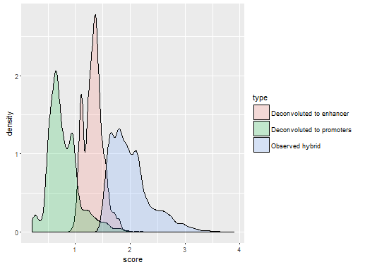
Example Preliminary Results: Deconvoluting Candidates of promoter-enhancer hybrids in PCAWG
The greater share assigned to enhancers is intuitively consistent with pure-enhancers having a higher score at baseline
Mean Output.bed pure-Enhancer score: 0.91
Mean Output.bed pure-Promoter score: 0.35
The deconvolved scores are much lower than the original scores. This appropriately reflects that there is a 41X greater frequency of scores in observed enhancer-promoter hybrid variants than in observed pure promoter variants (and 28X greater vs enhancers).

Slide 10
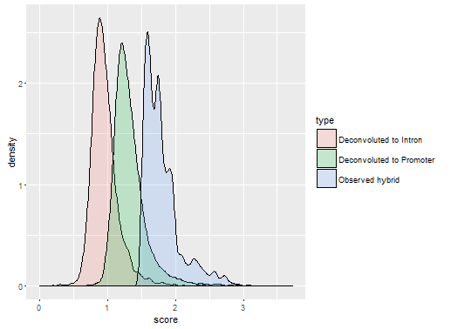
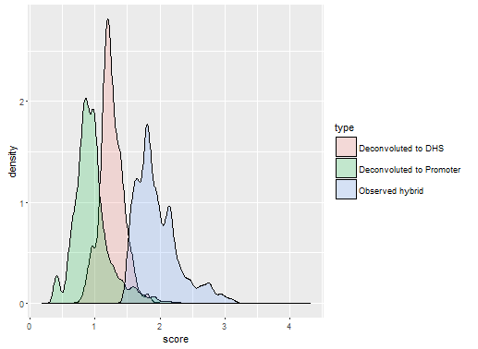
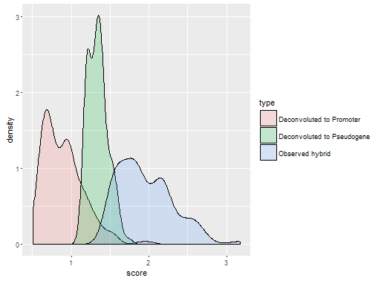
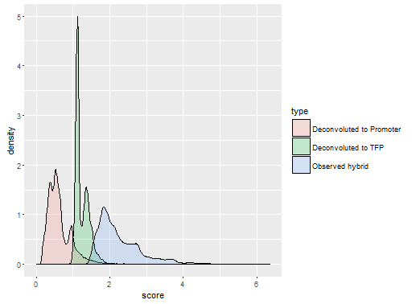
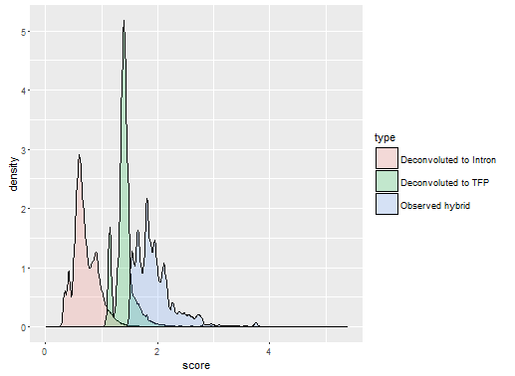
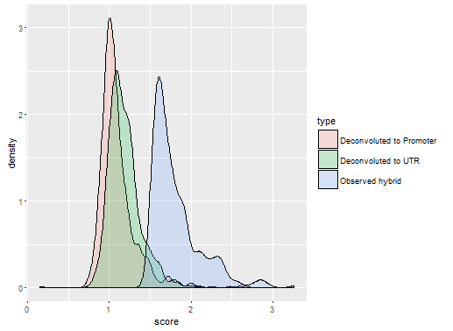

Slide 11
Active Issues
Would like results in the form of “THOSE were the most important individual functional elements (e.g. tert promoter) before deconvolution, and THESE are the top ones after deconvolution” – would be a team effort
How to handle sites that map to >=3 classes of functional element?
How to handle sites that map to multiple instances of the same functional element?
Bias due to selection
There are some unsolvable sums from observed data (imputation?)
Extend to SVs and Indels

