Slide 1
Impact of multiple enhancers on gene expression
Jinrui
July 19th 2016
gpmtg

Slide 2

Differential gene expression is the fundamental mechanism underlying animal development and cell differentiation.
  Human vs Chimp: different gene regulation
Notes:
(people belive that it is different regultion of gene expression separate us from chimp)
Differential exp regulated

Slide 3
Differential gene expression is largely due to enhancer
  Enhancer is a class of cis-regulatory modules (CRMs)
    A stretch of DNA with length 20-500 bp
    Distal from transcription starting site
Notes:
(with out enhancer, most genes can have only basal expression, rather than spatial and tempo expression patterns for development)

Slide 4
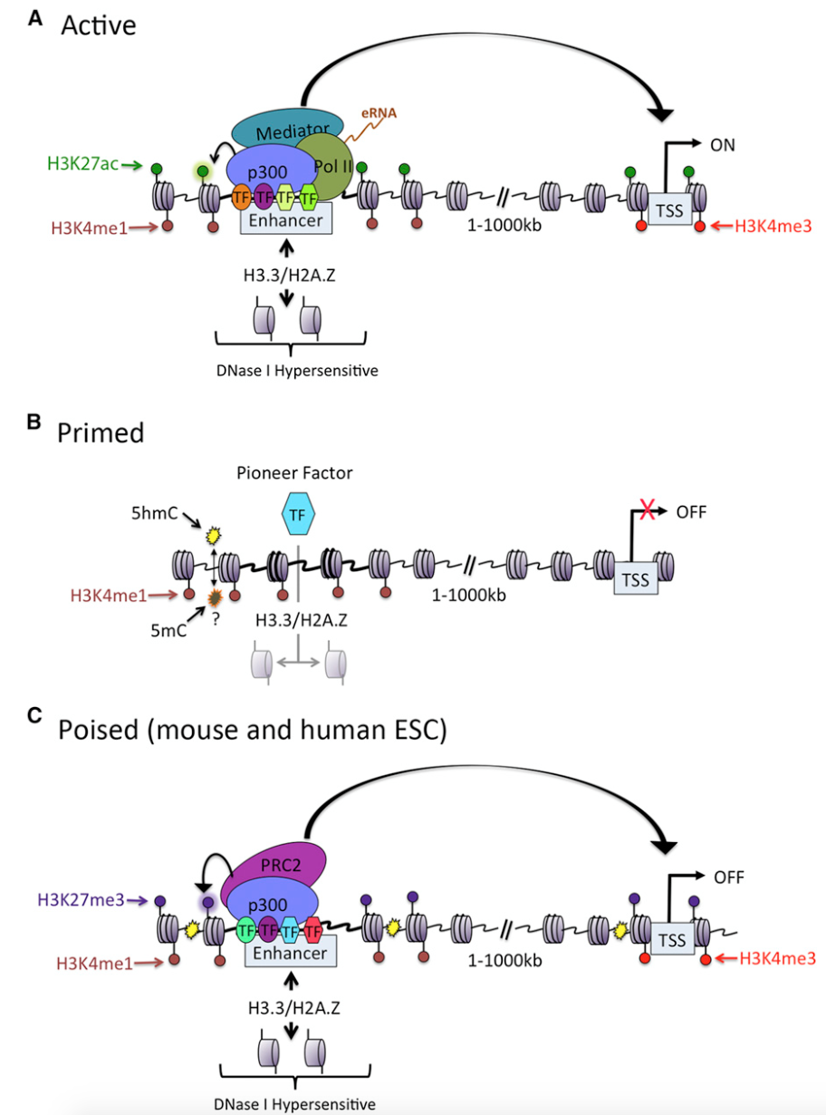
Enhancers can be roughly classified into three types
Active enhancer: with H3k27ac and H3k4me1
Primed enhancer: no H3k27ac, with H3k4me1
Poised enhancer: with H3k27me3 and H3k4me1
Eliezer Calo1 and Joanna Wysocka1,2,*
^{Molecular Cell, 2013}

Slide 5
Based on those features, many enhancers have been identified in genome wide
  Usually, multiple enhancers, one gene
  Different enhancers are used in different tissues by the gene for tissue specific expression
Notes:
A gene can be regulated by many enhancers

Slide 6
However, it is also very common that a gene uses multiple enhancers in the same cell line.
Impact of these enhancers on gene expression?
  Additive? interfere? ……
Notes:
First of all, this is an important questions: key step to understand gene expression
Not trivial multiple enhancers interaction

Slide 7
However, these answers are still ambiguous
  Michael Levine’s lab studied a couple of genes and finds that compared with single enhancer, two enhancers together can increase, decrease or unchanged gene expression

Slide 8
Genome-wide studies are limited by resolution
  Enhancer is DNA fragment with length around 20-500 bp.
  Current methods can only identify fragment with > 3.4 kb on average
  This length discrepancy cause underestimation of enhancers of a gene
Notes:
The Close enhancers (super-enhancer), close to promoter will be missed, and such close enhancers maybe more important in theory

Slide 9
Pelin et al developed Hicap, which managed to get resolution to single enhancer in mouse embryonic stem cell
  The distal CRMs with average length 699, much shorter than those (3.4-6.9kb) of other methods
  The distal CRMs involved in 94,943 interactions with 12,874 genes

Slide 10
Classification of the CRMs using ENCODE ChIP-Seq data
  Non-enhancer and gene interactions: 14,338
  Enhancer and gene interactions: 12,445
    Active Enhancer and gene: 11,024
    Primed (Intermediate) Enhancer and gene: 7,247
    Poised Enhancer and gene: 801

Slide 11
Expression of a gene is not correlated with its number of non enhancers
Notes:
Suggest nonE on average do not contribute mean exp

Slide 12
Expression positively correlated with number of active enhancers
Rho = 0.28, p < 2.2e-16
Notes:
Suggest nonE on average do not contribute mean exp

Slide 13
But no and weak negative correlations with intermediate and poised enhancers
Notes:
Poised E: in fact negatively correlated with exp
Not only poised there but also impede exp

Slide 14
Is enhancer a confounding factor of promoter?
  Schoenfelder et al used capture-hiC to identify enhancer-promoter interactions from mouse ESC and fetal liver cell (FLC), respectively

Slide 15
Based their enhancer-gene interaction, the mouse genes are classified into two groups
  (1) Genes have more enhancers in mESC than in mFLC
  (2) Genes have more enhancers in mFLC than in mESC
  For genes in a group, their expressions in mESC and in mFLC are compared
    Promoters associated with more enhancers generate higher expressions

Slide 16
Do the multiple enhancers work at the same time point? And why?
  ~19.1% enhancers are found interact with another enhancer regulating the same genes
Notes:
quite a lot EE work together at the same time

Slide 17
Enhancer-Enhancer (E-E) interaction are enriched during ribosome binding
  14% of the E-E interactions found with Pol II signal found vs ~7% without Pol II signal

Slide 18
Impact of enhancers on expression noise
mESC single cell RNA-Seq
Statistical model to remove technical noise (Kim et al)
For each gene, mean expression and standard deviation to calculate biological noise:
  Coefficient of variation, CV = mean/std

Slide 19
NO. of active enhancer and CV have no correlation after controlling mean expression
  no power after conditional on exp, or counter effects canceled out each other?
  According to TFs they bind, enhancers could be positively or negatively correlate with gene noise
Notes:
(reduce burst frequency)

Slide 20
NO. of poised enhancer and CV have positive correlation with mean expression controlled
  Rho = 0.07, p < 0.01

Slide 21
Active enhancer is negatively correlated with CV after controlling both mean expression and poised enhancers
    Rho = -0.11, p < 0.01

Slide 22
Future work of this project
Pelin is Hicaping more tissues and cell lines, including GM12878, which can be used to study TF patterns in the enhancers
Coexpression of genes sharing enhancers
Hicaping hESC for evolutionary analysis?
Hicaping Yeast for better expression noise analysis?

Slide 23
Thanks! Q?

