Slide 1
P2-TECH
Asthma and iHMP update
Dan Spakowicz
19 Jul 2016

Slide 2
CHAS project
Pilot study of the microbiome of sputum from asthmatic patients
08 Jun 2016
Dan Spakowicz

Slide 3
Background
Collaboration between
  Geoff Chupp (Yale SOM, Dir. Center for Asthma and Airway Disease)
  George Weinstock (Jackson Laboratory for Genomic Medicine)
  Mark Gerstein (Yale MB&B)
General Question
  Does microbial composition in sputum correlate with asthma severity (mild to severe asthma, no controls)?
Pilot Samples
  10 patients with asthma;
  Sputum processed to cell lystate (CL) and supernatent (S)
Specific Question
  Is there some trend observable in the pilot data that could be used to justify a larger study (e.g. ~100 supernatents from Yan et al 2015)
Data
  16S amplification (bacteria) – presented last time
  ITS amplification (fungi)
  Clinical data

Slide 4
Incorporating several definitions of asthma severity: EPR3, NICE
NICE guidelines for chronic inflammatory diseases
  FEV₁/FVC ratio < 0.7 &&
  Predicted FEV₁ < 80%
Recoded into a binary indicating top vs bottom halves
Expert Panel Report 3 (EPR 3): guidelines for the diagnosis and management of asthma. National Institutes of Health 40, (2007).
Chronic obstructive pulmonary disease: Management of chronic obstructive pulmonary disease in adults in primary and secondary care (partial update). NICE.org.uk. June 2010

Slide 5
Initial analysis: Principal component analysis of genus-level 16S and ITS relative abundances

Slide 6
Method for finding optimal separation
PC loadings for Genus 16S, Family ITS
Sum of two lowest PC p-values for each data combination

Slide 7
Optimal separation of two asthma groups: combination of Genus 16S and Family ITS

Slide 8
The organisms that drive separation between severe and moderate asthmatics

Slide 9
Literature precedence for Haemophilus association with corticosteroid use
1. Earl, C. S. et al. Haemophilus influenzae responds to glucocorticoids used in asthma therapy by modulation of biofilm formation and antibiotic resistance. EMBO Mol Med 7, 1018–1033 (2015).
“Using a mouse model of infection, we show that corticosteroid treatment promotes H. influenzae persistence. ”

Slide 10
Other correlates of potential interest
InteractorA | InteractorB | Correlation | p-value | Bonferroni-adjusted p-value
Emotional.Function..3..5..9 | unclassified_Fusobacteriales | 0.652 | 0.041 | 1
Environmental.Stimuli..2..7..11 | Hallella | 0.655 | 0.040 | 1
Age.SX.Onset | unclassified_Bacteroidales | 0.762 | 0.010 | 1
 | unclassified_Prevotellaceae | 0.711 | 0.021 | 1
 | Stereaceae | 0.706 | 0.022 | 1
 | Acidovorax | 0.671 | 0.034 | 1
 | Bacteroides | 0.671 | 0.034 | 1
 | Mobiluncus | 0.671 | 0.034 | 1
 | Fomitopsidaceae | 0.671 | 0.034 | 1
 | Hydnaceae | 0.671 | 0.034 | 1
 | Phanerochaetaceae | 0.671 | 0.034 | 1
X.POST..FEV1.FVC.Ratio | Rothia | -0.729 | 0.017 | 1
 | Kingella | -0.678 | 0.031 | 1
 | Gemella | -0.643 | 0.045 | 1
X12..Feel.bothered.by.or.have.to.avoid.STRENUOUS.ACTIVITIES.such.as.hurrying..exercising..running.up.stairs..sports | unclassified_Fusobacteriales | 0.738 | 0.015 | 1
 | unclassified_Anaerolineaceae | 0.653 | 0.041 | 1
 | unclassified_Erysipelotrichaceae | 0.653 | 0.041 | 1
 | Hallella | 0.633 | 0.049 | 1

Slide 11
No correlation with fungi for which there is literature precedence
Denning, D. W., O’Driscoll, B. R., Hogaboam, C. M., Bowyer, P. & Niven, R. M. The link between fungi and severe asthma: a summary of the evidence. European Respiratory Journal 27, 615–626 (2006).
“Many airborne fungi are involved, including species of Alternaria (Pleosporaceae), Aspergillus (Trichocomaceae), Cladosporium (Davidiellaceae) and Penicillium (Trichocomaceae), and exposure may be indoors, outdoors or both”
Denning, D. W., et al. The link between fungi and severe asthma: a summary of the evidence. European Respiratory Journal 27, 615–626 (2006).

Slide 12
Conclusions
PCA separation of severe and mild asthma (as defined by Fev1/fvc ratio 0.7) best when both bacterial and fungal abundances are used
Severe asthmatics → more Malasseziaceae fungi, Streptococcus bacteria and Polyporaceae fungi
Mild asthmatics → more Stereaceae fungi

Slide 13
Integrative human microbiome project: longitudinal model
Dan Spakowicz
11 May 2015

Slide 14
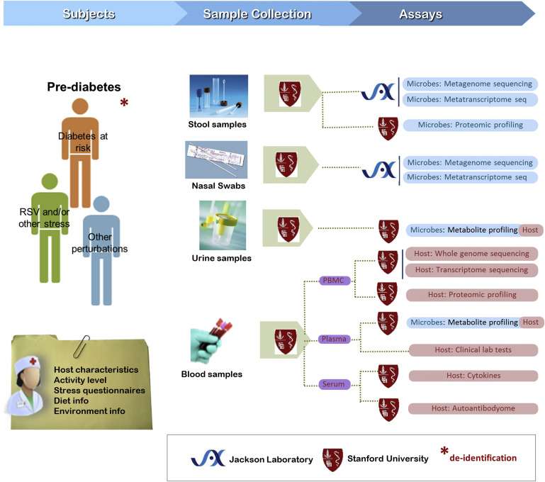
Background
Figure 3. Microbiome and Host Changes during Respiratory and Other Stress Conditions in Individuals at Risk for Type 2 Diabetes: Sample Collection, Assay, and Data Generation WorkflowAll samples are collected at the Stanford Clinical &amp; Translational Resear...
The Integrative Human Microbiome Project: Dynamic Analysis of Microbiome-Host Omics Profiles during Periods of Human Health and Disease
null, Volume 16, Issue 3, 2014, 276–289
http://dx.doi.org/10.1016/j.chom.2014.08.014

Slide 15
Background

Slide 16
Background

Slide 17
Data

Slide 18
Choice of predictor variables: metabolites
metabolites shown to correlate with either insulin sensitivity or resistance,
  phosphatidyl-inositols (PI) have been shown to be depleted in the diabetic state [9],
  phosphatidylserines (PS) enriched in the diabetic state [10].
9. Greene, et al Journal of Clinical Investigation 79, no. 5 (1987)
10. Kalofoutis, A. and Lekakis, JDiabetologia 21, no. 6 (1981

Slide 19
Choice of predictor variables: microbes
taxa implicated in sensitivity or resistance to insulin.
Eubacterium
  A study that performed fecal transplants from lean donors to those with metabolic syndrome found that increased insulin sensitivity in the recipients [3]
Escherichia was found to correlate with
  Correlated insulin resistance in obese Swedish women [12].
3. Qin, J et al Nature (2012)
12. Karlsson, et al Nature (2013)

Slide 20
Data

Slide 21
Data

Slide 22
Model: final model
 | Value | Std Error | p-value
(Intercept) | -25.41299 | 85.38594 | 0.7707
Weight | 2.49031 | 0.97036 | 0.0247
Eubacterium | -16.44987 | 11.22366 | 0.1685
Escherichia | -34.74217 | 16.55755 | 0.0577
PS22.1 | -9.93948 | 7.58501 | 0.2146
Days.Norm | -0.39702 | 0.27768 | 0.1783
Days.Norm2 | 0.00379 | 0.00195 | 0.0759

Slide 23
Conclusions
3 significant parameters (alpha 0.1):
  Quadratic time --
    makes sense given the study design
  Weight –
    as a predictor is well-documented, internal control
  Escherichia –
    First demonstration of having predictive power for serum glucose in a longitudinal analysis

Slide 24
Future directions
FDR analysis to test other microbes / metabolites
Try with PC loadings
Continuous data for microbes rather than 1/0
Classifier approach

Slide 25
Model Background
Linear mixed effects model
can incorporate both fixed and random effects

Slide 26
Model: random effects
Table 1. Comparison of the full model with the random effects for either the intercept or both the intercept and slope.
Component | Log-likelihood | χ-squared, df =2 | P-value
Intercept | -162.6307 | 9.5315 | 0.008517
Intercept + slope | -157.865
Model: SSPG ~ Weight + Eubacterium + Escherichia + PS22.1 + PI20.0 + Time (days, linear) + Time² (days², quadratic)

Slide 27
Model: unadjusted associations
Table 2. Unadjusted associations of each predictor variable. Each predictor was modeled alone with linear and quadratic time with random effects of intercept and slope.
Predictor | Beta | p-value
Weight | 26.59008 | 0.0723
PS22:1 | -6.56942 | 0.4076
PI20:0 | -2.98066 | 0.6277
Eubacterium | -17.49708 | 0.1523
Escherichia | -11.74115 | 0.5417
Model: SSPG ~ [Test Predictor] + Time (days, linear) + Time² (days², quadratic)

